Slide 1
A Review of Placement Tests for EFL EAP Contexts
Qatar National Research Fund(QNRF) Undergraduate Research Experience Program - Eighth Cycle.

Slide 2
Session Agenda
Collaborative Research Model
The Study
Findings
Test Reviews

Slide 3
The Researchers
Students (University of Calgary-Qatar)
Muna Aden
Noof Al Kuwari
Mihad Ibrahim
Omaima Souayah
Faculty (University of Calgary-Qatar )
Karen Brooke
Virginia Christopher
Dr. Brad Johnson
External Advisors
Dr. Dudley Reynolds (Carnegie Mellon University-Qatar)
Dr. Anne Nebel (Georgetown University-Qatar)
Dr. Peter Brown (College of the North Atlantic-Qatar)

Slide 4
Context
University of Calgary, Qatar (B.A. Nursing)
English the medium of all instruction
Most students do not have English as a first language
Most students require additional English language classes before starting regular studies

Slide 5
The CR Model in Use
Undergrad Research Experience Project (UREP)
Sponsored by the Qatar National Research Fund (QNRF)
Mission
Undergraduate research
Learning by doing
Skills Development
Problem-solving
Communication
Working independently
Understanding research methods
Ethics & rules of conduct
Notes:
Mission: To advance knowledge and education by supporting original, competitively-selected research in various fields by providing opportunities for research at all levels
Recognises importance of introducing

Slide 6
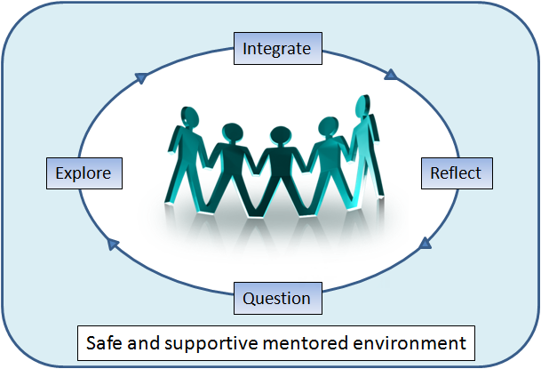
Collaborative Research Model
Core Elements
Guided Inquiry
Collaborative
Safe, supported, mentored
Key Characteristics
Students as CO-Researchers
Collaborative Deliberation
Group Reflection
Multiple Perspectives
Main Benefits
Actively Engages Students and Faculty
Promotes Effective Group Processes
Provides a Process for Conducting All Phases of Research

Slide 7
The Study
Assessing English Language Placement Tests for Use in Qatari Post-Secondary Institutions
The Problem
Western cultural perspective
Choosing best test for Gulf
The Goal
Assessment rubric
The Research Team
4 Undergrads
3 faculty members
3 External advisors
Notes:
Western cultural perspective of placement tests hinders accurate language assessment
Difficult to choose best test for Gulf students
The Goal
Develop a tool for placement test selection specifically for English language programs in Arabian Gulf
Tool: assessment rubric to help institutions choose placement tests systematically & judge test validity

Slide 8
The Study: Stages
All stages implement Collaborative Research methodology…
1. Getting started
2. Literature review
3. Development of assessment rubric/ Seeking advisor’s input
4. Applying the rubric
5. Recruiting subjects & piloting tests
6. Compare Test Scores to Expert Raters
7. Reflecting & assessing/ Writing reports & articles / Presenting
Notes:
1. First Steps: Setting meeting content & schedule ; Defining the research questions
2. Literature review: Conducting literature review; Presenting articles at team meetings; Duration: 3 months’ weekly meetings
3. Development of assessment rubric: Developing criteria for rubric; Creating rubric on Excel
4. Seeking external advisors’ input: Virtual meeting to discuss feedback/recommendations; Incorporating feedback; qualitative descriptors crucial
Development of Comments sections ; Value of experience for students: information; process
5. Applying the rubric to select pilot tests: 2 highest scoring and 1lowest scoring tests selected; Discovered shortcomings of rubric; clear need for descriptors; Addition of Summary Comments Sheet for each test
6. Recruiting subjects; piloting tests: Currently in progress
7. Evaluating the rubric’s ability to select best tests: a) Expert raters to be used to place subjects into 3 levels; b) 3 pilot tests to be used to place subjects into 3 levels; c) Rubric’s ability to select best tests to be evaluated
8. Reflecting and assessing: On-going reflection questions posed throughout activities; Concept Mapping Exercises: conducted 3-4 times
Final student feedback session; oral and written
9. Writing reports, articles, presentations
10. Presenting at conferences

Slide 9
Stage 2: Literature Review

Slide 10
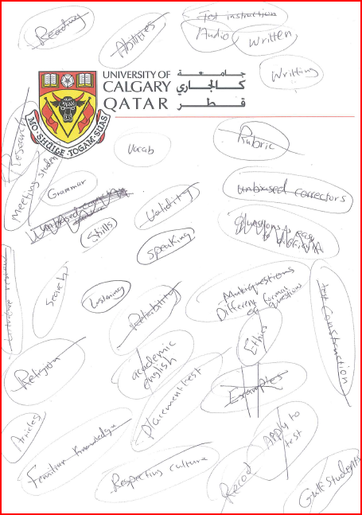
Stage 3: Development of Assessment Rubric
Brainstorm rubric criteria
Categorize
Develop rubric sections

Slide 11
Applying the Rubric: Scores
Test Name | Test Mode | Rubric Score /100 | Holistic Score /10
Accuplacer | Computer | 89 | 8
Compass | Computer | 85 | 9
University of Michigan English Placement Test | Paper | 71 | 8
Password | Computer | 66 | 7
OPT Online Test | Computer | 51 | 5
OPT Placement Test | Paper | 46 | 5

Slide 12
Recruiting Subjects and Piloting Tests
Oxford Placement Test: 23 participants
Oxford Online Test: 26 participants
Accuplacer: 16 participants

Slide 13
Evaluating the Rubric: Expert Raters
 | Accuplacer | OPT Online | OPT Paper
Cohen’s Kappa | .3766 | .2632 | .2477
Weighted Kappa (linear) | .4839 | .4257 | .2562

Slide 14
Evaluating the Rubric: Correlations
 |  | Oxford Online Test
 |  | Listening | Use of English | Total
Accuplacer | Language Use | 0.45369903 | 0.57537037 | 0.54591973
 | Listening | 0.62745738 | 0.54446715 | 0.62689216
 | Reading Skills | 0.7079608 | 0.57475001 | 0.69046848
 | Sentence Meaning | 0.49654448 | 0.68578513 | 0.62420157
 | Writeplacer | 0.44179812 | 0.59391448 | 0.5437714
 | Total Excluding Writeplacer | 0.63601477 | 0.67577507 | 0.69895996

Slide 15
Evaluating the Rubric: Correlations
 |  | OPT Paper
 |  | Listening | Grammar | Total
Accuplacer | Language Use | 0.07992 | 0.69098 | 0.62999298
 | Listening | -0.154 | 0.74158 | 0.54316763
 | Reading Skills | -0.109 | 0.66164 | 0.5003664
 | Sentence Meaning | 0.18287 | 0.73404 | 0.72358122
 | Writeplacer | 0.10428 | 0.65195 | 0.61041479
 | Total Excluding Writeplacer | 0.01529 | 0.79029 | 0.67832386

Slide 16
Evaluating the Rubric: Correlations
 |  | Oxford Online Test
 |  | Listening | Use of English | Total
OPT Paper | Listening | -0.0272 | -0.028 | -0.02
 | Grammar | 0.76837 | 0.70284 | 0.78485
 | Total | 0.63283 | 0.57745 | 0.64989

Slide 17
Findings
OPT Paper Based Listening not functioning well, as we had suspected

Slide 18
Findings
Culturally inappropriate material not common, rarely caused incorrect responses
Every test mentioned wine
One question required students to interpret the relationship between 2 room-mates – our students could not
One question relied on the knowledge that dogs’ fur gets thicker in winter – our students did not know this

Slide 19
Findings
Test Conditions
Computerised delivery not a problem for most test sections
Computerised writing tests may be seriously compromised by slow typing
Typing test showed average typing speed of only 11 wpm for one group of incoming students
Lack of familiarity with English keyboard

Slide 20
Findings
Possible mismatch between test content and skills needed for success in non-native classes
Tests have heavy emphasis on grammar. Teachers in this context may be more tolerant.
Some tests include knowledge of idioms. Teachers in this context learn to avoid idioms. Our students knew few common idioms.
One test had a section on collocations. Our students did very poorly on this section, despite advanced level of English.

Slide 21
Test Reviews
Accuplacer ESL:
American/ College Board
Internet Based
Computer Adaptive

Slide 22
Test Reviews
Accuplacer ESL:
Reading Skills
Sentence Meaning (Vocabulary in Context)
Language Use
Listening
WritePlacer ESL

Slide 23
Test Reviews
Accuplacer ESL
Pros
Good range of academic content
Familiar multiple choice format
Internet based
Reading tested a variety of skills (paraphrasing/ inferences/ fact-opinion)
Realistic listening conversations with pictures for context
Writing included short reading to give context
Description of what elements of writing will be graded
Very flexible delivery by institution

Slide 24
Test Reviews
Accuplacer ESL
Cons
Writing Prompt difficult
Americanisms (Miranda rights, American city names, Labor Day)
Difficult instructions
Very unhelpful tutorials

Slide 25
Test Reviews
Compass:
American/ ACT
Secure Browser on Internet
Computer Adaptive

Slide 26
Test Reviews
Compass:
Listening
Reading
Grammar/ Usage
Essay

Slide 27
Test Reviews
Compass
Pros
Good range of very realistic academic content from range of subjects
Listening items moved from short conversations in familiar context to long abstract lectures and dialogues
Reading items moved from short texts to long academic texts
Reading items tested a variety of skills (main ideas/ details, inferences, conclusions)
Grammar included not only sentence level grammar but relationships between paragraphs

Slide 28
Test Reviews
Compass
Cons
Test software must be downloaded to each computer
Screen resolution must be reconfigured before test is run

Slide 29
Test Reviews
Password:
British/ English Language Testing, Ltd.
Computerised and Unique, but not Computer Adaptive
Secure Browser

Slide 30
Test Reviews
Password:
5 sections of grammar and vocabulary, optional writing and reading sections
2 sections of multiple choice grammar
Vocabulary – choose best synonym
Collocations
Identify grammatically correct sentences

Slide 31
Test Reviews
Password
Pros
Vocabulary from Academic Word List
Cons
Intended student profile did not match ours
Poor performance by our students on collocations
Last section confusing and tiring

Slide 32
Test Reviews
Oxford Online Placement Test:
Computer Adaptive
Internet Based
Use of English (grammar, vocabulary, reading)
Listening

Slide 33
Test Reviews
Oxford Online Placement Test
Pros
Very easy to conduct
Cons
Not delivered on a secure browser
Test content less suitable for our students – range of settlement and business situations
Emphasis on idioms
British language and accents

Slide 34
Test Reviews
University of Michigan English Placement Test
Listening, reading, grammar, vocabulary
Pros
Very easy to conduct (paper based) Vocabulary from Academic Word List
Cons
Students found listening confusing (choose appropriate response or best paraphrase) Reading passages a few sentences at most

Slide 35
Test Reviews
Oxford Placement Test (paper)
Listening, grammar
Pros
Very easy to conduct (paper based)
Cons
Listening based on distinguishing similar sounding words Very low frequency words in listening section

Slide 36
Value of Using CR
For Students
Actively Engaged in Research Process
Learn Effective Group Processes
Learn a Process for Conducting All Phases of Research
For Faculty
Emphasizes Mentorship Role
Makes Research Process Explicit
Provides a Process for Conducting All Phases of Research
For Institutions
Provides a Best-Practices Model
Promotes Faculty-Student Working Relationships
Prepares Students for Graduate Work

Slide 37
References
Brooke, K., Aden, M., Al-Kuwari, N., Christopher, V., Ibrahim, M., Johnson, B., & Souyah, O. (2012). Placement Testing in an EFL Context. TESOL Arabia, 19 (2), 13-20.

Slide 38
Questions and Discussion
Contact kbrooke@vcc.ca
Thank You for Your Attention

