Slide 1


Thoughts on the theory of statistics
Nancy Reid
Notes:
Picture : Luc-Antoine Couturier (courtesy of Québec City Tourism)

Slide 2

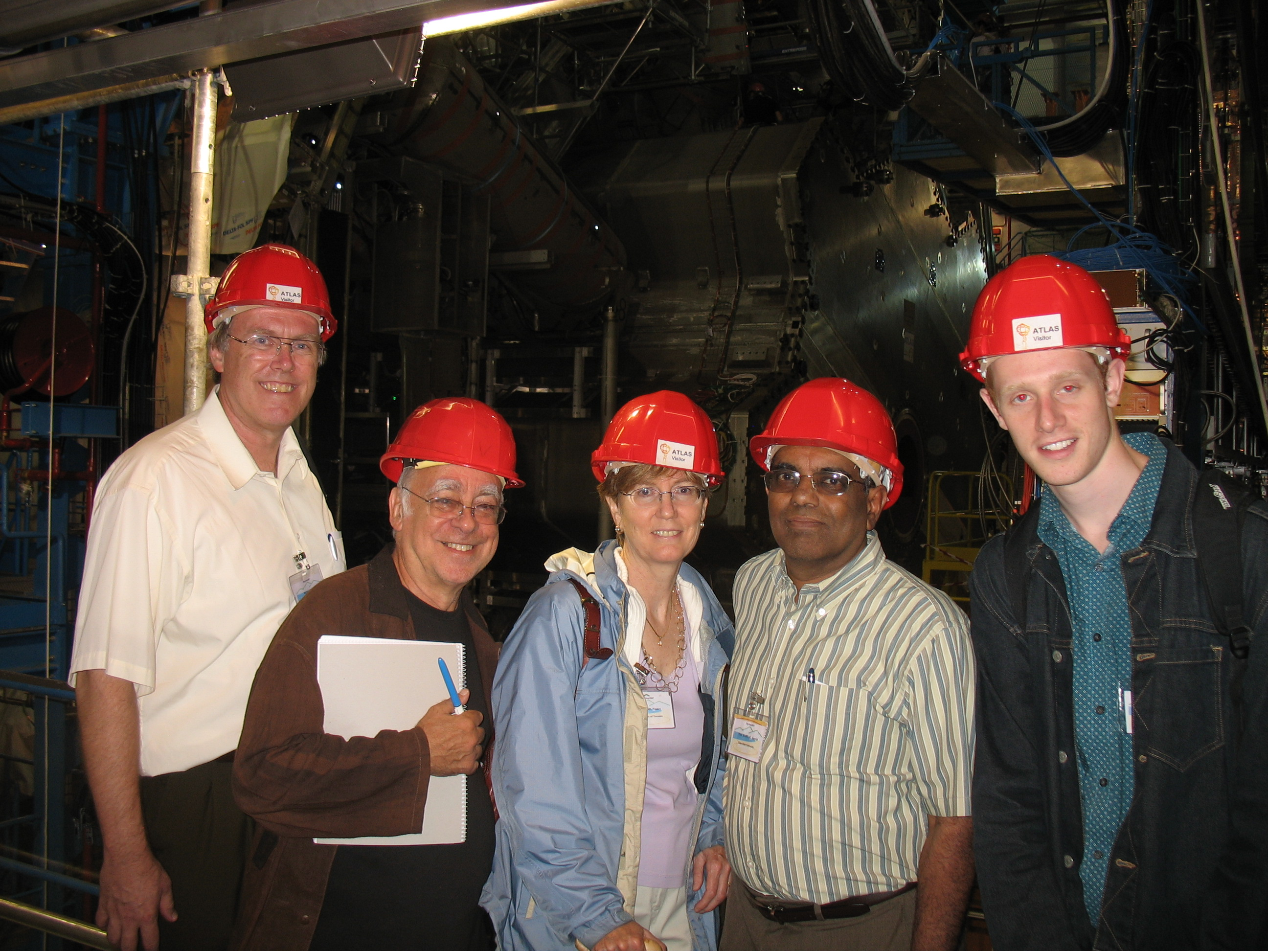
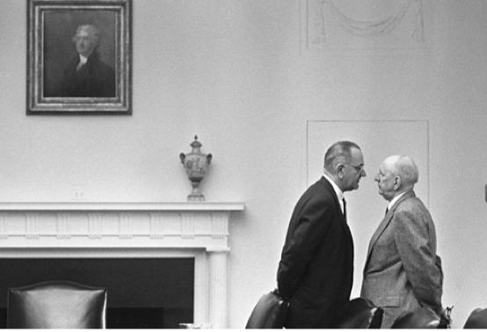
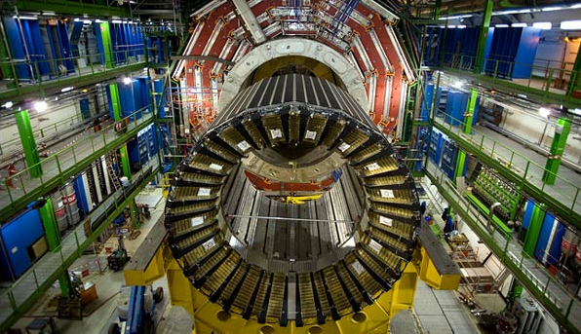
Statistics in demand
“Statistical science is undergoing unprecedented growth in both opportunity and activity”
High energy physics
Art history
Reality mining
Bioinformatics
Complex surveys
Climate and environment
SSC 2010 …

Slide 3
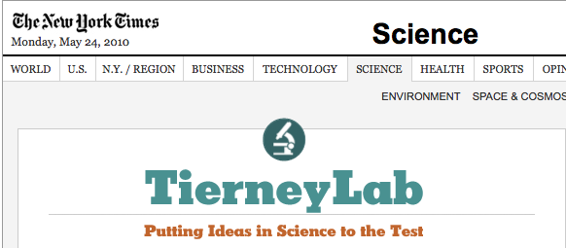



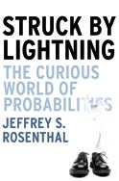

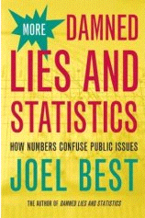
Statistical Thinking
Dramatic increase in resources now available
Notes:
One of a great many resources now available, including

Slide 4

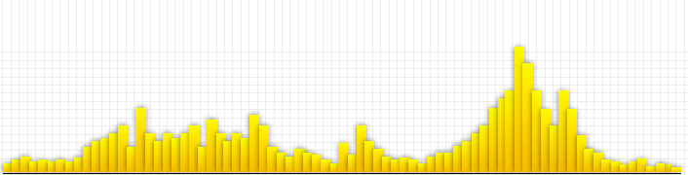
Statistical Thinking ¹
If a statistic was the answer, what was the question?
What are we counting?
Common pitfalls
means, medians and outliers
How sure are we?
statistical significance and confidence
Percentages and risk
relative and absolute change
Notes:
One of a great many resources now available, including

Slide 5
Statistical theory for 20xx
What should we be teaching?
If a statistic was the answer, what was the question?
Design of experiments and surveys
Common pitfalls
Summary statistics: sufficiency etc.
How sure are we?
Inference
Percentages and risk
Interpretation

Slide 6

Models and likelihood
Modelling is difficult and important
We can get a lot from the likelihood function
Not only point estimators
Not only (not at all!!) most powerful tests
Inferential quantities (pivots)
Inferential distributions (asymptotics)
A natural starting point, even for very complex models

Slide 7
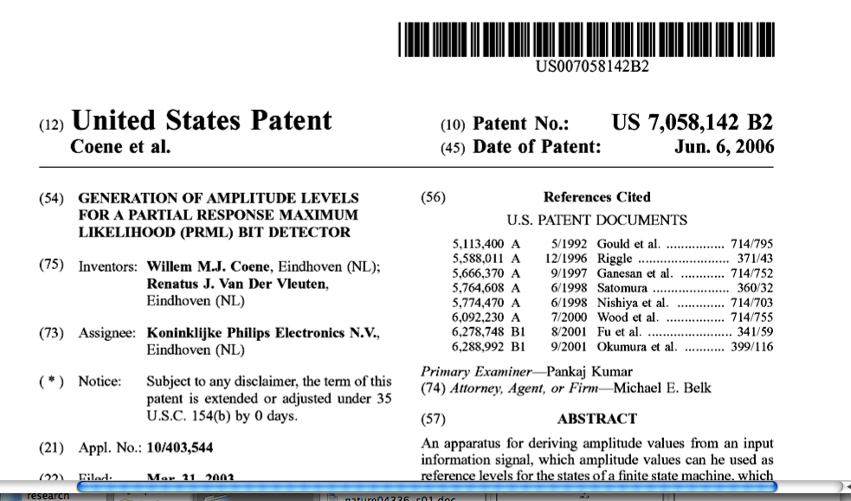
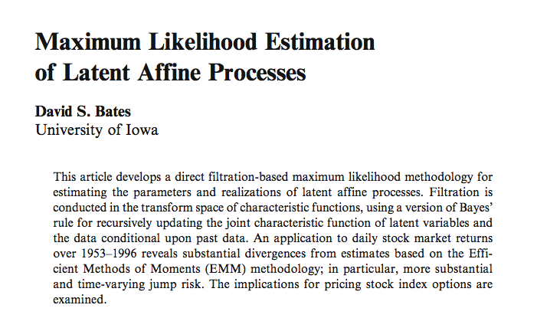
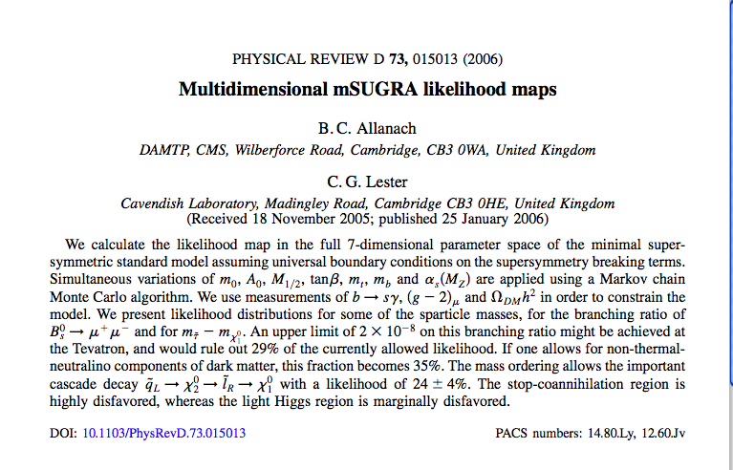
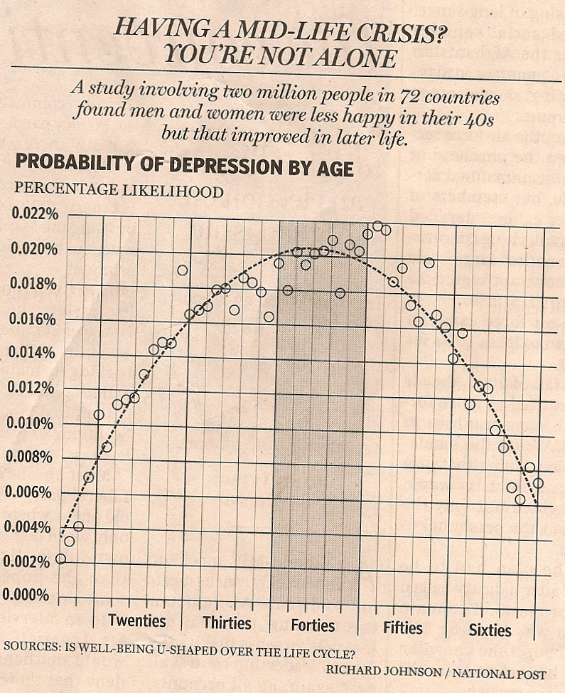
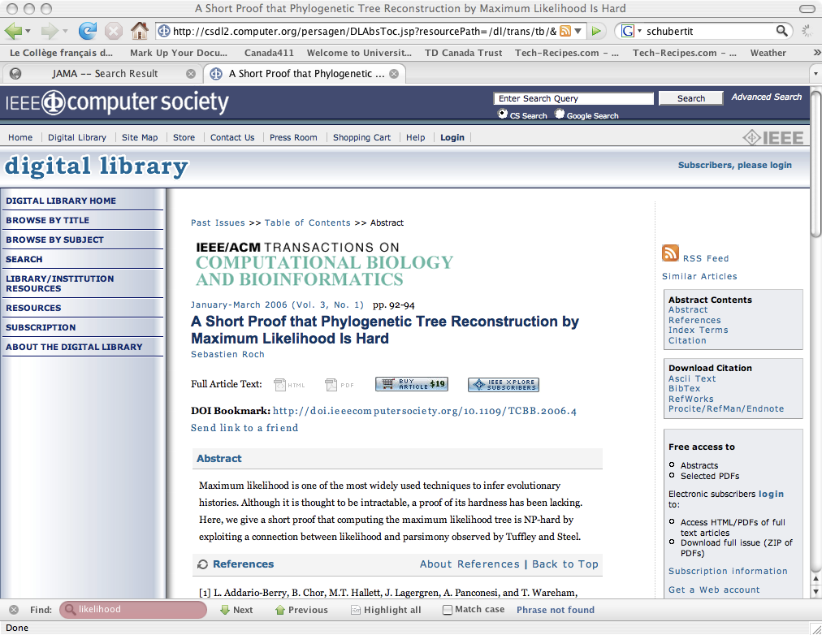
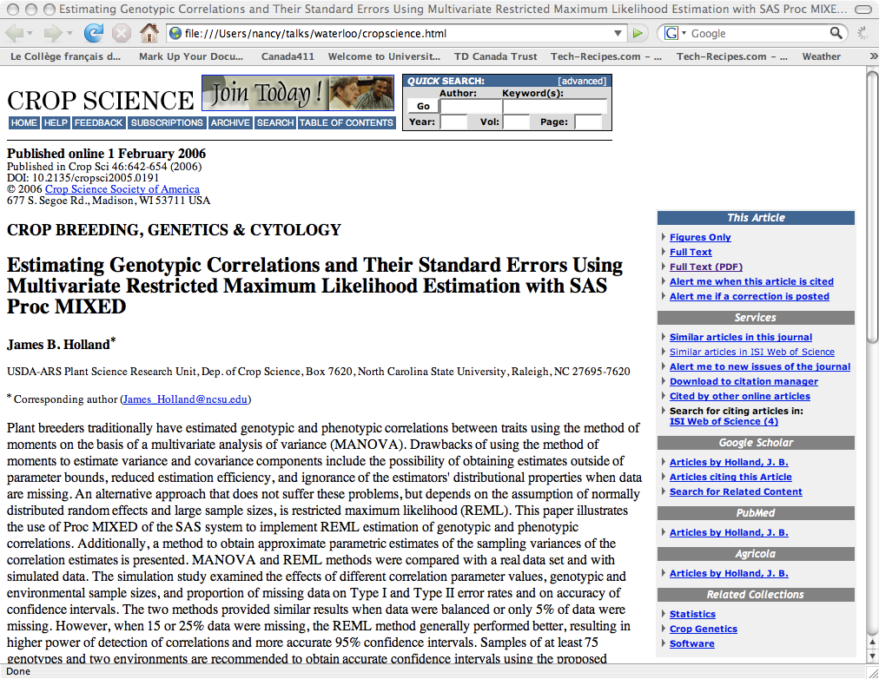
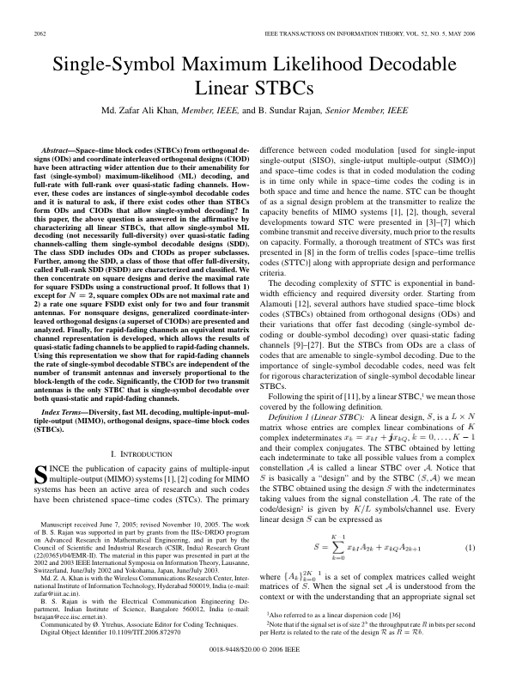
Likelihood is everywhere! ²
Notes:
Midlife: National Post, January 30, 2008.

Slide 8
Outline
Higher order asymptotics
likelihood as pivotal
Bayesian and non-Bayesian inference
Partial, quasi, composite likelihood
Where are we headed?

Slide 9
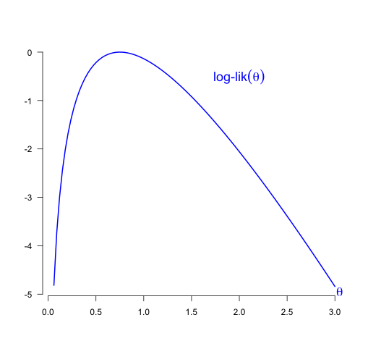
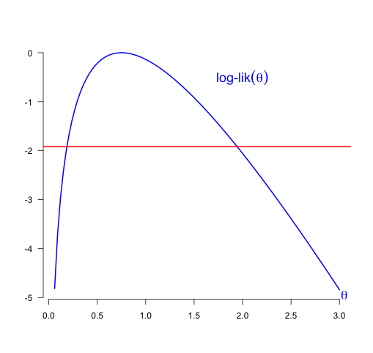
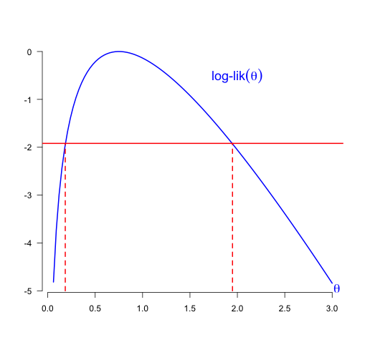
P-value functions from likelihood

Slide 10
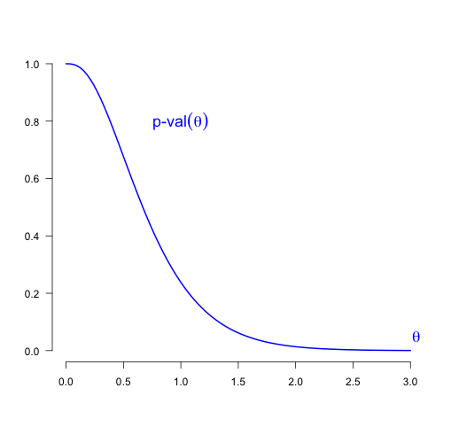
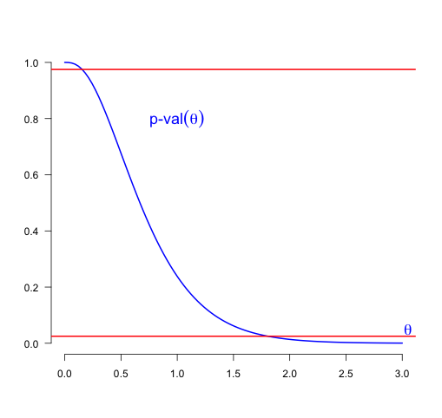
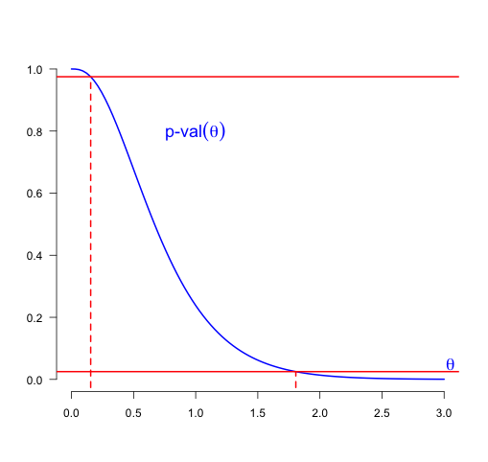
P-value functions from likelihood
0.975
0.025

Slide 11




Can be nearly exact
Likelihood root
Maximum likelihood estimate
Score function
All approximately distributed as
Much better :
can be

Slide 12
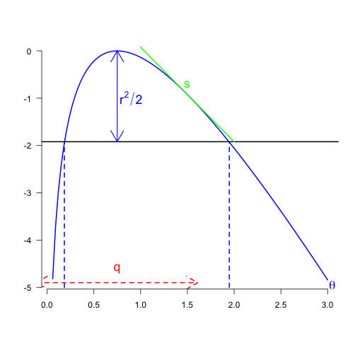



Can be nearly exact
Likelihood root
Maximum likelihood estimate
Score function

Slide 13
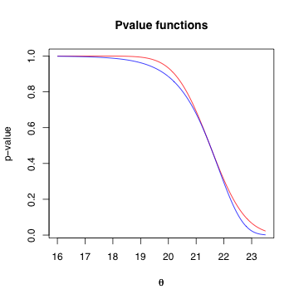
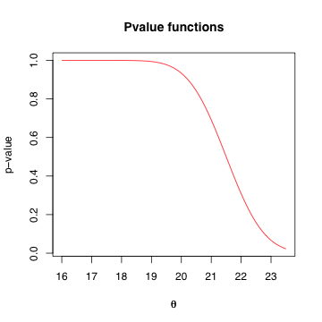
Can be nearly exact

Slide 14
Can be nearly exact

Slide 15
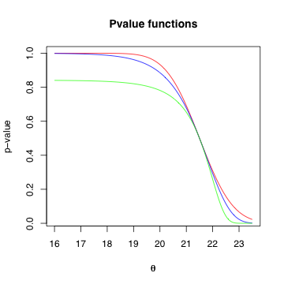
Can be nearly exact

Slide 16
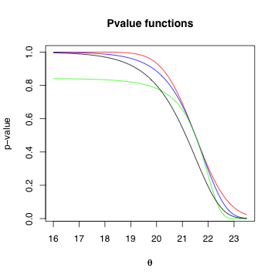
Can be nearly exact

Slide 17
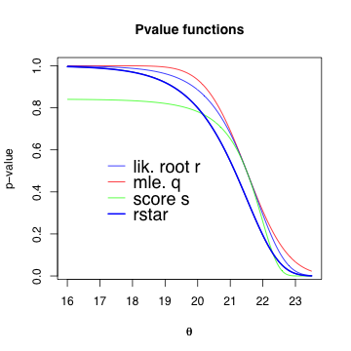
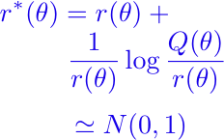
Can be nearly exact ³

Slide 18
Using higher order approximations
Excellent approximations for ‘easy’ cases
Exponential families, non-normal linear regression
More work to construct for ‘moderate’ cases
Autoregressive models, fixed and random effects,
discrete responses
Fairly delicate for ‘difficult’ cases
Complex structural models with several sources of variation
Best results for scalar parameter of interest
But we may need inference for vector parameters

Slide 19
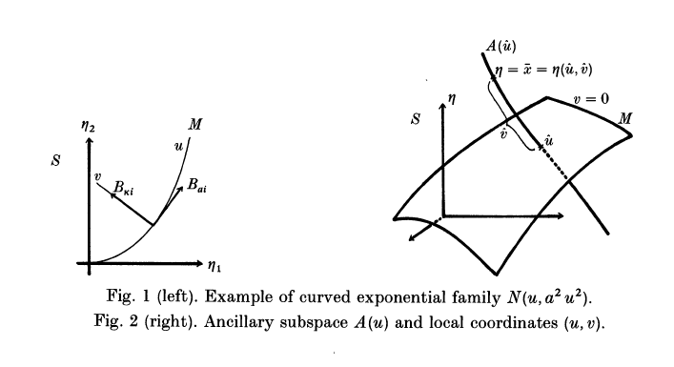
Where does this come from?
⁴Amari, 1982, Biometrika; Efron, 1975, Annals
Notes:
Amari 1982 Biometrika; Efron, 1975 Annals; 2nd order efficiency

Slide 20
Where does this come from? ^{5,6,7}
Differential geometry of statistical models
Theory of exponential families
Edgeworth and saddlepoint approximations
Key idea:
A smooth parametric model can be approximated
by a tangent exponential family model
Requires differentiating log-likelihood function
on the sample space
Permits extensions to more complex models
Notes:
Fraser, Reid Jianrong Wu 1999; Reid 2003; Fraser 1990

Slide 21
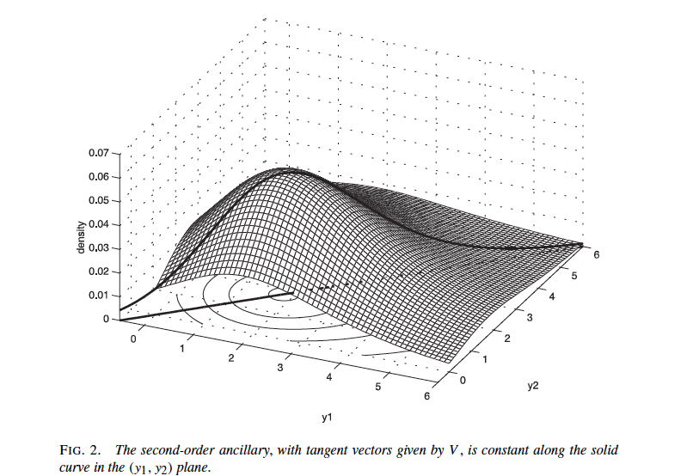
Where does this come from? ⁸
Notes:
Fraser, Reid Jianrong Wu 1999; Reid 2003; Fraser 1990

Slide 22

Generalizations
To discrete data
Where differentiating the log-likelihood on the sample space is more difficult
Solution: use expected value of score statistic instead
Relative error instead of
Still better than the normal approximation

Slide 23
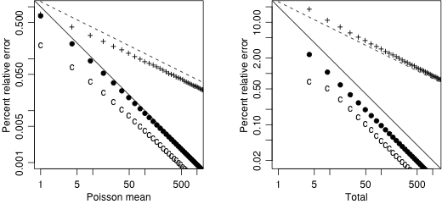
Generalizations ⁹
Notes:
Davison, Fraser, Reid 2006

Slide 24
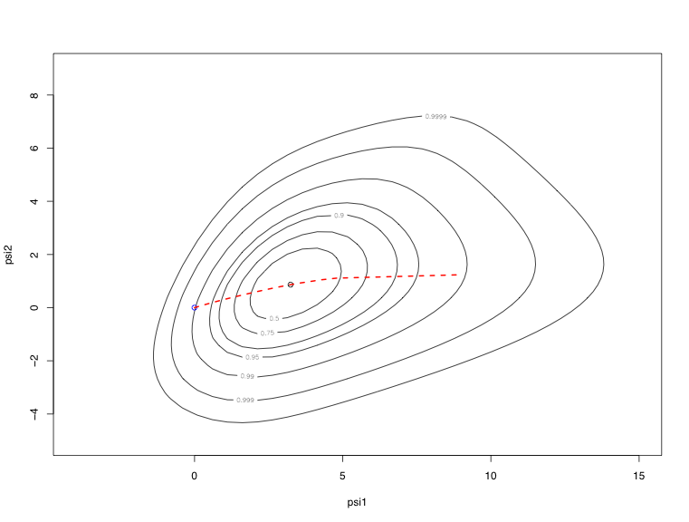
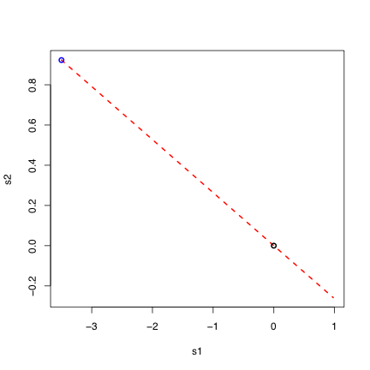
Generalizations ¹⁰
To vector parameters of interest
But our solutions require a single parameter
Solution: use length of the vector, conditioned on the direction
Notes:
Davison Fraser Reid Sartori 2010

Slide 25
Generalizations ¹¹
Extending the role of the exponential family
By generalizing differentiation on the sample space
Idea: differentiate the expected log-likelihood
Instead of the log-likelihood
Leads to a new version of approximating exponential family
Can be used with pseudo-likelihoods
Notes:
Fraser Reid 2010

Slide 26
What can we learn? ¹²
Higher order approximation requires
Differentiating the log-likelihood function
on the sample space
Bayesian inference will be different
Asymptotic expansion highlights the discrepancy
Bayesian posteriors are in general not calibrated
Cannot always be corrected by choice of the prior
We can study this by comparing Bayesian and nonBayesian approximations
Notes:
Default priors

Slide 27
Example: inference for ED50 ¹³
Logistic regression with a single covariate
On the logistic scale
Use flat priors for
Parameter of interest is
Empirical coverage of Bayesian posterior intervals:
0.90, 0.88, 0.89, 0.90
Empirical coverage of intervals using
0.95, 0.95, 0.95, 0.95
Notes:
Ye Sun and Reid 2009

Slide 28
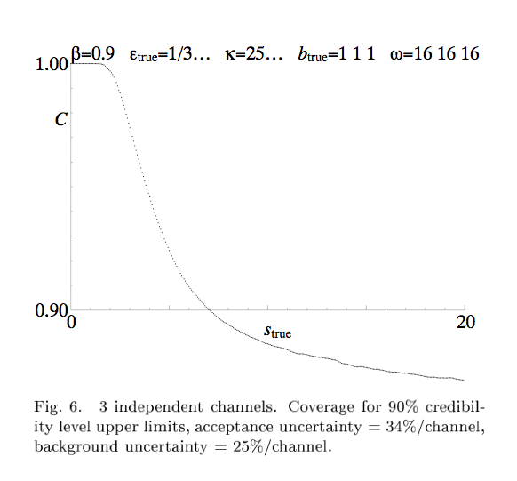
Flat priors are not a good idea! ¹⁴
Notes:
Heinrich 2003

Slide 29
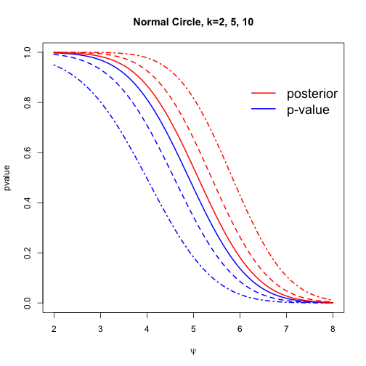
Flat priors are not a good idea!
Notes:
Default priors 2010

Slide 30



Flat priors are not a good idea!
Bayesian p-value –
Frequentist p-value

Slide 31
More complex models
Likelihood inference has desirable properties
Sufficiency, asymptotic efficiency
Good approximations to needed distributions
Derived naturally from parametric models
Can be difficult to construct,
especially in complex models
Many natural extensions: partial likelihood for censored data, quasi-likelihood for generalized estimating equations, composite likelihood for dependent data

Slide 32

Complex models ¹⁴
Example: longitudinal study of migraine sufferers
Latent variable
Observed variable
E.g. no headache, mild, moderate, intense …
Covariates: age, education, painkillers, weather, …
random effects between and within subjects
Serial correlation
Notes:
Varin and czado

Slide 33

Likelihood for longitudinal discrete data
Likelihood function
Hard to compute
Makes strong assumptions
Proposal: use bivariate marginal densities
instead of full multivariate normal densities
Giving a mis-specified model

Slide 34


Composite likelihood
Composite likelihood function
More generally
Sets index marginal or conditional (or …)
distributions
Inference based on theory of estimating equations
Notes:
Varin 2008; Varin Reid and Firth 2010

Slide 35

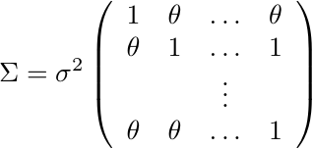
A simple example ¹⁶
Pairwise likelihood estimator of fully efficient
If , loss of efficiency depends on dimension
Small for dimension less than, say, 10
Falls apart if for fixed sample size
Relevant for time series, genetics applications
Notes:
Cox and reid 2004

Slide 36


Composite likelihood estimator
Godambe information
Notes:
Lindsay 1988

Slide 37
Recent Applications ¹⁷
Longitudinal data, binary and continuous: random effects models
Survival analysis: frailty models, copulas
Multi-type responses: discrete and continuous; markers and event times
Finance: time-varying covariance models
Genetics/bioinformatics: CCL for vonMises distribution: protein folding; gene mapping; linkage disequilibrium
Spatial data: geostatistics, spatial point processes
Notes:
\onslide<2-> \hfill {\footnotesize {\color{gray} Molenberghs and Verbeke, 2005, Ch.~9; Zhao \& Joe, 2005}}\\
\onslide<4->\hfill{\footnotesize {\color{gray} Parner, 2001; Andersen, 2004; Fiocco et al., 2009}}\\
\onslide<6-> \hfill {\footnotesize{\color{gray} de Leon and Carriere, 2007; Fieuws et al.,2007}}\\
\onslide<8->\hfill {\footnotesize {\color{gray} Engle et al., 2009}}\\
literature \\
\onslide<10->\hfill {\footnotesize{\color{gray}Tamura et al.,2007; Li, 2008; Mardia et al.,2009}}\\
\onslide<13-> {\footnotesize {\color{gray} Stein, 2004; Caragea and Smith, 2008; Varin et al., 2005; ...}}

Slide 38
… and more
Image analysis
Rasch model
Bradley-Terry model
State space models
Population dynamics
…
Notes:
\onslide<2-> \hfill {\footnotesize {\color{gray} Molenberghs and Verbeke, 2005, Ch.~9; Zhao \& Joe, 2005}}\\
\onslide<4->\hfill{\footnotesize {\color{gray} Parner, 2001; Andersen, 2004; Fiocco et al., 2009}}\\
\onslide<6-> \hfill {\footnotesize{\color{gray} de Leon and Carriere, 2007; Fieuws et al.,2007}}\\
\onslide<8->\hfill {\footnotesize {\color{gray} Engle et al., 2009}}\\
literature \\
\onslide<10->\hfill {\footnotesize{\color{gray}Tamura et al.,2007; Li, 2008; Mardia et al.,2009}}\\
\onslide<13-> {\footnotesize {\color{gray} Stein, 2004; Caragea and Smith, 2008; Varin et al., 2005; ...}}
NottandRyden,1999 Fearnhead,2008;Song,2008
LarribeandLessard,2008

Slide 39
What can we learn?

Slide 40
What do we need to know?
Why are composite likelihood estimators efficient?
How much information should we use?
Are the parameters guaranteed to be identifiable?
Are we sure the components are consistent with a ‘true’ model?
Can we make progress if not?
How do joint densities get constructed?
What properties do these constructions have?
Is composite likelihood robust?

Slide 41
Why is this important?
Composite likelihood ideas generated from applications
Likelihood methods seem too complicated
A range of application areas all use the same/similar ideas
Abstraction provided by theory allows us to step back from the particular application
Get some understanding about when the methods might not work
As well as when they are expected to work well

Slide 42
The role of theory
Abstracts the main ideas
Simplifies the details
Isolates particular features
In the best scenario, gives new insight into what underlies our intuition
Example: curvature and Bayesian inference
Example: composite likelihood
Example: false discovery rates
Notes:
Need subscript here from NSF report and Wasserman/Genovese

Slide 43
False discovery rates ¹⁸
Problem of multiple comparisons
Simultaneous statistical inference – R.G. Miller, 1966
Bonferroni correction too strong
Benjamini and Hochberg, 1995
Introduce False Discovery Rate
An improvement (huge!) on “Type I and Type II error”
Then comes data, in this case from astrophysics
Genovese & Wasserman collaborating with Miller and Nichol
Notes:
Need subscript here from NSF report and Wasserman/Genovese

Slide 44
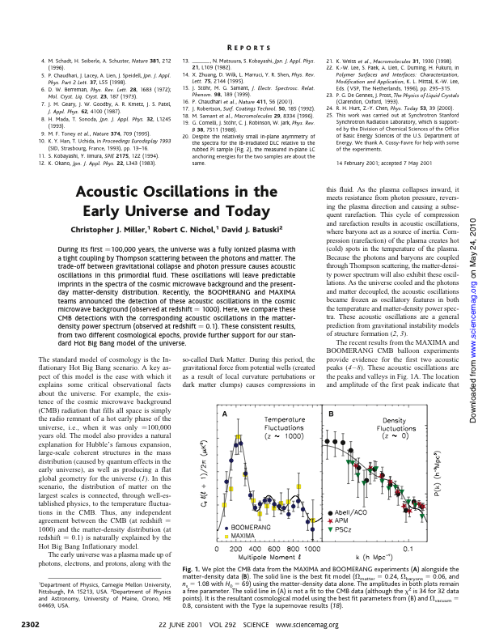
False discovery rates ¹⁹
Notes:
Need subscript here from NSF report and Wasserman/Genovese

Slide 45
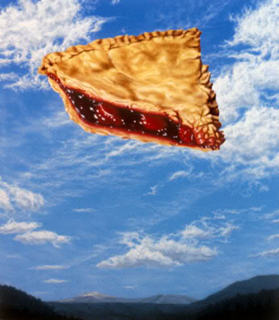
Speculation ²⁰
Composite likelihood as a smoother
Calibration of posterior inference
Extension of higher order asymptotics to composite likelihood
Exponential families and empirical likelihood
Semi-parametric and non-parametric models connected to higher order asymptotics
Effective dimension reduction for inference
Ensemble methods in machine learning
Notes:
http://epiac1216.wordpress.com/2008/09/23/origins-of-the-phrase-pie-in-the-sky/ for photo credit

Slide 46

Speculation ²¹
“in statistics the problems always evolve relative to the development of new data structures and new computational tools” … NSF report
“Statistics is driven by data” … Don McLeish
“Our discipline needs collaborations” … Hugh Chipman
How do we create opportunities?
How do we establish an independent identity?
In the face of bureaucratic pressures to merge?
Keep emphasizing what we do best!!
Notes:
Or we’re doomed!

Slide 47
Speculation
Engle
Variation, modelling, data, theory, data, theory
Tibshirani
Cross-validation; forensic statistics
Netflix Grand Prize
Recommender systems: machine learning, psychology, statistics!
Tufte
“Visual Display of Quantitative Information” -- 1983
Notes:
Or we’re doomed!

Slide 48
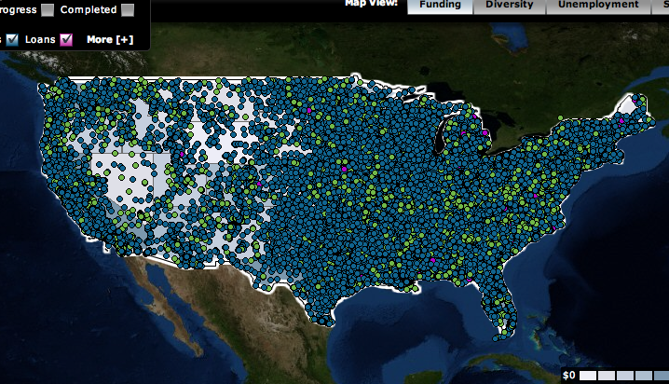
http://recovery.gov
787,000,000,000 $

Slide 49
Thank you!!

Slide 50
End Notes
“Making Sense of Statistics” Accessed on May 5, 2010. http://www.senseaboutscience.org.uk/
Midlife Crisis: National Post, January 30, 2008.
Alessandra Brazzale, Anthony Davison and Reid (2007). Applied Asymptotics. Cambridge University Press.
Amari (1982). Biometrika.
Fraser, Reid, Jianrong Wu. (1999). Biometrika.
Reid (2003). Annals Statistics
Fraser (1990). J. Multivariate Anal.
Figure drawn by Alessandra Brazzale. From Reid (2003).
Davison, Fraser, Reid (2006). JRSS B.
Davison, Fraser, Reid, Nicola Sartori (2010). in progress
Reid and Fraser (2010). Biometrika
Fraser, Reid, Elisabetta Marras, Grace Yun-Yi (2010). JRSSB
Reid and Ye Sun (2009). Communications in Statistics
J. Heinrich (2003). Phystat Proceedings
C. Varin, C. Czado (2010). Biostatistics.
D.Cox, Reid (2004). Biometrika.
CL references in C.Varin, D.Firth, Reid (2010). Submitted for publication.
Account of FDR and astronomy taken from Lindsay et al (2004). NSF Report on the Future of Statistics
Miller et al. (2001). Science.
Photo: http://epiac1216.wordpress.com/2008/09/23/origins-of-the-phrase-pie-in-the-sky/
Photo: http://www.bankofcanada.ca/en/banknotes/legislation/images/023361-lg.jpg
Notes:
TRADUCTION

