Slide 1
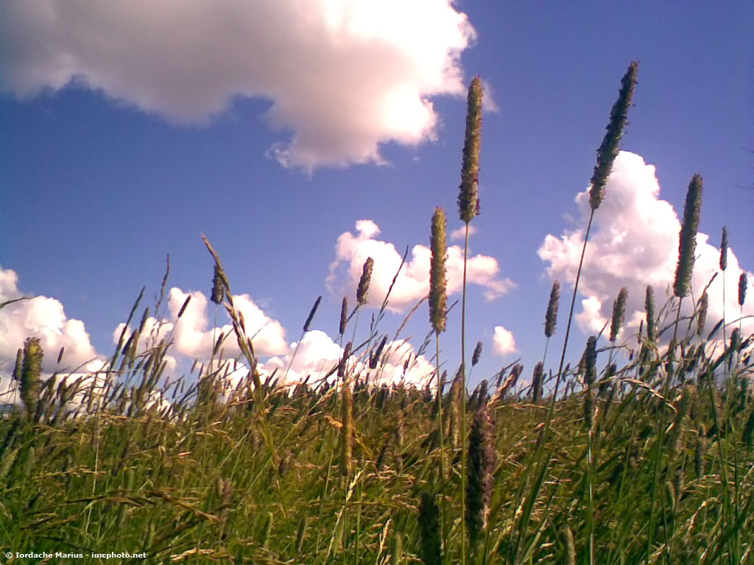
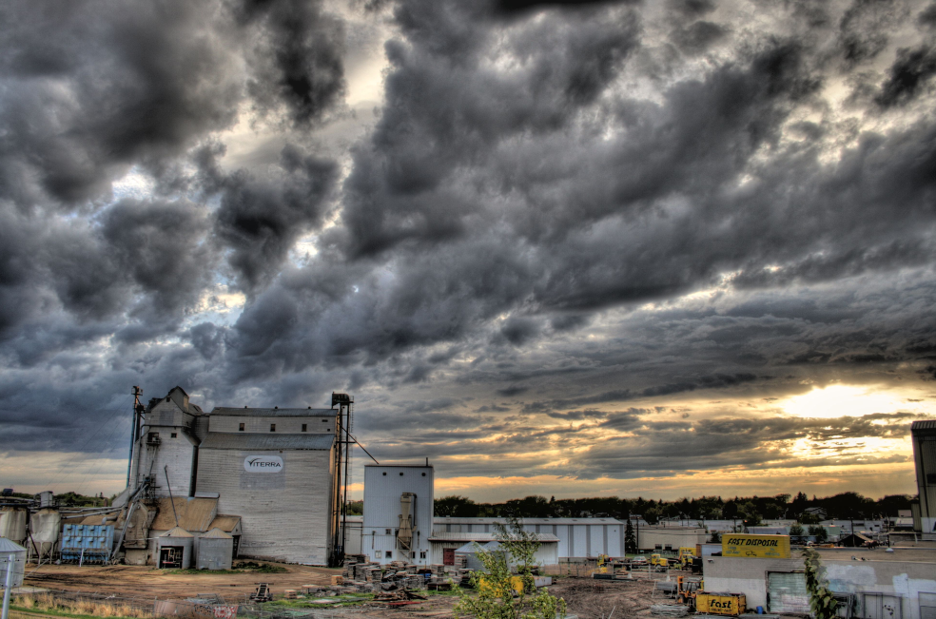
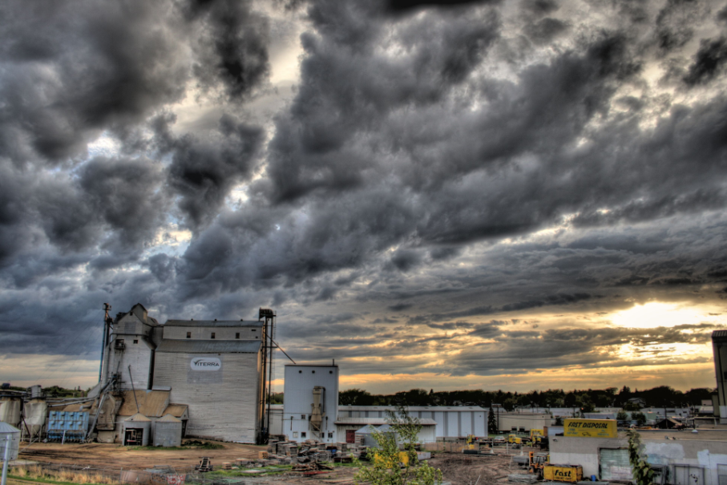
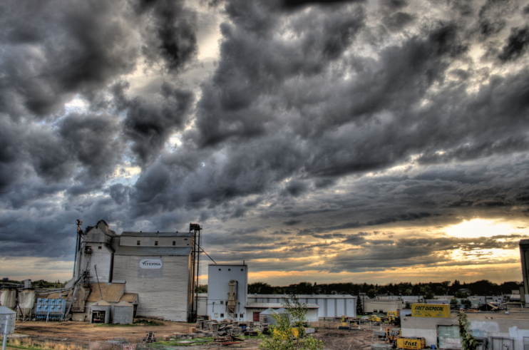
Viterra & ADM
Viterra & ADM
By Joseph Chan, Virginia Chu, Ruolin Li, Yi Peng Zhang
By Virginia Hiu Kwan Chu, Joseph Chan, Ruolin Li, Yipeng Zhang

Slide 2
Outline
Industry Analysis
Economic
Market
Viterra
Company Overview
Risk Management
Financial Statements Analysis
ADM
Company Overview
Risk Management
Financial Statements Analysis

Slide 3
Industry overview

Slide 4
Agriculture Industry
Includes different activities such as:
Harvesting crops
Planting
Livestock
Feeding
Biotechnology

Slide 5
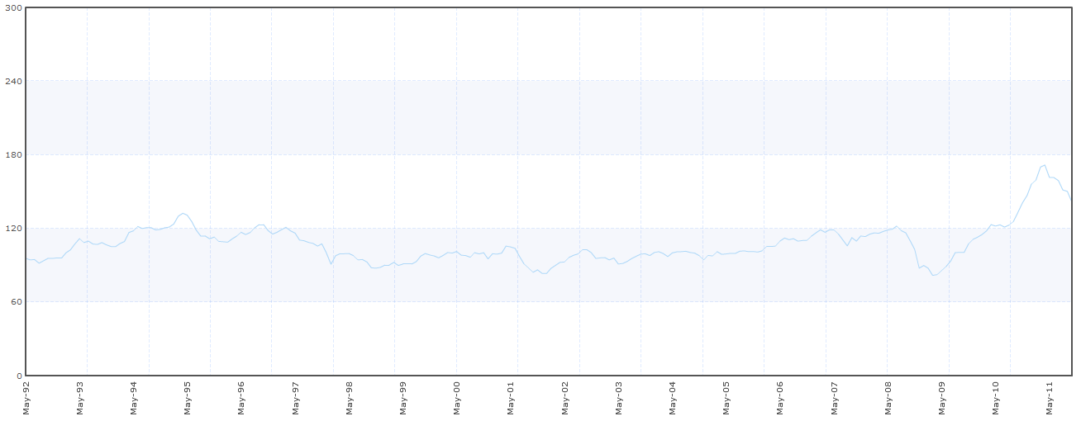
Commodity Agricultural Raw Materials Index

Slide 6
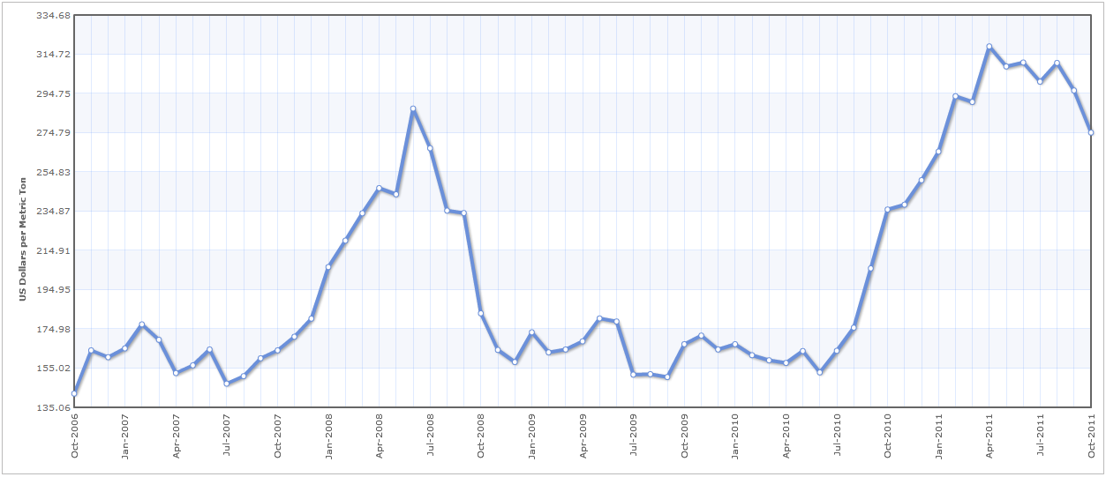
Corn Prices

Slide 7
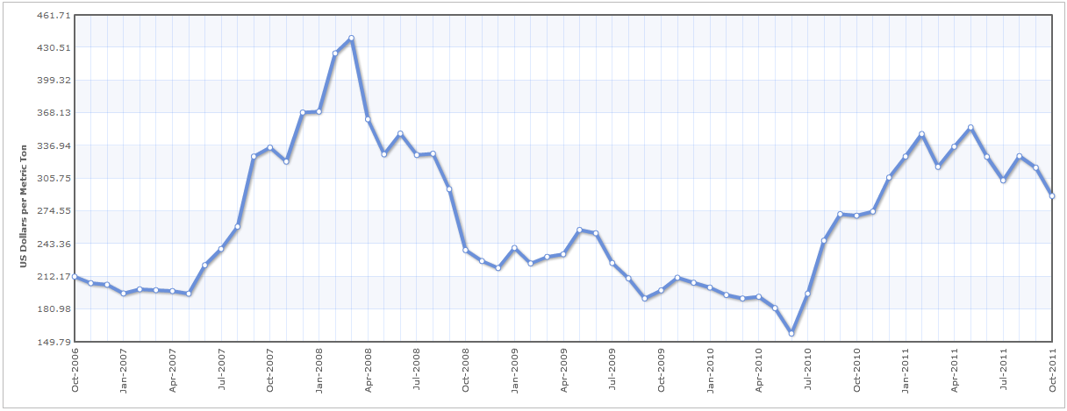
Wheat Prices

Slide 8
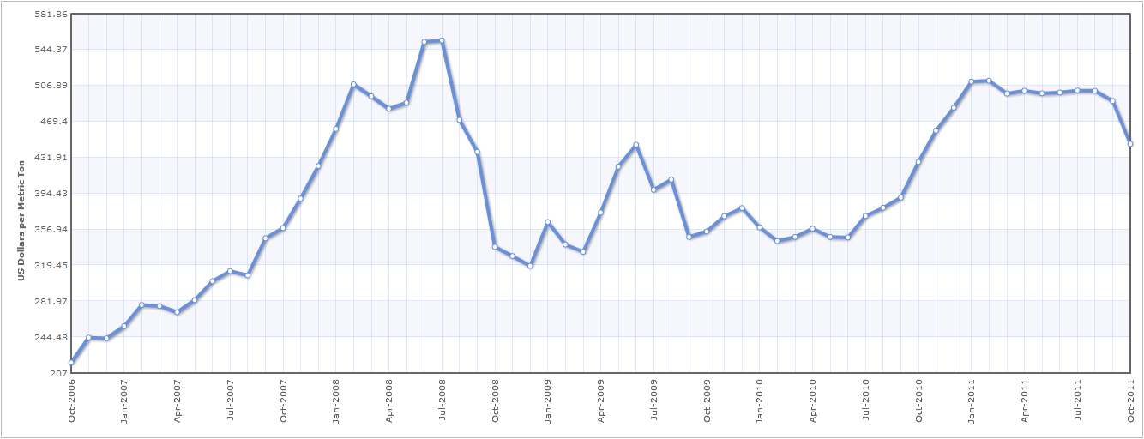
Soybeans Price

Slide 9
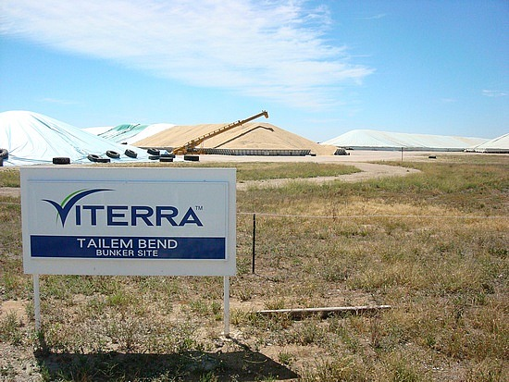
Company overview

Slide 10
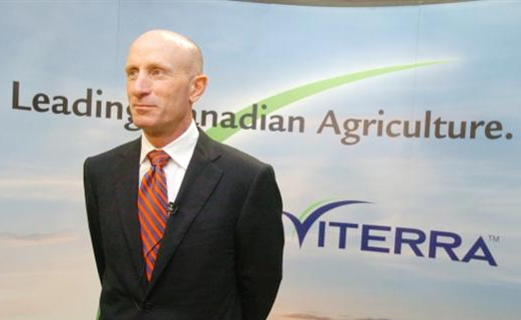
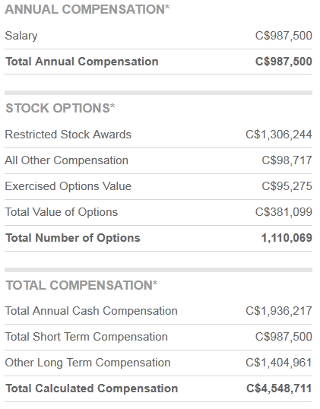
President and CEO
Mayo Schmidt

Slide 11
Company Overview & Structure
In the top 50 largest Company in Canada
Vertically integrated global agri-business headquartered in Canada.
Has offices in Canada, the U.S., Australia, New Zealand, Japan, Singapore, China, Vietnam, Switzerland, Italy, Ukraine, Germany and India.
Operates in three interrelated segments: Grain Handling and Marketing, Agriproducts, and Processing.

Slide 12
Products and Services
Crop Protection
Seed
Agriculture Equipment
Fertilizer
Grain Marketing
Financing
Food Ingredients
Feed Products

Slide 13
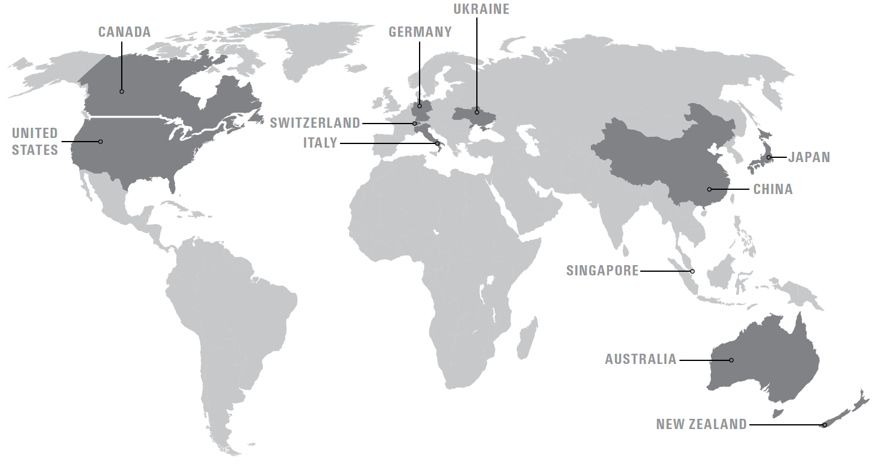
Viterra: International

Slide 14
Competitors
CHS Inc. (Inver Grove Heights, MN)
GROWMARK Inc. (Bloomington, IL)
SunOpta Inc. (Brampton, ON)

Slide 15
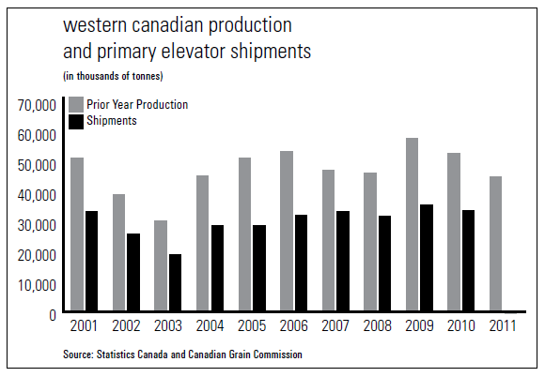

Slide 16
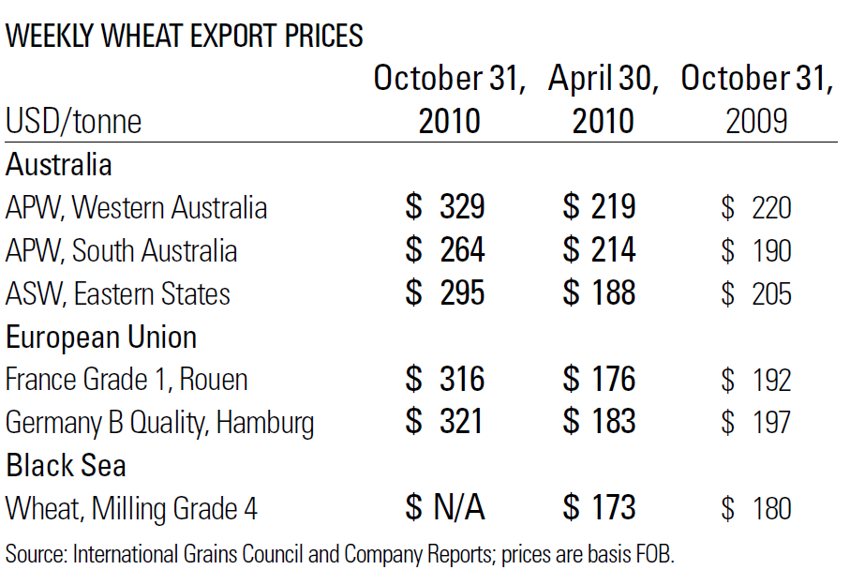

Slide 17
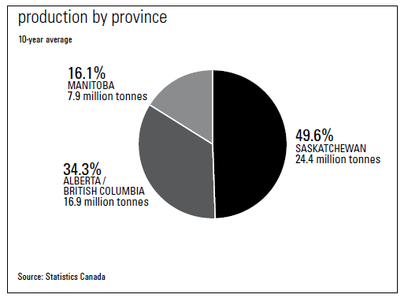
Production in Canada

Slide 18
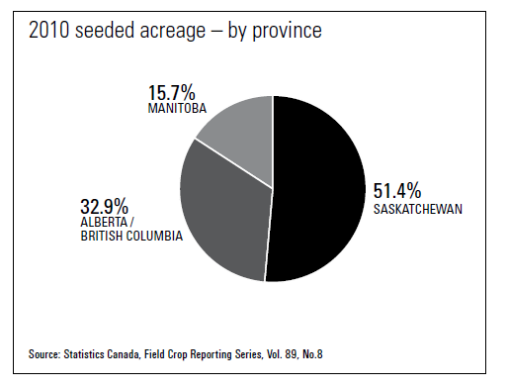
2010 Seeded Acreage (Canada)

Slide 19
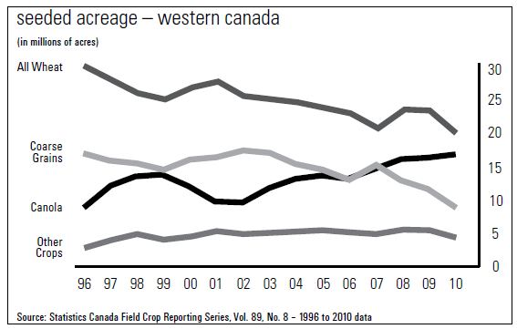

Slide 20
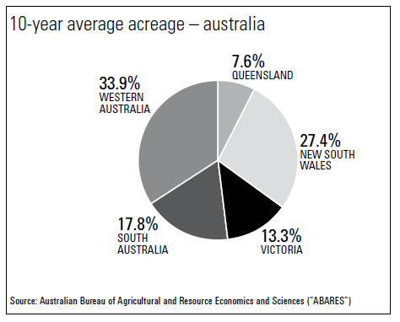
Average Acreage (Australia)

Slide 21
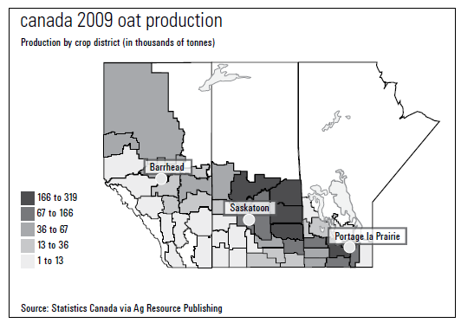
Oat Production (2009) Canada

Slide 22
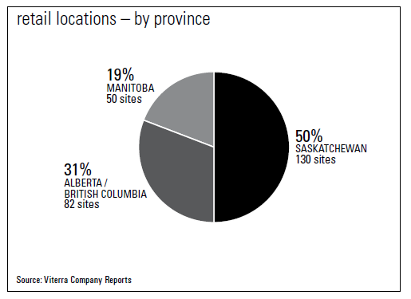
Retail Locations (Canada)
50% of the company’s retail in Canada are located in Saskatchewan

Slide 23
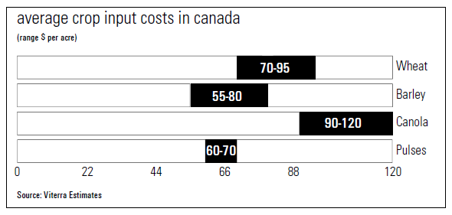
Input Cost

Slide 24
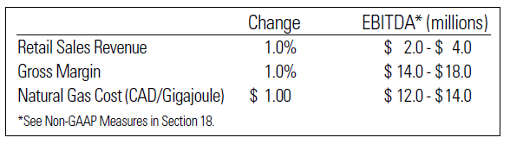

Slide 25
Regulatory: Viterra
Canada: Under the CWB Act, the CWB is established as the central selling agency for the export of wheat and barley and the sale of domestic wheat and barley for human consumption grown in Western Canada.
Australia: WEA administers a scheme under which all exporters of wheat must be accredited. Viterra’s Australian operations are accredited. To maintain its accreditation, Viterra must provide access to its port services to other exporters pursuant to access arrangements approved by the ACCC.

Slide 26
Firm’s strategy

Slide 27
Firm Strategy (Future Growth)
Remains focused on its diversification strategy to grow its portfolio of food and feed ingredients businesses.
Notes:
**Found in Q3 2011Management’s Discussion and Analysis

Slide 28
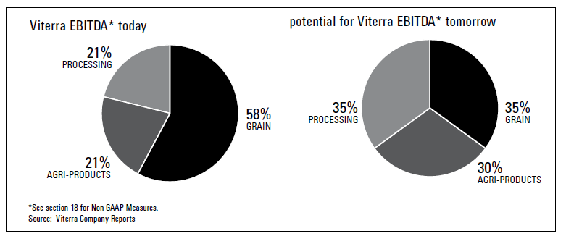
Strategic Direction

Slide 29
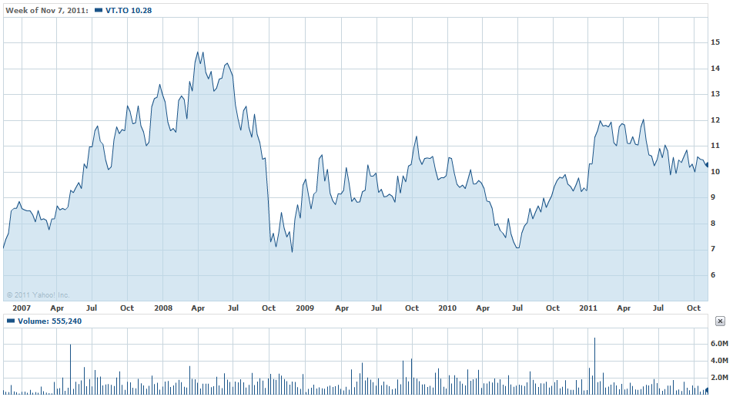
Historical Prices

Slide 30
Risk management

Slide 31
Governance and Oversight
Corporate risk at Viterra is managed on a basis of an Enterprise Risk Management (“ERM”) framework.
Identify potential risks that may impact the Company in order to manage those risks to be within the Company’s risk appetite and provide assurance regarding the Company’s objectives.
Notes:
Corporate risk at Viterra is managed on a proactive, explicit basis through the identification and mitigation of risks within an Enterprise Risk Management (“ERM”) framework.
Enterprise-wide risk management is a process effected by the Company’s Board of Directors, management and personnel, applied in particular settings and across the Company, designed to identify potential events that may impact the Company, manage risk to be within the Company’s risk appetite, and to provide reasonable assurance regarding the achievement of the Company’s objectives.

Slide 32
Governance and Oversight (cont’d)
Viterra’s Risk Management Committee: responsible for ongoing reporting of significant risks, as well as providing assurance that risk mitigation processes adequately reduce the impact of material risks on business performance and corporate reputation.
Viterra’s senior management: responsible for ensuring that key corporate risks are identified, assessed, monitored and reported, and that mitigation strategies are developed where prudent.

Slide 33
Weather Risk
As an agri-business companies, Viterra’s most significant risk is the WEATHER.
The effect of weather conditions on production volumes and crop quality present significant operating and financial risk to Viterra’s Grain Handling and Marketing segment.

Slide 34
Weather Risk (Cont’d)
Viterra offers a number of programs to its primary customers, including drying and blending opportunities, in an attempt to mitigate some of the quality risk.
Viterra has historically had grain volume insurance to protect the cash flow of the Company from significant declines in grain volumes as a result of drought or other weather-related events.
Notes:
Crop quality is also an important factor because the majority of the higher quality grains and oilseeds are sent to port terminals for export. The mix of grains and oilseeds that Viterra manages in any given year is an important factor affecting margins and earnings.
The level and mix of agri-products sales are also dependent on weather. Weather and moisture levels are a determining factor for,
among other things, crop selection by producers at seeding time, the variety of seed sown, and the amount of proprietary seed purchased.
Viterra has historically had grain volume insurance to protect the cash flow of the Company from significant declines in grain volumes as a result of drought or other weather-related events. For 2010, the Company had $75.0 million of coverage in place for Canadian and Australian exposure. For 2011, the Company has 49% of the $75.0 million of coverage in place under a multi-year program. The Company intends to place additional coverage for 2011.

Slide 35
Food and Feed Product Safety Risk
A large majority of the Company’s sales are generated from food products and the Company could be vulnerable in the event of a significant outbreak of food-borne illness or increased public health concerns in connection with certain food products.
Viterra has established a number of processes to track and identify crops at every stage of production: from seed to customer delivery.

Slide 36
Commodity Price and Trading Risk
In the case of Board grains handled in Canada, Viterra earns CWB(Canadian Wheat Board) storage and handling tariffs, and these are established independently of the market price for grain.
For these grains, the Company’s risks are reduced in part through the terms of formal legal arrangements between Viterra and the CWB. The arrangements provide for full reimbursement of the price paid to producers for grain as well as certain costs incurred by Viterra.

Slide 37
Commodity Price and Trading Risk
For non-Board or open market grains and oilseeds purchased by Viterra, as well as Australian grains and oilseeds, the Company is exposed to the risk of movement in price between the time the grain is purchased and when it is sold.
The Company uses exchange-traded futures and options contracts as well as Over the Counter (“OTC”) contracts to minimize the effects of changes in the prices of hedgeable agricultural commodities on its agri-business inventories and agricultural commodities forward cash purchase and sales contracts.

Slide 38
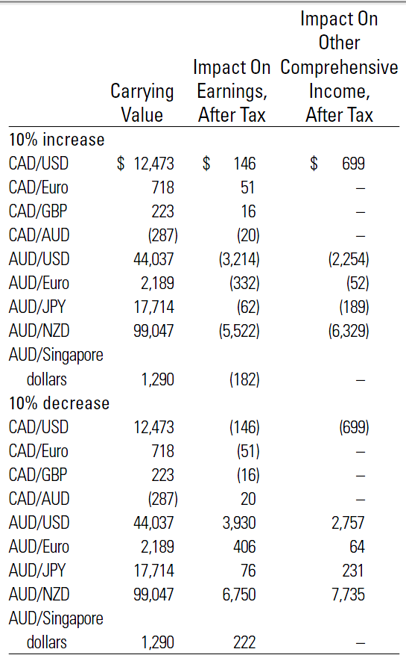
Sensitivity Analysis

Slide 39
Interest Risk
The Company’s exposure to interest rate risk relates primarily to the Company’s debt obligations.
Manages interest rate risk and currency risk on borrowings by using:
Cash instruments
Forwards
Interest rate swaps
Use interest rate swaps to manage variable interest rates associated with a portion of the Company’s debt portfolio

Slide 40
Merge and Acquisition Risk
•adverse changes to the industry of the purchased company or asset,
• difficulty integrating the operations and personnel, realizing
anticipated synergies, maximizing the financial and strategic
position of the combined enterprise, and maintaining uniform
policies, systems and controls across the organization,
• unexpected costs and liabilities which may be significant and
not covered by an indemnity in the acquisition agreement,
• disruptions to Viterra’s current businesses and its relationships
with employees, customers and suppliers, and
• business risks that Viterra has not been previously engaged in
and exposed to

Slide 41
Regulatory Risks
Regulatory risks related to climate change, including compliance risks, emissions trading exposures and increases in costs.

Slide 42
Third Party Relationship Risk
There is a risk to Viterra that third-party relationships may fail, resulting in the potential for:
Operational disruptions
Financial loss
Reputation loss

Slide 43
Third Party Relationship Risk (cont’d)
These third-party relationships include:
Minority equity positions in a number of companies
Operational relationships with key customers and suppliers
Company’s products to market
Banks that lend money to the Company directly and through lending syndicates, act as counterparties and provide banking services
Rating agencies such as DBRS Limited, Standard & Poor’s and counterparty relationships with trading partners
Futures exchanges

Slide 44
Commodity Price and Trading Risk
During the year ended October 31, 2010, management has implemented an updated Value at Risk (“VaR”) method to standardize the risk assessment globally.
To limit the amount of agricultural commodity positions permissible (combination of quantity and VaR limits)
VaR levels: reported daily and compared with approved limits.

Slide 45
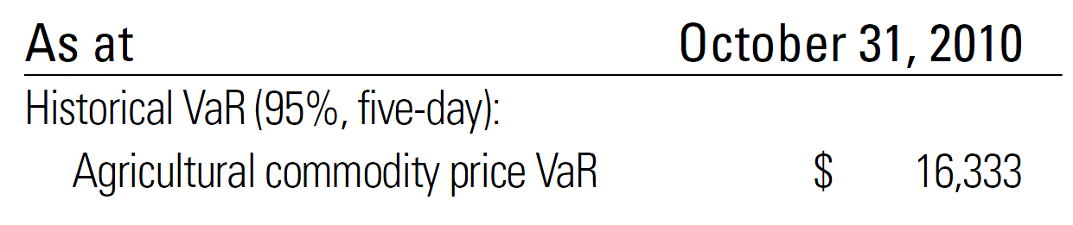
Commodity Price and Trading Risk

Slide 46
Sovereign and Political Risk
Both of these factors affect export levels of Board grains and open market grains and oilseeds, which in turn affect the Company’s handling volumes and can have a material adverse effect on the Company’s financial results, business prospects and financial condition.
International agricultural trade is affected by high levels of domestic support and global export subsidies, especially by the U.S. and the EU.

Slide 47
Sovereign and Political Risk (cont’d)
In addition, the Company’s foreign operations may be subject to the risks normally associated with the conduct of business in certain foreign countries.
The occurrence of one or more of these risks may have a material adverse effect on the Company’s financial results, business prospects and financial condition.

Slide 48
Liquidity Risk
The Company’s liquidity risk refers to its ability to settle or meet its obligations as they fall due.
The Company actively maintains credit facilities to ensure it has sufficient available funds to meet current and foreseeable financial requirements.

Slide 49
Capital Market Risk
General economic and business conditions that impact global debt or equity markets can impact the availability of credit and the cost of credit for the Company. This capital market risk could have a material adverse effect on the Company’s financial results, business prospects and financial condition.
Mitigates this risk by establishing long-term relationships with banks and capital market participants, maintaining the Company’s debt at prudent levels and by diversifying the source and maturity dates of its capital.

Slide 50
Credit Risk
The Company is exposed to credit risk in respect of its trade receivables:
The company mitigate this risk by:
Monitoring of credit balances
Ongoing credit reviews of all significant contracts
Analysis of payment and loss history
Customers that fail to meet specified credit requirements may transact with the Company on a prepayment basis or provide another form of credit support, such as letters of credit, approved by the Company.

Slide 51
Foreign Exchange Risk
Exposed to foreign exchange risk on commodity contracts which are denominated in foreign currencies, and on its investment in foreign subsidiaries.
Uses derivative financial instruments to limit exposures to changes in foreign currency exchange rates with respect to its recorded foreign currency denominated assets and liabilities as well as anticipated transaction such as:
Foreign currency forward contracts
Cross-currency swaps
Futures contracts
Options

Slide 52
Analysis of financial statements

Slide 53
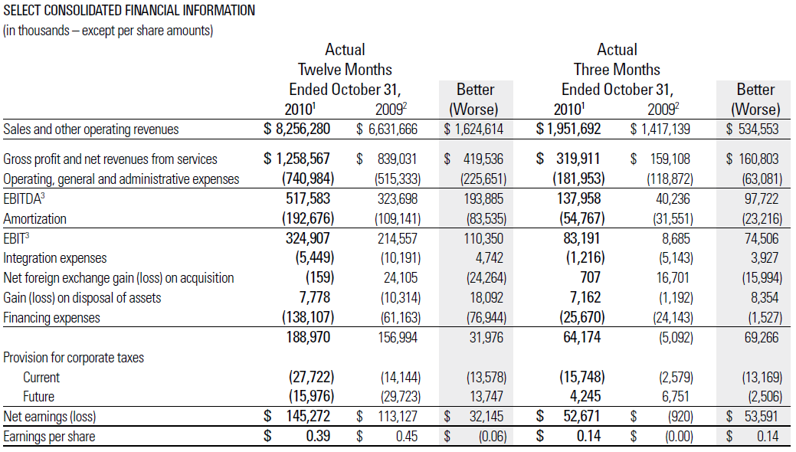
Notes:
They use fair value in the balance sheet

Slide 54
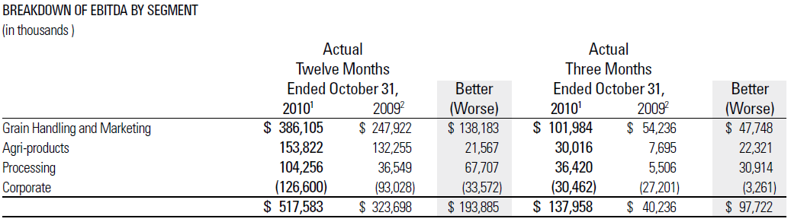

Slide 55
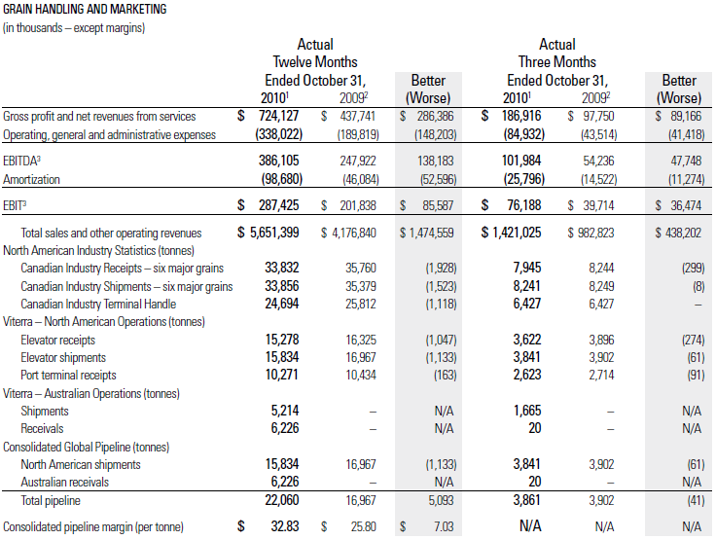

Slide 56
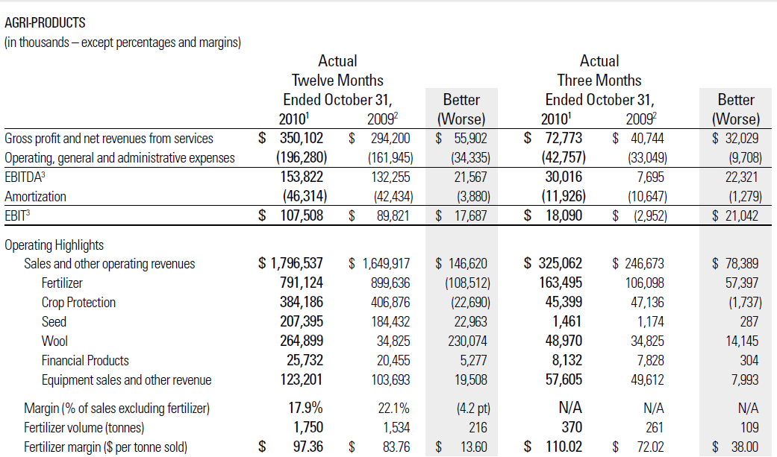

Slide 57
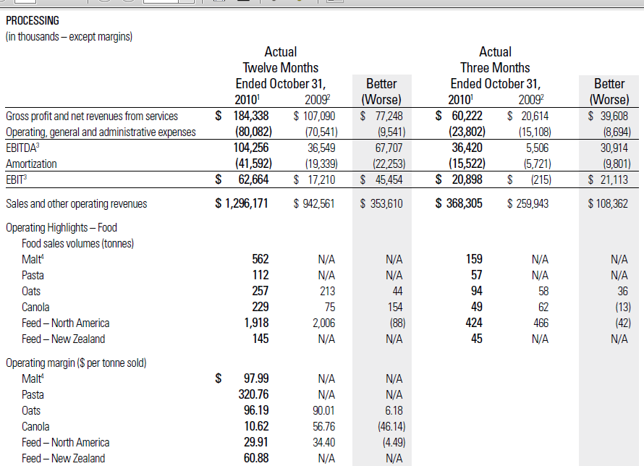

Slide 58
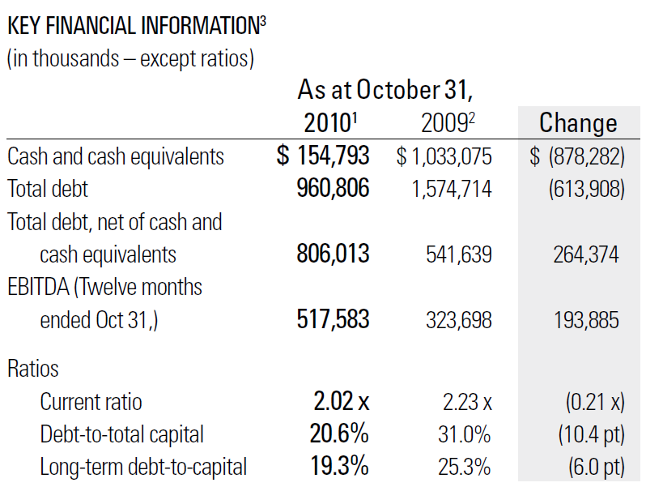

Slide 59
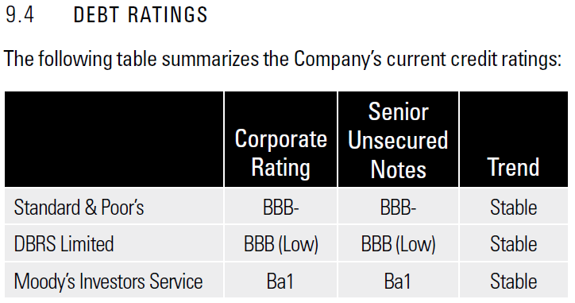

Slide 60
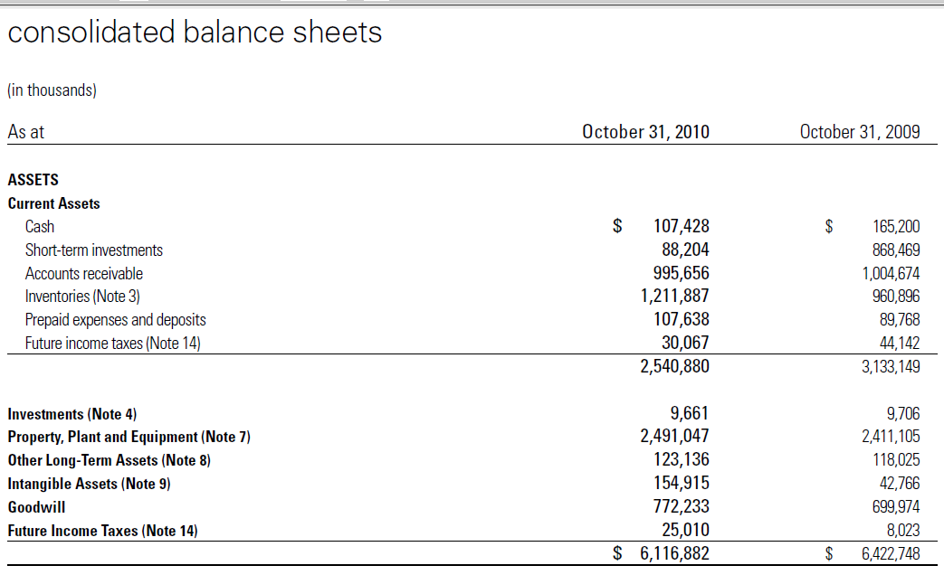

Slide 61
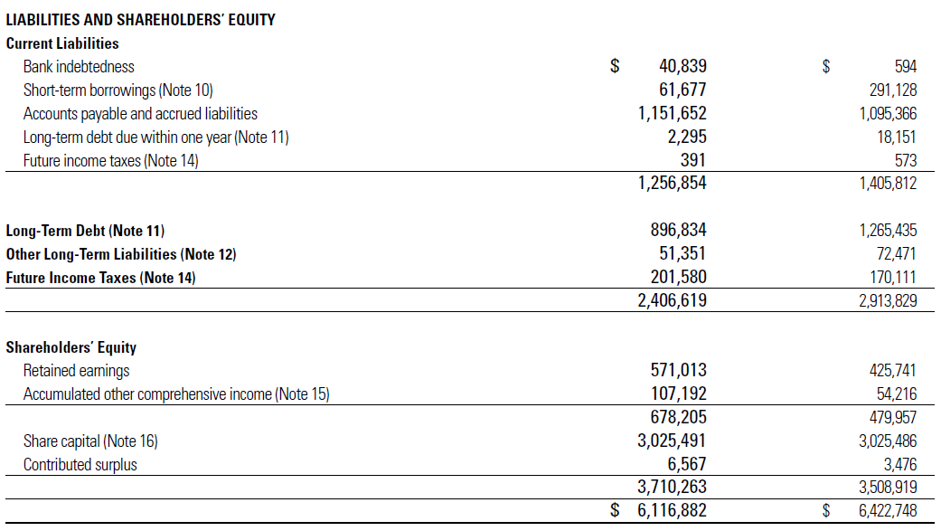

Slide 62
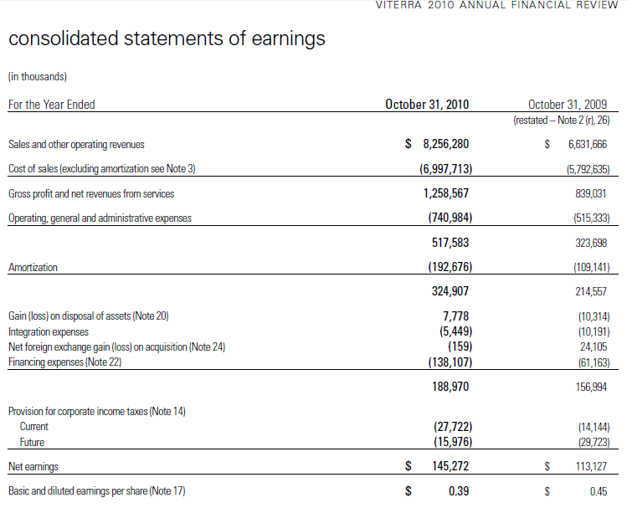

Slide 63
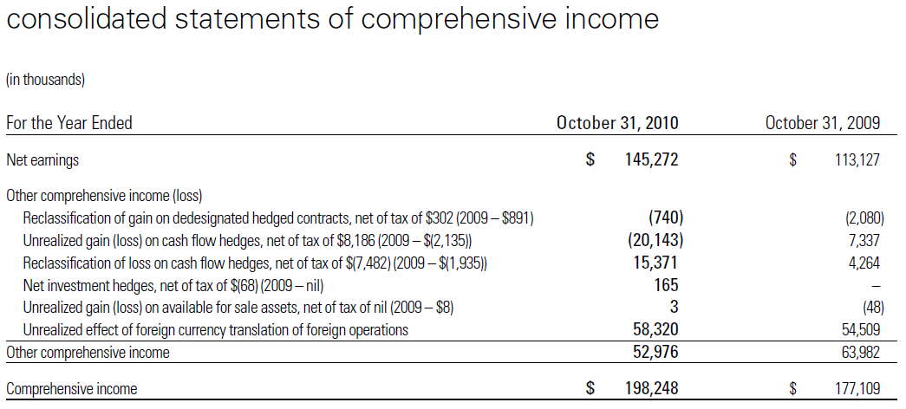

Slide 64
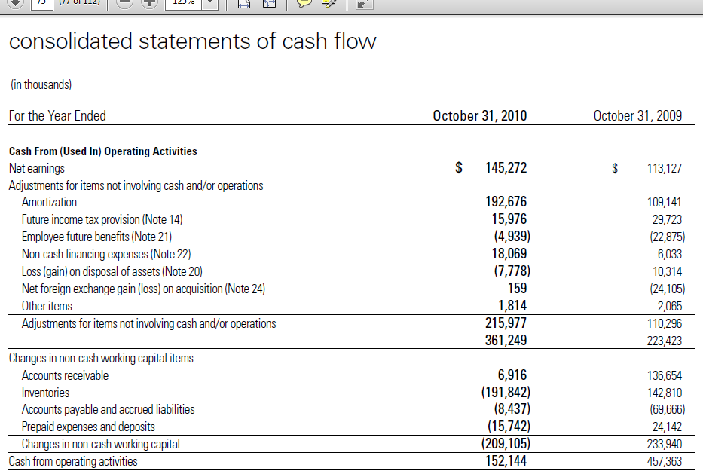

Slide 65
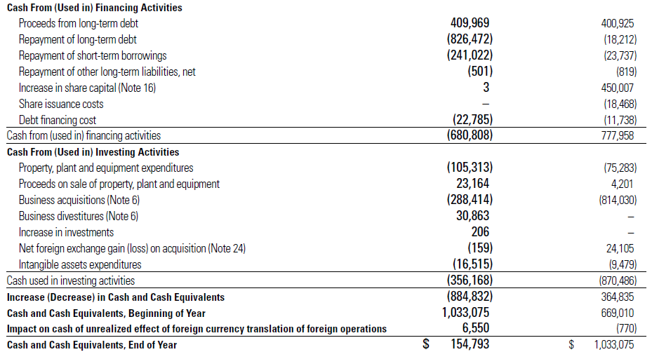

Slide 66
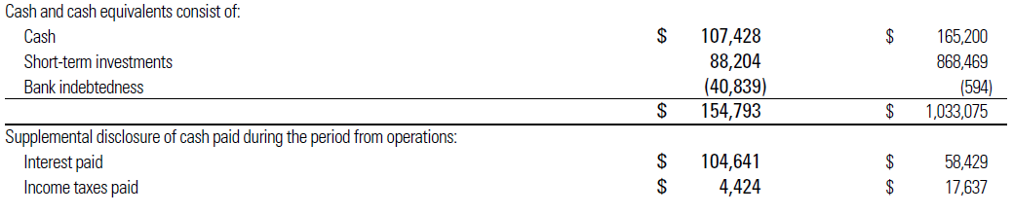
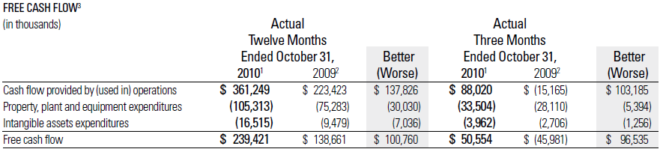

Slide 67
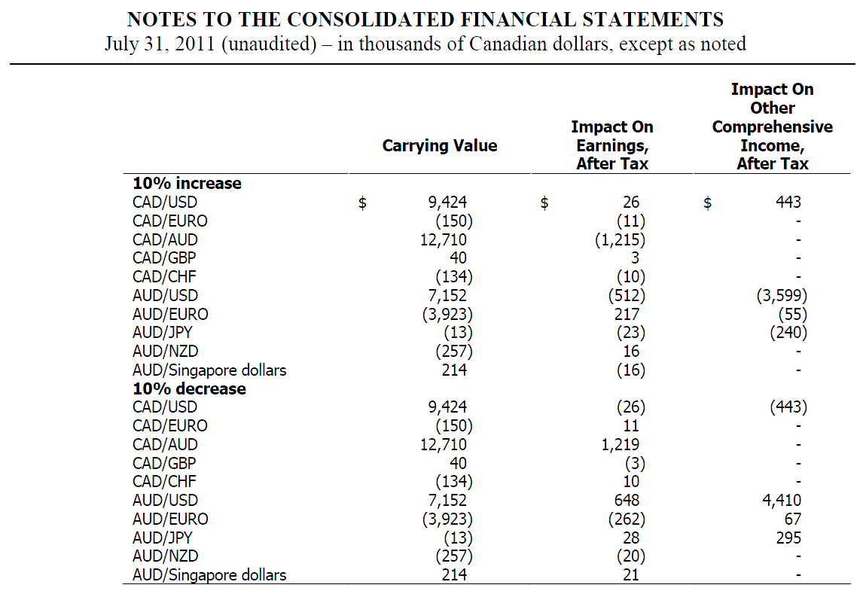
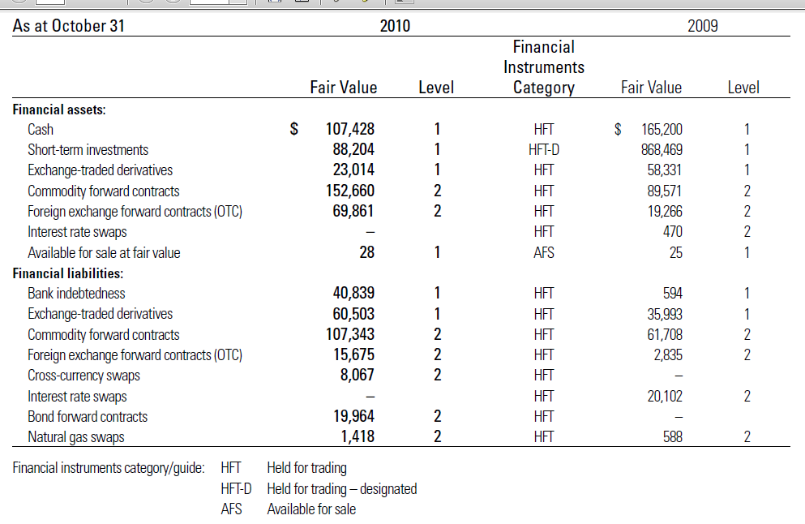

Slide 68
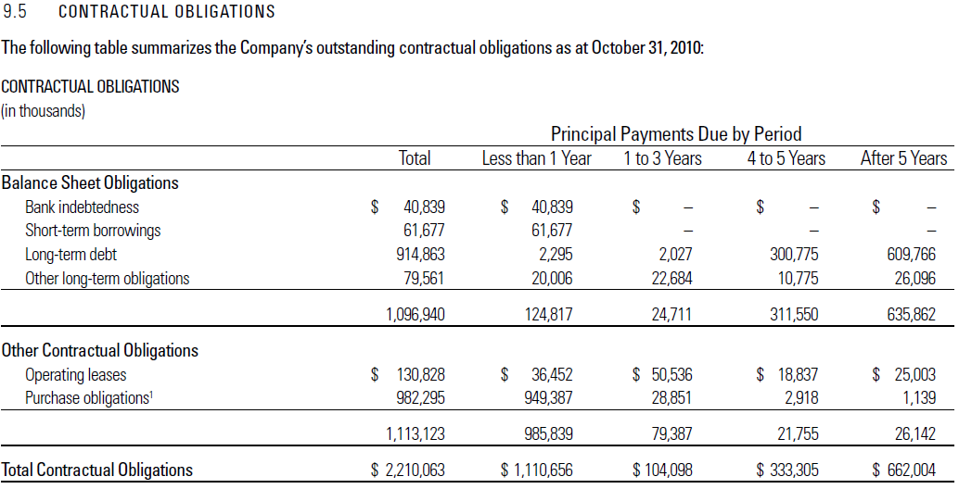

Slide 69
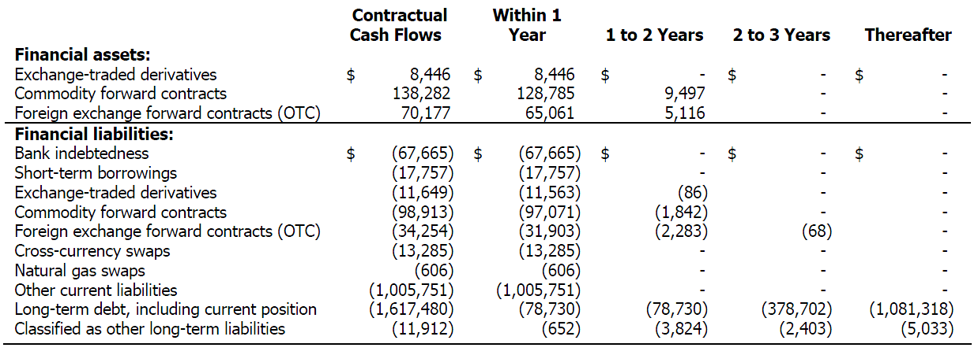

Slide 70
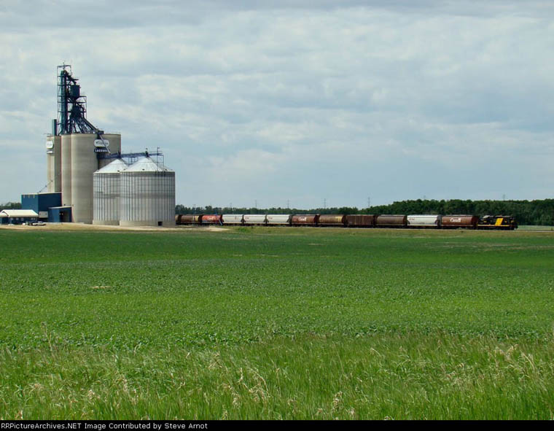

Slide 71
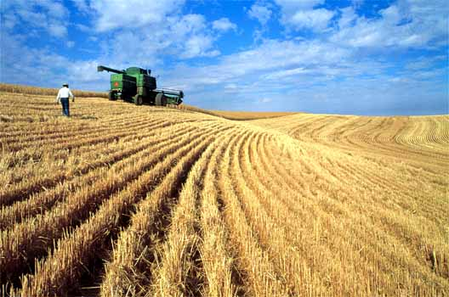
ADM

Slide 72
Company Overview
Archer-Daniels-Midland-Company (the Company) was incorporated in Delaware in 1923.
One of the world’s largest processors of agricultural commodities
Leading manufacturer of value-added food and feed ingredients; an extensive grain elevator and transportation network to procure, store, clean, and transport agricultural commodities.
The Company has significant investments in joint ventures.
Notes:
The Company is one of the world’s largest processors of oilseeds, corn, wheat, cocoa, and other agricultural commodities and is a leading manufacturer of vegetable oil, protein meal, corn sweeteners, flour, biodiesel, ethanol, and other value-added food and feed ingredients. The Company also has an extensive grain elevator and transportation network to procure, store, clean, and transport agricultural commodities, such as oilseeds, corn, wheat, milo, oats, and barley, as well as processed agricultural commodities.
The Company expects to benefit from these investments, which typically aim to expand or enhance the Company’s market for its products or offer other benefits including, but not limited to, geographic or product line expansion.

Slide 73
Company Overview (cont’d)
Vision: is to be the most admired global agribusiness while creating value and growing responsibly.
Strategy: involves expanding the volume and diversity of crops that it merchandises and processes, expanding the global reach of its core model, and expanding its value-added product portfolio.
The Company seeks to serve vital needs by connecting the harvest to the home and transforming crops into food and energy products.
Notes:
The Company is one of the world’s largest processors of oilseeds, corn, wheat, cocoa, and other agricultural commodities and is a leading manufacturer of vegetable oil, protein meal, corn sweeteners, flour, biodiesel, ethanol, and other value-added food and feed ingredients. The Company also has an extensive grain elevator and transportation network to procure, store, clean, and transport agricultural commodities, such as oilseeds, corn, wheat, milo, oats, and barley, as well as processed agricultural commodities.
The Company expects to benefit from these investments, which typically aim to expand or enhance the Company’s market for its products or offer other benefits including, but not limited to, geographic or product line expansion.

Slide 74
Segments
The Company’s operations are classified into three reportable business segments:
Oilseeds Processing
Corn Processing
Agricultural Services
Each of these segments is organized based upon the nature of products and services offered.
The Company’s remaining operations:
Wheat processing
Cocoa processing
Financial business units

Slide 75
Corn Processing
Corn wet milling and dry milling activities, primarily in the United States, to produce ingredients used in the food and beverage industry including syrup, starch, glucose, dextrose and sweeteners.
Dextrose is also used by the company as a feedstock for its bioproducts operations, including the production of ethanol, amino acids and industrial products.
Corn gluten feed and meal, as well as distillers grains, are produced for use as animal feed ingredients.
Corn germ, a by-product of the wet milling process, is further processed as an oilseed into vegetable oil and protein meal.

Slide 76
Oilseeds Processing
Activities related to the origination, merchandising, crushing and further processing of oilseeds such as soybeans, cottonseed, sunflower seeds, canola, peanuts, flaxseed and palm into vegetable oils and protein meals for food, feed, energy and other industrial products industries.
Oilseeds and oilseed products may be processed by ADM or resold into the marketplace as raw materials for other processing.

Slide 77
Agricultural Services
The Agricultural Services segment utilizes the company's extensive grain elevator and transportation network to buy, store, clean and transport agricultural commodities, including oilseeds, corn, wheat, milo, oats, rice and barley; and resells these commodities primarily as food and feed ingredients, and as raw materials, for the agricultural processing industry.
Agricultural Services' grain sourcing and transportation network provides reliable and efficient services to the company's agricultural processing operations.
The Agricultural Services segment includes 160 domestic and 25 international elevators, an animal feed facility in Illinois, 27 domestic and seven international formula feed and animal health nutrition plants, an edible bean plant in North Dakota, 23 domestic edible bean procurement facilities and a rice mill in California.

Slide 78
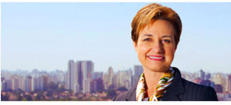
Executives
Patricia A. Woertz is chairman of the board of directors, chief executive officer and president of Archer Daniels Midland Company.
She was named CEO and president in April 2006, and assumed the additional role of chairman of the board in February 2007.
As CEO of ADM, in 2010, Woertz was ranked the 3rd most powerful women by Fortune magazine.
Formerly an Executive Vice President at Chevron Corporation

Slide 79
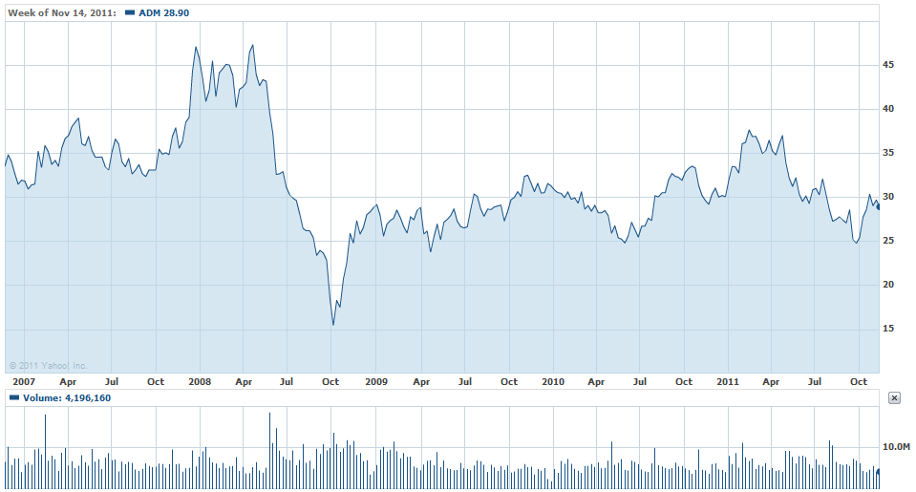
Historical Prices

Slide 80
Risk management

Slide 81
Major Risks
Weather risk
Commodity price risk
Interest rate risk
Regulation risk
Foreign exchange rate risk

Slide 82
Hedging Philosophy
ADM:
“The Company enters into derivative and non-derivative contracts with the primary objective of managing the Company’s exposure to adverse price
movements in the agricultural commodities used for, and produced in, our business operations.”

Slide 83
Hedging Philosophy
The Company’s position consists of:
energy and freight contracts
exchange-traded futures
exchange-traded and OTC options
contracts used to hedge portions of production

Slide 84
Analysis of financial statements

Slide 85
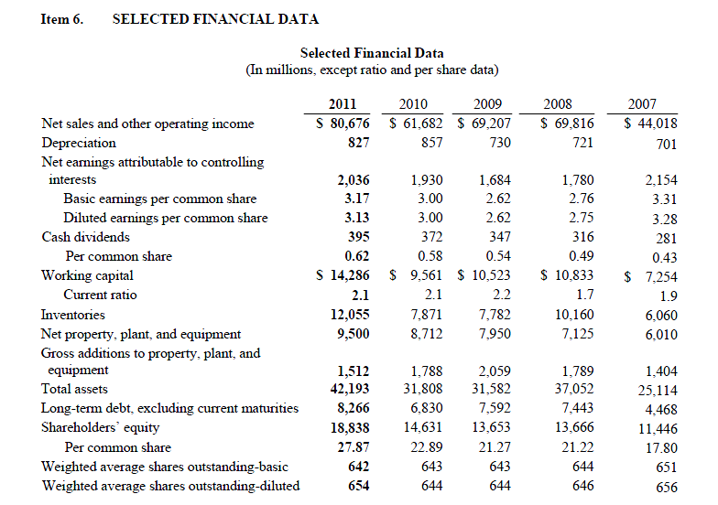

Slide 86


Slide 87


Slide 88


Slide 89



Slide 90



Slide 91



Slide 92
Fair Value Measurements
The Company determines the fair value of certain of its inventories of agricultural commodities, derivative contracts, and marketable securities based on the fair value definition and hierarchy levels

Slide 93
Fair Value Measurement (Cont’d)
Three levels are established within the hierarchy that may be used to measure fair value:
Level 1: Quoted prices (unadjusted) in active markets for identical assets or liabilities.
Level 2: Observable inputs, including Level 1 prices that have been adjusted
Level 3: Unobservable inputs that are supported by little or no market activity and that are a significant component of the fair value of the assets

Slide 94
Level 1 assets and liabilities include exchange-traded derivative contracts, U.S. treasury securities and certain publicly traded equity securities.
Level 2 quoted prices for similar assets or liabilities; quoted prices in markets that are less active than traded exchanges; and other inputs that are observable or can be substantially corroborated by observable market data.
Level 3 amounts can include assets and liabilities whose value is determined using pricing models, discounted cash flow methodologies, or similar techniques, as well as assets and liabilities for which the determination of fair value requires significant management judgment or estimation.

Slide 95


Slide 96


Slide 97


Slide 98


Slide 99

Notes:
For derivative instruments that are designated and qualify as cash flow hedges the effective portion of the gain or loss on the derivative instrument is reported as a component of AOCI and reclassified into earnings in the same line item affected by the hedged transaction and in the same period or periods during which the hedged transaction affects earnings.

Slide 100

Thanks for listening!

