Slide 1

E-MAIL 2.0
3.0
Steve Hillman
Simon Fraser University
hillman@sfu.ca

Slide 2



E-MAIL 2.0
3.0

Slide 3

Outline of Session
Who we are
Where we’re coming from
What we want to get to
How Zimbra’s going to get us there
..and When

Slide 4
Audience Participation!

Slide 5
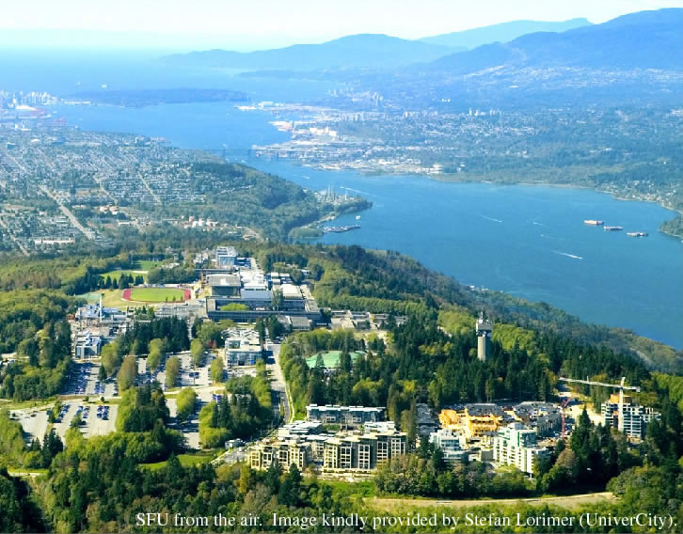
Who we are
Mid-sized university with ~30,000 students, 5000 staff/faculty. 50,000 accounts
Highly centralized IT dept provides all users with Mail, Web, File storage, Authn/Authz, as well as eLearning, ERP, etc

Slide 6
Where we’re coming from

Slide 7
Current Architecture
Amaint
LDAP Directory
Barracuda
MTA
MailLists
IMAP
POP
Webmail Store
Webmail
Barracuda
Mail Store
Desktop
Home Directories
Notes:
Simple, straightforward design
Webmail data is separate
Mailstore is on the server, hard to upgrade

Slide 8
Why redesign what already works??
What we have now already works:
It’s fast
It’s reliable
It’s simple
It’s been working well for 15 years

Slide 9
But..

Slide 10

It’s vulnerable to system failure

Slide 11
That one server is big and expensive to replace

Slide 12

The Webmail interface is dated

Slide 13

Eudora is dead

Slide 14
Our calendar is Corporate Time Oracle (not site-wide)

Slide 15


Slide 16
Our Email infrastructure is fully understood by one person – me.

Slide 17


Slide 18
What we want to get

Slide 19
Objectives
Fault tolerant
Lightweight e-mail accounts
Web-centric with modern look & feel
Easily expandable to support greater capacity
Calendaring
Mobile Support
Minimal loss of existing functionality (excellent maillist support, solid POP/IMAP/SMTP, anti-spam)
Open Source but supported

Slide 20
An Architecture to meet the objectives

Slide 21
Smtpserver
MTA
MailLists
IMAP
POP
Mail Store

Slide 22
Fault Tolerance
MTA
MailLists
MTA
MailLists
Amaint
LDAP
Web
Web
Web
Web
IMAP
POP
IMAP
POP
IMAP
POP
IMAP
POP
Cal
Cal
Cal
Cal
Index DB
Mail Store
Index DB
Mail Store
Notes:
-First we’ll duplicate the MTA
-Then we’ll add some dedicated client-access servers
-And a separate mailstore
-Then we’ll store our indexes in a database, for the best performance. This way, the mailstore can be slower, cheaper disks
-While we’re at it, let’s add a second store for redundancy, and replicate them
-Next, we’ll add a web server directly to the client access machines, to communicate directly between the mailstore and the web client written in Javascript
-Draw a line down the middle, locate each half on a different campus, and we have fault-tolerance
-Now what if we pencil in calendar support on the client access nodes

Slide 23
A Taste of What’s Out There
Cyrus/Horde-IMP
Alumni service runs Cyrus. IMP is mature but dated
MS Exchange
Poor Mac Support
Very foreign skill set req’d to support it
SunOne – Still being developed?
Scalix/OpenExchange
Similar to Zimbra, not as attractive overall

Slide 24
How Zimbra will get us there

Slide 25
But wait…Just what IS Zimbra??

Slide 26
Zimbra is..
On the server side:
Java-based application server (open source)
Numerous 3rd-party open-source packages. E.g. MySQL, JeTTY, Apache, Lucene, Postfix
Linux or Mac OS X platform

Slide 27
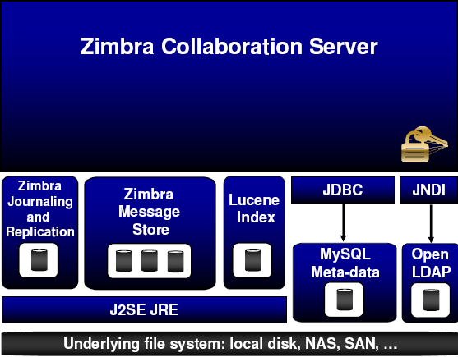
Server Architecture
HTTP/SOAP
IMAP/POP
Postfix

Slide 28
Zimbra is..
On the client side:
Browser-based SOAP client written in Javascript
Entirely AJAX-powered
Support for modular plug-ins (Zimlets) to extend functionality
Powerful ‘search’ functionality thanks to Lucene indexes
Collaboration via folder sharing (messages, calendars, contacts, file folders, etc)

Slide 29
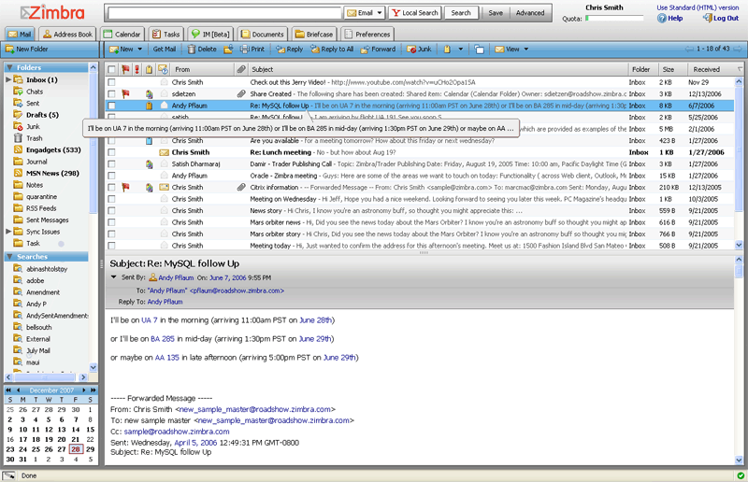
Zimbra is..

Slide 30
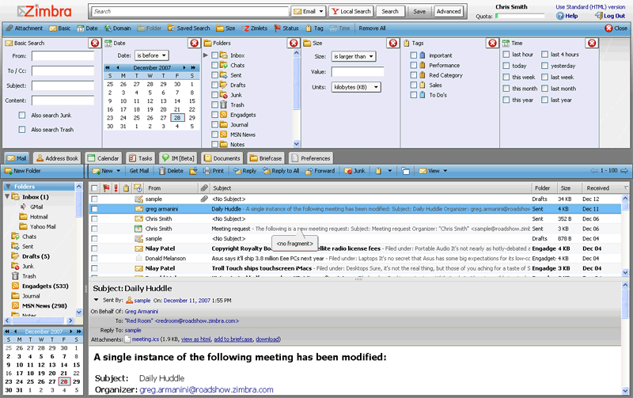
Search

Slide 31
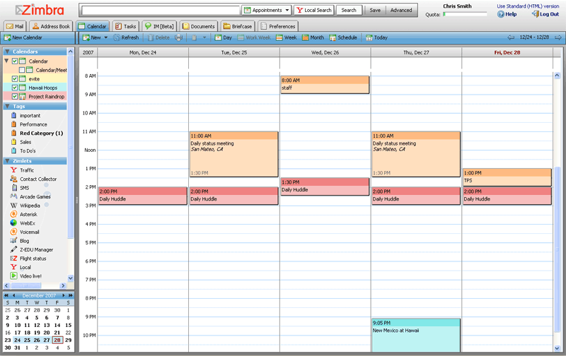
Calendar

Slide 32
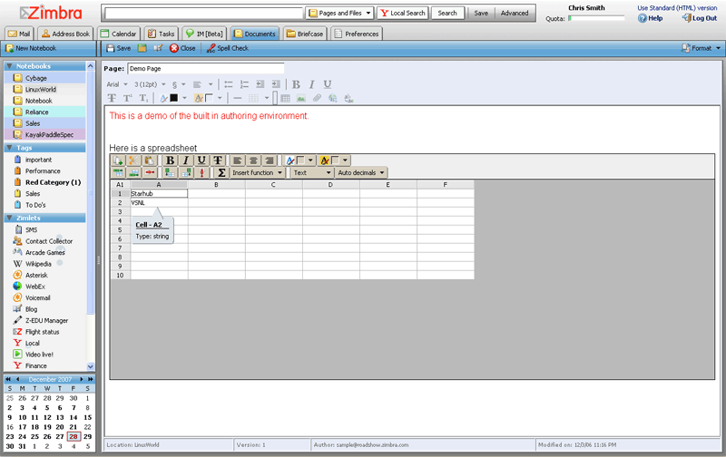
Documents

Slide 33
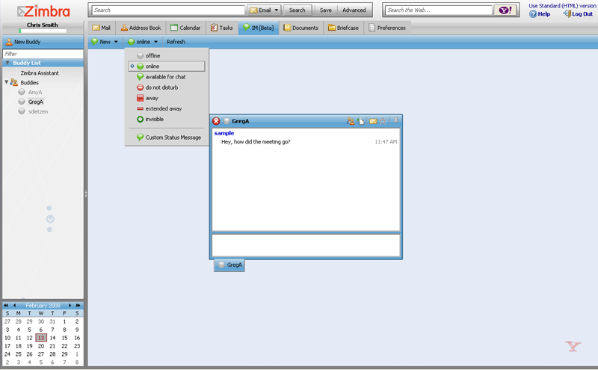
Instant Messaging

Slide 34
Clients
“Light” and “Mobile” HTML interface also available
Standard POP/IMAP/CalDAV clients supported
Zimbra Desktop offers “offline” web interface (beta)
ZCO – Zimbra Connector for Outlook provides Exchange-like functionality to Outlook users ($)
ZimbraMobile provides ActiveSync support for mobile devices ($)
Support for Blackberries (via BES server) (beta)

Slide 35
More Goodness
Server:
HSM Support ($)
WebDAV and REST access to content
Active/Standby Cluster support ($)
Client:
Briefcase: Web-based file space

Slide 36
It’s Not All Goodness
No Solaris support
Limited documentation
Very “young” code
Rapid code change means more bugs
Product expertise lies with the vendor

Slide 37
Objectives Met?
Fault tolerant – Multi-server architecture
Lightweight e-mail accounts - Yup
Web-centric with modern look & feel - Definitely
Easily expandable to support greater capacity - HSM
Calendaring - Check
Minimal loss of existing functionality (excellent maillist support, solid POP/IMAP/SMTP, anti-spam)
Supported

Slide 38
More on Zimlets

Slide 39

Simple Built-in

Slide 40
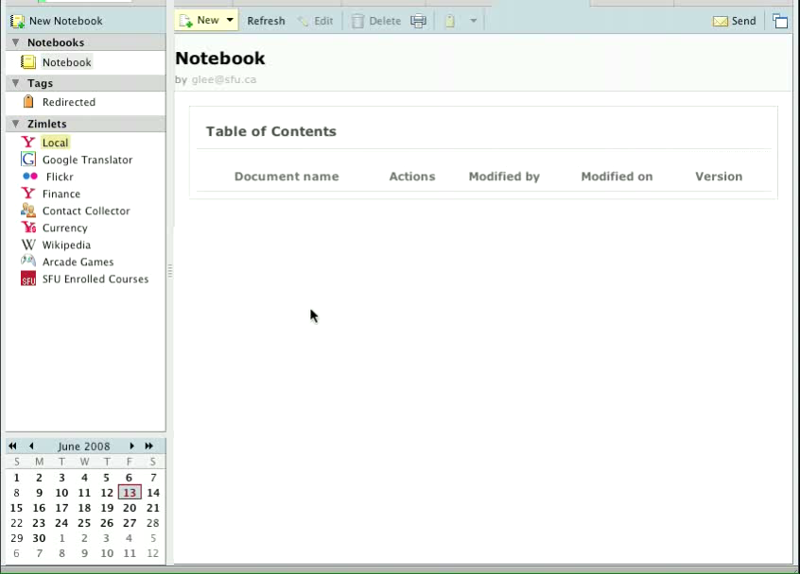
Advanced Built-in

Slide 41
SFU Additions - Courses

Slide 42
SFU Additions - ISBN

Slide 43
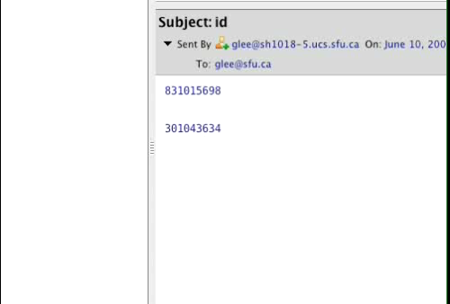
SFU Additions – SFUid

Slide 44
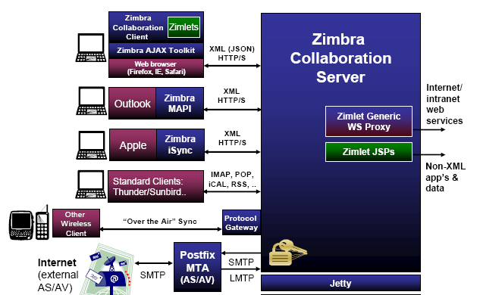
How They Work

Slide 45
Where We’re At Now

Slide 46
A Brief History of Time
Apr/07 – Test Server Up. Looking at OSS Zimbra
Oct/07 – Re-org of IT, Email upgrade gets attention
Dec/07 – Email Pilot Project created, pilot Zimbra license purchased for NE Zimbra
Mar/08 – Pilot multi-server environment up on Linux on existing hardware
Apr/08 – Migrated first “real” users over
May/08 – Storage stability and scaling issues
Jun/08 – New hardware purchased. Site-wide perpetual license purchased

Slide 47
Today - Hardware
Servers:
8 Sun blade X86 servers – 8 core, 32gb RAM
5 mailbox servers
3 MTA/LDAP/Proxy servers
Storage:
2 NetApp 3040 filers via iSCSI
Dedicated FC spindles for DB, Indexes
Shared SATA spindles for mail store
48 TB Sun Thumper for HSM

Slide 48
Today - Migration
250 users migrated so far on voluntary basis
Migration scripts for IMAP and Eudora-POP written
Aggressive marketing to students to begin after storage upgrade (still voluntary)

Slide 49
This Fall
Name the service!
Most Existing Portal functionality available via Zimlets
Continuous data protection via iSCSI mirror to remote site
New Admits added only to new system
Begin block moves of departments

Slide 50
Long Term
Minimize Unix Home Directory Creation
Substantially reduce desktop email support through migration to the web client

