Slide 1
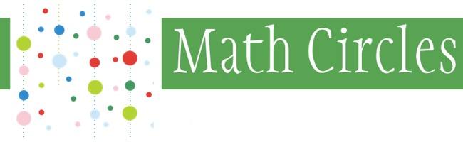


Fractals and Self-Similarity
Play the Chaos Game
Learn to Create Your Own Fractals

Slide 2
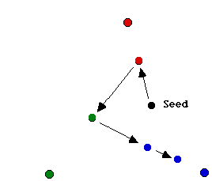
Jumping Seeds
Start: Choose a corner of the triangle. This is your first seed.
Jump:
Choose a corner (that is not your seed).
Draw a dot half way between your seed and the corner you
have chosen.
Colour the new dot in the colour
of the corner you had chosen.
Repeat the Jump-step with
the dot you just created as
your seed (choosing a new corner
to jump toward for each step) .
Notes:
As an alternative you can also let the students work “breadth first” rather than “depth first” and let them make the jumps toward all three corners with every seed (and let the seed multiply at each step).

Slide 3
Where Can You Jump?
[Clicker Question] Will all dots end up inside the triangle?
A = Yes
B = No
[Clicker Question] Which areas of the triangle will contain blue dots?
A: They can be anywhere in the triangle;
B: They can only be in the area that is higher than half the height of the triangle;
C: They can only be in the center of the triangle, not too far to the left or the right.
[Clicker Question] Are there areas that will never contain dots?
A = Yes
B = No
Notes:
Discuss the other colours informally with the class and get to a conclusion that gives the first approximation to the Sierpinski triangle

Slide 4
Double Colours
We colour in double colours according to the last two chosen corners. |  | Last Corner
 |  | BLUE | RED | BLACK
Second Last Corner | BLUE | BlueBlue | BlueRed | BlueBlack
 | RED | RedBlue | RedRed | RedBlack
 | BLACK | BlackBlue | BlackRed | BlackBlack
Where would the RedRed dots end up?
Where would the RedBlack dots end up?
Where would the BlackBlue dots end up?

Slide 5
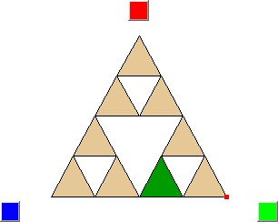
The Chaos Game
The activity you have just been involved in is called the Chaos Game and there is a version of this game on the internet at
http://math.bu.edu/DYSYS/applets/chaos-game.html

Slide 6
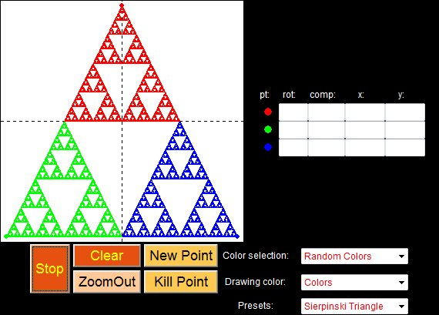
The Fractalina Applet
There is also a program called Fractalina where the computer draws all possible seeds,
http://math.bu.edu/DYSYS/applets/fractalina.html

Slide 7
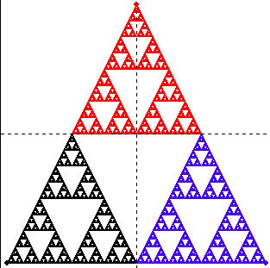
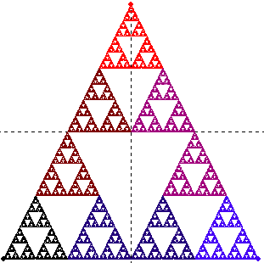
The Sierpinski Triangle
This is what the computer gives when colouring with the colour of the last corner you chose.
This is what the computer gives when colouring with an average of the last two colours.
This triangle is called the Sierpinski Triangle.
Notes:
Discuss what this means play the chaos game on the computer with them.

Slide 8
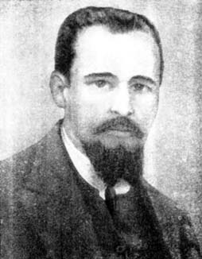
Waclaw Sierpinski (1882 – 1969)
He was a student in Warsaw during a Russian occupation of Poland.
He was awarded a gold medal by the university for work on the theory of numbers. However, he did not want to have his first work printed in the Russian language.
During World War II, under German occupation, Sierpinski continued working in the 'Underground Warsaw
University‘.
Rotkiewicz, a student of Sierpinski's, wrote:
Sierpinski had exceptionally good health and a
cheerful nature. ... He could work under any
conditions.

Slide 9
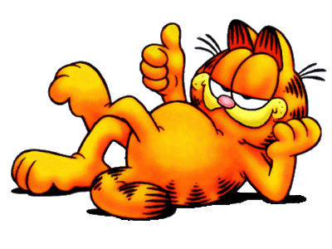
Congruent
Two objects are congruent when they have exactly the same shape, they would match if you put them on top of each other.

Slide 10
Congruences
Definition: A congruence only moves an object, it doesn’t change lengths or angles. The shape remains exactly the same.
Examples: for each of the following operations decide whether it is a congruence or not.
[Clicker Question] a translation A = Yes, B = No
[Clicker Question] a 60 degree rotation
[Clicker Question] a scaling (dilatation) by a factor 2

Slide 11
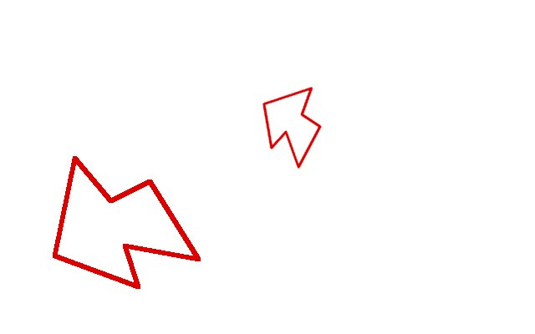
Similarities
A similarity moves an object and rescales it.
Similarities change lengths, but they don’t change angles or proportions.

Slide 12
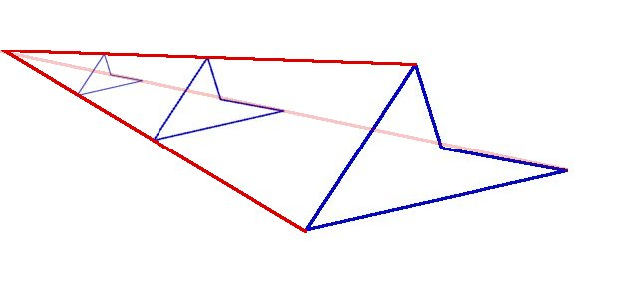
Examples of Similarities I
Dilatation: scale (expand or contract) by a constant factor with respect to a chosen center point.
Every dilatation has a unique center point that is kept fixed.

Slide 13
Examples of Similarities II
Roto-dilatation: scale and rotate.
Every roto-dilatation has a (unique) center point that is fixed.

Slide 14
Rotodilatations
We can describe each roto-dilation by giving the following information:
Its center fixed point
Its scaling factor
Its rotation angle

Slide 15
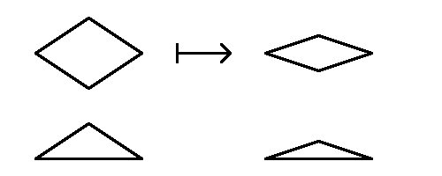
A Similarity?
Is this an example of a similarity? A = Yes, B = No
Scale only in one direction:

Slide 16
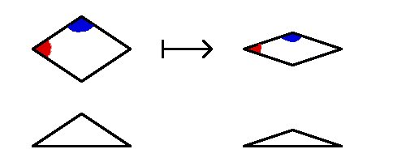
Scaling in one direction does not preserve the angles.

Slide 17
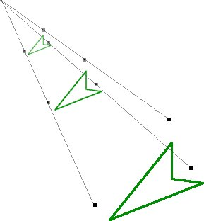
Similarities and Points
You can perform similarities on whole objects, but also on individual points.

Slide 18
Similarities and the Sierpinski Triangle
What are the similarities you used to find the seed points in the chaos game for the Sierpinski triangle?
A: three dilatations with each a
factor ½, with the centers at the
corners of the triangle.
B: three roto-dilatations with the center in the middle.
C: something else.

Slide 19


Self-similar Shapes
A figure is called self-similar if you can divide it into smaller parts which are similar to the whole figure.
Examples:
The figures below are divided into four parts that are similar to the whole.

Slide 20
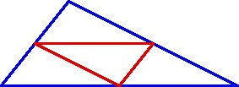
Some Self-similar Objects
Some self-similar objects are quite familiar to us.
Triangles are self-similar:
Rectangles are self-similar:

Slide 21
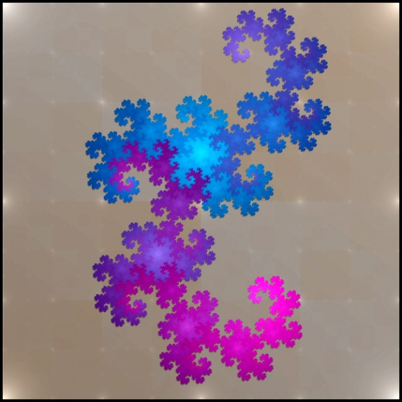
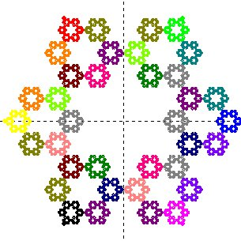
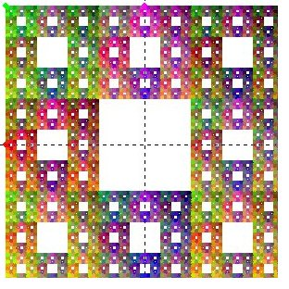
Strange Self-similar Objects
Some self-similar objects are very complex.

Slide 22
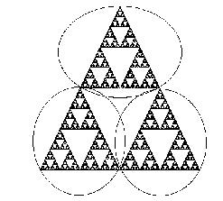
Features of Self-similar Objects
Self-similar objects have the feature that they look the same at every level of magnification.
Objects that have the same amount of complexity no matter how far you zoom in on them are called fractals.

Slide 23
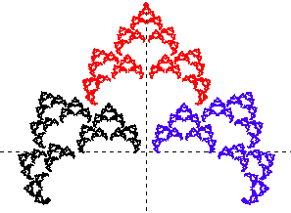
Some Variations on the Triangle
This image was created by a variation of the chaos seed-jumping game.
We used three similarities as before, but two of them are now roto-dilatations. Can you guess what the similarities are in each case?
A: use a roto-dilatation for black and red, but not for blue;
B: use a roto-dilatation for black and blue, but not for red;
C: use a roto-dilatation for blue and red, but not for black.

Slide 24
Which angles?
Can you guess the angles we used for the roto-dilatations?
A: 30 degrees clockwise for black, and 30 degrees counterclockwise for blue;
B: 30 degrees clockwise for both blue and black;
C: 30 degrees clockwise for blue, and 30 degrees counterclockwise for black.

Slide 25
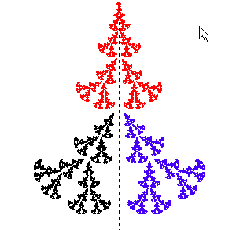
Another Variation
Which rotodilatations were used to create this image?
A: 30 degrees clockwise for black, and 30 degrees counterclockwise for blue, and scale everything by a factor 1/2;
B: 30 degrees clockwise for both blue and black, and scale everything by a factor 1/2;
C: 30 degrees clockwise for blue, and 30 degrees counterclockwise for black, and scale everything by a factor 1/2.

Slide 26
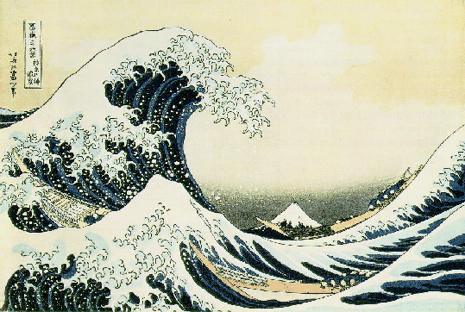
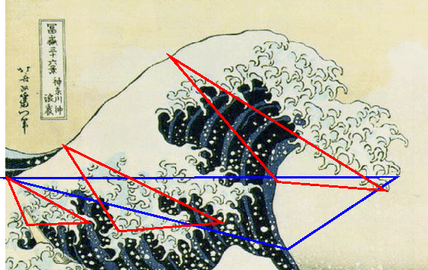
Self-similarity in Art
The tsunami wave in The Great Wave Off Kanagawa from the ``Thirty-six Views of Mount Fuji'' (1823-29) by Katsushika Hokusai, is approximately self-similar

Slide 27
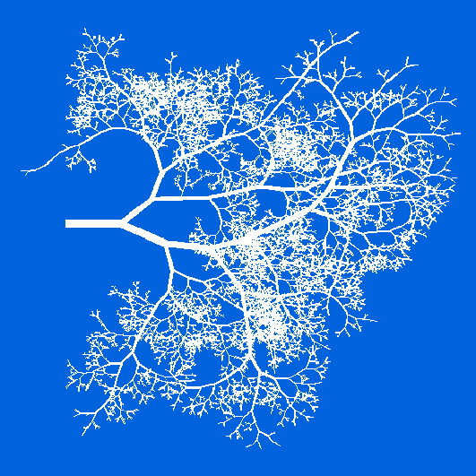
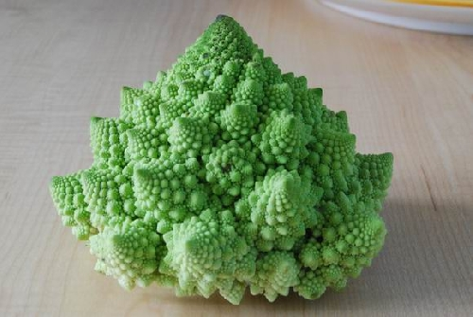
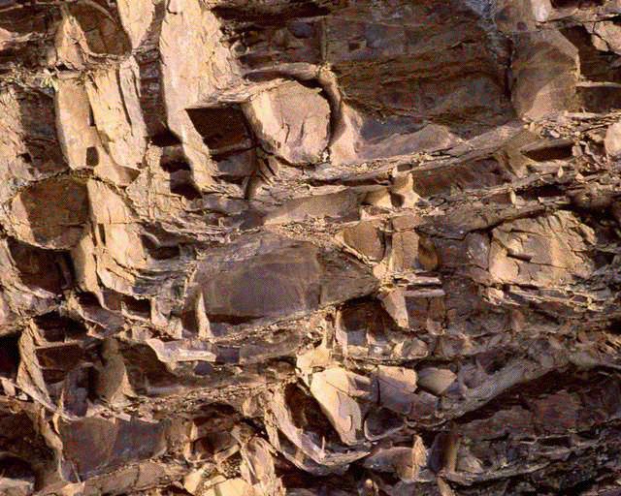
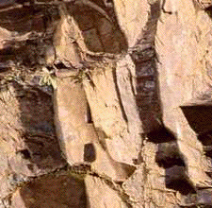
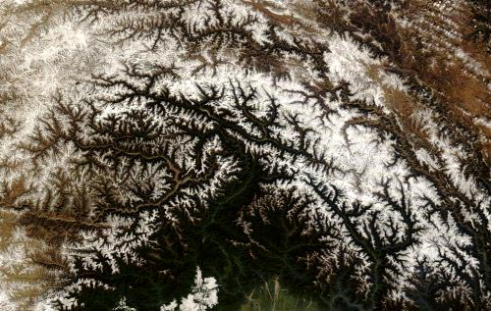
Self-similarity in Nature
Approximate self-similarity is also an important concept in science.

Slide 28
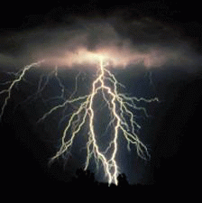
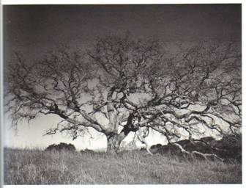
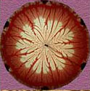
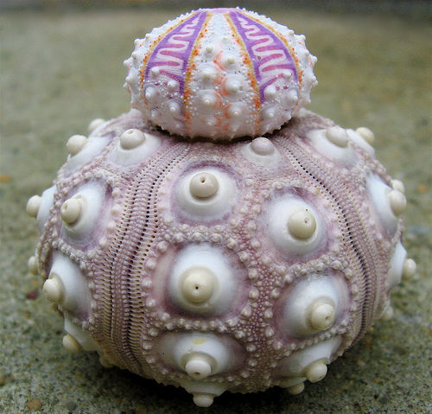
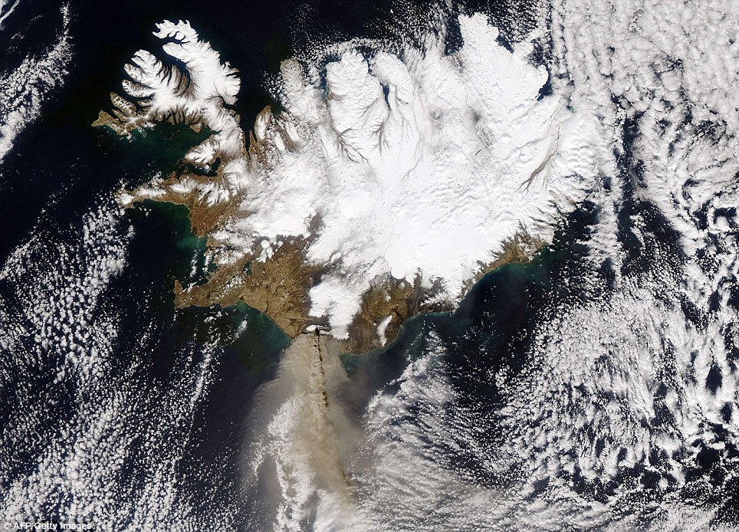

Slide 29
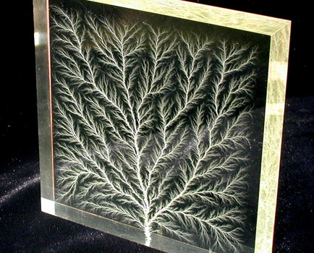
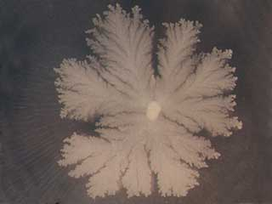
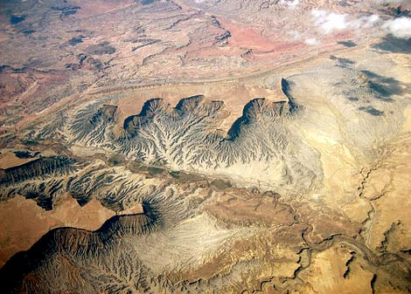
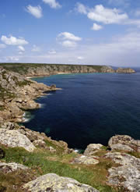

Slide 30
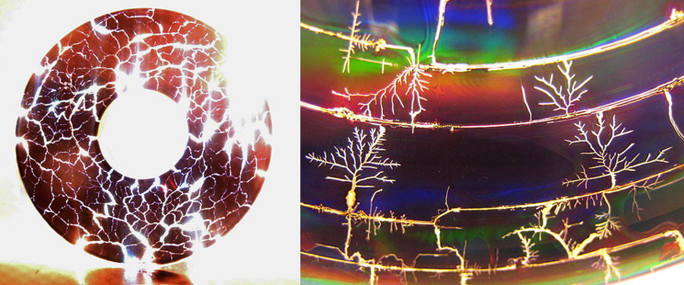
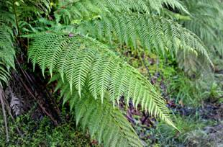
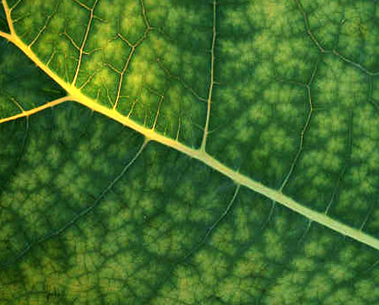

Slide 31
The Geometry of Nature
“Clouds are not spheres, mountains are not cones, coastlines are not circles, and bark is not smooth, nor does lightning travel in a straight line.” (Mandelbrot, 1983).
And here is a quote by Thomasina, from Arcadia:
“Each week I plot your equations dot for dot, and every week they draw themselves as commonplace geometry, as if the world of forms were nothing but arcs and angles. God's truth, Septimus, if there is an equation for a curve like a bell, there must be an equation for one like a bluebell, and if a bluebell, why not a rose? Do we believe nature is written in numbers?”

Slide 32
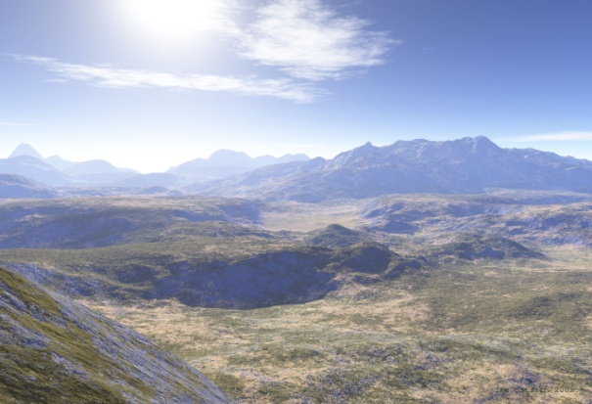
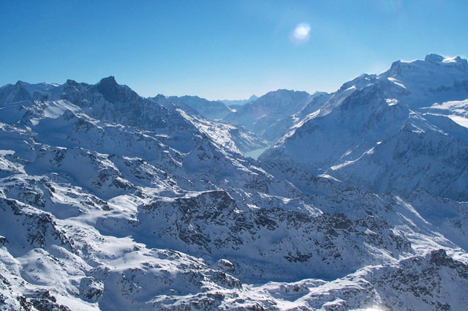
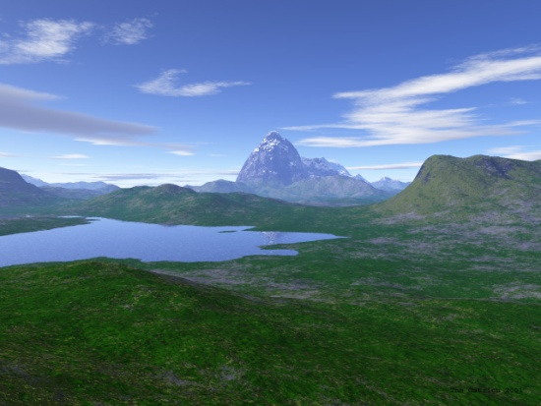
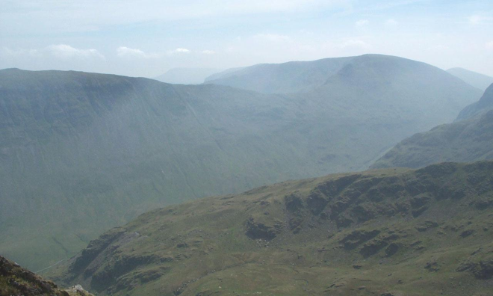
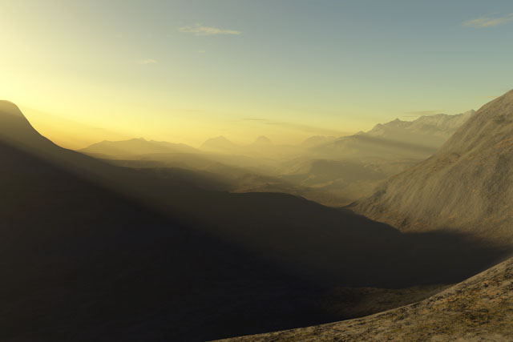
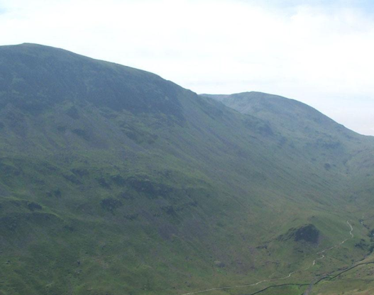
Landscapes
Can you determine which images are real and which are computer generated?

Slide 33
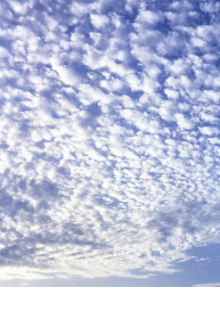
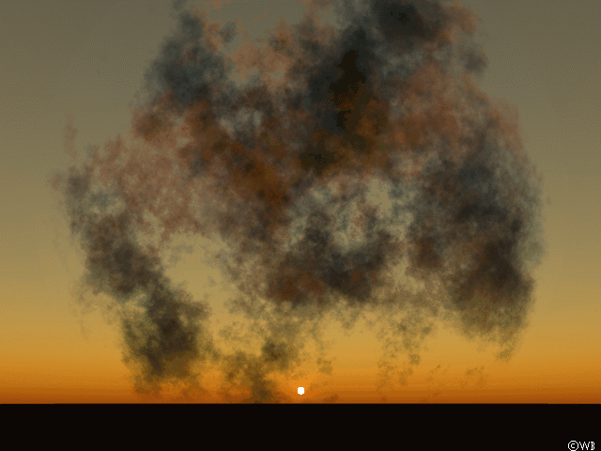
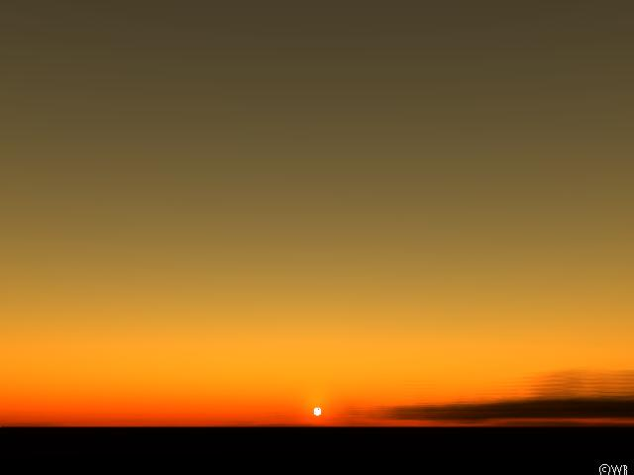
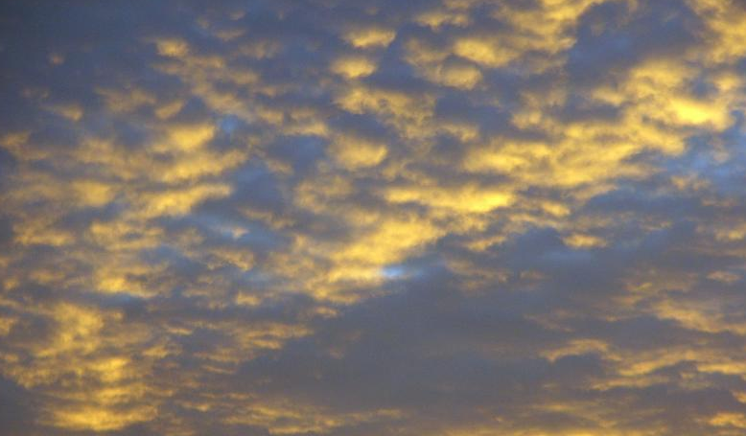


Clouds

Slide 34
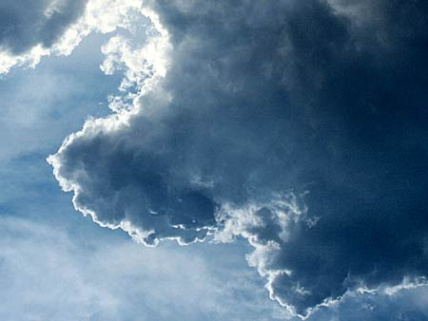



More Clouds

Slide 35

A Medical Application
Fractals are used in the diagnosis of skin cancer and liver diseases.
There is a notion of fractal dimension.
This is applied to images of the affected area and its boundary (they are both fractal).

Slide 36

The Creation of Fractals
Choose some similarities (with contracting scaling).
Let Fractalina play the chaos game with those similarities.

Slide 37

More Examples

Slide 38


Slide 39


Slide 40



When we add inversion…

Slide 41


Slide 42



More Circle-Based Fractals

Slide 43


Add Reflections to this mix…

Slide 44


Slide 45






The Mandelbrot Set

Slide 46





Slide 47


Slide 48


Slide 49


