Slide 1
Using the School’s Building as a Mind mapping Tool
Making the Writing Class More Active

Slide 2
Iranian English Language Teachers’ Society of Canada (IELTSC) PERA COLLEGE

Slide 3
Introduction
Challenges in teaching writing
Some ideas and solutions provided by Teachers
Building as a mind mapping tool: A new way of making the writing class fun and interactive
Advantages for teachers, students and language schools
Other skills
Problems and Solutions
Q & A

Slide 4
Challenges in Teaching Writing
The most challenging skill ?
Writing classes > Most students find it boring,
Students don’t have any ideas,
Students have ideas but have problems with vocabulary, grammar and sentence structure,
Students have ideas, acceptable sentence structure and know the vocabulary but lack organization.

Slide 5
Writing: The most challenging skill
Organization
Transitions
Cohesion
Unity
Conclusion

Slide 6
Organization
Time order
Comparison – Contrast
Problem-Solution
Classification
Cause and Effect

Slide 7
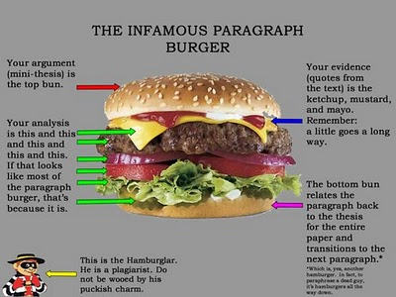
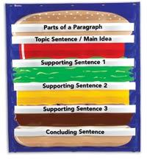
Hamburger paragraphs
Activities: Attractive, engaging, fun, …

Slide 8
Ideas?
Brainstorming: expanding thinking on a topic
Mind maps: organising ideas, considering the relationships between items
Spidergrams: more words and sentences

Slide 9
Organizing Ideas
Traditional: Group work, etc.
Pen and paper
Whiteboard
Lack of knowledge> Demotivation>Boredom
Technology enhanced: Provides clues
Overhead projectors
Video projectors
Smart boards
PC
Interesting, engaging/Not as interactive?

Slide 10
More Student Centered Methods
Project-based: e.g. Process writing
In-class: e.g. Cooking, baking, handicrafts, DIY, etc.
Outdoor: Visiting a workshop or a factory
Research-based: Not limited to one pattern
In-class: Online research (?), watching a documentary, etc.
Outdoor: Visiting a gallery, the zoo, a museum, etc.

Slide 11
Limitations
Budget
Time
Weather conditions
Responsibilities
Distance
Attendance

Slide 12
The School’s Building Alternative
Classroom’s walls
Other classrooms’ walls
Hallways/ Corridors
Stairways
Floors

Slide 13
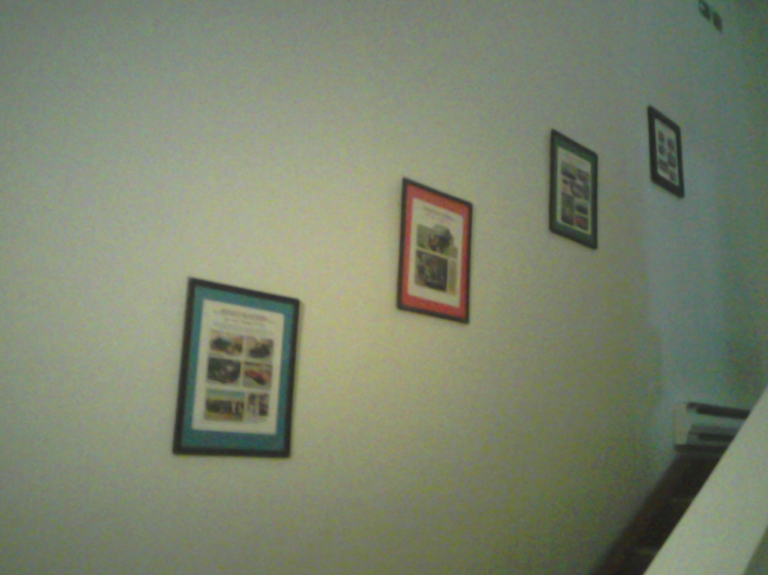
Stairways: Perfect tools to teach time-order

Slide 14
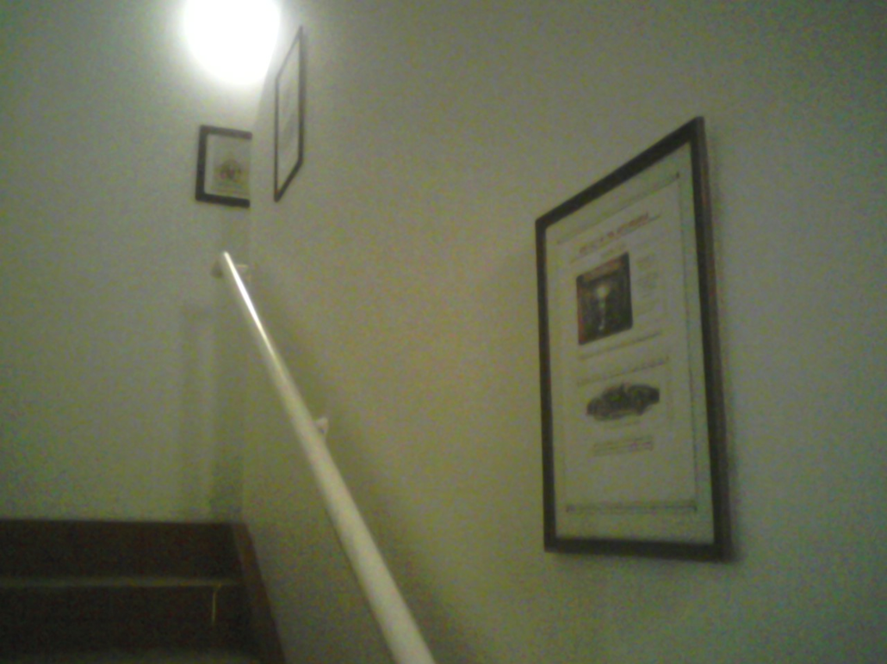
Stairways: Comparison-Contrast

Slide 15
Topics Suitable for using walls to teach Chronological Order The History of…..
the Automobile
the Printing Press
Fashion
Aviation
Cinema
Dance
The Computer and the Internet
Telephone

Slide 16
Classroom’s Walls for Paragraphs
A city’s Tourist Attractions
e.g. Vancouver:
1- Mountains and trails
Grouse M, Seymour, Capliano Suspension Bridge
2- Beaches
English Bay, Ambleside, Kitsilano
3- Downtown
Gas Town, Harbour Centre, VPL,

Slide 17
3 Classrooms or Corridores for Essays
Auto Show
1 – Family Cars
Sedans
Hatchbacks
Vans
2- Sports Cars
Convertibles/ Hard tops
Coupe’s
Roadsters
3 – Light Trucks
Trucks
SUVs

Slide 18
Buildings
1- Residential
Houses
Apartments
Condos
2- Educational
Daycares
Schools
Universities
3- Commercial
Stores
Malls
Workshops

Slide 19
Paragraph Level
Classification
Describe an auto show.
A visit to the zoo.
Advantages of living in big cities.
A picture story.
Problems of studying with a computer.
Advantages of studying with a computer.

Slide 20
Paragraph level The Auto Show
Sports cars
Sedans
Trucks
Ferrari Porsche Maserati
Mazda 3 Nissan Chevrolet
Ford Chevrolet Toyota

Slide 21
Possible Paragraph
The Vancouver auto show had a huge collection of three different types of cars.
On the right, several companies had displayed their sport cars. The best cars there were by Ferrari, Maserati, and Porsche.
In the centre of the auto show, family sedans and hatchbacks by companies such as Mazda, Nissan and Chevrolet had attracted many visitors.
Finally, trucks, Vans, and SUVs had occupied a large section of the auto show on the left. Chevrolet, Toyota, and Ford had all introduced their new products.

Slide 22
Conventional Writing Class Some Possible Class Activities
The teacher and students form a mind map
Students follow the teacher’s instructions and draw a floor plan of the auto show
Students group ready-made cut outs with names or pictures of cars
Teacher shows a documentary; Ss take notes
Teacher asks students to bring mini model cars to class
Etc,

Slide 23
Task –Based/ Student –led approach
1- Motivation: Ss in groups do research, print images, prepare frames, etc.
2 –Action : Ss discuss organization; decorate classes; add headings
3 – Negotiation: Groups visit other sections of the “Auto Show,” take notes, compare, evaluate, give suggestions, make adjustments

Slide 24
Task–Based/ Student –led approach
4- Organization:
Students organize their notes; create an outline, use notes to write the body of the paragraph
5 – Writing:
Students write their paragraphs
6 - Social Construction:
Writing class students invite other students and teachers to a tour

Slide 25
The Writing Class in Action
T divides the class into 3 groups: sedans, sport cars, and trucks.
Students in each group do research, choose and print pictures of some cars and trucks.
T provides the students with picture frames.
Students put the pictures in frames and decide where to hang them in the class.
T guides them to put them on three separate walls of the classroom ( or in 3 separate classes or corridors for an essay)

Slide 26
Advantages of “wall-teaching”
Makes learning unforgettable: Learning by doing
Motivating: Students experience research while having fun
Encourages creativity: Students provide innovative ideas
Accomplishment: Students take pride in what they have achieved
Team-work: Opportunities for peer learning
Social interaction: Students explain to other teachers and students

Slide 27
The Building as a Teaching Tool Teacher-led approach
T and the academic coordinator create the auto show in one or three classrooms,
T encourages the students to visit the school’s “auto show,”
Students are encouraged to take notes,
T asks students to draw a sketch of the auto show,
In 3 small groups, students write about the three sections of the auto show,
Writing class students take other students to a tour

Slide 28
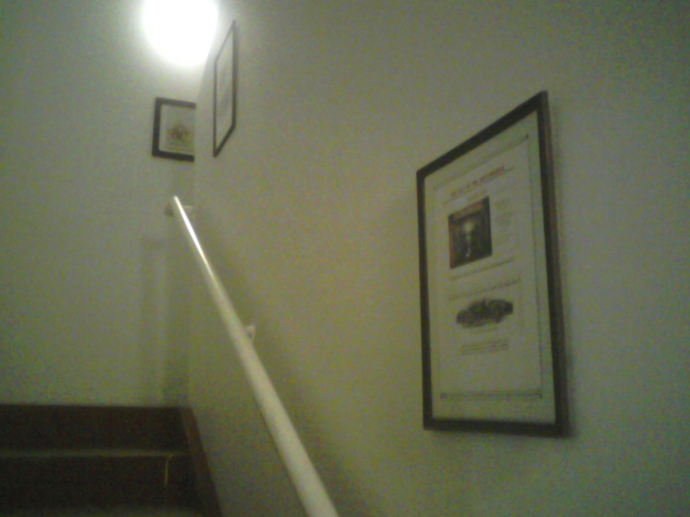
Stairway Gallery/ Corridors Comparison- Contrast

Slide 29
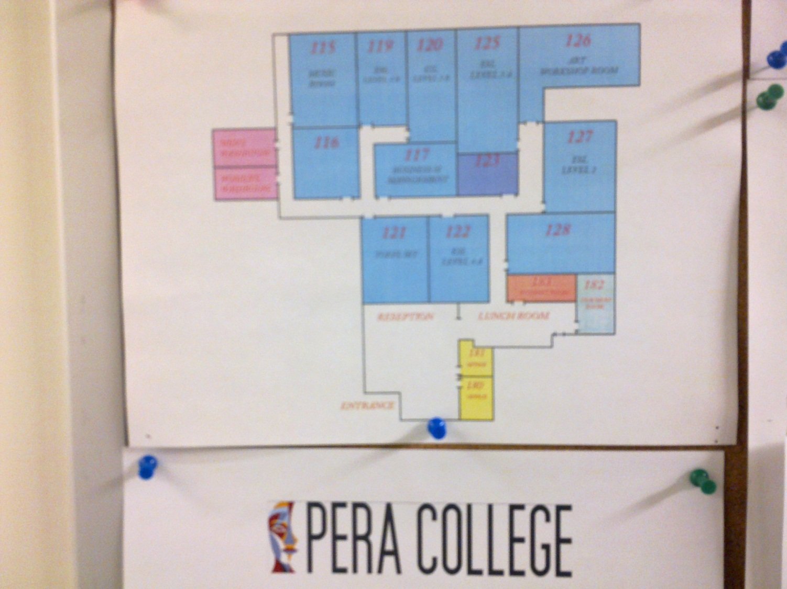
Parallel Corridors Essay Writing

Slide 30
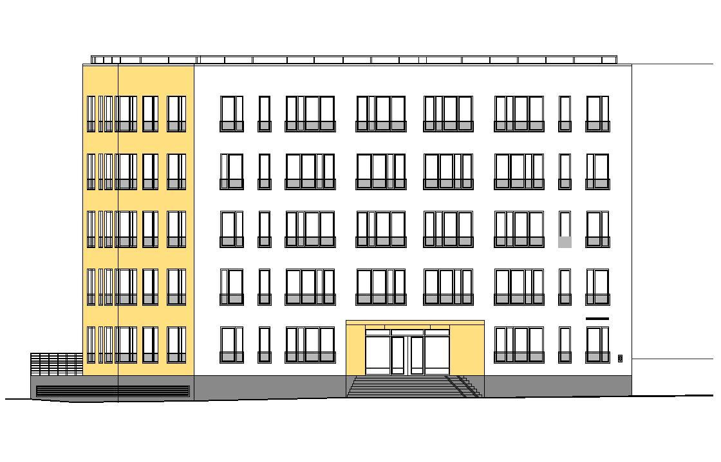
Multi- level Buildings 5 Paragraph Essays

Slide 31
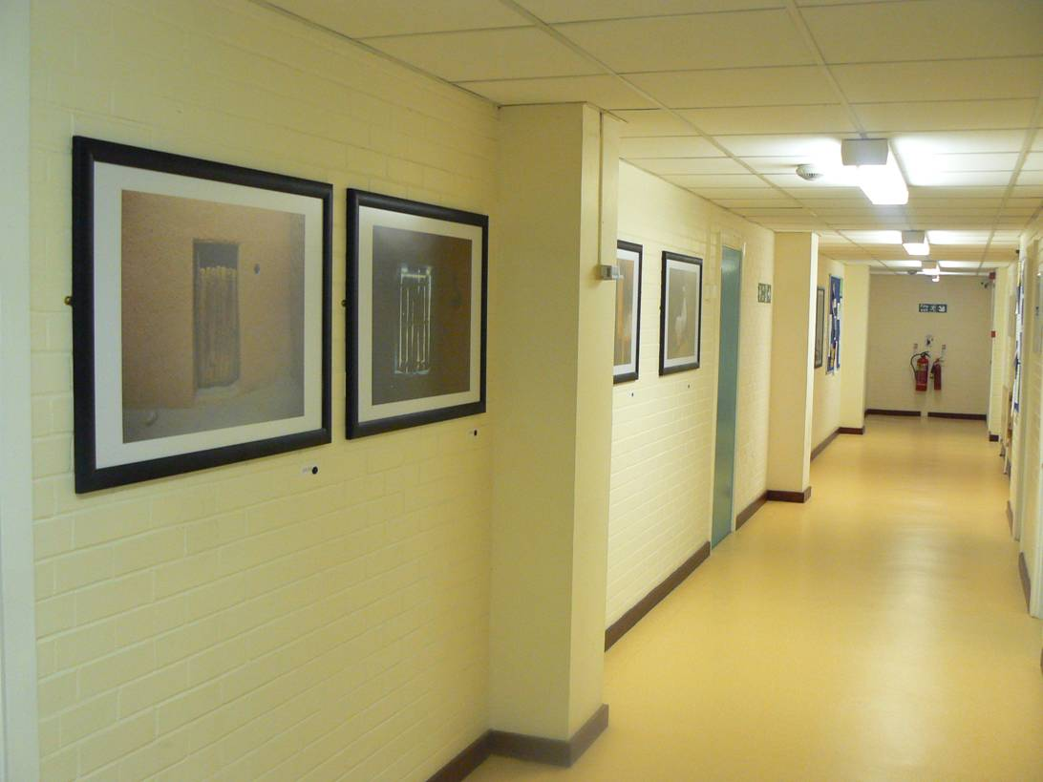
Corridors Chronological order

Slide 32

Corridors Comparison- Contrast

Slide 33
Using Corridors for Cause and Effect Essay Writing
Students place images on the walls of a corridor.
Students add labels.
Images could show causes and/or effects.
Alternatively, images could show a cause- effect chain organization.

Slide 34
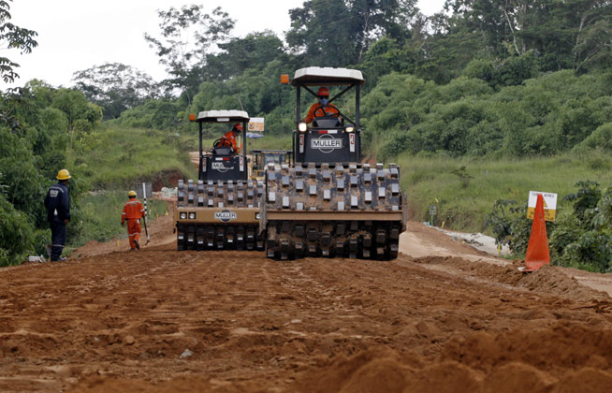

Causes of Deforestation
Road building
Forest Fires

Slide 35
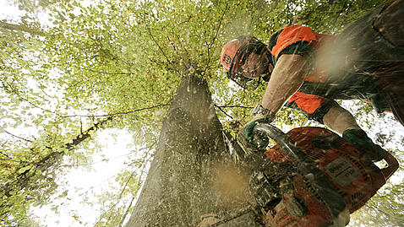
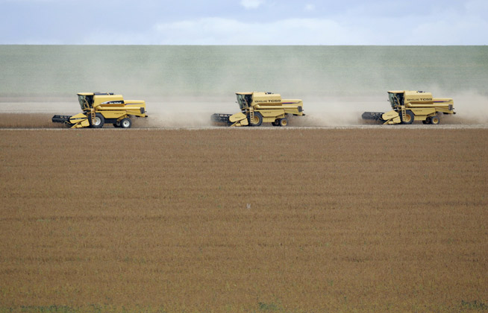
Causes of Deforestation
Logging
Farming

Slide 36
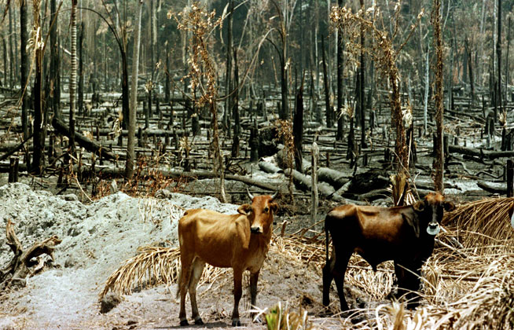
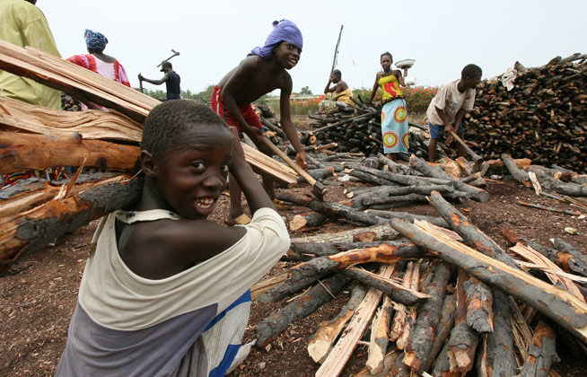
Causes of Deforestation
Cattle ranching
Fire wood collecting

Slide 37
Other Uses
Reading : scanning, organization, outlining
headings, etc.
Vocabulary: topic-based vocabulary, nouns, adjectives, adverbs,
Grammar: Passive, verb tenses
adverbs of frequency, conditionals, etc.

Slide 38
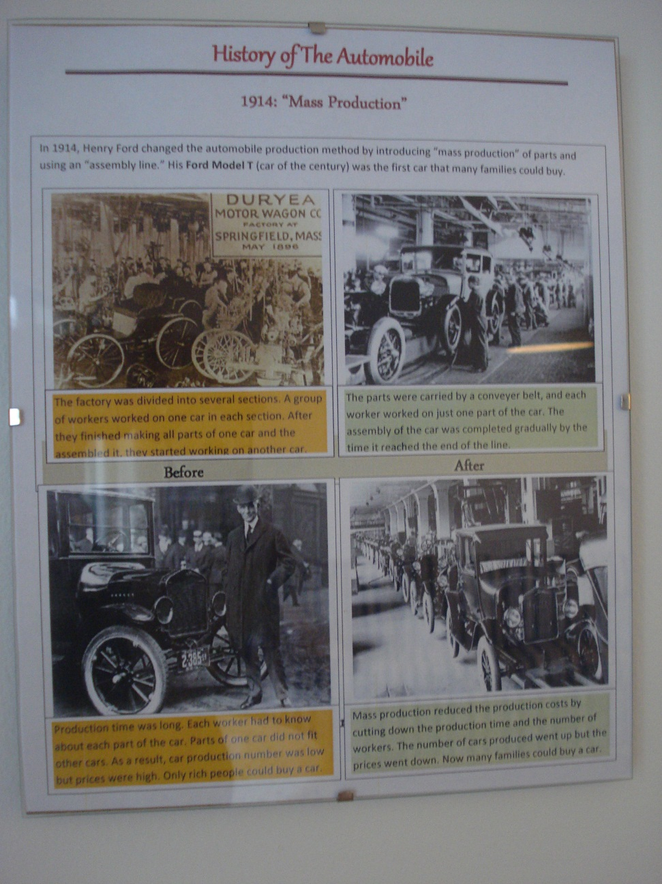
Teaching Grammar

Slide 39
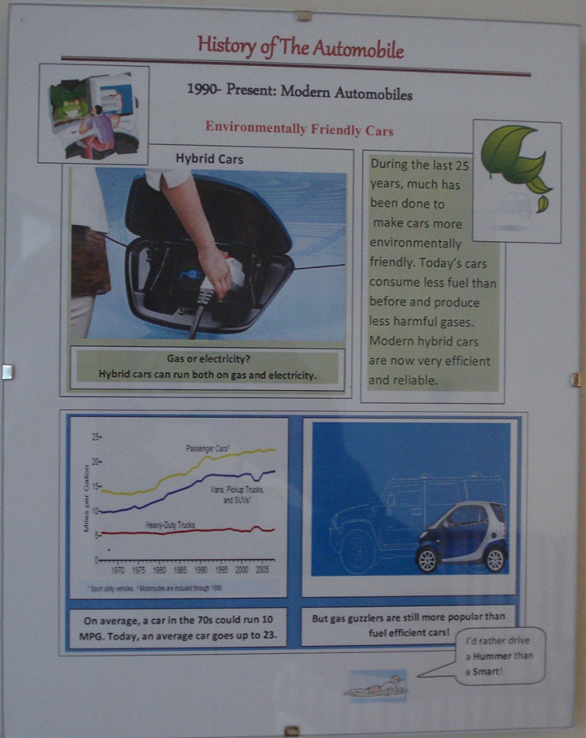
Teaching Vocabulary

Slide 40
Advantages
Teachers:
More interesting classes > student satisfaction
Easier to teach challenging patterns
Students:
Engaged > no boredom
Learning by doing
The School:
More attractive environment
Satisfied students > increase registration
Brochures, promotional videos

Slide 41
Problems/ Solutions
Teachers need to be creative, enthusiastic and resourceful > Provide training
School’s regulations > ?
Budget > Dollar stores!/ Recyclable
Time consuming > Recyclable / Other teachers can participate and use the same ideas to teach reading , speaking and vocabulary.

Slide 42
Thank You!

Slide 43
Questions? Comments? Suggestions?
Please contact :

Slide 44
Ramin Hatam, MA TEFL
ramin.hatam@gmail.com
604 – 724 4579
Iranian English Language Teachers’ Society of Canada
Jamzaban.ca@gmail.com
778 – 713 06 07
Pera College
raminh@peracollege.com
604 – 689 7372 Fax: 604 – 689 7373

