Slide 1

Business English programs for Saudi students: using classroom hours effectively
Pedagogical issues in western universities

Slide 2
Conference note:
In September 2012, the Saudi Cultural Bureau decided to cancel the ‘extra ESL hours’ that KASP students typically receive. In order to preserve the relevance and applicability of the presentation, the scope has been expanded to include more general ESL issues that Arabic ESL learners encounter.
Pedagogical issues in western universities

Slide 3
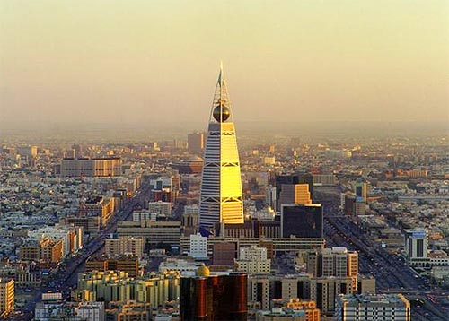
Saudi background
Saudi Arabia occupies almost 80 percent of the Arabian Peninsula
Religious breakdown:
100% Muslim the practice of other religions is forbidden
95% of the population is urban
In 1950, Saudi Arabia had a population of 3,000,000
2010, population 25,731,776
31% of the population (5,576,076) is made up of foreign nationals
(The [Saudi] Central Department of Statistics & Information, 2010).

Slide 4
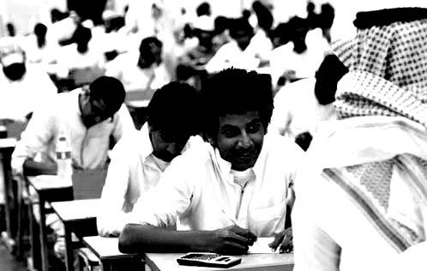
Saudi background
Saudi Demographics
Average age 25.7y
29.4% between 0-14y
Est. 75% under the age of 30y
Youth unemployment 28.2% (Economist, 2012)
(m 23.6%/f 45.8%)
CIA World Factbook, 2012

Slide 5
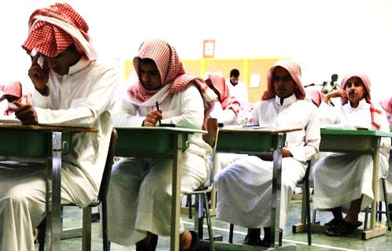
Saudi education
The Ministry of Higher Education (MOHE)was established in 1975
to create highly skilled individuals to develop the country.
free education from kindergarten through university.
the genders are
segregated at all levels.
(The [Saudi] Central Department of Statistics & Information, 2010). 1

Slide 6
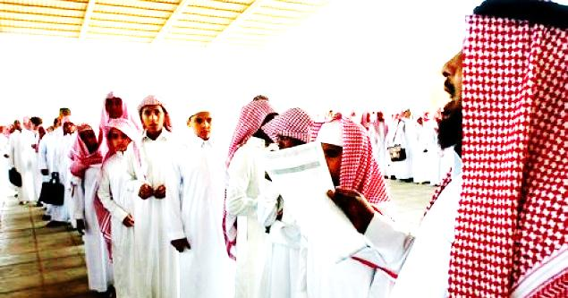
Saudi education: in the classroom
In the 2007, Saudi schoolchildren ranked near the bottom of the 48 countries surveyed according to U.S. National Center for Education Statistics, 2007 (in Lindsey, 2010)
teaching methods used within the Saudi classrooms
focused on memorization and rote learning (Ministry of Higher Education, 2000 in AlSharif & Atweh, 2010).
lack of understanding and critical thought. (Lindsey, 2010)
Little emphasis on formulating, planning and revision (Bersamina, 2009)
Questionable qualifications in teaching staff (Alosaimi, 2007)
Censorship, criticism and exposure to foreign concepts

Slide 7
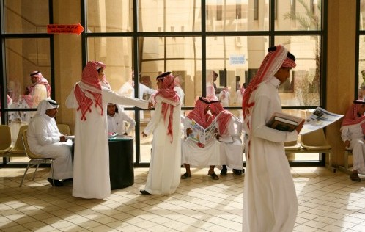
Problems that develop from Ed background
Most Arab students (Haq in Bersamina, 2009)
Fumble in their writing skills
Gross lexical errors
Weakness in tenses, verb structure, (Kambal in A Case Study of Saudi ESL Learners)
Pronunciation, morphology, knowledge and use of syntax and spelling
Difficulty expressing themselves in every day and scholarly issues
Have higher confidence in oral than writing skills

Slide 8
Learning disabilities
Obstacles
Negative public perception of disabilities:
No uniform diagnostics or treatment
there are no school based mechanisms for parents seeking services
In 2009, available programs serve 4.5 % of schools
Dr. Saja Jamjoom, Program Manager for the Learning Disabilities Program at the Prince Salman Center for Disability Research

Slide 9
Education, Culture and Wasta
‘Wasta.’ “an individual’s ability to leverage strategically beneficial relationships in order to consolidate the groups/families’ social standing” you help your brother with his problems. (Fagan, 2008)
social relationships to overcome various challenges resulting in (Muhammed, 2012)
Passing of ‘undeserving students’
‘cheating’
University rankings

Slide 10
Understanding KASP’s goals
The King Abdullah Scholarship Program goals:
exposure to a western experience
obtain a degree from a western university
Government claims that achieving either 1 or 2 is considered to be a success by the Saudi government (Fagan 2008)

Slide 11

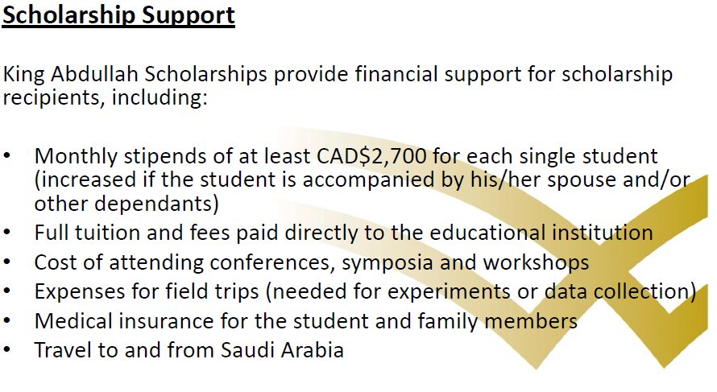
Understanding KASP’s goals

Slide 12
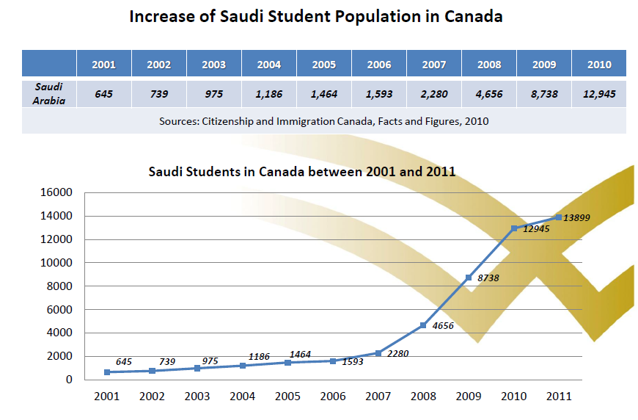
The first KASP influx in America and Canada
2004-2005 increase from 3000-10000 Saudis coming to America (Redden, 2007)
2007-2010 increase from 2200-13,899 Saudis (KASP PPT – 2011)

Slide 13
Understanding the economics motivating KASP (Saudization)
Saudization of the private sector:
limit dependence on foreign labour,
create a more dynamic economy
"is the fact that there aren't enough well-trained Saudis in the kind of jobs that are needed.“ J. Sfakianakis - Saudi Franzi Bank (in Lindsey, 2010)
"generally lacks the education and technical skills the private sector needs" (CIA Factbook, 2012; Lindsey, 2010)

Slide 14
The first KASP influx in America and Canada
But by and large, the recent history of Saudi-U.S. interaction on U.S. campuses is characterized by “broad failures,” (Redden, 2007)
first influx never screened academically
Key challenges including:
real skill sets vs. eligibility for academic programs (Fagan, 2008)
Low students unable to meet ESL requirements in time (Redden, 2007)

Slide 15
BICS and CALP (Cummins,1979)
BICS is Basic Interpersonal Communication Skills
conversational language
CALP is Cognitive Academic Language Proficiency
academic language
Children* develop native speaker conversational language within two years of immersion,
academic language takes between 5-7 years for a child to develop

Slide 16
Summary of Educational issues
Underdeveloped skills in analysis, problem-solving, and critical thinking
Undiagnosed learning disabilities
Non representative grading/qualifications
Outmoded pedagogical practices
Gaps between knowledge and ability
Limited amount of time/funding to bring students up-to-speed

Slide 17
Business English programs for Saudi students: using classroom hours effectively
linguistic issues and solutions

Slide 18
Contrastive analysis (Salem and Lawless, 2011)
Spelling
Arabic has 28 letters:
25 consonants
3 letters that correspond to long-vowel phonemes
3 short-vowel forms written as diacritics.
Resulting in:
Different spellings of the same word, e.g. Mohammad, Mohammed, Mohamed, Muhamad, Muhammed
Results in: poor overall spelling and particular problems with vowel sounds and phonemes in English

Slide 19
Contrastive analysis
writing/reading
Right-to-left vs left-to-right
Oral vs written culture
Students ‘imitate’ good essays
Consequently, English rhetorical style must be explicitly taught
(Salem and Lawless, 2011)

Slide 20
Contrastive analysis - morphology
All Arabic words are based on a root morpheme of three consonants.
book = ketaab
writer = kaateb
to write = yaktub
library = maktabah
written = kutiba Since the idea of roots, prefixes and suffixes CAN be used to teach vocabulary!
(Salem and Lawless, 2011)

Slide 21
Contrastive analysis - grammar
No distinction between upper and lower case letters.
Failure to capitalize at:
Beginning of sentences
Proper nouns/names
Poor/inconsistent punctuation
Solution: drill practice of rote memorization in early levels
(Salem and Lawless, 2011)

Slide 22
Contrastive Analysis - grammar
Arabic does not have
the verb be in the present tense.
Simple present sentences done without be, - She nice teacher.
the auxiliary verb do
questions written without an auxiliary verb -
What you say?
(Salem and Lawless, 2011)

Slide 23
Contrastive Analysis - grammar
Arabic does not have
past participles.
When forming perfect tenses, the past tense is used in its place - We have chose a leader.
an indefinite article.
resulting in an underuse of ‘a’ in writing and speech
Yesterday, I bought book.
Solution: Extensive writing and reading practice at lower levels.
(Salem and Lawless, 2011)

Slide 24
Contrastive Analysis - grammar
Arabic requires the use of
the pronoun in relative clauses.
English does not require the pronoun.
Relative clauses are written with a pronoun, e.g. Where is the book that I gave it to you yesterday?
Solution: teaching clauses as 2 sentence combos.
Where is the book? You know, the book I gave you yesterday?
Where is the book? You know, the book that I gave you yesterday?
(Salem and Lawless, 2011)

Slide 25
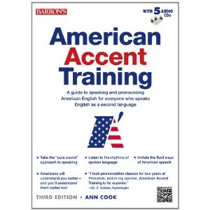
Contrastive Analysis - oral
Overview (Cook, 2012; Salem and Lawless, 2011)
The accent is typified by:
a leaden intonation and
the lack of several key consonants and vowels

Slide 26
Contrastive Analysis - oral
Intonation (Cook, 2012)
Syllable stress is also an issue as non-standard syllables are stressed, such as in subséquent and dévelopment.
there is a tendency to simply guess where intonation goes.

Slide 27
Contrastive Analysis - oral short vowel sounds
Saudis have a problem distinguishing these vowel sounds bad -near-open front unrounded vowel bed -open-mid central unrounded vowel bid -near-close rounded vowel bod -open back unrounded vowel bud -open central unrounded vowel
Results in: spelling and oral reading errors

Slide 28
Contrastive Analysis - oral consonants
The Arabic R
her = hair, verb =vairb, were =wear.
V – (labiodental) doesn’t exist
is often replaced with F (voiceless labiodental) very= fairy,
P- (voiceless bilabial plosive) doesn’t exist in Arabic,
is often replaced with a B (bilabial) - people = beeble

Slide 29
Contrastive Analysis – Oral consonants
Solution – comparative practice and oral/aural listening testing with minimal pairs
F V B F V B
fat vat bat ferry very berry
face vase base effort ever Ebber
fear veer beer foul vowel bowel

Slide 30
Contrastive Analysis - writing
During previous writing instruction in Arabic:
Arabic does not have strict punctuation rules
mostly descriptive or expository essays
writing is a product, not a process
repetition and paraphrase are rhetorically effective
display their linguistic in Modern Standard Arabic.
No critical analysis
rarely argumentative essays
(Salem and Lawless, 2011; Bersamina, 2009)

Slide 31
Contrastive Analysis - writing
Consequently
From a bottom up perspective, ESL writing displays:
loose punctuation
frequent use of synonyms or near synonyms.
frequent use of coordinating conjunctions,
e.g. and, but, so.
(Salem and Lawless, 2011; Bersamina, 2009)

Slide 32
Contrastive Analysis - writing
Consequently
From a top down perspective, paragraphs and essays display:
plagiarism through memorization.
repetition of ideas (paraphrase– restatement).
Little critical thought or analysis
Content:
Lacks focus and specificity
sufficient information
Vague and abstract ideas.
(Salem and Lawless, 2011; Bersamina, 2009)

Slide 33
Contrastive Analysis - writing
Subsequently, solutions involve:
Explicit instruction in:
English rhetorical styles
Clear sentence-by-sentence outlines
Explanation of the consequences of plagiarism
Connection support to thesis
Additional emphasis on
revision (and grade for drafts)
Not compromising on grammar vs content
Scaffolded problem solving.
Paper Eng-Eng dictionary skills
(Salem and Lawless, 2011; Bersamina, 2009)

Slide 34
Business English programs for Saudi students: using classroom hours effectively
Beyond the language: business English

Slide 35
Math and Numeracy
In Arabic
the (.) in Arabic means zero,
(0) means five in Arabic
13.6 = 1306, 250 = 255.
Difficulties in reading large numbers
Units of measure: km, kg, mm
Transfer of mathematical knowledge across languages
Yushau, 2004

Slide 36
Rhetorical Differences – cover letters
Some strategies do not transfer between cultures
When students were asked to write cover letters:
Cultural religious greetings
‘Glorified the institution of the prospective employer’
Bhatia (1993 in Al-Ali 2004) self-glorification ‘an unsupported claim of the writer’s own superiority based simply on feeling or desire rather than on rational judgment’
Invoking compassion
Al-Ali 2004

Slide 37
Business English programs for Saudi students: using classroom hours effectively
Is the mountain to high?

Slide 38
In summary and solution - linguistically
Grammar issues
Spelling issues
Pronunciation issues

Slide 39
In summary and solution - linguistically
Grammar issues – intensive formulaic writing IN CLASS
Spelling issues – etymology, basic phoneme practice, dictionary practice
Pronunciation issues – focused exercises, minimal pair practice

Slide 40
In summary and solution - pedagogically
Problems:
Skill deficits
Critical thinking skills
Rhetorical styles
Literacy
Innumeracy

Slide 41
In summary and solution - pedagogically
Problems:
Skill deficits – ESP classes/focused projects in areas of interest
Critical thinking skills – simple analytical problem solving
Rhetorical styles – explicit instruction with clear outlines
Literacy – in class reading, extensive reading and dictionary work (former students & course profs)
Innumeracy – simple mathematical business problems

Slide 42
The takeaway- can we do it?
Face significant pedagogical/linguistic challenges
But we’ve faced similar from other countries and overcome, this is no different.
Success is a combined effort on the part of the teacher and the student (Bersamina, 2009)
بإمكان أن تقود الخيل للماء. ولكن، لن تستطيع اجباره لشربه
“you can take a horse to water, but you can’t make it drink”

Slide 43
Business English programs for Saudi students: using classroom hours effectively
Thank you – references to follow

Slide 44
References
Abaalkhail, F. A. (November 20, 2011) CBIE’S 45th Annual conference on international education. Saudi Arabian Cultural Attaché in Canada Ottawa, Ontario
Al-Ali, M. (2004) How to Get Yourself on the Door of a Job: A Cross-cultural Contrastive Study of Arabic and English Job Application Letters Journal of Multilingual and Multicultural Development l. 25, 1
Alosaimi, N. (30 November2007), English Teachers Not Always Qualified, Arab News, 30 November. Retrieved from http://www.arabnews.com/?page=1&section=0&article=104142&d=30&m=11&y=2007
Alsharif, K., Atweh, B. (2010) Gaps in Understanding and Implementing Connectedness in Mathematics Teaching by Saudi Student Teachers. AARE International Education Research Conference 2010, Nov 28, 2010, Melbourne, Victoria. Retrieved from www.aare.edu.au/10pap/2525AlsharifAtweh.pdf
Bersamina, F. (2009) English as Second Language (ESL) Learners in Saudi Arabia A Case Study. Retrieved from http://voices.yahoo.com/english-as-second-language-esl-learners-saudi-arabia-2899149.html
CIA Factbook (2012) Saudi Arabia Retrieved from https://www.cia.gov/library/publications/the-world-factbook/geos/sa.html
Cook, A (2012) American Accent training 3rd Edition Revised & Enlarged Barrons NY, NY
Cummins, J. (1979). Cognitive/academic language proficiency, linguistic interdependence, the optimum age question and some other matters. Working Papers on Bilingualism, No. 19, 121-129.
Cummins, J. (1980). Psychological assessment of immigrant children: Logic or intuition? Journal of Multilingual and Multicultural Development. 1, 97-lll.
Economist, (23 June 2012) The long day closes: As royal heirs succumb to old age, Saudi Arabia faces an uncertain future. The Economist Online. Retrieved from http://www.economist.com/node/21557327
Muhammed, A. (20 June 2012) Disaster: ‘Wasta’ Undermines Saudi Education System. MiddleEastPosts.com Retrieved from http://mideastposts.com/2012/06/disaster-wasta-undermines-saudi-education-system
Lindsey, U (Oct 3 2010) Saudi Arabia's Education Reforms Emphasize Training for Jobs. The Chronicle of Higher Education Retrieved from http://chronicle.com/article/Saudi-Arabias-Education/124771/
Salem, N. and Lawless, M. (2011) The Effect of Language Differences on Arab Learners’ ESL Writing Contact 37 (3) 20
Saudi Arabia. (n.d.) Saudi Central department of Statistics and information. Retrieved from http://www.cdsi.gov.sa/english/
Redden, E. (2007) Supporting Saudi Students. Inside Higher Education. Retrieved from http://www.insidehighered.com/news/2007/08/16/saudi
Yushau, B. (2009) Language and Mathematics: A Mediational Approach to Bilingual Arabs International Journal of Mathematical Education. Science and Technology, (40)7, 915–926

