Slide 1
Morgan Stanley
Ka Him Ng
Kevin Yu
Eric Long Ming Chu

Slide 2
Agenda
Company overview
Risk management activities
Recommendation

Slide 3


Company Overview
Formed on September 16, 1935
Formed by J.P Morgan & Co. employees
Henry S. Morgan
Harold Stanley
1942: Join the New York Stock Exchange
US $808 billion as assets

Slide 4
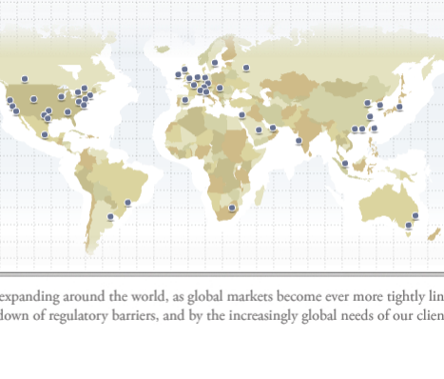
Global Offices
Calgary, only office in Canada
Headquarter in New York

Slide 5
Industry
Global Financial Services
Institutional Asset Management
Retail Asset Management
Investment Banking

Slide 6
Competitors
Citigroup
JP Morgan
Goldman Sachs
Merrill Lynch
UBS

Slide 7
Three Core Businesses
Institutional Securities
Capital raising
Financial advisory services
Corporate lending
Sales, trading, financing and market-making activities
Benchmark indices and risk management analytic
Investment activities
Global Wealth Management Group
Brokerage and investment advisory
Financial and wealth planning services
Annuity and other insurance products
Credit and other lending products
Cash management services
Retirement services
Trust and fiduciary services
Asset Management.
Global asset management products and services
Investment activities
Notes:
More explanation

Slide 8
5-Year Net Annual Revenue

Slide 9
Business Mix 2009 and 2010

Slide 10
Asset level evaluation
Level 1—Valuations based on quoted prices in active markets for identical assets or liabilities that the company has the ability to access. Valuation adjustments and block discounts are not applied to Level 1
Level 2—Valuations based on one or more quoted prices in markets that are not active or for which all significant inputs are observable, either directly or indirectly.
Level 3—Valuations based on inputs that are unobservable and significant to the overall fair value measurement.

Slide 11



Decompose Assets According to the Three Levels

Slide 12
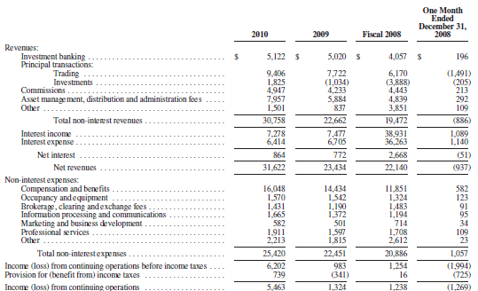
Income Statement

Slide 13
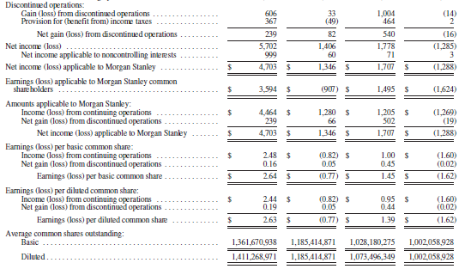
Income Statement (cont)

Slide 14
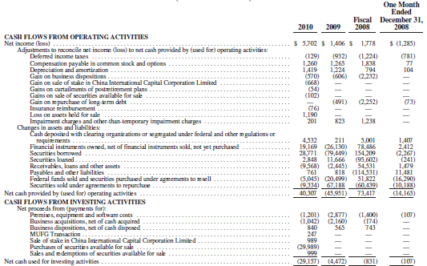
Cash Flow Statement

Slide 15
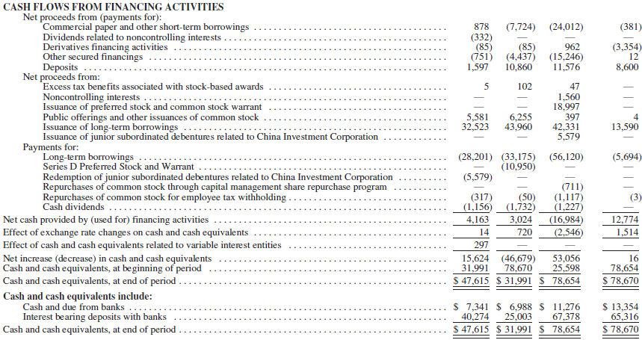
Cash Flow Statement (cont)

Slide 16
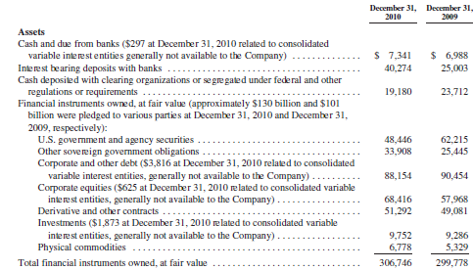
Balance Sheet

Slide 17
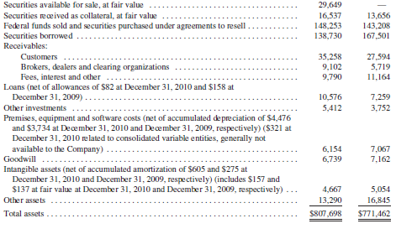
Balance Sheet (cont)

Slide 18
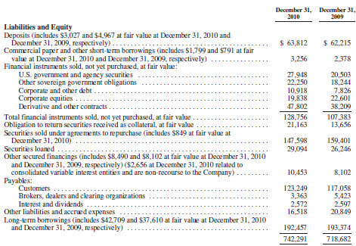
Balance Sheet (cont)

Slide 19
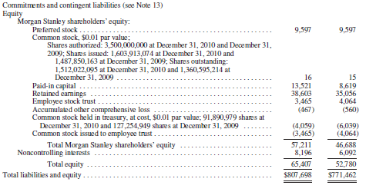
Balance Sheet (cont)

Slide 20
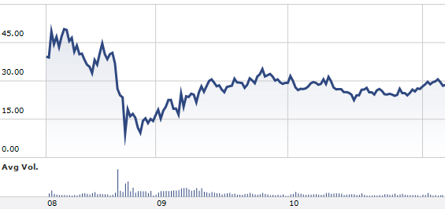
Financial crisis
Morgan Stanley Trading Price from 2008

Slide 21
Financial Crisis (cont)
Converted to bank holding company
Regulated by the Federal Reserve
No longer a securities firm
Invested by Mitsubishi UFJ Financial Group
Brought Smith Barney from Citigroup
Joint venture with Citigroup
No.1 in customer service among full-service brokerage firms

Slide 22
Future Considerations
Protection from market volatility
Build up reputation
Focus on technological development
Investors’ confidence
Inflation
Competitors
Legal requirements

Slide 23
Risk management philosophy
Comprehensiveness
Independence
Accountability
Defined risk tolerance
Transparency.

Slide 24
Types of risks
Operational risk
Risk of losses arising from insufficient controls on people, resources, and processes and external factors such as compliance risk
Legal/Regulatory risk
Risk of losses in fines, penalties, damages resulting from noncompliance and legal actions
Credit risk
Risk of default from borrowers

Slide 25
Types of Risk
Liquidity and funding risk
Risk of difficulty in accessing capital markets, inability to liquidate assets in a timely manner, and threats to going concern in satisfying financial obligations
Market risk
Risk of losses arising from changes in market prices, rates, volatility, and correlations

Slide 26
Types of Risks
Competitive environment risk
Risks from competition
International risk
Risks of losses from global operation
Acquisition risk
Risk of losses from acquisitions, minority stakes, forming joint ventures, and strategic alliances

Slide 27
Liquidity and Funding Risk
Risk of being unable to finance operations due to loss of access to capital markets, difficulty liquidating assets, or failing to meet financial obligations without experiencing significant business disruption

Slide 28
Liquidity and Funding Risk
Liquidity is essential and external sources finance a significant portion of operations
Affected by inability to raise funds in the long/short-term debt/equity capital markets or inability to access secured lending markets
Caused by:
Disruption of the financial markets
Negative views about the financial services industry
Negative perception of long or short term financial prospects
Large trading losses, downgraded or negative watch by rating agencies, decline in business activity, action by regulators, employee misconduct or illegal activity, and other reasons
Would have to liquidate assets to meet maturing liabilities and may have to sell at a discount

Slide 29
Liquidity and Funding Risk
Borrowing Costs and access to debt capital markets depend on credit ratings
Factors that determine credit ratings:
Level and quality of earnings
Capital adequacy
Liquidity
Risk appetite and management
Asset quality
Business mix and actual and perceived level of government support
Debt ratings can impact trading revenues
Post additional collateral in event of credit ratings downgrade
Notes:
Our debt ratings also can have a significant impact on certain trading revenues, particularly in those businesses where longer term counterparty performance is critical, such as OTC derivative transactions, including credit derivatives and interest rate swaps.
The rating agencies are considering the impact of the Dodd-Frank Act’s resolution authority provisions on large banking institutions and it is possible that they could downgrade our ratings and those of similar institutions.

Slide 30
Liquidity and Funding Risk
Depends on payments from subsidiaries
Regulations may prevent transfer of funds either to or from subsidiaries
Inability to access these funds may make it difficult to meet obligations
Regulations may also prevent dividend distribution or stock repurchase
Notes:
We are a holding company and depend on payments from our subsidiaries
Furthermore, as a bank holding company, we may become subject to a prohibition or to limitations on our ability to pay dividends or repurchase our stock

Slide 31
Liquidity and Funding Risk
Volatility in the global market and economic conditions have affected ability to raise funds in the long/short-term debt/equity capital markets and secured lending markets
Cost and availability of funding have been affected by illiquid credit markets and wider credit spreads in the past and may do so in the future

Slide 32
Market Risk
Risk that a change in the level of one or more market prices, rates, indices, implied volatilities, correlations or other market factors will result in a loss

Slide 33
Market Risk
Results of operations may be affected by market fluctuations and by global economic conditions
Factors affecting results:
Political and economic conditions
Effects of global equity, fixed income, and credit markets
Corporate and mortgage lending, and commercial real estate investments
Current, pending, and future legislation and regulation
Level and volatility of equity, fixed income, commodity prices, interest rates, currency values, and other market indices
Cost and availability of credit and capital and credit ratings
Performance of acquisitions, JV’s and strategic alliances
Reputation, inflation, natural disasters, war and terrorism
Actions by competitors and technological changes

Slide 34
Market Risk
Fluctuations affect the results of Institutional Securities business segments caused by factors mentioned above and global market activity
During unfavourable market conditions, the level of individual investor participation as well as level of client assets may decrease impacting the results of the Global Wealth Management Group business segment
Fluctuations in global market activity could impact flow of investment capital into or from the Asset Management business segment

Slide 35
Market Risk
Writedowns of financial instruments and other losses caused by volatile and illiquid market conditions
Valuation of certain securities is difficult
Sales may not realize fair value due to demand and liquidity in the market at the time of sale
These factors could require further writedowns in the value of securities portfolio
Under severe market conditions, hedging and other risk management strategies may not be as effective at mitigating losses as they are in more normal conditions
Severe market conditions are hard to predict and may result in substantial losses if they occur again

Slide 36
Market Risk
Holding large and concentrated positions expose Morgan Stanley to losses
Substantial amounts of capital are committed to market-making, investing, block trading, underwriting and lending businesses which results in large positions in securities of, or making large loans to, a particular issuer(s) in a particular industry, country, or region

Slide 37
Market Risk
Significant losses have been, and may continue to be incurred in the real estate sector
A number of principal positions have been acquired and financed by Morgan Stanley for their own account, investment vehicles by affiliates, separate accounts managed by affiliates, and major participants in commercial and residential real estate markets.
Originate loans on commercial and residential real estate
Securitize and trade in a wide range of real estate related products
Notes:
Further, we securitize and trade in a wide range of commercial and residential real estate and real estate-related whole loans, mortgages and other real estate and commercial assets and products, including residential and commercial mortgage-backed securities

Slide 38
Risk Management: Liquidity and Capital Resources
Senior management establishes liquidity and capital policies and reviews performance relative to policies, monitors the availability of alternative sources of financing, and oversees the liquidity and interest rate and currency sensitivity of the Company’s asset and liability position
The liquidity and funding risk management helps mitigate the risk that the company may not have access to adequate financing
The principal elements of the company’s liquidity and funding risk management framework are the Contingency Funding Plan (CFP) and the Global Liquidity Reserve
Uses Tier 1 common ratio and the balance sheet leverage ratio as indicators of capital adequacy

Slide 39
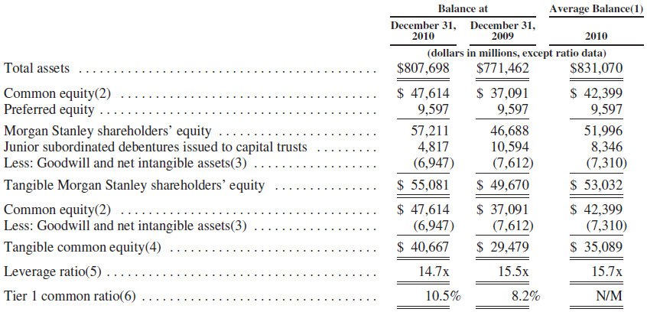
Leverage Ratios

Slide 40
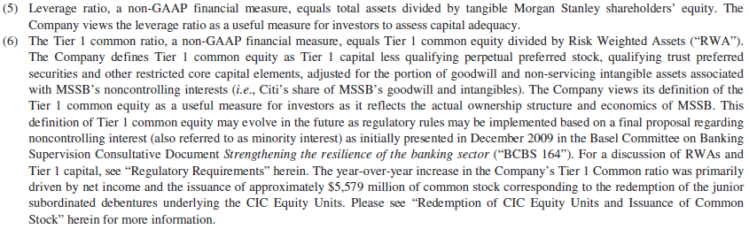
Leverage Ratios

Slide 41
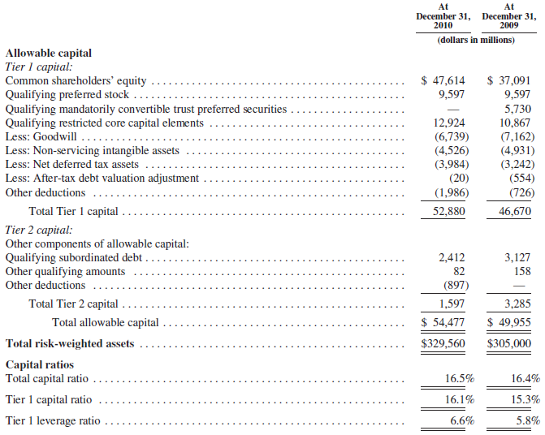
Notes:
Total allowable capital is composed of Tier 1 and Tier 2 capital. Tier 1 capital consists predominately of common shareholders’ equity as well as qualifying preferred stock, trust preferred securities mandatorily convertible to common equity and qualifying restricted core capital elements (trust preferred securities and non-controlling interests) less goodwill, non-servicing intangible assets (excluding allowable mortgage servicing rights), net deferred tax assets (recoverable in excess of one year), an after-tax debt valuation adjustment and certain other deductions, including equity investments
At December 31, 2010, the Company was in compliance with Basel I capital requirements with ratios of Tier 1 capital to RWAs of 16.1% and total capital to RWAs of 16.5% (6% and 10% being well-capitalized for regulatory purposes, respectively).

Slide 42
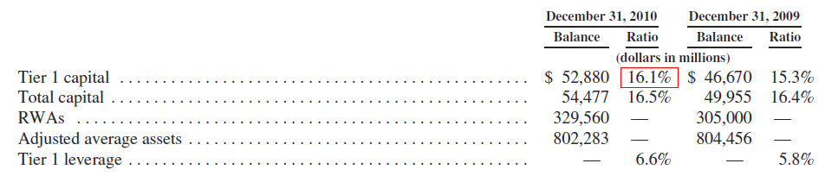
Capital Ratio

Slide 43
Contingency Funding Plan (CFP)
The company’s primary liquidity and funding risk management tool
Outlines response to liquidity stress and uses stress tests across multiple scenarios across various time horizons to set forth a course of action
Assumptions incorporated into the CFP:
No government support
No access to unsecured debt markets
Repayment of all unsecured debt maturing within one year
Higher haircuts and significantly lower availability of secured funding

Slide 44
Contingency Funding Plan (CFP)
Assumptions incorporated into the CFP (Cont’d):
Additional collateral that would be required by trading counterparties and certain exchanges and clearing organizations related to multi-notch credit rating downgrades
Discretionary unsecured debt buybacks
Drawdowns on unfunded commitments provided to third parties
Client cash withdrawals
Limited access to the foreign exchange swap markets
Return of securities borrowed on an uncollateralized basis
Maturity roll-off of outstanding letters of credit with no further issuance

Slide 45
Contingency Funding Plan (CFP)
Produced at the parent and major operating subsidiary levels, as well as major currency levels
Assumes subsidiaries will use their own liquidity first before drawing from the parent company
Assumes the parent will support its subsidiaries and will not have access to their liquidity reserves due to regulatory, legal or tax constraints
At December 31, 2010, the Company maintained sufficient liquidity to meet funding and contingent obligations as modeled in its liquidity stress tests
Notes:
The liquidity impact of additional collateral requirements is accounted for in the Company’s CFP

Slide 46
Global Liquidity Reserve
Liquidity reserves used to cover daily funding needs and meet liquidity targets sized by the CFP
Held within parent company and major operating subsidiaries
Comprised of cash and cash equivalents, securities reserved or borrowed on an overnight basis, and pools of federal reserve eligible securities
All assets are unencumbered and not pledged as collateral
Does not include other unencumbered assets that are available
The vast majority of the assets can be monetized on a next-day basis and the remainder of the assets can be monetized within two to five business days.
Notes:
It is comprised of cash and cash equivalents, securities that have been reversed or borrowed by the Company primarily on an overnight basis (predominantly consisting of U.S. and European government bonds and U.S. agency and agency mortgage-backed securities) and pools of Federal Reserve-eligible (eligible to be pledged to the Federal Reserve’s Discount Window) securities

Slide 47
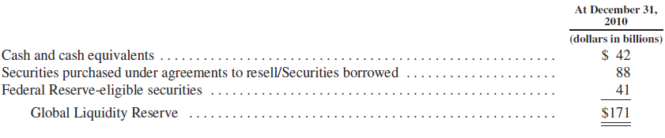
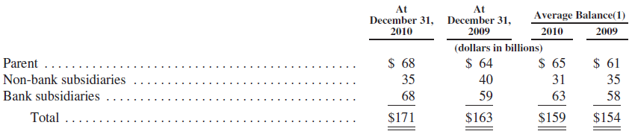
Global Liquidity Reserve

Slide 48
Capital Management Policies
Attempts to maintain total capital, on a consolidated basis, at least equal to the sum of its operating subsidiaries’ equity
$1.6 billion remaining under current share repurchase program out of $6 billion authorized in December 2006

Slide 49
Funding Management Policies
Attempt to ensure tenor of liabilities equals or exceeds the expected holding period of the assets being financed
Diversify funding sources
Substantial portion of assets as liquid marketable securities in order acquire secured financing
Obtain longer-term secured financing for less liquid assets
Stagger maturity for long-term borrowings to mitigate refinancing risk

Slide 50
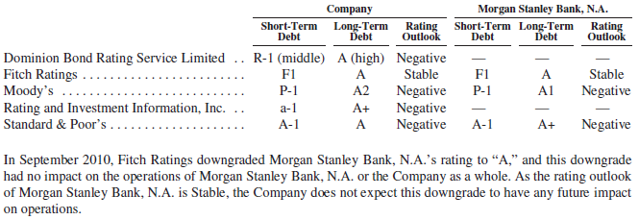
Credit Rating
Credit rating affects ability to acquire funding
CFP accounts for downgrade in credit rating

Slide 51
Required Capital
Capital estimation is based on the Required Capital Framework, an internal capital adequacy measure
Compared with regulatory Tier 1 capital to ensure they maintain an amount of risk-based going concern capital after absorbing potential losses from extreme stress events
Each business segment capitalized as if it were an independent operating entity, this is intended to align capital with the risks in each business segment

Slide 52
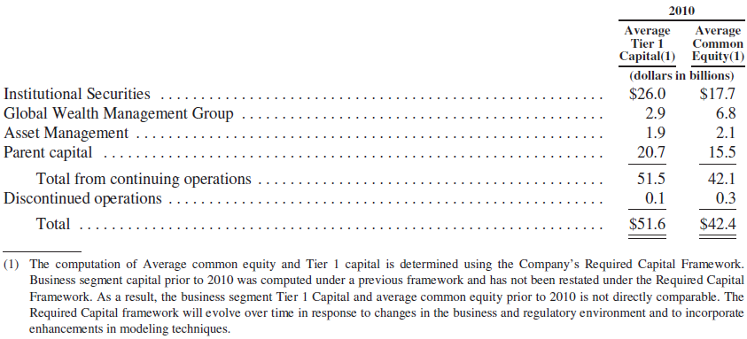
Average Tier 1 Capital and Average Common Equity by Business Segment
Notes:
The Company generally holds Parent capital for prospective regulatory requirements, including Basel III, organic growth, acquisitions and other capital needs.

Slide 53
Regulatory Requirements
Subject to regulation and oversight of the Federal Reserve which establishes capital requirements
Capital ratios and Risk Weighted Assets calculated in accordance with capital adequacy standards
Risks are calculated under Basel I and Basel II simultaneously as of July 2010
At December 31, 2010, the Company was in compliance with Basel I capital requirements with ratios of Tier 1 capital to RWAs of 16.1% and total capital to RWAs of 16.5% (6% and 10% being well-capitalized for regulatory purposes, respectively)

Slide 54
Basel II
The First Pillar: Minimum Capital Requirements
Maintain three major risks: Credit Risk, Operational Risk, Market Risk
Minimum Capital Requirement: (risk weighted) 8%
The Second Pillar: Supervisory Review
Assist the first pillar with regulatory responses
Deals with liquidity risk and other risks
The Third Pillar: Market Discipline
Market disclosure

Slide 55
Basel III
Implementation of Basel II may be impacted by development of Basel III
New capital standards that raise the quality of capital, strengthen counterparty credit risk capital requirements and introduces a leverage ratio as a supplemental measure to the risk-based ratio
New capital conservation buffer which imposes a common equity requirement above the new minimum that can be depleted under stress

Slide 56
Effects of Inflation and Changes in FX Rates
The Company’s assets are largely liquid in nature and are not significantly affected by inflation
Inflation may increase expenses which may adversely affect profitability
Business conducted in other currencies can affect the value of non-U.S. dollar net assets, revenues and expenses
Strategies to reduce impact of FX rate fluctuations include financing of non-U.S. dollar assets with direct or swap-based borrowings in the same currency and the use of currency forward contracts or the spot market in various hedging transactions related to net assets, revenues, expenses or cash flows

Slide 57
Risk Management: Market Risk
Institutional Securities business segment generates the substantial majority of Company’s Value at Risk (VaR) for market risk exposure
Global Wealth Management Group incurs trading related market risk
Asset Management incurs principally non-trading market risk

Slide 58
Market Risk Department
Responsibilities:
Ensuring transparency of material market risk
Monitoring compliance with established limits
Escalating risk concentrations to appropriate senior management
How responsibilities are carried out:
Monitor risk against limits on aggregate risk exposures
Perform risk analyses
Report risk summaries
Monitor risk through various measures
VaR
Position sensitivity
Routine stress testing

Slide 59
Primary Market Risk Exposures
Exposure to interest rates, equity prices, foreign exchange rates and commodity prices—and the associated implied volatilities and spreads—related to the global markets in which it conducts its trading activities

Slide 60
Value at Risk (VaR)
Used to measure, monitor and review market risk exposures of its trading portfolios
VaR estimated by using a model based on historical simulation for major market risk factors and Monte Carlo simulation for name-specific risk in corporate shares, bonds, loans and related derivatives
Historical simulation involves constructing a distribution of hypothetical daily changes in the value of trading portfolios based on two sets of inputs
Historical observation of daily changes in key market indices or other market risk factors
Information on the sensitivity of the portfolio values to these market risk factor changes
The company’s VaR model uses four years of historical data to measure it’s 95%/one-day VaR which corresponds to the unrealized loss in portfolio value that would have been exceeded with a frequency of 5% or 5 times in every 100 trading days if the portfolio were held constant for one day
Notes:
The Company’s VaR model generally takes into account linear and non-linear exposures to equity and commodity price risk, interest rate risk, credit spread risk and foreign exchange rates as well as linear exposures to implied volatility risks. The VaR model also captures certain implied correlation risks associated with portfolio credit derivatives as well as certain basis risks (e.g., corporate debt and related credit derivatives)

Slide 61
VaR Benefits and Limitations
Benefits
Permits estimation of portfolio’s aggregate market risk exposure
Reflects risk reduction due to portfolio diversification or hedging activities
Limitations
Past changes in market risk factors may not yield accurate predictions
Changes in portfolio value may differ from responses calculated by a VaR model
Doesn’t fully capture market risk of positions that cannot be liquidated or hedged within one day using a one day time frame
Limited insight into losses that could occur in unusual market conditions
Understates risk associated with severe events

Slide 62
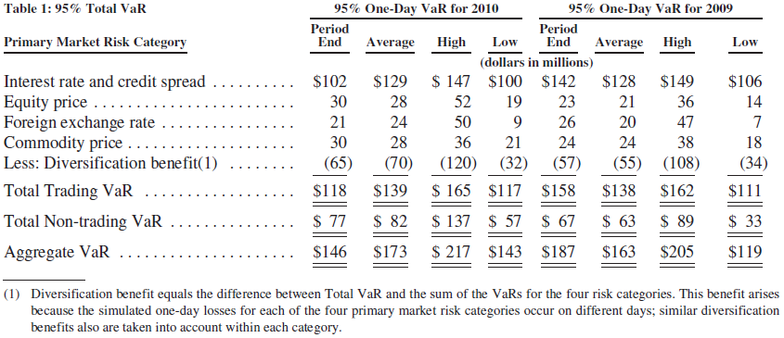
2010 95%/one-day VaR
Notes:
The increase in both Non-trading and Aggregate VaR was due primarily to the Company’s investment in Invesco, which was sold in November 2010, as well as increased interest rate sensitivity of deposits in the declining rate environment

Slide 63
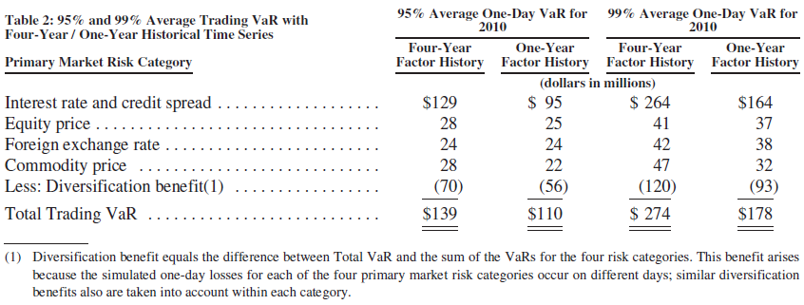
95% and 99% Average Trading VaR with Four-Year / One-Year Historical Time Series
Notes:
The four-year VaR measure continues to be sensitive to the high market volatilities experienced in the fourth quarter of 2008, while the one-year VaR is no longer affected by this phenomenon. Consequently, the four-year VaR is a more conservative approximation of the Company’s portfolio risk

Slide 64
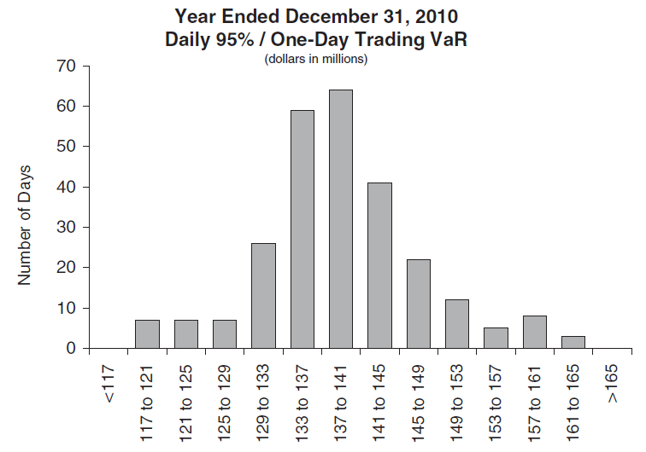
Notes:
As shown in Table 1, the Company’s average 95%/one-day Trading VaR for 2010 was $139 million. The histogram below presents the distribution of the Company’s daily 95%/one-day Trading VaR for 2010. The most frequently occurring value was between $137 million and $141 million, while for approximately 81% of trading days during the year VaR ranged between $129 million and $149 million

Slide 65
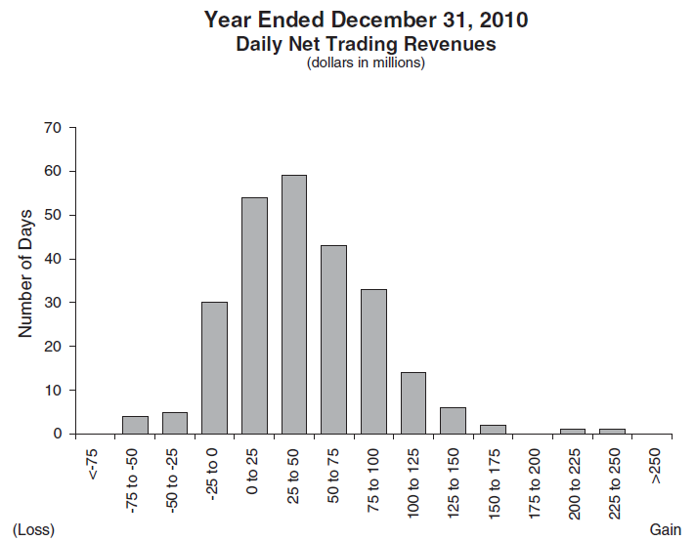
Notes:
One method of evaluating the reasonableness of the Company’s VaR model as a measure of the Company’s potential volatility of net revenues is to compare the VaR with actual trading revenues. Assuming no intra-day trading, for a 95%/one-day VaR, the expected number of times that trading losses should exceed VaR during the year is 13, and, in general, if trading losses were to exceed VaR more than 21 times in a year, the accuracy of the VaR model could be questioned. Accordingly, the Company evaluates the reasonableness of its VaR model by comparing the potential declines in portfolio values generated by the model with actual trading results. For days where losses exceed the 95% or 99% VaR statistic, the Company examines the drivers of trading losses to evaluate the VaR model’s accuracy relative to realized trading results.
The histogram below shows the distribution of daily net trading revenues during 2010 for the Company’s trading businesses (these figures include revenues from the counterparty portfolio and also include net interest and non-agency commissions but exclude certain Non-trading revenues such as primary, fee-based and prime brokerage revenues credited to the trading businesses). During 2010, the Company experienced net trading losses on 38 days, with zero excesses of the 95%/one-day Trading VaR.

Slide 66
Non-Trading Risks
Sensitivity analysis is a better approach for non-trading portfolios due to a variety of factors such as trading restrictions, illiquidity, and other factors
Counterparty Exposure Related to The Company’s Own Spread
The credit spread risk sensitivity of mark-to-market derivative counterparty exposure corresponds to an increase in value of approximately $8 million for each +1 basis point widening in the Company’s credit spread level for December 31, 2010

Slide 67
Funding Liabilities
The credit spread risk sensitivity of the Company’s mark-to-market funding liabilities, which corresponded to an increase in value of approximately $14 million for each +1 basis point widening in the Company’s credit spread level at December 31, 2010

Slide 68
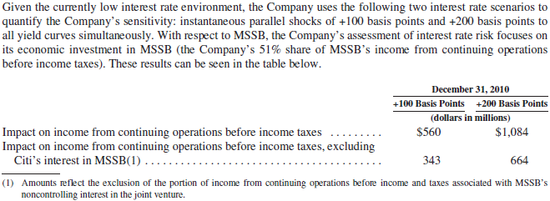
Interest Rate Risk Sensitivity

Slide 69
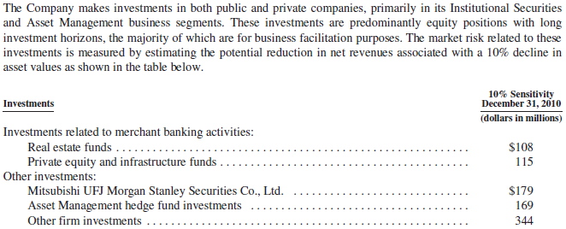
Investments

Slide 70
Derivative Instruments and Hedging Activities
Derivative Instruments are used for trading, foreign currency exposure management and asset and liability management
Risk mitigation strategies include diversification of risk exposure and hedging
Risk is managed on a company-wide basis, worldwide trading division level and on an individual product basis

Slide 71
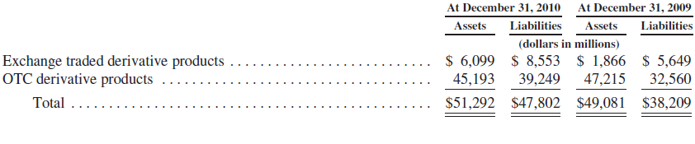
Derivative Products

Slide 72
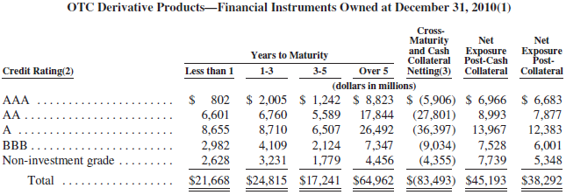
OTC Derivative Products

Slide 73
Hedge Accounting
The Company applies hedge accounting using various derivative financial instruments and non-U.S. dollar-denominated debt to hedge interest rate and foreign exchange risk arising from assets and liabilities not held at fair value as part of asset and liability management and foreign currency exposure management.
The Company’s hedges are designated and qualify for accounting purposes as one of the following types of hedges: exposure to changes in fair value of assets and liabilities being hedged (fair value hedges) and foreign operations whose functional currency is different from the reporting currency of the parent company (net investment hedges).
For all hedges where hedge accounting is being applied, effectiveness testing is performed at least monthly.

Slide 74
Hedge Accounting
Fair Value Hedges – Interest Rate Risk
Consist primarily of interest rate swaps designated as fair value hedges of changes in the benchmark interest rate of fixed rate senior long-term borrowings
Net Investment Hedges
Forward foreign exchange contracts and non-U.S. dollar-denominated debt used to manage the currency exposure relating to its net investments in non-U.S. dollar functional currency operations

Slide 75
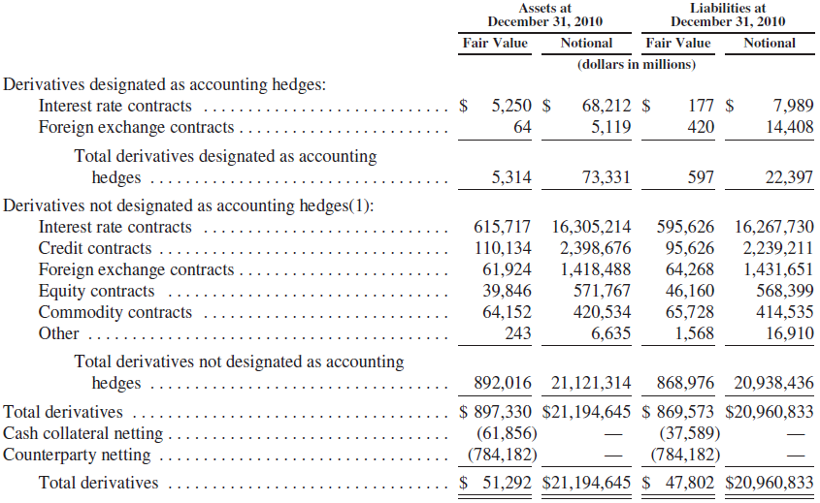
Value of (Non)-Accounting Hedges

Slide 76
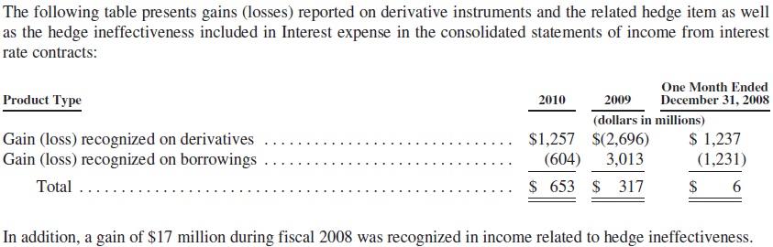
Derivatives Designated as Fair Value Hedges

Slide 77
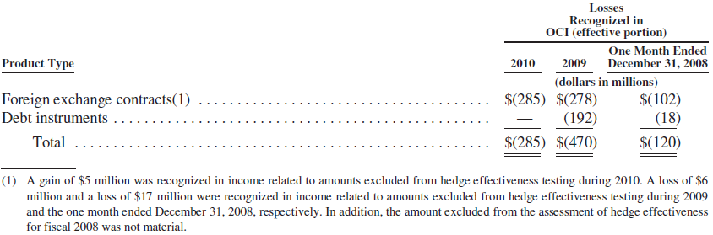
Derivatives Designated as Net Investment Hedges

Slide 78
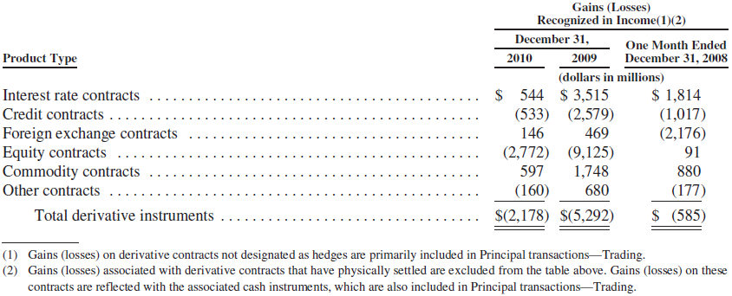
Derivative Instruments NOT Designated as Accounting Hedges
The table below summarizes gains (losses) on derivative instruments not designated as accounting hedges for 2010, 2009 and the one month ended December 31, 2008, respectively

Slide 79
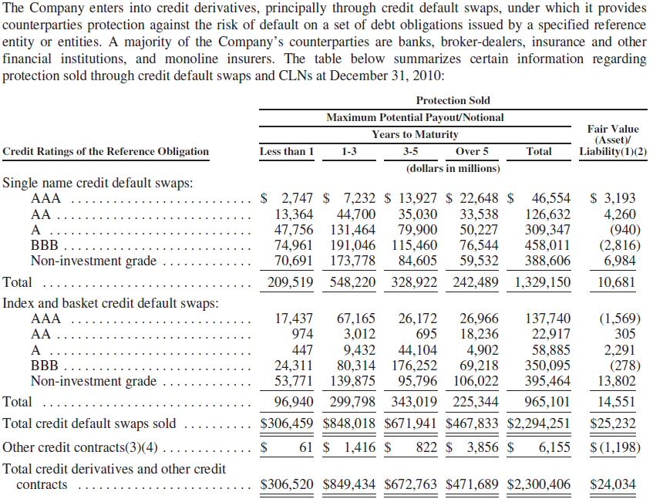
Credit Derivatives and Other Credit Contracts
Notes:
Credit Derivatives and Other Credit Contracts.
The Company enters into credit derivatives, principally through credit default swaps, under which it provides counterparties protection against the risk of default on a set of debt obligations issued by a specified reference entity or entities. A majority of the Company’s counterparties are banks, broker-dealers, insurance and other financial institutions, and monoline insurers. The table below summarizes certain information regarding protection sold through credit default swaps and CLNs at December 31, 2010

Slide 80
Credit Risk
Refers to the risk of loss arising from borrower or counterparty default when a borrower, counterparty or obligor does not meet it’s obligation
Notes:
Disclosure about Market Risk—Risk Management—Credit Risk” in Part II, Item 7A herein.

Slide 81
Credit Risk
third parties indebted to us not perform obligation
incur through Institutional Securities business segment
incur in traded securities and loan pools
incur in Global Wealth Management Group business segment
continued difficult economic conditions may further negative impart clients and firm’s current credit exposures

Slide 82
Credit Risk Institutional Securities business segment
entering into swap or other derivative contract which counterparties have obligations to make payment
extending credit to clients through various lending commitments
providing short or long-term funding secured by physical or financial collateral whose value may at times be insufficient to fully cover the loan repayment amount
Posting margin or collateral to clearing houses, clearing agencies, exchanges, banks, securities firms and other financial counterparties

Slide 83
Credit Risk Institutional Securities Activities
Corporate Lending
Relationship-driven
expand business relationships
Event-driven
activities associated event or transaction such as support client merger or recapitalization
Securitizations
extend funding to clients through lending commitments secured by assets
Provide for over-collateralization

Slide 84
Credit Risk Institutional Securities Activities (cont)
Derivative Contracts
Represent future commitments to swap interest payment streams, exchange currencies on specific terms at specified future days
Morgan Stanley as a dealer of OTC derivatives

Slide 85
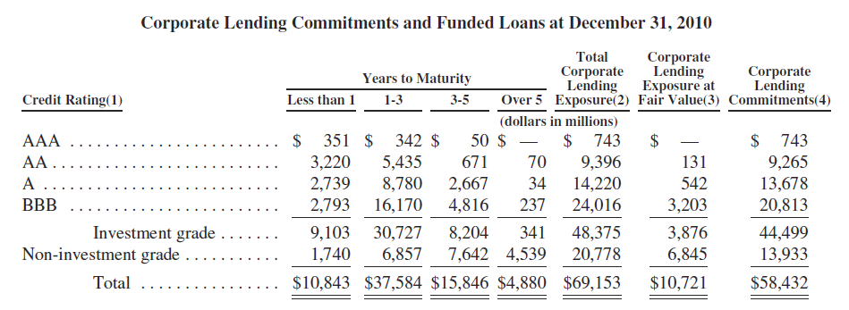
Credit Exposure Corporate Lending

Slide 86
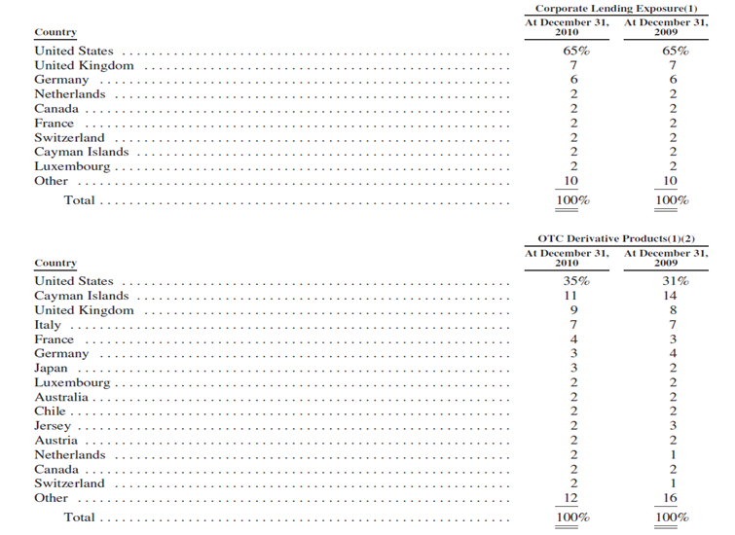
Country Exposure

Slide 87
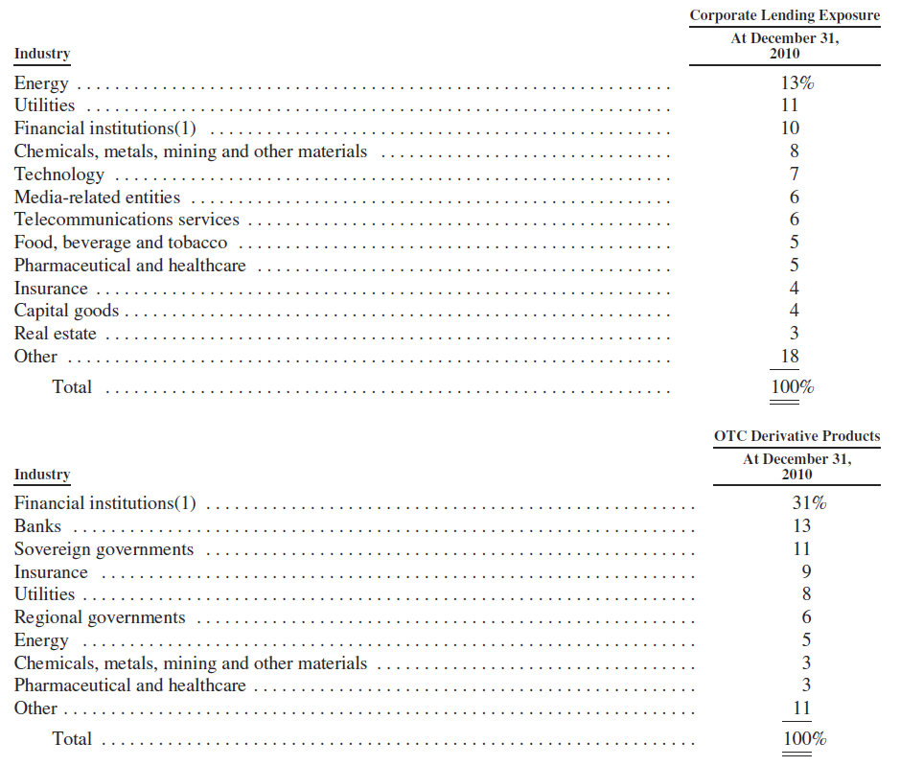
Industry Exposure

Slide 88
Credit Risk Management
Credit Risk Management Department
Credit Limits Framework

Slide 89
Analyzing Credit Risk
Credit Risk Management Department
Ensure lending transactions and derivative exposure are analyzed
Review Creditworthiness of counterparties and borrowers regularly
Actively monitor and manage credit exposure
Assigns obligor credit ratings to counterparties and borrowers
Evaluate relative position of particular obligation in borrower’s capital structure and recovery prospects

Slide 90
Risk Mitigation
Through management of key risks elements such as size, financial covenants and collateral
Sell, assign or sub-participate funded loans to other financial institutions
Enter master netting agreements and collateral arrangements with counterparties to offset obligations, request collateral or liquidate collateral

Slide 91
Credit Risk Global Wealth Management Group business segment
Lending to individual investors, margin and non-purpose loans collateralized by securities, residential mortgage loans and home equity lines of credit

Slide 92
Credit Risk Global Wealth Management Group Activities
Margin lending
monitors margin levels, establishes credit limits
reviews amount of margin loans, intended purpose and degree of leverage
Non-purpose securities-based lending (Consumer lending)
allows clients borrow money against the value of qualifying securities for purposes other than trading or refinancing margin debt
establishes approved lines and advance rates against qualifying securities

Slide 93
Credit Risk Global Wealth Management Group Activities
Commercial lending
provides structured credit facilities to high net worth individuals and their small and medium-sized domestic businesses
with working capital lines of credit, revolving lines of credit, standby letters of credit, term loans and commercial real estate mortgages
Residential mortgage lending
Regards mortgages, HELOC loans, a loan evaluation process is adopted within a framework of credit underwriting policies and collateral valuation
ensure that all borrowers pass an assessment of capacity and willingness to pay
loan-to-value ratio, a FICO score, home price index, and delinquency status

Slide 94
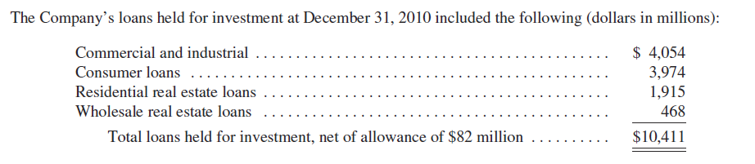
Credit Exposure Global Wealth Management Group Activities

Slide 95
Credit Risk Default risk
firm as a clearing member firm
responsible for the defaults or misconduct of customers
although regular review, may arise from event or circumstance that difficult to detect or foresee

Slide 96
Credit Risk Systemic risk
Defaults by another large financial institution could adversely affect financial market generally
commercial soundness of financial institution closely interrelated as a result of credit, trading, clearing and other relationships between the institutions
concerns, default or threatened default by, one institution could lead to significant market-wide liquidity and credit problems, losses or defaults by other institutions

Slide 97
Operational Risk
refers to the risk of financial or other loss, or damage to a firm’s reputation, resulting from inadequate or failed internal processes, people, resources, systems or from other internal or external events
Notes:
Operational Risk” in Part II, Item 7A herein

Slide 98
Operational Risk
incur across full scope of business activities:
revenue-generating activities (sales & trading)
support functions (information technology and trade processing)
other strategic decisions (integration of MSSB or other joint ventures, acquisition or strategic alliances

Slide 99
Operational Risk
dependent on ability to process, on a daily basis, large number of transactions across numerous and diverse markets in many currencies
perform function required to operate different businesses either by ourselves or through agreement with third parties

Slide 100
Operational Risk
rely on ability of employees, internal systems and systems at technology centers operated by third parties to process high volume of transactions
rely on secure processing, storage and transmission of confidential and other information in computer systems

Slide 101
Operating Risk Management
Operational risk Oversight Committee
Chaired by CRO, provides oversight of operational risk
Operational risk manager
Monitors, measures, analyzes and reports on operational risk
Independent of business segments
Business Manager
Maintain processes and controls designed to manage operational risk

Slide 102
Operating Risk Management
Business Continuity Management
Contingency planning to ensure continuity of operations in case of disaster
External vendors
Risk managed through service level, contractual agreements, service and quality reviews

Slide 103
Operational risk Legal and Regulatory Risk
Legal and compliance risk includes the risk of exposure to fines, penalties, judgments, damages and/or settlements in connection with regulatory or legal actions as a result of non-compliance with applicable legal or regulatory requirements or litigation
contractual and commercial risk such as the risk that a counterparty’s performance obligations will be unenforceable.

Slide 104
Operational risk Legal and Regulatory Risk
Extensive regulations
subject to extensive regulation by U.S. federal and state regulatory agencies and securities exchanges in major markets
risk of investigations and proceedings by governmental and self-regulatory agencies in countries conducting business
Dodd-Frank Act
Present SEC with information related to securities laws violations leads to successful enforcement action
Subject to significantly revised and expanded regulation and supervision, to new activities limitations, to a systemic risk regime which impose high capital and liquidity requirement

Slide 105
Operational risk Legal and Regulatory Risk
substantial litigation and regulatory investigations
– damage reputation and legal liability
governmental fiscal and monetary policies
Actions directly impact our cost of funds for lending
commodities activities
Engage in production, usage, transportation in metals , agricultural, energy product, etc.
Subject to related extensive regulation, potential catastrophic events and environmental risks and regulation which expose to cost and liability
failure to address conflicts of interest
Potential conflicts give rise to litigation or enforcement actions
Notes:
Legal Proceedings” in Part I, Item 3 herein.

Slide 106
Legal Risk Management
Legal and Compliance Division
“Develops various procedures addressing issues such as regulatory capital requirements, sales and trading practices, new products, potential conflicts of interest, structured transactions, use and safekeeping of customer funds and securities, credit granting, money laundering, privacy and recordkeeping”

Slide 107
Competitive environment risk
compete with commercial banks, brokerage firms, insurance companies, sponsors of mutual funds, hedge funds, energy companies, etc.
Pricing pressure
Automated trading markets increased pressure on trading commissions
Pressure in obtaining quality employees
Notes:
“Competition” and “Supervision
and Regulation” in Part I, Item 1 herein

Slide 108
International Risk
Subject to numerous political, economic, legal, operational, franchise and other risks
In many countries, the laws and regulations applicable to the securities and financial services industries are uncertain and evolving, difficult to determine exact requirements of local laws
Various emerging market countries have experienced severe political, economic and financial disruptions, including significant devaluations of their currencies, capital and currency exchange controls, high rates of inflation and low or negative growth rates. Crime and corruption also existed is these countries

Slide 109
Acquisition and Joint Venture Risk
unable to fully capture the expected value from acquisitions, joint ventures, minority stakes and strategic alliances
need to combine accounting and data processing systems and management controls and to integrate relationships with clients, trading counterparties and business partners
conflicts or disagreements between Morgan Stanley and its joint venture partners

Slide 110
Compensation Practices
Compensation practices are subject to oversight by the Federal Reserve
The Company is subject to the compensation-related provisions of the Dodd-Frank Act
In June 2010, the Federal Reserve and other federal regulators issued final guidance in accordance with compensation principles and standards designed to encourage sound compensation practices established by the Financial Stability Board

Slide 111
Compensation Objectives and Strategy
Attract and Retain Top Talent. The Company competes for talent globally with commercial banks, brokerage firms, hedge funds and other companies offering financial services. Long-term incentive awards encourage executives not to leave the Company for a competitor
Deliver Pay-for-Performance. Executive compensation program emphasizes variable incentive compensation that is linked to Company and individual performance
Align Executive Compensation with Shareholders’ Interests. The Company delivers a significant portion of long-term incentive compensation in equity to align employee interests to increased shareholder value
Evaluate Risk-taking and Compensation Arrangements. The CMDS Committee works with the Company’s Chief Risk Officer and the CMDS Committee’s independent consultant to help ensure that the structure and design of compensation arrangements do not encourage unnecessary and excessive risk-taking
Notes:
Compensation, Management Development and Succession (CMDS)

Slide 112
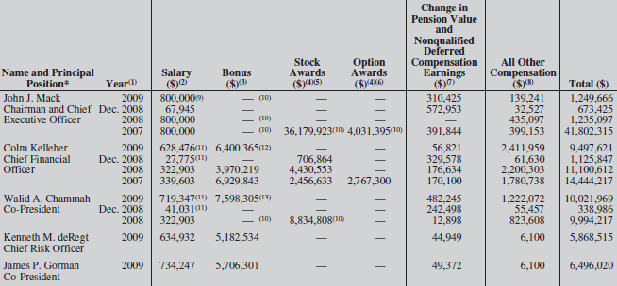
Executive Compensation (2009)

Slide 113
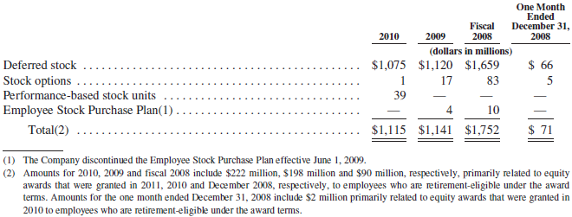
Employee Stock-Based Compensation Plans
The accounting guidance for stock-based compensation requires measurement of compensation cost for equity-based awards at fair value and recognition of compensation cost over the service period, net of estimated forfeitures

Slide 114
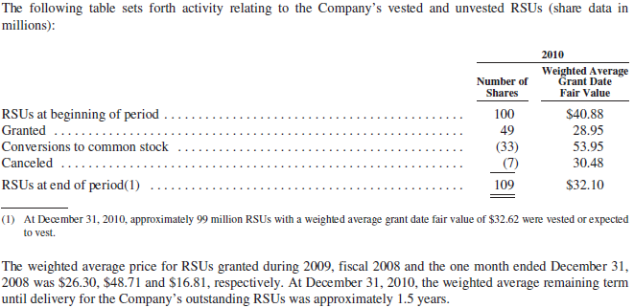
Deferred Stock Awards

Slide 115
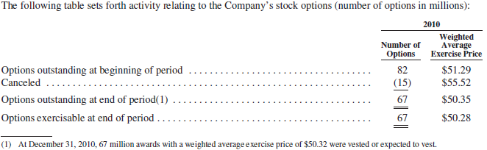
Stock Awards

Slide 116
Thank You!

