Slide 1
419 Presentation Mining & Materials
Barric, Teck & xstrata
By Tang,Tao,Wu,Zhang

Slide 2
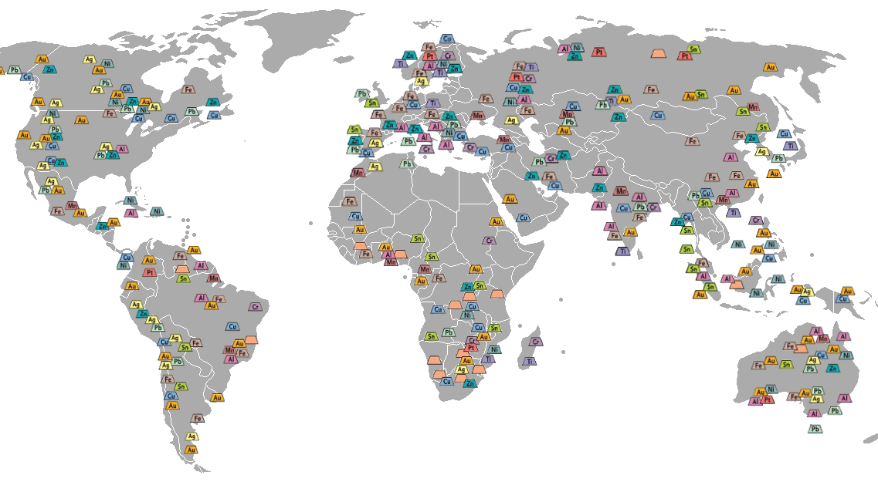
Industry Overview
What is mining industry
Exploration
Extraction
Refining
Industry Use
}Transactions

Slide 3
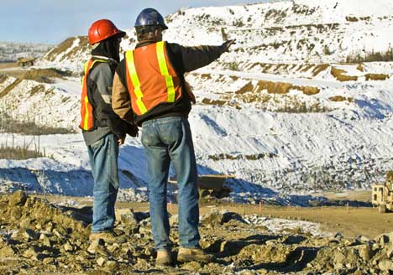
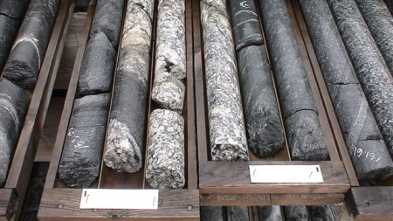
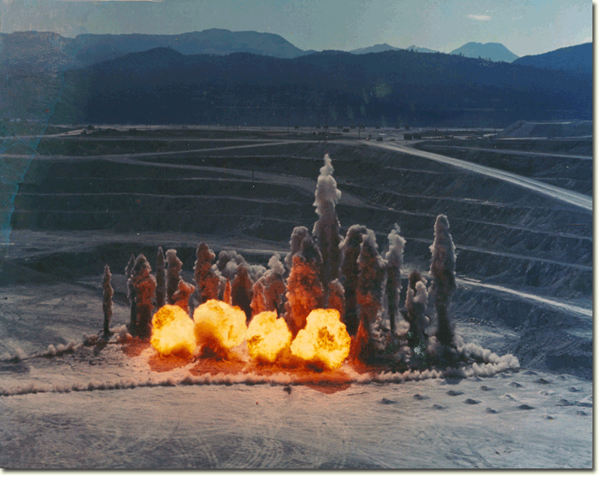
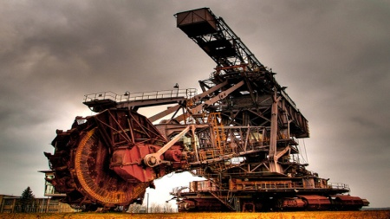
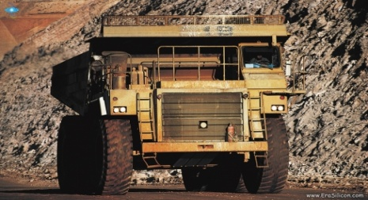
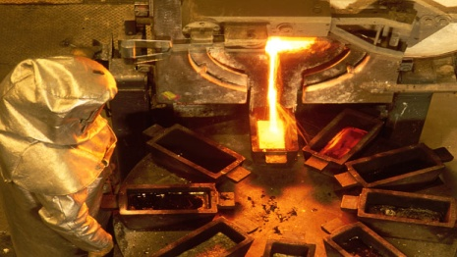
Industry Overview
EXPLORATION
CORE SAMPLES
BLASTING
MINING
HAULING
REFINING

Slide 4
Industry Overview
Cost Structure
Exploration, R&D
Depreciation and amortization
Interest expenses
General Operation costs
Other
Revenue Composition
Mining revenue
Financial activities revenue (ie. Hedging)
Interest income revenue

Slide 5
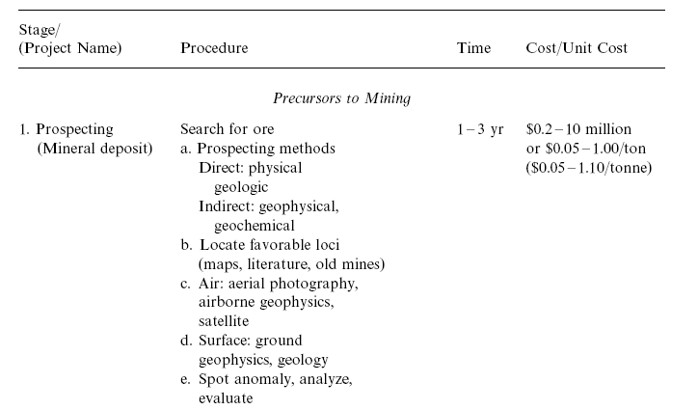
Industry Overview
Operating Cycle
1. Prospecting 1-3 yr

Slide 6

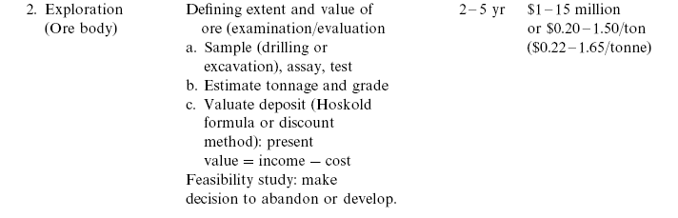
Industry Overview
2. Exploration 2-5 yr

Slide 7
Industry Overview
3. Development 2-5 yr

Slide 8
Industry Characteristics
Capital Intensive—giant-only game
Hedging is popular
Sensitive to economy cycle
Both risk averse and risk taking
Revenue driven by multi-factors
Commodity price
FX rate
Interest
Etc.
Environmental Concerns

Slide 9
Risk Factor Recognition
Commodity Price
Spot fluctuation
Future prediction
Exchange Rate
Interest Rate
Debt
Financial Activities
Political
Environmental regulations
License
Permits
Counterparties
Suppliers
Consumers
Debt holders
Etc.
5-7 permits and licenses in total

Slide 10
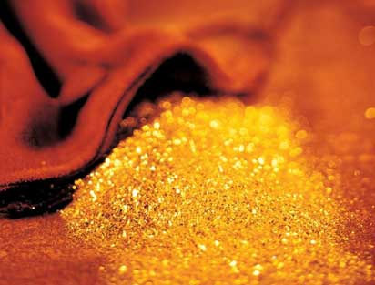
Main Products: Gold
Gold
Market value
World total reserve 163,000 metric tones
Grew 41.1% in 2010, reached a volume of $83.3 billion
Predicted to be $313.5 billions in 2015
Contago

Slide 11
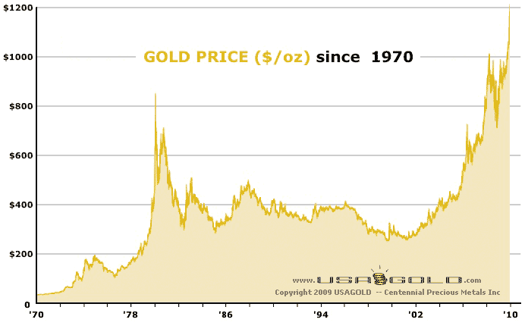
Historical Gold Price
Now, global
Mexican, Latin America
Japan
Asia

Slide 12
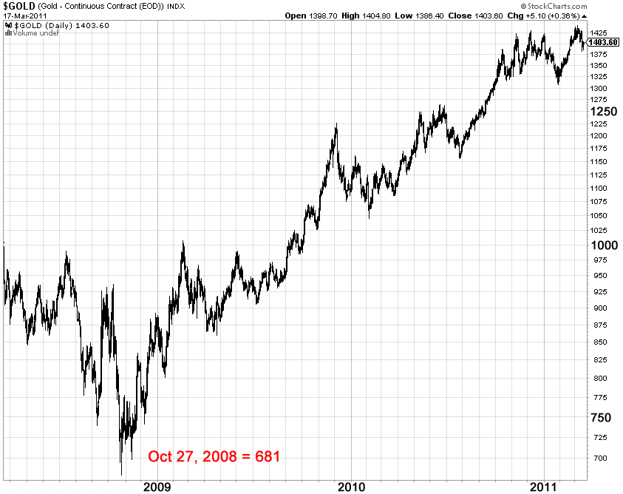
Historical Gold Price
“U” shape of gold price,
1. Low demand
2. Investment transfer
3. Recovery
U

Slide 13
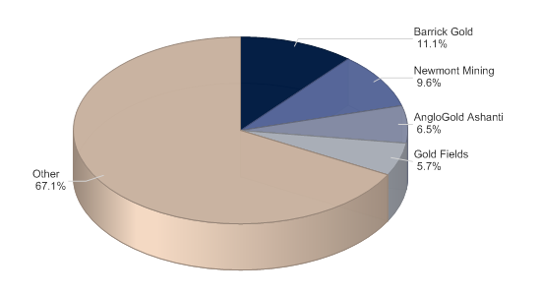
Global gold market share: % share, by value, 2010

Slide 14
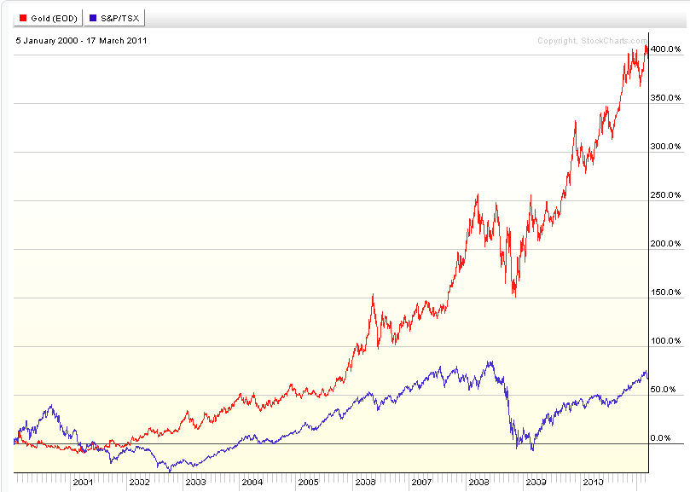
Gold Price V.S. Stock Market

Slide 15
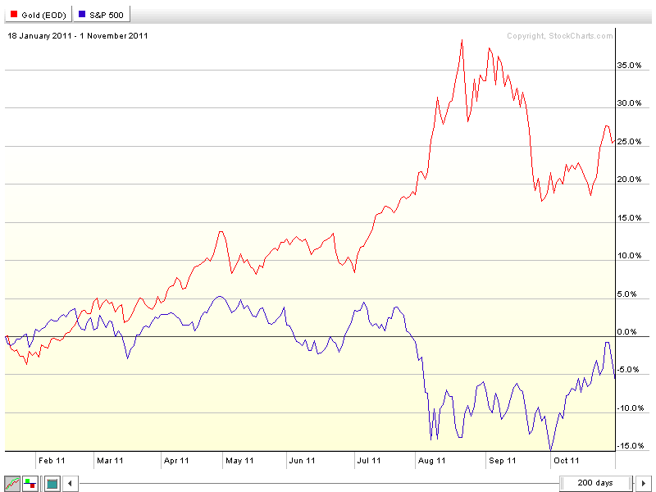
Gold Price in 2011

Slide 16
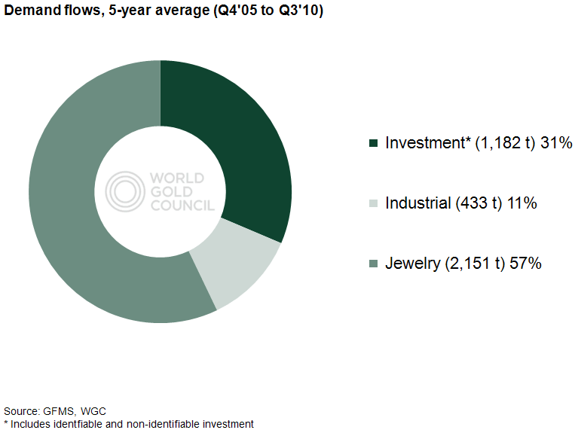
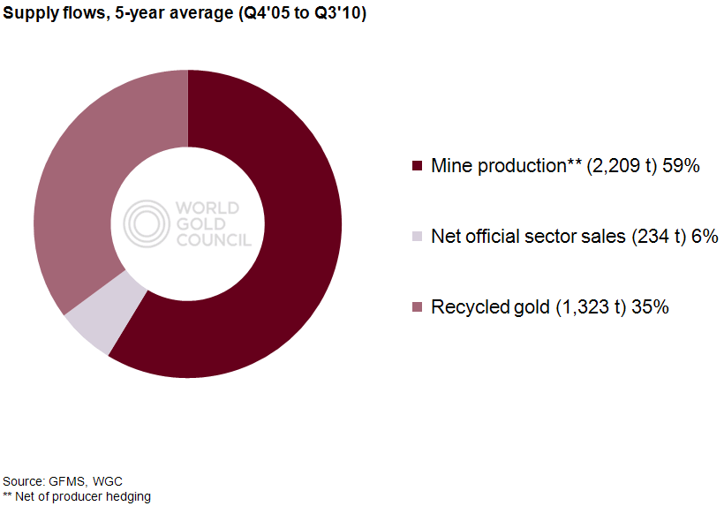
India, China, Mid East accounted for about 70% of demand for jewelry. Trend: more gold for jewelry

Slide 17
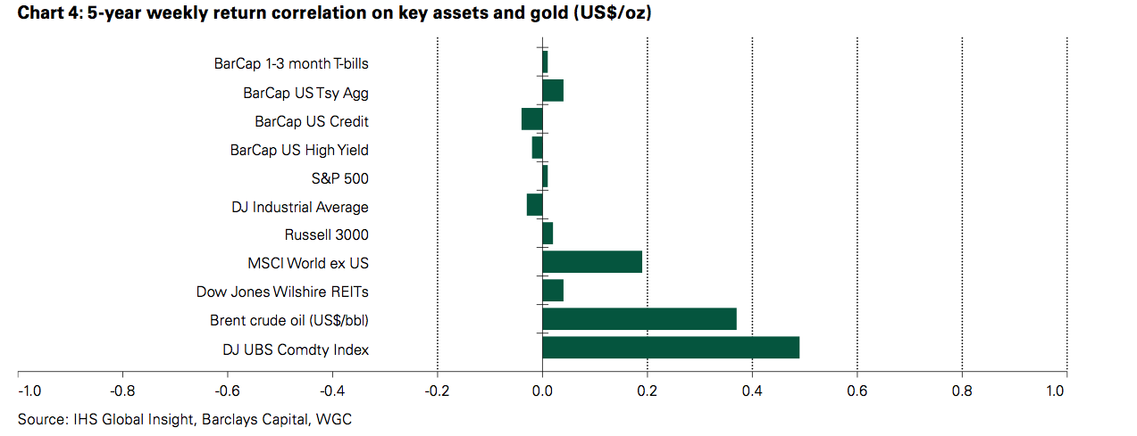
Gold as Investment
Safety investment, fluctuation, but always have value
Hedge against inflation
Reflect people’s expectation and confidence of market.

Slide 18

Main Products: Copper
Copper
Internationally traded
Contago
Infinite recyclable
Markets:
New York Mercantile Exchange (COMEX)
London Metals Exchange (LME)
Shanghai Futures Exchange (SHFE)

Slide 19
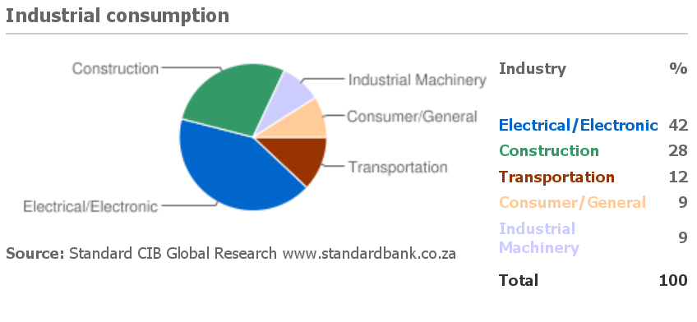
Copper Demand
Global Economic Conditions: Driven by US, EU
Industrialization: China, India

Slide 20
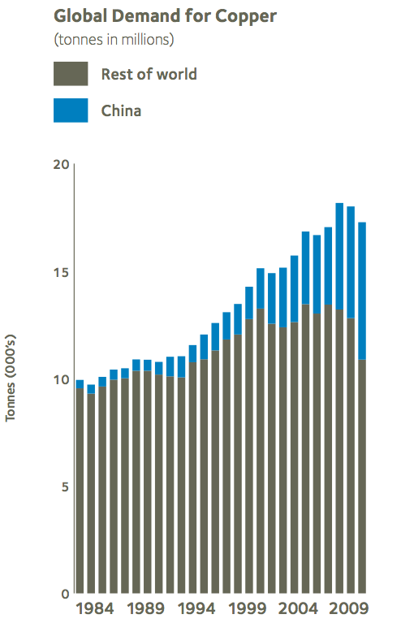
Copper Demand
China drove up the international copper price by 140% in 2009

Slide 21
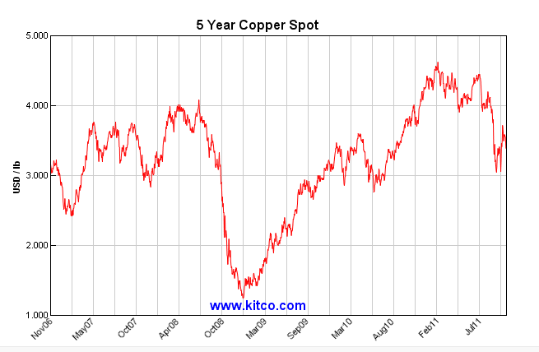
Five Year Copper Price

Slide 22
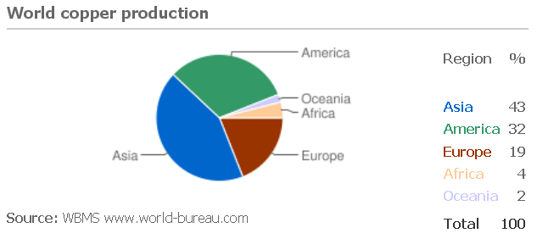
Copper Supply

Slide 23
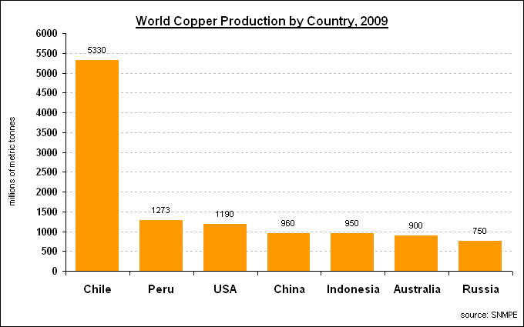

Slide 24
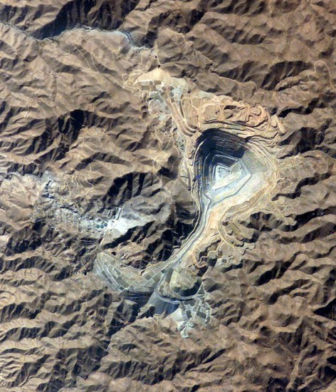
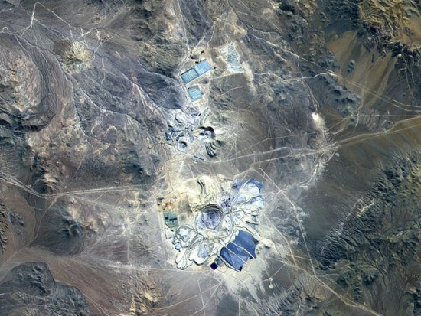
Peru is the largest copper supplier in the world, so watching out for South America, especially Peru’s political conditions is a must.

Slide 25
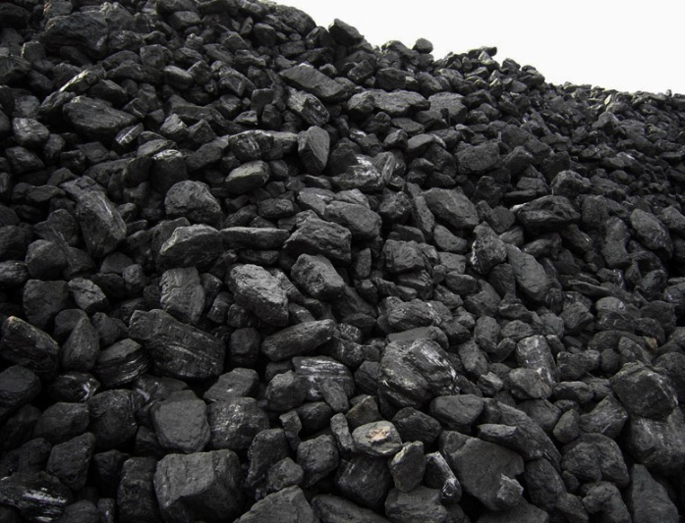
Main Products: Coal
Coal
Most widely distributed and used fossil fuel
70% of the total world coal production is consumed for electricity generation (Thermal Coal)
Other uses: steel production(Coking Coal), cement manufacturing, and as a liquid fuel

Slide 26
Coal
Main Use of Coal
POWER GENERATION (THERMAL COAL)
STEEL PRODUCTION (COKING COAL)
CEMENT MANUFACTURING
AS A LIQUID FUEL
70%
}
30%

Slide 27
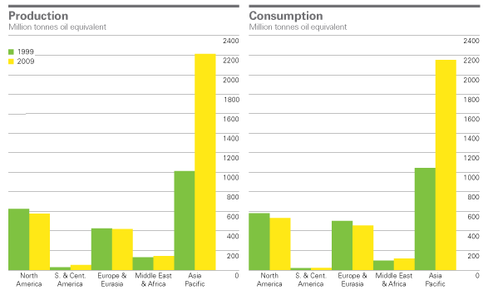
Supply and Demand

Slide 28
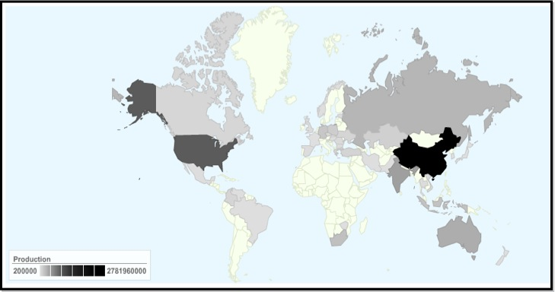
Supply and Demand

Slide 29
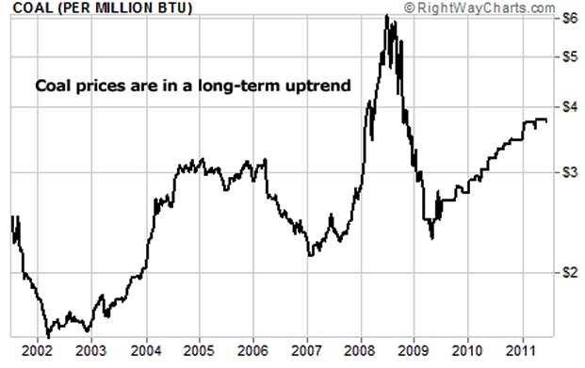
Coal Price

Slide 30
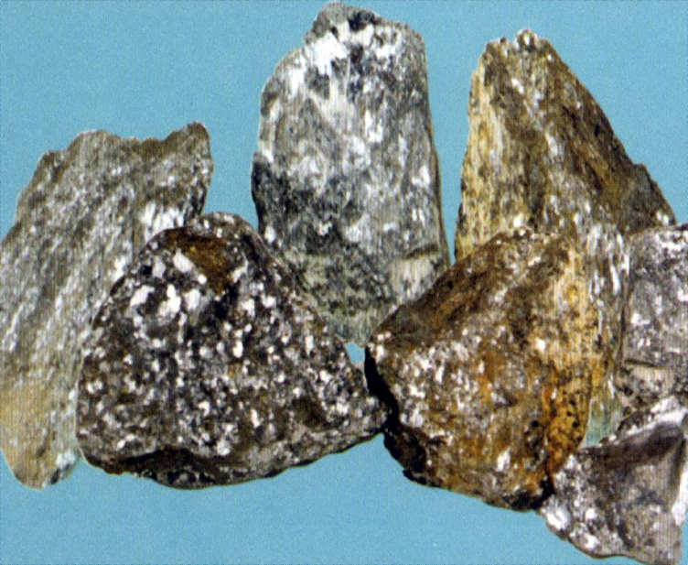
Main Products: Iron Ore
Iron
98% of iron ore are used to make steel
Major producers of iron ore include Australia, Brazil, China, Russia and India
Trade OTC

Slide 31
Iron OreProductions
COUNTRY | PRODUCTION (2009 mmT)
China | 880
Australia | 394
Brazil | 300
India | 245
Russia | 92
Ukraine | 66
South Africa | 55
Iran | 33
Canada | 32
US | 27

Slide 32
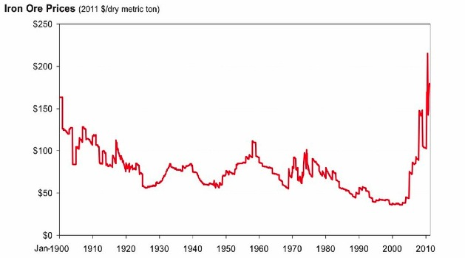
Iron Ore Prices

Slide 33

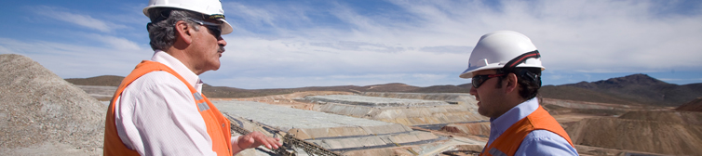


Slide 34

Company Overview
A Canadian mining company, began as Gold Mining company
It was formed from the amalgamation of Teck and Cominco in 2001 and rebranded as Teck in 2009.
In 2009, China Investment Corporation bought a 17% stake in Teck for C$1.74bn.
13 mines in Canada, the USA, Chile and Peru
Coal, copper and zinc sales represent 95% of revenue in 2010

Slide 35


Executives
Norman B. Keevil
Chairman of the Board
Donald R. Lindsay
President and Chief Executive Officer

Slide 36
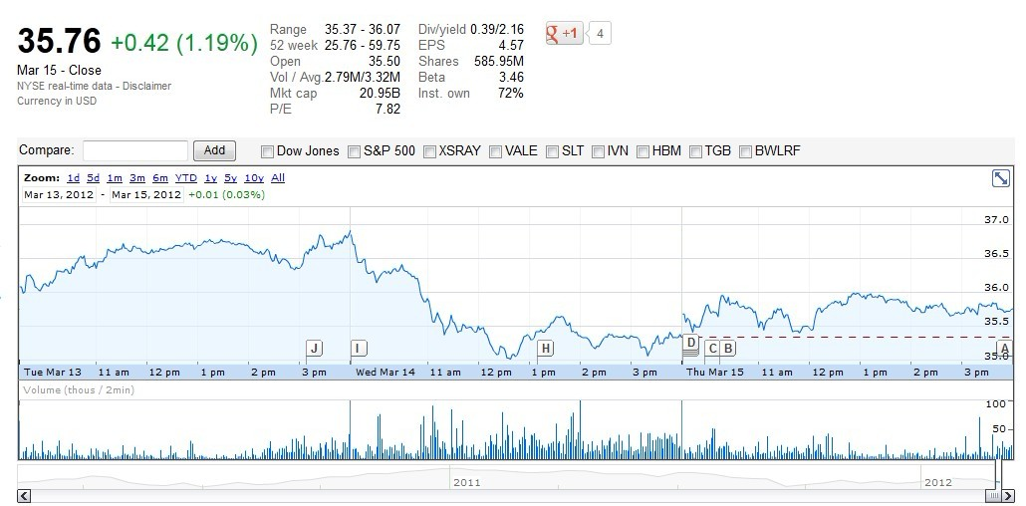
Stock Price

Slide 37
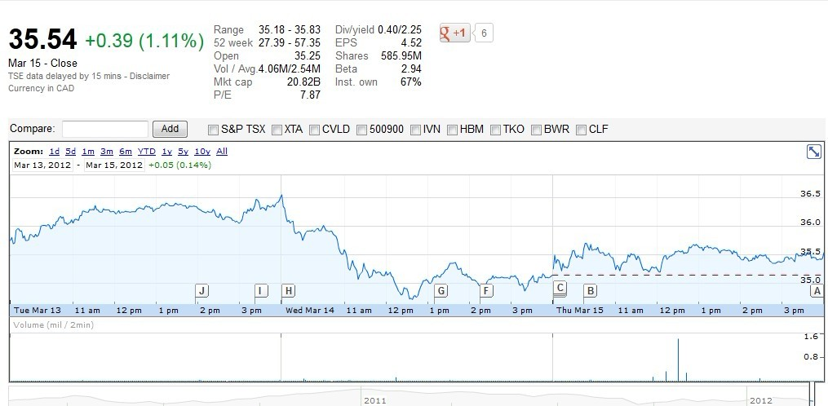

Slide 38
Operation Segments
Principle Product
Copper
Coal
Zinc
Other Product
Lead
Molybdenum

Slide 39
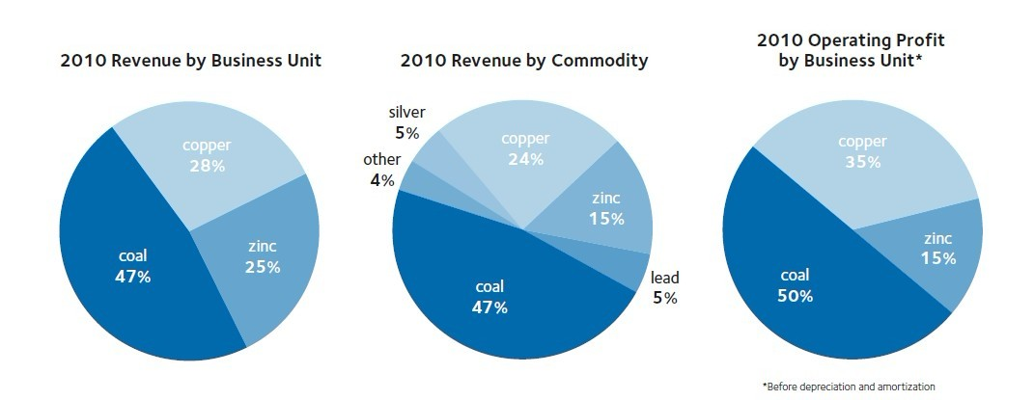

Slide 40
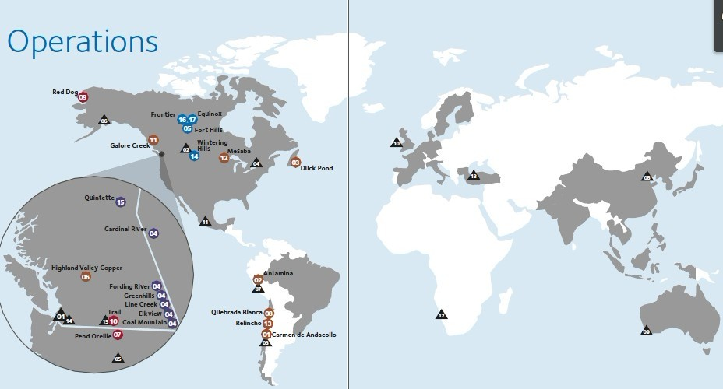
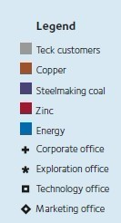
Operation Location

Slide 41
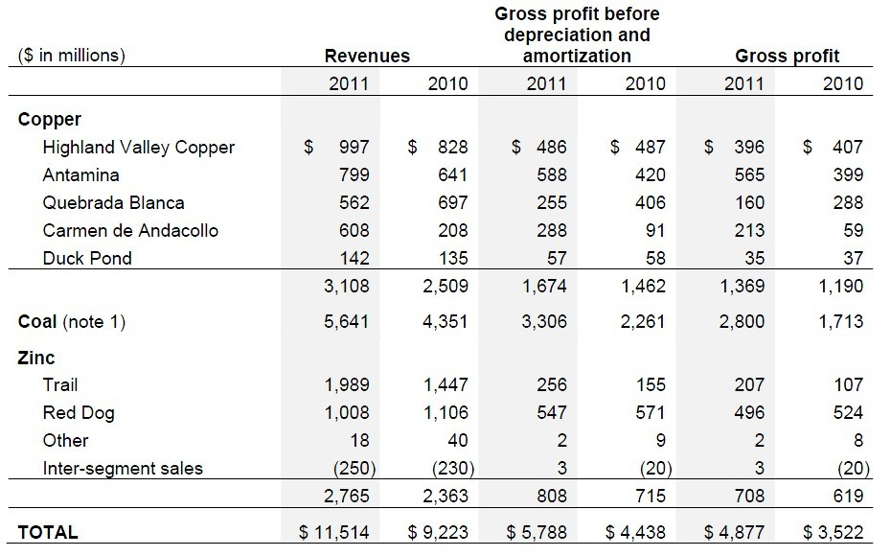
Segment Revenue

Slide 42
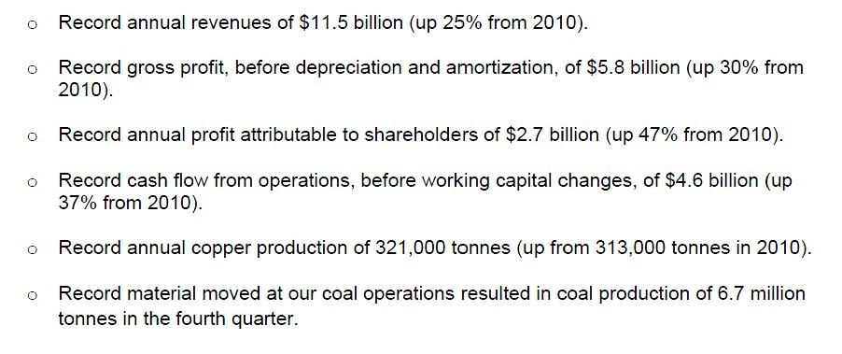
Financial & Operation Highlights

Slide 43
Risk Management Philosophy
They use foreign exchange forward contracts, commodity price contracts and interest rate swaps. They do not have a practice of trading derivatives. The use of derivatives is based on established practices and parameters, which are subject to the oversight of our Hedging Committee and our Board of Directors.

Slide 44
Risk Management Philosophy
Capital risk management objectives:
over the medium and long term, a target debt to debt plus equity ratio of less than 30%, and a target ratio of debt to EBITDA of below 2.5.

Slide 45
Financial Risk Factors
commodity price risk,
foreign exchange risk,
interest rate risk,
liquidity risk,
credit risk,

Slide 46
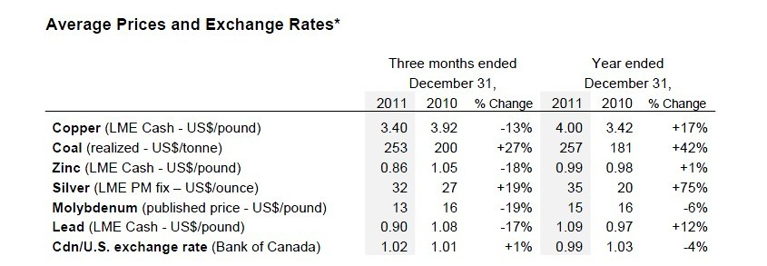
Commodity Price Risk
Use commodity price contracts to manage exposure to fluctuations in commodity prices.

Slide 47
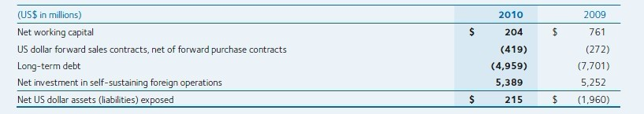
Foreign Exchange Risk
It operate on an international basis and therefore, foreign exchange risk exposures arise from transactions denominated in a foreign currency. Its
foreign exchange risk arises primarily with respect to the US dollar

Slide 48
Interest Rate Risk
Arises from cash and cash equivalents.
Its interest rate management policy: borrow at fixed rates. However, floating rate funding may be used to fund short‑term operating cash flow requirements or, in conjunction with fixed to floating interest rate swaps, be used to offset interest rate risk from our cash assets.

Slide 49
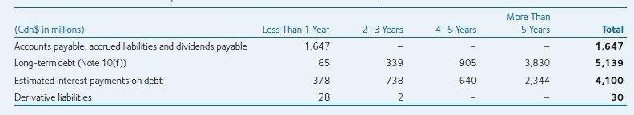
Liquidity Risk
Liquidity risk arises from general and capital financing needs. It has planning, budgeting and forecasting processes to help determine funding requirements to meet various contractual and other obligations.

Slide 50
Credit Risk
Credit risk arises from the non‑performance by counterparties of contractual financial obligations.
Manage credit risk for trade and other receivables through established credit monitoring activities
Maximum exposure: carrying value of our cash and cash equivalents, receivables and derivative assets

Slide 51
Derivative Financial Instruments and Hedges
Interest Swap
marketable equity securities,
fixed price forward metal sales contracts
settlements receivable
settlements payable

Slide 52
Derivative Financial Instruments and Hedges
Sales and Purchases Contracts
The majority of its metal concentrates are sold under provisional pricing arrangements where final prices are determined by quoted market prices in a period subsequent to the date of sale.
Revenues are recorded at the time of sale, which usually occurs upon shipment, based on forward prices for the expected date of the final settlement.
Notes:
Metal concentrates for smelting and refining operations are purchased under similar arrangements.
Adjustments to the balance of our concentrate receivables and payables from changes in underlying market prices affect revenue or operating costs as
appropriate. The effect of these adjustments on earnings is mitigated by the effect that changing commodity prices have on price participation clauses in
the concentrate sales agreements, royalties and taxes.

Slide 53
Derivative Financial Instruments and Hedges
Prepayment Rights On Notes Due 2016 and 2019
2016 and 2019 notes include prepayment options that are considered to be embedded derivatives.
At December 31, 2010 these prepayment rights are recorded as other assets on the balance sheet

Slide 54
Derivative Financial Instruments and Hedges
Cash Flow Hedges
At December 31, 2010, US dollar forward sales contracts with a notional amount of $427 million remained outstanding.
Most of these contracts have been designated as cash flow hedges of a portion of future cash flows from anticipated US dollar coal sales.
Unrealized gains and losses: recorded in other comprehensive income.
Realized gains and losses: recorded in revenue.

Slide 55
Derivative Financial Instruments and Hedges
Economic Hedge Contracts
Zinc and lead forward sales contracts
Use lead forward sales contracts to mitigate the risk of price changes for a portion of sales.
Do not apply hedge accounting to commodity forward sales contracts.

Slide 56
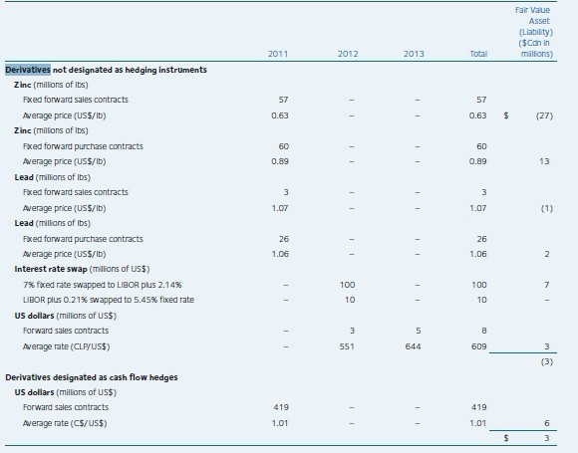
Outstanding Derivative Positions

Slide 57
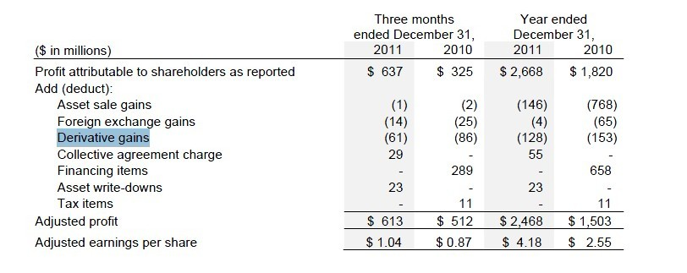
Effect of Hedging Activities

Slide 58
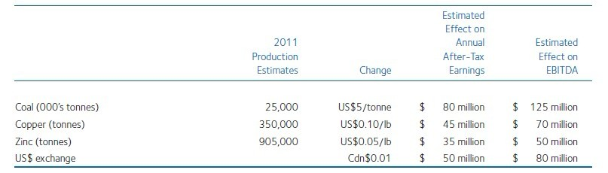
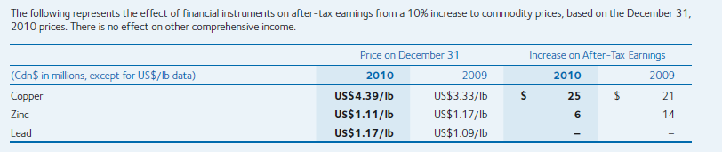
Sensitivity Analysis

Slide 59
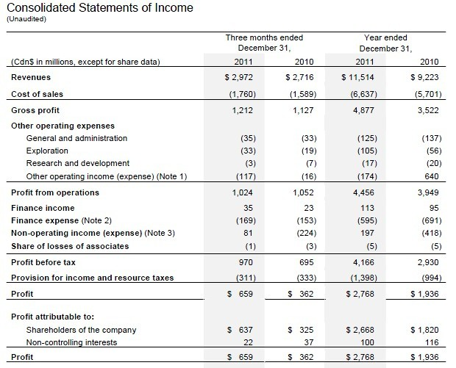
Financial Statement

Slide 60
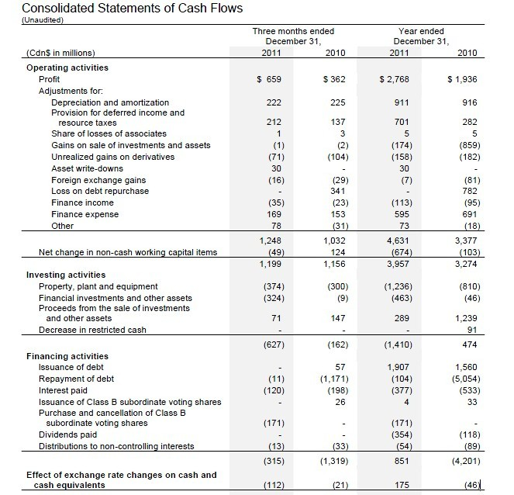

Slide 61
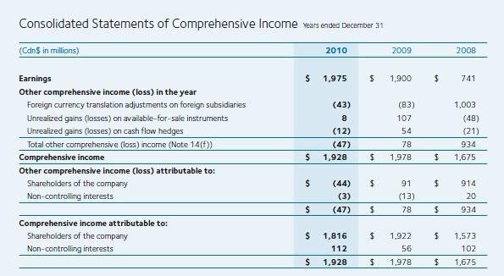

Slide 62
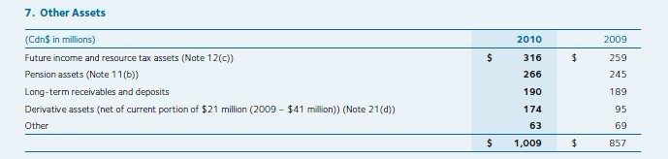



Slide 63



Barrick Gold

Slide 64

Company Overview
Barrick Gold is the largest gold producer in the world
Founded in 1983 by Peter Munk, CC
Headquartered in Toronto, Canada
Has 4 regional business units (RBU's) located in Australia, Africa, North America and South America
Revenue $10.924 Billion (2010)
Net income $3.274 Billion (2010)
Notes:
African Barrick Gold is created as separate company to hold assets in Tanzania. African Barrick Gold is listed in London Stock Exchange
Engages in both mining and exploration

Slide 65

Summary of Financial Performance

Slide 66
Mines and reserves
26 operating mines in Saudi Arabia, Papua New Guinea, the United States, Canada, Dominican Republic, Australia, Peru, Chile, Russia, South Africa, Pakistan, Colombia, Argentina and Tanzania (under African Barrick Gold) .
Largest reserves in the industry:
140 million ounces of proven and probable gold reserves,
6.5 billion pounds of copper reserves
1.07 billion ounces of silver (contained within gold reserves) as of December 31, 2010.

Slide 67

Mine map
Notes:
the Zaldivar mine in Chile is specifically for copper
-both its copper and silver productions can be found in N.A., S.A., and African mines.
-We also produce significant amounts of copper and have significant silver reserves contained within our gold reserves at our Pascua-Lama project.

Slide 68


Operations
2010 production: 7.8 million ounces of gold at total cash costs of $457 per ounce or net cash costs of $341 per ounce
2011 production: 7.68 million ounces of gold at total cash costs of $460 per ounce or net cash costs of $339 per ounce
The Company is targeting 9.0 million ounces within five years
2011 gold production by region: 2011 gold reserves by region:
Notes:
Net cash costs = total cash cost – full credit for non-gold sales basis (reflects copper prices)

Slide 69

Gold cash cost comparison

Slide 70

Gold reserves comparison

Slide 71


Stock price - NYSE

Slide 72


Stock price - TSE

Slide 73
In The Past

Slide 74
In the past....
Barrick’s has engaged in heavy hedging activities previously (No.1 hedger in Gold industry)
The following slides are presented in Sep 2002 by Ammar Al-Joundi, VP and Treasurer who noted that: “Nobody is buying gold for $345/oz.”

Slide 75

In the past...

Slide 76

In the past...

Slide 77

In the past...

Slide 78
Back to TODAY

Slide 79


Slide 80
Financial strength
‘A’ rated balance sheet
 ~$2.9 B of cash and undrawn revolver capacity of $1.0 B at Q2 2011
 Strong operating cash flow (OCF) generation – 2010 adjusted OCF of ~$4.8 B and EBITDA of ~$5.9 B (at $1,228/oz gold) – H1 2011 adjusted OCF of ~$2.4 B and EBITDA of ~$3.9 B (at $1,452/oz gold)
Notes:
S&P

Slide 81
Goals for Currency and Commodity Risk Mgmt
 Protection against rising prices
 Greater certainty and predictability of costs / guidance
 Multi-year coverage
 Opportunistic program – not trying to “beat the market” – take advantage of market sell-offs/dislocations, forward discounts/backwardations – assess market/commodity correlations
– strong credit
– ability to react quickly
– primarily fixed-price forward contracts
 Competitive advantage for Barrick

Slide 82
Risk exposures
Gold & copper prices
Foreign exchange rates
Operation and project development
Licensing and political risks

Slide 83
Risk exposures – gold & copper price
“The market prices of gold and copper are the primary drivers of our profitability and our ability to generate free cash flow for our shareholders. “
“The prices of gold and copper are subject to volatile price movements over short periods of time and are affected by numerous industry and macroeconomic factors that are beyond our control.”

Slide 84
Risk exposure – foreign exchange risk
The largest single exposure is the Australian dollar/US dollar exchange rate.
Other exposures: Canadian dollar (Canadian mine operating costs and corporate administration costs) Chilean peso (Pascua-Lama project and Chilean mine operating costs) Papua New Guinea kina Peruvian sol Zambian kwacha Argentinean peso

Slide 85
Risk exposures – political issue
Governments that are facing fiscal pressures may result in a search for new financial sources, and there is possibility of higher income taxes and royalties.
On November 15th, 2011 the Government of Balochistan rejected the mining lease application for our Reko Diq copper-gold project in Pakistan. The investment in Reko Diq has carrying value of $121 million.
Notes:
e.g.: The Australian Mineral Resources Rent Tax (“MRRT”), which if enacted will apply from July 1, 2012. currently not applicable to gold but is extending.
After 2010 earthquake, the Chilean government enacted a temporary first tier income tax increase from 17% to 20% in 2011 and 18.5% in 2012 as well as a new elective mining royalty. The temporary tax increase and royalty caused the company $18 million and $8 million respectively, on 2011 income tax expense.
The Peruvian government enacted new tax legislation, effective October 1, 2011, which will apply specifically to mining operations. It caused the company $12 million in fourth quarter 2011 on income tax expenses.
Zambia tax increases…
Australian carbon tax…

Slide 86
Risk exposures – others
Operating: volume and/or grade of ore mined could differ from estimates;
Litigation risk, the regulatory environment
the impact of global economic conditions.
Mining rates are impacted by various risks and hazards inherent at each operation, including natural phenomena such as inclement weather conditions, floods and earthquakes, and unexpected civil disturbances, labor shortages or strikes.
Notes:
e.g.: The Australian Mineral Resources Rent Tax (“MRRT”), which if enacted will apply from July 1, 2012. currently not applicable to gold but is extending.
After 2010 earthquake, the Chilean government enacted a temporary first tier income tax increase from 17% to 20% in 2011 and 18.5% in 2012 as well as a new elective mining royalty. The temporary tax increase and royalty caused the company $18 million and $8 million respectively, on 2011 income tax expense.
The Peruvian government enacted new tax legislation, effective October 1, 2011, which will apply specifically to mining operations. It caused the company $12 million in fourth quarter 2011 on income tax expenses.
Zambia tax increases…
Australian carbon tax…

Slide 87
Enterprise Risk Management
Enterprise risk management process identifies, evaluates and manages company-wide risks
“All risks and associated mitigation plans are reported through our business units and corporate functional leaders. These risks are reviewed, consolidated, ranked and prioritized by senior management. An analysis is performed to ensure there is proper assessment of risks that may interfere with achieving our strategic objectives. “

Slide 88
Enterprise Risk Management
Human resource: Our ability to attract and retain staff with critical mining skills affects our ability to deliver on our strategic objectives, move on opportunities and provide resources for our projects.
Reserve depletion: We must continually replace reserves depleted by production to maintain production levels over the long-term.
Project delay risk: Our significant capital projects represent a key driver to our plans for future growth and the process to bring these projects into operation may be subject to unexpected delays that could increase the cost of development and the ultimate operating cost of the relevant project.

Slide 89
Enterprise Risk Management
License risk: In order to maintain our license to operate, it is essential that we:
Ensure every person goes home safe and healthy every day;
Actively review talent and develop people for the future;
Manage our reputation proactively;
Are a partner welcomed in the communities where we operate;
Protect the environment;
Maintain good relations with governments and other stakeholders;
Comply with all regulatory standards; and
Conduct our business in an ethical manner.

Slide 90
Strategy
Gold: anticipating continuous strong demand – NOT hedging
Copper: floor protection on half of expected 2012 copper production at $3.75 per pound (with full upside potential) Hedging costs on copper option is $0.13 per pound on all 2012 copper production.
Silver: option collar strategies on 45 million ounces of expected silver production from 2013 to 2018, inclusive, with floor price of $23 per ounce and ceiling price of $57 per ounce.
Notes:
due to sovereign debt concerns and very accommodative monetary policies by some of the world’s most prominent central banks, resulting in gold performing its traditional role as a store of value and an alternative to fiat currency. The continuing uncertain macroeconomic environment and loose monetary policies, together with the limited choice of alternative safe haven investments, is supportive of continued strong investment demand.
Exchange Traded Funds (“ETFs”), which increased by 5 million ounces to a total of 77 million ounces
Silver: Pascua-Lama project (between Chile and Argentina)

Slide 91


Slide 92
Strategy - Currency Exchange Rates
For 2011, $24 million hedge gains is recorded in corporate administration cost and additional $64 million hedge gains is capitalized
Hedged: AUD $1.7 billion at $0.81 CAD $500 million at $1.01 CLP $300 billion at 516
Assuming Dec 31, 2011’s exchange rate, $300 million gain is expected in 2012

Slide 93



Slide 94



Slide 95
Strategy - fuel
Fuel: 5.0 million barrels
In 2011, fuel hedging positions generates $48 million earnings.
Assuming the market rate at Dec 31, 2011, $20 million gain is expected to realize in 2012.

Slide 96



Slide 97
Strategy – US interest rate
Exposures:
Interest receipts on cash balances ($2.7 billion at the end of the year);
the mark-to-market value of derivative instruments;
the fair value and ongoing payments under US dollar interest-rate swaps;
the interest payments on our variable-rate debt ($3.6 billion at December 31, 2011)

Slide 98

Financial instruments

Slide 99

Risk-management related financial statements items

Slide 100

Consolidated Statements of Income

Slide 101

Corresponding notes

Slide 102

Consolidated Statements of Cash Flow

Slide 103

Consolidated Balance Sheet

Slide 104

Corresponding Notes

Slide 105

Corresponding Notes

Slide 106

Corresponding Notes

Slide 107

Consolidate Statement of Equity

Slide 108

Consolidated Statement of Comprehensive Income

Slide 109

Corresponding Notes

Slide 110

Sensitivity analysis

Slide 111

xstrata

Slide 112

Company Overview
Xstrata is one of the largest diversified mining companies in the world and it’s headquartered in Zug, Switzerland.
March 2012 marks the tenth anniversary of the creation of Xstrata plc.
Xstrata has employ over 70,000 people in more than 20 countries.
Current market value around $60 billion.
Xstrata primary listing on London and Swiss Stock Exchange.
Notes:
Our mantra from the start has been an unerring focus on value and our shareholders have enjoyed total returns of some 370% since our IPO in March 2002, compared to 54% for the FTSE100 index overall.

Slide 113

Operation
Notes:
A global and diversified natural resource super major
with reach, scale and diversity
18 commodities, operations in 33 countries, marketing in 40 countries, 101 mines, 25
smelters, 31 concentrators, significant logistics, 130k employees with 2.7k in marketing

Slide 114
News: Xstrata-Glencore Deal
Glencore and Xstrata Deal: massive merger.
This merger would be worth $90 billion mining entity.
Create the worlds fourth largest natural resources company
This creates a, fully integrated along the commodities value chain, from mining and processing, storage, freight and logistics, to marketing and sales.
Notes:
Key advantage to over his competitors
Glencore commodities trading company, sells product market and trades them.
Good for Glencore when they have physical asstes they could maket profit forom arbitrage and shortage.

Slide 115

Notes:
A unique business model to capture value in a
changing landscape
Significant presence across the entire value chain
Strong advantage for Xstrata

Slide 116

Notes:
At close on 6 February the implied value
of Xstrata based on a 2.8 ratio was:
– 1290p per share (US$60.5bn market
capital)
• 15% higher (+US$7.9bn) versus 1
February*
• 28% higher (+US$13.7bn) versus
three month average to 1 February
• Credit default swap spreads narrowed
c.90bps for Glencore and c.18bps for
Xstrata on announcement
– Moody’s commented that “the
transaction, if it goes ahead, would be
credit positive for both companies”(1)

Slide 117

Share Price

Slide 118
Financial Highlights
Operating EBITDA* of $11.6 billion, up 12%
Attributable profit* of $5.8 billion, up 12%
Final dividend of 27¢ per share proposed, bringing the full year dividend to 40¢, a 60% increase on 2010
Notes:
Divident increases indicated the company attractiveness increases in the eyes of the investor.
the stock price tends to increase. Benefit investors and attractive more investor.
(divident provide a source of income and benefit them from the tax credit).

Slide 119


Slide 120

Notes:
Operational EBITDA pre-exceptional items
We can see a strong performance in coal. Nickel, and copper.

Slide 121
Operational Highlights
Dow Jones Sustainability Index Sector Leader for fifth consecutive year
Real cost savings of $391 million, moving all commodity businesses into lower half of industry cost curves
Continued improvement in safety and environmental performance; 26% improvement in total recordable injuries versus 2010
Notes:
are a family of indexes evaluating the sustainability performance of the largest 2,500 companies listed on the Dow Jones

Slide 122

Financial Review

Slide 123
Financial Review
Base on Alloys, Coal, Copper, Nickel, Zinc, and other commodity.
Notes:
In 2011, they achieved record EBITDA of $11.6 billion and the highest net earnings of $5.8 billion in our history. Operating profit rose by 10% to $8.4 billion.
The record result was due to increased volumes, cost savings and higher commodity prices which outweighed some significant headwinds from adverse currency movements and ongoing regional and mining-specific inflationary pressures.

Slide 124

Commodity prices changes
Notes:
Commodity prices began 2011 strongly, responding well to returning confidence in the US, a positive outlook for continued Chinese growth and ongoing supply constraints across our commodities.

Slide 125

Currency Changes
Notes:
2011, adverse exchange rates in our major producing regions against the US dollar dampened the positive impact of higher average commodity prices. The Australian dollar, South African rand and Canadian dollar were all stronger relative to the US dollar, resulting in an increase in costs of $820 million.

Slide 126


Notes:
Xstrata’s operations generated record cash flows of $11.3 billion in 2011, an increase of 14% on 2010, due to a strong operational performance and improved commodity prices. Net debt in the period increased by $511 million, or 7% to $8.1 billion, as we increased our investment in expansionary capital projects. Cash tax payments increased by 15% to $1,664 million due to higher earnings.

Slide 127
Risk Management Philosophy
“Our approach to risk management is value driven. A structured and comprehensive risk management system has been implemented across our businesses”
“The Objective of our risk management system is to ensure an environment where we can confidently grow shareholder value and pursuer business opportunities while developing and protecting our people, our assets, our environment and our reputation”
Notes:
Risk is an intrinsic aspect of business and is inseparable from opportunity. It is our ability to pursue opportunity with enthusiasm, entrepreneurial flair and innovation, secure in the knowledge and confidence that we have effectively identified and managed the associated risks that determines our success.
using a consistent framework and methodology to seek and exploit opportunities to create benefits while managing the potential downsides, therefore ensuring that shareholder value is created and enhanced.

Slide 128
Financial Risk Factors
Commodity price volatility
Fluctuations in currency exchange rates
Credit Risk
Liquidity risk
Interest rate risk

Slide 129
Commodity Price Risk
Impact on operating profit.
Reduce impact by:
maintain a diversified portfolio of commodities.
do not implement large-scale strategic hedging or price management initiatives.
Notes:
Xstrata’s revenue and earnings are dependent on prevailing commodity prices which are determined by the supply of, and demand for, raw materials and are closely linked to global economic growth. Commodity prices for all products, and particularly for exchange-traded commodities, may fluctuate widely.
aim to reduce costs on a continuous basis and maintain low cost, efficient operations, optimising our portfolio and returns throughout the commodity price cycle.

Slide 130
Currency Exchange Risk
Xstrata’s products are generally sold in US dollars.(data next slide)
Operations costs are spread across several different countries.
Notes:
in particular movements in the Australian dollar, Canadian dollar and South African rand against the US dollar, may have a material impact on Xstrata’s financial results or affect our investment rating.

Slide 131

Currency Exchange Risk
Notes:
CPI inflation, predominantly in Canada and Argentina, further reduced operating profit by $102 million and adverse local currency exchange rates against the US dollar, predominately in Australia and Canada, had a $164 million impact

Slide 132
Currency Exchange Risk
To reduce the risk:
maintain a diversified portfolio of assets across several different geographies and operating currencies.
Using currency cash flow hedging
Notes:
reducing the impact of movement in any one commodity price.
cash flow hedging may be used to reduce our short-term exposure to fluctuations in the US dollar against local currencies. (Forward contracts)

Slide 133


Slide 134


Slide 135

Sensitivity Analysis
Notes:
If the US$ had gained (lost) 5% against all currencies significant to the Group, the impact would have been:

Slide 136
Credit Risk
The Group's financial assets include cash on hand, trade and other receivables and investments.
Major exposure to credit risk is in respect of trade receivables.
Notes:
Counter-parties are assessed prior to, during, and after the conclusion of transactions to ensure exposure to credit risk is limited to an acceptable level.
Given the geographical industry spread of the Group’s ultimate customers and the solvency of major trade debtors, credit risk is believed to be limited. (Report2010 page210)

Slide 137
Liquidity Risk
The risk that the Group may not be able to settle or meet its obligations on time or at a reasonable price.
Liquidity risk, including funding, settlements, related processes and policies, the Group’s Treasury Department is responsible.
Manage the risk by consolidated basis utilising various sources of finance to maintain flexibility while ensuring access to cost-effective funds when required
utilises both short- and long-term cash flow forecasts and other consolidated financial information to manage liquidity risk
Notes:
(2010report page211)

Slide 138
Interest rate risk
Promarily as a result of exposures to movements in LIBOR.
Limited amount of fixed rate hedging or interest rate swaps may undertaking.
Notes:
Page212(2010) It is the Group’s preference to borrow and invest at floating rates of interest, notwithstanding that some borrowings are at fixed rates.

Slide 139
Derivative Instruments
Currency swaps
Currency cash flow hedging
Forward currency contract
Forward commodity contracts
Interest rate swaps
Notes:
Such derivative financial instruments are initially recognised
at fair value on the date on which a derivative contract is entered
into and are subsequently remeasured at fair value. Derivatives are
carried as assets when the fair value is positive and as liabilities when
the fair value is negative.
(2011 page 12)
Our revenues are generally denominated in US dollars. As a result, we typically source debt capital in US dollars, either directly or by borrowing in other currencies and swapping them into US dollars.
From time to time we also use currency cash flow hedging to reduce our short-term exposure to fluctuations in the US dollar against local currencies. We realised currency hedging gains for the year of $86 million, reflected in the income statement. These gains are related to coal sales for which prices were contractually fixed. We did not enter into any strategic, long-term base metals hedging contracts in the year.

Slide 140


Slide 141
Hedging strategy
Fair value hedges
Cash flow hedges
Hedges of a net investment
Notes:
Fair value hedges are hedges of the Group’s exposure to changes in
the fair value of a recognised asset or liability that could affect profit
or loss. The carrying amount of the hedged item is adjusted for
gains and losses attributable to the risk being hedged, the derivative
is remeasured at fair value, and gains and losses from both are taken
to profit or loss.

