Slide 1
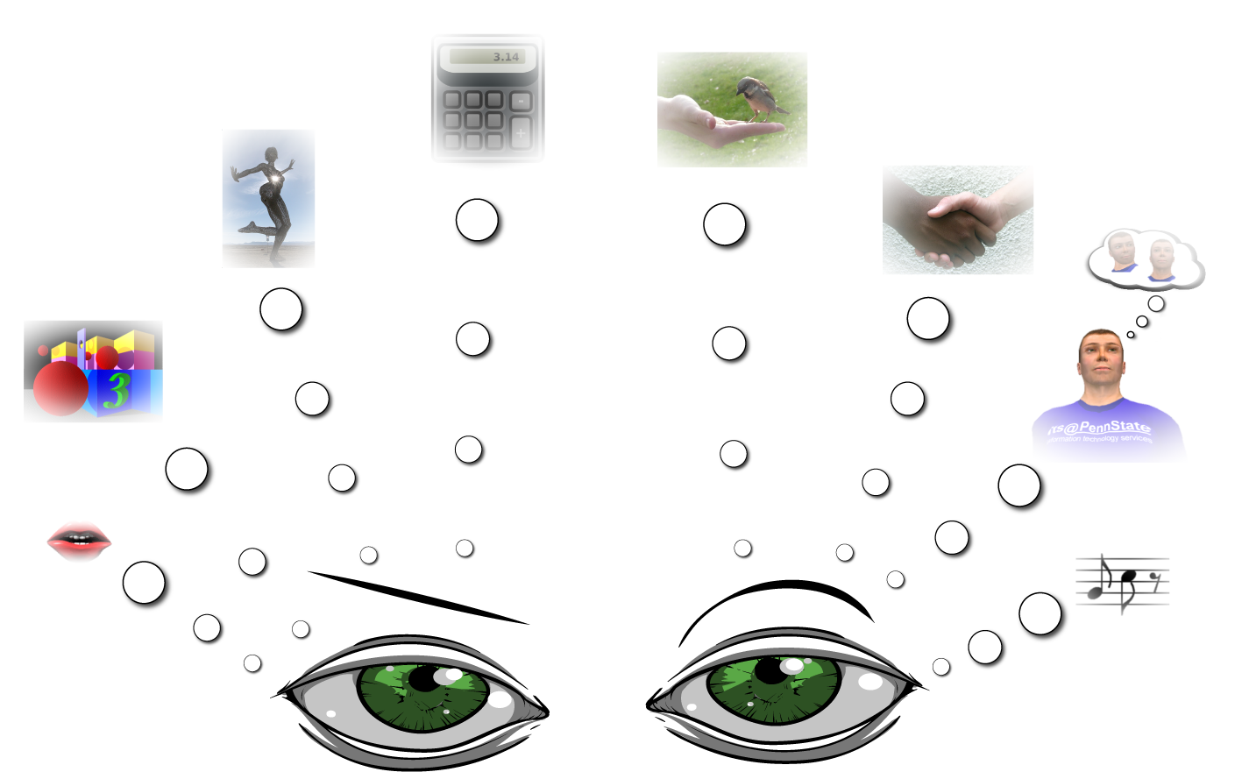

In the name of the most intelligent
TESL CANADA 2012 CONFERENCE
THOMPSON RIVERS UNIVERSITY
Applying the Theory of Multiple Intelligences in Teaching Vocabulary to Iranian Beginner EFL Learners
PRESENTER: NAJI KHODASHENAS
Oct- 2012
NAJIKHODASHENAS@YAHOO.COM
NAJIKHODASHENAS@GMAIL.COM

Slide 2

Presenter Biography
Naji Khodashenas Firouzabadi
7 7 77
Married , 1 little boy
BA: Mining engineering – Exploration
MA: TEFL
MBA and Post MBA
Finishing DBA
Life guard in swimming pools and open water diver (PADI)
Love : Learning and Teaching

Slide 3
IS THERE ANY QUESTION BEFORE
I START?

Slide 4
What we will discuss…
First Part : Introduction of the MI theory
Second Part : The applying of this theory in TEFL

Slide 5
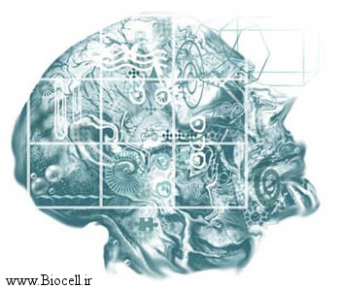
Introduction
Alfred Binet’s view toward intelligenece
Individual Differences
Howard Gardner’s view toward intelligenece

Slide 6
A prize!
for who knows ….

Slide 7
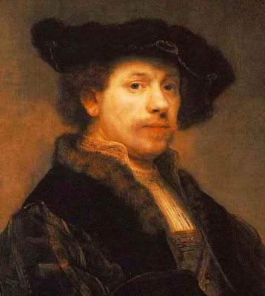
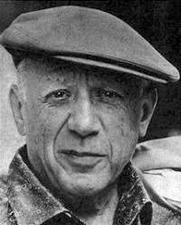
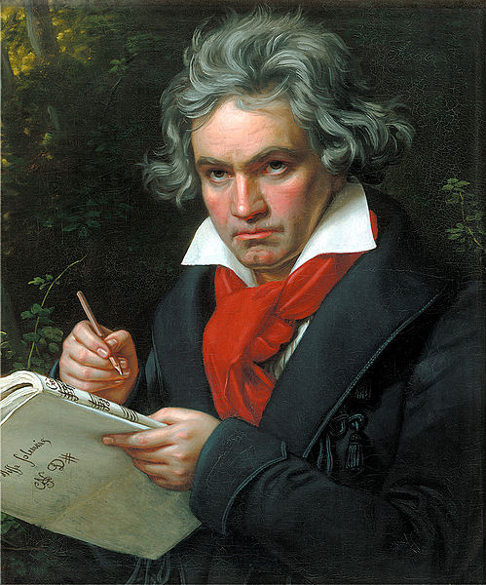
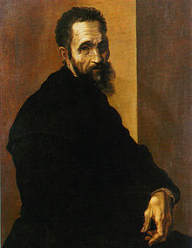
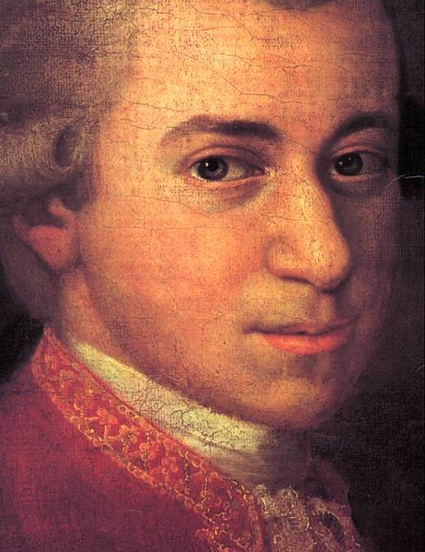
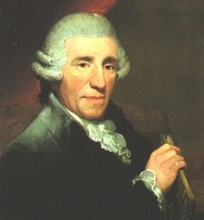
Michelangelo di Lodovico Buonarroti Simoni - Italy
(1475 – 1564)
Pablo Picasso - Spain
(1881-1973)
Rembrandt van Rijn - Netherland
(1606 - 1669)
Franz Joseph Haydn – Austria (1732-1809)
Ludwig van Beethoven – Germany (1770-1827)
Leopold Mozart - Italy (1719–1787)

Slide 8
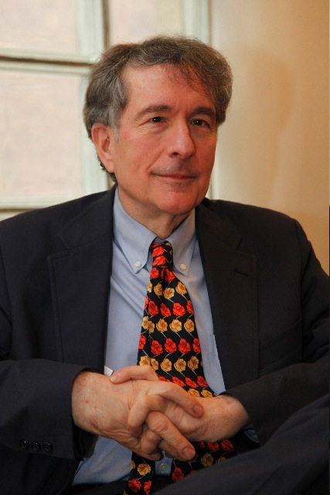
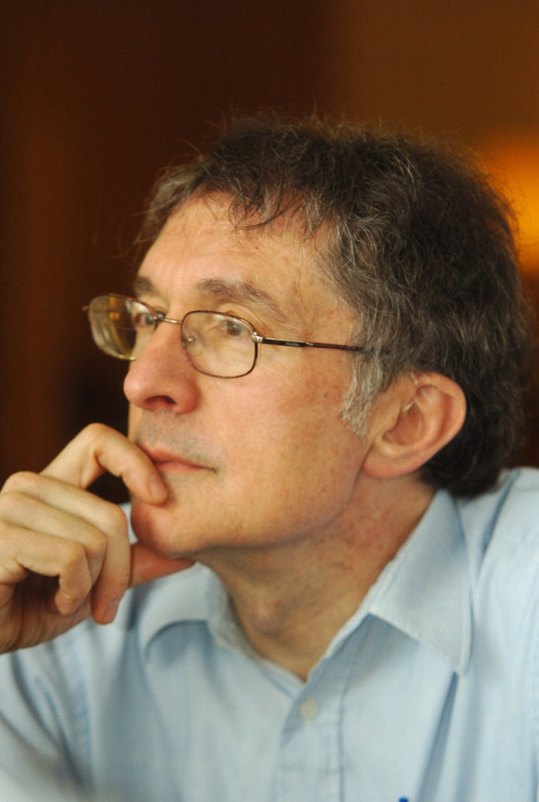
Gardner’s Theory of Multiple Intelligences (1983)

Slide 9
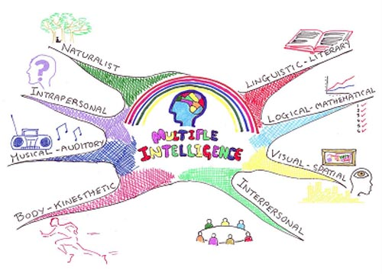
. . .Multiple Intelligences

Slide 10
Definition of Key terms
Intelligence : Intelligence is defined as "the capacity to solve problems or to fashion products that are valued in one or more cultural setting.” (Hatch & Gardner, 1989, p85, cited in Armstrong, 2000)
MDI : More dominant intelligence of each learner, based on the MIDAS test
Musical type learners : The learners with more dominant intelligence in music, as determined by the MIDAS test results
Pictorial type learners: The learners with more dominant intelligence in pictures, as determined by the MIDAS test results

Slide 11
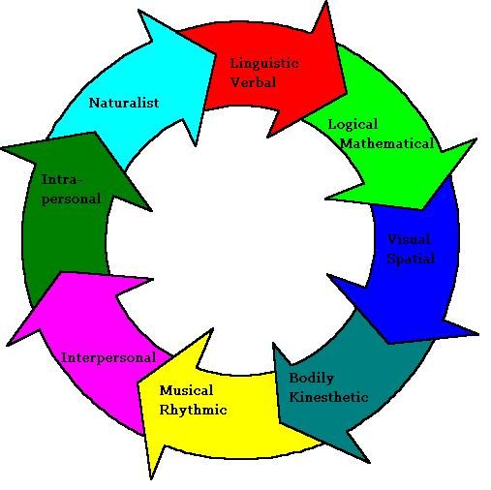
. . . Multiple Intelligences

Slide 12
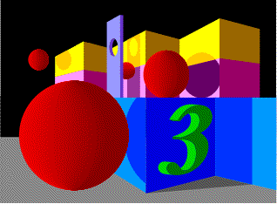
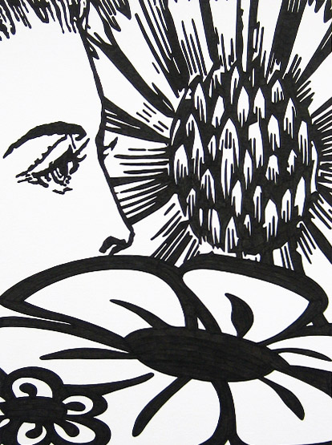
1. Spatial intelligence (Pictorial Int.)
Perceiving the world visually
Preferred way of communication is
through out the pictures and photos
Preferred jobs: interior decorator, architect, artist, painter
Pictorial Memory

Slide 13

2. Linguistic intelligence
The capacity to use words effectively, whether orally or in written form
Influential auditors
Lawyer, reporter, Novelist

Slide 14
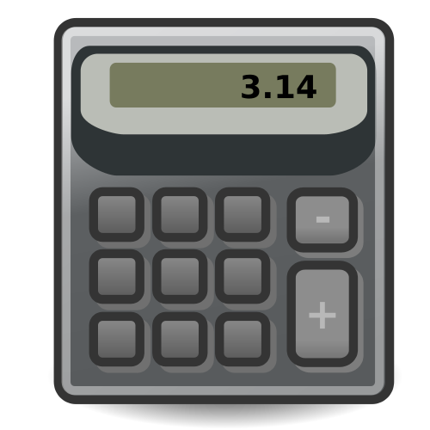
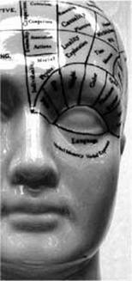
3. Logical-mathematical intelligence
The capacity to use numbers effectively
Mathematician, tax accountant, or statistician
Well Reasoning ability
Scientist, computer programmer, or logician

Slide 15
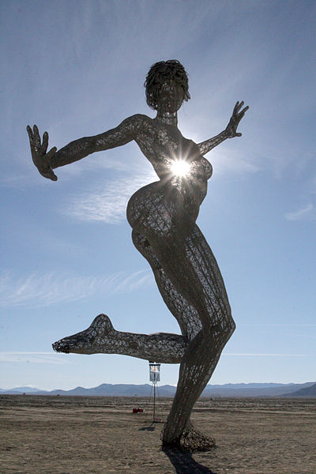
4. Bodily-Kinesthetic intelligence
Expertise in using one's whole body to express ideas and feelings
Actor, Dancer, Athlete
Craftsperson, a sculpture, mechanic

Slide 16

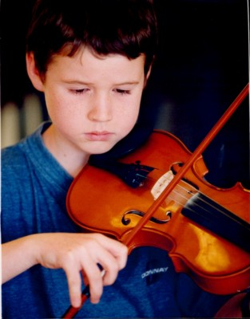
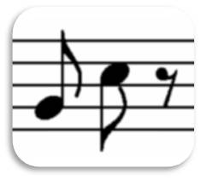
5. Musical intelligence
The capacity to perceive and work with musical aspects
Musicians, Composer
Musical memory

Slide 17

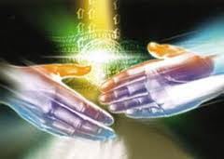
6. Interpersonal intelligence
Understanding other people’s mood
Making effective communications
Conveying meaning and concepts to others
The role of this type of intelligence in successfulness of teachers …
Public relations , Negotiators, Sellers, teachers ( Moafin survey)

Slide 18
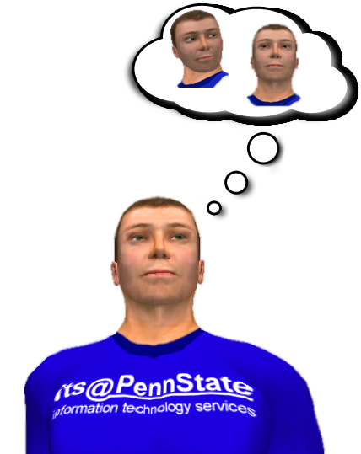
7. Intrapersonal intelligence
Self awareness
Self Control
A golden key for Poseidon Archetypes (Emotional peoples) to become successful
Actors and actresses

Slide 19
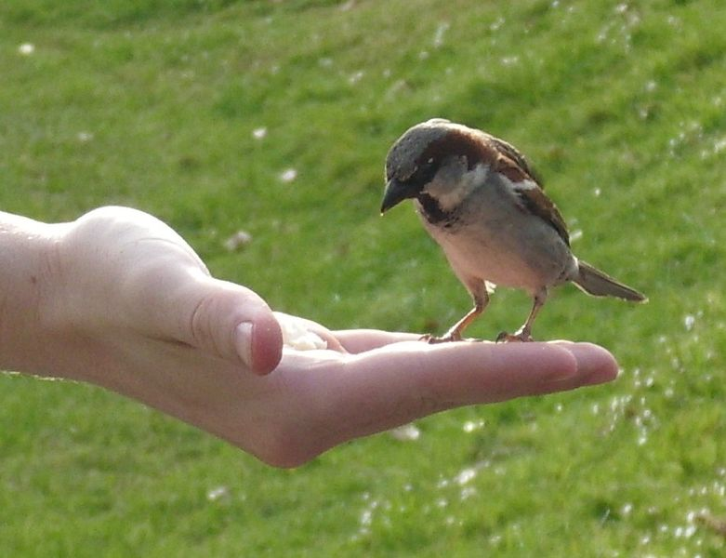
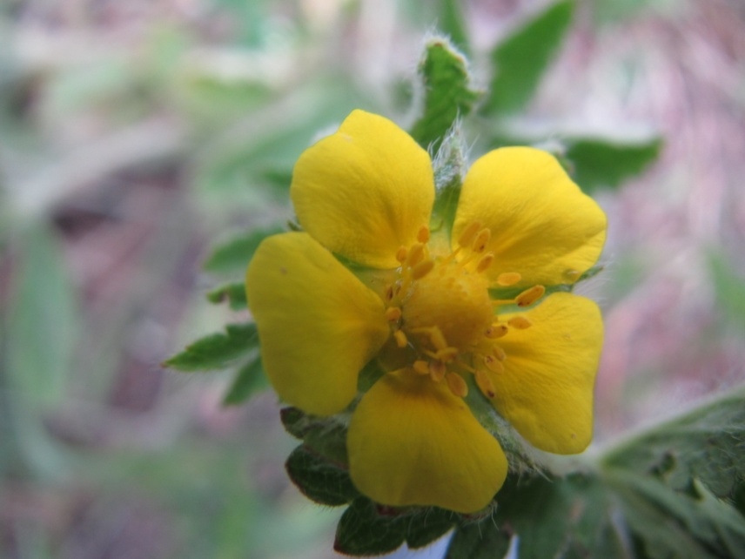
8. Naturalistic intelligence
Loving the nature
Trees, Animals, Deserts, Sea, Ocean, Mountain
Feeling and becoming relax at the nature

Slide 20
Paradigm Shifting toward Intelligence
New Paradigm | Old Paradigm
The intelligences could be nurtured or neglected The intelligence could not be measured exactly by scores and would be outperformed in the problem solving procedure only.. The intelligence has different types and different students have different level of each intelligences and consequently different level of efficiency in each area The intelligence should be measured in real life (Authenticity of the assessment procedure) Self awareness for both teachers and students would be resulted from recognition of each person potentials | The intelligence was a constant variable for each student. The intelligence was raveled out just by a score in IQ test. Limitation in classification for students (Low, Normal and high IQ) The intelligence was measured unauthentic Non-effective teaching methods were applied for teaching ( Not in accordance with students MDI)

Slide 21
Method
Participants
Materials
Procedure

Slide 22
















Teaching strategy & the used material for pictorial students …

Slide 23

Results & Discussion
To check for the homogeneity of the two groups, the subjects were
pre-tested through KET.
The descriptive statistics for the two groups are displayed in Table 3.
Table 3: Descriptive statistics of the pre-test (KET)
 | GROUP | N | Mean | Std. Deviation | Std. Error Mean
PRETEST KET | Musical | 30 | 11.96 | 2.47028 | .45101
 | Spatial | 30 | 10.80 | 2.63138 | .48042

Slide 24
It might be claimed that the groups are homogeneous in terms of their language proficiency prior to the administration of the treatment to the groups.
The mean scores for both groups were 11.96 and 10.80, respectively. An independent t-test was run to compare the mean scores of the groups on the pre-test. As displayed in Table 4 below, the t-observed value is 1.77, lower than the critical value of t at 58 degrees of freedom.
Table 4: Independent t-test of the pre-test (KET)
 | Critical t | Observed t | Df | Sig. (2-tailed)
KET Test | 2 | 1.77 | 58 | .082

Slide 25
The homogeneity of the two groups were tested through a validated vocabulary test.
An independent t-test was run to compare the mean scores of the groups on the pre-test. As displayed in Table 5, the t-observed value was 125. This amount of t-value at 58 degrees of freedom was lower than the critical value of t. The descriptive statistics for the two groups are displayed in Table 5.
Table 5: Descriptive Statistics of the Pre-test (Vocab.)
 | GROUP | N | Mean | Std. Deviation | Std. Error Mean
PRETEST Vocab. | Musical | 30 | 6.43 | 2.20 | .40
 | Spatial | 30 | 6.36 | 1.90 | .34

Slide 26
….
Thus, it could be claimed that the groups were homogeneous in terms of their vocabulary ability prior to the administration of the treatment to the groups. The mean scores for both groups were 6.43 and 6.36, respectively.
Since there were two independent experimental groups with relevant posttest scores, two-way ANOVA repeated measure was applied to analyze the results. The descriptive statistics for the two groups are displayed in Tables 7 and 8.
Table 6: Independent t-test of the pre-test
 | Critical t | Observed t | df | Sig. (2-tailed)
Vocabulary test | 2 | .125 | 58 | .901

Slide 27
Table 7: Descriptive statistics of the groups

Slide 28
Table 8: Two way ANOVA repeated measure
Table 8: Two way ANOVA repeated measure

Slide 29
The comparisons between posttest scores were done through Post Hoc analysis. The results are reported in Table 9.
Table 9: Post Hoc tests results

Slide 30
Graphical showing the result of the Post Hoc test

Slide 31
The obtained results and Post Hoc results reveal that:
1. No statistically significant difference on vocabulary knowledge improvement between pictorial learners that had been taught through musical strategies and musical learners that received pictorial strategies
2. No statistically significant difference on vocabulary knowledge improvement of learners between applying pictorial strategies and musical strategies
3. Statistically significant difference between using teaching strategies in accordance with learners’ MDI and teaching strategies not in accordance with learners’ MDI

Slide 32
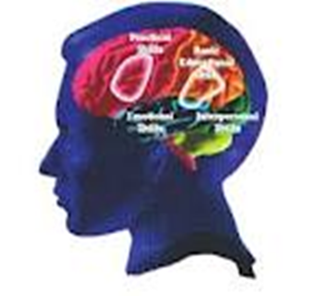
Important points about MI model and the observations
We all have all however may be one/some is/are more dominant.
The intelligences could be nurtured / neglected.
It was seen that some pictorial students can not draw however their MDI is pictorial. (WHY?)
The pictorial students draw nouns better than verbs.
The art of the teacher (as a learning facilitator) is having a full understanding of this theory and being aware of her/his students differences and consequently using a variety of teaching strategies/materials to fulfill and guarantee that all students will take benefit and enjoy from teaching materials.

Slide 33
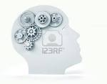
Conclusion
Becoming aware of learners’ individual differences leads to applying various teachng strategies
Understanding more easily why learners perform differently within a unique class with the same applied strategy
Designing the appropriate curriculum and come up with an effective syllabus design based on various intelligences exist among learners.
Being aware of each person competency in general and each learner competency in particular, helping to understand and focus on competencies and positive potentials consciously

Slide 34
Michelangelo di Lodovico Buonarroti Simoni - Italy
(1475 – 1564)
Pablo Picasso - Spain
(1881-1973)
Rembrandt van Rijn - Netherland
(1606 - 1669)
Franz Joseph Haydn – Austria (1732-1809)
Ludwig van Beethoven – Germany (1770-1827)
Leopold Mozart - Italy (1719–1787)

Slide 35
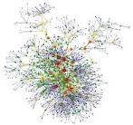
Last words . . . Pay attention to the competencies
Do not hide your talents
For use they are made …
Its not matter how much are you smart
IT’S MATTER
HOW YOU ARE SMART…
Instead of focusing on weaknesses focus on strength points and develop them among you and your students

Slide 36
Thanks for your attention and patient …. Dedicated to Dr. Hasan Karimi (RP)

