Slide 1
Graduate Application Project Design Concept Walkthrough
BACKGROUND
Design concept for new graduate application built from feedback from:
Associate Deans, meeting (September 2011)
Graduate Assistants, town hall meetings, survey (December 2011)
Oracle Training (March 2012)
Prototyping (May 2012 to November 2012)

Slide 2
Graduate Application Project Design Concept Walkthrough
LOCATION
Project aims to develop full service admissions system within Student Center environment
Lifecycle of application will be created, updated, assessed and decided upon within Student Center

Slide 3
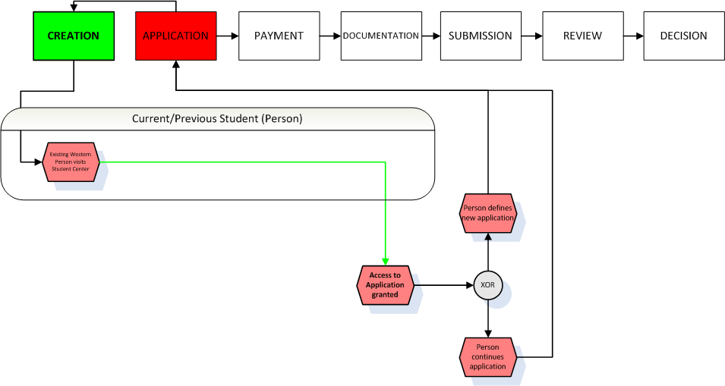
Graduate Application Project Design Concept Walkthrough
CREATION
How can individuals access the application?
Three distinct groups will access the application in three distinct manners
1. Persons with previous record in PeopleSoft Student Center system including:
Current students
Previously registered students
Current applicants who have already submitted an application

Slide 4
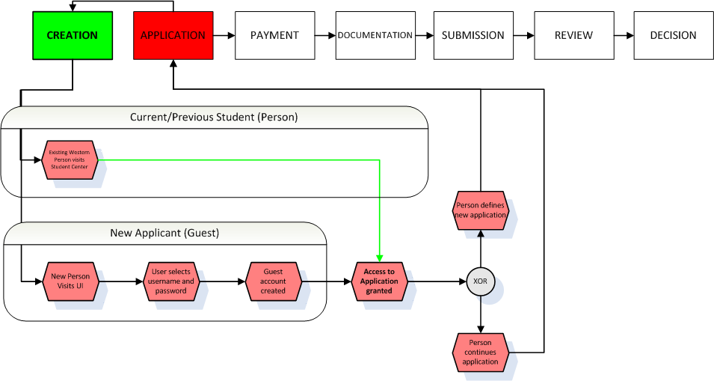
Graduate Application Project Design Concept Walkthrough
CREATION
How can individuals access the application?
Three distinct groups will access the application in three distinct manners
2. Persons who do not currently have a person record in PeopleSoft
Will create user ID and password for guest account into PeopleSoft
Access restricted to ONLY application

Slide 5
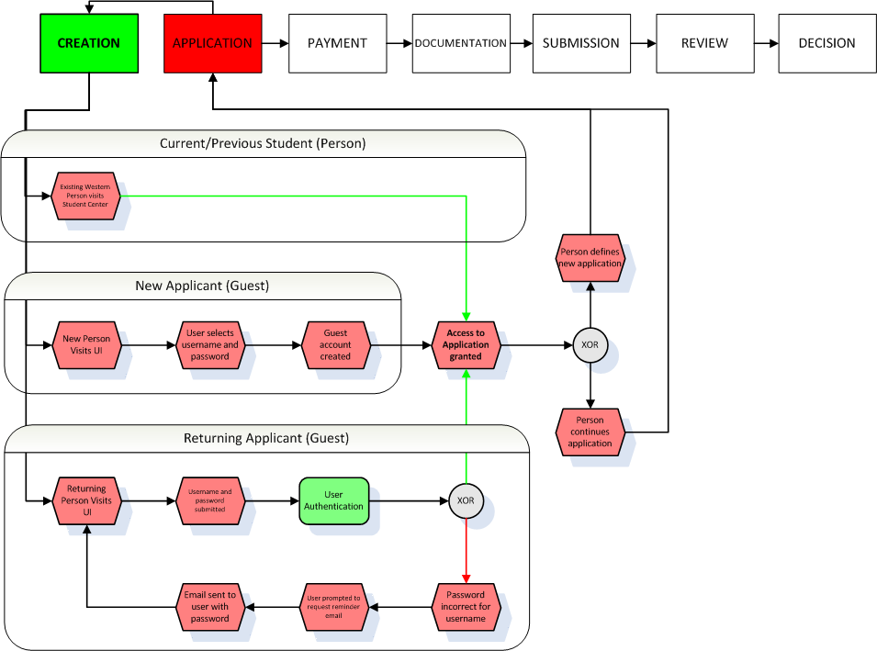
Graduate Application Project Design Concept Walkthrough
CREATION
How can individuals access the application?
Three distinct groups will access the application in three distinct manners
3. Persons who have previously established a Guest account
Will use their chosen ID and password to return and continue working on application

Slide 6
Graduate Application Project Design Concept Walkthrough
CREATION
What if a user forgets their account information?
Existing Student Center users:
Will rely on existing ITS structure to reconnect with user account information
Guest account users:
Will be able to request a reminder email be sent to their primary email account of record

Slide 7
Graduate Application Project Design Concept Walkthrough
CREATION
Additional Proposed Features:
Identifying current students and providing existing Student Center data within their application
Identifying students applying to further studies within their current program and expediting their application
Successful CREATION leads user to APPLICATION phase

Slide 8
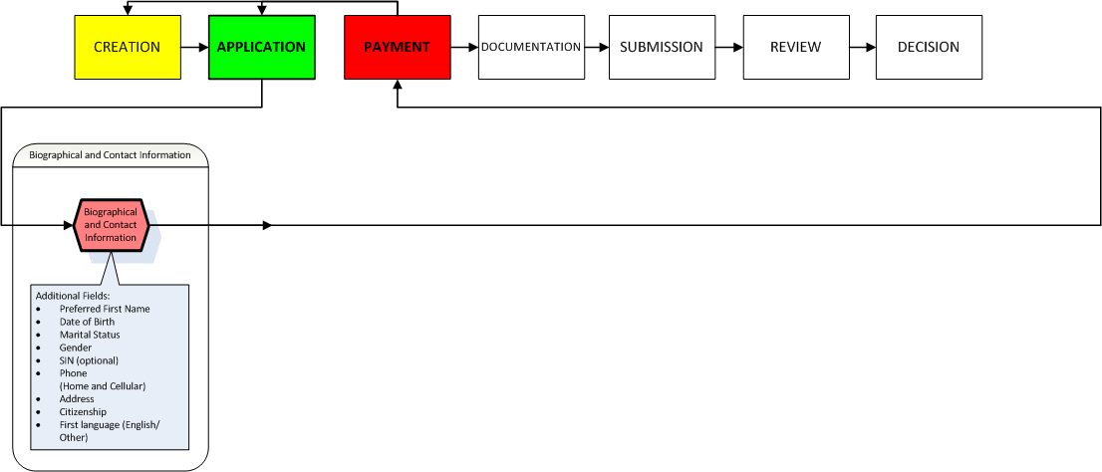
Graduate Application Project Design Concept Walkthrough
APPLICATION
Essential information for each application
Biographical and Contact Information:
Preferred First Name, Date of Birth, Gender, SIN (optional), Phone (Home and Cellular), Address, Citizenship, First language (English/Other)

Slide 9
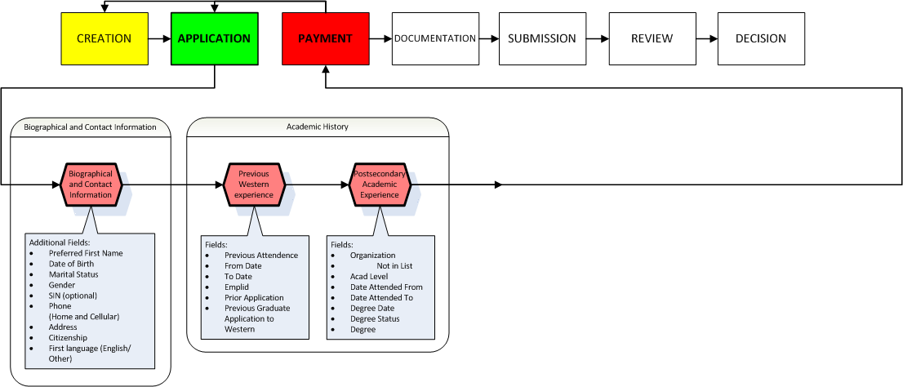
Graduate Application Project Design Concept Walkthrough
APPLICATION
Essential information for each application
Academic History:
Previous Western Experience
Postsecondary Academic Experience

Slide 10
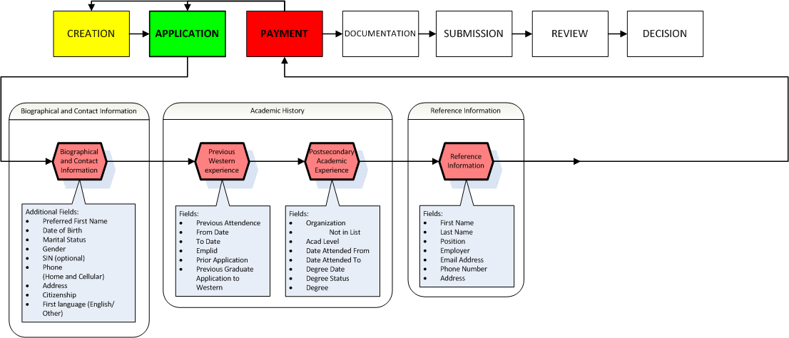
Graduate Application Project Design Concept Walkthrough
APPLICATION
Essential information for each application
Reference Information:
Contact information for referee
Number of references required set by program and degree
Electronic References:
Application will connect directly to existing GradNet service

Slide 11
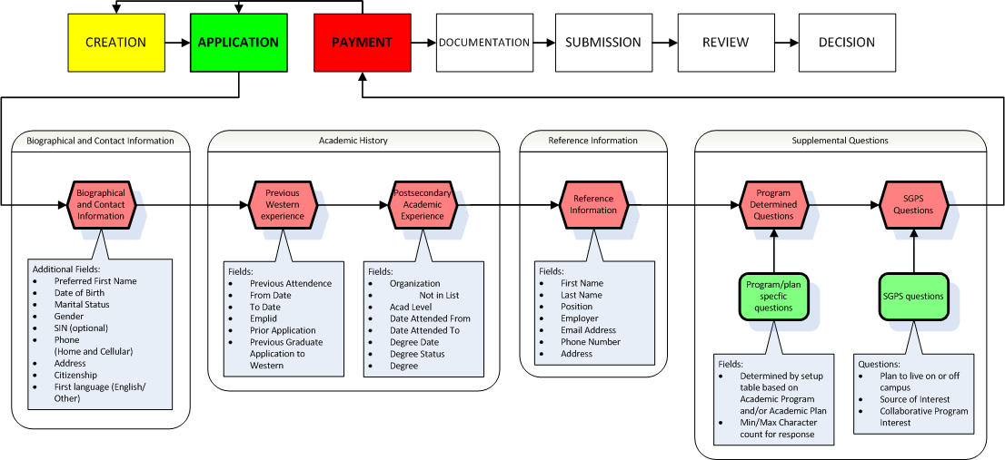
Graduate Application Project Design Concept Walkthrough
APPLICATION
Essential information for each application
Supplemental Questions:
Program controlled questions
Set questions and, if necessary, min/max character count in response
Central questions
Include: residence, source of interest, collaborative program interest

Slide 12
Graduate Application Project Design Concept Walkthrough
APPLICATION
Additional Proposed Features:
Population of updateable information for person with existing identity in Student Center
Successful APPLICATION leads user to PAYMENT phase

Slide 13
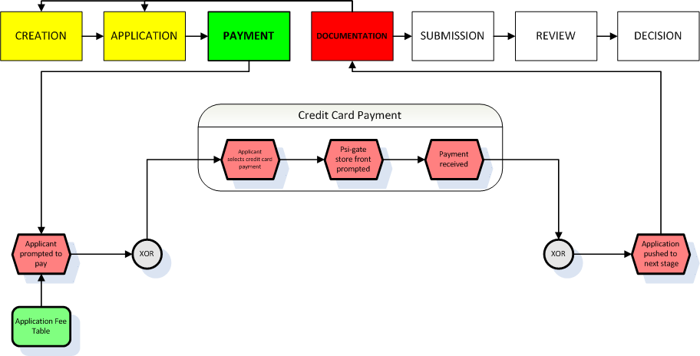
Graduate Application Project Design Concept Walkthrough
PAYMENT
How can individuals pay for the application?
Three methods of payment
1. Credit Card Payment
Applicants routed to third-party credit card payment system Psi-gate which presents required amount, collects payment, and allows applicant to proceed to next stage

Slide 14
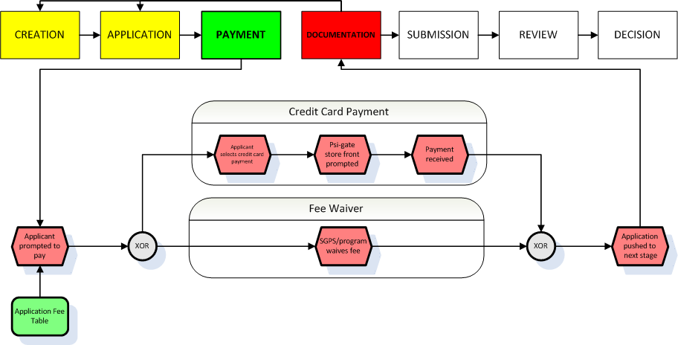
Graduate Application Project Design Concept Walkthrough
PAYMENT
How can individuals pay for the application?
Three methods of payment
2. Fee Waiver
Fee waived for applicant by SGPS
Important to Note:
This will require procedure to approve request for waiver

Slide 15
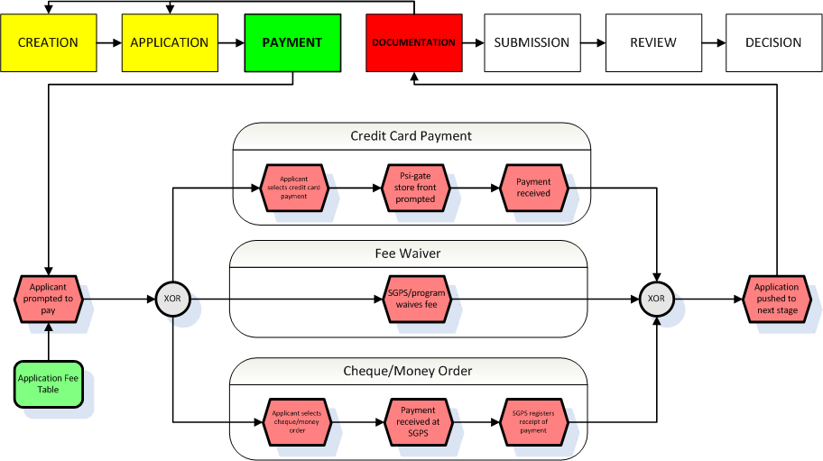
Graduate Application Project Design Concept Walkthrough
PAYMENT
How can individuals pay for the application?
Three methods of payment
3. Cheque/Money Order
Payment received at SGPS and staff confirms receipt of payment in application center
Important to Note:
This will require human resources in SGPS

Slide 16
Graduate Application Project Design Concept Walkthrough
PAYMENT
Important to Note:
Applicants cannot progress further within the application without one of these three payment options being completed.
Successful PAYMENT leads user to DOCUMENTATION phase

Slide 17
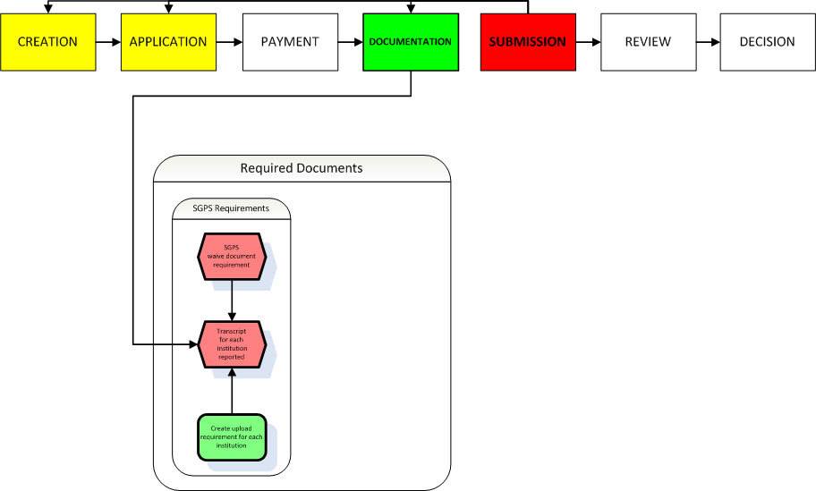
Graduate Application Project Design Concept Walkthrough
DOCUMENTATION
What documents will an applicant be asked to submit?
1. SGPS Requirements
Standard requirements for all applicants:
Transcripts for each institution reported
Additional Proposed Features:
Western records/transcripts will not be requested and instead be collected automatically

Slide 18
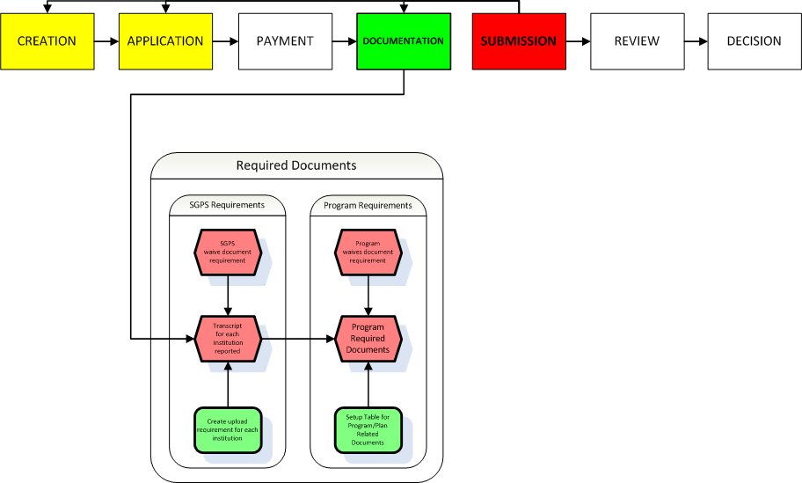
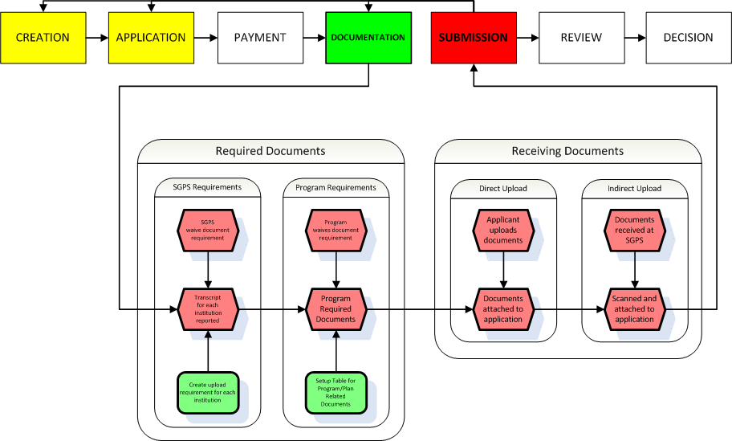
Graduate Application Project Design Concept Walkthrough
DOCUMENTATION
What documents will an applicant be asked to submit?
2. Program Requirements
Program may dictate specific requirements based on program or degree including:
Writing samples
Statements
CV

Slide 19
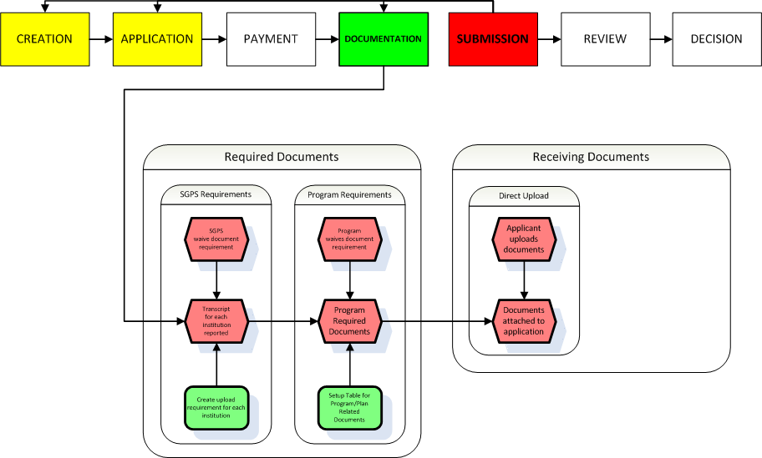
Graduate Application Project Design Concept Walkthrough
DOCUMENTATION
How will applicants submit their documentation?
1. Direct upload
Applicant will obtain a digital copy of the document and upload the file directly through the application process
Additional Proposed Features:
Restrictions on file type and size

Slide 20
Graduate Application Project Design Concept Walkthrough
DOCUMENTATION
How will applicants submit their documentation?
2. Indirect upload
SGPS will obtain document and upload copy into application on behalf of applicant
Important to Note:
This will require human resources in SGPS
Successful DOCUMENTATION leads user to SUBMISSION phase

Slide 21
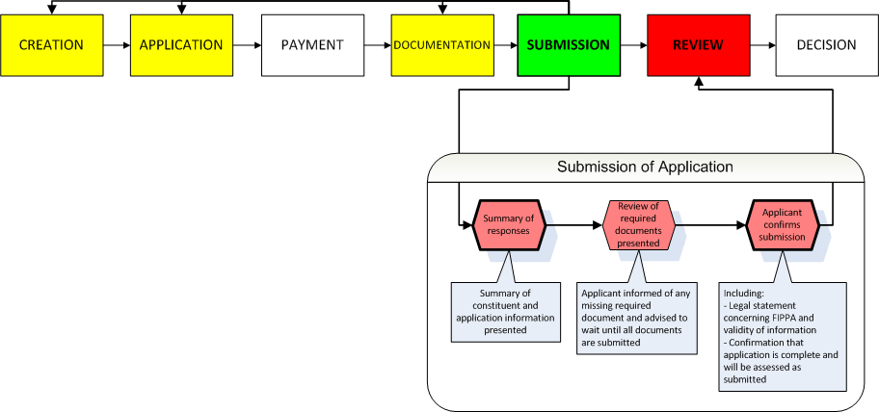
Graduate Application Project Design Concept Walkthrough
SUBMISSION
How will applicants declare their application complete?
Summary of responses and documentation presented to application.
Applicant informed of any missing responses or documentation and asked to verify validity of application and supporting documents.
Successful SUBMISSION leads user to REVIEW phase

Slide 22
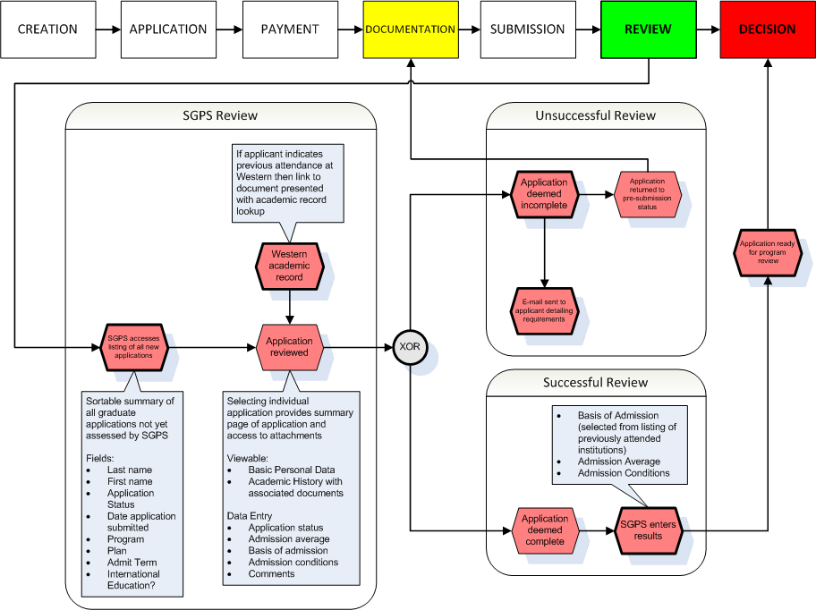
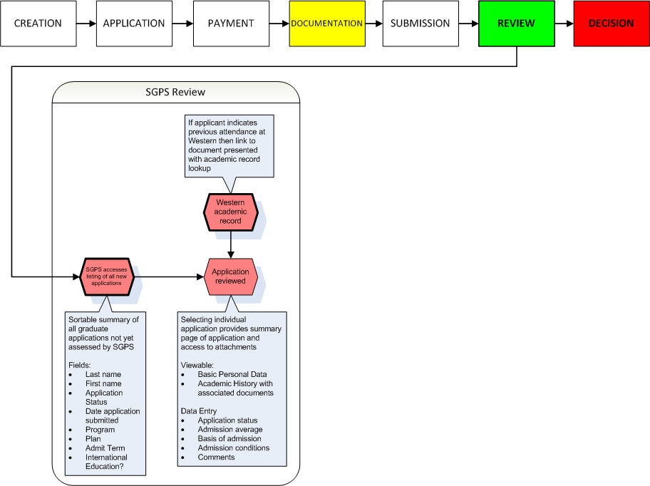
Graduate Application Project Design Concept Walkthrough
REVIEW
How will SGPS review applications?
User interface in Student Center summarizes all applications requiring assessment.
Initial assessment: are all required documents received and legible?
Additional Proposed Features:
Western academic records will be populated on demand for each applicant ensuring they are up to date

Slide 23
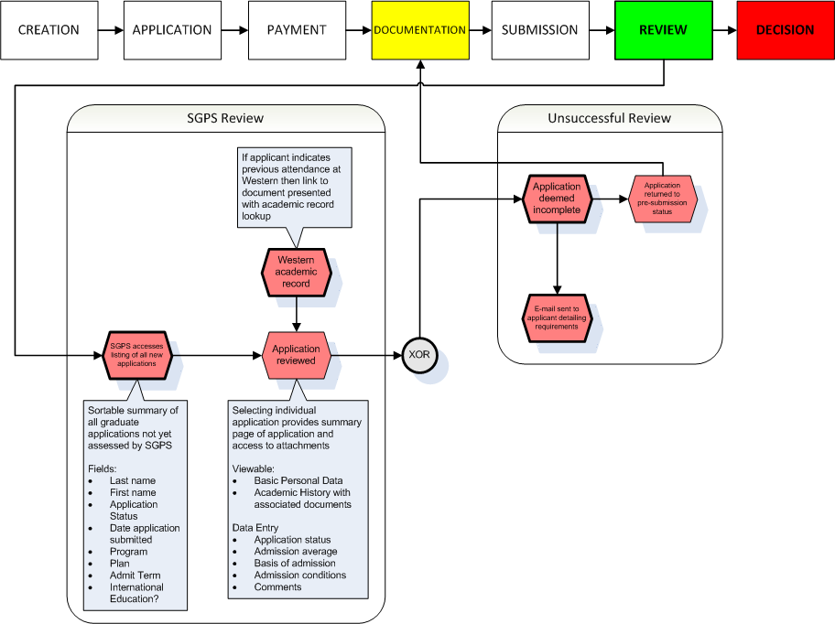
Graduate Application Project Design Concept Walkthrough
REVIEW
How will SGPS review applications?
User interface in Student Center summarizes all applications requiring assessment.
Missing/illegible documents results in an unsuccessful review. Communication to applicant requests revised documents.
Applicant returned to documentation phase of application.

Slide 24
Graduate Application Project Design Concept Walkthrough
REVIEW
How will SGPS review applications?
User interface in Student Center summarizes all applications requiring assessment.
All required documents results in a successful review.
SGPS determines:
Admission average
Basis of admission
Admission conditions

Slide 25
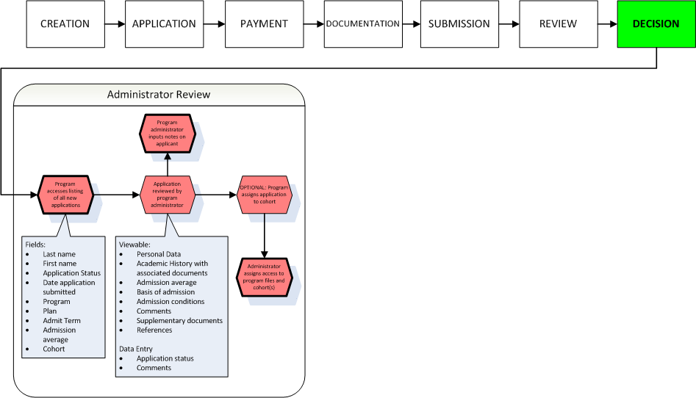
Graduate Application Project Design Concept Walkthrough
DECISION
How will programs render decisions?
User interface in Student Center summarizes all applications requiring decision.
Program administrator reviews applications and sorts them into various cohorts as determined by program need.

Slide 26
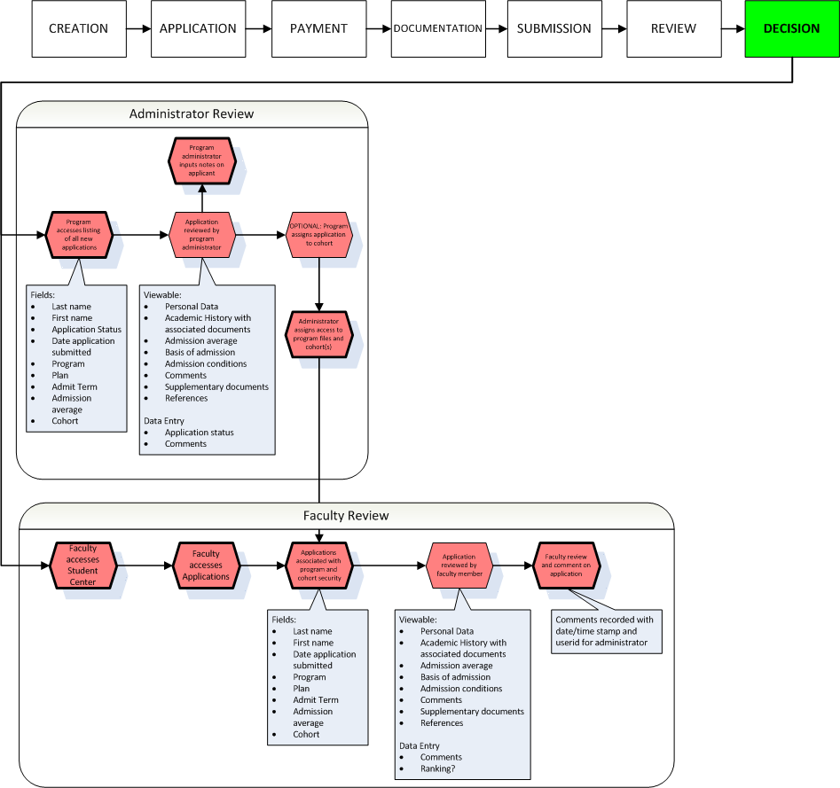
Graduate Application Project Design Concept Walkthrough
DECISION
How will programs render decisions?
Faculty have access to applications based on cohort setup of program administrator.
Faculty can view applicant information and supporting documentation. Able to submit comments on applications to administrator via student center.

Slide 27
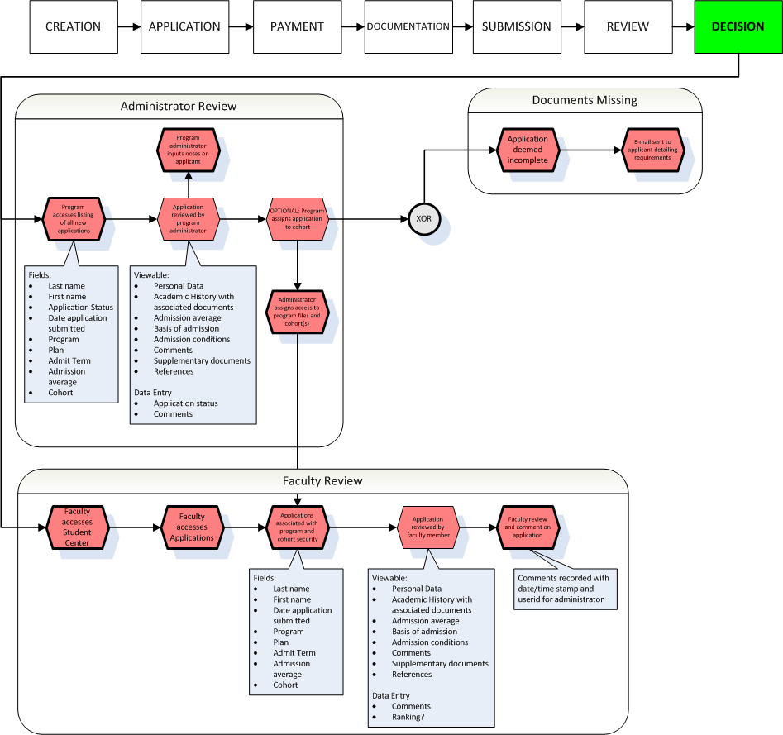
Graduate Application Project Design Concept Walkthrough
DECISION
How will programs render decisions?
Administrator or Faculty Review may determine that documents are insufficient for accurate decision.
Administrator able to reconnect with applicant via email through Student Center and request updated documentation.

Slide 28
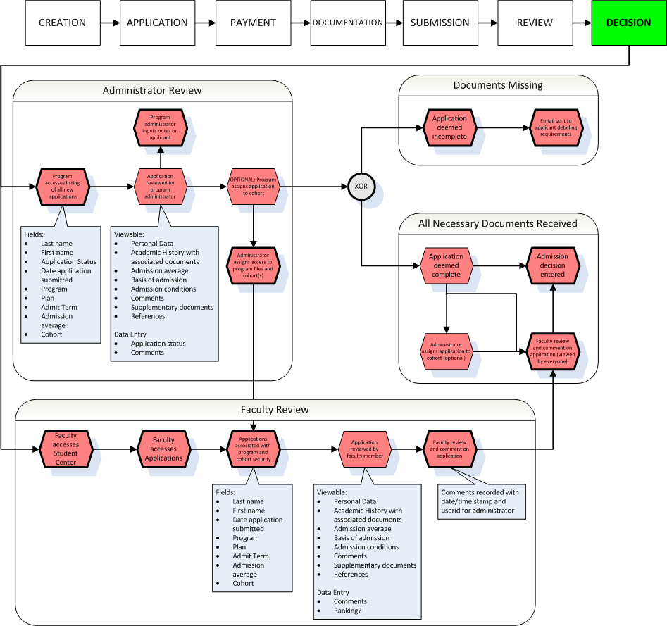
Graduate Application Project Design Concept Walkthrough
DECISION
How will programs render decisions?
Department administrator maintains the decision process within the program.
Ultimately submits the decisions within the Student Center resulting in immediate actions both in processing application and alerting applicant.

Slide 29
Graduate Application Project Design Concept Walkthrough
DECISION
How will applicants learn of decision?
Department decisions will automatically create communications to applicants informing them of an update to their application.
Applicants may then enter Student Center to view decision and, if admitted, accept the offer.

Slide 30
Graduate Admissions Project Project Task Force
Looking for representatives to be attached to the project as testers
Work would begin in January 2013
Would not be more than a few hours a month
If you are interested in helping in this project please speak with Matt or Teri

Slide 31
Graduate Admissions Project Schedule
June 2012 – October 2012: Prototyping within Student Center Upgrade Project
November 2012 – October 2013: Development of Admissions System
October 2013: New Admissions System Online

Slide 32
Graduate Application Project Design Concept Walkthrough
Questions?

