Slide 1

Eliminating stigma and removing barriers
to access

Slide 2
Michelle Gold
Senior Director
Policy and Planning
Canadian Mental Health Association, Ontario

Slide 3

Heather Stuart
Bell Mental Health
and Anti-stigma Research Chair
Queen’s University

Slide 4
Donna Duncan
President and CEO
Hincks-Dellcrest Centre

Slide 5
Aseefa Sarang
Executive Director
Across Boundaries

Slide 6
Eliminating stigma and removing barriers
to access

Slide 7
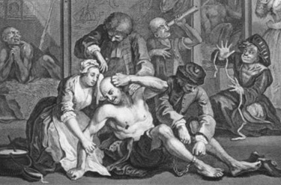
Heather Stuart, PhD professor and Bell Canada mental health and Anti-stigma Research chair, Queen’s university, Senior Consultant, Opening minds Anti-stigma program, mental health Commission of Canada
Stigma and Mental Health

Slide 8
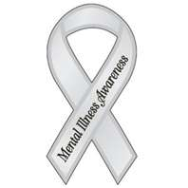
Stigma is a growing public health concern
Internationally
WPA
Open-the-Doors Global Network (1996)
Stigma and Mental Disorder Section (2005)
Task force on the destigmatization of psychiatry and psychiatrists (2009)
WASP, WHO, and others
Nationally
Mental Health Commission of Canada’s Opening Minds
Grand Challenges in Mental Health, Canada
Bell Canada’s Mental Health Program

Slide 9
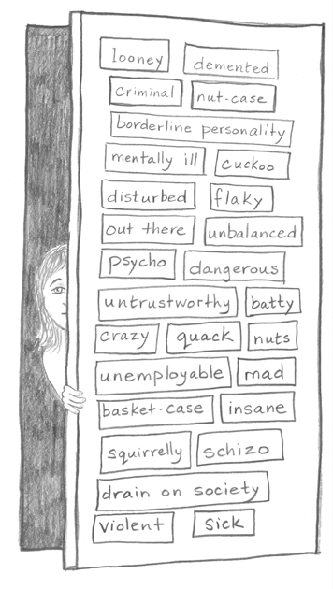
What Stigma is….
A powerful social process that uses
Stereotyping,
Prejudice,
Discrimination, and a
Power imbalance to…
Socially oppress people based on their membership in a group (in this case an illness group)
Stigma
Donna, Canada, 2003

Slide 10
Components defined & intertwined
Emotional
Behavioural
Cognitive component
Labelling
Stereotyping (eg: violence)
Emotional component
Generalized negativity
Prejudice (They don’t belong)
Behavioural component
Unfair treatment
Discrimination
Structural component
Acts of omission
Acts of commission
Cognitive
Structural

Slide 11

Stigma an issue of human rights – UN Convention
Recognize systematic disadvantage not only flows from individual acts, but from institutions and structures of society
Disability is socially determined - not based on individual impairments
Stigma recast as a form of social oppression in a rights-based framework
Signatories agree to eliminate social inequities and promote full and effective social participation for all people with a disability
States parties
States that have signed, but not ratified
States that have not signed
Wikipedia, accessed March 27, 2012

Slide 12
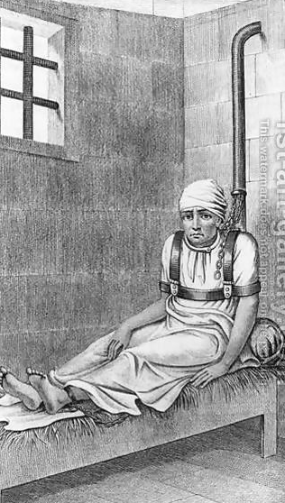
Implications for health care
Entrenched Inequities
Policy vacuum related to mental health initiatives
Lack of funding for programs
Sustainability of funding a problem
Suspiciousness about efficacy of treatments
Mental health professionals held in low esteem
Inadequate medical care for people with a mental illness

Slide 13
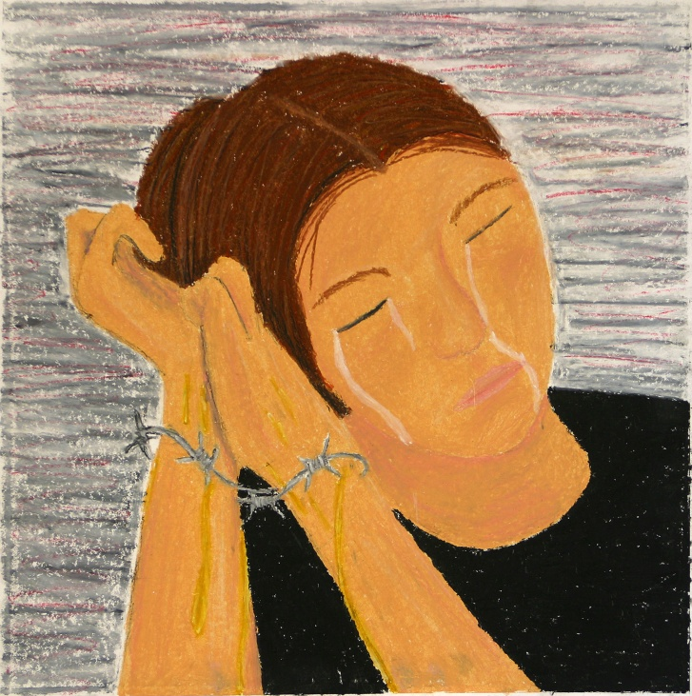
Implications for mental health
Poor social and health outcomes
Disrupted educational and career trajectories
Poverty, disenfranchisement, social exclusion
Poor recognition of signs and symptoms (literacy)
Fear, shame, embarrassment and a wish for secrecy
Treatment avoidance
Poor adherence to treatment plans
Higher morbidity, disability, and mortality

Slide 14

Final Thought stigma is resistant to change so requires fierce and unequal combat

Slide 15
Eliminating stigma and removing barriers
to access

Slide 16

Two Solitudes
Transition-Age Youth
Notes:
Discrimination based on ministry…

Slide 17
Two Solitudes
Adult Mental Health & Addictions | Children’s Mental Health Addictions
Impact of anti-stigma campaigns is having an impact | Stigma is most prevalent with children & youth: “The orphan of the orphans”
Services start at 18 years old | Services run from birth to 18
Rooted in the Mental Health Act | Rooted in the Child & Family Services Act
Funded and regulated through the Ministry of Health and Long-Term Care | Funded through the Ministry of Children and Youth Services
Majority of adults with a mental illness had its onset before the age of 17 | 1 in 5 children will have a mental health problem 4 of 5 children requiring mental health services will not get them
Addiction supports funded – increasing services for concurrent disorders | Addiction supports not funded-little support for concurrent disorders
Increasing collaboration among service providers | Highly fragmented sector: there is no “system”
Services and supports for “transition age” youth are the most marginalized

Slide 18
Unfortunately there is no ministry for people…
There is only one taxpayer, one Consolidated Revenue Fund (CRF)
Need for collaboration
Need for cross-sectoral approaches
Need for social innovation, especially in a time of austerity
Need to put a face on “transition-age youth”: college and university students
Notes:
Current funding models perpetuate the stigma
Based on funding models and mandates: MTCU

Slide 19
The Answer we get: Why it can’t be done
Stigma
Funding
Drummond
Ministry silos
System capacity/lack of expertise
Inconsistent standards/language/models of care
Inability to “transition” adolescents to adult services
Technology
Notes:
Rooted in 1950’s thinking that children with mental health problems are juvenile delinquents /”wayward” boys and girls and bad parents
System built to support child welfare – in 1970’s rolled up into the Child and Family Services Act
Take that philosophy
Add decades of inertia
Flavouring of ideology that’s the system
For some reason, we accept that mental illness in adults is physiological, yet we don’t accept that in children
At MCYS 90 per cent of the budget goes to child welfare

Slide 20
The Answer we need: How it can be done
Stigma reduction – “normalizing” mental illness
Youth and family engagement
Funding
Drummond
Research
Innovation and collaboration
Ownership & accountability
Regulatory – system transformation
Make the process work for you
Notes:
Rooted in 1950’s thinking that children with mental health problems are juvenile delinquents /”wayward” boys and girls and bad parents
System built to support child welfare – in 1970’s rolled up into the Child and Family Services Act
Take that philosophy
Add decades of inertia
Flavouring of ideology that’s the system
For some reason, we accept that mental illness in adults is physiological, yet we don’t accept that in children
At MCYS 90 per cent of the budget goes to child welfare

Slide 21
An example: Stella’s Place: Breaking down barriers by building something together
New thinking driven by families
Informed by extensive research and consultations
Offer an age-appropriate, non-stigmatized environment for care
Concept of a social enterprise bringing together students, colleges, universities, community providers, hospitals, researchers – and the private sector – to align services and supports with the needs of clients
Foster shared accountability across sectors
Special focus on assessment and a holistic approach to treatment and creating clear pathways for service access
Develop a program model that can be used across the country
Notes:
Rooted in 1950’s thinking that children with mental health problems are juvenile delinquents /”wayward” boys and girls and bad parents
System built to support child welfare – in 1970’s rolled up into the Child and Family Services Act
Take that philosophy
Add decades of inertia
Flavouring of ideology that’s the system
For some reason, we accept that mental illness in adults is physiological, yet we don’t accept that in children
At MCYS 90 per cent of the budget goes to child welfare

Slide 22
Words may inspire, but only actions create change.
Simon Sinek
Notes:
Rooted in 1950’s thinking that children with mental health problems are juvenile delinquents /”wayward” boys and girls and bad parents
System built to support child welfare – in 1970’s rolled up into the Child and Family Services Act
Take that philosophy
Add decades of inertia
Flavouring of ideology that’s the system
For some reason, we accept that mental illness in adults is physiological, yet we don’t accept that in children
At MCYS 90 per cent of the budget goes to child welfare

Slide 23
Eliminating stigma and removing barriers
to access

Slide 24
Focus On Mental Health Conference Eliminating Stigma and Removing Barriers to Access
May 17th, 2012
Aseefa Sarang
Executive Director
Across Boundaries: An Ethnoracial Mental Health Centre

Slide 25
Overview
Demographics
Current State
Gaps and Impacts
Moving Forward

Slide 26
Terminology
Ontario Human Rights Commission's Policy and Guidelines on Racism and Discrimination:
the term racialized person or racialized group is preferred over racial minority, visible minority, person of colour or non-White as it recognizes the dynamic and complex process by which racial categories are socially produced by dominant groups in ways that entrench social inequalities and marginalization.”

Slide 27
Demographics
Department of Canadian Heritage study – projection of Immigrant and racialized profile by year 2017
75% of newcomers to live in Toronto, Montreal and Vancouver
2006 census - Over 125,000 immigrants became permanent residents in Ontario
52% of Toronto’s population are “visible minorities” -minoritized

Slide 28
Current state
Studies suggest 15 to 21 per cent of children and youth, in Ontario, have at least one mental health disorder
70 percent of mental illnesses have their onset during childhood or adolescence
25 percent of young people in Canada with mental-health problems receive professional help
Sources: Centre for Addiction and Mental Health, Canadian Mental Health Association, Canadian Association of College and University Student Services, University of Alberta Spring Survey,
The Jack Project

Slide 29
Current State
According to a 2009 study by the American College Health Association that included six universities in Ontario:
15 percent of students have been treated by a professional for mental health problems
51 to 60 percent of campus respondents in the province reported feeling hopeless
33 to 43 per cent reported feeling so depressed they were unable to function
six to nine per cent considered suicide in the 12 months before the survey
Source: Ontario College Health Association

Slide 30
Gaps
Demographic profile of racialized students
Research on students needs and development of relevant services
Effectiveness of current services for racialized students*
Impact on student participation and academic success
Impact of lived experiences of racism and other forms of oppressions including post traumatic stress disorders

Slide 31
Impacts
Misdiagnosis
Inappropriate treatment
Delayed intervention
Prolonged illness
More acute illness
More involvement by the justice system
Drop out of academic institution
Negative impact on quality of life

Slide 32
Moving Forward
Awareness and Acknowledgement of Gaps
Needs assessments to inform programming
Funder support
Responsibility of service delivery with larger sector – partnerships and collaborations
Access to traditional eastern treatments in coordination with traditional western treatments
Best vs Better and Emerging Practices
“diversity” should not be a catch all phrase so that everyone is included but nobody is served

Slide 33
Moving Forward
Recommendations from the Mental Health Strategy of Canada
1.2.3
Increase comprehensive school health and post- secondary mental health initiatives that promote mental health for all students and include targeted prevention efforts for those at risk
4.1.2
Use ‘health equity lenses’ to ensure that new mental health policies and programs reduce disparities while improving mental health for the population as a whole
4.1.3
Strengthen data and research to develop a better understanding of the mental health needs and strengths of diverse population groups

Slide 34
Moving Forward
4.2.3
Better evaluate the potential of traditional knowledge, customs and practices to address mental health problems and illnesses, and improve access to those that work
4.2.5
Develop and implement mental health plans in all jurisdictions to address the mental health needs of immigrants, refugees, ethno- cultural and racialized groups, with their full involvement

Slide 35
Thank You
Aseefa Sarang
Executive Director
Across Boundaries: An Ethnoracial Mental Health Centre
416 787 3007, ext. 226
aseefa@acrossboundaries.ca
www.acrossboundaries.ca

Slide 36
Eliminating stigma and removing barriers
to access

