Slide 1
Mental Health on Campus
The need for a Systemic Approach
to Health and Wellness

Slide 2
Mental Health is Foundational for Learning
Campuses need to focus on Mental Health deeply, structurally, and broadly - the ability of students to learn and participate in campus life depends on it.
Must move to a systemic model. Goal must be shared by more than the health and counselling services. It must be a campus commitment.
Goal is to create a campus community that is deeply conducive to positive mental health by focusing on
environment factors that impact student mental health
building students’ awareness and self-management capacity
early identification programs
timely and appropriate access to resources and services as needed.

Slide 3
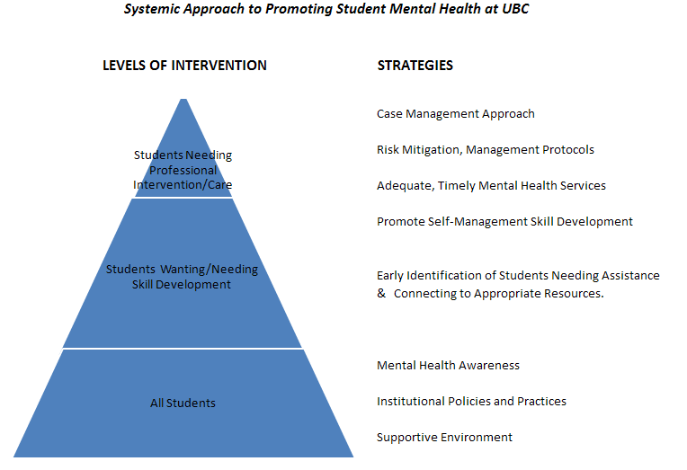
Need to Pay Attention at each level of intervention

Slide 4
Building a Supportive Campus Environment
Issue:
Post Secondary Institutions need a comprehensive response that includes:
Mental Health Awareness and Education Programs
Training Programs
Support Programs
Policies and Procedures
Best Practise:
Cornell – Mental Health Framework
Carlton – Mental Health Framework

Slide 5
Scenario
Jasmine: registered with Accessibility Services with a confirmed diagnosis of depression and anxiety. She was taking anti-depressive medication and was seeing a doctor in Health Services regarding the medication. She used accommodations for her first two semesters (accommodations included extension on assignments, absenteeism without penalty, time and half to write tests/exams). In her second year, she does not connect with Disability Services and stops taking her medication. She does well her subsequent year(an A average). In her last semester, her pattern of behavior changes. The final year experience is very intense and she starts to miss classes in the middle of the semester. She tells her profs she is missing classes to get her other work done. She requests extensions from her profs stating she is struggling with depression. She fails one of her midterms. At the end of the semester, she misses handing in her 2 final assignments and fails one exam. She has now failed two of her five classes due to the combination of missed work and failed examination. She cannot graduate. She requests extensions on assignments after the course has completed and asks to rewrite the final exam that she failed so she can pass the course and graduate. She notes that the holding of the two final examinations on the same day resulted in an anxiety panic and she couldn’t think.

Slide 6
Small Group Discussion
Thinking strategically of a systematic approach, what issues does this case raise for you in terms of:
Mental Health Awareness and Education Programs
Training Programs
Support Programs
Policies and Procedures

Slide 7
Mental Health Awareness
Issue:
Stigma is a powerful barrier preventing people from getting the help they need.
People living with Mental illness experience inequality in education, work, housing; loss of friends and family; and, self-stigma.
“Only 6% of respondents were reluctant or unsure if they would seek help for Type 2 Diabetes, whereas almost 40% of respondents felt the same about Mental Illness”.
“40% of parents say they would not admit to anyone, not even their doctor that they had a child with mental illness”
(Geeta Modgill, MSc, & Scott Patten, MD, PhD- Opening Minds Anti-stigma )
We need to educate our campus community about mental health issues and find ways to collectively leverage resources to make this a system-wide campaign. Anti-stigma workshops, training programs and campaigns have been proven to have a significant positive change

Slide 8
Mental Health Awareness
Best Practice:
Mental health websites
Example University of Guelph
Deliberate and Ongoing outreach programs
Posters
Speakers
Plays
Campus Mental Health Conferences (George Brown College/CAMH)
A number of systemic initiatives underway.
The Jack Project
Wear your Heart on Your Sleeve
CMHA Mental Health Week Programming
Active Minds Mental Health Awareness

Slide 9
Training and Support for Faculty and Staff
Issue:
All faculty and staff need to see their role in supporting and referring students
The need for professional development and training tools has been identified
Best Practice:
Queens is endeavors to have all its faculty and staff do the Mental Health First Aid training.
George Brown College has ASIST (suicide intervention) trained all staff in Student Affairs
Mental Health EDU – Identifying Students in Distress
Ontario College Counsellors (OCC) – Trained to facilitate Safetalk (suicide awareness and intervention) at each College
Waterloo uses QPR (suicide referral) training for its faculty and staff
Guelph has developed its own modules (ALERT) that range from 1 hour to 4 hours depending upon group being trained. Also offered on-line
COU, in partnership with, the University of Toronto, the University of Guelph, and York University will be developing an on-line program that could be used by any university or college.

Slide 10
Support Programs
Issue:
Post Secondary Institutions in the past had been funded assuming support systems were for short-term personal issues. Seeing expectations for long-term sustained support. Funding has not followed.
Increases in class sizes make it harder to notice someone in trouble
Increased demand for staffing funding support from areas most impacted: Counselling Offices, Accessibility/Disability Offices, Housing Offices, Health Services, Campus Police.
Best Practise:
Creation of Health and Counselling Centres with a triage function (McMaster)
Effective depression screening (Boston University)
Cross functional teams to integrate services across unit boundaries
On-line resources such as Feeling Better Now, Student Health 101
UBC Early Alert Identification and Intervention Program

Slide 11
Policies
Issue:
Institutions need to review policies and take a Universal design approach stress issues on campus. Questions to consider:
Are examination schedules reviewed to ensure not back to back?
Are there flexible time limits to finish academic work, reducing pressure for the student?
Are there realistic course loads and structure?
Are students permitted to reduce to PT without penalty or extra cost?
Are there unnecessary methods of evaluation or flexible methods of evaluation?
Post Secondary Institutions need policies that outline a university’s responsibility on issues related to mental health, such as Involuntary Withdrawal policies, back to school policies and sharing of information with others on campus.

Slide 12
Policies
Best Practice:
Post Secondary Institutions that have done full mental health frameworks have often addressed these issues.
MTCU and COU retained legal counsel to develop a document on policy issues. It includes a number of helpful recommendations and case law including:
Best practices for involuntary withdrawal
Templates for behavioural contracts, return to school letters, withdrawal letters.
Opinions on divulging information, restricting access to campus, parental involvement, requesting medical documentation, parental involvement.

Slide 13
Additional References
Patterson, P. and Kline,T. (2008). Report on Post-Secondary Institutions as Healthy Settings. The Pivotal Role of Student Services, Health and Learning Knowledge Centre: Victoria, B.C., Canada
National Association of Student Personnel Administrators (NASPA) Health Education and Leadership Program. (2004). Leadership for a healthy campus: An ecological approach for student success.
Dooris, M. (2001). Health promoting universities: Policy and practice – A UK perspective. Community-Campus Partnerships for Health.

