Slide 1

Building a healthy workplace

Slide 2
Karla Thorpe
Director
Leadership and Human Resources
Conference Board of Canada

Slide 3
Christine Hildebrand
Director
National Disability Claims Services
Great-West Life Assurance Company

Slide 4
Mary Ann Baynton
Principal
Mary Ann Baynton & Associates Consulting

Slide 5
Building a healthy workplace

Slide 6
Building Mentally Healthy Workplaces: Perspectives of Canadian Workers and Front-Line Managers
Karla Thorpe
Director
Leadership & Human Resources Research

Slide 7
Project Purpose
The overarching purpose of this project was to:
Provide organizations with information to manage employee mental health and wellness
Identify challenges and successes faced by employees with mental health issues
Provide suggestions to ensure workplaces are supportive, healthy, and high-performing

Slide 8


Project Sponsors

Slide 9
Project Advisory Board
Bell
Canada Post Corporation
Canadian Auto Workers
Canadian Mental Health Association
Manulife Financial
Mental Health Commission of Canada
Mood Disorders of Canada
Morneau Shepell
Public Service Alliance of Canada
TD Bank Group
Treasury Board
University Health Network
University of Calgary
University of Montreal

Slide 10
Project Phases
1. Roundtable Consultation
2. Literature Review
3. National Survey of Employees and Front-Line Managers
4. Interviews with Employees and Front-Line Managers

Slide 11
Prevalence of Mental Health Issues
Percentage of respondents; n=1,010
Source: The Conference Board of Canada
Notes:
Definition: For our research, the definition of a mental health issue was very broad. It included excessive stress; anxiety; depression; burnout; addictions and substance abuse; and mania, bipolar, and schizophrenia disorders, among others.

Slide 12

Profile
Mental illness affects people of all ages, educational and income levels, and cultures
Some groups more likely to report mental health issues:
Women
Non-managers
Not-for-profit sector
Unionized employees
Some groups less likely to report mental health issues:
Residents of Québec
People 65 years and older
Construction sector

Slide 13
What is a Mentally Healthy Workplace?
Workload
Workloads are monitored
Work Scheduling
Flexible work arrangements exist
Work-Life Balance
Work-life balance is promoted
Employees encouraged to take vacation
“Face time” does not equal better job performance
Overtime is compensated
Employees not expected to respond to e-mail 24/7

Slide 14
What is a Mentally Healthy Workplace?
Work Environment
People are friendly, empathetic, understanding, and supportive
Management Style
Managers are well trained and good people managers
Communication
Open communication between management and employees
Bullying, harassment, and discrimination are not tolerated
Not a high-stress environment; no hostility or conflict
Employees are not blamed or punished for mistakes
Human resource professionals and managers are approachable
Discussions are kept confidential
Managers are not autocratic, authoritarian, controlling, and aggressive

Slide 15
Canadians’ Report Card on Mentally Healthy Organizations
46 per cent of respondents agree their employer promotes a mentally healthy work environment
Perspectives differ by occupational category/level

Slide 16
Do Employers Promote a Mentally Healthy Workplace?
Percentage of respondents; n=1,010
Source: The Conference Board of Canada

Slide 17
Supervisors/Managers Have Confidence in Their Knowledge and Abilities
81% of managers feel comfortable discussing mental health with their staff members
81% feel that they could direct staff to appropriate supports

Slide 18
But Employees Don’t Agree….
29% believe their manager is knowledgeable about mental health
32% would not feel comfortable talking to their manager about a mental health issue
26% agree that their supervisor is able to “effectively” manage mental health issues
32% feel that their supervisor would not be helpful if they were to approach them about a mental health issue

Slide 19
Training Received by Front-Line Managers
Percentage of respondents; n=478
Source: The Conference Board of Canada

Slide 20
Additional Training Front-Line Managers Want
Recognizing signs and symptoms
Community supports available
Medical factors influencing mental health issues
Strategies for keeping employees functional and successful in the workplace
Responses to negative reactions
Insight into legal requirements
Handling difficult conversations
Softer skills
Creating an inclusive work environment

Slide 21
Creating Positive Change in Organizations
Focus on education and communication to reduce fear, stigma and discrimination
Create a culture conducive to good mental health
Demonstrate leadership at the top
Provide the tools and training to support managers in their role

Slide 22
Contact Us
Karla Thorpe
Associate Director
Leadership & Human Resources Research
thorpe@conferenceboard.ca
(613) 526-3090 ext. 408
Louise Chénier
Research Associate
Leadership & Human Resources Research
chenier@conferenceboard.ca
(613) 526-3090 ext. 305

Slide 23
Building a healthy workplace

Slide 24
Building a Healthy Workplace
Focus on Mental Health

Slide 25
Building a Healthy Workplace – what have we done
Guarding Minds@Work
Focus on workplace values
Leadership Development
Great-West Life Centre for Mental Health in the Workplace

Slide 26







www.guardingmindsatwork.ca

Slide 27

A FREE resource to help employers answer:
Do we have a problem?
What are the causes of the problem?
What actions will help address the problem?
How do I assess the results?
Available free at:
www.guardingmindsatwork.ca
For more information on this resource:
www.workplacestrategiesformentalhealth.com
™Guarding Minds @ Work is a trademark of the Consortium for Organizational Mental Healthcare and is used with permission.

Slide 28
Includes:
A management assessment tool
A ‘quick assessment employee survey (6 questions)
A full employee survey (62 questions)
Templates on short-term and longer-term potential actions which can address specified risk areas
An evaluation guideline
Available free at:
www.guardingmindsatwork.ca
For more information on this resource:
www.workplacestrategiesformentalhealth.com
™Guarding Minds @ Work is a trademark of the Consortium for Organizational Mental Healthcare and is used with permission.

Slide 29
What you get:
A risk scorecard by 12 psychosocial risk factors for each ‘group’ surveyed and aggregated summaries
Psychological Support Recognition & Reward
Organizational Culture Involvement & Influence
Clear Leadership & Expectations Workload Management
Civility & Respect Engagement
Psychological Job Fit Balance
Growth & Development Psychological Protection
™Guarding Minds @ Work is a trademark of the Consortium for Organizational Mental Healthcare and is used with permission.

Slide 30
What you get:
By survey unit – specific counts re # of employees experiencing a mental illness, harassment, etc.
X% of employees reported experiencing discrimination because of their cultural/ethnic background, disability, sexual orientation, gender or age.
X% of employees believe they are suffering from a mental illness.
Of these, X% reported being treated unfairly in the workplace due to their mental illness.

Slide 31
What Great-West Life did
As early adopter, worked with researchers from the Consortium for Organizational Mental Healthcare (GM@W designed to minimize need for external support)
Appointed an internal project manager
Completed management audit and full employee survey
Notes:
31

Slide 32
Results
Received detailed results organized by
Organization (e.g. Group Disability)
Office/city
Overall results were relatively positive
Generally showed moderate or minimal risk levels
A few pockets of significant risk
Notes:
32

Slide 33
Follow Up Process for Great-West Life
Shared results with employees
Picked area(s) of concern and held staff focus groups
Reviewed solutions identified by focus group
Conducted one-on-one discussions and additional surveys
Created a Leader’s Guide with references and tips
Implemented solutions or specific actions to address low frequency but high impact issues – e.g. collecting feedback about leaders
Action planning has been completed – and is ongoing - at multiple levels
Notes:
33

Slide 34
What Great-West Life learned
It’s not just the outcomes, it’s the process. This process to assess risk levels and engage in an ongoing dialogue directly between management and staff has many benefits – for the business – and for our people!
Engaging in dialogue with staff and building a healthy workplace involves significant management time – there is no free ride!
All of this was done with no change or provision in the expense budget!
We have a lot of strengths - GWL employees are engaged and customer focused
Notes:
34

Slide 35
What Great-West Life learned
Problem areas were not always where we leaders thought they would be
Media etc. tend to focus on leadership, workload, and work-life balance as areas of concern.
Organization culture, civility and respect, and communication are prevailing areas of opportunity
Results can vary considerably by ‘unit’. We uncovered some surprises – including extremely positive results in some units and some ‘problem situations’ needing attention
Employees need to trust leaders if they are to bring forth concerns
Communication is KEY. We have a strong focus on communication, but needed to engage more in a dialogue with staff.
Notes:
35

Slide 36
What Great-West Life learned
Leaders need to have a far better understanding of mental health aspects in the workplace
Our organizational values are aligned with the principles of a psychologically health workplace but our values were not deeply ingrained principles guiding our behavior or actions
Even with excellent corporate policies and support for employees in the areas of mental health, harassment and discrimination, staff may still not know what services/supports are available. Leaders need to reinforce policies and processes
Strong leadership is fundamental
Notes:
36

Slide 37
Building a Healthy Workplace – Leadership Development
Building trust
Ensuring each employee understands their purpose
Setting clear expectations
Focusing on the most important priorities
Creating a circle of accountability
Growing and developing their employees
Developing Emotional Intelligence
Understanding mental health aspects in the workplace
Literature, courses etc…
GM@W
GWL Centre for Mental Health in the Workplace

Slide 38


Slide 39
Mandate
The Centre works towards preventing and reducing the impacts of mental health issues in workplaces by:
increasing knowledge and awareness and supporting knowledge exchange
helping turn knowledge into action.
www.workplacestrategiesformentalhealth.com
A public service
Resources for employers
Incubator for innovative new tools

Slide 40
Building a healthy workplace

Slide 41

One supervisor’s experience

Slide 42
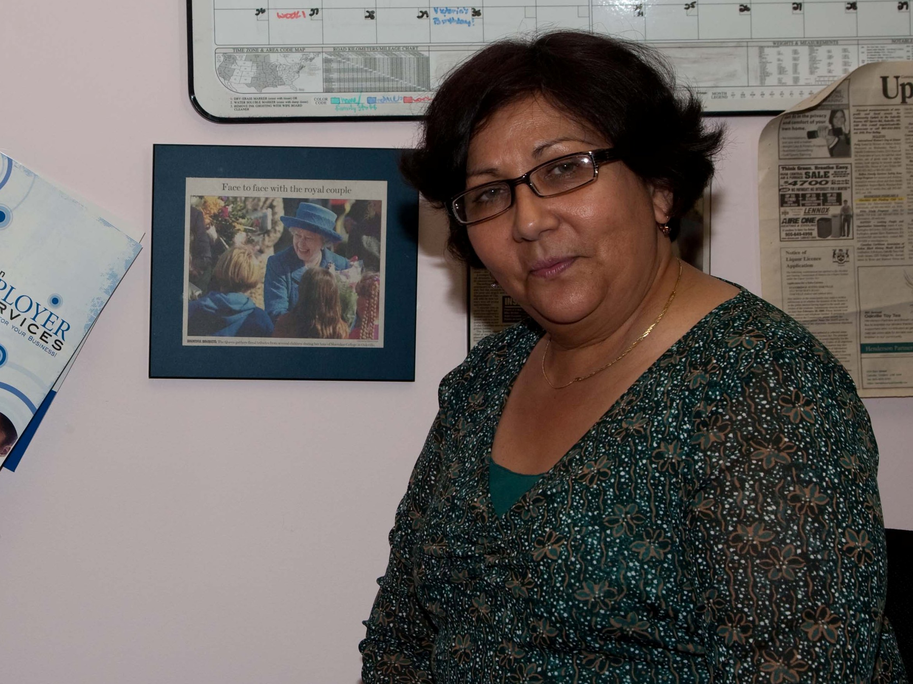
Accommodating violence?

Slide 43
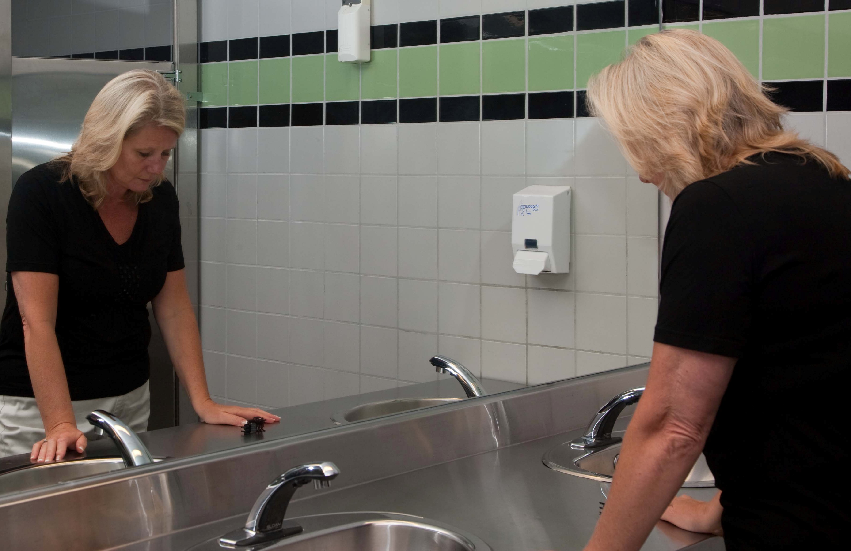
Triggers and Emotional Cost

Slide 44
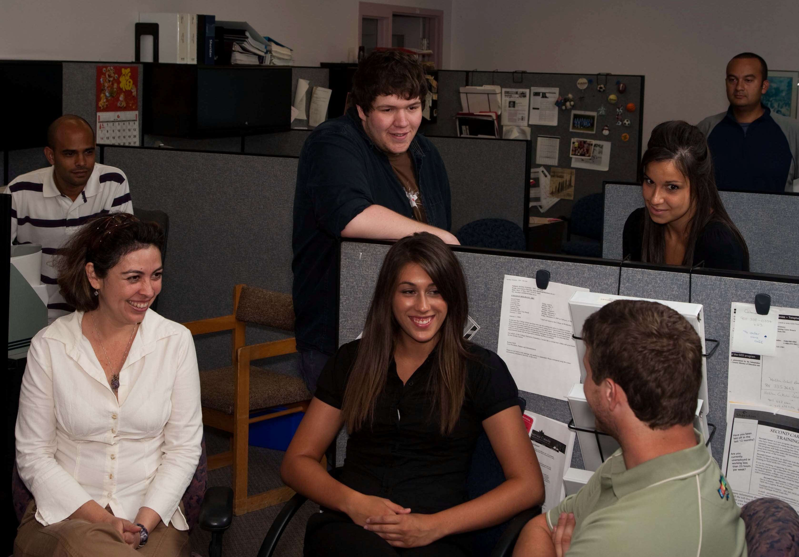
Who has your back?

Slide 45
A Call to Action
"When dealing with people, remember you are not dealing with creatures of logic, but creatures of emotion."
- Dale Carnegie

Slide 46
Building a healthy workplace

