Slide 1


Wind and the Ontario Electrical Grid – The Good, Bad and Ugly
Paul Acchione, P. Eng., B.A.Sc., M. Eng.
Chair – OSPE Energy Task Force
Management Consultant – MIDAC Corp.
Presented to the Energy Mini-Conference Series 2012
Joint IEEE/ISA/PEO/SIPwK/SDP
Toronto, SPK Halls, 206 Beverley St., Ontario
March 22, 2012

Slide 2
Wind and the Electrical Grid – The Good, Bad and Ugly Data Sources
The Ontario generation and customer demand data was obtained from the IESO website (http://www.ieso.ca).
Electricity production cost data was obtained from the Projected Costs of Generating Electricity, 2010 Editio, Organization for Economic Co-operation and Development, median case with carbon tax removed.

Slide 3
Wind and the Electrical Grid – The Good, Bad and Ugly The Benefits of Wind Generation
Wind generation has matured over the past 2 decades and is now competitive on a cents/kWh basis with many other forms of new generation.
Wind generation has zero GHG emissions.
Wind generation is easy to install and distribute geographically and has low operating costs.
Wind generation produces no significant waste products.
Wind energy delivers the best environmental performance in grids that have significant amounts of coal fired generation (eg: USA, Europe, China and Alberta).

Slide 4
Wind and the Electrical Grid – The Good, Bad and Ugly The Challenges in Ontario’s Grid
Customer demand for electricity has dropped. The global recession and conservation have reduced demand.
Embedded generation such as combined heat and power (CHP) and smaller scale solar, wind and bioenergy are reducing the demand in the IESO managed grid.
Ontario’s IESO managed grid currently has surplus base load generation and may have surplus peak load generation in the future if large amounts of solar generation are added to the grid.

Slide 5
Wind and the Electrical Grid – The Good, Bad and Ugly Ontario’s Electrical Demand is Flat

Slide 6
Wind and the Electrical Grid – The Good, Bad and Ugly Ontario Spring / Summer Demand Variation

Slide 7
Wind and the Electrical Grid – The Good, Bad and Ugly Installed Capacity and Energy Delivered

Slide 8
Wind and the Electrical Grid – The Good, Bad and Ugly Ontario’s Future Installed Capacity

Slide 9
Wind and the Electrical Grid – The Good, Bad and Ugly Storage – Benefits and Costs
Wind generation is intermittent so it needs a dependable backup supply.
Daily and seasonal storage would be very helpful not only to supply energy when wind is absent but also to store energy when wind is blowing strongly at night and demand is low.
Unfortunately, storage is expensive. Estimates by various sources vary from $1,000 to $9,000 per KW depending on various factors including the amount of energy stored (kWh). This compares to $2,000 to 2,800 per kW for the wind turbines.

Slide 10
Wind and the Electrical Grid – The Good, Bad and Ugly Wind Variability in the Spring

Slide 11
Wind and the Electrical Grid – The Good, Bad and Ugly Wind Variability in the Summer

Slide 12
Wind and the Electrical Grid – The Good, Bad and Ugly The Challenges with Wind Generation
Health concerns for residents close to wind farms (noise related). Growing anti-wind lobby by residents and municipal politicians.
Ontario is not geographically large enough to eliminate hourly fluctuations in wind generation among wind farms.
Wind production is out of step with actual electrical demand.
The highest production is in the spring, fall and winter especially at night when demand is lowest.
The lowest production is during the summer and during peak hours when demand is highest.

Slide 13
Wind and the Electrical Grid – The Good, Bad and Ugly Annual Cumulative Wind Generation in Ontario

Slide 14
Wind and the Electrical Grid – The Good, Bad and Ugly Wind Generation is Not Grid Friendly
Wind competes with base load plants for electrical demand.
If we continue to give wind priority access to the grid, when there is insufficient demand and strong wind:
we spill water at hydraulic plants
we sell power at negative electricity prices to neighbouring grids.
we need to shutdown nuclear units down that cannot maneuver sufficiently

Slide 15
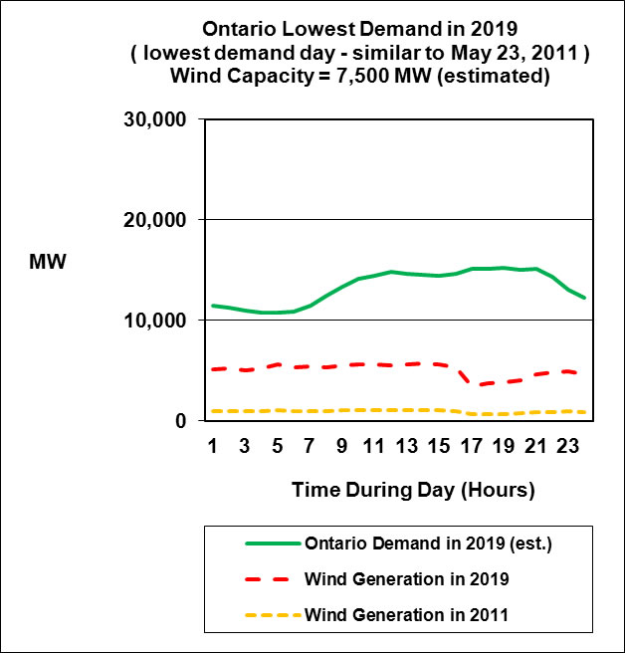
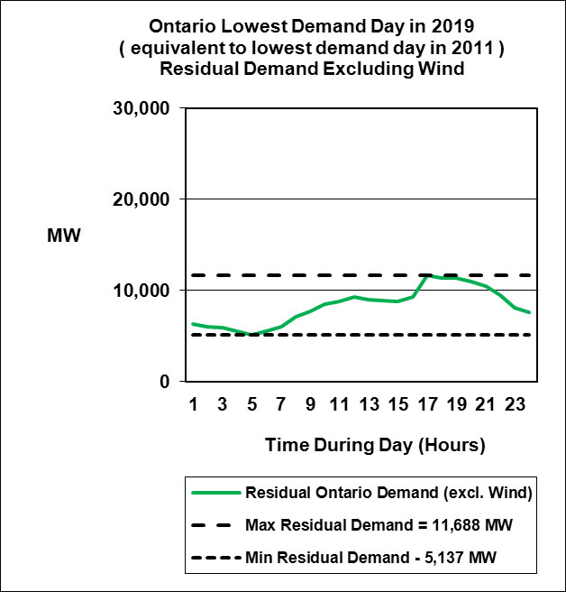
Wind and the Electrical Grid – The Good, Bad and Ugly Giving Wind Priority Forces Nuclear Off-Line

Slide 16
Wind and the Electrical Grid – The Good, Bad and Ugly Ontario’s Grid Constraints Affect Wind LCOE
Ontario has relatively little storage, cannot export large quantities of surplus power on the spot market and relies on hydraulic and nuclear plants for base load generation.
Base load demand in spring/fall is less than base load supply on Ontario.
If we dispatch wind or solar generation their levelized cost per kWh (LCOE) rises rapidly because they have low capacity factors and we don’t utilize the available energy.

Slide 17
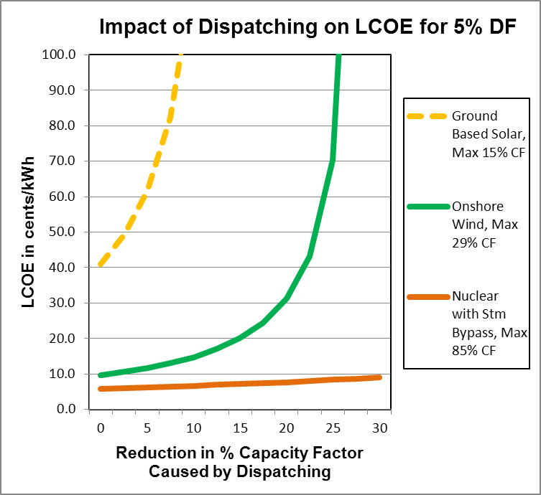
Wind and the Electrical Grid – The Good, Bad and Ugly Impact of Dispatching on LCOE is Significant

Slide 18
Wind and the Electrical Grid – The Good, Bad and Ugly The Impact of Nuclear Shutdowns in Ontario
Nuclear has limited maneuvering capability. If we don’t dispatch wind generation we get hydraulic spill and nuclear shutdowns during very low demand periods (spring and fall).
Nuclear plant shutdowns last 2 to 3 days minimum and result in higher fuel cost and higher GHG emissions for gas-fired replacement power.
For 2014 (not the worst year) IESO estimates that nuclear shutdowns will result in 180 Million $’s in additional natural gas fuel costs and 1.6 million tons in additional CO₂ emissions if we don’t dispatch wind and solar generation.

Slide 19
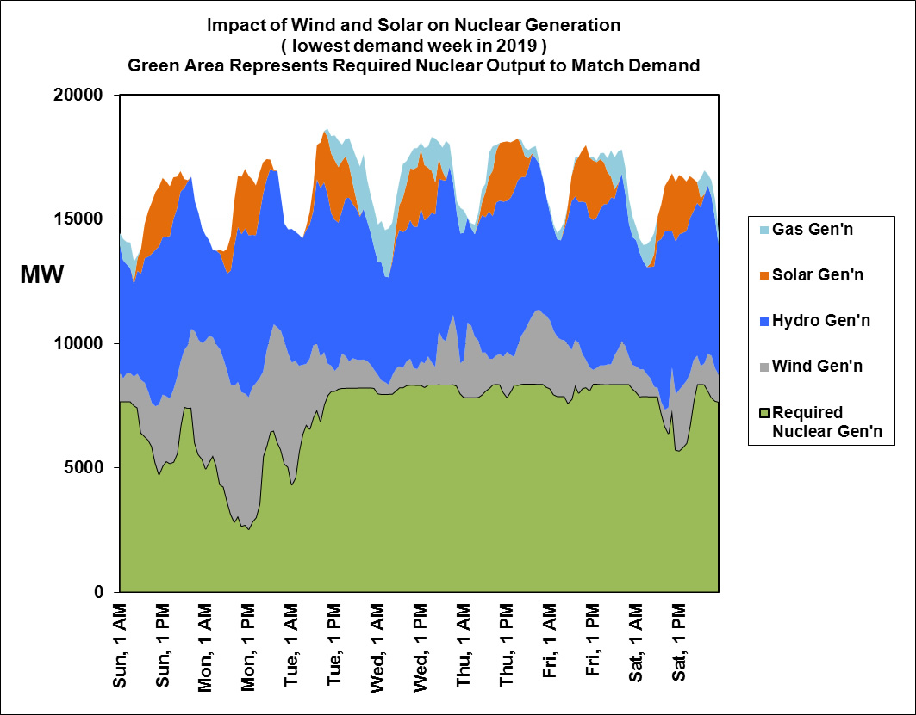
Wind and the Electrical Grid – The Good, Bad and Ugly If Wind Has Priority Nuclear Must Maneuver

Slide 20
Wind and the Electrical Grid – The Good, Bad and Ugly If Nuclear Can’t Maneuver it Must Shutdown

Slide 21
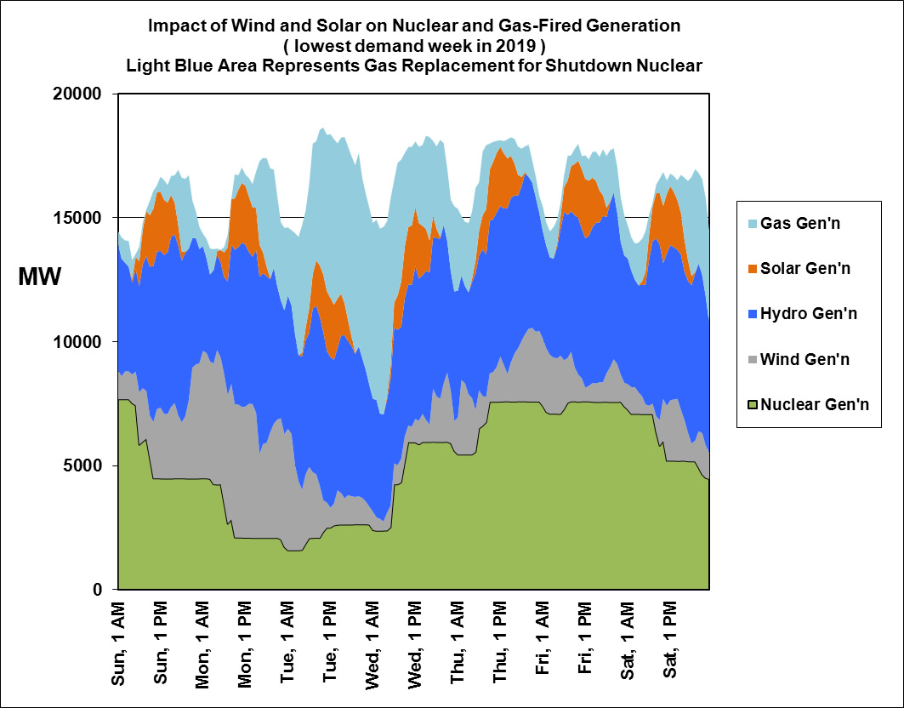
Wind and the Electrical Grid – The Good, Bad and Ugly If Nuclear Shuts Down – CO₂ Emissions Rise

Slide 22
Wind and the Electrical Grid – The Good, Bad and Ugly Summary/Conclusions
The current design of the Ontario electrical grid is not compatible with a large increase in wind generation.
The reduced customer demand for electricity is making the surplus base load generation problem worse.
The large increase in wind generation will place upward pressure on electricity rates and will drive GHG emissions higher unless:
wind and solar are dispatched
demand is shifted from day to night, or new electrical loads are added at night such as electrical vehicle charging, Hydrogen production, etc.
surplus energy is sold on a firm basis to neighbouring grids
nuclear plants are modified to improve their maneuverability
more daily and seasonal storage is added

Slide 23
Wind and the Electrical Grid – The Good, Bad and Ugly Summary/Conclusions (continued)
There was inadequate professional engineering input into the development of Ontario’s electrical energy policies, directives and implementation plans.
Ontario’s long term energy plan is not optimum with respect to cost and environmental performance.
Ontario’s Ministry of Energy needs to include more power engineering expertise specific to Ontario’s grid design in the development of electrical energy policies, directives and implementation plans in order to achieve optimum cost and environmental performance.

