Slide 1
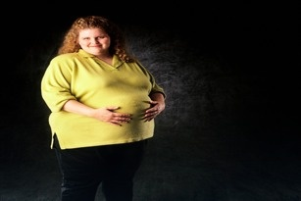
Weight Expectations: Experiences and needs of overweight and obese pregnant women and their healthcare providers
Yvonne Hanson
June 7, 2012
Regina Research Day

Slide 2
Study objectives
What do we know about the psychological & emotional implications of overweight & obesity in pregnancy?
How does the social context of women’s lives affect their experiences of overweight & obesity throughout pregnancy?
How do healthcare providers support women & what are their ideas to improve the system for women?

Slide 3
Methods
Interviewed 33 individuals: 18 women; 15 health care providers (family doctors, nurses, ob/gyns, midwives, dieticians)
Joint study between ACEWH & PWHCE
Co-researcher – Jennifer Bernier (ACEWH)
2010-2012 (First year in N.S. included women only; second year expanded to rural N.S. All women & hcp were from Saskatoon HR)
Face-to-face interviews and phone interviews
Audio podcast (summer 2012)

Slide 4
Physical health & pregnancy/ birth outcomes
Literature indicates morbidities & co-morbidities associated with obesity for mothers (i.e. gestational diabetes, pre-eclampsia, cesarean birth, postoperative infection, hypertension, blood clots)
Also for babies (i.e. stillbirth, macrosomia, neural tube defect, incidences from cesarean)
Pregnancy outcome deteriorates in linear manner as BMI increases

Slide 5

perception of Pregnant women with obesity ?
The Globe and Mail - “Canadian doctors are considering a policy that would bar obese women from trying to have babies through fertility treatments – provoking debate over whether the fat have the same
reproductive rights
as the thin.”
(Sept 20, 2011)
Notes:
Bariatric obstetrics. Calls of scare providers vs care providers. Very little tracking on the rates of women with elevated BMI and how prevalent the physical incidences of morbidities really are.
Co-founder of Ottawa Fertility Centre, Dr. Arthur Leader will not treat women with BMI of higher than 35, yet others such as Dr. Anthony Cheung at UBC and Grace Fertility Centre add, “These people already know they have a problem – are you going to make it worse, add feelings of social injustice, low self-worth and depression?|”

Slide 6
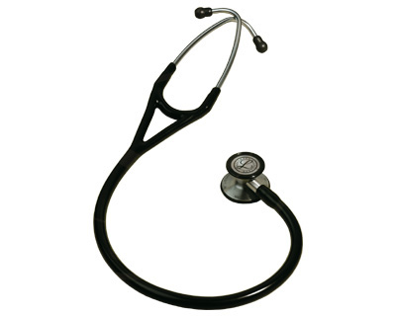
Caregivers in study: competition, stigma & ethical practice
The different orientations to maternity care in Canada has been historical & political (i.e. midwifery care vs. physician)
Stigma of obesity & overweight are pervasive
Maternity care providers of all scopes of practice are both ethically & professionally obligated
to provide best care possible
Notes:
First point: With the political issues, have been deep philosophical differences (woman-centred vs. Medical). This was sometimes evident in the caregivers’ answers as they referred to women. One midwife noted, “It’s just that midwives have a different focus. They see giving birth and pregnancy as something normal that happens in a woman’s life. And obstetricians look for the risk, the catastrophe that is waiting to happen… When we’re looking at an obese woman we say okay, we have a lot of obese women, and yes, they can give birth just fine and we’ll work with that. We strive to keep things normal and support the normal process of having a baby and the joy of it. We don’t like to subscribe to the risk talk”. Regardless, it was often felt that team approach – interprofessional collaboration, or share-care, were felt to be a solid approach in working with women, in particular women with obesity (as suggested by one midwife). Nova Scotia was noted to be doing more of that than in Sask.
Second point: Another hcp, One nurse comments,”Some of the doctors have a hard time with the fact that they’re overweight. It’s a personal... Their personal opinions come into play. And I have heard the anesthetist too in particular would say you’re too fat. “You’re too fat. I can’t get this. You’re too fat.” And going on and on and on about it while they’re trying to put an epidural in. “
Another maternity unit nurse, “All of us hate it [working with their large sizes] and I know that they pick up on it. Ideally it would be better if they never got that way but there you are I don’t know what you would do. Some physicians are totally rude to their patients even about it and I don’t think that’s the way to go about it. It’s a problem – it’s a big problem.
Point three: One caregiver, “you probably give them a more supportive introduction when they have what you can foresee as difficulties at the beginning. Like for example, with weight and that you know the severity of weight problems for them and for their offspring. So you probably take a little extra time with them in order to reinforce a very positive aspect of healthy weight gain and healthy living during their pregnancy”.

Slide 7
self-perception & Image
“ I was very good during my pregnancy because I was taking care of somebody else. But once the baby was born, I wasn’t so good at taking care of myself. So my nutrition wasn’t probably as attentive as when I was pregnant.” (SK woman)
“You see those pictures, beautiful pictures of pregnant women who are naked & covered up just so…I guess the biggest thing about weight and pregnancy was I missed the aesthetics of looking cute & pregnant. I know that sounds horribly selfish & shallow but [it’s] the biggest thing that has affected my mood or feelings during the pregnancy” (NS woman)
Notes:
Point one: Notion of pregnant women focusing on her baby more than herself.
Point two – socialized role of pregnancy – what does the “look” of pregnancy look like – models and media role in shaping stereotypes, self-perception

Slide 8
Women’s experiences with caregivers
18 women interviewed: 11 described experiences as either neutral or positive (although all have some negative experiences)
Instances of uncertainty with caregiver – how to talk about weight?
Subtleties of comments or actions towards stigmatizing behaviour
Notes:
one woman commented that her caregiver – a midwife – was “fat-phoebic” right from the beginning and insisted that she birth in the hospital. She comments, “From the first appointment everything degenerated to my weight and how I was going to have hypertension and I was probably going to be pre-clampsic and I was probably going to have gestational diabetes and not even look at having a home birth and be prepared for a C-Section or to have an epidural from the very beginning and it was always about that.”
On issue of wanting to discuss weight – women felt they had to bring it up because caregivers were apprehensive to (but notably caregivers we interviewed often didn’t bring it up for fear they may lose patient or upset them)

Slide 9
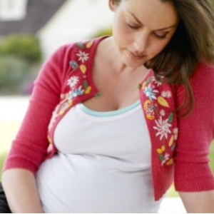
Women’s emotional responses during pregnancy
Two over-riding emotions in interviews:
self-blame/guilt
fear of judgment
Notes:
– on emotion of self blame/guilt – “Oh and everyone was saying, ‘Oh that’s going to be a big baby’ or ‘oh you’re gaining a bunch of weight’. It was so annoying… It made me feel like I was hurting my baby, that I was gaining too much weight. That I was setting him up for a lifelong risk of obesity, which I didn’t want for him”.
On fear of judgment – So when I went in, it was almost like sneaking in. Like you know, I know I’m not supposed to be overweight and get pregnant but I did…
Q: So would it be fair to say that you hid some information from your healthcare provider because you feared judgement?
-I did yes. Yes, he didn’t know any of the fertility information I was seekign out. Nor did he know the tracking I was doing. Nor did he know that I came off birth control pills. So yes, I dare say there was a lot of hidden stuff”…

Slide 10
Call for action
Team approach to maternity care for women with overweight/obesity (intercollaborative practice)
Information on weight gain & risk needs to be more systematically shared among all women, so as not to stigmatize
An understanding of risk among women with obesity should be tempered with other factors (age, pre-existing conditions, genetics)
Many obese women have negative experiences within health care, so sensitivity important

Slide 11
“I think it is hard for women who are overweight and obese to really love their bodies. It’s rare. But you know, we can kind of stretch that concept a little bit. And again, going through the process of giving birth often helps women to have this more profound respect for what their bodies are capable of and how miraculous the whole process is. And again, helping them feel like they are doing it. They have accomplished this great feat.”
- N.S. caregiver, 2012

Slide 12
www.pwhce.ca

