Slide 1
The Federal Internship for Newcomers – The Graduate Advantage

Slide 2

Looking for professional, experienced help?
Information Technology
Finance
Project Management
Administration
Research

Slide 3
The Solution
The Federal Internship For Newcomers Program Graduates
A pool of talented, proven and trusted professionals ready to work for your organization.

Slide 4
Why Hire Immigrants?
Respond to demographic and labour market trends:
Aging population and workforce, looming retirements
Employers need skilled workers; report recruitment difficulties
Growing ethno-cultural diversity (workforce, consumers, clients)
Immigration key contributor to Ottawa’s labour force growth
Increase workplace performance:
Enhance productivity, creativity, employee relations, and decision-making through diverse approaches and perspectives
Increase organizational performance
Better understand and respond to your diverse customer base
Expand local markets, and develop new global markets

Slide 5
Federal Internship for Newcomers (FIN) Program
A flagship award winning Government of Canada internship program for newcomers to Canada.
Supports public service renewal and diversity objectives.
Created to respond to a key barrier to labour market participation for newcomers: Canadian work experience.
Rapid expansion driven by demand –
from 2 to 20 departments in 24 months
more than 130 work placements
pilot expansion beyond Ottawa to Toronto and Vancouver in 2011
Overwhelmingly positive employer satisfaction.
Now expanding into private sector to help graduates secure long-term employment.
Notes:
Since its inception, the Program has evolved from a modest pilot to a multi-departmental initiative, offering over 130 work placements to newcomers between 2010-2012, to respond to the human resources requirements of over 20 participating departments/agencies. (63 placements for the 2011-2012 program year). Participating hiring departments and agencies include CIC, HRSDC, Health Canada, Agriculture, CBSA, CRA, DND, PSC, WED, DFAIT, PHAC, DFO, CSIS, NRCan, PWGSC, Public Safety, Statistics Canada, Courts Administration Services, Tribunal, Canada Economic Dev. Quebec, ACOA.
Due to the success of the Program in NHQ, departments and agencies expressed a keen interest in exploring how the Program could be used to respond to regional human resources requirements and leverage local talent. As a result, working in close collaboration with our regional offices, the FIN Program expanded to offer placements in Toronto and Vancouver/Victoria in September 2011. These locations were identified as pilot locations based on departmental need and immigrant intake numbers. This year, 18 positions were offered in pilot locations.
The HUMA standing committee recommended that FIN continue and provide additional placements if resources allow.

Slide 6
The FIN Program Approach
Local Immigrant Serving Organizations identify and screen applicants for job readiness and language skills.
Applicants undertake rigorous screening and interview process, assessed against established criteria for each job category.
from 4000 applicants to 200 qualified candidates and approximately 70 interns/graduates.
Interns work for up to 8 months.
Each intern is paired with a mentor and provided with cross-cultural training to support success.
Notes:
Program is currently delivered in partnership with Immigrant Serving Organizations (ISOs) in Ottawa, Toronto, and Vancouver that screen for employment readiness.
Partner ISOs screen their clients for ‘job readiness’, and refer job-ready clients to apply to the FIN program.
*Job readiness includes but is not limited to: an in person-meeting and assessment, functional language capacity in English and/or French (minimum Canadian Language Benchmark of 6-8); referral to appropriate licensing/assessment bodies for credential assessment; and referral to additional job readiness training where needed i.e. resume writing or interviewing coaching
The FIN Program is open to:
Permanent residents and Canadian citizens who have been in Canada less than 10 years
Candidates with a post secondary degree (Assessment of Foreign Credentials not mandatory but recommended during their internship)
During the intake process for the 2011-2012 internships:
over 4000 applications were received
2000 resumes were screened
Over 350 interviews were conducted by CIC
Majority of placements take place from September to April.

Slide 7
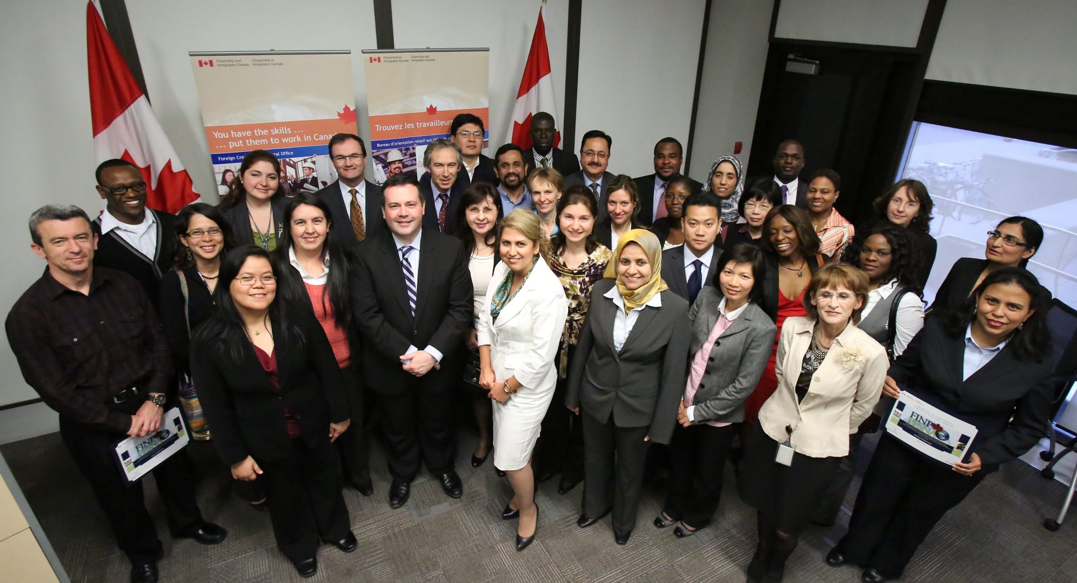
Meet some of our graduates…

Slide 8
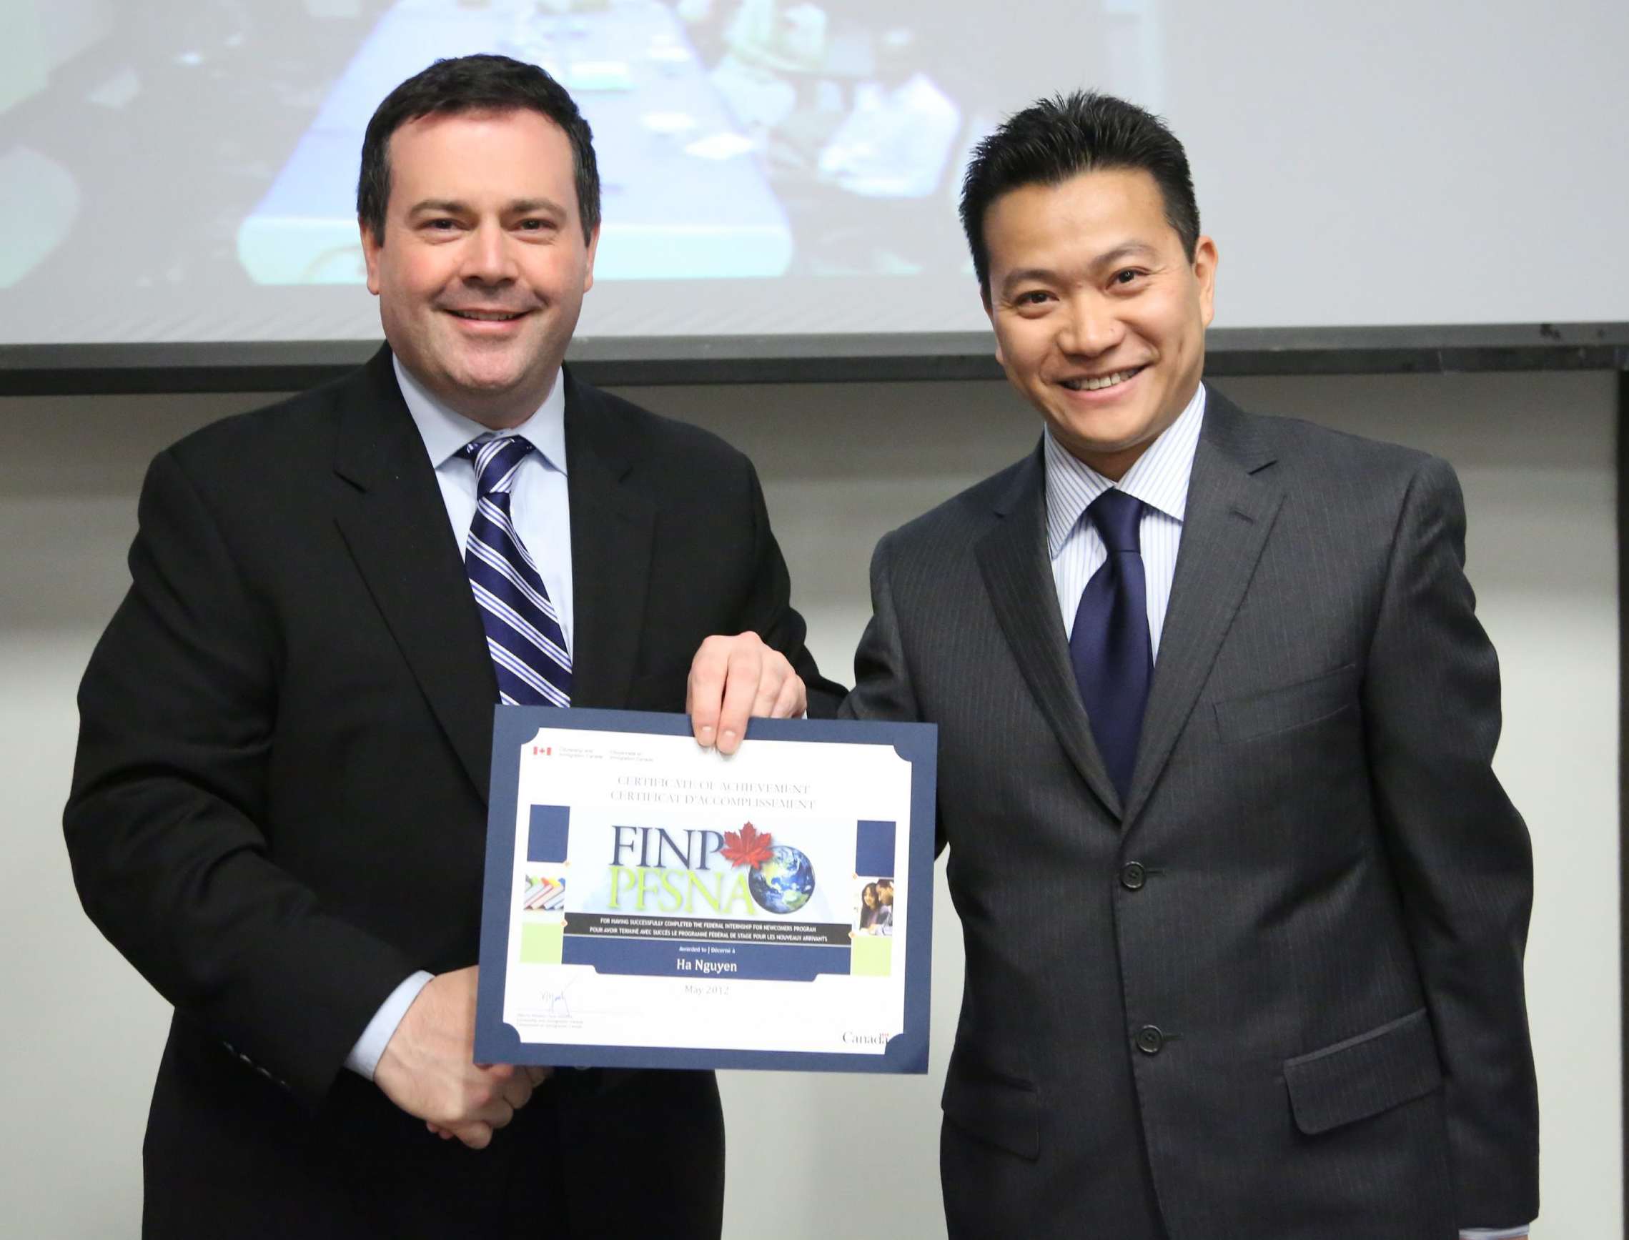
Ha: Trade Policy Analyst, Agriculture
His Story:
Immigrated to Canada with his family from Vietnam as a doctoral student in 2005 and became a permanent resident in 2008.
Studied at the University of Manchester, University of Vietnam, Ukraine and he is currently completing his doctorate in public policy at Carleton University in Ottawa.
Obtained bachelor’s of Law and International Studies, and Masters of public policy.
His Internship Experience:
“The FINP internships have enabled me to acquire not only technical, work-related skills but also improve my soft, transferable skills such as communication, interpersonal and problem-solving skills ...that would definitely be vital in my next phase of securing a permanent position.”
Notes:
Ha recently spoke at the graduation ceremony for the 2011-2012 FIN internships. In his case, a department was able to match their needs with his skills perfectly, as he was placed in the Asia and Oceanic division of Agriculture as a trade policy analyst. His networks and knowledge gained abroad has been a real asset to his team.

Slide 9

Jean-Marie: Finance/Program Officer, CIC
His Story:
Immigrated to Canada through the World University Service of Canada’s (WUSC) Student Refugee Program in 2006 after spending 12 years in refugee camp in Malawi.
Studied at Algoma University at Sault Ste-Marie, Ontario.
Obtained a Bachelor’s degree in Finance and Economics in 2010.
His Internship Experience:
“The opportunity equipped me with valuable, career-boosting experience...The internship at CIC has been a life-transforming experience and shaped my professional identity and approach for many years to come.”
Notes:
Jean-Marie was one of our World University Services Canada referred candidates. He came to Canada through their Student Refugee Program which sponsors high potential students from refugee camps to study in Canadian universities. Jean-Marie gained some much needed Canadian work experience at CIC, and since graduating last year is now working in his field (finance) in the private sector.

Slide 10
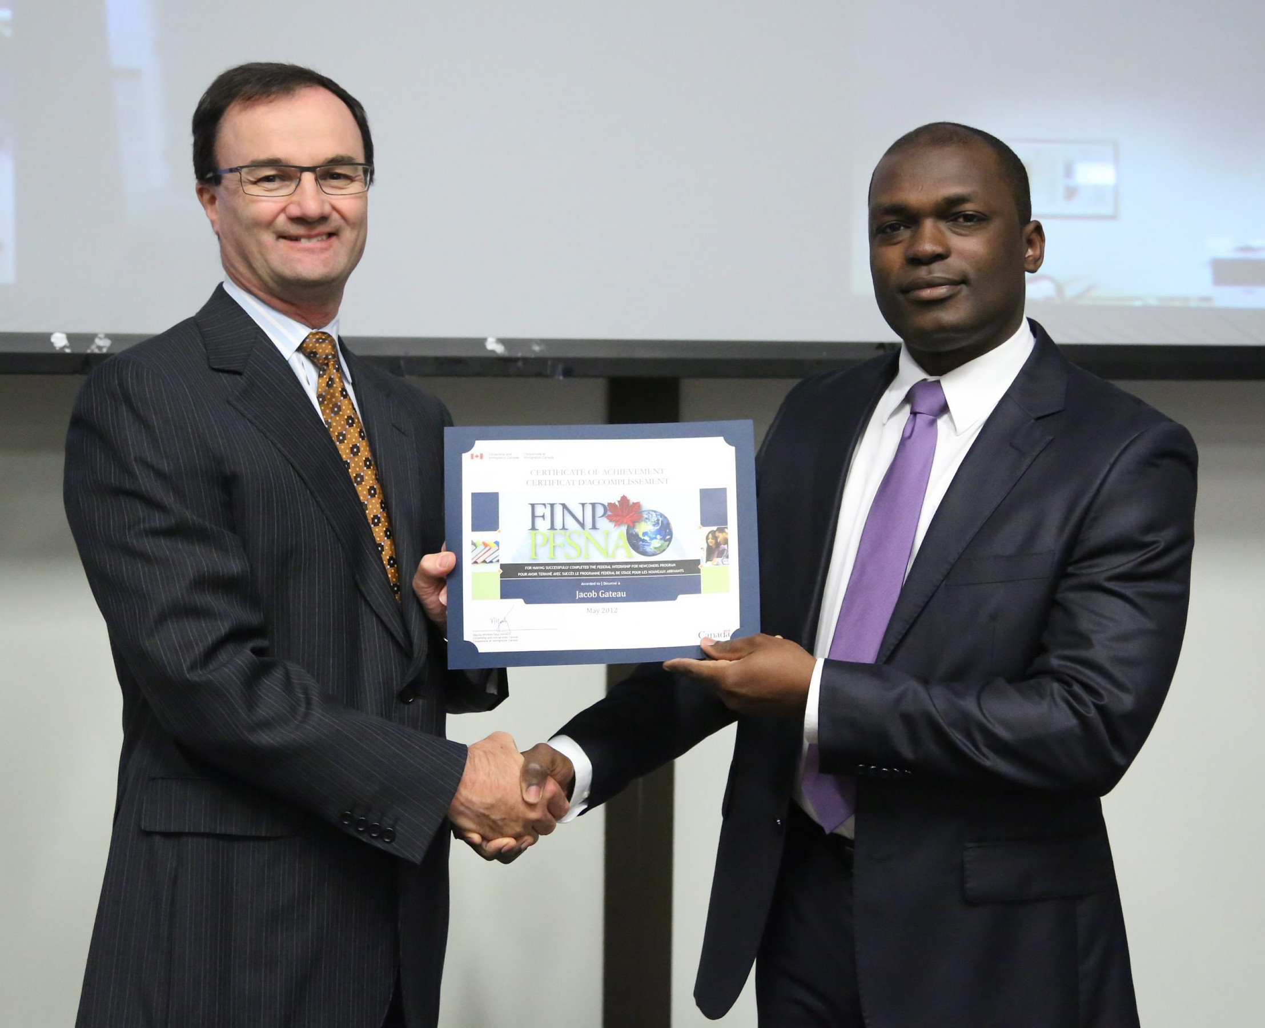
Jacob: Business Analyst, CIC
His Story:
Immigrated from Haiti to Canada in 2010.
Studied at École Nationale d’Administration (ENA), Strasbourg, France and École Nationale d’administration publique (ENAP), Gatineau, Canada.
Obtained a degree in International Relations and Diplomatic Affairs and a Masters of Public Administration in Program Evaluation.
His Internship Experience:
“FINP strikes me as a valuable integration tool, enabling immigrants to get involved in their new adopted land and serve the collective good...it helped me feel useful and find meaning in my decision to immigrate to Canada.”
Notes:
Jacob is another outstanding graduate. He originally came to Canada in 2008, but was asked to come back to Haiti to work for the Haitian Prime Minister that year. After contributing his skills working there, returned to Canada in 2010. He has continued his studies here in Canada and has been a valuable asset to CIC’s performance management branch.

Slide 11
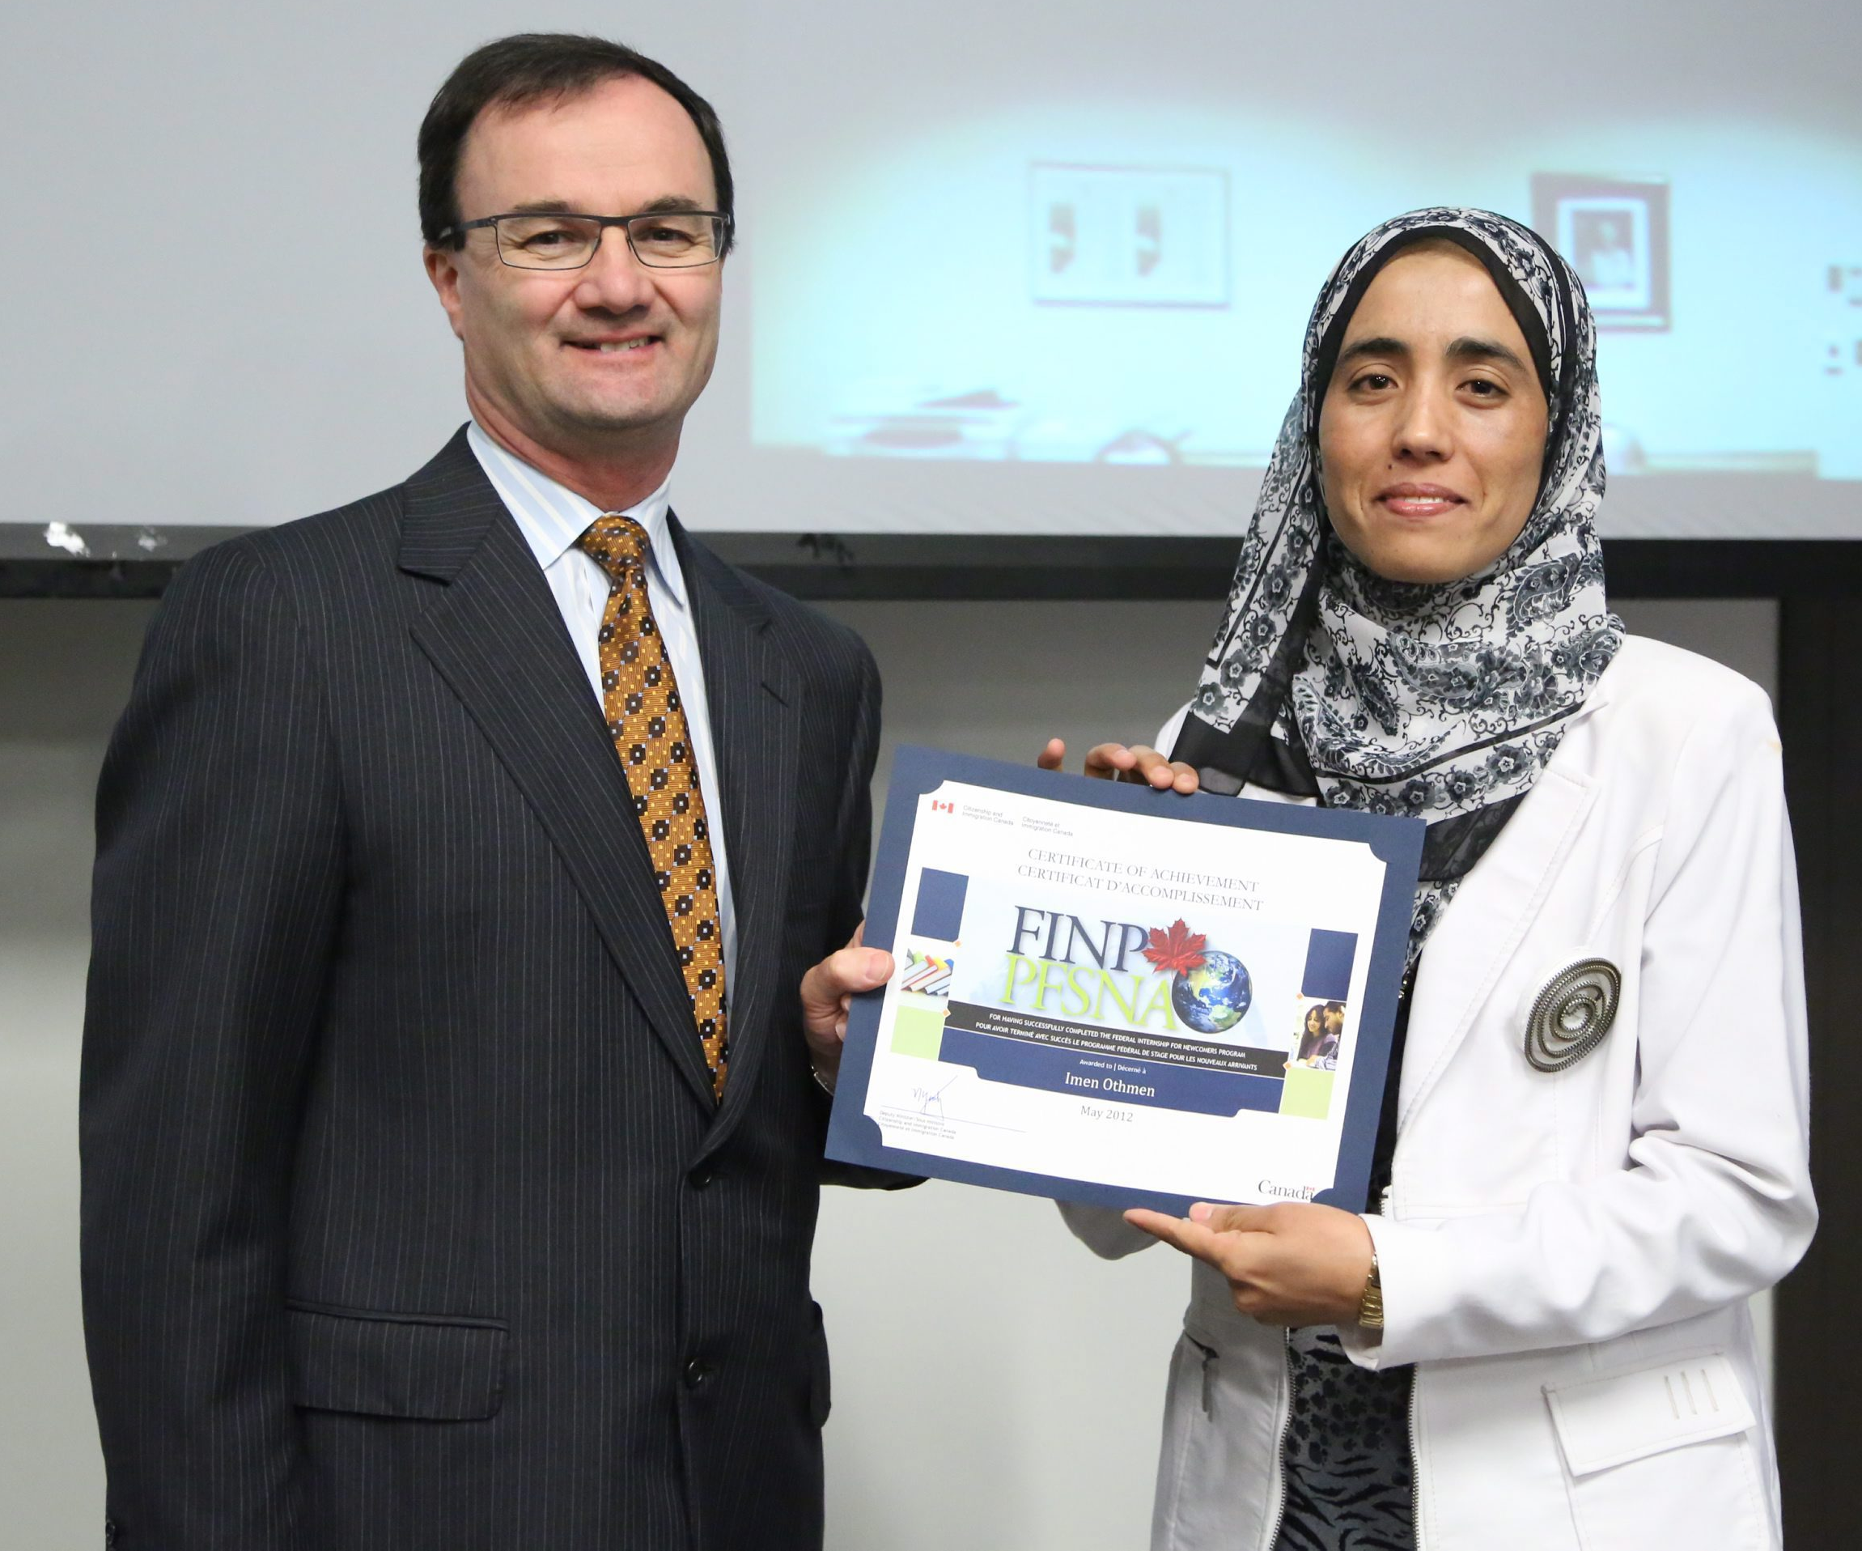
Imen: Information Technologist, HRSDC
Her Story:
Immigrated from Tunisia to Canada in 2009.
Studied at National School of computer Sciences in Tunisia.
Obtained a diploma in computer science.
Her Internship Experience:
“Everything is gathered together to achieve success: the coaching process, the information sessions, the support of the entire FIN Program team and more. Personally, this experience has opened the door to a successful life in this beautiful country. Now, I have more confidence in myself -which I had lost for a while.”
Notes:
Imen has been working as a computer programmer in HRSD. Her employer spoke at an evaluation event for the FIN Program earlier this year and he remarked on what a wonderful experience he’s had working with Imen.

Slide 12
FIN Program Graduates for your Organization
We have graduates with post-secondary degrees and experience in high-demand sectors.
We can send you several CV’s of graduates that meet your job description.
You may wish to interview graduates and complete further assessment to determine the best fit for your organization.
Once you find a match, the graduate and your organization have access to a range of cross-cultural support services to help everyone succeed at no cost to you.
Notes:
The primary objectives of private sector partnerships are to:
- diversify the range and duration of work experience offered to newcomers; and
- help employers meet temporary or permanent needs
- Support improved labour market integration of newcomers in fields matching with their skills and experience.

Slide 13
The FIN Graduate Advantage
Experienced
Graduates are professionals with work experience in Canada and internationally.
Proven
Graduates have federal public service work experience and working level language skills
Trusted
Graduates possess a Government of Canada security clearance.
Networked
Graduates have developed global and local relationships with decision-makers in government and the private sector.
Supported
Graduates come with access to resources and training designed to help them succeed in the workplace.

Slide 14

Here’s what employers are saying
“We have had an excellent experience with our intern – from day one a real team player with a strong work ethic and capacity as well as an all-around fun person to work with and lead. Over the last eight months we have learned much and hope we have provided a good introduction to the fast moving and high intensity environment of a policy shop.” - CIC Manager
“I find that our interns quickly understand what we are trying to accomplish and are not only motivated to do good work, but are motivated to improve our program and help families. The Interns arrive with an open mind; a willingness and eagerness to learn while working; and bring with them an array of skills and abilities that complement our own.” - HRSD Manager

Slide 15

FIN Employer Recognition Program
You and your organization featured on the FIN Program partner page.
News release announcing your involvement.
Attend FIN graduation and other Program events.
Access to FIN logo to use on your page, demonstrating your corporate diversity/social responsibility
Current featured partners: CGI and CIBC

Slide 16
Contact us
Mary Da Costa Lauzon
Manager, FIN Program
613-941-8970
Mary.da-costa-lauzon@cic.gc.ca
Jennifer Moores
Senior Analyst, FIN Program
613-957-5829
Jennifer.moores@cic.gc.ca

