Slide 1

Thompson Rivers University
Operating Budget
2012– 2013
Board of Governors
May 24, 2012

Slide 2
Budget Committee of Senate - BCOS
Regular monthly meetings
Regular capital construction updates
Presentations from
Faculty of Culinary Arts and Tourism
School of Nursing
Human Resources – Benefits
Finance
TRUSU – Tuition Fees

Slide 3
Sub-committees of BCOS
Budget Review of New Programs and Courses
Tuition Waiver

Slide 4
Background
Enrolment Data
School District #73
TRU - trends
Revenue Sources
Government grants
Tuition
Other revenues
Expenditures
Categories
Benchmark Data
Comparative information

Slide 5
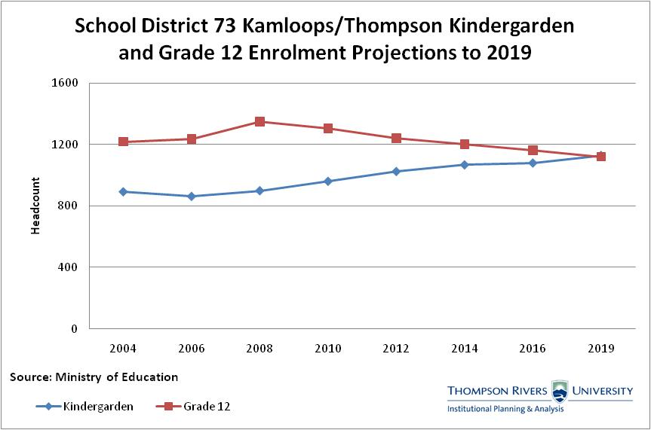

Slide 6
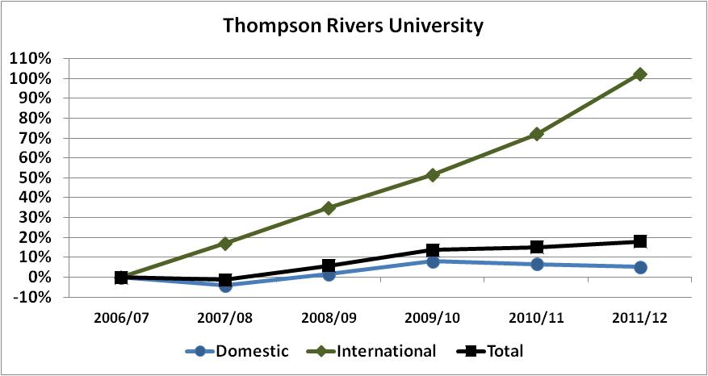
Academic Course Registrant Enrolment Trends % Change 2006-07 to 2011-12

Slide 7

% Change Enrolments - 2006-07 to 2011-12

Slide 8
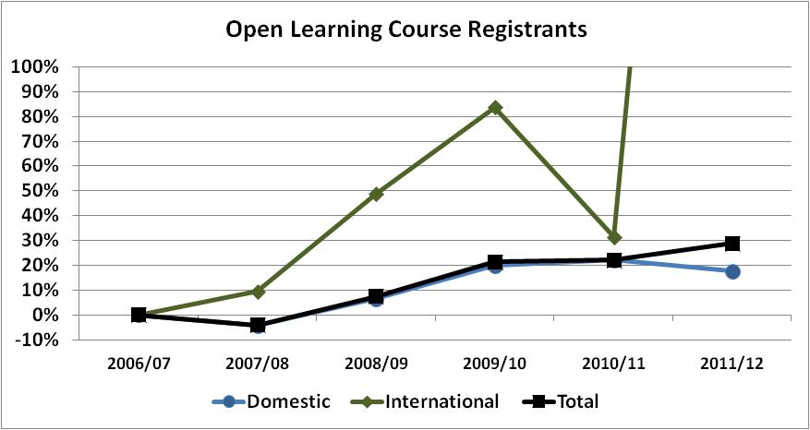
% Change Enrolments - 2006-07 to 2011-12
Course registrant data for International:
2006-07 - 351
2007-08 - 384
2008-09 - 522
2009-10 - 644
2010-11 - 461
2011-12 - 2218
In 2011-12 , there was a change in the determination of domestic students, must show proof of citizenship

Slide 9
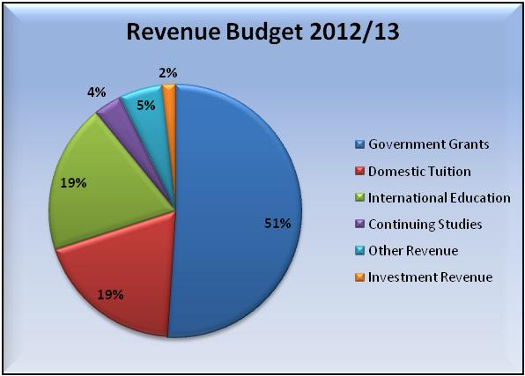
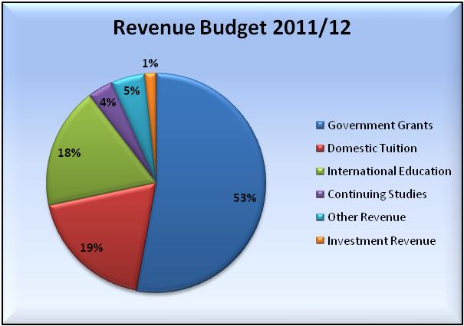
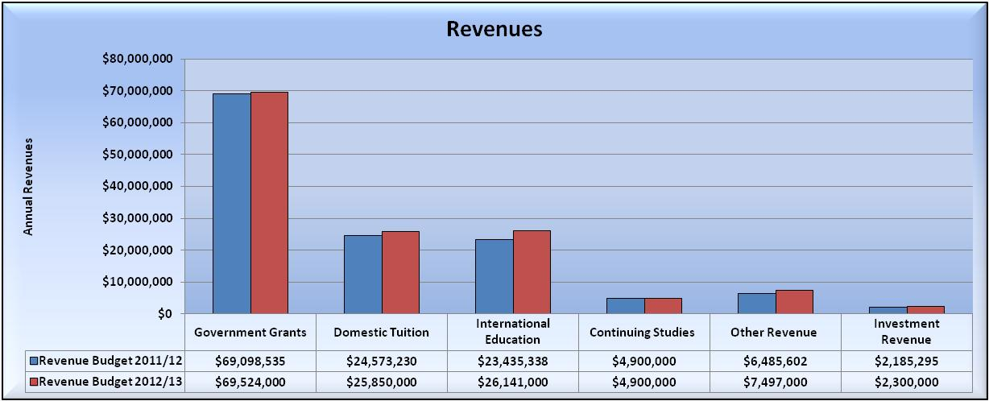
Draft Operating Fund Revenues (Total)

Slide 10
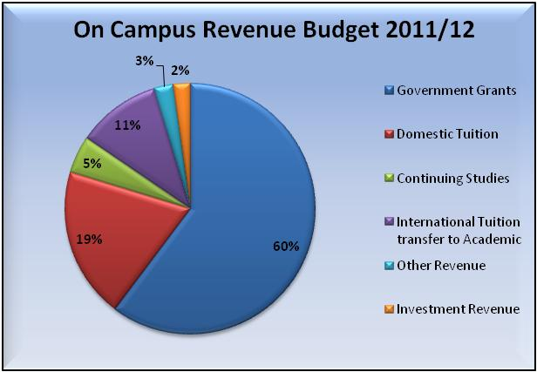
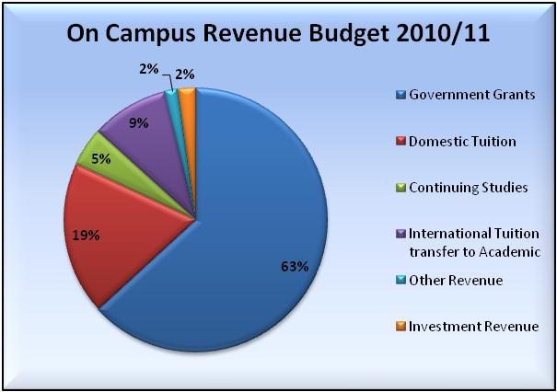
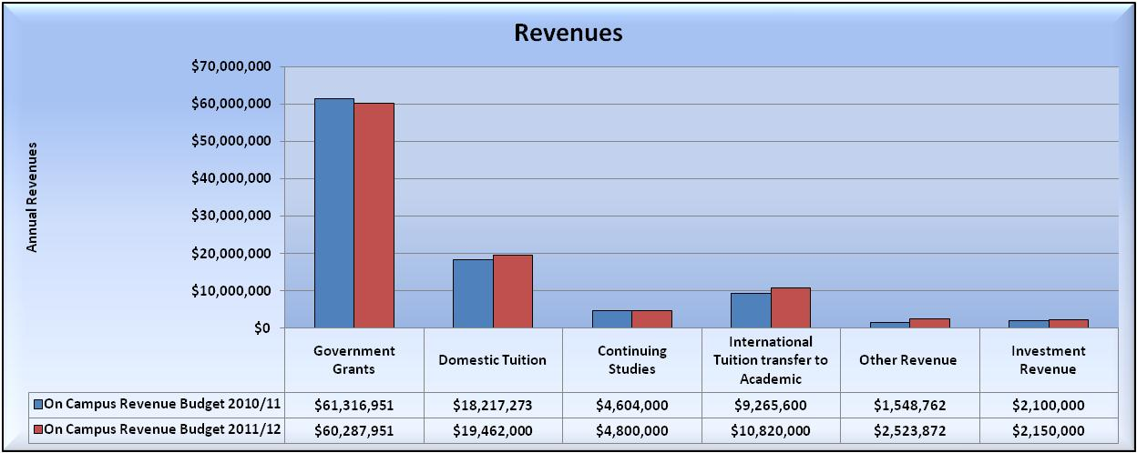
Draft Operating Fund Revenues – On Campus
Excludes Open Learning and TRU World Support

Slide 11
 | Provincial Operating Grant
 | FY2005/06 |  | FY2006/07 |  | FY2007/08 |  | FY2008/09 |  | FY2009/10 |  | FY2010/11 |  | FY2011/12
 |  | dollars per FTE |  | dollars per FTE |  | dollars per FTE |  | dollars per FTE |  | dollars per FTE |  | dollars per FTE |  | dollars per FTE
Royal Roads University |  | 6,855 |  | 7,394 |  | 7,780 |  | 8,040 |  | 8,673 |  | 8,678 |  | 8,678
Simon Fraser University |  | 9,020 |  | 9,491 |  | 9,891 |  | 9,994 |  | 10,614 |  | 10,736 |  | 10,731
Thompson Rivers University |  | 6,777 |  | 7,096 |  | 7,435 |  | 7,549 |  | 8,058 |  | 8,076 |  | 8,079
University of B.C. (Okanagan) |  | 6,343 |  | 8,243 |  | 8,801 |  | 8,930 |  | 9,070 |  | 9,070 |  | 9,070
University of British Columbia (Vancouver) |  | 11,034 |  | 11,738 |  | 12,754 |  | 13,181 |  | 14,274 |  | 14,501 |  | 14,716
University of Northern BC |  | 11,712 |  | 12,256 |  | 12,647 |  | 12,773 |  | 13,565 |  | 13,716 |  | 13,721
University of Victoria |  | 8,761 |  | 9,266 |  | 9,703 |  | 9,880 |  | 10,532 |  | 10,672 |  | 10,672
Total Grants to Group
Average funding per FTE |  | 9,502 |  | 10,099 |  | 10,726 |  | 10,965 |  | 11,709 |  | 11,864 |  | 11,949

Slide 12
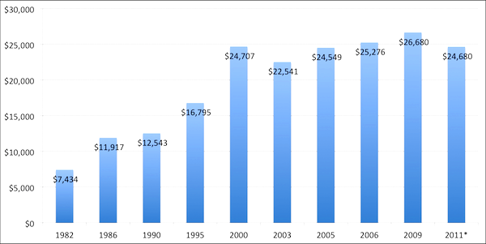
Average Debt Among Borrowers at Graduation in Canada for Bachelor's Degree Graduates, 1982-2009 (in 2009 dollars)
Source: Statistics Canada's National Graduate Surveys, Canadian University Survey Consortium Graduating Student Surveys

Slide 13
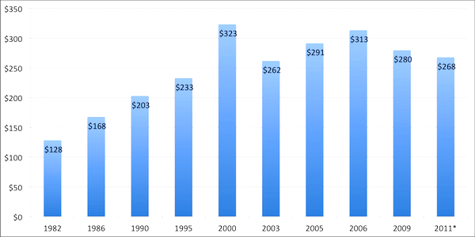
Monthly Student Loan Payments in Canada, 1982 to 2011 (in 2009 dollars)
Source: Statistics Canada's National Graduate Surveys, Canadian University Survey Consortium Graduating Student Surveys

Slide 14
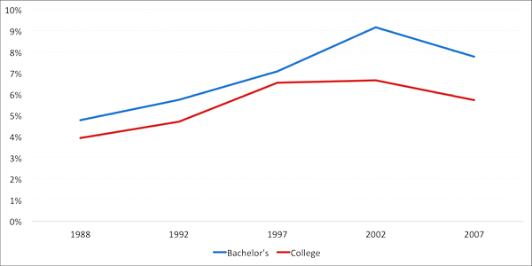
Percentage of Monthly Gross Earnings of Graduates Devoted to Student Loan Payments by Year of Graduation and Level of Study, 1988-2007 (in 2007 Real Dollars
Source: Statistics Canada's 1986, 1990, 1995, 2000 and 2005 National Graduates Surveys

Slide 15
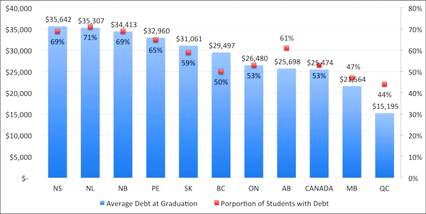
Incidence and Average Amount of Undergraduate Debt at Graduation in 2005, by Province (in 2011 Dollars)
Source: Statistics Canada's National Graduates Survey

Slide 16
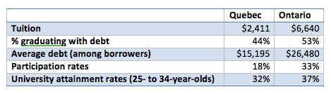
Access and Tuition

Slide 17
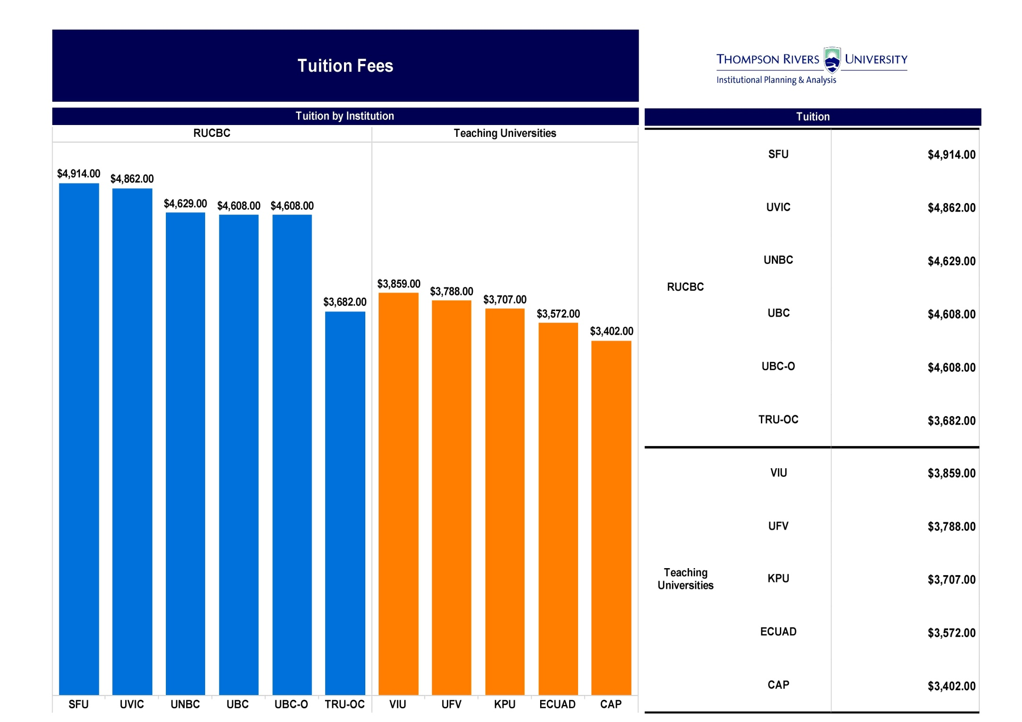

Slide 18
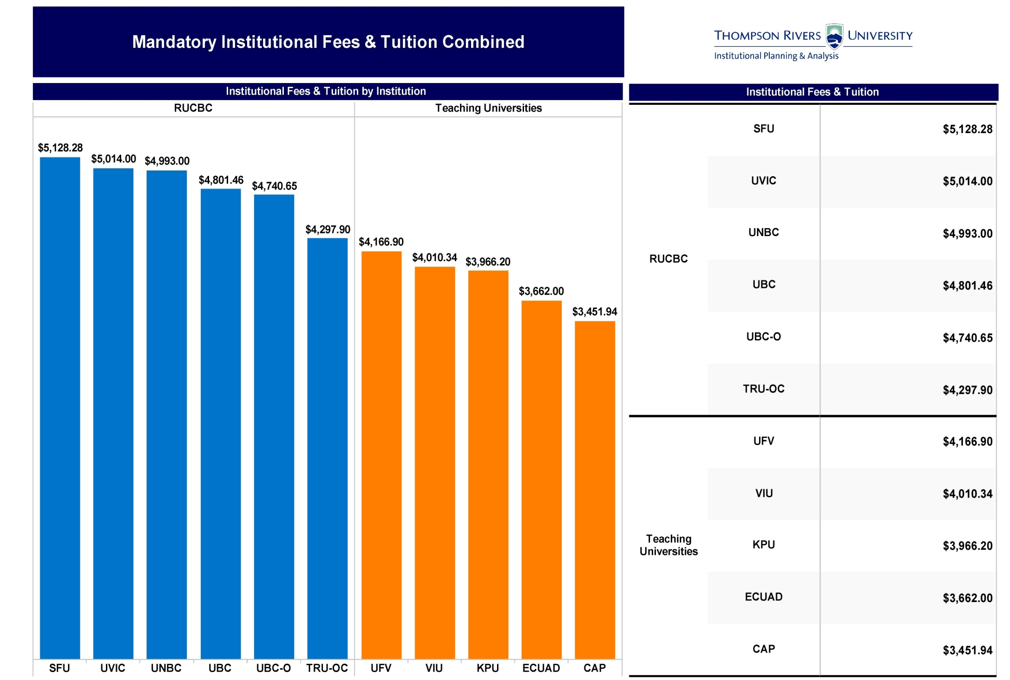

Slide 19
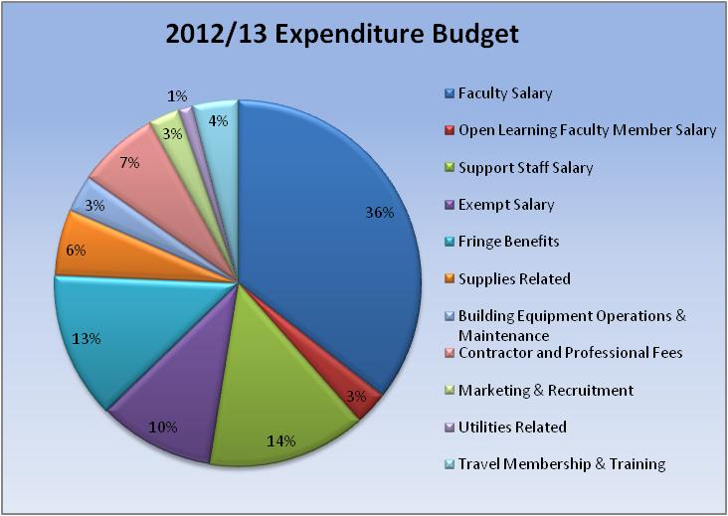
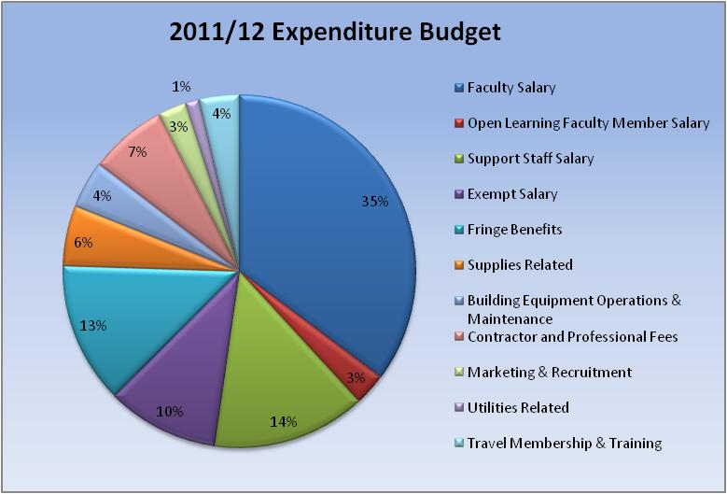
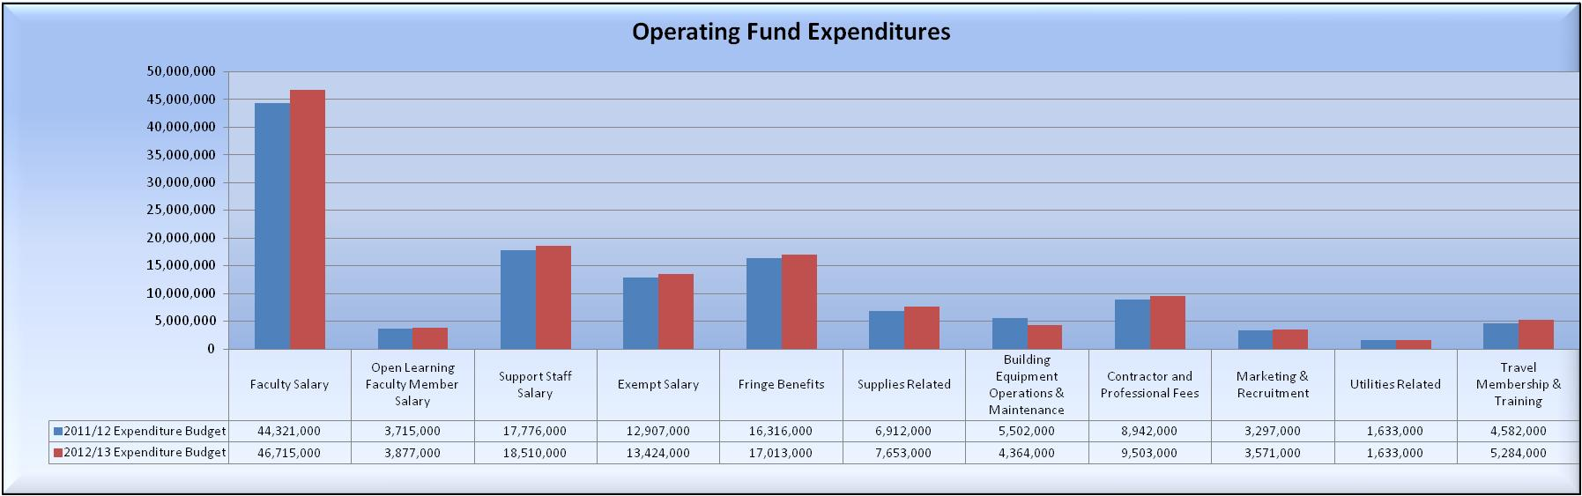
Draft Operating Fund Expenditures (Total)

Slide 20
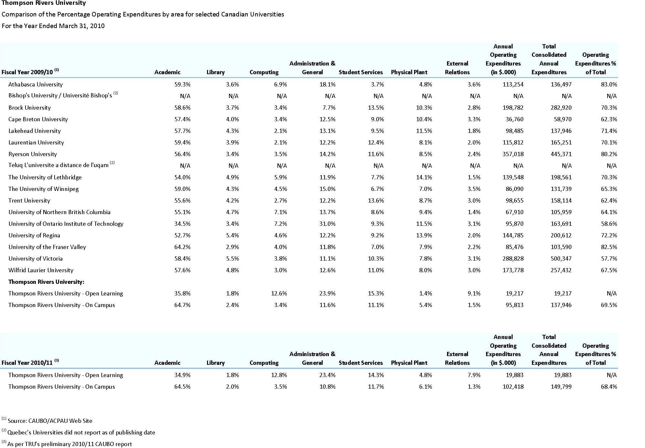

Slide 21
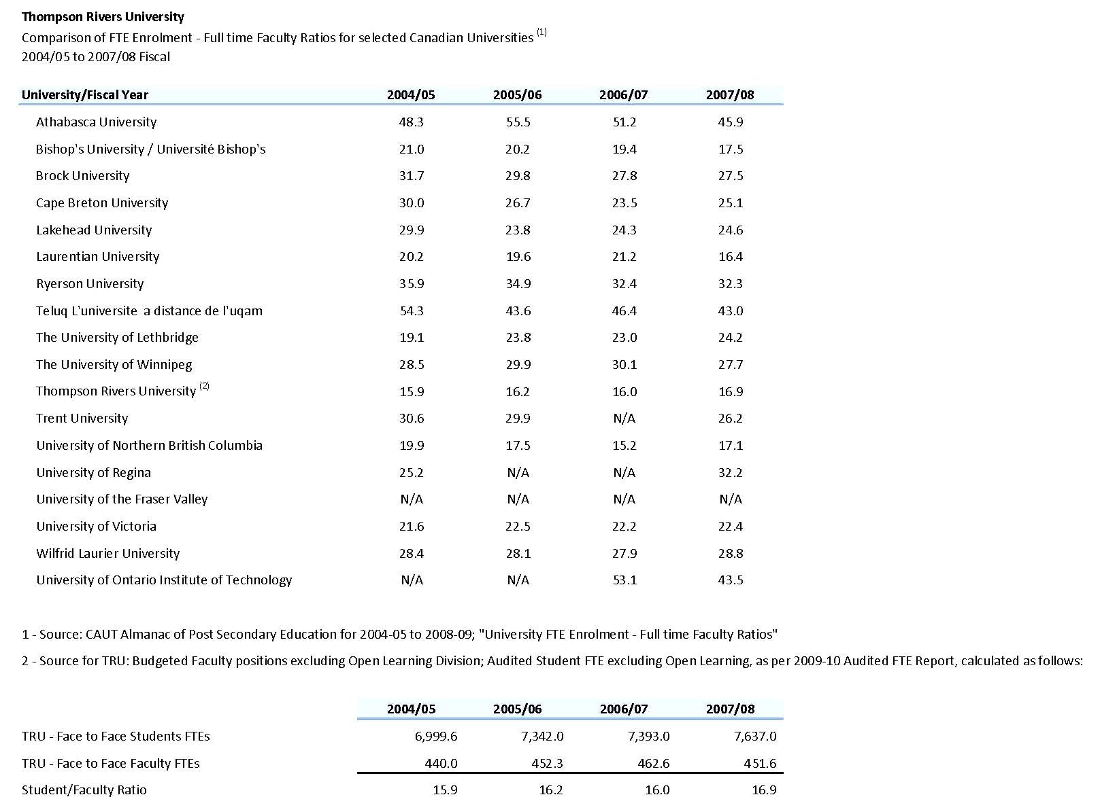

Slide 22
Current Situation
On Campus enrolment continues to decline slightly
International Enrolment continues to increase
Law School will be enroling the second cohort
Cost Drivers continue to rise
Salaries and benefits (before any COLA adjustment)
Progression through the scales
Benefit Premiums
Promotion through the ranks
Higher Education Cost Index – Non Salary
Fiscal Year Results for 2011-12
Projected to have a small surplus
Divisional Carry Forwards
Faculties, Schools and Divisions projected to have a positive carry forward
Institutional Contingency
Anticipated to remain at 2%

Slide 23
Storm Clouds 2012-13 and Beyond
Government Grants
Has been 0, 0 for the past two years
0,-1.0, and -1.5 over the next three years
On Campus Domestic Enrolment
Continues to decline
Domestic Tuition and Mandatory Ancillary fees
Capped at 2%
Reduced Annual Capital Allowance – Deferred Maintenance
Rising Cost Drivers
Progression, promotion, inflation and increased services
Salaries and Benefits
Have just come off a 0 and 0

Slide 24
Budget Strategies - Discussion
Increase Revenues
Increase Services
Identify institution wide savings
Faculty, school, divisional savings
Other Considerations
Other revenue / cost savings suggestions to bcos@tru.ca by March 16, 2012. Following March 19th BCOS meeting a further extension for suggestions to April 10th
Will be posted to the BCOS filepro site as they are received
Will be forwarded to the appropriate area(s) for consideration
BCOS budget deliberation timeline and internal communication plan

Slide 25
Thompson Rivers University
Budget Committee of Senate
Deliberations and Recommendations
April 10, 2012

Slide 26
Understanding included in BCOS Recommendation
Understanding
Revenue and Expenditure Budget v3
Budget Assumptions
Domestic Tuition and Ancillary Fee Increase
International Student Tuition Fee and Ancillary Fee Increase
Parking Fee Increase
Expenditure Reduction – Savings Plan
2012/13 - savings of 1.5% to 2.0%
2013/14 – savings of 1.5%
2014/15 – savings of 1.5% to 2.0%

Slide 27
Draft Operating Fund Budget of Revenues and Expenditures for the 2012/2013 Fiscal Year
 | Revenue/Expenditure Category | 2012/13 Budget | 2011/12 Q3 Forecast | 2011/12 Budget | 2010/11 Actual
Government Allocations
 | ALMD Block Grant | 64,600,000 | 65,481,980 | 64,314,885 | 65,478,818
 | ALMD Aboriginal Funding | 200,000 | 200,000 | 200,000 | 300,000
 | ALMD one time Trades delivery Funding | - | 384,386 | 384,386 | 204,000
 | ITA Funding | 4,724,000 | 4,112,442 | 4,199,264 | 4,590,958
Government Allocations Total |  | 69,524,000 | 70,178,808 | 69,098,535 | 70,573,776
Tuition and Other Revenue
 | Tuition - Domestic (Credit & Non-Credit) | 30,450,000 | 27,182,807 | 29,173,230 | 26,266,003
 | Tuition - International | 26,141,000 | 25,866,259 | 23,435,338 | 21,768,858
 | Lab & Course Fees | 4,792,000 | 5,306,439 | 4,291,005 | 4,279,251
 | Other Revenues | 3,005,000 | 2,635,760 | 2,477,036 | 3,118,720
 | Investment Revenue | 2,300,000 | 2,263,000 | 2,185,295 | 2,530,353
 | Internal Revenue Transfer | - | (220,282) | 17,561 | 584,963
Tuition and Other Revenue Total |  | 66,688,000 | 63,033,983 | 61,579,465 | 58,548,148
Total Revenue |  | 136,212,000 | 133,212,791 | 130,678,000 | 129,121,924
Expenditures
 | Divisional Operating - On Campus | 104,290,000 | 102,238,452 | 100,242,794 | 95,902,756
 | Divisional Operating - Open Learning | 16,257,000 | 15,418,000 | 15,655,206 | 15,087,855
 | Divisional Operating - TRU World | 11,000,000 | 10,305,079 | 10,005,000 | 10,084,580
Expenditures Total |  | 131,547,000 | 127,961,531 | 125,903,000 | 121,075,191
Reserves | Board Reserves | 2,000,000 | 1,900,000 | 1,900,000 | 1,650,000
 | Law School Start Up | (335,000) |  |  | -
 | International Building Reserves and Payments (net) | 3,000,000 | 2,579,237 | 2,875,000 | 2,760,000
Excess (Deficiency) of Revenues over Expenditures |  | $ 0 | 772,023 | 0 | 3,636,733

Slide 28
Thompson Rivers University
Capital Projects Update
2012 – 2013

Slide 29
Capital Projects Completed in 2011-12 and/or currently under construction
House of Learning - complete
Old Main Building Code Upgrades - complete
Faculty Annex N - complete
Third Floor Campus Activity Centre - complete
Third Floor Old Main (Shell) – under construction
University Village

Slide 30
Old Main – Third Floor Addition
Overview
Project Budget – Two Phases
Phase I - Shell including replacement of windows and cladding (Capital building levy and internal restriction of funds) - $10M
Phase II - Fit out to be financed through public and private fundraising - $9.2M. Phase II construction will not commence until funding is secured
Additional 40,000 square feet
Schedule - Shell
Onsite construction will commence May 20112 with the completion of the shell targeted for September 2012
Working Drawings – Fit out
Will commence May 2012
Completed working drawings – November 2012

Slide 31
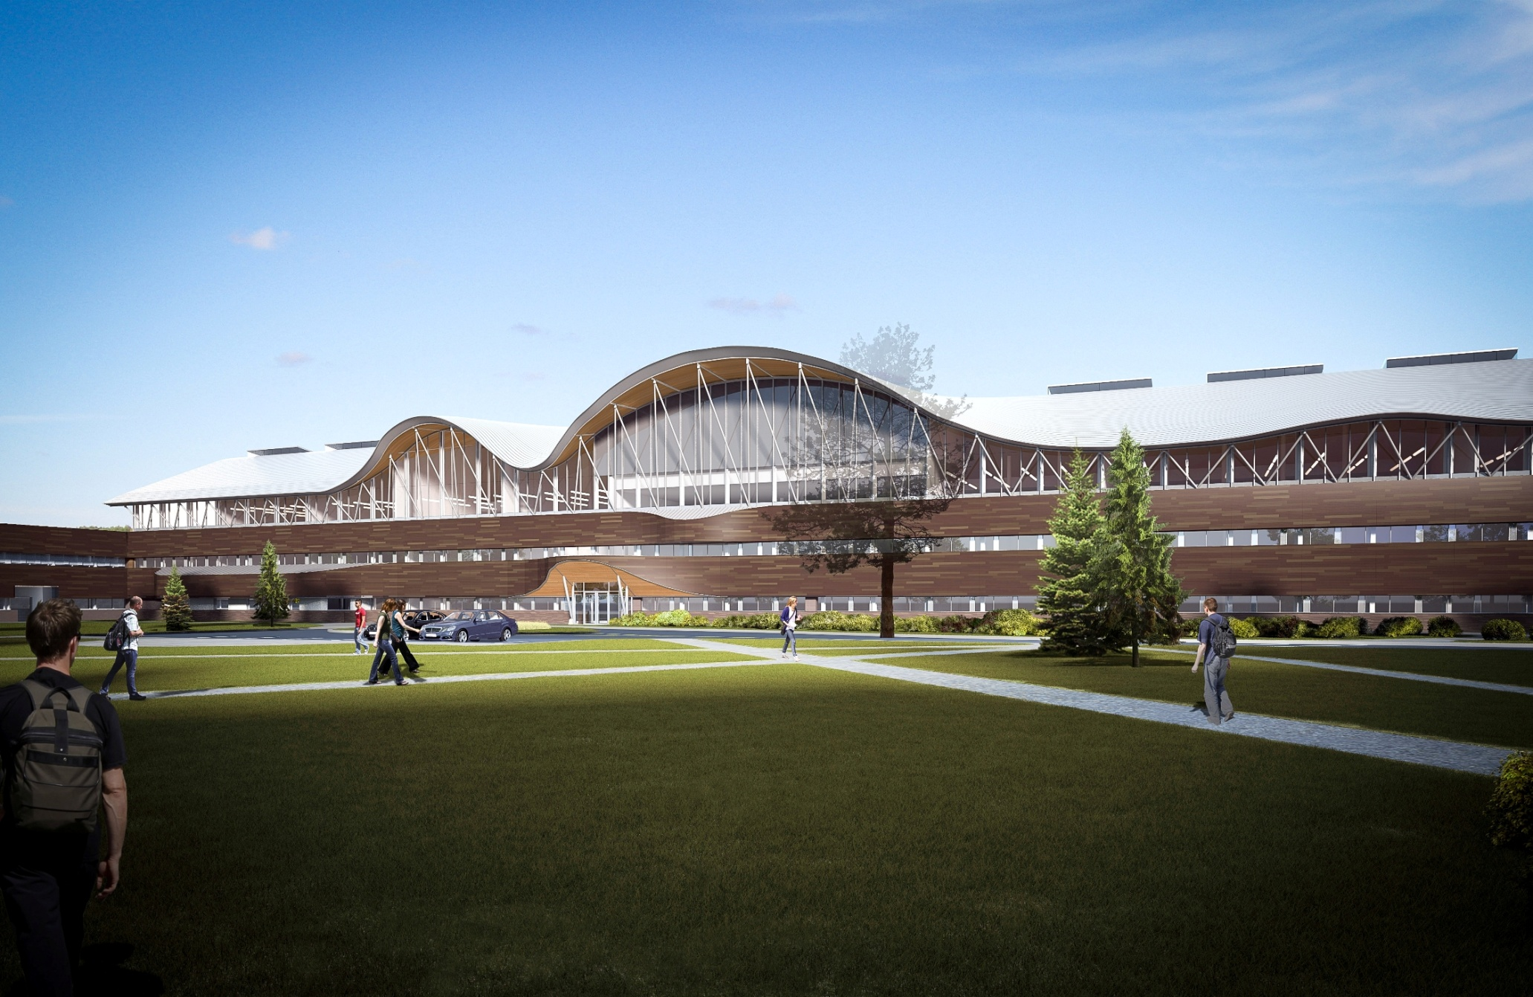
South View

Slide 32
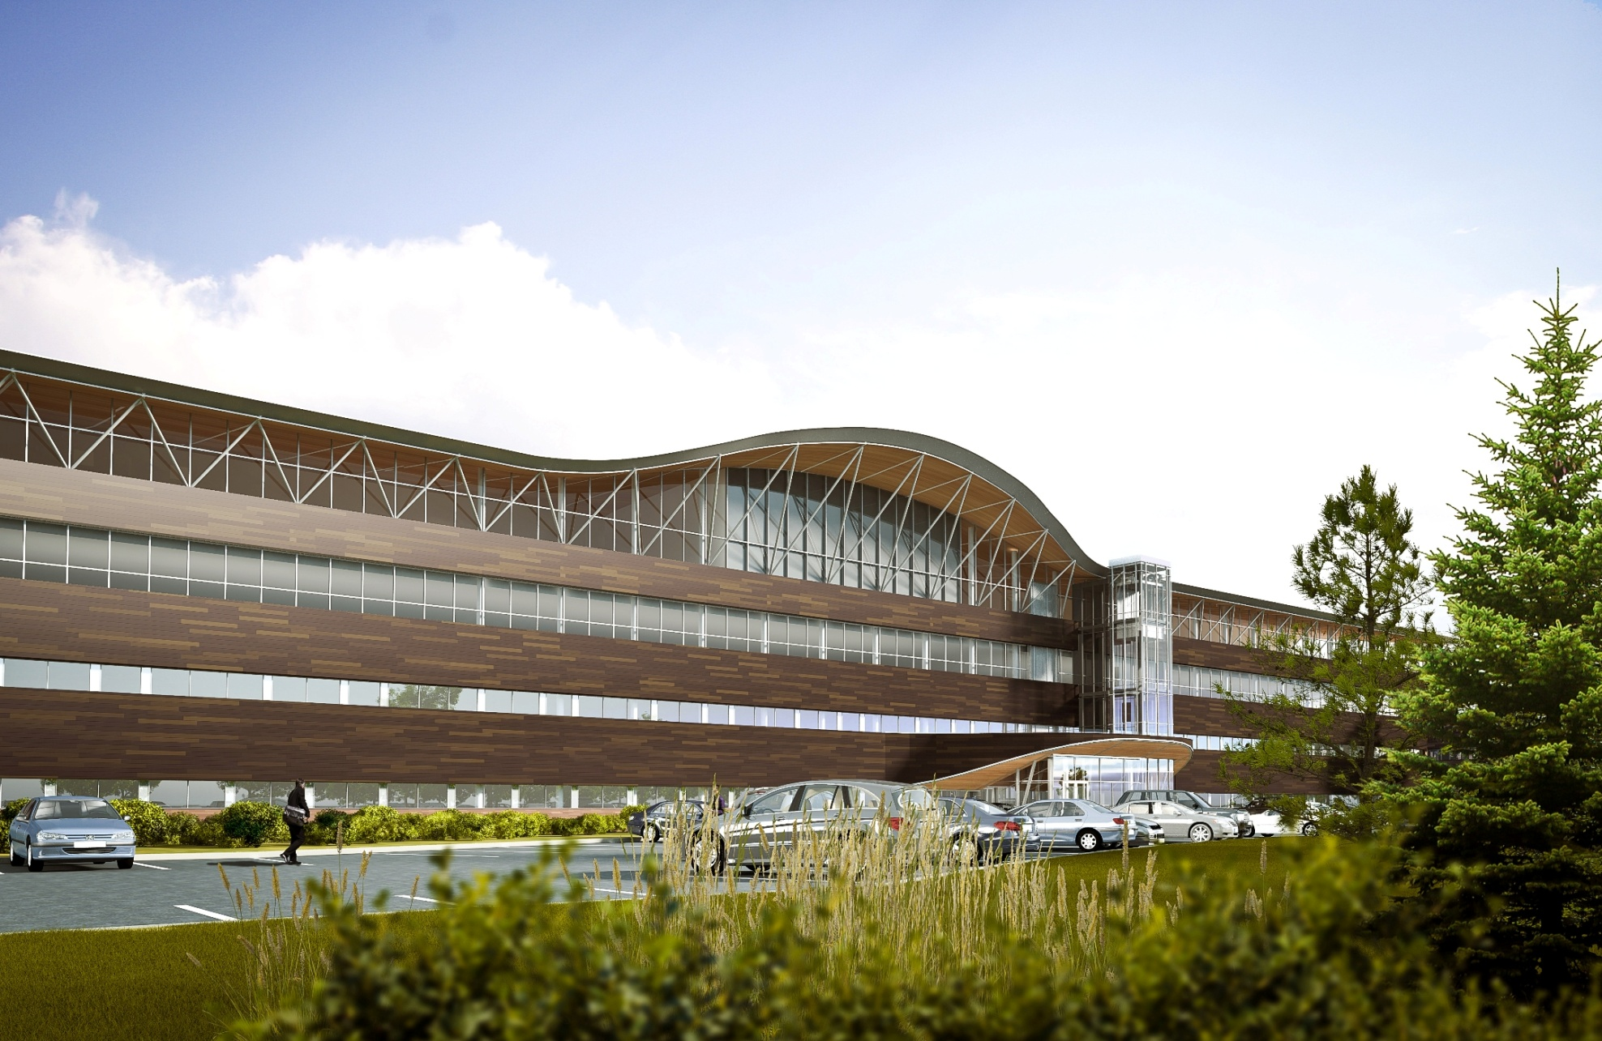
North View

Slide 33
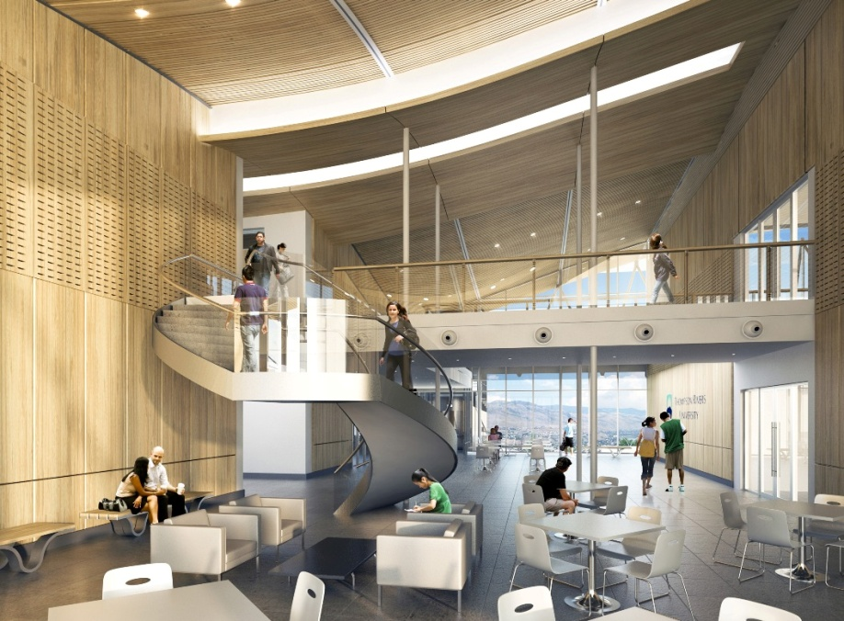
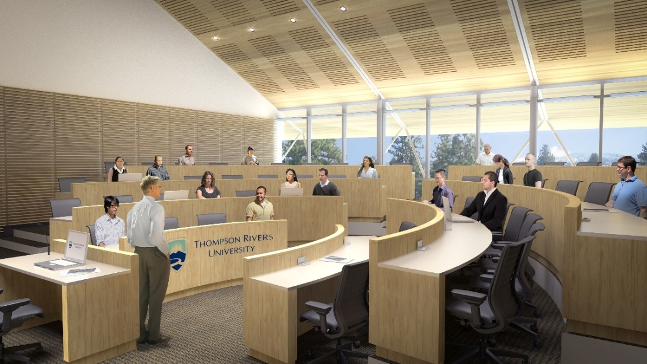
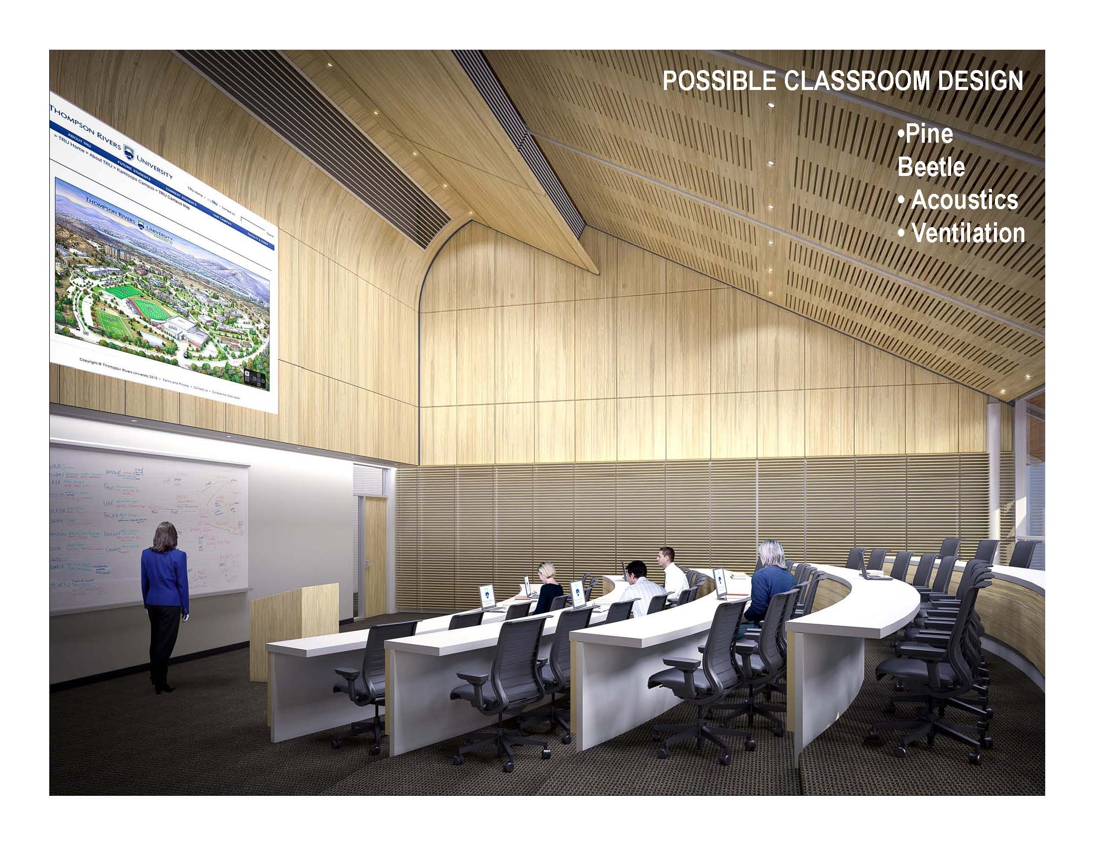
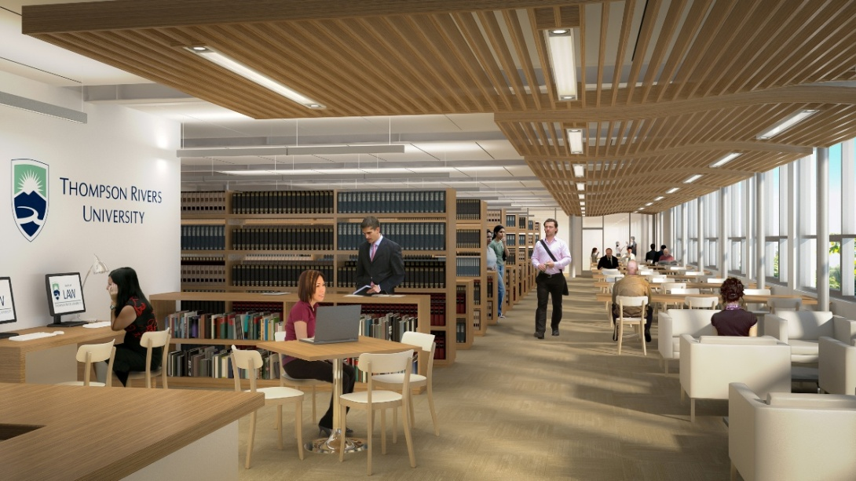
Conceptual / Rendering View only

Slide 34
University Village
Update
External Board members have been appointed by the Board of Governors
Faculty and Student Board member need to be elected appointed

Slide 35
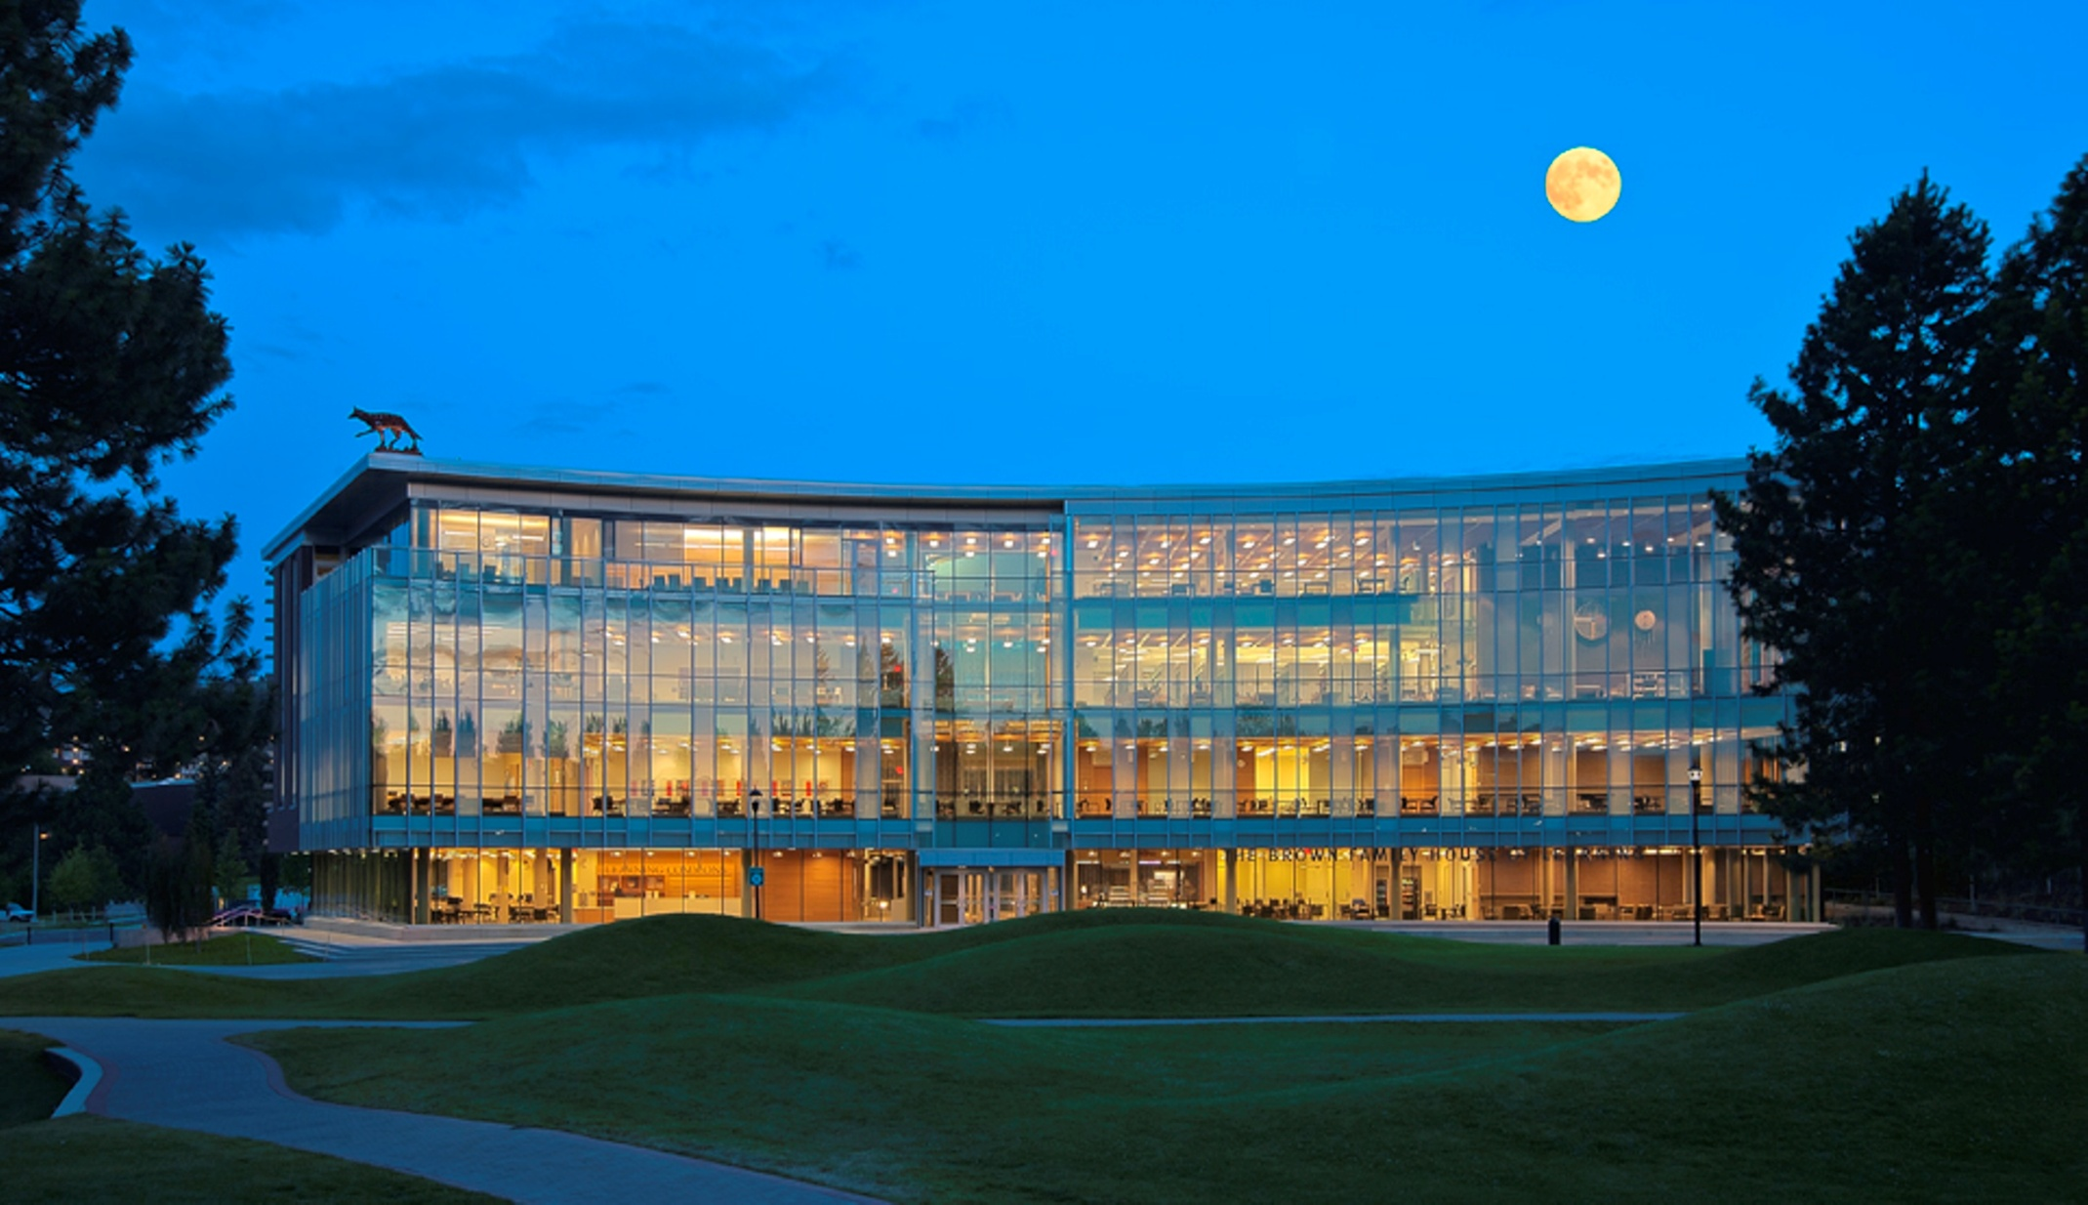
Thank You

Slide 36

Questions ??

