Slide 1
Lesson 3
The Human Quest for Meaning: When We Ask “Why” Questions

Slide 2
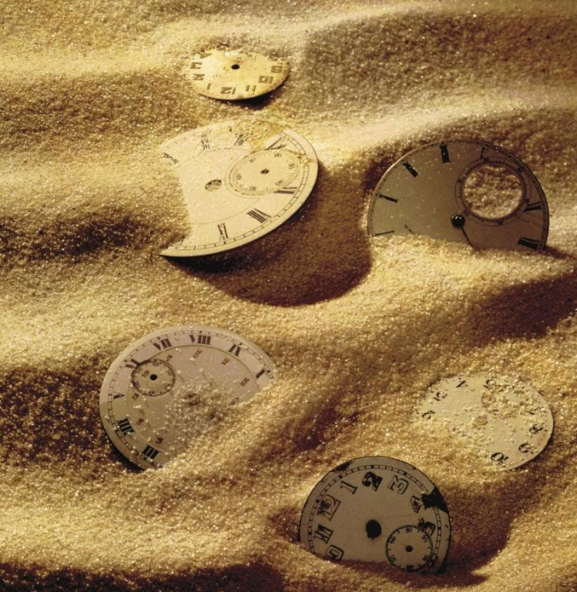
A Time for Everything
“A time to weep and a time to laugh
A time to mourn and a time to dance
A time to search and a time to give up
A time to keep and a time to throw away”
– Ecc. 3:1-9, NIV

Slide 3

What Are You Seeking?
Everybody is after something.
Are you looking for happiness or love?
Are you seeking wisdom and understanding?
But at times it may be better to stop the search.
Sometimes “waiting” or “doing nothing” may be the best.

Slide 4
The Quest for Meaning Scale (QMS)
The 8 major existential questions are:
Who am I?
How and where do I find happiness?
What should I do with my life?
How can I avoid making the wrong choices in the major areas of my life?
Where do I belong?
What is the point of all my striving?
What will happen to me after I die?
What would make my life more meaningful and significant?

Slide 5
Types of Responses
There are three types of responses to existential quest:
Not searching – i.e. existentially indifferent.
Actively engaged in different stages of the meaning quest.
Suspension of the quest because “I have already found the answer.”

Slide 6

Luck and Fate Intervene
“But time and chance happen to them all…
No man knows when his hour will come…
As fish are caught in a cruel net
Or birds are trapped by evil times,
So men are trapped by evil times
That fall unexpectedly upon them.”
– Ecc. 9:11-12, NIV

Slide 7
Free Will and Human Agency
Fate may dictate what happens to us and God may preordain our steps, but our happiness, well-being and our future depends on:
How we react to event that happen to us.
How we relate to God and others.
How we make sense of life.
How we answer existential questions.
We need to take ownership of our own lives and decide how to move forward.

Slide 8
The UCLA Study on Spontaneous Attribution
(Study by Wong & Weiner, 1981)
People do engage in spontaneous attribution searches.
When the outcomes are unexpected or negative.
Causal versus existential attributions.
People are lay scientists and lay philosophers.

Slide 9
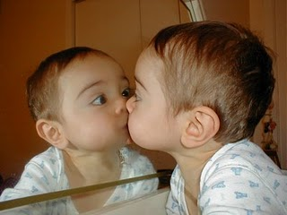
Self-Awareness
The human quest for meaning begins with self-awareness.
Primates and infants may develop self-awareness:
“The Mirror Test”.

Slide 10

Self-Consciousness
The ability to ask “why” questions sets us apart from animals.
Asking, “Who am I?” is a sign of self-consciousness and cognitive development.
Self-consciousness leads to self-determination.

Slide 11
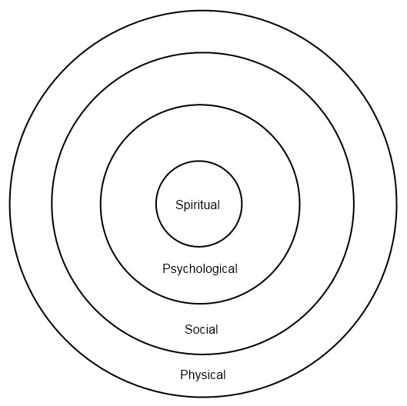
The Four Dimensions of the Self

Slide 12
Self-Inquiry and the Spiritual Self
The real self is the spiritual core of our being consisting of our fundamental beliefs, core values, ultimate concerns, and the essence of personal history.
Who we are to others may be different from who we really are on the inside.
Spiritual beliefs provide a sense of order or coherence in the midst of uncertainties.
Spirituality enables us to create meaning and understand the mysteries of life.

Slide 13
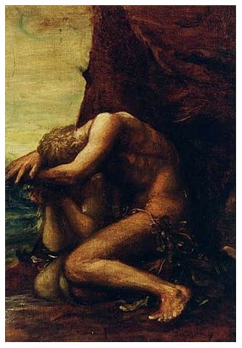
Loss of Innocence
“Then the eyes of both of them were opened, and they realized they were naked…and they hid from the Lord God.”
– Genesis 3: 7-8, NIV
After eating the forbidden fruit, Adam and Eve became self-conscious.
They became aware of and embarrassed about their nakedness and sinfulness
They knew “experientially” the evil of violating spiritual law and the consequence of shame, guilt, confusion, lostness, and alienation.

Slide 14
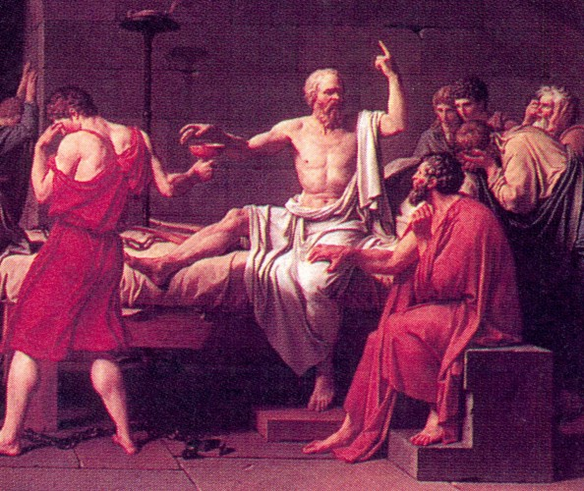
Self-Knowledge
“The unexamined life is not worth living.” – Socrates
“Know thyself.” – Socrates

Slide 15
Restoring a Healthy Sense of Self
Confronting the dark sides of the self.
Reconciling the negative and positive aspects of the self.
Avoiding illusions and delusions of the self.
Making sense of the self and one’s role in the world.
Self-concept is an ongoing process of meaning-making and meaning-reconstruction.

Slide 16
The Need for Self-Reflection
Self-reflection on our experiences enables us to:
Go beyond the mechanical and instinctual level of existence.
Cope with the predicaments and paradoxes in life.
Discover what really matters.
Develop an open and healthy sense of self and one’s place in the word.
How we see ourselves is more important for our well-being than what we are or what we possess.
A sense of emptiness an uselessness can result from the absence of a consistent sense of self as a worthwhile person.

Slide 17

Reflection Questions
Reflect on one unmet need and discover something new about yourself.
Can you articulate your worldview or philosophy of life?
In hindsight, can you detect any defensiveness or denial in our responses when you completed the QMS?
Do you think that you now have a better sense of who you are and your place in the world after this lesson?

