Slide 1
Lesson 2
Human Agency and Free Will: Blessing or Curse?

Slide 2
Why the Big Fuss about Freedom?
The aim of liberal education is to cultivate the intelligent use of freedom.
The aim of psychotherapy is to develop inner freedom.
Abuse of freedom brings destruction to self and others.
Escape from freedom robs us of human dignity and authenticity.
Learn to exercise human agency and free will wisely and responsibly.

Slide 3
How Free Are You?
Do you have the freedom to create your own future?
“You say: I am not free. But I have raised and lowered my arm. Everyone understands that this illogical answer is an irrefutable proof of freedom.”
– Leo Tolstoy (War and Peace)
“So if the Son sets you free, you will be free indeed.”
– John 8:36 (NIV)

Slide 4
Four Basic Types of Freedom
Physical freedom – the ability to move around and control our own body.
Psychological freedom – the freedom to love, work and make choices.
Spiritual freedom – liberation from sins, inner demons and destructive desires.
Political freedom – the freedom to exercise human rights.

Slide 5
The Constant Moral Combat
The battle between good and evil is waged within us.
No one is immune from inner moral conflict.
Apostle Paul: “I have the desire to do what is good, but I cannot carry it out…The evil I do not want to do—this I keep on doing.”
– Romans 7: 18-19 (NIV)

Slide 6
How Free Are We?
Asch conformity studies: http://www.youtube.com/watch?v=iRh5qy09nNw
Milgram obedience experiments: http://www.youtube.com/watch?v=BcvSNg0HZwk
Zimbardo Stanford Prison Experiments: http://video.google.com/videoplay?docid=677084988379129606
“Personality’s Role in Moral Action” in Science: http://www.sciencemag.org/content/332/6036/1380.full?sid=0a0bcb53-0157-4b1d-9ab0-6108b6a74535
We need the defiant human spirit to restore freedom and dignity

Slide 7
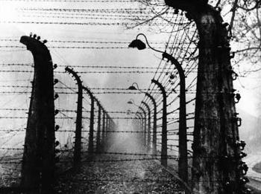
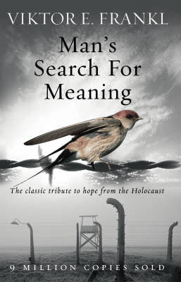
Viktor Frankl’s 3 Basic Tenets of Logotherapy
Freedom of choice
Will to meaning
Meaning of life
“Everything can be taken from a man or a woman but one thing: the last of human freedoms to choose one’s attitude in any given set of circumstances, to choose one’s own way.”
– Viktor Frankl (Man’s Search for Meaning)

Slide 8
Self-Determination
A human being is not one thing among others; things determine each other, but man is ultimately self-determining. What he becomes - within the limits of endowment and environment - he has made out of himself.
– Viktor Frankl
Man is not fully conditioned and determined but rather determines himself whether he gives in to conditions or stands up to them.“
– Viktor Frankl

Slide 9
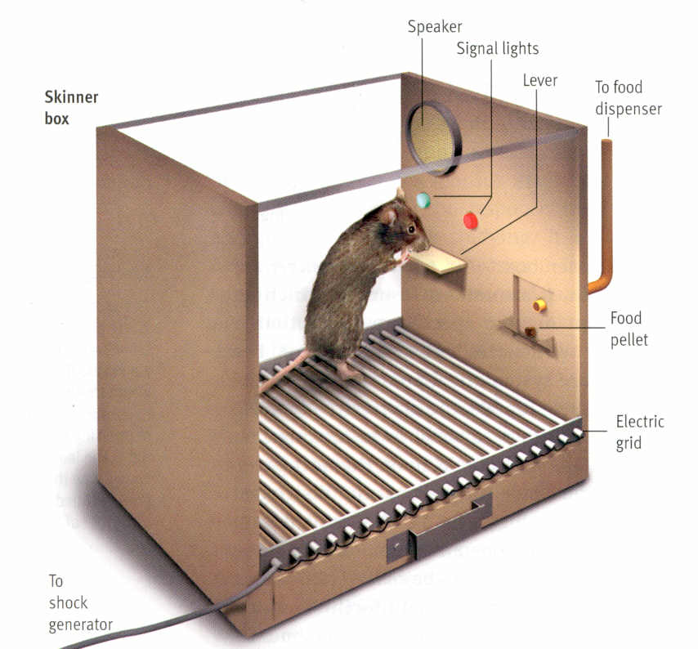
B. F. Skinner’s Determinism
Skinner wrote the controversial book Beyond Freedom and Dignity in 1971. He makes the following points:
Freedom is an illusion.
Behaviour is determined by genetics and the environment.
There is no such thing as the “autonomous person.”
Scientific analysis can reveal the controlling relationships between behaviour and the environment.

Slide 10
Types of Determinism
Our behaviour is often determined by various factors without our awareness.
Environment & Genetics
Unconscious & Freud
Cause & Effect
Physical Laws (e.g. Gravity)
Spiritual Laws
Fate or Predestination
Desires, Obsessions, and Addictions

Slide 11
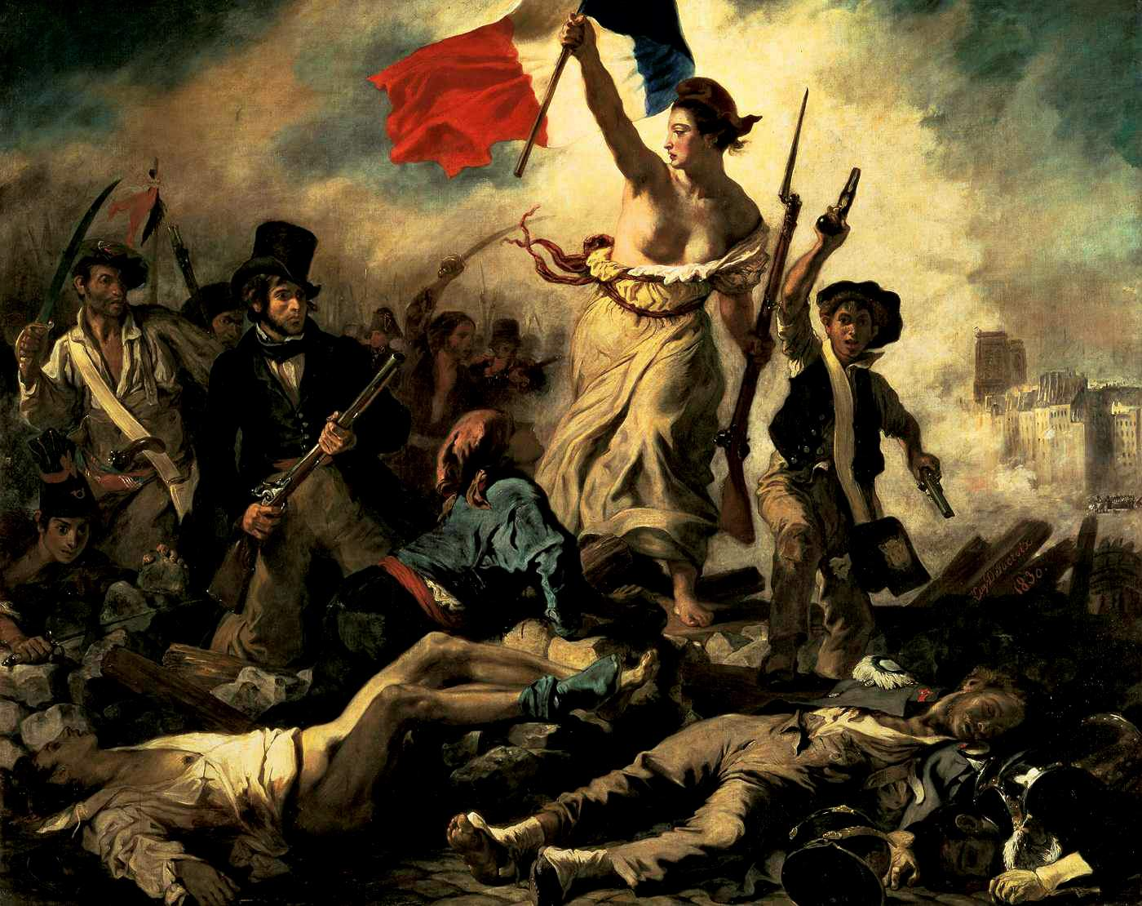
The Human Yearning for Freedom and Liberty
The French Revolution
The American Experiment
The Inspiration of the Statue of Liberty
The Worldwide Democratic Movement
Psychological Reactance

Slide 12
Escape from Freedom
“…Freedom has a twofold meaning for modern man: that he has been freed from traditional authorities and has become an ‘individual,’ but that at the same time he has become isolated, powerless and an instrument of purposes outside of himself, alienated from himself and others; furthermore, that this state undermines his self, weakens and frightens him, and makes him ready for submission to new kinds of bondage. Positive freedom on the other hand is identical with the full realization of the individual’s potentialities, together with his ability to live actively and spontaneously.”
– Eric Fromm

Slide 13
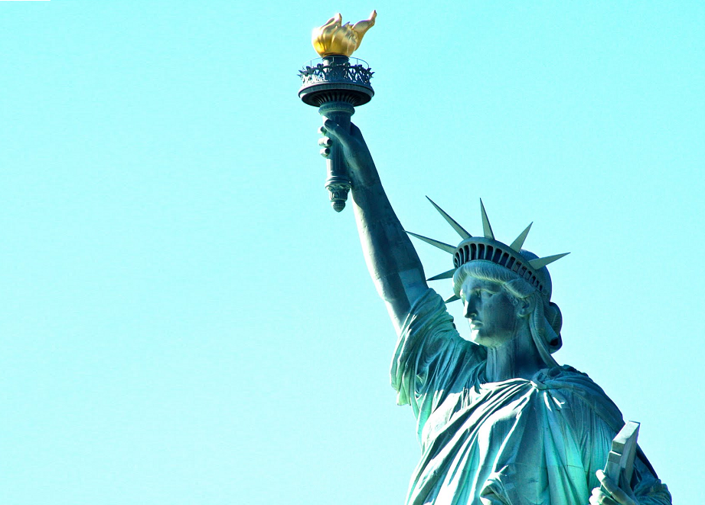
Limits of Freedom and Democracy
What would you choose: being free and alone, or belonging to an authoritarian group?
Is freedom and democracy an illusion?
Is democracy the ideal social political system?

Slide 14
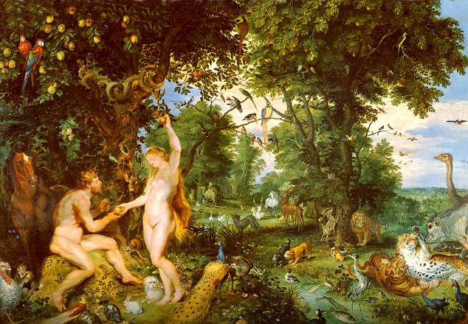
The Story of Adam and Eve
A story of rebellion against authoritarian control.
A story of human finiteness and limitation.
Is free will a gift or a curse?
How do you balance free will with determinism?

Slide 15
Free Will: Blessing or Curse
The best gift from God and the crowning glory of creation.
Human agency and the creation of culture and civilization.
Enables us to love, work, worship, create, and become unique individuals.
Free will becomes a curse when we play god and defy moral and spiritual laws.
Most of the sufferings in the world are caused by human evils.
We create our own hells and live in prisons of our own making.

Slide 16
The Implications of Free Will
The autonomous person and responsibility.
Moral agency and personal accountability.
Executive agency and self-determination.
Am I “the master of my fate and the captain of my soul”?

Slide 17
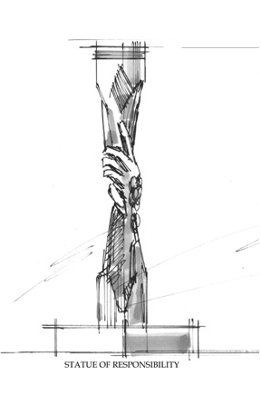
Personal Responsibility for a Better Life
The appeal of Oprah Winfrey.
You have the control and power to make your life better.
Bandura’s concept of self-efficacy.
Your choices determine your destiny – life is what you make of it.
We are responsible to our neighbours and the environment.

Slide 18
“For you will certainly carry out God’s purpose, however you act, but it makes a difference to you whether you serve like Judas or like John.”
– C. S. Lewis (The Problem of Pain)

