Slide 1
Lesson 7
Living on Purpose: Discover Your Calling and Passion

Slide 2
Learning Objectives
To realize why the idea of death can save many lives.
To understand the different types of life purpose.
To find out ways to discover your own purpose in life.

Slide 3
Introduction
The resignation of Steve Jobs
The death of Jack Layton
If you were told that you only had 3 months to live, would you live any differently? What would you do with the remaining days of your life?
Both Jack Layton and Steve Jobs are examples of people who have found their calling and mission in life so that they can die happy doing what they love.

Slide 4
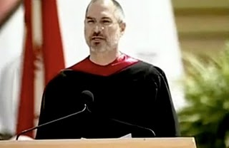
Steve Jobs
“If today were the last day of my life, would I want to do what I am about to do today?”

Slide 5

Jack Layton (1950-2011)
“All my life I have worked to make things better. Hope and optimism have defined my political career, and I continue to be hopeful and optimistic about Canada.”
“As my time in political life draws to a close I want to share with you my belief in your power to change this country and this world.”

Slide 6
The Power of Purpose
What makes one’s life rich in poverty and another unfulfilling in abundance?
The answer may be found in the seriousness of purpose.
In fact, our survival, both individually and collectively, depends on it.

Slide 7
Purpose and School Achievement
Academic value and achievement motivation study (Wong, 1998)
Three wrong reasons for attending college
No better option
Parental pressure
Social interest
Three right reasons for attending college
Intrinsic value
Instrumental value
Personal development

Slide 8
Purpose and Career Accomplishment
Three different attitudes towards work:
As a job to make a living
As a career for self-advancement
As a vocation for fulfilling a calling

Slide 9
Changing Concepts of Calling
Calling defined as fulfilling a specific life role for the greater good.
The theology of work according to Luther and Calvin.
A sense of calling from alternative transcendent sources.
The positive psychology of calling.
Calling to parenthood and child rearing.
Each person may have two or three callings in his or her lifetime.

Slide 10
Intrinsic vs. Extrinsic Motivation
Intrinsic motivation refers to the pursuit of some activity for its own sake. Intrinsically motivated activities are rewarding and satisfying in their own right.
Extrinsic motivation refers to the pursuit of some activity for some external reward such as approval/praise, monetary incentives, and recognition or honor. Extrinsically motivated activities are a means to an end.

Slide 11
Five Sources of Intrinsic Motivation
Love someone unconditionally
Do something you love
Learn something new
Do something kind
Pursue an ideal beyond self-interest

Slide 12
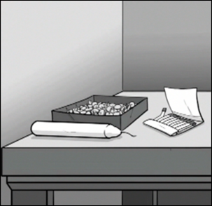
Duncker’s Candle Problem
Problem: Fix a lit candle on a wall in a way so that the candle wax won’t drip onto the table below. You may only use the following items provided: a candle, a book of matches, a box of thumbtacks.
Solution

Slide 13
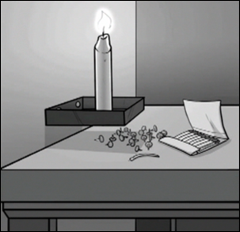
Duncker’s Candle Problem
Problem: Fix a lit candle on a wall in a way so that the candle wax won’t drip onto the table below. You may only use the following items provided: a candle, a book of matches, a box of thumbtacks.

Slide 14
Approach vs. Avoidance Motivation
Approach motivation: primarily motivated to achieve some positive goals and outcomes.
Avoidance motivation: primarily motivated to avoid some negative outcomes, such as failure and stress.
Going through life with an avoidance orientation tends to create more stress and anxiety and less life satisfaction.

Slide 15
Meaning vs. Happiness Motivation
A meaning-orientation is more likely linked to intrinsic motivation and approach motivation.
A happiness-orientation is more likely linked to extrinsic motivation.
These two types of life orientations tend to result in different kinds of life goals.

Slide 16
How do you find your purpose in life?
Be consistent with inner goodness and ethical principles.
Look deep into one’s own heart.
Assess one’s unique gifts, strengths, and interests.
Assess available opportunities and resources.
Seek God’s will and consult experts.

Slide 17
What is Your Mission in Life?
Perhaps, a good starting point for a purposeful life is a personal mission statement.
Write a concise and realistic mission statement for your work or your life. Then, describe two or three objectives or life goals based on your mission statement.
A mission statement is a practical guide for planning and actions.

Slide 18
Recommended Readings
Dale Bourke’s Second calling: Passion and purpose for the rest of your life
Charles Colson’s The good life: Finding meaning, purpose, & truth in your life
Lee Hardy’s The fabric of this world: Inquiries into calling, career choice, and the design of human work
Richard Leider’s The power of purpose: Creating meaning in your life and work
Rick Warren’s The purpose driven life
Irvin Yalom’s Momma and the meaning of life: Tales of psychotherapy

