Slide 1
Lesson 10
Pathways to Happiness and Flourishing

Slide 2
Learning Objectives
Gain a clear understanding of well-being.
Identify the pathways to flourishing.
Highlight important lessons learned in Part 1.
Highlight new lessons to be learned in Part 2.

Slide 3
A Message from Steve Jobs
At the 2005 Stanford Commencement, Steve Jobs shared with us his philosophy of life:
“If today were the last day of my life, would I want to do what I am about to do today?”
Death teaches us how to live with a sense of urgency, passion and purpose.
Follow your own heart, pursue your dream with courage and determination.

Slide 4
The Purpose of M4L
To awaken people from their slumber and meaningless existence.
To gain a better understanding of self, which is one’s worst enemy and biggest obstacle.
To provide road signs to living a more worthy and rewarding life.
To fulfill one’s potential and calling.
To learn how to flourish in spite of fate, circumstances and human foibles.

Slide 5
What is the Good Life?
People have very different ideas of what constitutes the good life and how to flourish.
Wrong pursuits lead to tragic consequences.
Correct pursuits lead to flourishing.
Therefore, be careful what you dream for.

Slide 6
A new vision for flourishing
The good life is not just about you– not just about your happiness and success.
The whole is more than the sum of its parts.
Good people + Good community + World peace = Good life

Slide 7
types of Well-Being
The good life entails different types of well-being
Psychological well-being
Physical well-being
Social/relational well-being
Spiritual well-being
Existential well-being
Financial well-being

Slide 8
Psychological well-being
Ryff and Keyes (1995): Dimensions of psychological well-being
Self-acceptance
Person growth
Purpose in life
Environmental mastery
Autonomy
Positive relationships with others

Slide 9
1.The Philosophical Pathway

Slide 10
The Ultimate Concern
Make sense of life and know what you really want in life.
Make sense of the self and one’s role in the world
What is your overall life orientation?
Pleasure and excitement?
Money, fame and power?
An ordinary family life?
A meaningful life?

Slide 11
8 Major Existential Q’s
Who am I?
How and where do I find happiness?
What should I do with my life?
How can I avoid making the wrong choices in the major areas of my life?
Where do I belong?
What is the point of all my striving?
What will happen to me after I die?
What would make my life more meaningful and significant?

Slide 12
Self-Knowledge
Know what kind of person you want to become.
The good life is an authentic life
“The unexamined life is not worth living.” – Socrates
“Know thyself.” – Socrates

Slide 13
2.The Meaning Pathway

Slide 14
Advantages of the Meaning Pursuit
Meaning provides the royal road to the good life.
Protects you against adversities and fears.
Avoids the pitfalls of self-centered pursuit of happiness and success.
Happiness and flourishing will sneak in through the back door.

Slide 15
Self-Transcendence
Self-transcendence is essential to living a meaningful life.
Enables us to rise above external and internal constraints.
Allows us to reach beyond ourselves and live for the people we love and the causes we care about.

Slide 16
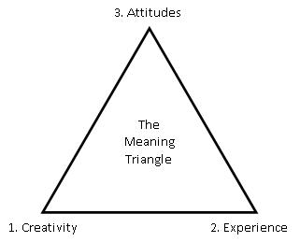
Frankl’s (1985) 3 avenues to Meaning
Giving or contributing something to the world through our work.
Experiencing something or encountering someone.
Choosing a courageous attitude towards unavoidable suffering.

Slide 17
Sources of Meaning

Slide 18
PURE as a definition of meaning in life
Meaning in life can be operationally defined in terms of PURE, which stands for:
Purpose
Understanding
Responsibility
Enjoyment

Slide 19
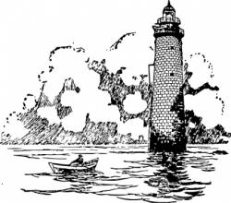
Purpose
Involves:
Clarifying our life direction and core values.
Organizing our activities.
Deliberating your daily plans.
Pursuing one’s calling and mission in life with passion and commitment.

Slide 20

Understanding
Involves:
Full awareness of the situation and the consequences of one`s actions.
Knowing right from wrong.
Understanding the legal/ethical principles in decision making.
Self-knowledge of our strengths and weaknesses.
Understanding/knowing the world we live in.
Achieving a sense of coherence.

Slide 21

Responsibility
Involves:
Taking full responsibility of our own life.
Assuming responsibility for our decisions and actions.
Holding ourselves accountable.
Being a moral agent.

Slide 22
Enjoyment/Evaluation
The natural outcome of leading a purposeful and responsible life.
But a positive outcome is not inevitable.
Sometimes, the personal costs of being responsible can be too high.
This stage involves reflection and sometimes re-evaluation of PURE.

Slide 23
3.The Virtue Pathway

Slide 24
The Good Life is a Virtuous Life
The good life is based on virtue and inner goodness.
“The end of life is eudaimonia.”—Aristotle
Eudaimonia means well-being, virtue and human flourishing.
To live the good life is to become what we ought to be as human beings—moral agents who strive for moral excellence.

Slide 25
Is the Good Life possible without Inner Goodness?
We feel good from doing good.
We are moral beings living in a moral universe.
We cannot flourish without a moral compass.

Slide 26
4.The Spiritual Pathway

Slide 27
The Good Life is a Spiritual Life
Spirituality is good for survival and flourishing.
Good for your adaptation and well-being
A moral compass and answers to the big questions.
Belief in an Ultimate Rescuer.
Hope beyond the grave.
Significance in mundane activities.

Slide 28
5.The Freedom Pathway

Slide 29
4 Types of Freedom
Physical freedom – the ability to move around and control our own body.
Psychological freedom – the freedom to love, work and make choices.
Spiritual freedom – liberation from sins, inner demons and destructive desires.
Political freedom – the freedom to exercise human rights.

Slide 30
Frankl’s 3 Basic Tenets of Logotherapy
Freedom of choice
Will to meaning
Meaning of life

Slide 31
Freedom of choice
You are always free to live a meaningful life regardless of circumstances.
“Everything can be taken from a man or a woman but one thing: the last of human freedoms to choose one’s attitude in any given set of circumstances, to choose one’s own way.” – Viktor Frankl

Slide 32
6.The responsibility Pathway

Slide 33
Responsibility is the key
Just do it – do the right thing no matter what.
Blaming never get us anywhere, responsible action will.
We are responsible for the rippling effects of our words and actions.
We are responsible for making life better for ourselves and others.

Slide 34
Frankl’s definition (1985)
To Frankl, responsibility means “response-ability” to meet the demand of meaning unique in each situation as well as the demand of life as a whole.

Slide 35
7. The Wisdom Pathway

Slide 36
What is Life Intelligence (LQ)?
You need wisdom and courage to live well and die well.
LQ is the ability to learn wisdom and courage.
So many people have ruined their own lives because of a lack of LQ.
LQ includes multiple intelligences

Slide 37
The 4 main Components of LQ
Courage
Self-knowledge
Understanding life, others, and the human condition
Problem-solving

Slide 38
How do we develop LQ?
Reflecting on one’s life experiences, especially from painful experiences.
Learning from other people, especially wise people.
Learning from the wisdom literature.
Cultivating an attitude of being open-minded, curious, and inquisitive.
Develop the courage to explore and engage life.

Slide 39
8. The Self-esteem Pathway

Slide 40
Feeling good about yourself
Love yourself for your inner qualities.
Build self-esteem based on your human dignity, self-respect and inner goodness rather than possession, position and pretension.
Failure for a noble ideal is more honourable than success thru manipulation and ruthless competition.

Slide 41
Restoring a Healthy Sense of Self
Recognize the dark sides of the self.
Reconcile the negative and positive aspects of the self.
Avoid self-deceptions.
Self-concept is an ongoing process of meaning-making.

Slide 42
Self-Deception
We tend to know ourselves less than we think we do.
There are many reasons for self-deception.
Pride and ambition.
Defense mechanisms, such as denial.
Intentional bias and prejudice.
Unintentional blind spot.
False feedback from close associates.

Slide 43
9. The Resilience Pathway

Slide 44
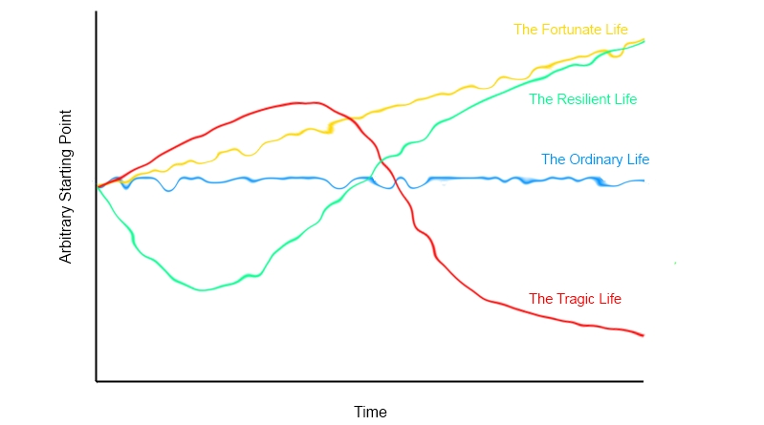
Four Prototypical Life Trajectories

Slide 45
The Good Life in Tough Times
Meaning makes life worth living in the midst of suffering and death.
Find meaning through a heroic attitude (Frankl, 1985).
Whatever does not kill you make you stronger.

Slide 46
The ABCDE Strategy
Accept and confront reality – the reality principle
Believe that life is worth living – the faith principle
Commit to goals and actions – the action principle
Discover the meaning and significance of self and situations – the Aha! Principle
Evaluate the above – the self-regulation principle

Slide 47
Tragic Optimism
Elements of Meaning-Centred Tragic Optism.
Acceptance of the worst.
Affirmation in the value and meaning of life.
Self-transcendence (altruism).
Faith in God and others.
Courage to face adversity.

Slide 48
The Power of Acceptance
Accept what cannot be changed.
Accept reality, limitations, loss, trauma, and existential givens.
Acceptance does not mean giving up or resignation.
Confront one’s worse fears with courage and tragic optimism.

Slide 49
Concluding Remarks

Slide 50
9 Pathways to flourishing
Philosophy – Make sense of life.
Meaning – Provides the royal road to the good life.
Virtue – The good life based on inner goodness.
Spirituality – Good for survival and flourishing.
Freedom – Free to choose a meaningful life.
Responsibility – Do what is right no matter what.
Wisdom – Need wisdom and courage to live well.
Self-esteem – Love yourself for your inner qualities.
Resilience – Meaning makes life worth living.

Slide 51
ABCDE Strategy of Resilience
Acceptance
Belief
Commitment
Discovery
Enjoyment and Evaluation
Elements of Tragic Optimism
Acceptance of the worst
Affirmation in the value and meaning of life
Self-transcendence (altruism)
Faith in God and others
Courage to face adversity
Approach
Avoidance
The PURE Principles of Meaningful Living
Purpose
Understanding
Responsibility
Enjoyment

