Slide 1
Lesson 5
What is the Good Life?
Sources of Meaning and Happiness

Slide 2
OBJECTIVES
To explain
The risk factors of the happiness pursuit without meaning and virtue.
The advantages of a meaning perspective of the good life (Wong, 2011).
The need for a balanced meaningful live based on Wong’s implicit theories research (1998a).

Slide 3
A PUZZLING PROBLEM
People want to be healthy but many consume junk food.
People want to be happy but many do things that make themselves miserable.
Most things that taste good are probably bad for you.
Most things that give you a thrill are probably bad for you too.

Slide 4

WHAT IS THE GOOD LIFE?
People have different ideas of what constitutes the good life.
Wrong pursuits may lead to tragic consequences.
Correct pursuits may lead to flourishing.
Therefore, be careful what you dream for.

Slide 5
THE HAPPINESS PURSUIT
Everybody wants more happiness and success.
It’s good to know how to optimize happiness and success.
There are many happiness coaches and self-help books on the market.

Slide 6
RISK FACTORS
There are risk factors when:
The happiness pursuit becomes one’s ultimate purpose in life.
The happiness pursuit is not guided by a philosophy of life informed by general principles of meaning, spirituality and virtue (e.g., the Golden Rule).

Slide 7
THE GOLDEN RULE
Confucius: What you do not want done to yourself, do not do unto others.
Aristotle: We should behave to others as we wish others to behave to us.
Buddhism: Hurt not others with that which pains thyself.
Christianity: Do unto others as you would have them do unto you.

Slide 8
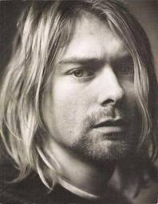
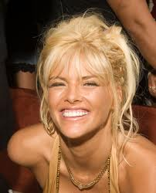
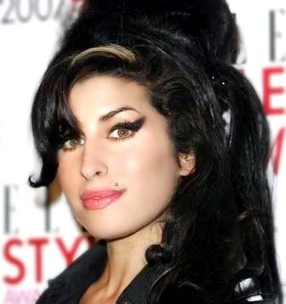
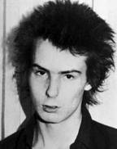
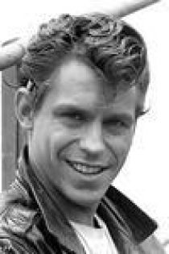
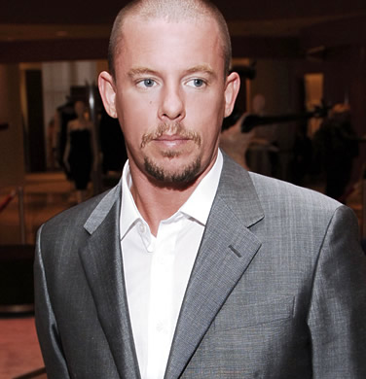
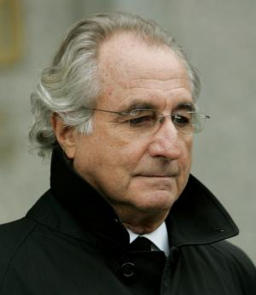
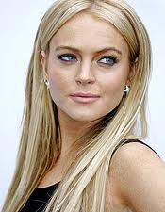
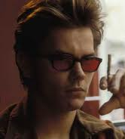
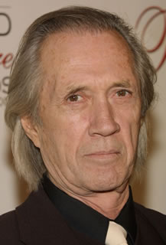
THE AMERICAN NIGHTMARE
The pursuit of the good life has ended in misery and self-destruction for many people.

Slide 9
WHAT IS THE COMMON CAUSE?
They make personal happiness and success their ultimate end of life without a moral compass and without the desire to pursue inner goodness.

Slide 10
DISILLUSION
King Solomon realized the vanity of success long, long ago:
The world will never be enough: “The eye is not satisfied with seeing, nor the ear filled with hearing” (Eccl. 1:8).
It takes more and more to reach the same level of happiness—addiction, money, etc.

Slide 11
DISILLUSION
Nothing in this world can fill the spiritual vacuum within us.
Dreams are often broken when reality strikes.

Slide 12
FATE AND CIRCUMSTANCE
Bad things happen to good people
Reversal of fortune
For some people, most days are bad days (e.g. poverty)
Lack of opportunities to pursue PERMA (Seligman, 2011)

Slide 13
ADVANTAGES OF THE MEANING PURSUIT
Avoids the pitfalls of self-centered pursuit of happiness and success.
Sustains us between the highs of inspiration and the lows of despair.
Happiness and flourishing will sneak in through the back door.
Ability to transform adversities into opportunities for personal growth.

Slide 14
THE GOOD LIFE IS A VIRTUOUS LIFE
A meaningful, authentic good life is based on inner goodness.
“The end of life is eudaimonia.”—Aristotle
Eudaimonia means well-being, virtue and human flourishing.
To live the good life is to become what we ought to be as human beings—moral agents who strive for moral excellence.

Slide 15
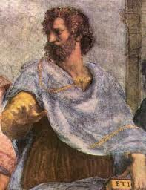
ACCORDING TO ARISTOTLE
His moral theory is teleological.
Aristotle’s virtue ethics.
The golden mean to avoid extremes.
Practical wisdom: the proper end to our actions and the proper means to our end.
Four cardinal virtues: prudence, justice, fortitude, and temperance.

Slide 16
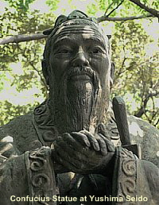
ACCORDING TO CONFUCIUS
Lived in a tumultuous period of war and conflict.
Equates the good life with social harmony.
The need to fit in an ordered society.
Five cardinal virtues: benevolence, righteousness, propriety, wisdom, and faithfulness or loyalty.
Inner cultivation of virtues leads to world peace.

Slide 17
A SHIFT IN THE NARRATIVE OF THE GOOD LIFE
A shift from virtue and ethics to personal happiness and success.
An increase in personal freedom and gross domestic product (GDP).
Money does not always buy happiness.

Slide 18
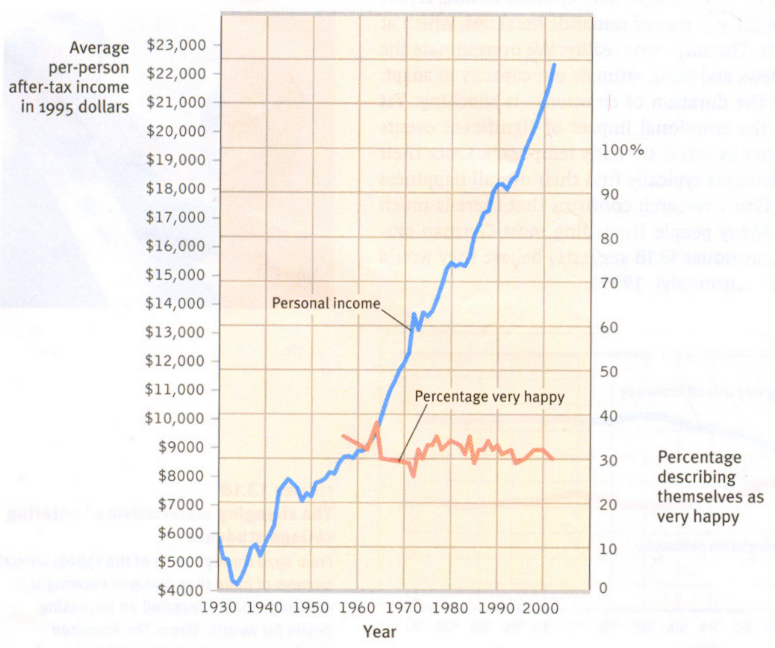

Slide 19
IS THERE THE GOOD LIFE WITHOUT INNER GOODNESS?
A morally neutral stand on the good life will lead to risk factors.
We feel good from doing good.
We are moral beings living in a moral universe.
We cannot flourish without a moral compass.

Slide 20

THE HOLISTIC APPROACH
The whole is more than the sum of its parts.
Good people + Good community + World peace = Good life.

Slide 21
THE GOOD LIFE IN TOUGH TIMES
Finding meaning through a heroic attitude (Frankl, 1985).
Accepting what cannot be changed.
“Every cloud has a silver lining.”
Transforming adversities through meaning and faith.
Reducing stress, depression and anxiety.
Integrating negatives with positives.

Slide 22
THE GOOD LIFE IS A SPIRITUAL LIFE
The adaptive advantages of religion and believing in God.
A moral compass and answers to the big questions.
Belief in an Ultimate Rescuer.
Hope beyond the grave.
Significance in mundane activities.
A meaning-mindset is a faith-filled perspective.

Slide 23



THE GOOD LIFE IS A BALANCED LIFE
A single-minded pursuit is not always beneficial.
Active engagement needs to be balanced by rest.
Exclusive love needs to be balanced by greater love.
Achievement needs to be balanced by acceptance.
Self-transcendence needs to be balanced by fair treatment.
vs.

Slide 24
SOURCES OF MEANING FOR THE GOOD LIFE
Wong’s implicit theory research.
Achievement, religion/spirituality, positive affect, relationships, self-transcendence, intimacy, self-acceptance, fair treatment.
Basic needs for mental health and flourishing.

Slide 26
A BALANCED MODEL OF THE GOOD LIFE
Religion/
Spirituality
Achievement
Acceptance
Positive Emotion and Well-being
Intimacy
Relationship
Self-transcendence
Fairness
Situational and Cultural Context

