Slide 1
Lesson 4
What is the meaning of life? How to discover meaning according to Viktor Frankl

Slide 2
Objective of this Lesson
To clarify the concept of meaning of life as the foundation for survival and flourishing.

Slide 3
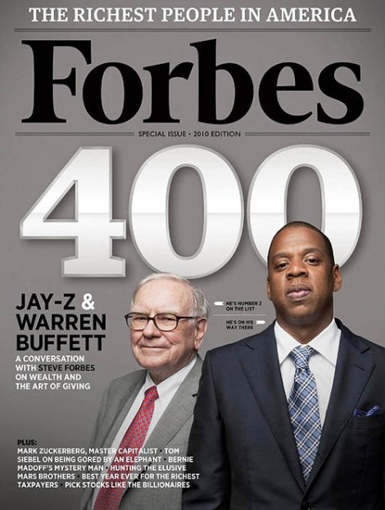

The American Vision of the Good Life
Born in a time of peace and prosperity.
It focuses on what is right and good about people.
Emphasizes pursuit of happiness and success.
PERMA: positive emotion, engagement, relationship, meaning and accomplishment (Seligman, 2011).
Achieved through activities designed to enhance each element of PERMA.

Slide 4

Viktor Frankl’s Vision of the Good Life
Born in a time of war and suffering.
Focuses on both what is wrong and what is right.
Emphasizes the human potential for living a meaningful and responsible life.
Concerned with the pursuit of meaning and responsibility.
Emphasizes the spiritual core and self-transcendence.
Frankl’s 3 basic tenets of logotherapy: freedom of will, will to meaning, and meaning of life.

Slide 5
Contrast between the Two Visions
Normal circumstances vs. extreme or noxious situations.
What I can get from life? vs. What does life demand of me?
Individualism vs. collectivism
Molecular vs. holistic
Bottom-up vs. top-down
Outside-in vs. inside-out
Cognitive-behaviour vs. existential-spiritual

Slide 6
Integrating the Two Approaches
Different assumptions, worldviews, life orientations and approaches.
Complement each other but have very different implications.
Only empirical research can determine which approach is better.
Meaning approach is more appropriate when lives going through challenges.
Meaning approach integrates and adapts happiness-inducing and strength-enhancing exercises with priority on awakening and fulfilling meaning and responsibility.

Slide 7

The Spiritual Core
The noetic dimension of the human spirit contains our healthy spiritual core.
Characterized by uniquely human attributes.
Remains healthy but can be blocked by existential anxieties, worldly concerns and materialistic pursuits.
Logotherapy seeks to remove these blockages and awaken will to meaning.
Can squeeze meaning from life and turn suffering into triumph.

Slide 8
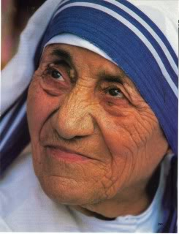
Self-Transcendence
Essential to living a meaningful and spiritual life.
Enables us to rise above external and internal constraints.
Allows us to reach beyond ourselves to people we love or causes we care about.
Self-actualization is a side-effect of self-transcendence.

Slide 9
Importance of Meaning
“A strong will to meaning promotes human health, both physically and mentally, and prolongs, as well as preserves, life” – Graber, 2004, p. 65
High score on PERMA but still empty if have not experienced meaning in the 5 major domains of life
Life satisfaction only when discover and experience meaning in life, relationship, work, suffering, and death
Meaning provides reasons for living and basis for well-being

Slide 10
Definitions
Existential vacuum: A general sense of meaninglessness and inner void typically manifest itself in a state of boredom, but persistent and serious types of meaninglessness is related to tragic triad and neurotic triad.
Tragic Triad: pain, guilt, death
Neurotic Triad: depression, aggression, addiction
pain
depression
The
Tragic
Triad
The Neurotic Triad
guilt
death
aggression
addiction

Slide 11
Freedom of Will
The demand to exercise personal responsibility and human agency.
A sense of responsibility is a prerequisite for living an authentic life.
4 types of misuse of responsibility: relinquishing, abusing, overstepping, depriving others.
Mandate our spiritual core: How should we live? What do I ought to do with my life?
An authentic person must take a stand and make a choice in spite of fear and anxiety.

Slide 12
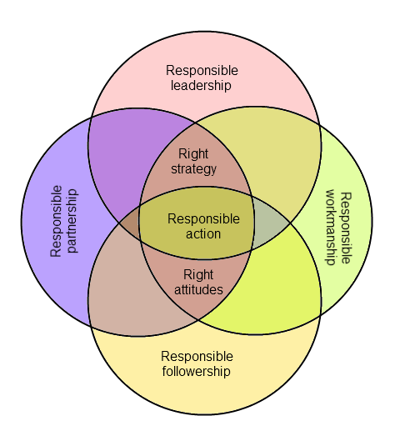
Responsibility

Slide 13
Will to Meaning
Human beings are not driven primarily by drives and instincts but drawn forward by the pursuit of meaning (Frankl, 1969).
The will to meaning is predicated on the freedom of will and a sense of responsibility.
The will to meaning is a primary motivation.
It is a basic drive that compels us.
In order to fulfill the will to meaning, individuals need to be prepared psychologically for suffering and death.
To challenge a person with a potential meaning to fulfill can help trigger the will to meaning (Frankl, 1985).

Slide 14
The Ultimate Concern
It makes a great difference whether one’s primary objective in life or ultimate concern is meaning and virtue, or happiness and success.
King Solomon’s book of Ecclesiastes makes it very clear that one can gain the whole world and indulge in all one’s desires and still find life empty.
A meaning-mindset and a happiness-mindset dictates very different life principles and choices.

Slide 15
The Meaning of Life
The meaning of life is unique and specific to each person.
Frankl (1963) emphasizes the discovery rather than the creation of personal meaning.
“The meaning of our existence is not invented by ourselves, but rather detected” (p. Frankl, 1963, p.133).
Meaning of life includes both situational and ultimate meaning (Frankl, 1985).
The search for meaning has to be based on authenticity and time-tested values.

Slide 16

Ultimate Meaning
We can never hope to grasp ultimate meaning in its totality.
We can never fully understand ultimate meaning.
Having a sense of one’s calling is an important guide in decision-making and discovering the meaning of the moment.
When our spiritual call is connected with the demands of ultimate meaning, we discover our calling.
A musician says that I did not choose music, music chose me. A pastor may say, I did not choose the ministry, the ministry chose me or God called me.

Slide 17
The Meaning Triangle
Frankl’s (1985) three pathways to meaning:
Giving or contributing something to the world through our work.
Experiencing something or encountering someone.
Choosing a courageous attitude towards unavoidable suffering.
3. Attitudes
My
Meaning
Triangle
1. Creativity
2. Experience

Slide 18
Exercises
Keep in mind Frankl’s challenge of asking yourself what life demands of you instead of what you demand from life. Write a concise mission statement for your career or for your life.
Set one or two realistic achievable life goals that are consistent with your mission statement and core values.

