Slide 1

Diathesis-Stress: Perfect Fuzzy Cognitive Map
Math 800 Term Project
Hilary Kim Morden

Slide 2
Overview
Introduction
Complex Social System
Diathesis-stress – deviance
Model 1 – logistic regression
Model 2 – Fuzzy cognitive map
Conclusion

Slide 3
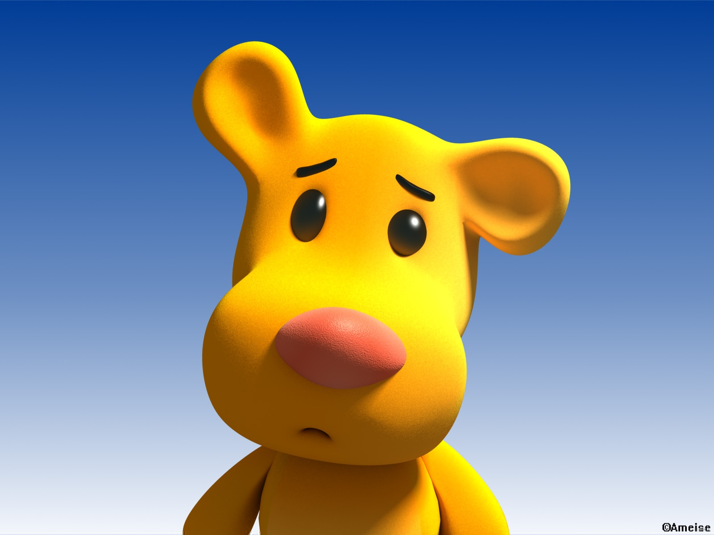
Notes:
At first we thought humans were unto themselves – neither nature nor nurture had anything to do with the way they were – only God could effect them

Slide 4
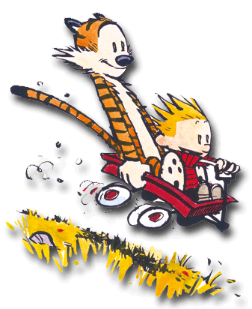
Notes:
Then we wondered if it was the environment that changed people

Slide 5
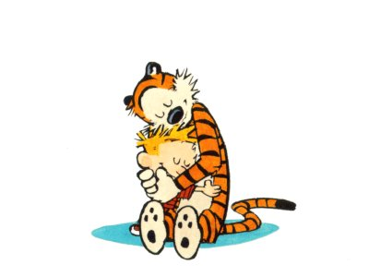

Slide 6
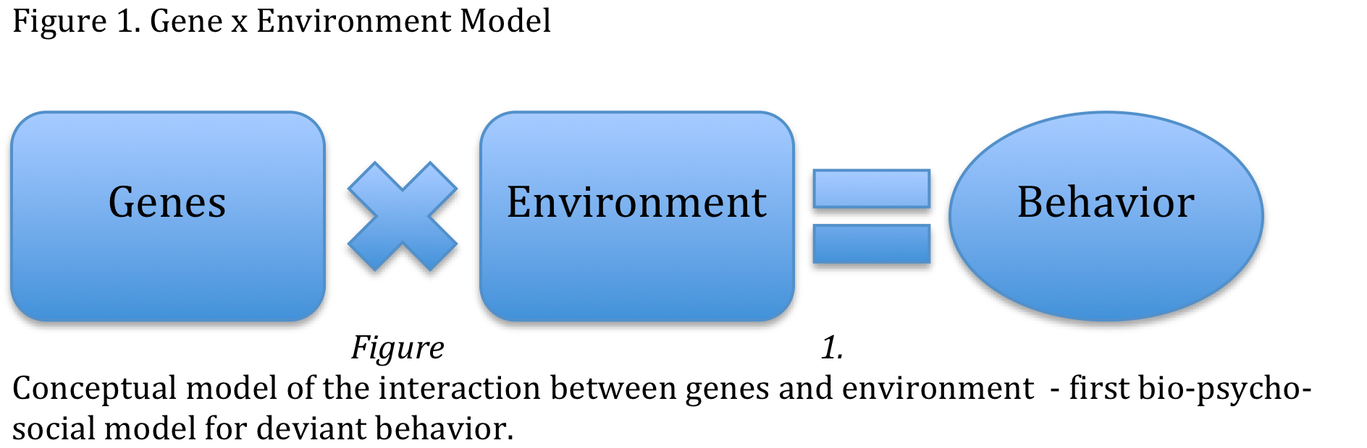

Slide 7
Diathesis-Stress Model
Constitutional predispositions/weaknesses (biology)
Diatheses
Genetic weaknesses
Tendency towards a specific state of being
Combined with stressful conditions (environment)
Play a precipitating/facilitating role
Leading to expressions of
Disease
Psychological pathology
Deviance

Slide 8
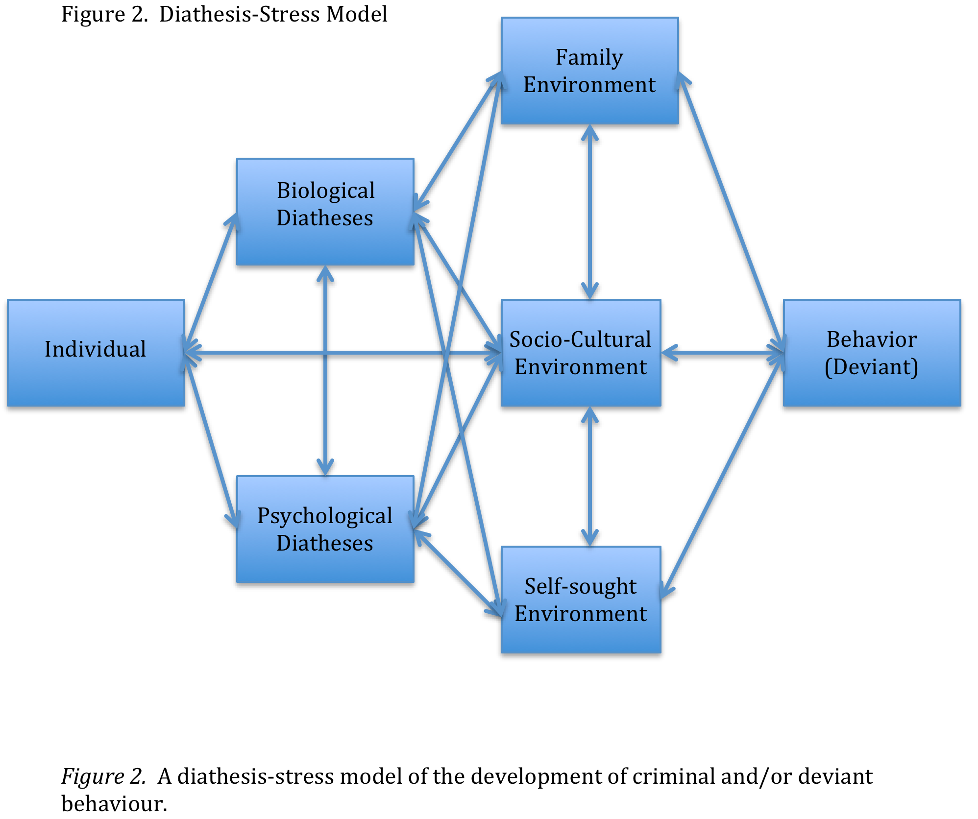

Slide 9
Variables and Parameters
Diatheses (evidenced by):
Psychological, including:
DSM-IV-TR identified disorders including personality disorders, addictions, clinically defined pathological emotional states including anxiety, depression, anger
Childhood personality/mood/state disorders such as ODD and ADHD
Low self-efficacy
Biological including:
neuro-biological insult/injury/deficiency/abnormality;
physiological such as low auto-nomic nervous system arousal, under-performance or over-performance of hormones and neuro-chemicals as well as yet-underdetermined chemicals (ie. testosterone, estrogen, cortisol, dopamine)

Slide 10
Variables and Parameters
Environmental protectors including:
Religion
pro-social interactions
High family efficacy
Environmental stressors including:
Social disorganization
Anti-social interactions
Family breakdown
Low socio-economic status
Low family efficacy

Slide 11
Parameters
Difficult/impossible to define in a diathesis-stress model given human/environmental plasticity
Could possibly be defined (depending on the model) as:
School efficacy dependent upon inability to change schools and assuming that there can be no change in levels of efficacy
Family efficacy dependent upon inability to leave family and assuming that there can be no change in levels of efficacy
Self-efficacy dependent upon the inability of the person to change themselves (ie personality disorders) and an assumption that there can be no change in levels of efficacy

Slide 12
Same as Gene X Environment?
Psychology
Biology
Environment
Behaviour

Slide 14
Deviance Diathesis-Stress Model 1 Logistic Regression Series
Multiple logistic regressions (non-linear, probabilistic, dynamic, continuous, qualitative and quantitative series)
Outcome variable: categorical
Predictor variables: continuous/categorical
Given the predictors we can predict which category the individual is most likely to belong to:
Deviant
Not deviant

Slide 15
Predictor Variables
Diatheses
Environmental
Education diathesis
Anxiety diathesis
Addiction diathesis
Residence/neighbourhood disorganization
Low socio-economic status
Living with non-biological parent(s) or absent biological parent

Slide 16
Outcome Variable -Dichotomous
Deviancy and violence composite created – including the following criminal acts committed in the prior 12 months
Property damage
Theft over $500
Theft under $500
Violence in group or individual
Carry/use of weapon
Drug trafficking
Run away from home
Disorderly in public
Shoot/stab others – being shot/stabbed

Slide 17
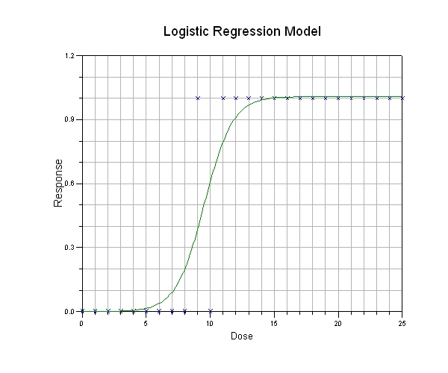
The Math of it All
Formula
Graph

Slide 18
Method
Series of logistic regressions (48 total)
Forced entry
Baseline model using environmental stressor alone/diathesis alone
Other variables added one at a time in all possible sequences (ex. D1XS2; D1XS2; D1XS3; D1XS1,2 etc.) until all possible combinations of diatheses and stressors had been regressed
Examined main effects and interaction effects
Two goals:
to find the combinations of stressors and personal diatheses most likely to result consistently in violent/deviant behavior
To find the “tipping point: after which deviant/criminal behavior was assured

Slide 19
Results
Beginning with single diathesis crossed with single environmental stressor
Ending with two diatheses crossed with three environmental stressors
Provided support for the diathesis-stress model of behavior
Approximated a dynamic social system with improved model fit for more predictors, but, all models which crossed a diathesis with a stressor were significant at .05
13 significant models

Slide 20
Limitations
Model not really meant to show interaction effects
Model was limited to “yes/no” outcomes
Model was not iterative
Model was limited to single source of data – National Longitudinal Study of Adolescent Health 1994 – 2002 (Harris & Udry, 2004) on deposit at the Inter-University Consortium for Political and Social Research (ICPSR 21600)

Slide 21
Limitations
Area of uncertainty

Slide 23
Preliminary Fuzzy Cognitive Map
Strain
Family disruption
Parental deviance
High residential mobility
Lack of suitable daycare
Mother’s employment
Race – non-dominant
Environmental stressors
Social disorganization
Parental absence
Low socio-economic status
Access/lack of education
Household overcrowding
Religion
Parental inadequacy
Crime
Biological diatheses
Genetic transference
Pre-natal insult/injury
Peri-natal insult/injury
Learning disabilities
Mental illness
Addictions
Psych. diathesis
Behaviour
Notes:
Building a fcm to independently and interactively model the factors in a model more closely approximating the ds in the hopes of teasing apart the effects of each factor in the hopes of helping to provide information for policy makers regarding early intervention programs as well as restorative justice initiatives

Slide 24

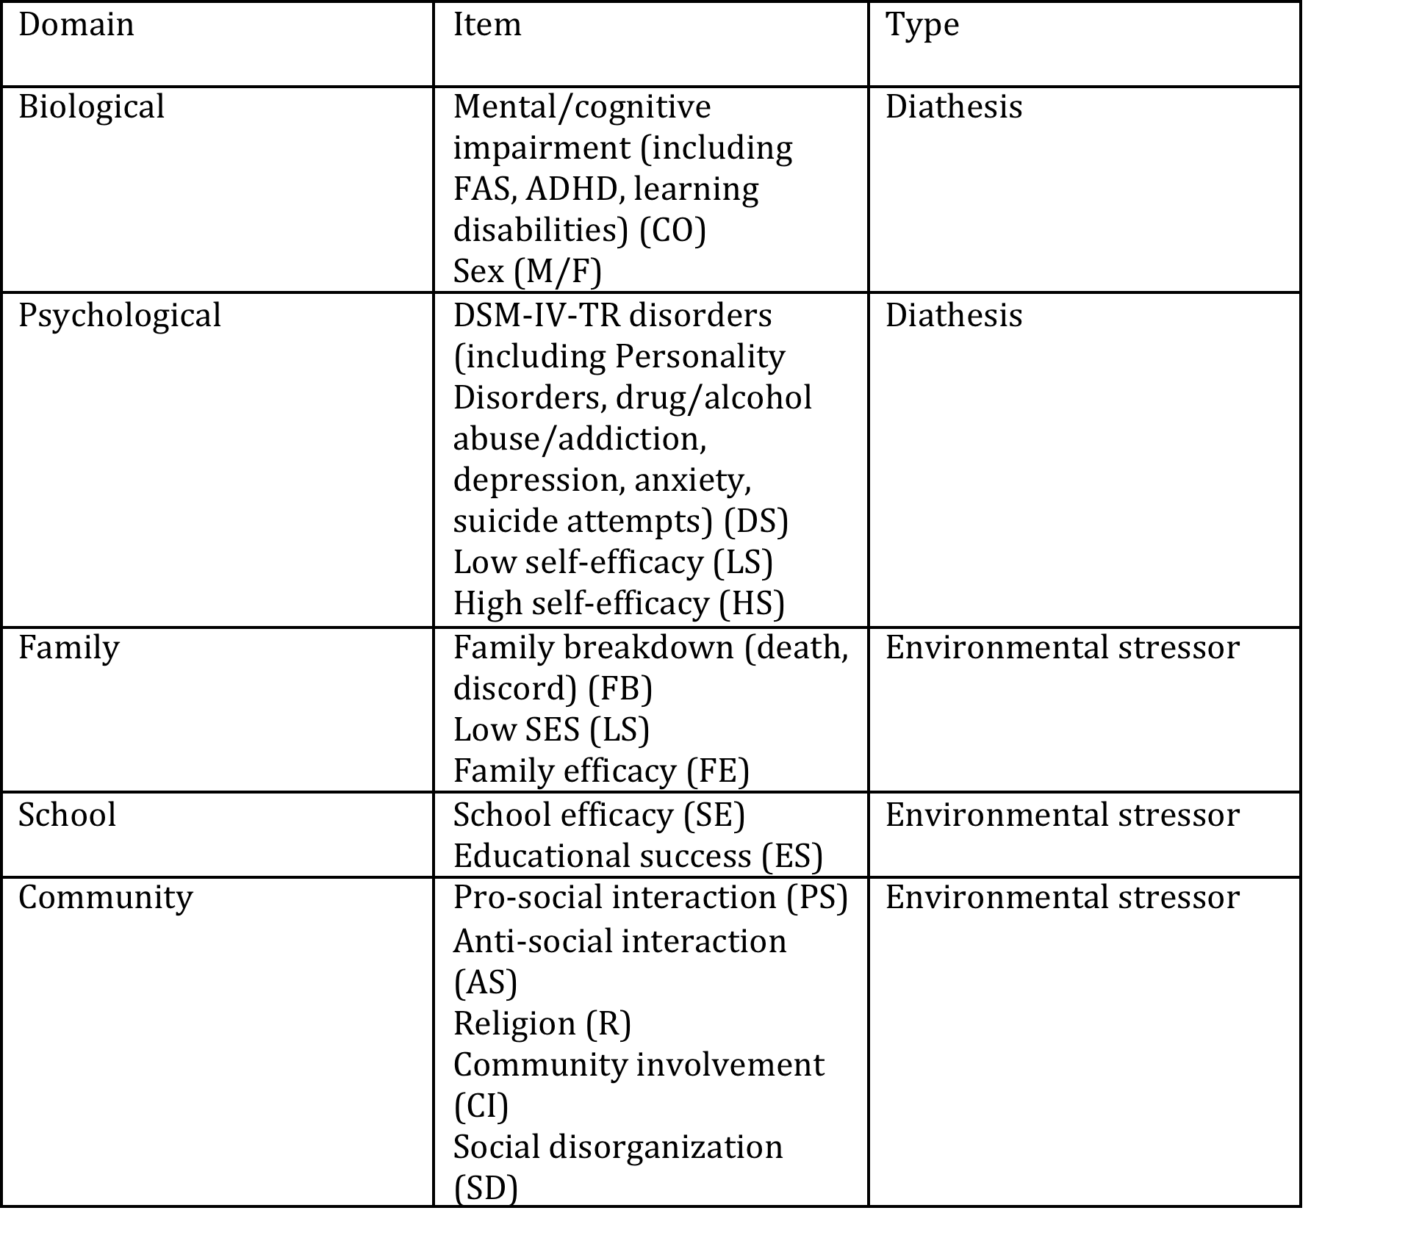
Domains and Variables

Slide 25
Trivalent FCM
Biological
Psychological
DSM-IV-TR Disorders
Cognitive Impairment
+1
+1
+1
+1
+1
+1
Sex: Male
+1
Low Self-efficacy
-1
-1
+1
-1
+1
+1
+1
-1
Sex: Female
High Self-efficacy
-1
-1
DEVIANCE
-1
+1
Community
-1
+1
Family
Pro-social Involvement
+1
+1
-1
+1
-1
+1
+1
+1
Family Efficacy
-1
Educational Success
Anti-Social Involvement
+1
+1
-1
-1
-1
+1
-1
+1
Social Disorganization
-1
Family Breakdown
Community Involvement
+1
-1
+1
-1
-1
-1
+`1
+1
School Efficacy
Religion
-1
Low SES
School

Slide 26
Causal Matrix
 | F | M | CO | HS | LS | DS | SD | FB | FE | LS | CI | R | ES | SE | AS | PS | D
F | 0 | 0 | 0 | 0 | 0 | 0 | 0 | 0 | 0 | 0 | 0 | 0 | 0 | 0 | 0 | 0 | -1
M | 0 | 0 | +1 | 0 | 0 | 0 | 0 | 0 | 0 | 0 | 0 | 0 | 0 | 0 | 0 | 0 | +1
CO | 0 | 0 | 0 | 0 | 0 | 0 | 0 | 0 | 0 | 0 | 0 | 0 | 0 | 0 | 0 | 0 | +1
HS | 0 | 0 | -1 | 0 | 0 | -1 | 0 | 0 | 0 | 0 | 0 | 0 | 0 | +1 | 0 | 0 | -1
LS | 0 | 0 | 0 | 0 | 0 | +1 | 0 | 0 | 0 | 0 | 0 | 0 | 0 | 0 | 0 | 0 | +1
DS | 0 | 0 | 0 | 0 | 0 | 0 | +1 | +1 | 0 | 0 | 0 | 0 | 0 | 0 | 0 | 0 | +1
SD | 0 | 0 | 0 | 0 | 0 | +1 | 0 | 0 | 0 | 0 | -1 | 0 | -1 | 0 | 0 | 0 | +1
FB | 0 | 0 | 0 | 0 | 0 | 0 | 0 | +1 | -1 | 0 | 0 | 0 | 0 | 0 | 0 | 0 | +1
FE | 0 | 0 | 0 | 0 | 0 | -1 | -1 | -1 | 0 | 0 | 0 | 0 | +1 | 0 | 0 | 0 | -1
LS | 0 | 0 | 0 | 0 | 0 | 0 | +1 | 0 | 0 | 0 | 0 | 0 | 0 | 0 | 0 | 0 | +1
CI | 0 | 0 | 0 | 0 | 0 | 0 | 0 | 0 | 0 | 0 | 0 | 0 | 0 | 0 | 0 | 0 | -1
R | 0 | 0 | 0 | 0 | 0 | 0 | 0 | -1 | 0 | 0 | +1 | 0 | 0 | 0 | 0 | 0 | -1
ES | 0 | 0 | 0 | 0 | 0 | 0 | 0 | 0 | 0 | 0 | 0 | 0 | 0 | 0 | 0 | 0 | -1
SE | 0 | 0 | 0 | +1 | 0 | 0 | 0 | 0 | 0 | 0 | 0 | 0 | +1 | 0 | -1 | +1 | -1
AS | 0 | 0 | 0 | 0 | +1 | 0 | 0 | 0 | 0 | 0 | 0 | 0 | 0 | -1 | 0 | 0 | +1
PS | 0 | 0 | 0 | +1 | 0 | 0 | 0 | 0 | 0 | 0 | 0 | 0 | 0 | +1 | 0 | 0 | -1
M =

Slide 27
Causal Matrix Algebra
The causal concepts, or fuzzy sets, are nonlinear functions that map the input causal action (effect of the first concept) into an output fuzzy degree.
In the matrix, M, the links are stated in numbers denoted the ith concepts of the system ( C_{i}).
The value, C_{i} of a concept, C_{i} expresses the strength of its corresponding physical value according to the following rules:
If e_{ik} > 0 then C_{i} causally increases
If e_{ik} < 0 then C_{i} causally decreases
If e_{ik} = 0 then C_{i} causally has no effect

Slide 28
Causal Matrix Algebra
At each step the value of the concept, C_{i} is influenced by the values of all the concepts connected to it and is updated according to:
where S(x) is a bounded signal function.
The FCM will converge to a steady state (equilibrium) when:

Slide 29
Simulation of the Trivalent FCM For Functioning and State Status
Three cases should be chosen:
Case most likely to result in deviancy (low self-efficacy, DSM-IV-TR disorders, low school efficacy, and high family efficacy)
Case least likely to result in deviancy (female, high self-efficacy, school efficacy, and low SES)
Case where outcome is uncertain (male, DSM-IV-TR disorders, high family efficacy, educational success)

Slide 30
Converting Empirical Literature to Fuzzy Values using Fuzzy Rules
males engage in substantially more delinquent acts than females
Concept one: males
Adjective describing the effect of the first concept on the destination concept
Destination concept - deviance

Slide 31
Statements cont.
In a path analysis, self efficacy statistically influenced both classroom engagement and performance
Concept one: self-efficacy
Adjective describing effect of first concept on destination concept: statistically influenced
Destination concept: classroom engagement and performance = school efficacy

Slide 32
Word Bank and Rankings
Very Low | Low | Moderate | High | Very High
Gives rise Related to Results in Shows evidence of | Accompanied by Associated with Appears Can increase Carry through Contributes to Found that Generally Helps to account for Higher odds Increase Propensity Influenced by | At risk Considerable Empirical support Correlation between Cultivates Exerts moderate Deterrent Fosters Greater likelihood Higher odds Less likely Meaningful link | Considerable empirical support Closely related Highly related Important predictor Important role Important Most common Most significant Much greater risk Potent effects | Key mechanism Major source Majority by far Profoundly Robust Salient Most noticeable or importatn

Slide 33
Conversion via Fuzzy Rules
In a path analysis, self efficacy statistically influenced both classroom engagement and performance
Converted via Likert-type scale (very low, low, moderate, high, very high)
Transformation use rule statement:
If < A is ON > THEN < B is H>

Slide 34
Triangle Membership Function
VL L M H VH
1
Membership value (μ)
Output Variable

Slide 35
Examples of Membership Functions
IF < social disorganization is ON > THEN < deviance is M>
IF < social disorganization is ON > THEN < deviance is VH >
IF < social disorganization is ON > THEN < deviance is M >
Converted and summed in MatLab@ Fuzzy Toolbox

Slide 37
Experimentation with Weighted FCM
Consistent with empirical evidence/knowledge
Captured the dynamics of the system it is modeling
Using cases similar to those used in the trivalent/simple FCM
“what-if” for effect of interventions, protective factors, prevention, restorative measures, education, government policy
Interpretation through “expert knowledge”

Slide 38
Analysis of Network Concepts
Degree of impact
Varying value from 0.1 to 1 while fixing other concepts except concept of interest (deviance)
Record value of deviance after several iterations
For factors with stated positive effect on deviance
value of deviance should increase as factor value is increased – gradually converging to a positive value
For factors with stated negative effect on deviance
Value of deviance should decrease as factor value is increased
Allows for “ranking” of concepts

Slide 39
Discussion and Questions
FL and FCM suitable to model complex biological and psychological diatheses and protective factors, interacted with environmental stressors
May help confirm the efficacy of using FL and FCM for the modeling of complex social problems
Early-onset deviance is costly – educational/social assistance affect = 85% of income assistance expenditures in BC in 2006
Traditional rigid statistical models are sub-optimal to model dynamic systems
Diathesis-stress is suitable for FL and FCM
Direct policy implication

