Slide 1

Two distinct models of the criminal justice system in B.C.
Bojan Ramadanovic
Alexa van der Waall
Math 800
02nd November 2011
Models in practice

Slide 2
The project
Models for the Ministry of the Attorney General and the Ministry of Public Safety and Solicitor General in B.C.
Models are developed by the CSMG and the ministries.
Ongoing since 2007
About 26 collaborators

Slide 3
The Criminal Justice System of B.C.
A high level model

Slide 4
The Criminal Justice System of B.C.
Many actors
Police
Crown
Several courts
Corrections
Many dependencies within and between parts
Hearings versus people in remand
Sentencing outcomes and time in custody
Many units of interests
People
Charges
Cases
Time at stages
It is HUGE and COMPLEX

Slide 5
The Criminal Justice System of B.C.
What is the purpose of a model of the CJS?
Forecast impacts from changes to or from within the system
Decision making
Legislative changes
Resource demand or utilization
Strategic planning

Slide 6
Two models
General Criminal Justice System model
Remand credit model
Connects Police, Crown, courts and corrections at a high level
Focuses on how a change in one part of the system affects the others
System dynamics model
Connects courts processes and custodial corrections
Focuses on the impact of a specific bill on Custodial corrections
Queue network model

Slide 7
The general Criminal Justice System model
A system dynamics adventure

Slide 8
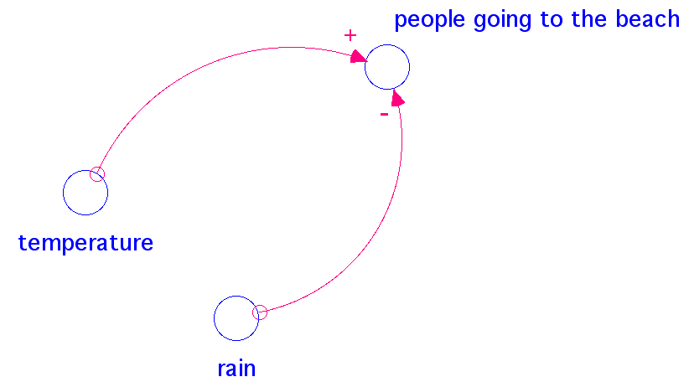
System dynamics model characteristics I
System thinking
Method of thought as opposed to a modelling technique.
System as a whole
Describe the interactions between parts qualitatively
Influence diagram

Slide 9
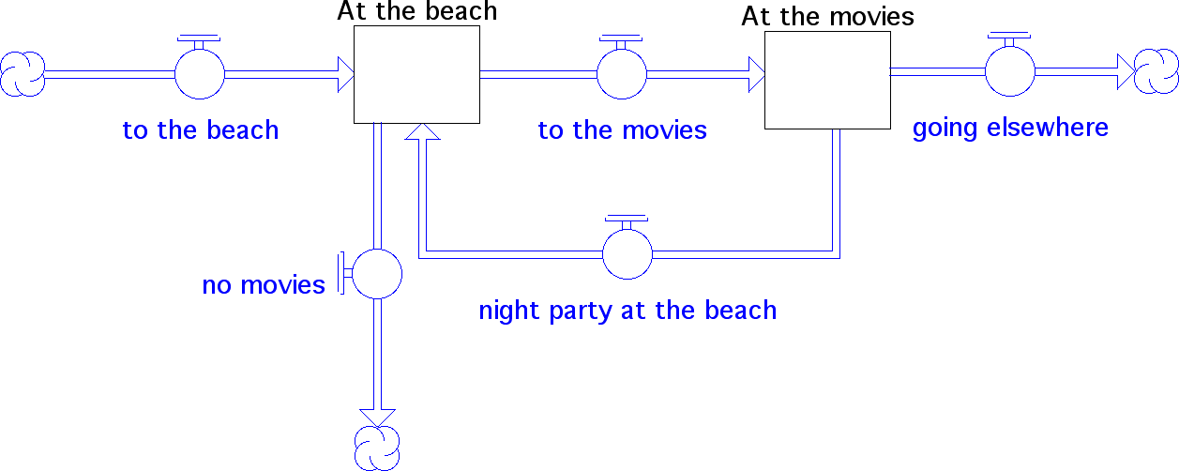
System dynamics model characteristics II
Stocks
Values at specific dates
``Accumulation points’’ of entities
Flows
Movement of undistinguishable entities
Determine volume changes to a stock
Volumes at main stage

Slide 10
System dynamics model characteristics III
Qualitative
Conceptual design of processes
Expert knowledge
Quantitative
Equations based on actual data to govern the stocks
May rely on time
May rely on the state of the system or stocks
Predictions of the system’s behaviour
Mainly presents averages
Continuous
Relatively data friendly

Slide 11
The general CJS model design
Major stages in each sub-system
Bottlenecks
Points where changes are imposed, expected or explored
Incorporate expert knowledge
Incorporate data from different sources
Crime types
Regions
Many monthly time series data
Notes:
528 time series

Slide 12
Equations and estimation tools
For model inputs monthly data series forecasts
State space method with exponential smoothing
Seasonality
Time trend
No linear regressions
Linear regressions
Within limits
Optimization techniques
Simultaneous stock and flow estimation of linear equations such as the Nelder-Mead method
Beware of the initial value
Out of sample testing
Validation

Slide 13
Once satisfied use it
General model demo
Notes:
Show impact of Changes in volumes of RCCs to Crown

Slide 14
Remand credit model
A queue network treasure

Slide 15
Bill C-25
Bill C-25: Truth in Sentencing Act came into effect on February 22nd, 2010.
Previously it was common practice to count one day of time served in pre-trial detention (remand) as two days of sentenced custody.
The Bill notes that in general cases judges may provide one day of credit for one day of time served in remand.
What is the effect of Bill C-25 on the number of people in remand, provincial sentenced custody and federal sentenced custody?

Slide 16
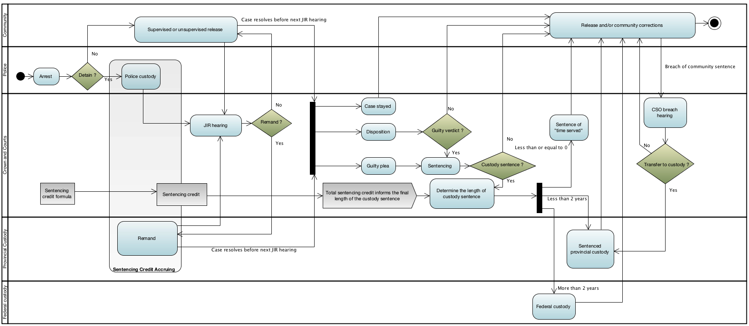
A remand credit model
Notes:
The word Arrest is used in the legal sense.
The court decision stage is where findings are set.
The not-guilty, other findings box represent all findings that do NOT lead to a sentencing hearing.
Thus they contain stays of proceedings as well.
Non-custody sentences contain all outcomes from the sentencing hearing that are NOT custodial.
The custody sentence decision represents the stage where the credits of time served are
applied towards the custodial sentence. These credits are 2:1 in the old regime and 1:1 in the new.

Slide 17
Queue network model characteristics
Entities with attributes
Volumes at main stages
Time measurements are important
Wait-times
Quantitative
Averages insufficient
Distributional information
Correlations between remand and sentences
Data hungry

Slide 18
What is a queue ?
Queue consists of one or more servers processing “customers” and the group of “customers” waiting for service.
It is defined by the arrival process, service process and the number of servers (for example M/M/5) and the “service discipline” (for example “first in, first out”)
Time spent in a queue is a dynamical property dependent on both, fixed properties of the queue and the state of queue at any given time (i.e. number of other customers waiting for service).
Equilibrium state of a queue is best described in terms of distributions.
Number of queues linked together form a queuing network

Slide 19
Arrival and service processes
Arrival processes could be:
Deterministic (another widget comes down the production line every 2 minutes)
Stochastic (people arriving to a checkout at the supermarket)
Markovian: present is past and future independent. I.e. “Interarrival times sample Poisson distribution”.
A lot of queues have Markovian arrival processes.
Service processes are likewise diverse, but fewer systems have strictly Markovian services.
Another popular distribution that can be sampled for service times is “Weibull” which is a generalization of “Poisson” distribution.
When modelling, arrival and service time distributions most often have to be inferred from the system data

Slide 20
Advantages of the queue network modelling
Because results are distributional, it is possible to account for the situations going beyond the average state of the system.
Consider hospital emergency room
Short average waiting times are not very good if people arriving at certain times have to wait unacceptably long for service.
Or a prison
Being “at capacity” on average is not good enough if facility is overcrowded half the time
Easier to account for system resources

Slide 21
Incarceration as a queuing network
Arrival into the criminal justice system is well modelled by a Poisson process.
Prison sentence can be considered an operation of a server.
Non Poisson service time.
What about remand custody ?
Can be made up of a number of in-and-out of jail periods separated by interim release hearings and breach events.
Duration of each individual stint in jail turns out to be close to Poisson distributed.
It is possible to calculate the overall distribution of time spent in pre-sentence custody from atomic properties of individual stints in jail.

Slide 22
Impact of correlations
Given the distribution of pre-sentence incarceration, credit rules and the distribution of sentences it should be easy to calculate overall distribution for occupancy of prison facilities.
But remand stay and eventual prison sentence are not independent.
Individuals with longer remand stays are also more likely to receive custody sentences and to have longer custody sentences
Model which does not take this dependency into account will under estimate the impact of the change in sentence credit.
This can not be accounted for in a non-agent based model
In context of queuing theory model it is addressed by fitting data to a “Bivariate Weibull” distribution.

Slide 23
Acknowledgment
This work would not have existed without the support from the Ministry of Attorney General of B.C. and
the Ministry of Public Safety and Solicitor General of B.C.
Their support is greatly acknowledged.
Our appreciation also goes to the IRMACS at SFU for their technical and their daily general support.

