Slide 1
Modeling of Complex Social Systems
MATH 800
Fall 2011

Slide 2
Complex Social Systems
A system is a set of elements and relationships
A complex system is a system whose behavior cannot be easily or intuitively predicted

Slide 3
Complex Social Systems
A system is a set of elements and relationships
A complex system is a system whose behavior cannot be easily or intuitively predicted
5
3
200
300 = (5-3) t + 200

Slide 4
Complex Social Systems
A social system is a collection of individuals and interactions.
A complex social system is a complex system whose behavior is primarily the result of the behavior of individuals

Slide 5
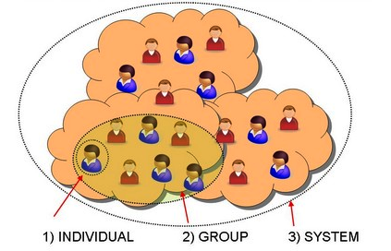
Complex Social Systems
A social system is a collection of individuals and interactions.
A complex social system is a complex system whose behavior is primarily the result of the behavior of individuals
© Ken Thompson

Slide 6
What is Modeling?
is abstraction of reality!
is a representation of a particular phenomena, idea, or condition.
is never perfectly accurate.

Slide 7
What is Mathematical Modeling?
Framing questions in/about the real world in mathematical terms.
Simplified representations of some real-world entity in equations
It is characterized:
Variables (the things which change)
Parameters (the things which do not change)
Functional forms (the relationships)

Slide 8
What is Mathematical Modeling?
5
3
200
300 = (5-3) t + 200
5
3%
X
X(t) = (5-3% X(t-1)) + 200

Slide 9
Purpose of Modeling
In General, Modeling helps
 Answering specific questions
 Understanding problems better
 Communicating with others

Slide 10
First Steps in Modeling
Define systems and boundaries.
Simplify assumptions.
Draw an overall block diagram

Slide 11
Good Models
Simple
Have clearly defined questions
Have clearly stated assumptions
Adaptable
Reproducible
Have clearly defined variables
Validated
Use the best data available
Interpret results with caution

Slide 12
The Modeling Process

Slide 13
The Modeling Process

Slide 14
A Conceptual Modeling Diagram
The SIR Epidemic Model
S
I
R
Transmission (α)
Recover (β)
Susceptibles (S): Individuals susceptible to the disease
Infectious (I): Infected Individuals able to transmit the parasite to others
Recovered (R): Individuals that have recovered, are immune or have died
from the disease and do not contribute to the transmission of the disease
Parameters: α, β
Variables: S, I, R

Slide 15
A Conceptual Modeling Diagram
D
The SIR Epidemic Model
Death (δ)
S
I
R
Transmission (α)
Recover (β)
(γ)
Susceptibles (S): Individuals susceptible to the disease
Infectious (I): Infected Individuals able to transmit the parasite to others
Recovered (R): Individuals that have recovered
Death (D): Individuals that have died from the disease
Parameters: α, β, γ, δ
Variables: S, I, R, D

Slide 16
Computational Modeling
Simulation: Simulation is any technique for analyzing, designing, and operating complex systems.
Visualization: Visualization is any technique for creating images, diagrams, or animations to communicate and describe the behavior of complex systems.

Slide 17
Types of Mathematical Models
Linear vs. Non-linear Models
In linear models all the variables and the parameters are connected by linear equations. Otherwise the model is non-linear.
D
The SIR Epidemic Model
Death (δ)
S
I
R
Transmission (α)
Recover (β)
(γ)

Slide 18
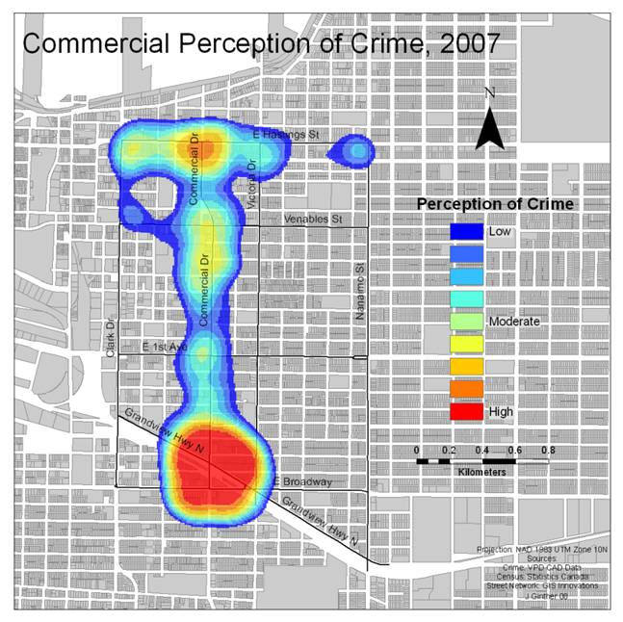
Types of Mathematical Models
Aggregate vs. Individual Models
© Ken Thompson

Slide 19
Types of Mathematical Models
Deterministic vs. Stochastic Models
Deterministic models have no uncertain components (no parameters are characterized by probability), as opposed to stochastic models
D
The SIR Epidemic Model
Death (δ)
S
I
R
Transmission (α)
Recover (β)
(γ)

Slide 20
Types of Mathematical Models
Static vs. Dynamic Models
A dynamic model refers to a system that changes over time, whereas static model refers to a system that is at steady state
Dynamic model is a representation of the behavior of the static components of the system.

Slide 21
Types of Mathematical Models
Continuous vs. Discrete Models
In discrete Models variables change only at a countable number of points in time, whereas in continuous models variables change in a continuous way.
α
β
X

Slide 22
Types of Mathematical Models
Qualitative vs. Quantitative Models
Quantitative models lead to a detailed, numerical predication about responses, whereas qualitative models lead to general descriptions about the responses.
α
β
X
α
X
β
X

