Slide 1
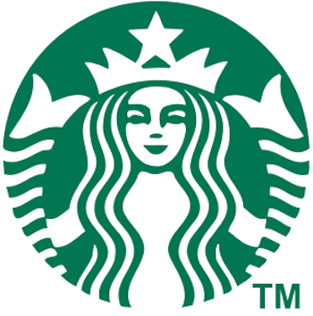
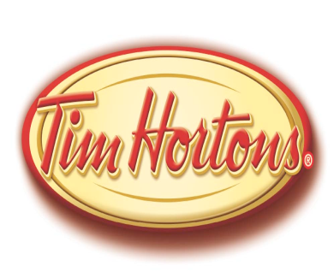
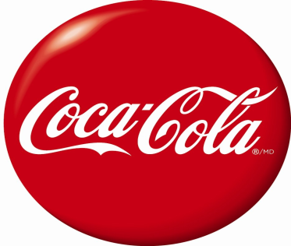
Consumer Products
Ana-Maria Lovrich
Shasha Liang
Sunny Har

Slide 2
Agenda
Industry Overview
Coca-Cola
Starbucks & Tim Hortons
Company Overview
Financial Statement
Risk Factors & Management

Slide 3
Soft Drink Industry
The soft drink industry makes and bottles non-alcoholic carbonated beverages, including fruit flavored beverages, colas, ginger ales, ginger beers, root beers, iced tea, iced coffee, soda waters, tonic waters and other mixers.

Slide 4
Cost Structure
Low fixed costs relative to high variable costs
“The tendency for competing on price is further limited by Coke and Pepsi’s near-century of competition – a history that has allowed them to learn how to avoid destroying profits in mutually damaging price wars.”

Slide 5
Industry Changes
Entry/exit of major firms
Globalization
Changing societal concerns, attitudes, and lifestyles
Long-term industry growth rate
Product innovation

Slide 6
Governmental Regulations
Regulated under
the Food and Drugs Act and Regulations
the Consumer Packaging and Labeling Act.
Health Canada's Natural Health Product Regulations
the Canadian Environmental Protection Act and the Canadian Environmental Assessment Act

Slide 7
Soft Drink Industry
Challenges & Opportunities:
Higher degree of competition
Health problem, e.g. child obesity
Increased packaging costs (PET plastic)
Higher transportation and distributions costs

Slide 8
Soft Drink Industry
Industry Major Players (Top 10 Soft Drink Companies in US)
Rank Companies | Market Share (%)
1. Coca-Cola Co. | 42.0
2. PepsiCo | 29.3
3. Dr PepperSnapple | 16.7
4.Cott Corp. | 4.8
5. National Beverage | 2.8
6. Hansen Natural | 1.0
7. Red Bull | 0.8
8. Big Red | 0.5
9. Rockstar | 0.5
10. Private label and other | 1.6

Slide 9
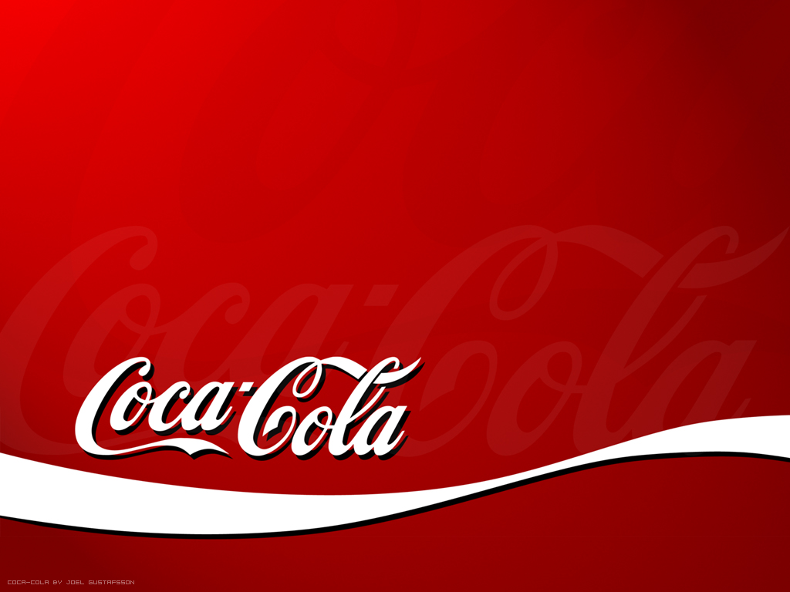
Company Overview

Slide 10
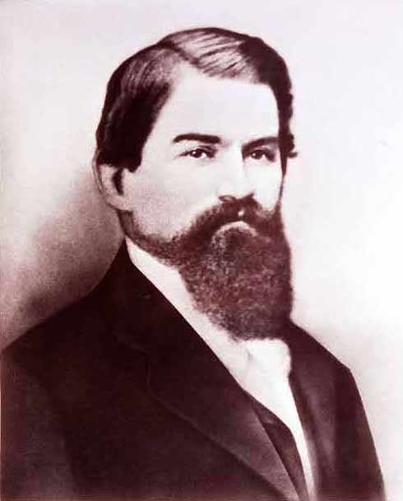
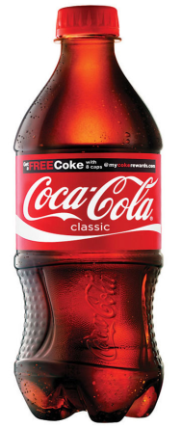
Coca-Cola History
1886, created by Dr. Pemberton, Georgia.
1895, be sold in the whole U.S.

Slide 11
Coca-Cola Mission
Our Roadmap starts with our mission, which is
enduring.
To refresh the world...
To inspire moments of optimism and happiness...
To create value and make a difference.

Slide 12
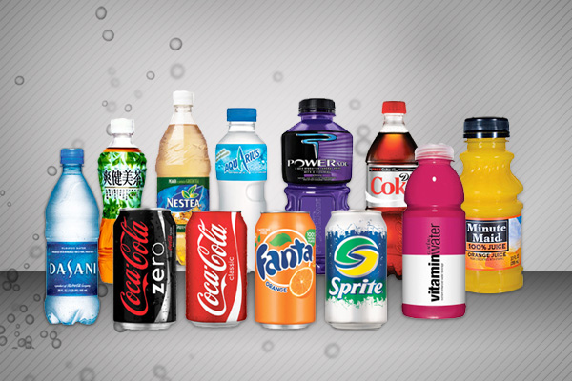
Products: product list
3,500 products in over 200 countries

Slide 13
Financial Analysis
Revenue Structure
Operating Revenues
Sale of beverage concentrates & syrups
Sale of fountain syrups to fountain retailers
Sale of finished beverages
Revenues from Financial Activities
Cost Structure

Slide 14
Financial Statement

Slide 15
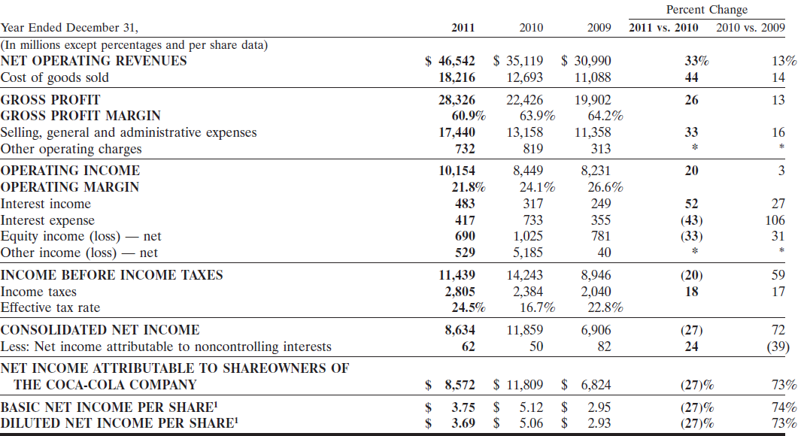
Income Statement of Coca-Cola (in million$)

Slide 16
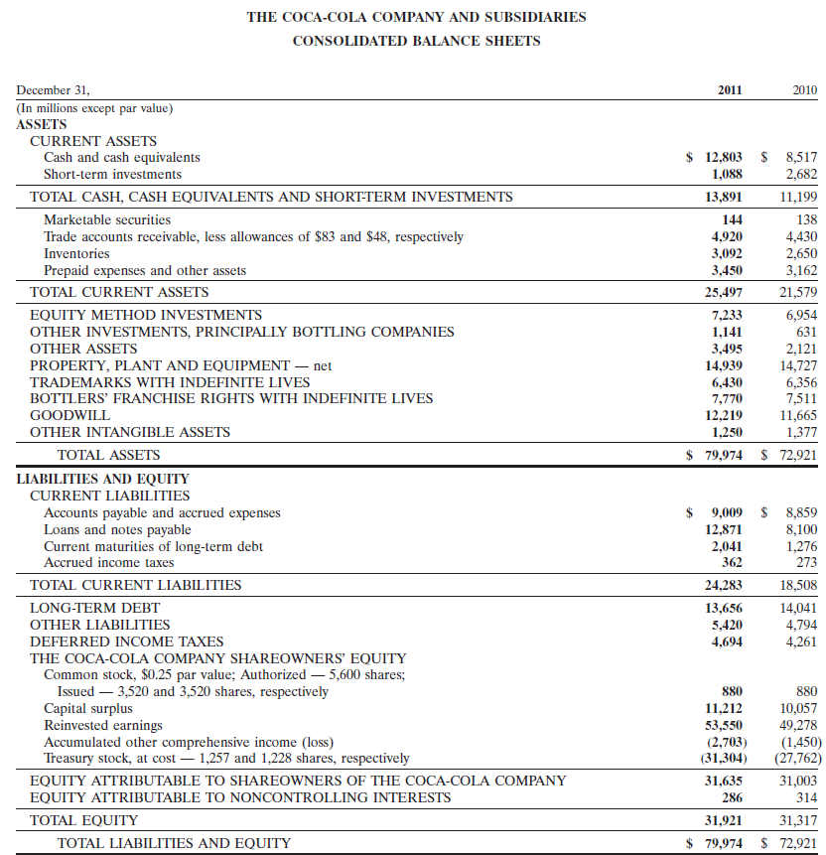

Slide 17
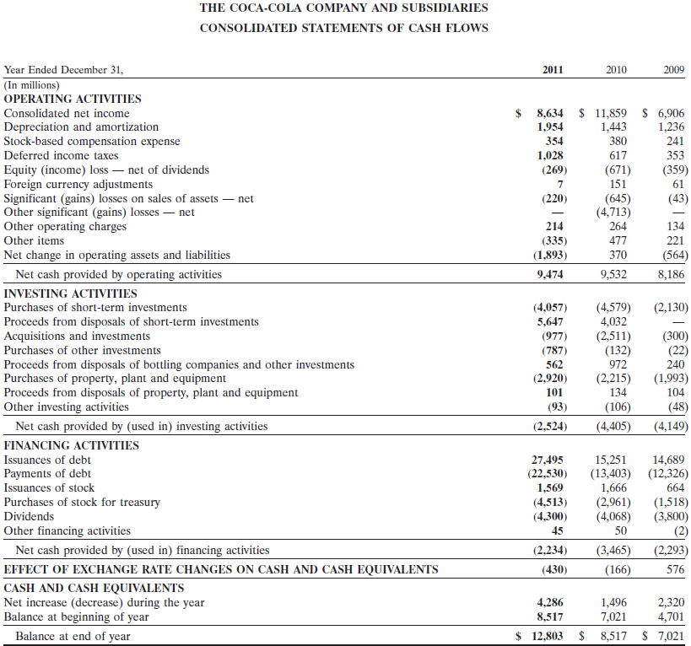
The Coca-Cola Consolidated Cash Flows Statement (in million$)

Slide 18
Risk Factors & Management

Slide 19
Risk Management
Board and Company’ Roles
Anti-Hedging Policy
Risk Factors
Financial Risks and Strategies

Slide 20
Risk Management
The Board’s Role in Risk Management
understand critical risks;
allocate responsibilities for risk oversight;
evaluate the Company’s risk management;
facilitate open communication between management and Directors;
foster an appropriate culture of integrity and risk awareness

Slide 21
Risk Management
Company management
enterprise risk management program,
risk management committee,
regular internal management disclosure committee meetings,
Codes of Business Conduct,
robust product quality standards and processes,
ethics and compliance office
comprehensive internal and external audit process

Slide 22
Anti-Hedging Policy
“Prohibits Directors, the Company’s executive officers and certain other employees from purchasing any financial instrument that is designed to hedge or offset any decrease in the market value of the Company’s stock, including prepaid variable forward contracts, equity swaps, collars and exchange funds.”

Slide 23
Risk Factors
Obesity and other health concerns
Water scarcity and poor quality
Continuing uncertainty in the credit and equity markets
Fluctuations in foreign currency exchange and interest rates
Relationships with bottling partners
Bottling partners’ financial & non-financial condition
Increases in income tax rates or changes in income tax laws
Increase in the cost, disruption of supply or shortage of energy, ingredients, other materials
Product safety or quality issues, or negative publicity
Integrate and manage Company-owned or controlled bottling operations

Slide 24
Financial Risk Management
Foreign Exchange Risk
Interest Risk
Commodity Risk
Other Market Risk

Slide 25
Foreign Exchange Risk
Strategies: Foreign currency exchange management
75 functional currencies: Weakness in one particular currency offset by strengths in the other currencies
Derivative instruments

Slide 26
Foreign Exchange Risk
The Coca-Cola Company Operating Segments (In millions) Three Months Ended (December 31, 2011)

Slide 27
Foreign Exchange Risk
“Our Company enters into forward exchange contracts and purchases currency options (principally euro and Japanese yen) and collars to hedge certain portions of forecasted cash flows denominated in foreign currencies. Additionally, we enter into forward exchange contracts to offset the earnings impact related to exchange rate fluctuations on certain monetary assets and liabilities.”

Slide 28
Foreign Exchange Risk
Time | Total notional value of foreign currency derivatives (in million$)
2009 | 4.6
2010 | 6.3
2011 | 10.5

Slide 29
Interest Rate Risk
“We monitor our mix of fixed-rate and variable-rate debt, as well as our mix of short-term debt versus long-term debt. From time to time, we enter into interest rate swap agreements to manage our mix of fixed-rate and variable-rate debt.”

Slide 30
Interest Rate Risk
Time | Percentage change | Change in interest expense
December 31, 2011 | 1% | $191 million

Slide 31
Interest Rate Risk
“A swap agreement is a contract between two parties to exchange cash flows based on specified underlying notional amounts, assets and/or indices.”
 | Dec 31, 2011 | Dec 31, 2010
Interest rate swap (assets) | 246 | ---
Interest rate swap ( liabilities) | --- | 97

Slide 32
Commodity Prices Management
“Whenever possible, we manage our exposure to commodity risks primarily through the use of supplier pricing agreements that enable us to establish the purchase prices for certain inputs that are used in our manufacturing and distribution business. We also use derivative financial instruments to manage our exposure to commodity risks at times.”

Slide 33
Commodity Prices Management
Time | Open commodity derivatives that qualify for hedge accounting’s notional value (in million$) | Fair value (in million$) | Change in price (%) | Net gain/loss(in million$)
Dec 31, 2011 | $26 | $1 | (10)% | $(1)
Time | Open commodity derivatives that do not qualify for hedge accounting’s notional value (in million$) | Fair value (in million$) | Change in price(%) | Net gain/loss (in million$)
Dec 31, 2011 | $1,165 | $7 | (10)% | $(78)

Slide 34
Summary of Risk management
The following table presents the fair values of the Company's derivative instruments that were designated and qualified as part of a hedging relationship (in millions):
Derivatives designated as hedging instruments | Balance sheet location | Dec 31, 2011 | Dec31, 2010
Assets:
Foreign currency contracts | Prepaid expenses and other assets | 170 | 32
Commodity contracts | Prepaid expenses and other assets | 2 | 4
Interest rate swaps | Other assets | 246 | ---
Total assets |  | 418 | 36
Liabilities:
Foreign currency contracts | Accounts payable and accrued expenses | 41 | 141
Commodity contracts | Accounts payable and accrued expenses | 1 | 2
Interest rate swaps | Other liabilities | --- | 97
Total liabilities |  | 42 | 240

Slide 35
Summary of Risk management
Gain and loss on risk management:
Time | Net gain (loss) on derivatives (in million) (after-tax amount) | Accumulated derivative net losses
2008 | 1 | ---
2009 | 34 | (78)
2010 | (120) | (198)
2011 | 145 | (53)

Slide 36
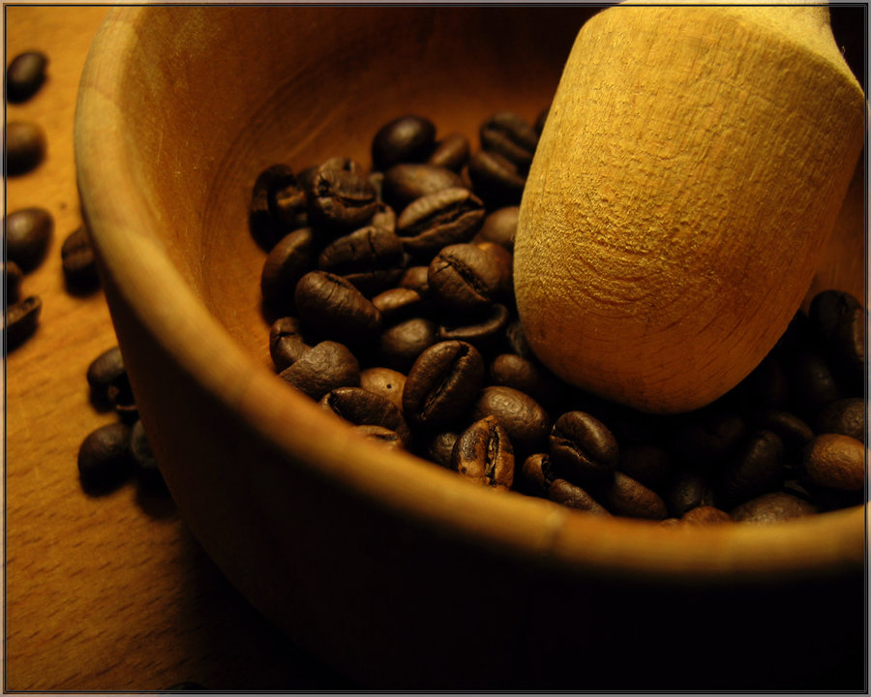
Industry Overview Tim Hortons & Starbucks

Slide 37
Industry Overview
Starbucks and Tim Hortons are in the coffee shop industry which is part of the larger specialty eateries industry.

Slide 38
Specialty Eateries
Fits within the largest segment of disposable income spending, food and beverages
In the US, industry includes more than 35,000 companies with combined annual revenue of about $25 billion
Major companies include Dunkin' Brands, Krispy Kreme Doughnuts, and Starbucks. The industry is fragmented: the 50 largest firms generate about 45 percent of industry revenue.
Notes:
Dunkin brands like baskin robbins and dunkin donuts

Slide 39
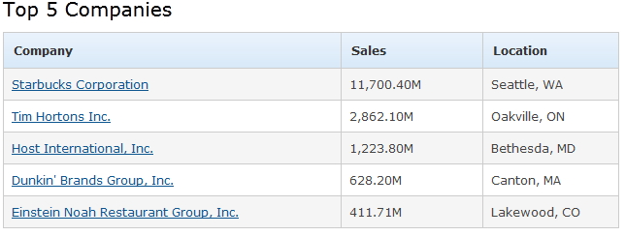
Top 5 Companies

Slide 40
Competitive Landscape
Consumer taste and personal income drive demand
The profitability depends on efficient operations and high volume sales.
As well as, the ability to secure prime locations, drive store traffic, and deliver high-quality products
Notes:
Drive store traffic with good product mix, store atmosphere, free wifi etc

Slide 41
Industry Cost Structure
Low to moderate costs for each location
Major start-up expenditures
Property
Equipment
Major operating costs
Labour
Cost of sales

Slide 42
PEST
Political
Government regulations
Economic
Changes in disposable income
Social
Consumer preferences
Technological
Technology to improve operational efficiencies
Notes:
Government regulations especailly for SBs since it has expanded to many different countries with their own regulations

Slide 43
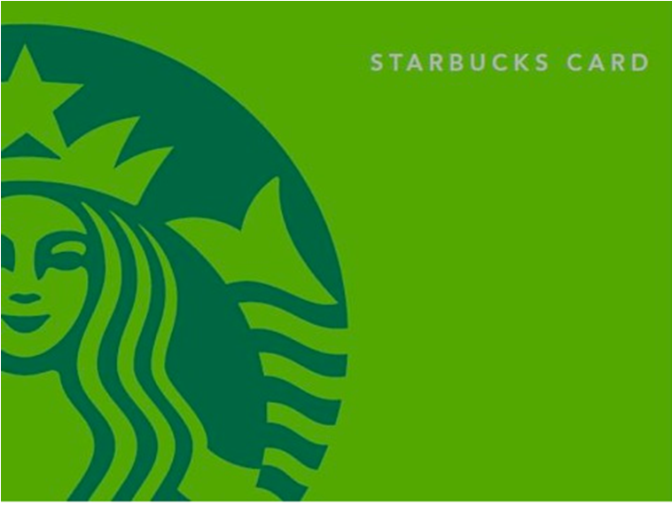

Company Overview

Slide 44
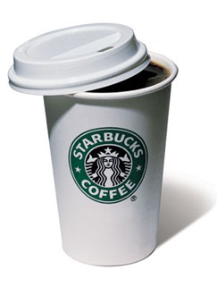
Starbucks (SBUX)
First Starbucks opened in Seattle on March 30, 1971
More than 17,000 retail stores in over 55 countries
Our mission: to inspire and nurture the human spirit – one person, one cup and one neighbourhood at a time.

Slide 45
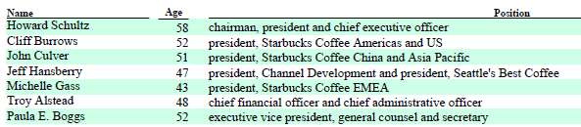
Upper Management

Slide 46
Objective
Maintain Starbucks standing as one of the most recognized and respected brands in the world.

Slide 47
Strategies to Achieve Goal
Continue the disciplined expansion of their store base outside of the US.
Continue to offer consumers new coffee products in multiple forms, across new categories, and through diverse channels
Starbucks Global Responsibility
Employer of choice
Notes:
To achieve their objective, Starbucks does the following....
As well SB’s
Global responisbility strategy
A program that has commitments related to coffee and the communities they do business in
Global Responsibility
We are committed to being a deeply responsible company in the communities where we do business around the world. Our focus is on ethically sourcing
high-quality coffee, reducing our environmental impacts and contributing positively to communities. Starbucks Global Responsibility strategy and
commitments are integral to our overall business strategy. As a result, we believe we deliver benefits to our stakeholders, including employees, business
partners, customers, suppliers, shareholders, community members and others. For an overview of Starbucks Global Responsibility strategy and commitments,
please visit www.starbucks.com.
And being an Employer of choice
- Are also key complements to their business strategies

Slide 48
Core Business
Purchase and roast high-quality whole bean coffees for sale
Sell handcrafted coffee and tea beverages and a variety of fresh food items.
Sell a variety of coffee and tea products
License their trademarks through other channels
Portfolio includes Tazo® Tea, Seattle's Best Coffee®, and Starbucks VIA® Ready Brew.
Notes:
License our trademarks thro other channels such as licensed stores, grocery and national foodservice accounts.
In addition to the flagship Starbucks brand, they also have a portfolio of other brand such as

Slide 49
Financial Statement

Slide 50
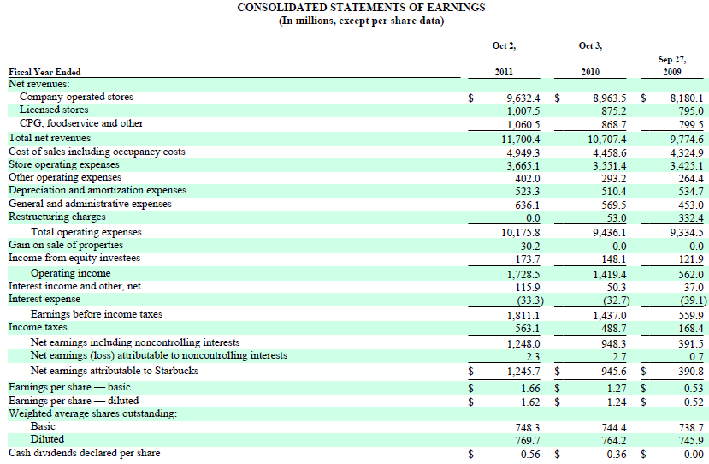
Notes:
Net revenue increased to 11 billion in 2011
Consolidated operating income was $1.7 billion for fiscal 2011 compared to $1.4 billion in fiscal 2010
Part of the contribution to the increase in total net revenues was favorable foreign currency
translation (approximately $126 million) resulting from a weakening of the US dollar relative to foreign currencies
operating margin increased to 14.8% compared to 13.3% in fiscal 2010. The operating margin expansion was driven by increased sales leverage, partially offset by higher commodity costs
Operating margin just net earnings / net revenues
Operating margin of about 15% for 2011
Net profit margin of about 10.6%

Slide 51
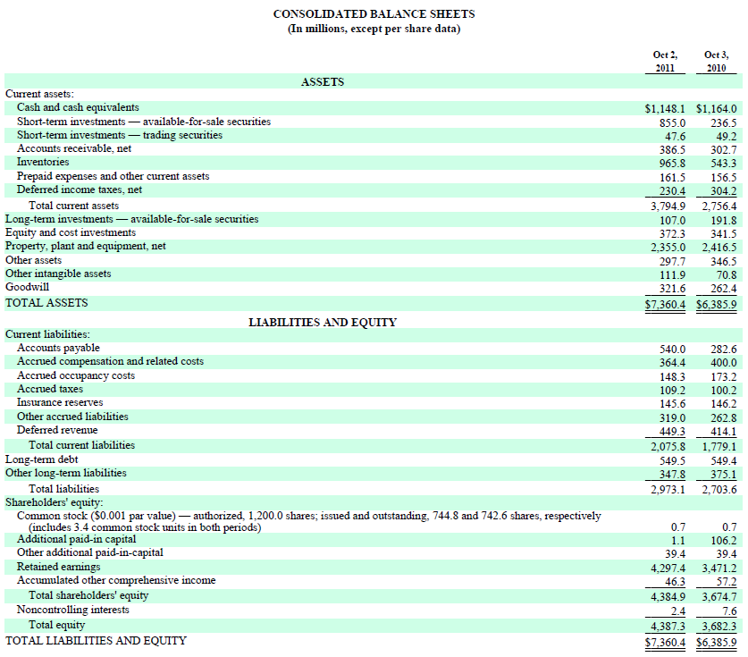

Slide 52
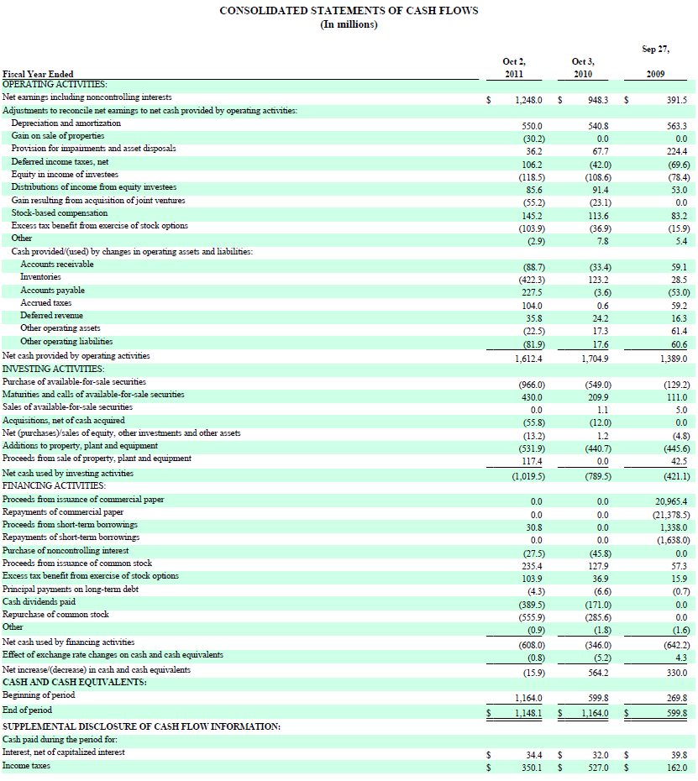
Notes:
Cash flow from operations was $1.6 billion in fiscal 2011 compared to $1.7 billion in fiscal 2010. Capital expenditures were approximately
$532 million in fiscal 2011 compared to $440 million in fiscal 2010. Available operating cash flow after capital expenditures during fiscal 2011 was
directed at returning approximately $945 million of cash to our shareholders via share repurchases and dividends.
Lot of cash on hand

Slide 53
Revenue by Region
Notes:
This is their revenue by segments for fiscal year 2011
United States
US operations sell coffee and other beverages, complementary food, whole bean coffees, and a focused selection of merchandise primarily through companyoperated
stores. Other operations within the US include licensed stores.
International
International operations sell coffee and other beverages, complementary food, whole bean coffees, and a focused selection of merchandise through companyoperated
stores in Canada, the UK, and several other markets. Other operations in international markets primarily include retail store licensing operations in
nearly 50 countries and foodservice accounts, primarily in the UK and Canada. Many of our international operations are in the early stages of development
that require a more extensive support organization, relative to the current levels of revenue and operating income, than in the US.
Our international portfolio, which contributed 22% of total net revenues in fiscal 2011, continues to improve, with an operating margin of 13% for the year.
We continue to leverage the valuable lessons learned from the turnaround of our US business, and continue to make progress on scaling the infrastructure of
this segment. We are aggressively pursuing the profitable expansion opportunities that exist outside the US, including disciplined growth and scale in our
more mature markets, and faster expansion in key emerging markets like China (so in future, more foreign exchange exposure).
Global Consumer Products Group
CPG operations sell a selection of whole bean and ground coffees as well as a selection of premium Tazo® teas in US and international markets. CPG
operations also produce and sell ready-to-drink beverages which include, among others, bottled Frappuccino® beverages, Starbucks DoubleShot® espresso
drinks, and Discoveries® chilled cup coffee. In addition, CPG operations produce and sell Starbucks VIA® Ready Brew, as well as Starbucks® super-premium
ice creams through its marketing and distribution agreements and a joint venture. The US foodservice business sells coffee and other related products to
institutional foodservice companies with the majority of its sales through national broadline distribution networks.
Other
Other includes Seattle's Best Coffee and Digital Ventures as well as expenses pertaining to corporate administrative functions that support the operating
segments but are not specifically attributable to or managed by any segment, and are not included in the reported financial results of the operating segments.

Slide 54
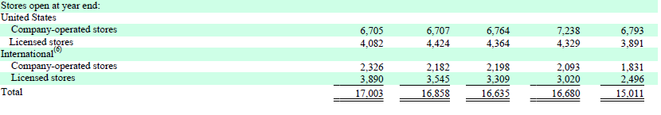
Number of Stores
Notes:
See a trend
Closing more US stores, opening more stores and licenses internationally especially in China, Canada, and Japan

Slide 55
Risk Factors & Management

Slide 56
General Risk Factors
Highly dependent on the financial performance of their US operating segment.
Increasingly dependent on the success of their international operations in order to achieve growth targets.
Economic conditions in the US and certain International markets
International operations are subject to inherent risks of conducting business abroad, such as:
foreign currency exchange rate fluctuations
changes in economic, legal, regulatory, social and political conditions in their markets
Interpretation of laws and regulations
Notes:
Highly dependent on performance in US as it comprised approximately two thirds of consolidated total net revenues in
fiscal 2011. If revenue trends slow or decline our business and financial results could be adversely affected, and because the US segment is relatively mature
and produces the large majority of our operating cash flows, could result in reduced cash flows for funding the expansion of our international business and for
returning cash to shareholders.
However, future growth increasingly depends on the growth and sustained profitability of our international operations.
So economic conditions in the US and certain internaional markets could adversely affect SBs business and financial results

Slide 57
Hedging Philosophy
“Our financial condition and results of operations are sensitive to, and may be adversely affected by, a number of factors, many of which are largely outside our control.”

Slide 58
Risk Management Policy
Manage exposure to various market-based risks according to an umbrella risk management policy.
Market-based risks are quantified and evaluated for potential mitigation strategies, such as entering into hedging transactions.
Governs the hedging instruments the business may use and limits the risk to net earnings.
Notes:
This policy will have market-based risks quantified and evaluated for potential hedging
As well it governs the hedging instruments SBs can use

Slide 59
Risk Management Policy
Monitor and limit the amount of associated counterparty credit risk.
Additionally, this policy restricts, among other things, the amount of market-based risk to be tolerated before implementing approved hedging strategies and prohibits speculative trading activity.
In general, hedging instruments do not have maturities in excess of five years.
Notes:
As well, it will monitor and limit....

Slide 60
Financial Risk Management
Commodity Risk
Foreign Exchange Risk
Equity Security Risk
Interest Rate Risk
Notes:
Starbucks manages 4 financial risks

Slide 61
Commodity Risk
“Increases in the cost of high-quality Arabica coffee beans or other commodities or decreases in the availability of high quality Arabica coffee beans or other commodities could have an adverse impact on our business and financial results”
“Commodity price risk represents Starbucks primary market risk”
Notes:
They are worried not only about the price but the availability of the high quality coffee that they demand
The price of coffee is subject to significant volatility. Although most coffee trades in the commodity market, high-altitude arabica coffee of the quality sought by Starbucks tends to trade on a negotiated basis at a premium above the "C" coffee commodity coffee price. Both the premium and the commodity price depend upon the supply and demand at the time of purchase. Supply and price can be affected by multiple factors in the producing countries, including weather, political and economic conditions. Price is also impacted by trading activities in the arabica coffee futures market, including hedge funds and commodity index funds. In addition, green coffee prices have been affected in the past, and may be affected in the future, by the actions of certain organizations and associations that have historically attempted to influence prices of green coffee through agreements establishing export quotas or by restricting coffee supplies.
In their statement, they label commodity costs as a cost increase that is wholly or partially beyond our control and can only be partially hedged

Slide 62
Commodity Risk
Commodity inputs
Coffee
Dairy products
Diesel
Cost increases are either wholly or partially beyond their control
Costs for commodities can only be partially hedged
Notes:
We purchase commodity inputs, including coffee, dairy products and diesel that are used in our operations and are subject to price fluctuations that impact our
financial results.
In their statement, they label commodity costs as a cost increase that is wholly or partially beyond our control and can only be partially hedged
For fiscal 2011, SB estimates that higher commodity costs negatively impacted EPS by approximately $0.20 per share for the year, equivalent to approximately 220 basis points of operating margin. Most of the commodity pressure was related to coffee, with dairy, cocoa, sugar and fuel accounting for the rest
We buy coffee using fixed-price and price-to-be-fixed purchase commitments, depending on market conditions, to secure an adequate supply of quality green coffee.
Fixed-price commitments are basically like a forward contract, fixes the price of the Arabica coffee
Price-to-be-fixed contracts are purchase commitments whereby the quality, quantity, delivery period, and other negotiated terms are agreed upon, but the date at which the base "C" coffee commodity price component will be fixed has not yet been established.
For these types of contracts, either Starbucks or the seller has the option to select a date on which to "fix" the base "C" coffee commodity price prior to the delivery date. Until prices are fixed, SB estimates the total cost of these purchase commitments.
As of October 2, 2011, we had a total of $1.0 billion in purchase commitments for green coffee, $846 under fixed-price contracts and an estimated $193 million under
price-to-be-fixed contracts
All price-to-be-fixed contracts as of October 2, 2011 were at the Company's option to fix the base "C" coffee commodity price component. Total purchase commitments, together with existing inventory, are expected to provide an adequate supply of green coffee through fiscal 2012.
So SB has the option to fix the base coffee commodity price component to secure a price that is favorable.
They have somewhat secured the price, and will have enough coffee to supply 2012 thro commitments (contracts) that work like forward contracts.
In addition to fixed-price and price-to-be-fixed contracts for coffee purchases, we have entered into commodity hedges to manage
commodity price risk using financial derivative instruments. We performed a sensitivity analysis based on a 10% change in the underlying commodity prices
of our commodity hedges, as of October 2, 2011, and determined that such a change would not have a significant impact on the fair value of these
instruments. (they do not say the amount)

Slide 63
Commodity Risk
Starbucks buys coffee using fixed-price and price-to-be-fixed purchase commitments
Total of $1 billion in purchase commitments as of Oct 2, 2011
$846 million under fixed-price
$193 million under price-to-be-fixed

Slide 64
Commodity Risk
Have entered into commodity hedges
Sensitivity analysis based on a 10% change in the underlying commodity prices in their commodity hedge as of Oct 2, 2011
No significant impact
Notes:
And found no significant impact to SBs

Slide 65
Foreign Exchange Risk
“We may engage in transactions involving various derivative instruments to hedge revenues, inventory purchases, assets, and liabilities denominated in foreign currencies”

Slide 66
Foreign Exchange Risk
Majority of transactions in USD
Primary foreign currencies
Canadian dollar
British pound
Euro
Japanese yen
Notes:
Most of revenues and costs comes from US operations
The majority of transactions from international operations are done in the CAD, pound, Euro, and the yen

Slide 67

Foreign Exchange Risk
Forward FX contracts to hedge
Portions of anticipated international revenue streams and inventory purchases
Starbucks’ net investment in Starbucks Japan
Free standing derivatives to hedge
The translation of certain foreign currency denominated payables and receivables
Notes:
As of October 2, 2011, we had forward foreign exchange contracts that hedge portions of anticipated international revenue streams and inventory purchases.
In addition, we had forward foreign exchange contracts that qualify as accounting hedges of our net investment in Starbucks Japan to minimize foreign
currency exposure.
Starbucks also had forward foreign exchange contracts that are not designated as hedging instruments for accounting purposes (free standing derivatives), but
which largely offset the financial impact of translating certain foreign currency denominated payables and receivables. Increases or decreases in the fair value
of these derivatives are generally offset by corresponding decreases or increases in the US dollar value of our foreign currency denominated payables and
receivables (i.e. "hedged items") that would occur within the period.
The following table summarizes the potential impact as of October 2, 2011 to Starbucks future net earnings from
changes in the fair value of these derivative financial instruments due in turn to a change in the value of the US dollar as compared to the level of foreign
exchange rates. The information provided below relates only to the hedging instruments and does not represent the corresponding changes in the underlying
hedged items (in millions):

Slide 68
Equity Security Price Risk
Minimal exposure to price fluctuations on equity mutual funds and equity exchange-traded funds within trading portfolio
Sensitivity analysis based on a 10% change in the underlying equity prices of their investments as of October 2, 2011
No significant impact
Notes:
We also have a trading securities portfolio, which is comprised of marketable equity mutual funds and equity exchange-traded funds. Trading securities are
recorded at fair value with unrealized holding gains and losses included in net earnings.
performed a sensitivity analysis based on a 10% change in the underlying equity prices of our investments as of October 2, 2011
and determined that such a change would not have a significant impact on the fair value of these instruments.

Slide 69
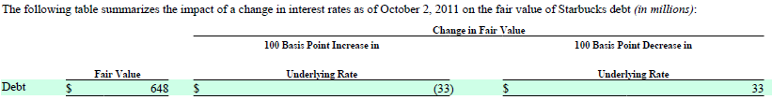
Interest Rate Risk
Starbucks uses short-term and long-term financing
May use interest rate hedges to manage the effect of interest rate changes on existing debt as well as the anticipated issuance of new debt.
As of October 2, 2011, did not have any interest rate hedge agreements outstanding.
Notes:
Sensitivity analysis of a 100 basis point, or 1%, change in interest rates to the value of SB debt

Slide 70
Interest Rate Risk
Starbucks does not hedge the interest rate exposure on their available-for-sale securities
Performed a sensitivity analysis based on a 100 basis point change in the underlying interest rate of their available-for-sale securities as of Oct 2, 2011
No significant impact
Notes:
SB also has interest rate exposure on their available-for-sale securities as its mostly comprised of fixed-income instruments. And the main objective of these it is to preserve capital and liquidity.
performed a sensitivity analysis based on a 100 basis point change in the underlying interest rate of our available-for-sale securities as of October 2, 2011, and
determined that such a change would not have a significant impact on the fair value of these instruments

Slide 71
Derivative Instruments
Cash Flow hedges
Canadian dollar, yen, and the US dollar
Net Investment hedges
Other derivatives
Notes:
Starbucks and certain subsidiaries enter into cash flow derivative instruments to hedge portions of anticipated revenue streams and inventory purchases in
currencies other than the entity's functional currency. Outstanding forward contracts, which comprise the majority of our derivative instruments, hedge
monthly forecasted revenue transactions denominated in Japanese yen and Canadian dollars, as well as forecasted inventory purchases denominated in US
dollars for foreign operations.
Net investment derivative instruments are used to hedge our equity method investment in Starbucks Coffee Japan, Ltd. ("Starbucks Japan") as well as our net
investments in our Canada, UK and China subsidiaries, to minimize foreign currency exposure.
To mitigate the translation risk of certain balance sheet items, we enter into certain foreign currency forward contracts that are not designated as hedging
instruments. These contracts are recorded at fair value
Gains and losses from these instruments are largely offset by the financial impact of translating foreign currency denominated payables and receivables,
We also enter into certain swap and futures contracts that are not designated as hedging instruments to mitigate the price uncertainty of a portion of our future
purchases of dairy products and diesel fuel. These contracts are recorded at fair value, with the changes in fair value recognized in net interest income and
other on the consolidated statements of earnings.

Slide 72


Slide 73
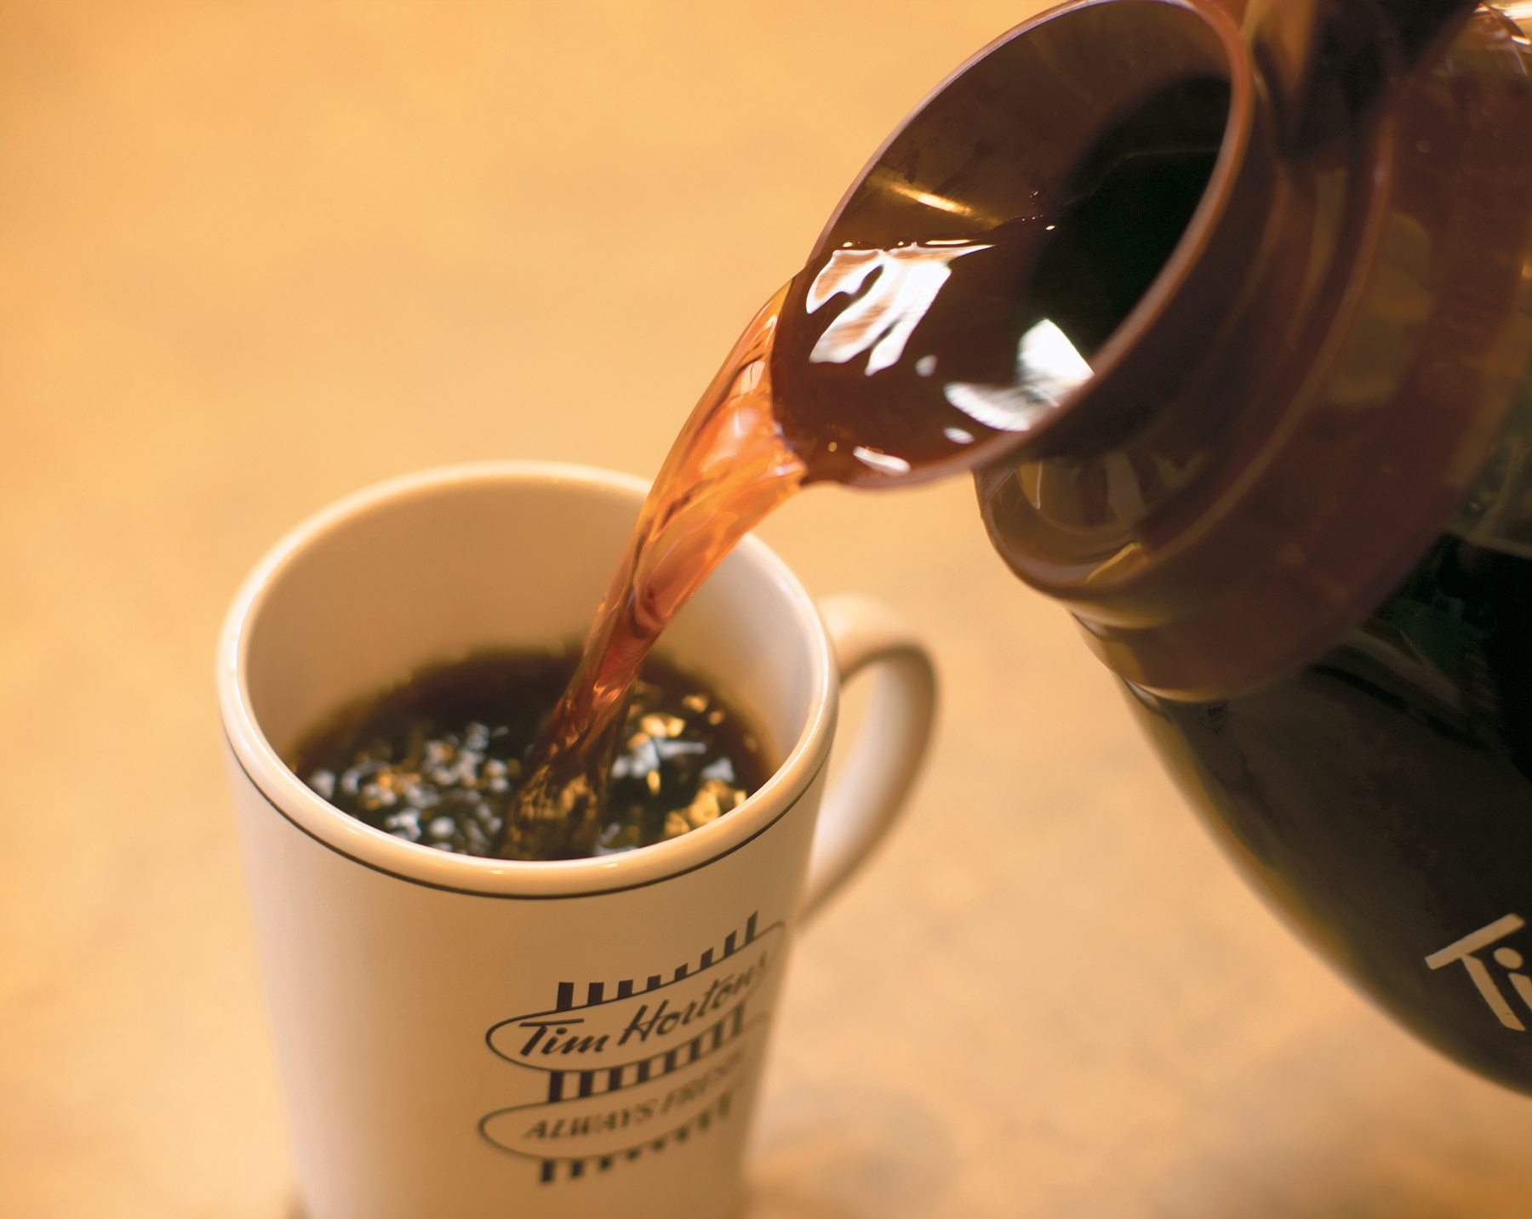
Company Overview

Slide 74
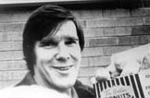
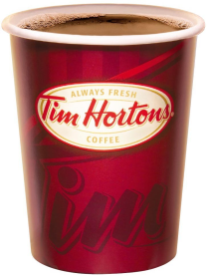
Tim Hortons History
Founder: Tim Horton
National Hockey League All-Star defenseman

Slide 75
Tim Hortons History
1964 First Tim Hortons opens
1995 Wendy’s purchased Tim Hortons
2006, Tim Hortons completes IPO becoming a standalone Canadian public company trading on the NYSE and TSX (THI)
2012 | Number of Restaurants
Canada | 3295
United States | 714
Gulf Cooperation Council | 5

Slide 76
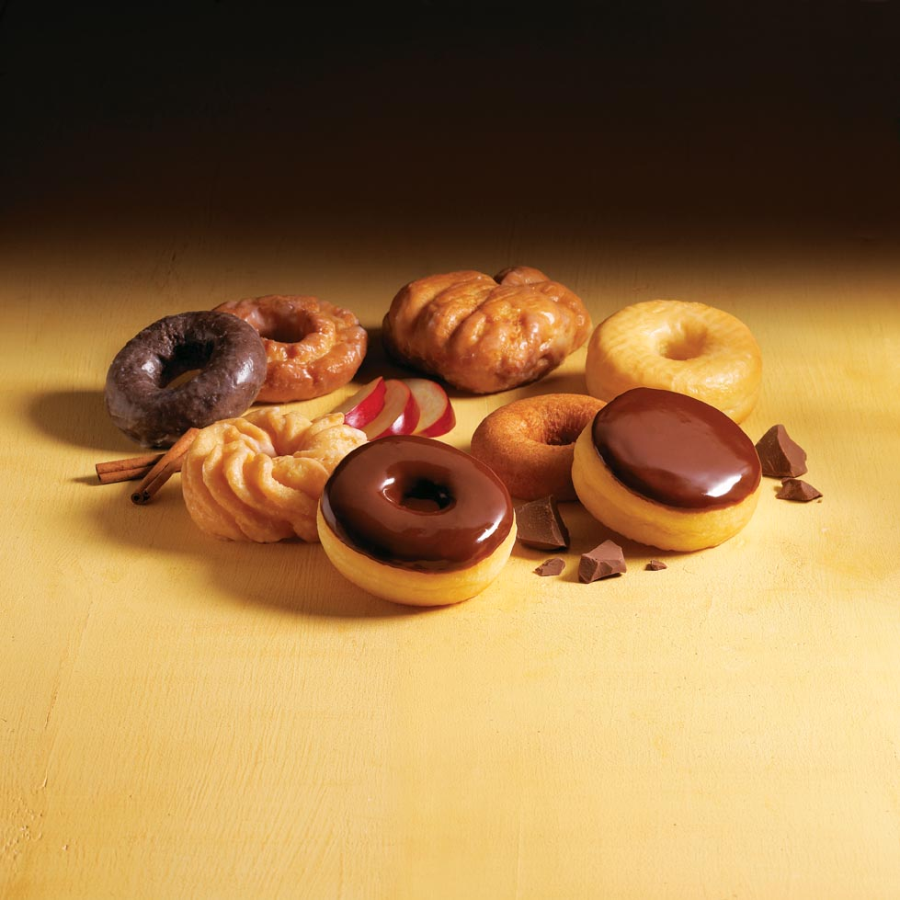
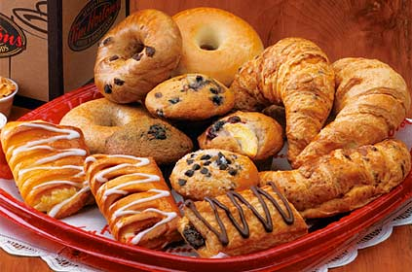
Products
Tim Hortons offers a wide menu of "Always Fresh" quality food and beverages:

Slide 77
Mission Statement
“Our guiding mission is to deliver superior quality products and services for our guests and communities through leadership, innovation and partnerships. Our vision is to be the quality leader in everything we do.”

Slide 78
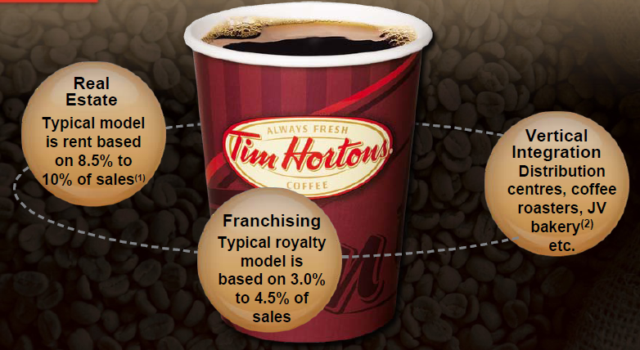
Primary Business Model

Slide 79
Growth Strategy 2010 - 2013
Increasing same-store sales via marketing and menu opportunities
Investing to build our scale and brand in new and existing markets
Leveraging core business strengths and the franchise system
Growing differently in ways we have not grown before

Slide 80
Financial Statement

Slide 81
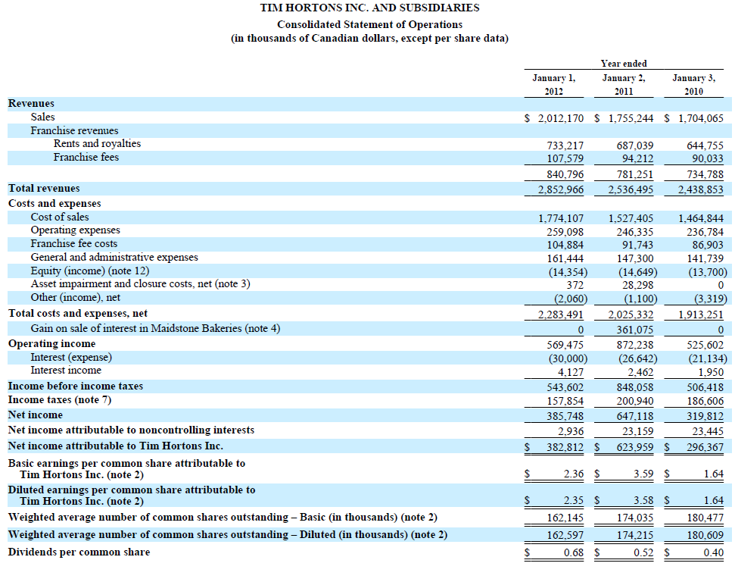
P

Slide 82
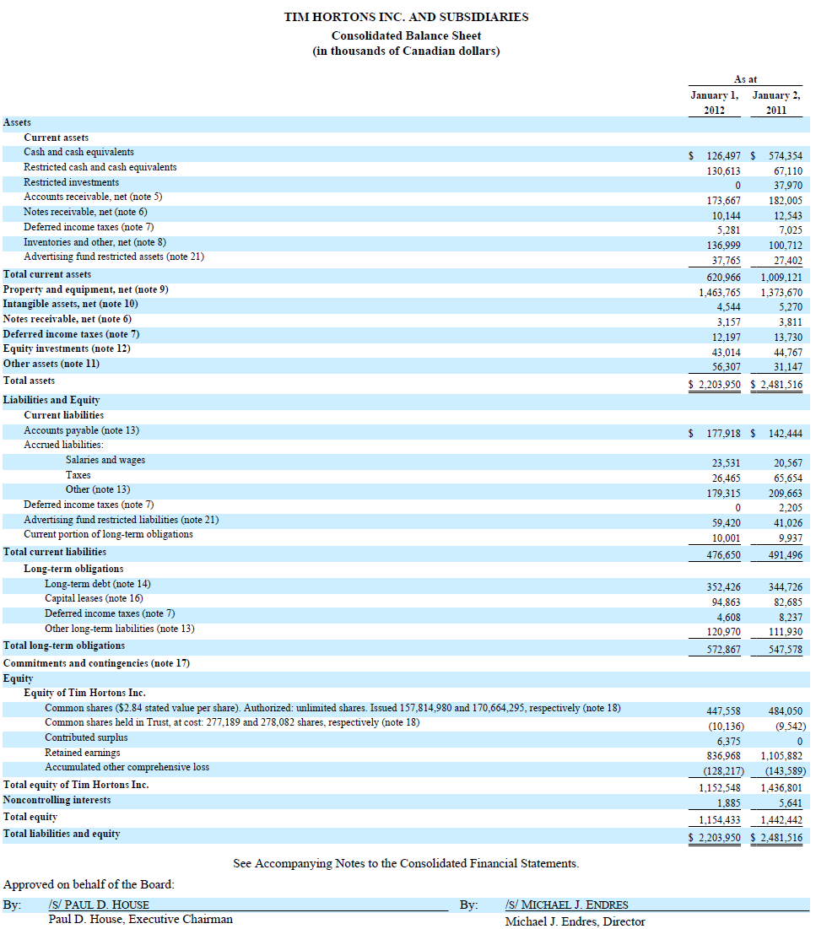
P

Slide 83
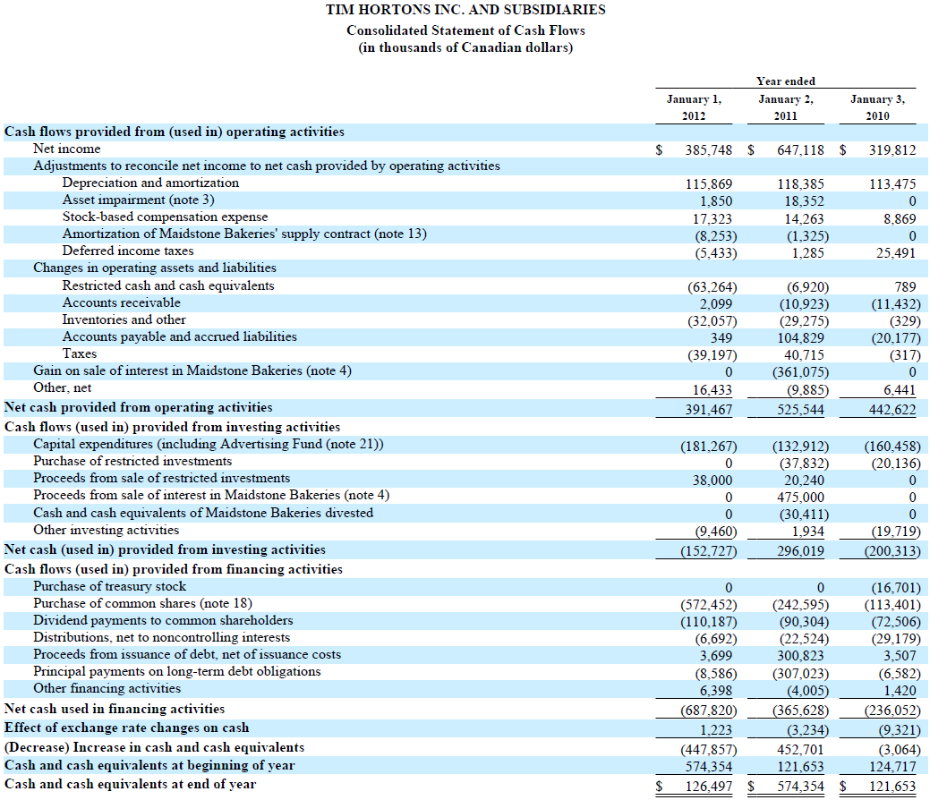
P

Slide 84
Risk Factors & Management

Slide 85
Enterprise Risk Management Program
Developing of internal performance scorecards
Monitoring stakeholder relations
Assessing sustainability and responsibility trends
Considering public policy, consumer, corporate, general public trends, issues, and developments that may impact Tim Hortons.

Slide 86
Risk Factors
Growth strategy
Brand value
Competition
Innovation
Commodity cost
Food Safety & Health concerns
Distribution operations & supply chain
Success of restaurant owners
Changes in franchise laws and regulations
...
Exchange rate - U.S. & Canadian dollar
Real Estate

Slide 87
Financial Risk Management
Foreign Exchange Risk
Commodity Risk
Interest Rate Risk
Inflation Risk

Slide 88
Foreign Exchange Risk
Exposure to foreign exchange risk is primarily related to fluctuations between the Canadian dollar and the U.S. dollar

Slide 89
Foreign Exchange Risk Philosophy
“We may use derivative products to reduce the risk of a significant impact on our cash flows or net income. Forward currency contracts are entered into to reduce some of the risk related to purchases paid for by the Canadian operations in U.S. dollars, such as coffee, and certain intercompany purchases”
“We do not hedge foreign currency exposure in a manner that would entirely eliminate the effect of changes in foreign currency exchange rates on net income and cash flows.”
“We have a policy forbidding speculating in foreign currency. By their nature, derivative financial instruments involve risk, including the credit risk of non-performance by counterparties, and our maximum potential loss may exceed the amount recognized in our balance sheet. “
“To minimize this risk, except in certain circumstances, we limit the notional amount per counterparty to a maximum of $100.0 million”

Slide 90
Derivative Instruments
“Tim Hortons may enter into derivative instruments with maturities ranging up to 7 years to hedge foreign exchange risk and interest rate risk”

Slide 91
Derivative Instruments
Derivatives are recognized and measured as either assets or liabilities at fair value on the Consolidated Balance Sheet
Derivatives that qualify as hedging instruments are generally cash flow hedges as a means to help protect from the cash flow variability of the hedged item

Slide 92
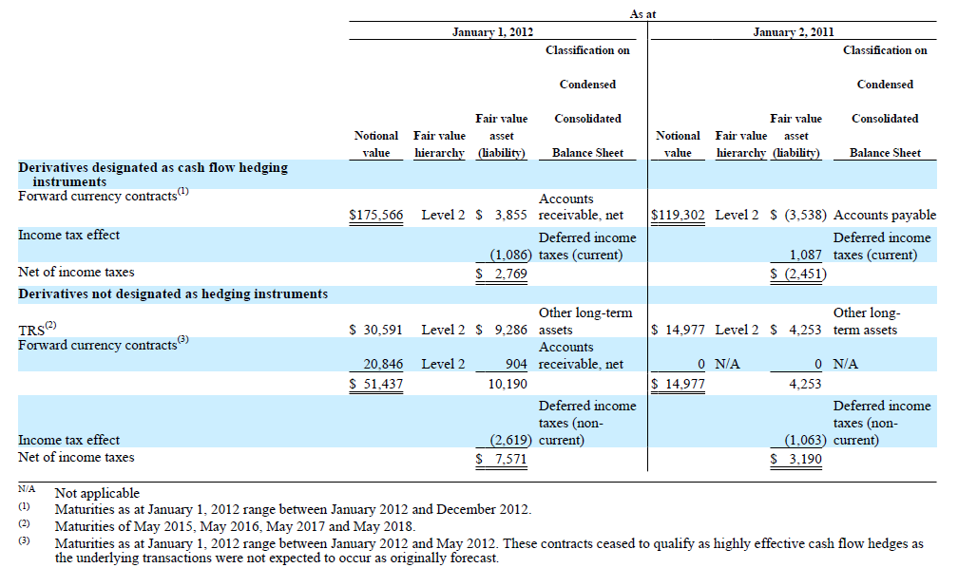
Outstanding Derivatives

Slide 93
Foreign Exchange Risk Measurement
“If the U.S. Currency rate changes by 10% the entire year, the annual impact on our net income and annual cash flows would not be material”

Slide 94
Commodity Risk
Exposure to price input fluctuations due to unforeseen weather and market volatility.
Commodity inputs:
Coffee
Wheat
Edible oil
Sugar

Slide 95
Commodity Risk Philosophy
“We monitor our exposure to commodity prices and our forward hedging program of varied duration, depending upon the type of underlying commodity.”
“We employ various purchasing and pricing contract techniques in an effort to minimize volatility, including setting fixed prices for periods of up to one year with suppliers, setting in advance the price for products to be delivered in the future, and unit pricing based on an average of commodity prices over the corresponding period of time. We purchase a significant amount of green coffee and typically have purchase commitments fixing the price for a minimum of 6 to 12 months depending upon prevailing market conditions. We also typically hedge against the risk of foreign exchange on green coffee prices at the same time.”
“We do not make use of financial instruments to hedge commodity prices, partly because of our other contract pricing techniques”

Slide 96
Commodity Risk Measurement
“Increases and decreases in commodity costs are largely passed through to restaurant owners, resulting in higher or lower revenues and higher or lower costs of sales from our distribution business”

Slide 97
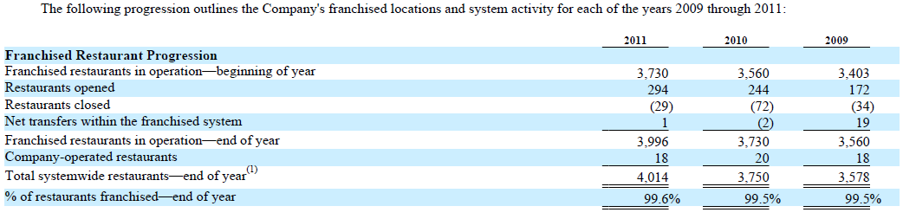
Potential Hazard – Franchise Risk

Slide 98
Interest Rate Risk
Exposure to risk in interest rate fluctuations:
Refinancing
Reinvesting
To minimize this risk, in the past, Tim Hortons has entered into:
Interest rate forwards
Interest rate swaps
“If interest rates change by 100 basis points, the impact on our annual net income would not be material”

Slide 99
Inflation Risk
“Due to inflation historical financial statements may not accurately reflect all the effects of changing prices on an enterprise”
Factors impacted include:
inventories with approximate current market prices
property holdings at fixed costs (substantial)
commodity price
increased labour costs
Result: Tim Hortons and restaurant owners may not be able to adjust prices sufficiently in order to offset the effect of the various cost increases.

Slide 100
Conclusion

Slide 101
Questions?
Thank you

