Slide 1
Foucault & Deleuze : The Docile Body Becoming a Protester in the Arab Spring: The role of Social Media
Professor Indhu Rajagopal, PhD.
York University, 2012

Slide 2
Thesis:
Foucault’s ‘Power’ in Discipline and Punish oppresses and manipulates human bodies to become subjected and practiced bodies; the exercise of power is through a calculated policy and action of coercions and surveillance of the body.
Arabs rejected the despotic power relations based on autocratic power, political and military control to liberate themselves. Challenging the inferiority of the ordinary citizens’ body, protesters refuted the autocrats’ despotic paternalism and exposed the realities of docility, a result of the political and military control and oppression.
Foucault and Deleuze argue that the power to turn bodies docile, has been constructed to subjugate the populations. If they were to become ‘free’ individuals/people, then their dominated bodies have to be liberated.
The Egyptian youth constructed their liberation by kindling and harnessing the latent power of resistance through social media. However, social media fell short of provoking a confluence of ‘desires’ in the social body to pursue the Deleuzian ‘line of flight’ to reach freedom as the limit.

Slide 4
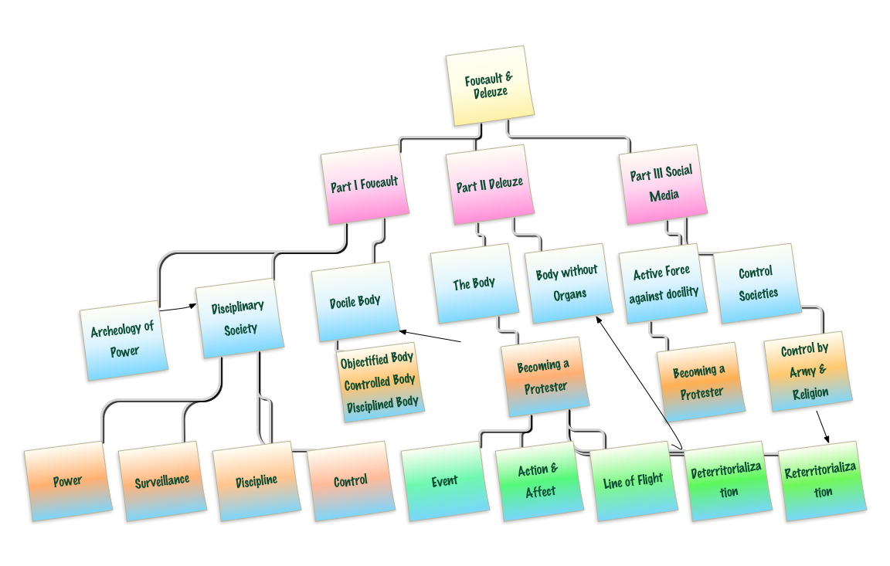

Slide 5
III. Active Force against Docility
Becoming a Protester to reject the dominance: the Role of Social Media (SM)
SM as a Strategy of Resistance
SM as a Weapon of Control
Deleuze’s Control Societies
Deleuze’s ‘What the body can do?’

Slide 6
Becoming
'becoming' (devenir) describes “the continual production (or 'return') of difference immanent within the constitution of events, whether physical or otherwise”(Parr, 2005).
When an individual changes from a docile body to become a resisting body, becoming is a range of changes one goes through in becoming a protester.
It is not the outcome, i.e., of turning into protesters but the very dynamic process of change from docility to activity without knowing what the end state of the body (social body) will be.
Becoming protesters as an event, shares the process of becoming different from docile bodies in the continual production of resisting body, which is a special dynamic process. The protesters are unified in their very becoming.
Notes:
Deleuze uses the term 'becoming' (devenir) to describe the continual production (or 'return') of difference immanent within the constitution of events, whether physical or otherwise. Becoming is the pure movement evident in changes between particular events. This is n~ to say that becoming represents a phase between two states, or a range of terms or states through which something might pass on its journey to another state. Rather than a product, final or interim, becoming is the very dynamism of change, situated between heterogeneous terms and tending towards no particular goal or end-state. Becoming is most often conceived by comparing a start-point and an end-point and deducing the set of differences between them.
For him, becoming is neither merely an attribute of, nor an intermediary between events, but a characteristic of the l__ very production of events. It is not that the time of change exists between one event and another, but that every event is but a unique instant of production in a continual flow of changes evident in the cosmos. The only thing 'shared' by events is their having become different in the course of their production. The continual production of unique events entails a special kind of continuity: they are unified in their very becoming. It is not that becoming 'envelops' them (since their production is wholly immanent) but that becoming 'moves through' every event, such that each is simultaneously start-point, end-point and mid-point of an ongoing cycle of production.

Slide 7
Becoming Protesters : Role of Social media in Reclaiming the Body
Social Media as a Strategy of Resistance
Social Media as a Weapon of Control
Notes:
popular uprising that began on Tuesday, 25 January 2011

Slide 8
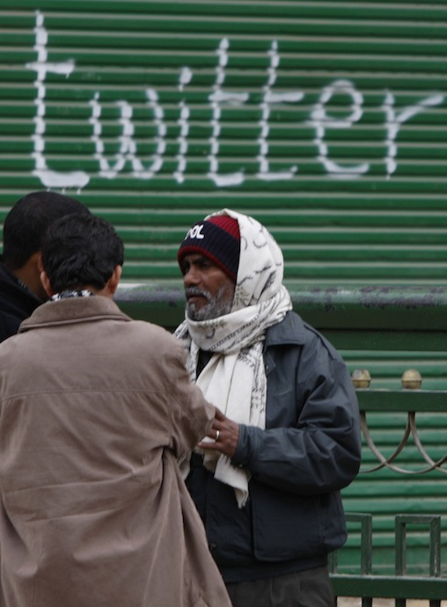
http://www.computerworld.com/s/article/9209159/Social_networks_credited_with_role_in_toppling_Egypt_s_Mubarak

Slide 9
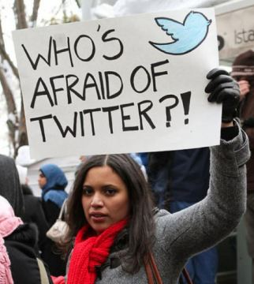
http://selnadeem.wordpress.com/2011/03/01/how-social-media-sparked-a-revolution-2/

Slide 10
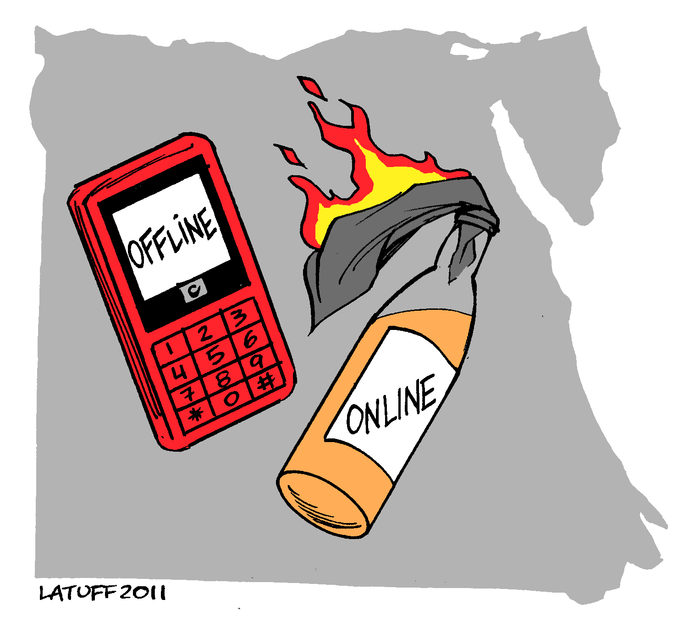

Slide 11
III. Active Force against Docility
Becoming a Protester to reject the dominance: the Role of Social Media (SM)
SM as a Strategy of Resistance
SM as a Weapon of Control
Deleuze’s Control Societies
Deleuze’s ‘What the body can do’

Slide 12
Social Media: A Strategy of Resistance
SM as scaffolding for organizing a virtual public sphere outside of the State
Embraced by all social groups that joined the protest movements
Notes:
For Deleuze, the present is merely the productive moment of becoming, the moment correlating to the productive threshold of forces. As such, it represents the disjunction between a past in which forces have had some effect and a future in which new arrangements of forces will constitute new events. In other words, becoming per se is Deleuze's version of pure and empty time. Such a view of the world has important implications for concepts traditionally considered central to philosophy. It undercuts any Platonic theory that privileges being, originality and essence. For Deleuze, there is no world 'behind appearances', as it were. Instead of being about transitions that something initiates or goes through, Deleuze's theory holds that things and states are products of becoming. The human subject, for example, ought not to be conceived as a stable, rational individual, experiencing changes but remaining, principally, the same person. Rather, for Deleuze, one's self must be conceived as a constantly changing assemblage of forces, an epiphenomenon arising from chance confluences of languages, organisms, societies, expectations, laws and so on.
For him, becoming is neither merely an attribute of, nor an intermediary between events, but a characteristic of the l__ very production of events. It is not that the time of change exists between one event and another, but that every event is but a unique instant of production in a continual flow of changes evident in the cosmos. The only thing 'shared' by events is their having become different in the course of their production. The continual production of unique events entails a special kind of continuity: they are unified in their very becoming. It is not that becoming 'envelops' them (since their production is wholly immanent) but that becoming 'moves through' every event, such that each is simultaneously start-point, end-point and mid-point of an ongoing cycle of production.

Slide 13
SM’s architecture
SM facilitated mechanisms for popular framing of the resistance to appeal to the public.
No feasibility to falsify one’s identity or preference on the Facebook allowed the participants to know that the general public was involved in the protests – this attracted the ordinary citizens to join the resistance
Low cost medium of popular mobilization

Slide 14
SM as the tool of public interactivity
Expanded information dissemination
Popularized the resistance by framing of issues to appeal to the public
Created a climate against the dictator
Diverted the State’s attention away from major demonstrations
Created Protesters’ oppositional identity
Expanded networks nationally and internationally
Turned popular frustration into a cause
Provided a Locational Identity (Tahrir Square)

Slide 15

http://www.computerworld.com/s/article/9209159/Social_networks_credited_with_role_in_toppling_Egypt_s_Mubarak

Slide 16
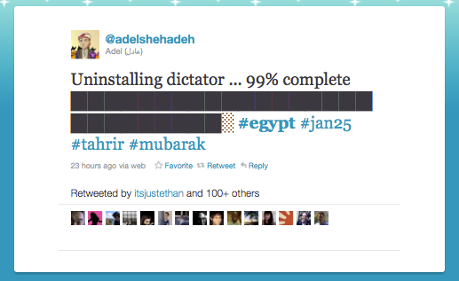

Slide 17
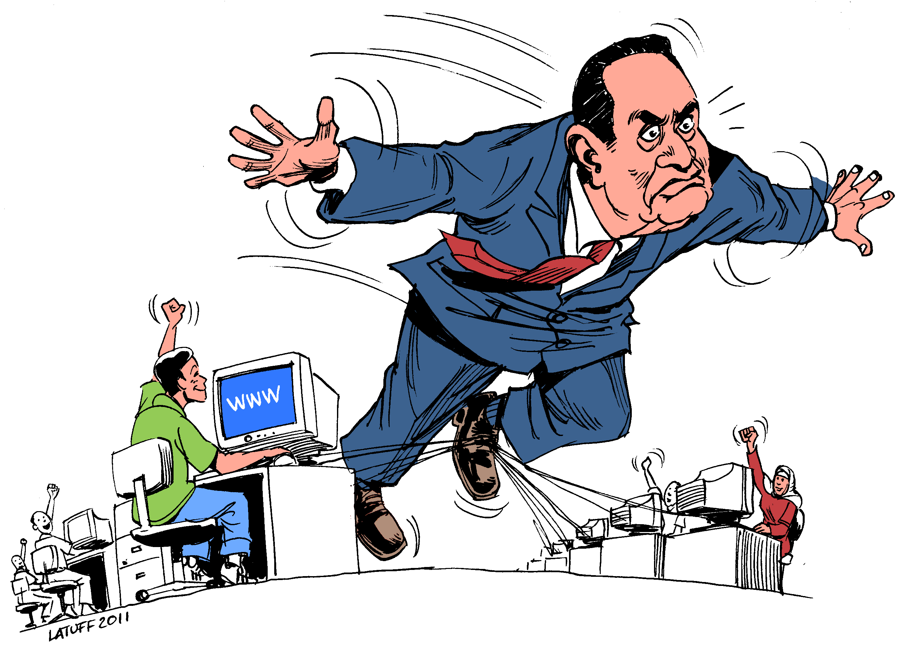

Slide 18
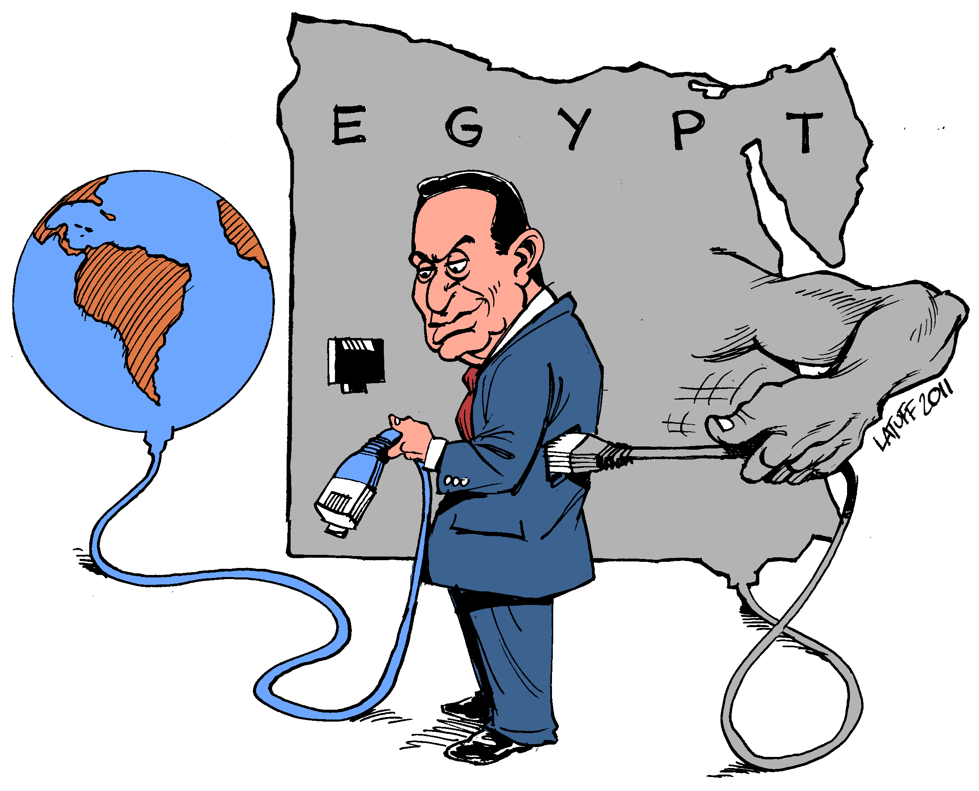

Slide 19

http://www.computerworld.com/s/article/9209159/Social_networks_credited_with_role_in_toppling_Egypt_s_Mubarak
Notes:
a shot of that neat service that Egyptians were using to send voice messages to Twitter after the Internet was shut down on 28 Jan 2011. Feb 2, 2011 it was restored- 5 days blackout.

Slide 20
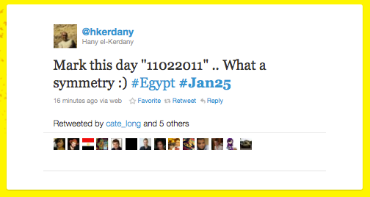
Notes:
Mubarak resigns11 feb 2011

Slide 21
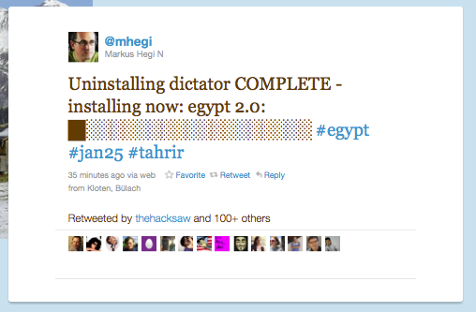

Slide 22
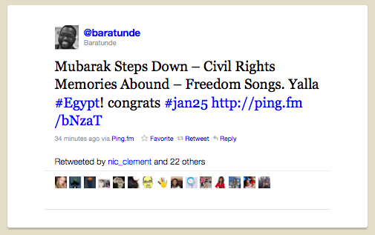

Slide 23
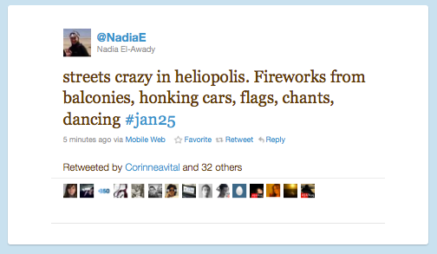

Slide 24
Deterritorialization
A process of becoming free from an imposed rigid organization of hierarchic units or discrete categories with singular coded meaning or identities
The process releases one from the relations that constrain individuals/groups from the actualization of their potential.
It unfolds the bodies’ virtual dimensions leading to a dynamic set of interconnected identities with permeable individual boundaries.

Slide 25
III. Active Force against Docility
Becoming a Protester to reject the dominance: the Role of Social Media (SM)
SM as a Strategy of Resistance
SM as a Weapon of Control
Deleuze’s Control Societies
Deleuze’s ‘What the body can do?’

Slide 26
Muslim Brotherhood’s use of Social Media
Muslim Brotherhood pragmatically separated its religious ideological platform from the political interests the protest movement presented to it
SM in conjunction with Dot com (.com) webpage was aimed at uniting world Muslims of different languages and races
MB party accused SM as Islamphobic & as being biased against Muslims
But, MB party exploited the Facebook to advertise its Ikhwanbook.com.
Notes:
Ikhwan means brother

Slide 27
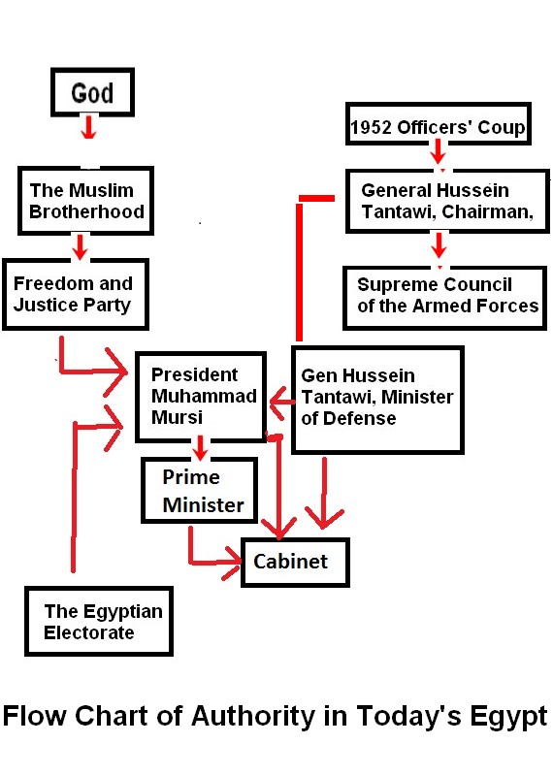
http://www.juancole.com/2012/07/flow-chart-of-authority-in-todays-egypt.html/egypt-flow-chart-2

Slide 28
SM as a Weapon of Control
SM increases control over the dissidents
The Internet helps authoritarian regimes than harming them
The Internet mobilizes and organizes espionage networks and political and religious extremists
Going beyond technological control, the internet fosters social engineering aimed at disrupting dissenters’ networks
Notes:
We are all Essam Atta weareall Kalid Said FB pages

Slide 29
III. Active Force against Docility
Becoming a Protester to reject the dominance: the Role of Social Media (SM)
SM as a Strategy of Resistance
SM as a Weapon of Control
Deleuze’s Control Societies
Deleuze’s ‘What the body can do?’

Slide 30
Deleuze’s Control societies
Free floating control through Internet as the operating system
The Internet provides new weapons of control over the individual.
Corporate dominance over commercial & technological productions
A universal system of deformation (change for the worse) works endlessly
Codes or numerical systems control everyone and everything

Slide 31
Deleuze’s Control societies (cont’d)
Computers track e-ach individual’s position and effects a universal modulation
A progressive and dispersed installation of a new system of domination

Slide 32
Control societies (cont’d)
No longer mass/individual pair, but individual becomes ‘dividuals’, masses, samples, data, markets or data banks
Passwords regulate the society
Man of control is in undulating orbit , in continuous network of control
Control is short term, of rapid rates of turnover, is continuous and unlimited
Notes:
Gilles Deleuze introduces the idea of humans as “dividuals,” entities comprised of multiple parcels of data that can be bought, sold, and traded in the new marketplace. In previous centuries, the individual was “one of many,” a member of a larger mass. Today’s dividual is known by his password, a code that can grant or restrict access to information¹. This new conceptualization recasts the each of us as a user, an aggregate of recorded preferences, histories, and proclivities. Every interaction with the market is thus mediated by the password: the human existence is constantly reconfigured in accordance to the user’s associated dataset.

Slide 33
Reterritorialization
In reality, as absolute deterritoriaization is not easily achieved, often only relative deterritorialization can occur since complete flight to freedom while being a part of a society is a fallacy.
After a regime falls, the new power reterritorializes the individuals/ groups
The new rulers enforce their own beliefs and practices through their rules and information in order to control the people

Slide 34
Reterritorialization
Computer tracks protesters
No Preference falsification: lack of anonymity on SM
SM fosters looser coordination - ties for action are weaker rather than stronger
Low cost of SM allows the state to combine it with their sophisticated older methods of surveillance to control the protesters

Slide 35
Reterritorialization (cont’d)
Coalesce ‘dividuals’ through SM’s facilitation of homophily and create divisions among the ideologues

Slide 36
III. Active Force against Docility
Becoming a Protester to reject the dominance: the Role of Social Media (SM)
SM as a Strategy of Resistance
SM as a Weapon of Control
Deleuze’s Control Societies
Deleuze’s ‘What the body can do?’

Slide 37
Deleuze’s ‘What a body can do?’
Virtual body’s potential for action outside and against the determinate state
Not any one organ has power over the body
Dismantling of the social body
Deterritorialization vs. Reterritorialization

Slide 38
Freeing the Social Body
Desiring to use the potentials of their virtual bodies to ‘Become’ a BwO to achieve true freedom
Taking a ‘line of Flight’ to shed constraints on the social body

Slide 39
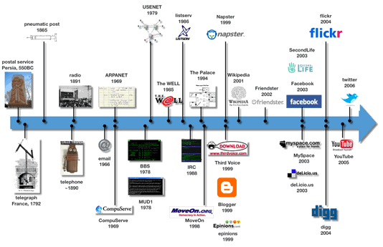
Chronology of the Development of Communications Media
by graphic designer Sean Carton
http://mindymcadams.com/tojou/2011/timelines-in-journalism-a-closer-look/

Slide 40
Theoretical Themes: Part I Foucault
Part I : Foucault and Disciplinary Society
Disciplinary Society
Docile body
Archeology of Power

Slide 41
Theoretical Themes: Part II
Deleuze’s Conceptualization of the Body
The Body
Body without Organs
Deleuze’s Concepts

Slide 42
Theoretical Themes : Part III
Part III: Active Force against Docility
Becoming a Protester : Role of Social Media (SM)
SM as a Strategy of Resistance
SM as a Weapon of Control

Slide 43
Theoretical Themes: Part I Foucault
Part I : Foucault and Disciplinary Society
Disciplinary Society
Docile body
Archeology of Power

Slide 44
Disciplinary Society
Power
Surveillance
Discipline
Control

Slide 45
Docile Body
A body “that may be subjected, used, transformed, and improved and that this docile body can only be achieved through strict regimen of disciplinary acts” Foucault, Discipline and Punish (1995)

Slide 46
Foucault’s Archeology of Power
Construction of a Docile Body
Objectified Body
Controlled Body
Disciplined body
Discipline is the Technology of Power over the Docile Body
Notes:
"[The] archaeological level -- the level of what made [an event or a situation] possible." (The
Order of Things, p.31)

Slide 47
1.Objectified Social Body (Egypt)
West’s Oil Burden: Colonialism - racial superiority & economic interest camouflaged as the benevolent civilizing force
Alliance with Pro-West Saudi Arabia’s dictatorship to fight socialism in Egypt
Nasser’s Arab Socialist Union, State capitalism
& nationalization of foreign capital and local
capital
US Backing of Egypt’s pro-West military dictatorships – a client military of the West’s oil consuming countries
Notes:
the Suez Canal was the central route for oil tankers moving oil from the Arabian Gulf oil fields to Europe. In fact, I would expect, at that time at least, it was the majority of Europe's oil would've been traveling through the Suez. So it had enormous strategic interests for England and France, but also for the United States, who wants to start to control the world by controlling the Middle East oil supply.

Slide 48
2. Controlled Social Body (Egypt)
Military control of the State
Nationalization of the Economy and the Industrial capital
Creation & control of an uniform public with few pluralistic interest groups: i.e., class, religion, labour.

Slide 49
3.Disciplined Social Body
Created through the Technologies of Power:
Influence of Saudi Arabian Wahhabisim enforced social discipline on individual bodies
Local plurality of interests and knowledge were erased through the Muslim Brotherhood’s (MB) power of religious indoctrination
MB’s constructed new knowledge based on Islamic power and anti-Western ideologies
Military Dictatorship’s control disciplined the society and diverted public attention through fear of war
Ideology of Arab unity, Mecca as the centre of Islam in a conflict-ridden Middle East, disciplined the objectified bodies
.

Slide 50
Docile Body: Site of Resistance
Protesters’ Actions to Reclaim the Docile body as a Site for Resistance
Deconstruction of the Disciplined body
Expose the dimensions of power over the oppressed body
Resistance against dictatorial subjugation
Transform the body as a site for agency
Notes:
Pierre Bourdieu, refer to as a "re-membering" of the body. In such contexts, "attempts to remake habit tend to treat the body as a `memory' in which are lodged, in mnemonic form, the organizing principles of an embracing context. Scrambling this code (that is, erasing the messages carried in banal physical practice) is a prerequisite for retraining the memory, either to deschool the deviant or to shape new subjects, as the bearers of new worlds" (Comaroff and Comaroff 1992:70).
Taussig (1992:84), like the Comaroffs (1991:62), points out that colonization tends to bring with it pressures for a new kind of person; one that will be amenable to the modernizing forms of discipline required for life within a very different social milieu than the kind that previously existed. "At its core was the modernist self: the familiar figure of the right-bearing, responsible, `free' individual whose very condition of possibility was the nation-state itself" (Comaroff and Comaroff 1997:365). Pressures for the creation of a modern self were neither one sided nor limited to situations of colonization; they were exerted against both peasants and the newly emerging working class in Europe (Frykman and Lofgren 1987) and rebounded from these colonial and noncolonial "others" to affect the consciousness of the European middle classes themselves. That is, the European middle classes were fashioning their conceptions of modern life at home at the same time as they were trying to create it elsewhere (Frykman and Lofgren 1987; Comaroff and Comaroff 1997).

Slide 51
Theoretical Themes Part II: Deleuze
Deleuze’s Conceptualization of the Body
The Body
Body without Organs
Deleuze’s Concepts

Slide 52
Body without Organs (BwO)
Deleuze refers to the ‘virtual’ dimension of the body as BwO
Every ‘actual’ body has or embodies a set of traits, habits, movements, emotions, etc.
Every ‘actual’ body also has a ‘virtual’ dimension: i.e., an immense pool of potential of characteristics, connections, affects, movements, etc.

Slide 53
Body without Organs (cont’d)
Deleuze’s BwO is the ‘virtual’ body with a reservoir of potentials.
To attain freedom, one must unleash these potentials and push towards becoming a BwO
This requires one to engage in active experimentation with oneself to realize these virtual potentials
Actualization or activation of these virtual potentials occur mostly in conjunction with other bodies (BwOs).
This process is called ‘becomings’

