Slide 1
Research Publications Analysis Saint Mary’s 2001 -2011

Slide 2
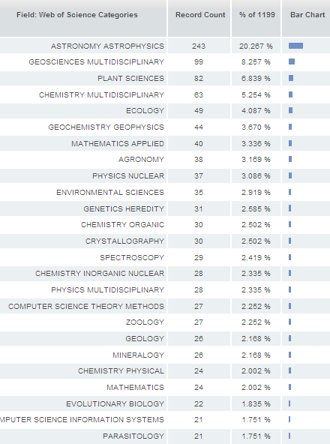
Thompson Reuters “Web of Knowledge” Science Citation Index Expanded 25 August 2011

Slide 3
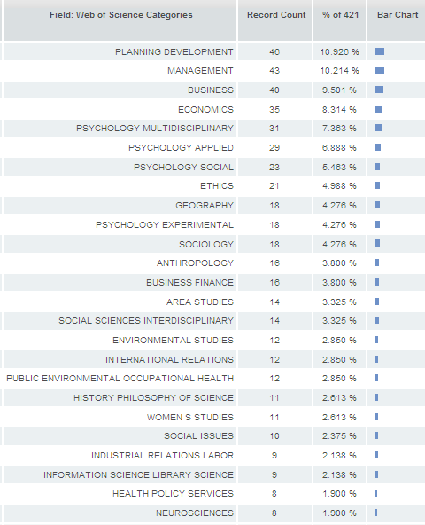
Thompson Reuters “Web of Knowledge” Social Sciences Citation Index 25 August 2011

Slide 4
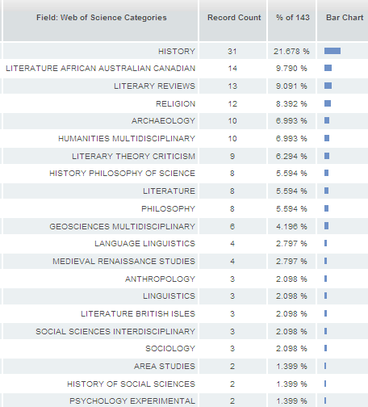
Thompson Reuters “Web of Knowledge” Arts & Humanities Citation Index 25 August 2011

Slide 5
Caution
Only peer-reviewed articles in journals contained within the databases
Science: 8368 journals
Social: 2177 journals
Arts & Humanities: 1650 journals
Analysis “double counts” paper if falls into more than one category.

