Slide 1
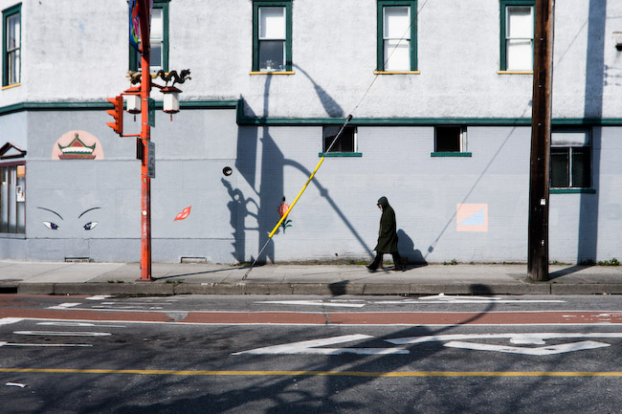

Teaching sustainability indicators: a dialogue in improving practice
Cameron Owens & Meg Holden
Simon Fraser University
Regional Vancouver Urban Observatory
Canadian Sustainability Indicators Network
2nd National Conference, March 2-4, 2010 Toronto
Notes:
Meg intro
Cam Intro

Slide 2
Workshop objectives
Introduce research findings of a recently piloted online sustainability assessment course
Inspire discussion on the role of university teaching & learning in improving sustainability indicators practice

Slide 3
Key Questions
What role can universities play in improving sustainability indicators practice? How can courses and programs be made more useful to working professionals (and others) who use sustainability indicators?
What should be included in university courses on sustainability assessment, both in terms of content and in terms of the skills or literacies to be developed?
What techniques, methods and media could help improve the delivery of courses?
Notes:
Talk about university usefulness: ****
---- capacity for research: --> case studies, critical reflection
---- capacity for teaching: raising awareness, creating receptive audience understadning the importance of rigorous measurement
--- dedicated programs , units within standard university courses and hybrid, new forms of

Slide 4
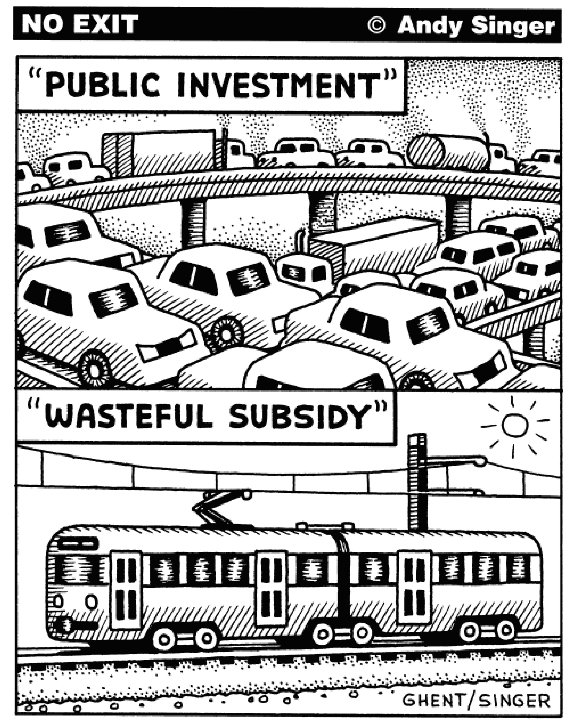
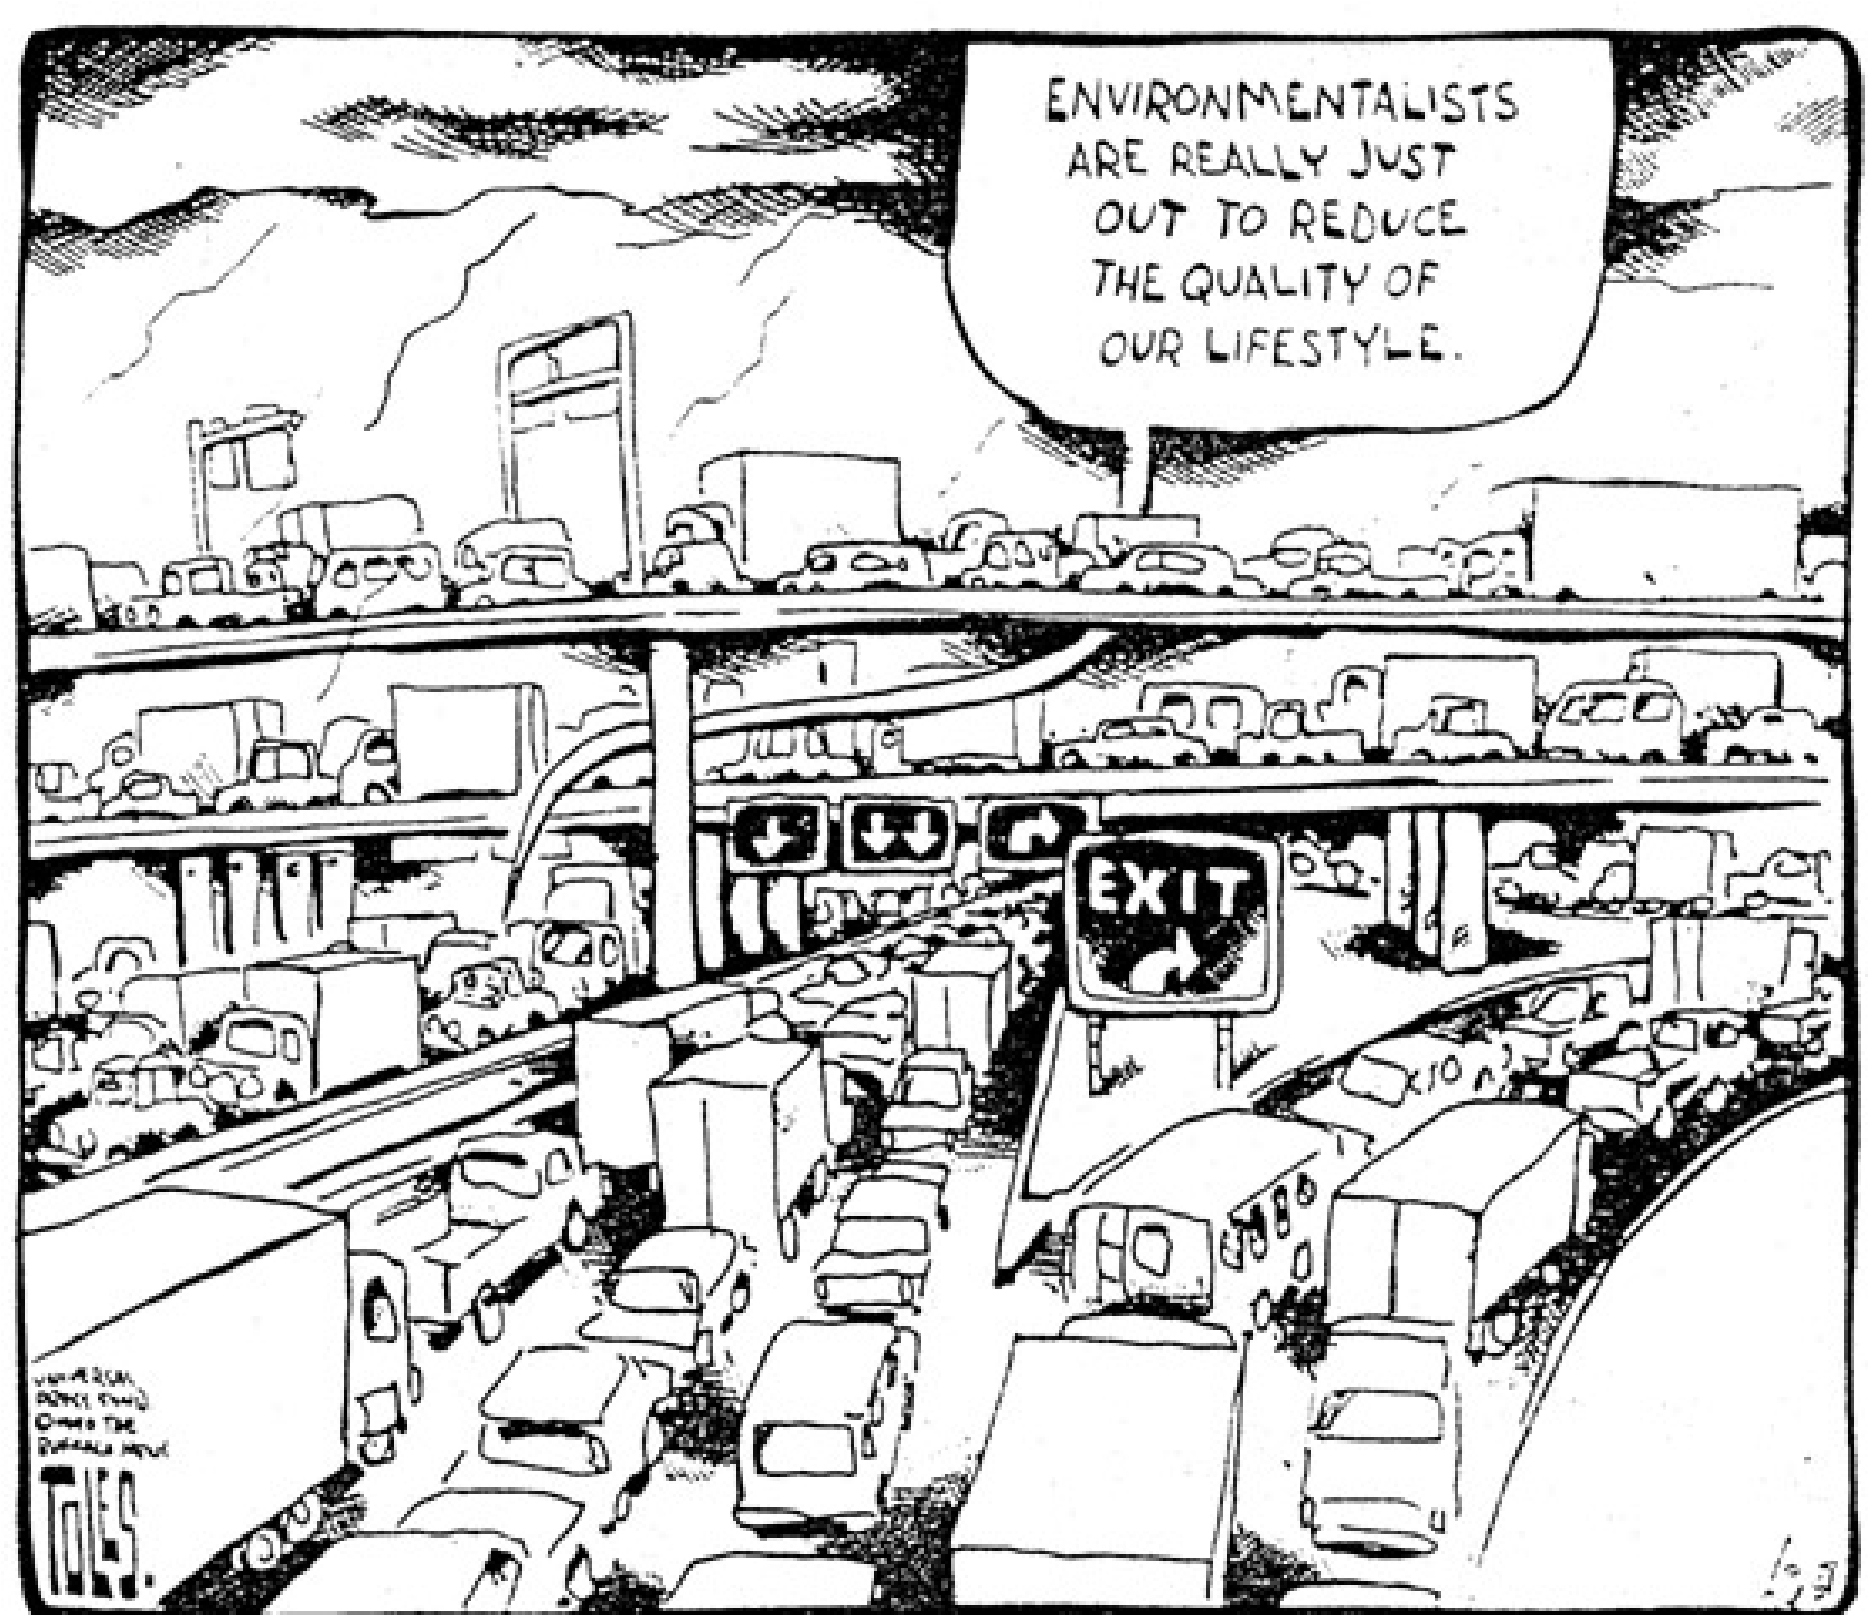
Teaching & learning sustainability indicators
Notes:
What can universities do?

Slide 5
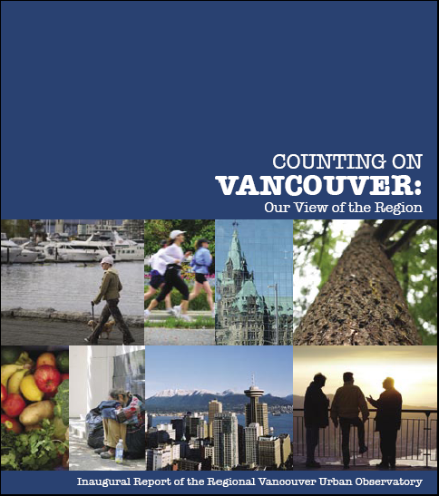

“Sustainability Assessment for Cities” (background)
Successes and challenges of RVu (UN Habitat) participatory regional indicators process
See http://www.rvu.ca
“Time to take a step back from the policy implementation front lines to work first on generating a regional aptitude for indicators, their value and uses”
Notes:
Background - RVu – “measures to match our values” (UN Habitat)
Major participatory regional sustainability indicators process (2005-2006)
Results released World Urban Forum 3 (2006) to considerable international attention but local political resistance RVu is the first member of the UN Habitat global network of urban observatories located in a developed country city
(immediate impetus for this particular course (and the big picture impetus) )

Slide 6
Sustainability indicators challenges (feedback on RVu process)
“If … you asked me to cooperate in this exercise, I would say no, they have raised the bar so high that this is an absolute no-win for me. No matter what comes out, I’m going to be the problem.” (Former City Councillor)
“Indicators and actions are quite different things … you can present indicators, that doesn’t mean people are going to act on them. There are all kinds of indicators out there, and at some point you have to make the political decision which is trading off one set of principles and values and another.” (Active City Councillor)
Notes:
We were surprised at these tough comments that came out as a blatant refusal to accept the credibility of a publicly-generated set of indicators of sustainability.
The resistance of political leaders, and the failure of other indicator projects in the region to make an impact, suggested to us that it was time to take a step back from the policy implementation front lines to work first on generating a regional aptitude for indicators, their value and uses.

Slide 7
“Sustainability Assessment for Cities” (features)
First course in sustainability indicators and assessment in BC
Developed 2008-09 through collaboration of SFU, BCIT, UNBC, with an external review process
Piloted in Summer 2009 as a 15-week graduate course, with both students and working professionals (15 students admitted, 10 completed the course)
Fully online delivery, both synchronous and asynchronous learning using WebCT and Elive Open access curriculum via BC Campus SOL*R repository (see http://solr.bccampus.ca/cms2/ )
Notes:
--> spent a year developing content, getting modules reviewed and thinking through online learning strategies
The objectives of the pilot program were as follows:
SOLR = sharable online learning resources

Slide 8
Sustainability assessment course (objectives)
Build competencies in the areas of:
Indicators, assessment and performance measurement tools
Local sustainability and climate change strategies
Design, use and evaluation of indicators and assessment tools in planning and decision making
Explore the opportunities of online learning and promotion of (online) community development
Emphasize learner-centered approach
Integrate professional and academic learners

Slide 9
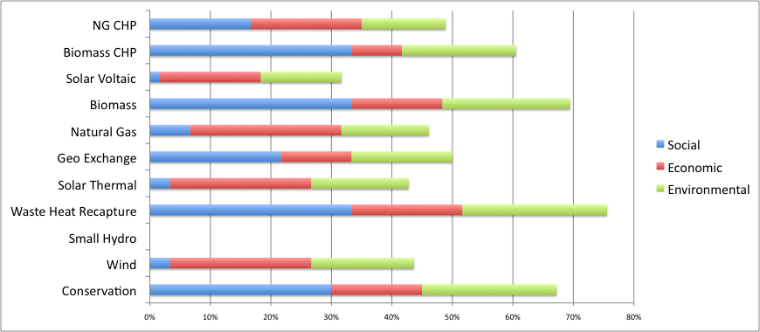
(Student project examples)
Students developed frameworks for:
evaluating alternative energy options in BC accounting for social, ecological and economic dimensions
evaluating protected areas candidates in NWT
assessing sustainability of summer camps in Windsor, ON
See http://www.rvu.ca for these and other examples
Notes:
Student projects were successful and covered a large gamut of applications of sustainability assessment from the sustainability of summer children’s camps in Windsor Ont, (1) to sustainability indicators in the development of a transit village in Central Surrey(4), to a sustainability assessment framework for protected areas in the NWT(3), to a system for assessing alternative energy possibilities for communities,
2) bc for a whole

Slide 10
Pilot evaluation
comfort, confidence and competency in online learning?
developing expertise specific to sustainability assessment?
fostering a professional community of practice?
Notes:
Copies of the full evaluation report available upon request.
Evaluation involved: pre , during and post course surveys, interviews
--- big question = how do you see formal education amongst other kind of prof. development activities … How important is this in terms of improving sust. Indicators.
Originally thought this would be a concern but assessment revealed students were comfortable and appreciative of online tools --> KEY: synchronous learning - E-live / Twitter useful
students appreciated course focus (indicators = gap in human / environment relation)
Useful depth / integrative / big -picture thinking
Online = relevant to sust. Course, opportunity to share across space , accessible , low impact
Mixed reviews: “we felt online course could offer new possibilities for connecting people, solving local problems, building knowledge and creating long term networks
Concuring with Brown (2001) - those looking for community found it
Missing: ability to create relationships
Up learning opps but down sense of community / spirit down longterm networking opps.
Imposter syndrome?

Slide 11
Pilot Evaluation (testimonials)
“It is a valuable tool for teaching sustainability because it allows you to reach a large variety of people without traveling.”
“Theoretically I thought that wow, this is a great idea, for global kind of education giving you more opportunity to communicate in class, you don’t have to travel any distance. However, I just think you can’t get past the value of face-to-face interaction and the connection that it creates in a person. So ultimately if I had a choice I would go back to the person-to-person classroom experience.”
“I think with this topic I think it is quite relevant to have an online course. First of all, from my standpoint, if you are doing this course online, you don’t have to commute to SFU ... Participating online lets you build social sustainability and capital and it is also economically sustainable as well, I think it is the future of education. To reach out to as many as possible, online is the avenue to go.”
Notes:
-- evaluation: interviews w,. Students before course - survey at start (based on 3 topics)
3 web surveys
Twitter - tracked twitter and discussion posts to guage community building
Students hungry for online sust. Educ. Opportunities

Slide 12
Discussion Questions
www.rvu.ca
What role can universities play in improving sustainability indicators practice? How can courses and programs be made more useful to working professionals (and others) who use sustainability indicators?
What should be included in university courses on sustainability assessment, both in terms of content and in terms of the skills or literacies to be developed?
What techniques, methods and media could help improve the delivery of courses?
Notes:
Does this experience provide members how universities can help support CSIN>
What do you think is important to teach and learn?
What are pedagogical techniques….

