Slide 1
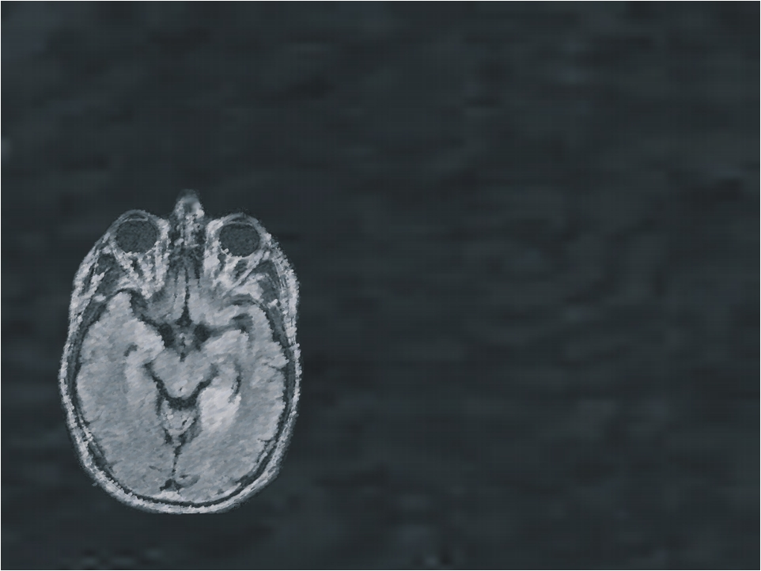
Oligodendroglioma: Whole genome and Transcriptome analysis
Yaron Butterfield Oct 26, 2010

Slide 2
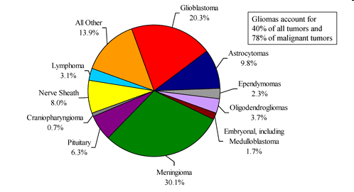
Primary Central Nervous System (CNS) Tumours
Arise from the brain, spinal cord, and associated tissues
~10,000 new cases/year
in Canada
A slowly growing brain cancer of adults
Tumor likely begins much earlier in life
The first symptom is often a convulsion
Sensitive to but not cured by today’s Rx
Like many cancers, accelerates over time
The most common type of primary brain tumor is Meningioma (benign)
The second most common type is Glioblastoma Multiforme (GBM) (highly malignant)
From www.brainsciencefoundation.org
Notes:
Question for Olena: 10,000 new cases/year in Canada --- of all CNS tumours? Gliomas account for 40% of all tumours?

Slide 3
Oligodendroglioma
Oligodendroglioma is a slow-growing brain tumor comprised of oligodendrocyte-like cells, occurring primarily in patients 35-44 years of age. Approximately 60-90% of oligodendroglioma patients have a co-deletion of chromosome arms 1p and 19q; these cases are characterized by slower tumour growth and better response rate to chemotherapy than those without the deletions. The molecular mechanisms leading to better prognosis in these patients are not yet understood, and to date, no genome-wide sequencing studies have been performed on oligodendroglioma tumors.
Notes:
oligodendrocyte-like cells: ?

Slide 4
TP53 mutation
17p loss, 22q loss,
Over-expression of
PDGF & PDGFR
1p/19q loss
Astrocytoma
Oligodendroglioma
RB mutation 13q loss
9p loss
19q loss
Anaplastic
Astrocytoma
10p & 10q loss
EGFR amplification
chromosome 10 loss & other genetic changes
10p & 10q loss
Glioblastoma
(secondary)
Glioblastoma
(primary)
Anaplastic Oligodendroglioma
GC

Slide 5
Oligodendroglioma Stem Cells
Line 54 – newly diagnosed and untreated
Line 88 – recurrent and previously-treated

Slide 6
Line 54
49 year old with frontal mass and partial seizure
Notes:
All seizures are caused by abnormal electrical disturbances in the brain. Partial (focal) seizures occur when this electrical activity remains in a limited area of the brain. The seizures may sometimes turn into generalized seizures, which affect the whole brain.

Slide 7
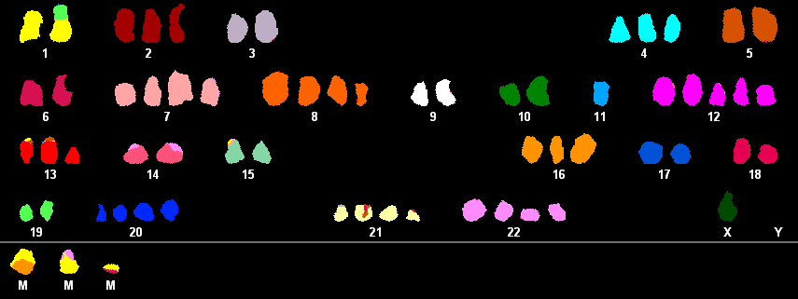
Line 54
t(1;19) demonstrated in all cells in line 54
Notes:
Ask Olena – how is this karyotype created? What technology?

Slide 8
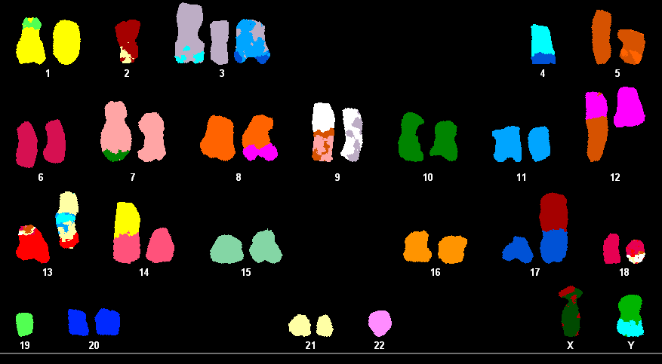
Line 88

Slide 9
CNV analysis
For copy number analysis, sequence quality filtering was used to remove all reads of low mapping quality (Q ≤ 10). Due to the varying amounts of sequence reads from each sample, aligned reference reads were first used to define genomic bins of equal reference coverage to which depths of alignments of sequence from each of the tumor samples were compared. This resulted in a measurement of the relative number of aligned reads from the tumors and reference in bins of variable length along the genome, where bin width is inversely proportional to the number of mapped reference reads. After an estimate of differential GC bias was used to reduce noise, an HMM was used to classify and segment continuous regions of copy number loss, neutrality, or gain.
50 million reads from normal and tumour each
Take normal and make bins of 200 reads.
Compare tumour reads per bin (y axis)
Notes:
So another way to look at the genome with with bioinformatics of next generation sequencing….

Slide 10
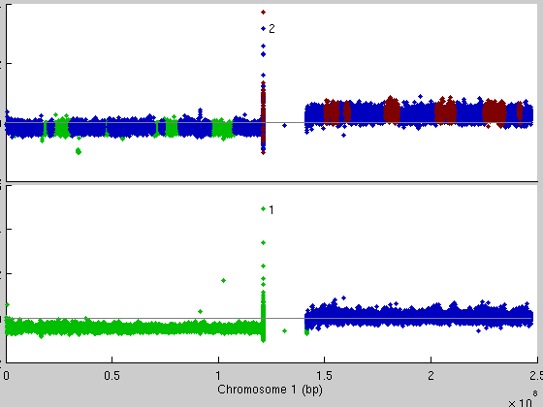
CNV chr 1
Line 54
Line 88
Gain
Neural
Loss
Corbett
Notes:
We can calculate and create plots of CNV

Slide 11
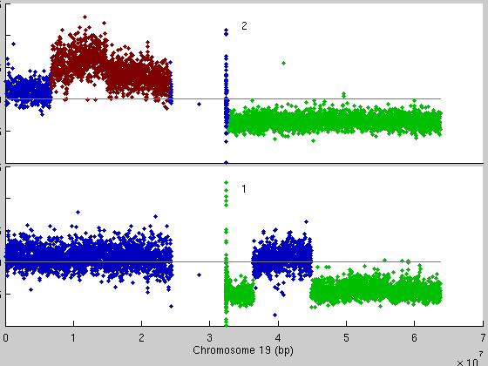
CNV chr 19
Line 54
Line 88
Gain
Neural
Loss
Corbett

Slide 12
LOH
LOH information was generated for each sample from the lists of genomic SNPs that were identified through the dibayes Solid pipeline. This analysis allows for classification of each SNP as either heterozygous or homozygous based on the reported SNP probabilities. For each sample, genomic bins of consistent SNP coverage are used by an HMM to identify genomic regions of consistent rates of heterozygosity. The HMM partitioned each tumor genome into three states: normal heterozygosity, increased homozygosity (low), and total homozygosity (high). We infer that a region of low homozygosity represents a state where only a portion of the cellular population had lost a copy of a chromosomal region.

Slide 13
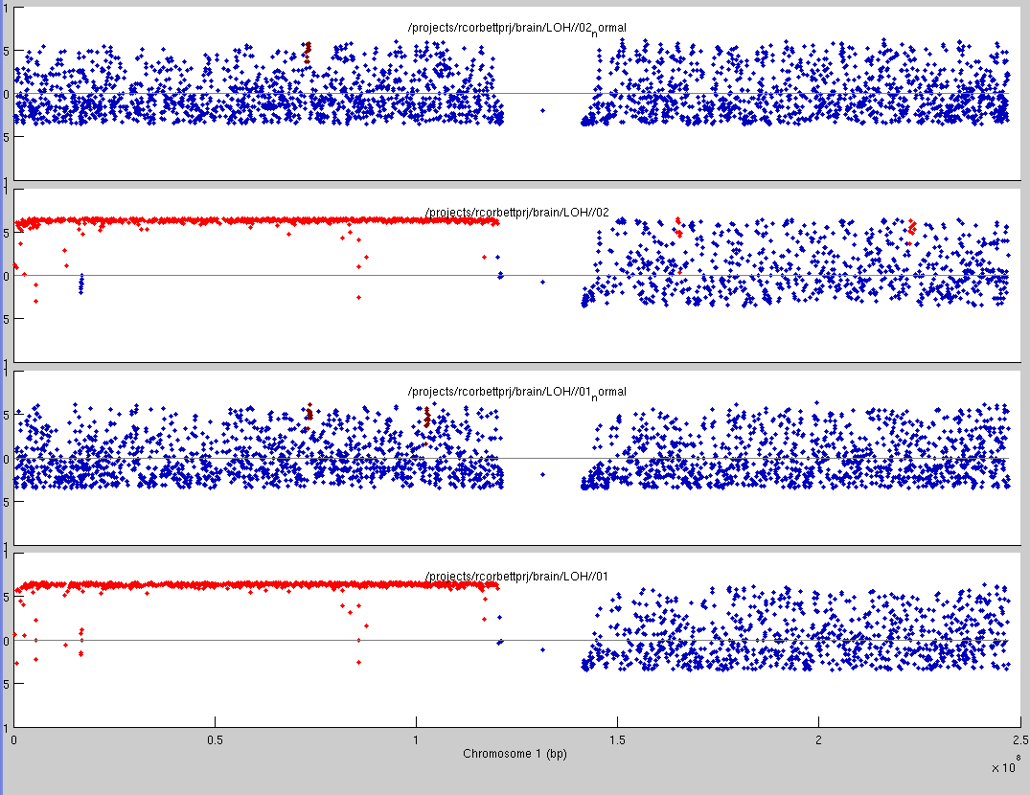
LOH in 1p based on mutation analysis
Line 54 NORMAL (HS2426)
Line 54 TUMOUR (HS2425)
Line 88 NORMAL (HS2424)
Loss
Neutral
Line 88 TUMOUR (HS2423)
Corbett
Notes:
We can detect 1p/19q loss by array CGH but it’s ‘pretty cool’ to see that we can do it with SNVs called by Solid Dibayes!

Slide 14
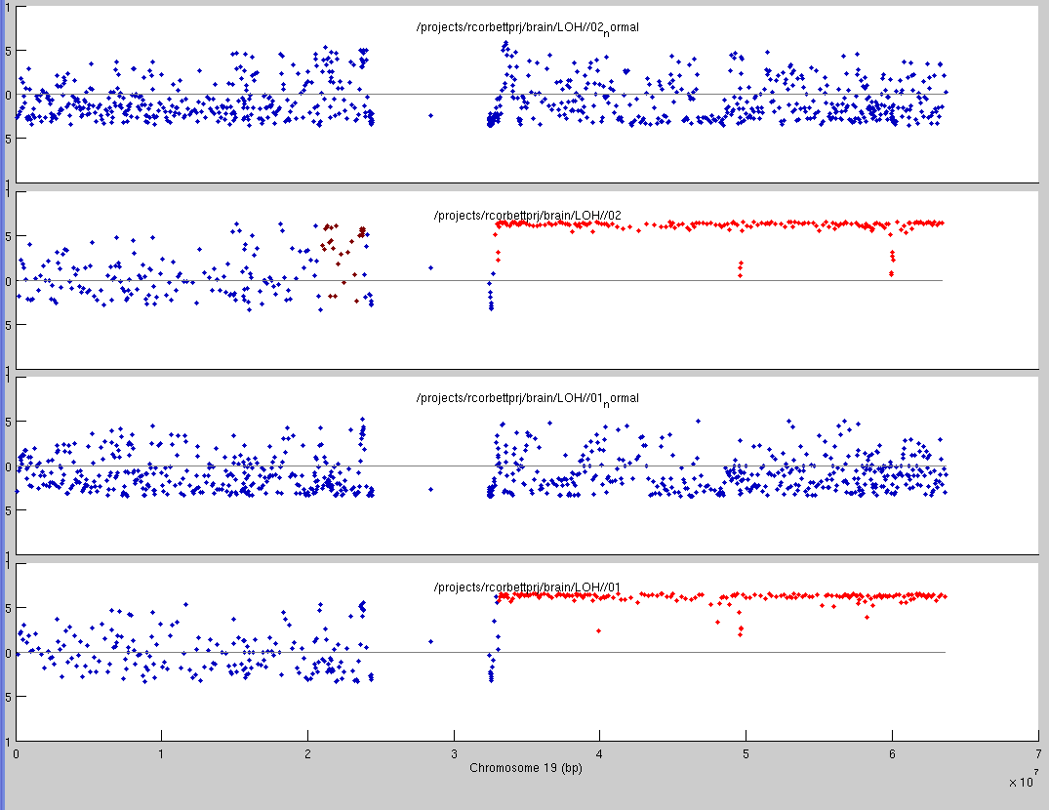
LOH in 19q based on mutation analysis
Line 54 NORMAL (HS2426)
Line 54 TUMOUR (HS2425)
Line 88 NORMAL (HS2424)
Loss
Neutral
Line 88 TUMOUR (HS2423)
Corbett

Slide 15
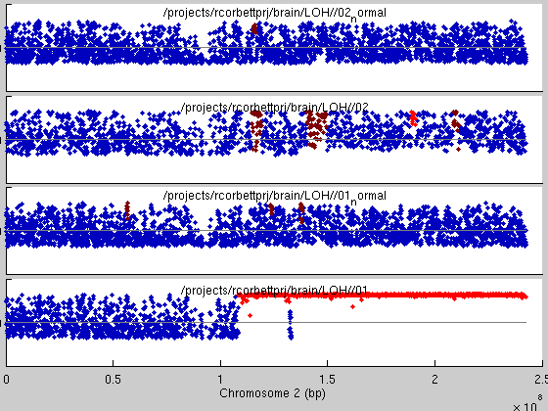
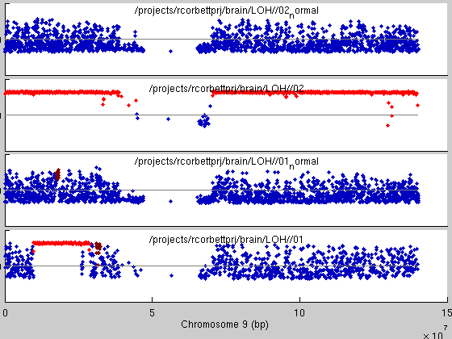
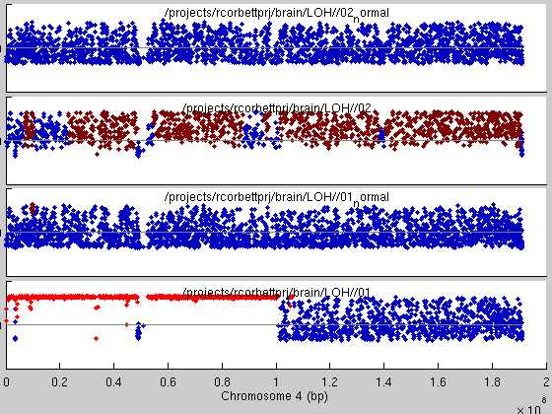
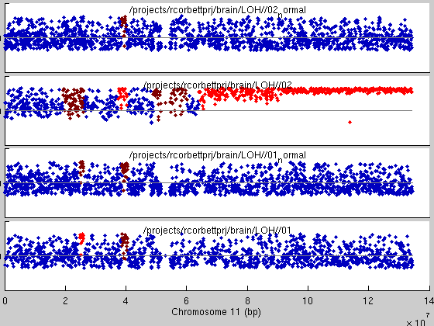
Corbett

Slide 16
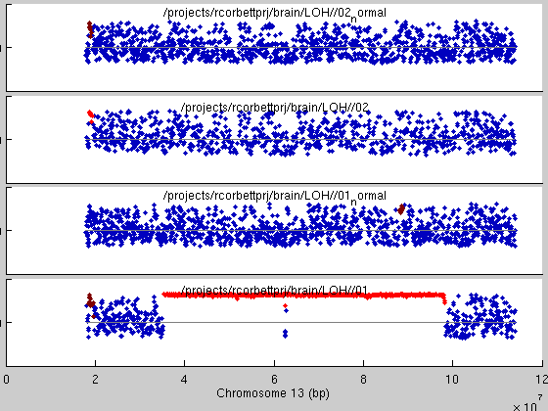
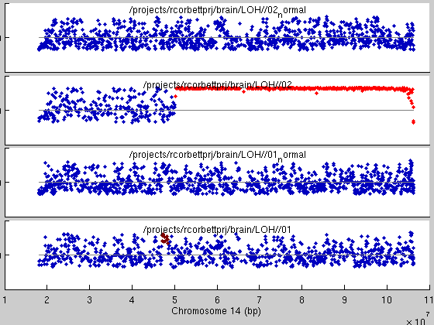
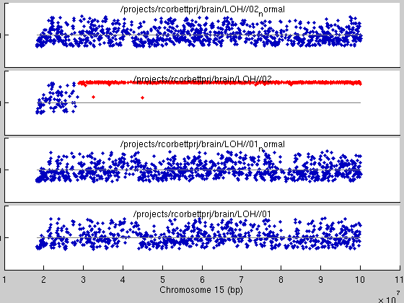
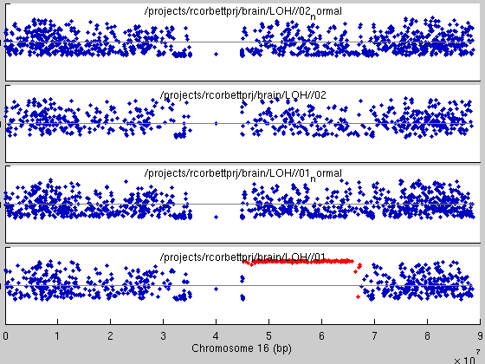
Corbett

Slide 17
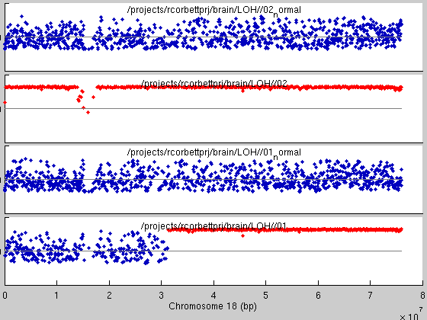
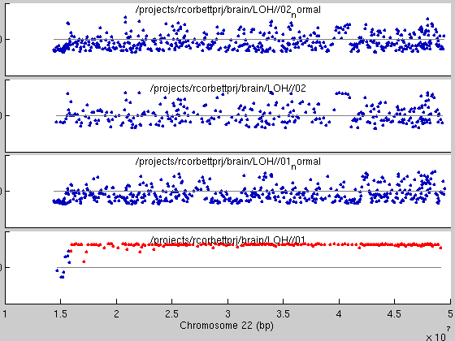
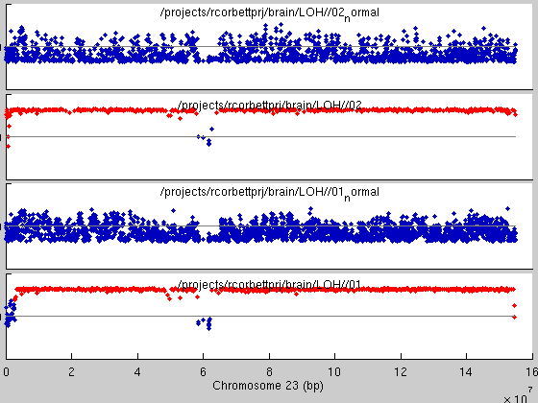
Corbett

Slide 18
Summary of ODG samples
STATUS / LIBRARY REFERENCE
Calgary ODG BTICs/1° Tumour/matched normal NGS sequencing master table
CalgaryID | GSC_library | GSC_sourceID | Library Type | Comment
line 54 | HS0709 | GR001 | WTSS-PET Library | line 54
line 54 | HS0710 | GR001 | miRNA Library | line 54
line 54 | HS0777 | GR002 | miRNA Library | line 54
line 54 | HS0778 | GR003 | miRNA Library | line 54
SF07-05071 | HS1082 | GR004 | WTSS-PET Library | line 54 tumor
SF08-12071 | HS1083 | GR005 | WTSS-PET Library
SF08-09280 | HS1084 | GR006 | WTSS-PET Library
SF07-16930 | HS1085 | GR007 | WTSS-PET Library
SF08-04184 | HS1086 | GR008 | WTSS-PET Library
SF07-05071 | HS1893 | GR004 | EXC-PET Library | line 54 tumor
line 54 normal | HS1894 | GR004N | EXC-PET Library | line 54 normal
SF08-12071 | HS2040 | GR005 | EXC-PET Library
 | HS2041 | GR005N | EXC-PET Library
SF08-09280 | HS2042 | GR006 | EXC-PET Library
 | HS2043 | GR006N | EXC-PET Library
 | HS2044 | GR007N | EXC-PET Library
SF08-04184 | HS2045 | GR008 | EXC-PET Library
 | HS2046 | GR008N | EXC-PET Library
line 88 | HS2423 | GR015 | Genome-SPE Library | line 88
line 88 normal | HS2424 | GR015N | Genome-SPE Library | line 88 normal
line 54 | HS2425 | GR016 | Genome-SPE Library | line 54
line 54 normal | HS2426 | GR016N | Genome-SPE Library | line 54 normal
SF07-16930 501T | HS2805 | GR007 | EXC-PET Library | In queue
303T | HS2806 | GR017 | EXC-PET Library | In queue
305T | HS2807 | GR018 | EXC-PET Library | In queue
313T | HS2808 | GR019 | EXC-PET Library | In queue
317T | HS2809 | GR020 | EXC-PET Library | In queue
334T | HS2810 | GR021 | EXC-PET Library | In queue
368T | HS2811 | GR022 | EXC-PET Library | In queue
386T | HS2812 | GR023 | EXC-PET Library | In queue
471T | HS2813 | GR024 | EXC-PET Library | In queue
636T | HS2814 | GR025 | EXC-PET Library | In queue
324T | HS2815 | GR026 | EXC-PET Library | In queue
303N | HS2816 | GR017N | EXC-PET Library | In queue
305N | HS2817 | GR018N | EXC-PET Library | In queue
313N | HS2818 | GR019N | EXC-PET Library | In queue
317N | HS2819 | GR020N | EXC-PET Library | In queue
334N | HS2820 | GR021N | EXC-PET Library | In queue
368N | HS2821 | GR022N | EXC-PET Library | In queue
386N | HS2822 | GR023N | EXC-PET Library | In queue
471N | HS2823 | GR024N | EXC-PET Library | In queue
636N | HS2824 | GR025N | EXC-PET Library | In queue
324N | HS2825 | GR026N | EXC-PET Library | In queue
1
14
4
1
Exome-Seq (15)
Genome-Seq (2)
RNA-Seq (5)
Notes:
Olena: what do the overlaps mean? i.e. so one sample is seen in all three sequencing types – patient 54 I gather…

Slide 19
SNV annotation of Line 54 and Line 88 based on Solid dibayes SNV results
Library: | HS2423 | HS2424 | HS2425 | HS2426 | HS0709 | HS1082 | HS1893 | HS1894
Source: | Line 88 genomic |  | Line 54 genomic |  | Line 54 RNA-seq |  | Line 54 exome
Type: | tumour | normal | tumour | normal | tumour | tumour | tumour | normal
Total number of SNPs | 2655332 | 4050992 | 2165750 | 3923918 | 18053 | 332969 | 80889 | 179512
dbSNP 129 concordance | 0.81577445 | 0.6955859 | 0.90447282 | 0.7286949 | 0.86074337 | 0.6933018 | 0 | 0.8516032
Intergenic | 1663267 | 2606896 | 1353654 | 2509523 | 0 | 91483 | 10590 | 76452
Intragenic | 992065 | 1444096 | 812096 | 1414395 | 18053 | 241486 | 70299 | 103060
not coding | 9775 | 21395 | 8503 | 20810 | 366 | 1225 | 3648 | 3283
5-UTR | 1961 | 3211 | 1977 | 3444 | 682 | 1568 | 709 | 1015
3-UTR | 25203 | 35980 | 20610 | 35176 | 8621 | 15398 | 2272 | 3569
intron | 935952 | 1360393 | 764327 | 1330622 | 1518 | 212267 | 47520 | 86007
synonymous | 9216 | 11229 | 8521 | 11441 | 3907 | 5984 | 8283 | 4907
non-synonymous | 9958 | 11888 | 8158 | 12902 | 2959 | 5044 | 7867 | 4279
novel non-synonymous | 2996 | 2521 | 792 | 3732 | 341 | 726 | 667 | 482
somatic novel non-synonymous | 2390 |  | 192

Slide 20
Non-synonymous SNV concordance between patient 54 cell line and transcriptome and patient 88 cell line
Line 88 tumour genomic 2390 somatic
Non-synonymous SNVs
2384
6
Line 54 tumour genomic
192 somatic
non-synonymous SNVs
156
30
311
Line 54 RNA-seq
341 non-synonymous SNVs

Slide 21
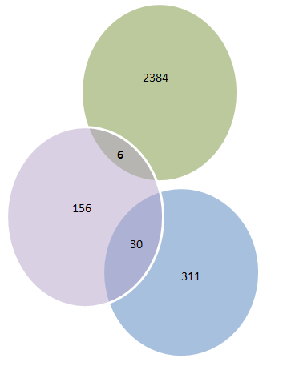
6 SNVs in seen in both Line 88 and Line 54
X 47192200 C S G 17 ZNF41 ENSG00000147124 ENST00000313116 1913 638 S T GKAFIQKSHFIAHHRIHTGEKPYEC=S=DCGKCFTKKSQLRVHQKIHTGEKPN Zinc finger protein 41 [Source:UniProtKB/Swiss-Prot;Acc:P51814] ZNF41 n n
1 146713257 A W T 20 NBPF10 ENSG00000203832 ENST00000369202 124 42 C S ILEINEKLRPQLAENKQQFGNLKER=C=FVTQLAGFLANQQKKYNYEECKDLI Neuroblastoma breakpoint family member 10 [Source:UniProtKB/Swiss-Prot;Acc:Q6P3W6] -
11 47603814 A R G 25 MTCH2 ENSG00000109919 ENST00000302503 737 246 V A YSQAVTGFFASMLTYPFVLVSNLMA=V=NNCGLAGGCPPYSPIYTSWIDCWCM Mitochondrial carrier homolog 2 (Met-induced mitochondrial protein) [Source:UniProtKB/Swiss-Prot;Acc:Q9Y6C9] MTCH2 n n
3 75797530 A R G 24 FRG2C ENSG00000172969 ENST00000308062 497 166 E G TCDAHHRGSSRACTGRSKRHRSRAL=E=VQTPSLRKSLVTSVRAMSEAVYQDL Protein FRG2-like-2 (FSHD region gene 2 protein family member C)(HSA3-FRG2) [Source:UniProtKB/Swiss-Prot;Acc:A6NGY1] FRG2C n n
3 75797533 T W A 26 FRG2C ENSG00000172969 ENST00000308062 500 167 V D CDAHHRGSSRACTGRSKRHRSRALE=V=QTPSLRKSLVTSVRAMSEAVYQDLA Protein FRG2-like-2 (FSHD region gene 2 protein family member C)(HSA3-FRG2) [Source:UniProtKB/Swiss-Prot;Acc:A6NGY1] FRG2C n n
17 77004431 A R G 34 AC110285.14 ENSG00000214094 ENST00000397526 580 194 Y H TPILMDTHAHTHIHPSSWTHTHTCA=Y=THPHGHTHTRIHP Putative uncharacterized protein ENSP00000380660 Fragment [Source:UniProtKB/TrEMBL;Acc:A8MYS4] -
Annotation of SNPs from spreadsheet (highlighted in orange in the spreadsheet) that are seen in both sets of novel non-synonymous SNVs for Line 88 and Line 54

Slide 22
Non-synonymous SNV concordance between patient 54 cell line and exome and patient 88 cell line
Patient 88 cell line tumour genomic 2390 somatic
Non-synonymous SNVs
2383
5
1
Patient 54 cell line tumour genomic
192 somatic
non-synonymous SNVs
1
163
Ubiquitin carboxyl-terminal hydrolase
23
642
Patient 54 exome
667 non-synonymous SNVs
Protein FRG2-like-2
Notes:
Put up IGV slide… Or mention false SNP in IGV

Slide 23
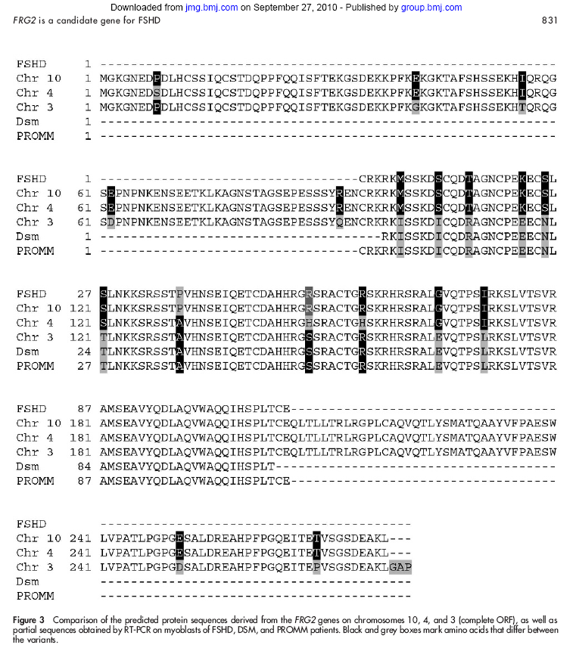
SNV in FRG2 potentially not real
From Rijkers, Journal of Medical Genetics 2004
FRG2 transcripts exist on chromosomes 10, 4, 3 with single base difference.
It’s possible that reads can align to the wrong place resulting in a false positive SNP.

Slide 24
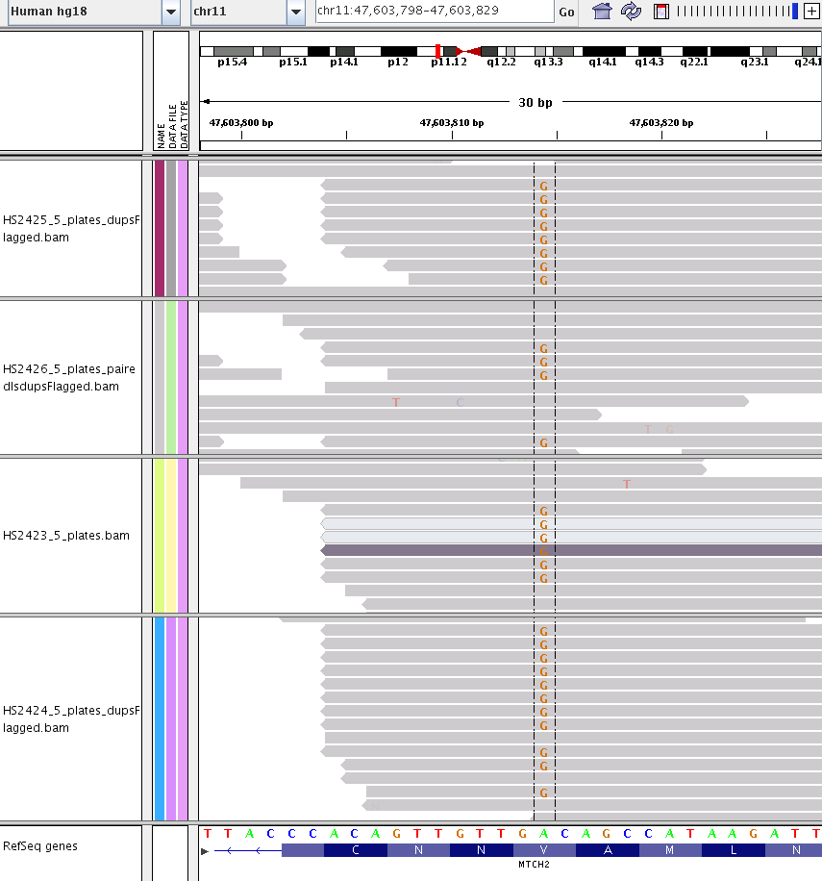
SNVs in MTCH2 seen in normal and tumour
Line 54 TUMOUR
47603815
Line 54 NORMAL
Line 88 TUMOUR
Line 88 NORMAL
Notes:
Is this gene relevant?

Slide 25
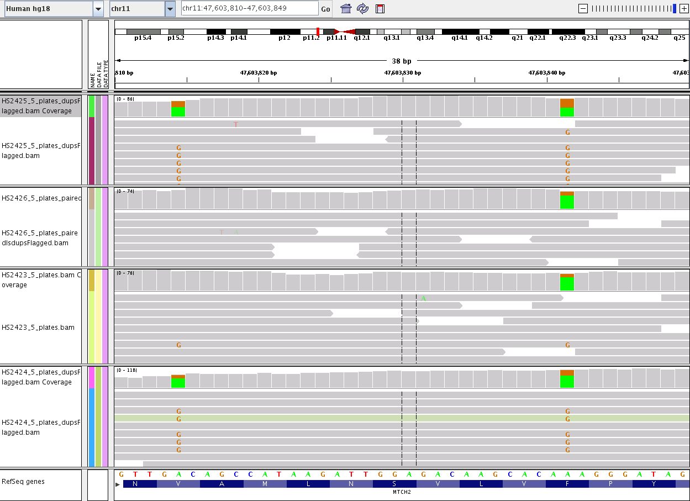
SNVs in MTCH2 seen in normal and tumour
Line 54 TUMOUR
Line 54 NORMAL
Line 88 TUMOUR
Line 88 NORMAL

Slide 26
IDH1
Entrez Gene summary for IDH1: Isocitrate dehydrogenases catalyze the oxidative decarboxylation of isocitrate to 2-oxoglutarate. These enzymes belong to two distinct subclasses, one of which utilizes NAD(+) as the electron acceptor and the other NADP(+). Five isocitrate dehydrogenases have been reported: three NAD(+)-dependent isocitrate dehydrogenases, which localize to the mitochondrial matrix, and two NADP(+)-dependent isocitrate dehydrogenases, one of which is mitochondrial and the other predominantly cytosolic. Each NADP(+)-dependent isozyme is a homodimer. The protein encoded by this gene is the NADP(+)-dependent isocitrate dehydrogenase found in the cytoplasm and peroxisomes. It contains the PTS-1 peroxisomal targeting signal sequence. The presence of this enzyme in peroxisomes suggests roles in the regeneration of NADPH for intraperoxisomal reductions, such as the conversion of 2, 4-dienoyl-CoAs to 3-enoyl-CoAs, as well as in peroxisomal reactions that consume 2-oxoglutarate, namely the alpha-hydroxylation of phytanic acid. The cytoplasmic enzyme serves a significant role in cytoplasmic NADPH production. (provided by RefSeq)

Slide 27
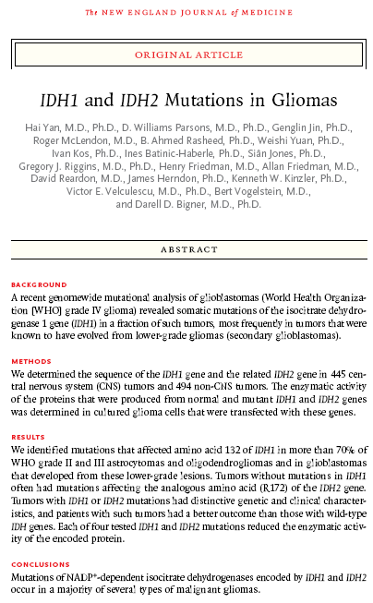
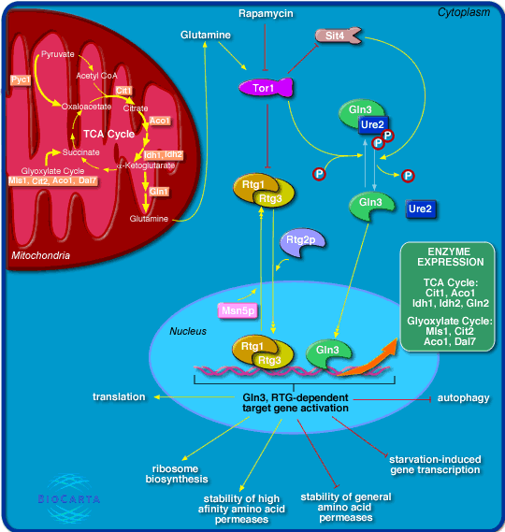
IDH1
Tumors with IDH1 or IDH2 mutations had distinctive genetic and clinical characteristics, and patients with such tumors had a better outcome than those with wild-type IDH genes.
http://www.nejm.org/doi/pdf/10.1056/NEJMoa0808710
Notes:
How does rapamycin work? Can one assume that with a mutation in IDH1,

Slide 28
Searching for mutations in IDH1…
Line 88
[ybutterf@xhost08 Cairncross]$ less ./HS2423/*.snp | grep "y,y" | grep "IDH"
2|208816562|C|T|-|14|ENSG00000138413|ENST00000345146|532|178|V|I|EITYTPSDGTQKVTYLVHNFEEGGG=V=AMGMYNQDKSIEDFAHSSFQMALSK|Isocitrate dehydrogenase [NADP] cytoplasmic (IDH)(EC 1.1.1.42)(Cytosolic NADP-isocitrate dehydrogenase)(Oxalosuccinate decarboxylase)(NADP(+)-specific ICDH)(IDP) [Source:UniProtKB/Swiss-Prot;Acc:O75874]|IDH1|non-synonymous|IDH1,y,y
[ybutterf@xhost08 Cairncross]$ less ./HS2424/*.snp | grep "y,y" | grep "IDH"
2|208816562|C|Y|T|29|ENSG00000138413|ENST00000345146|532|178|V|I|EITYTPSDGTQKVTYLVHNFEEGGG=V=AMGMYNQDKSIEDFAHSSFQMALSK|Isocitrate dehydrogenase [NADP] cytoplasmic (IDH)(EC 1.1.1.42)(Cytosolic NADP-isocitrate dehydrogenase)(Oxalosuccinate decarboxylase)(NADP(+)-specific ICDH)(IDP) [Source:UniProtKB/Swiss-Prot;Acc:O75874]|IDH1|non-synonymous|IDH1,y,y
Line 54
[ybutterf@xhost08 Cairncross]$ less ./HS2425/*.snp | grep "y,y" | grep "IDH"
2|208821357|C|Y|T|25|ENSG00000138413|ENST00000345146|395|132|R|H|VFREAIICKNIPRLVSGWVKPIIIG=R=HAYGDQYRATDFVVPGPGKVEITYT|Isocitrate dehydrogenase [NADP] cytoplasmic (IDH)(EC 1.1.1.42)(Cytosolic NADP-isocitrate dehydrogenase)(Oxalosuccinate decarboxylase)(NADP(+)-specific ICDH)(IDP) [Source:UniProtKB/Swiss-Prot;Acc:O75874]|IDH1|non-synonymous|IDH1,y,y
[ybutterf@xhost08 Cairncross]$ less ./HS2426/*.snp | grep "y,y" | grep "IDH“
[ybutterf@xhost08 Cairncross]$ less ./HS1893/*.snp | grep "y,y" | grep "IDH"
2|208821357|C|Y|T|45|ENSG00000138413|ENST00000345146|395|132|R|H|VFREAIICKNIPRLVSGWVKPIIIG=R=HAYGDQYRATDFVVPGPGKVEITYT|Isocitrate dehydrogenase [NADP] cytoplasmic (IDH)(EC 1.1.1.42)(Cytosolic NADP-isocitrate dehydrogenase)(Oxalosuccinate decarboxylase)(NADP(+)-specific ICDH)(IDP) [Source:UniProtKB/Swiss-Prot;Acc:O75874]|IDH1|non-synonymous|IDH1,y,y
less ../RemovedNansRepositionedHS2425_SNP.gff3 | grep "208821357"
chr2 SOLiD_diBayes SNP 208821357 208821357 0.000360 . . genotype=Y;reference=C;coverage=25;refAlleleCounts=17;refAlleleStarts=12;refAlleleMeanQV=24;novelAlleleCounts=6;novelAlleleStarts=5;novelAlleleMeanQV=21;diColor1=13;diColor2=31;het=1;flag=

Slide 29
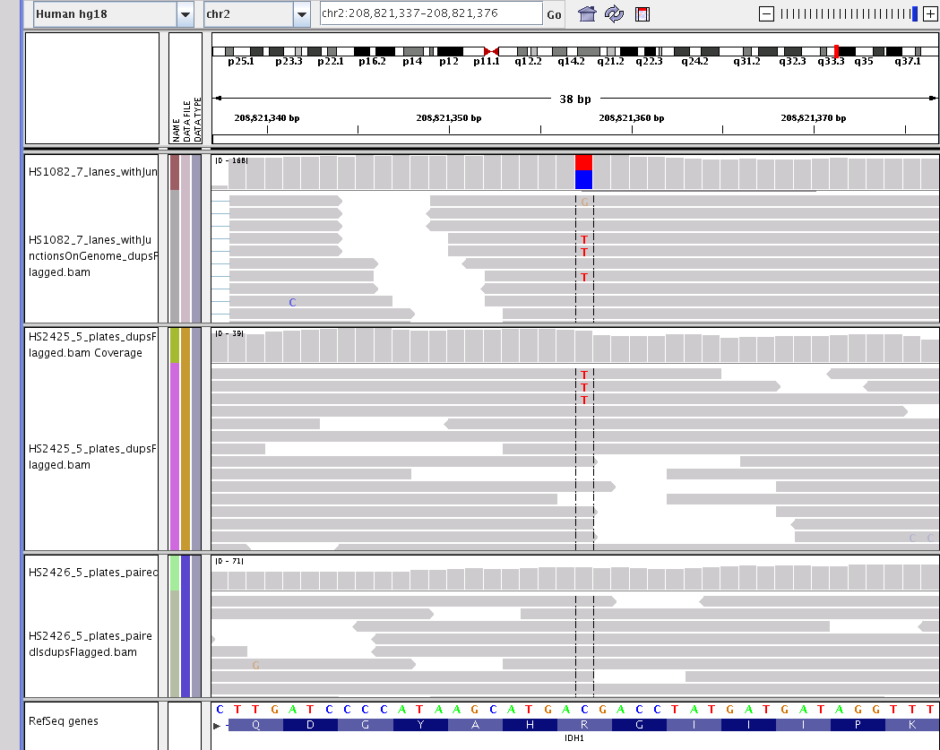
Known somatic mutation in IDH1: R132H
Seen in patient 54 in tumour (both GSS and WTSS) but not the normal (as expected).
Causes known protein coding change.
Patient 54
tumour
208821357
tumour
normal

Slide 30
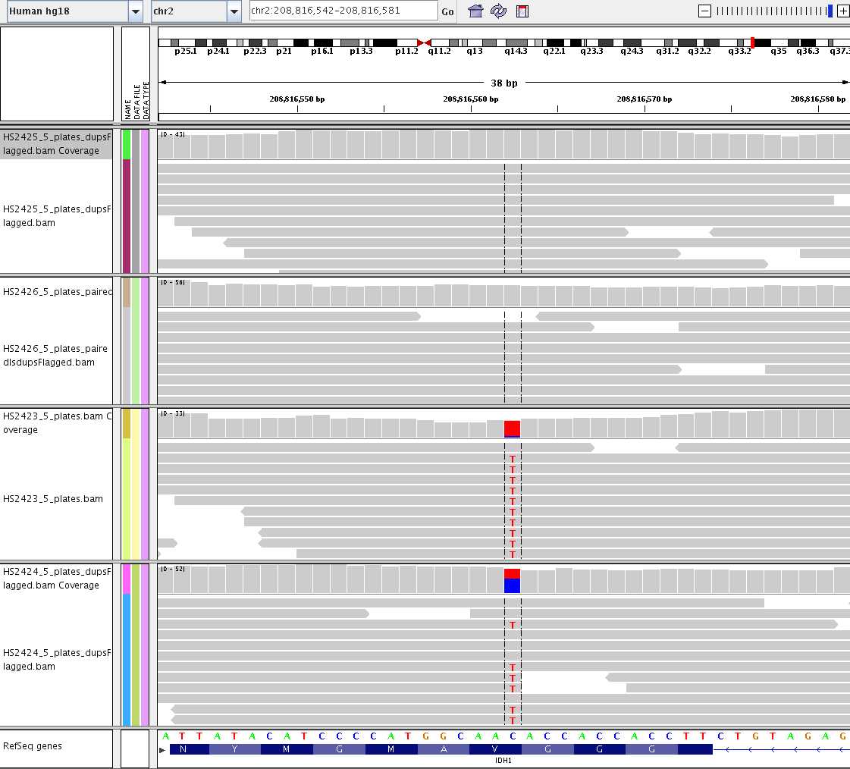
Other SNVs in IDH1
Line 54 TUMOUR
Line 54 NORMAL
Line 88 TUMOUR
208816562
Line 88 NORMAL

Slide 31
EGLN3
UniProtKB/Swiss-Prot: EGLN3_HUMAN, Q9H6Z9 Function: Catalyzes the post-translational formation of 4-hydroxyproline in hypoxia-inducible factor (HIF) alpha proteins. Hydroxylates HIF-1 alpha at 'Pro-564', and HIF-2 alpha. Functions as a cellular oxygen sensor and, under normoxic conditions, targets HIF through the hydroxylation for proteasomal degradation via the von Hippel-Lindau ubiquitination complex. May play a role in cell growth regulation in muscle cells and in apoptosis in neuronal tissue. Promotes cell death through a caspase-dependent mechanism (By similarity)

Slide 32
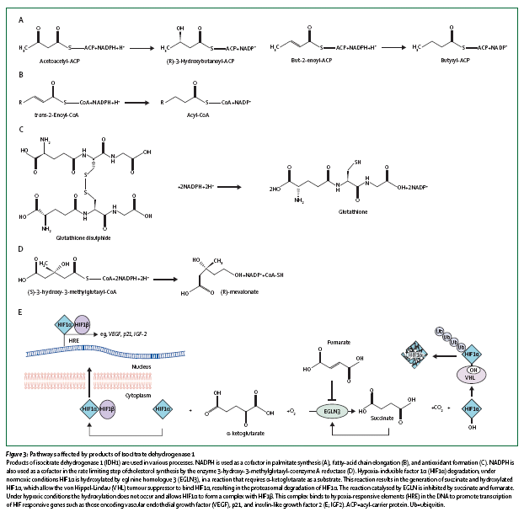
Novel non-syn mutation in EGLN3 in line 88 tumour

Slide 33
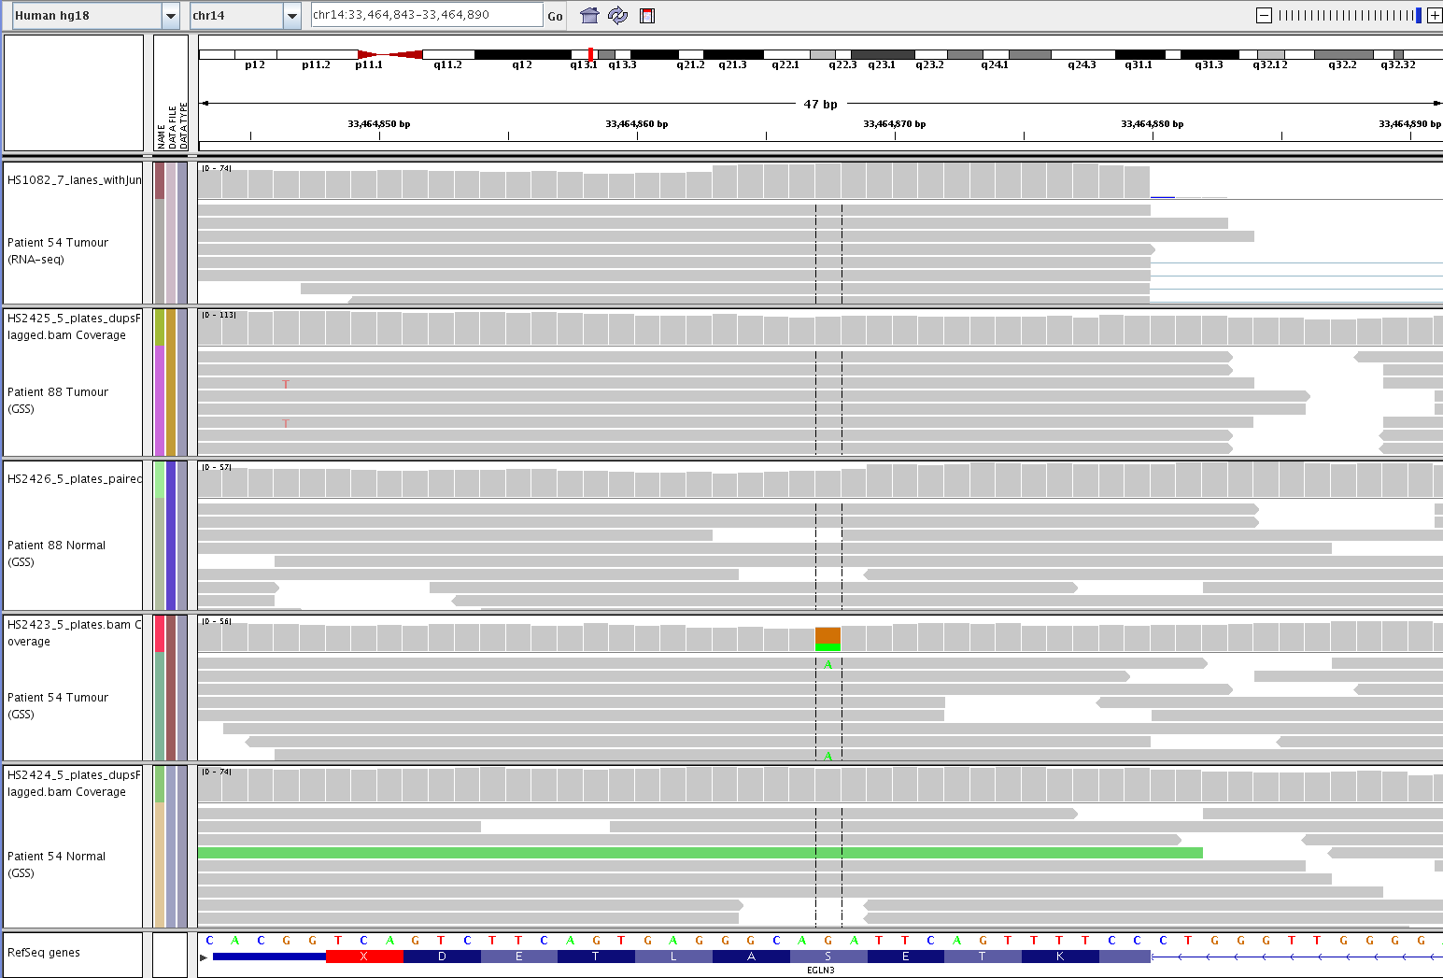
EGLN3

Slide 34
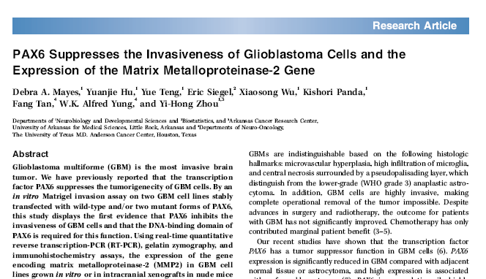
PAX6 mutations in line 88
[ybutterf@xhost09 HS2423]$ less HS2423.annotated.somatic.snp | grep "PAX6"
11|31768845|G|R|A|34|ENSG00000007372|ENST00000379115|1172|391|T|I|GRSYDTYTPPHMQTHMNSQPMGTSG=T=TSTGLISPGVSVPVQVPGSEPDMSQ|Pair
ombin)(Aniridia type II protein) [Source:UniProtKB/Swiss-Prot;Acc:P26367]|PAX6|non-synonymous|PAX6,n,n
11|31779717|C|Y|T|48|ENSG00000007372|ENST00000379109|325|109|E|K|VSKIAQYKRECPSIFAWEIRDRLLS=E=GVCTNDNIPSVSSINRVLRNLASEK|Paire
mbin)(Aniridia type II protein) [Source:UniProtKB/Swiss-Prot;Acc:P26367]|PAX6|non-synonymous|PAX6,n,n
11|31779717|C|Y|T|48|ENSG00000007372|ENST00000379115|325|109|E|K|VSKIAQYKRECPSIFAWEIRDRLLS=E=GVCTNDNIPSVSSINRVLRNLASEK|Paire
mbin)(Aniridia type II protein) [Source:UniProtKB/Swiss-Prot;Acc:P26367]|PAX6|non-synonymous|PAX6,n,n
Mutation analysis of gene PAX6 in human gliomas
G.R. Pinto, C.A. Clara, M.J. Santos, J.R.W. Almeida, R.R. Burbano, J.A. Rey and C. Casartelli
Abstract. Gliomas are the most common tumors of the central nervous system. In spite of the marked advances in the characterization of the molecular pathogenesis of gliomas, these tumors remain incurable and, in most of the cases, resistant to treatments, due to their molecular heterogeneity. Gene PAX6, which encodes a transcription factor that plays an important role in the development of the central nervous system, was recently recognized as a tumor suppressor in gliomas. The objective of the present study was to analyze the mutational status of the coding and regulating regions of PAX6 in 94 gliomas: 81 astrocytomas (11 grade I, 23 grade II, 8 grade III, and 39 grade IV glioblastomas), 5 oligodendrogliomas (3 grade II, and 2 grade III), and 8 ependymomas (5 grade II, and 3 grade III). Two regulating regions (SX250 and EIE) and the 11 coding regions (exons 4-13, plus exon 5a resulting from alternative splicing) of gene PAX6 were analyzed and no mutation was found. Therefore, we conclude that the tumor suppressor role of PAX6, reported in previous studies is not due to mutation in its coding and regulating regions, suggesting the involvement of epigenetic mechanisms in the silencing of PAX6 in these tumors.
Glioblastoma multiforme (GBM) is the most invasive brain
tumor. We have previously reported that the transcription
factor PAX6 suppresses the tumorigenecity of GBM cells.
Genetics and Molecular Research 6 (4): 1019-1025 (2007)
Genetics and Molecular Research 6 (4): 1019-1025 (2007)
Notes:
The expression level of PAX6 in human glioma cell lines was shown to be negatively associated with the degree of tumorigenicity. PAX6 expression level is lower in glioblastoma compared to the adjacent normal tissue and to the anaplastic astrocytoma previously formed in the same patient (Zhou et al., 2003). Ectopic expression of PAX6 in glioma cell lines suppressed cell anchorage independent growth, ability to survive under oxidative stress induced by cell detachment, ability to invade partially by suppression of MMP2 gene expression, ability to induce angiogenesis by initiating a new signaling pathway independent of PI3K/Akt-HIF1A signaling to suppress VEGFA, and overall tumor growth after intracranial implantation in immunocompromised mouse brain (Zhou et al., 2005; Mayes et al., 2006; Chang et al., 2007; Zhou et al., 2009). Mutation analysis for PAX6 in gliomas failed to identify PAX6 mutation in its coding and regulating regions, suggesting involvement of epigenetic mechanisms in the silencing of PAX6 in glioma (Pinto et al., 2007). PAX6 expression is activated in glioma cell line with re-introduction of a normal ch.10, suggesting that PAX6 is regulated by a gene(s) on ch.10 (Zhou et al., 2005).http://atlasgeneticsoncology.org/Genes/PAX6ID211ch11p13.html

Slide 35
Calling the amplified allele
For comparing tumour/normal, currently looking at measuring allelic imbalance: “B allele frequency” (BAF)
BAF = (Bsignal)/(Σ AandBsignals)
ΔBAF = BAF_{tumour} – BAF_{matchednormal}
Identify allele calls where |ΔBAF| > 0.05
LaFramboise, Allelic Selection of Amplicons in Glioblastoma Revealed by Combining Somatic and Germline Analysis

Slide 36
GSC Human Variant Database*
Allows us to query tumour and normal datasets either generated in-house or downloaded from external sources
1) Annotation of variant calls (SNV’s and indels) for a given library and the identification of its presence in other libraries.
time java SNP_Database/ExperimentalRecord -conf ../lib/constants.conf -psql ../lib/PSQL.conf -out_path /projects/ybutterfprj/analysis/Cairncross/HS2425/HumanVariantDatabase -library HS2425
2) Given a gene, identify all libraries which contain a variant in that gene.
time java SNP_Database/Get_SNPs_by_name -conf ../lib/constants.conf -psql ../lib/PSQL.conf -output /projects/ybutterfprj/analysis/Cairncross/HVD_Genes/ -gene IDH1
* Anthony Fejes, ….,
Notes:
Remove actual java command

Slide 37
1) Comparing patient 54 novel somatic nsSNVs that exist in other libraries (normal or tumour)
Of 192 novel ns SNVs in patient 54 we see..
X SNVs in normals of other libraries
Y SNVs in tumour libraries
Z SNVs remain as unique to this cell line.
Venn diagram?

Slide 38
2) Non-synonymous SNV in IDH1
6526389 2 208816562 exon
ns: 208816562 C T ENST00000345146 IDH1-001 178 V>>>I EITYTP
SDGTQKVTYLVHNFEEGGG*V*AMGMYNQDKSIEDFAHSSFQMALSKG
10 11 NA10851 normal tissue 130
3 4 NA11831 normal tissue 141
46 120 HS1795 cancer tissue 1144
2 5 HS2160 cancer tissue 1150
18 35 HS1794 cancer tissue 1296
28 46 HS1884 normal tissue 1306
40 40 HS1805 cancer cell_line 1316
19 39 HS1794_P cancer tissue 1338
37 60 HS1884_P normal tissue 1348
8 29 HS1085 cancer tissue 1386
13 22 A00005 cancer tissue 1400
22 57 A00017 cancer tissue 1411
56 112 A00027 cancer tissue 1421
106 194 A00179 cancer tissue 1561
23 48 A00185 cancer tissue 1565
49 104 A00187 cancer tissue 1567
36 72 HS2308 normal tissue 1597
36 81 HS2309 normal tissue 1598
11 25 HCT20148 normal tissue 1609
22 47 HS2488 normal tissue 1619
19 34 HS2490 normal tissue 1621
25 48 A00036_T cancer tissue 1636
17 37 A00079_T cancer tissue 1637
17 31 A00050_T cancer tissue 1645
14 36 A00050_N normal tissue 1664
19 33 A00079_N normal tissue 1671
19 42 A00036_N normal tissue 1677
10 29 HS2424 normal tissue 1684
13 14 HS2423 cancer tissue 1711
an: rs34218846 dbsnp129 dbSNP database version 129
an: rs34218846 dbsnp130 dbsnp_annotation
SNV is seen in a number of other cancer and normal tissue libraries and is also seen in dbSNP

Slide 39
2) Searching for the canonical mutation in IDH1 (in patient 54) in other samples
79335777 2 208821357 exon
ns: 208821357 C T ENST00000345146 IDH1-001 132 R>>>H VFREAIICKNIPRLVSGWVKPIIIG*R*HAYGDQYRATDFVVPGPGKVEITYTP
36 82 HS1893 cancer tissue 1355
72 146 HS2040 cancer tissue 1357
68 148 HS2042 cancer tissue 1359
1 203 HS2045 cancer tissue 1361
82 165 HS1084 cancer tissue 1385
28 60 HS1085 cancer tissue 1386
5 8 A00021 cancer tissue 1415
30 88 A00041 cancer tissue 1435
25 56 A00092 cancer tissue 1479
96 200 A00096 cancer tissue 1482
6 25 HS2425 cancer tissue 1712
21 55 A00575 cancer tissue 1727
acute myeloid leukemia
QC measure…
2 208821357 C Y T 25 IDH1 ENSG00000138413 ENST00000345146 395 132 R H VFREAIICKNIPRLVSGWVKPIIIG=R=HAYGDQYRATDFVVPGPGKVEITYT Isocitrate dehydrogenase [NADP] cytoplasmic (IDH)(EC 1.1.1.42)(Cytosolic NADP-isocitrate dehydrogenase)(Oxalosuccinate decarboxylase)(NADP(+)-specific ICDH)(IDP) [Source:UniProtKB/Swiss-Prot;Acc:O75874] IDH1 y y
Notes:
Comment on QC in terms of identifying a novel (as compared to dbSNP) non-synonymous SNV and calculating correct protein coordinates and amino acid change as a result. Database also identifies the IDH2 mutation existing in our AML TCGA samples. I am sure many are aware of this mutation in AML but one could potentially discover for the first time such a type of connection with the database. If you search the literature…

Slide 40
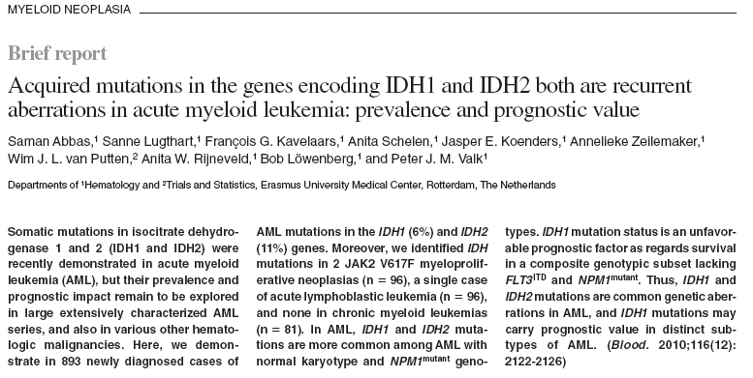
IDH1 mutation in AML
BLOOD, 23 SEPTEMBER 2010 VOLUME 116, NUMBER 12
Oligodrendroglioma Patient 54 13|27522294|G|A|-|38|ENSG00000122025|ENST00000241453|680|227|T|M|
QGESCKEESPAVVKKEEKVLHELFG=T=DIRCCARNELGRECTRLFTIDLNQT
|FL cytokine receptor Precursor (EC 2.7.10.1)(Tyrosine-protein kinase receptor FLT3)(Stem cell tyrosine kinase 1) (STK-1)(CD135 antigen) [Source:UniProtKB/Swiss-Prot;Acc:P36888]|FLT3|non-synonymous|FLT3,y,y
Notes:
Interestingly, a non-synonymous mutation in this gene is seen in patient 54. This is a known cancer gene based on the Cosmic database. I did a quick search and did not find any literature on it in the context of OGD.
FLT3^{ITD} = FLT3 (Fms-like trrosine kinase 3) with internal tandem duplication (ITD) seen in 30% of AML patients and are associated with a poor prognosis (Zhang, Mutant FLT3: A Direct Target of Sorafenib in Acute Myelogenous Leukemia)

Slide 41
CpG Islands

Slide 43

Acknowledgements
Olena Morozova
Sasha Maslova
Richard Corbett
Stephen Yip
Gregory Cairncross
…. Other in Calgary?
Marco Marra
Suganthi Chittaranjan
Nina Theissen et al
Richard Varhol et al

