Slide 1
Soc 332.6: Principles of research design Finding statistics

Slide 2
Statistics
Canada
Make
Data
Anonymous
Web-based Extractors
Public Use Microdata Files
(PUMF)
<odesi>
Equinox
Surveys/ Admin Data
DLI License
Research Data Centre
CANSIM
CanadianCensus Analyser
Create Tables
Free
Aggregate Data
Submit Proposal

Slide 3
Microdata vs Aggregate
Microdata: Each line in the file contains information on a person
For example, income of each person in SK
Aggregate Data (statistics): Information aggregated from the microdata
For example, average income of people in each province
Data ≠ Statistics

Slide 4
CANSIM
Aggregate data tables generated from surveys and administrative records
Contains very little Census data
Access
CANSIM Website at Statistics Canada [http://www5.statcan.gc.ca/cansim/home-accueil]
Through search engine (Google): CANSIM

Slide 5
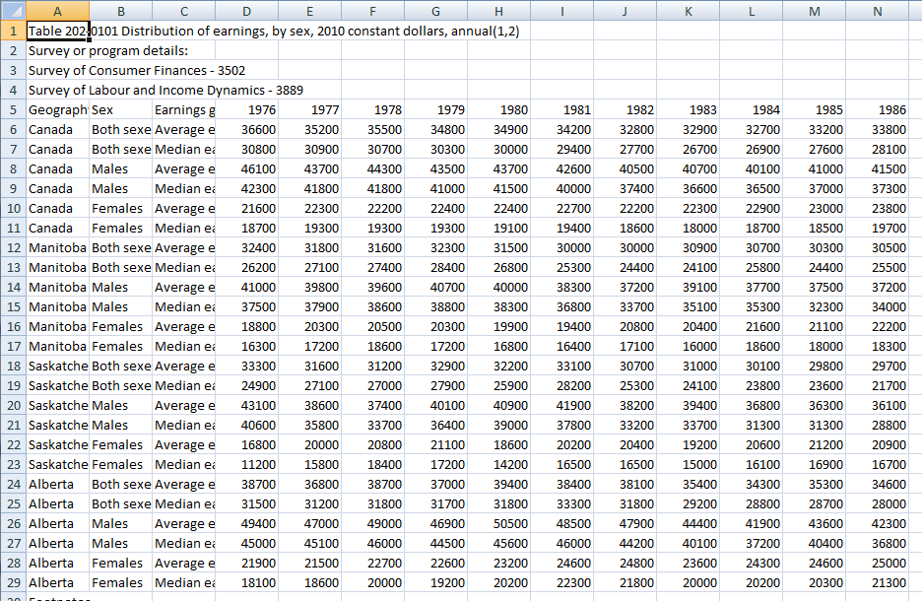
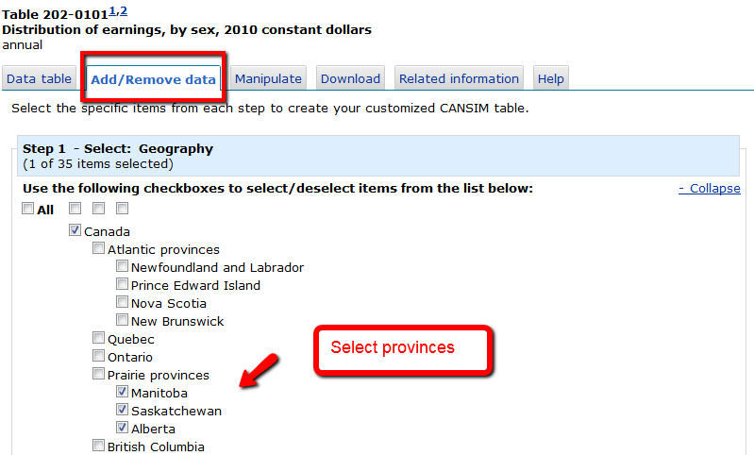
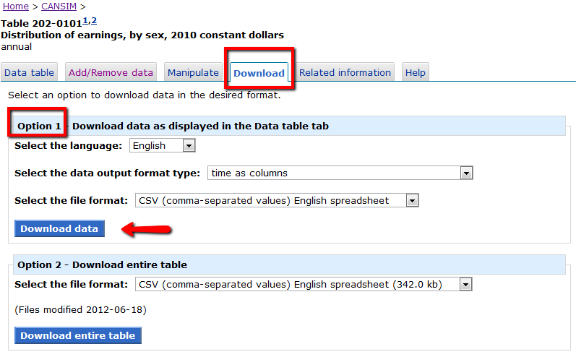
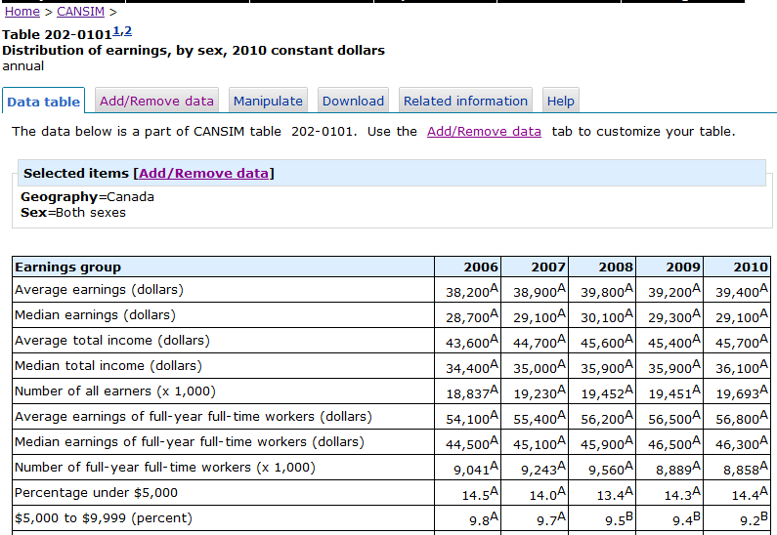
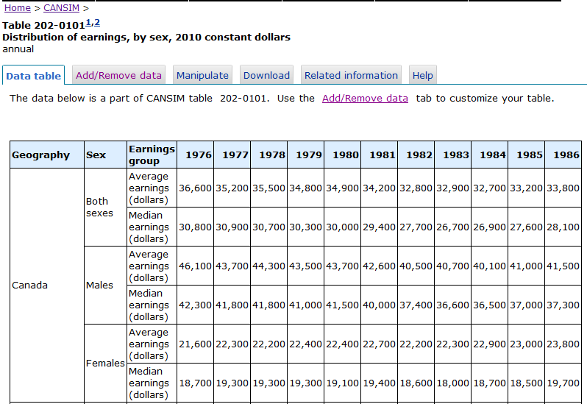
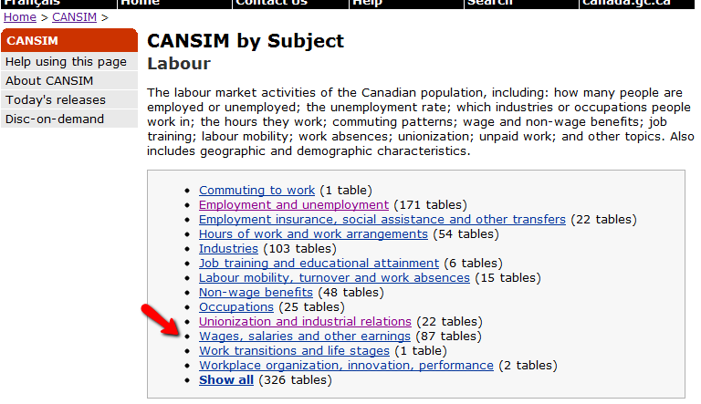
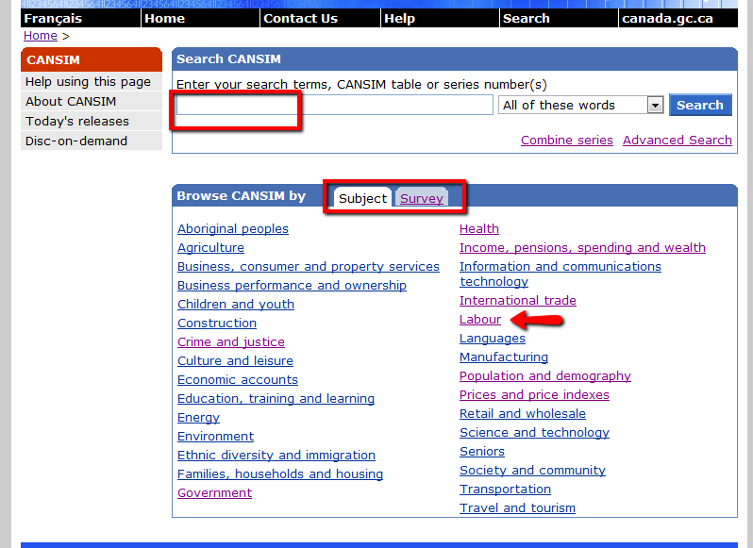
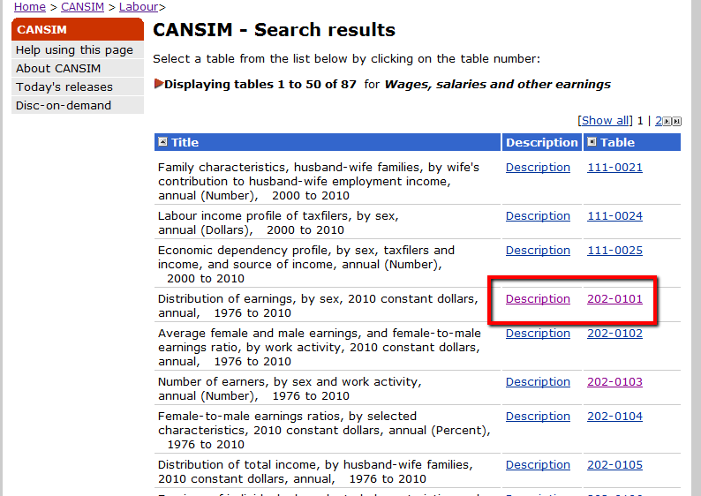
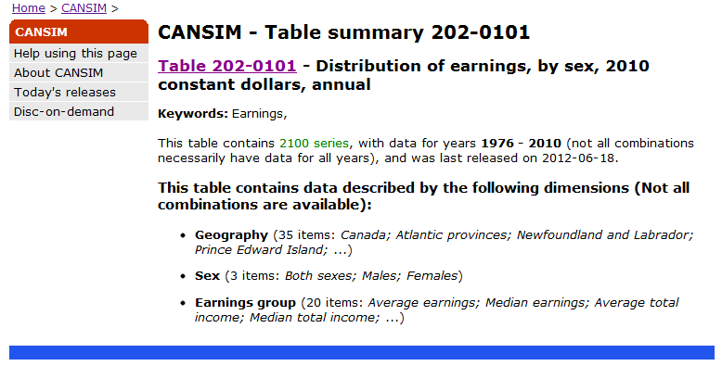
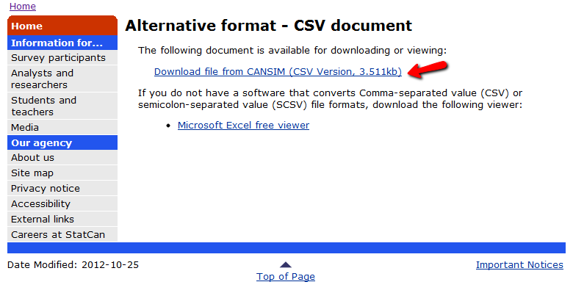
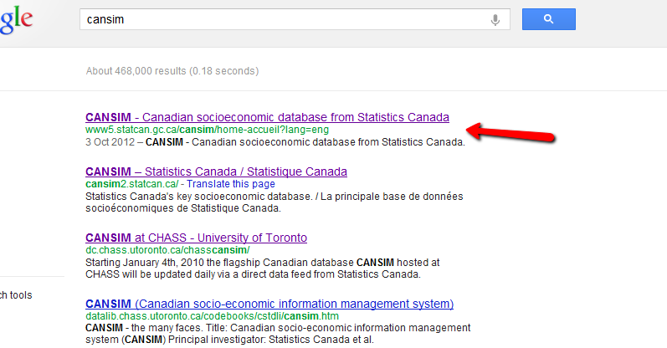
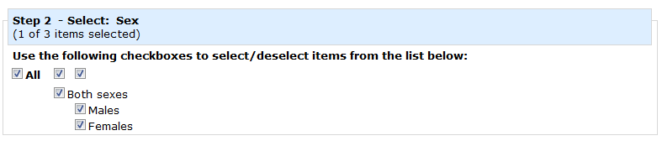
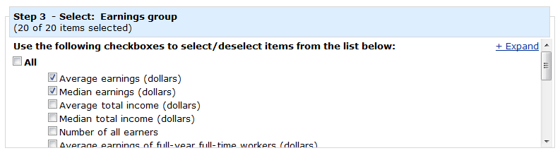
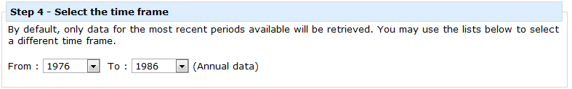
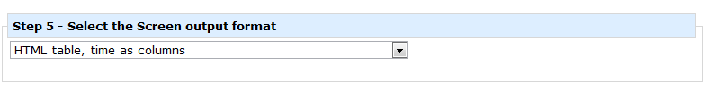

CANSIM

Slide 6
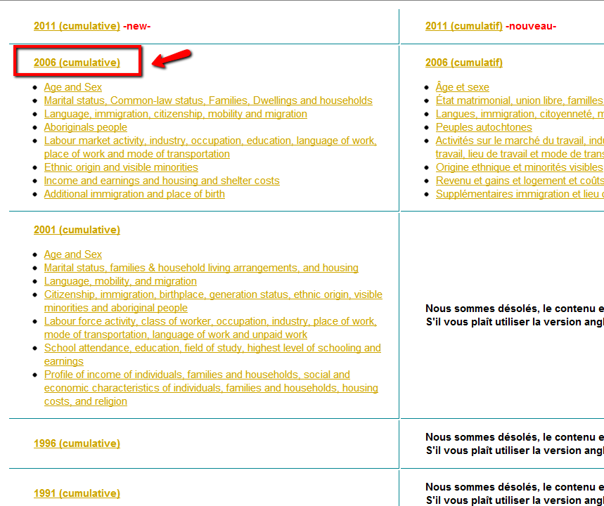
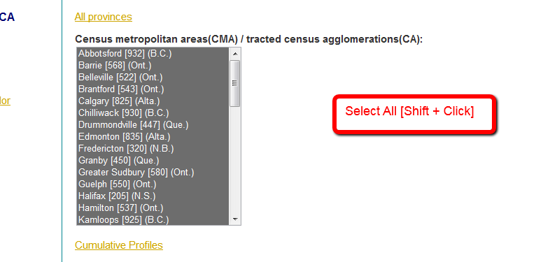
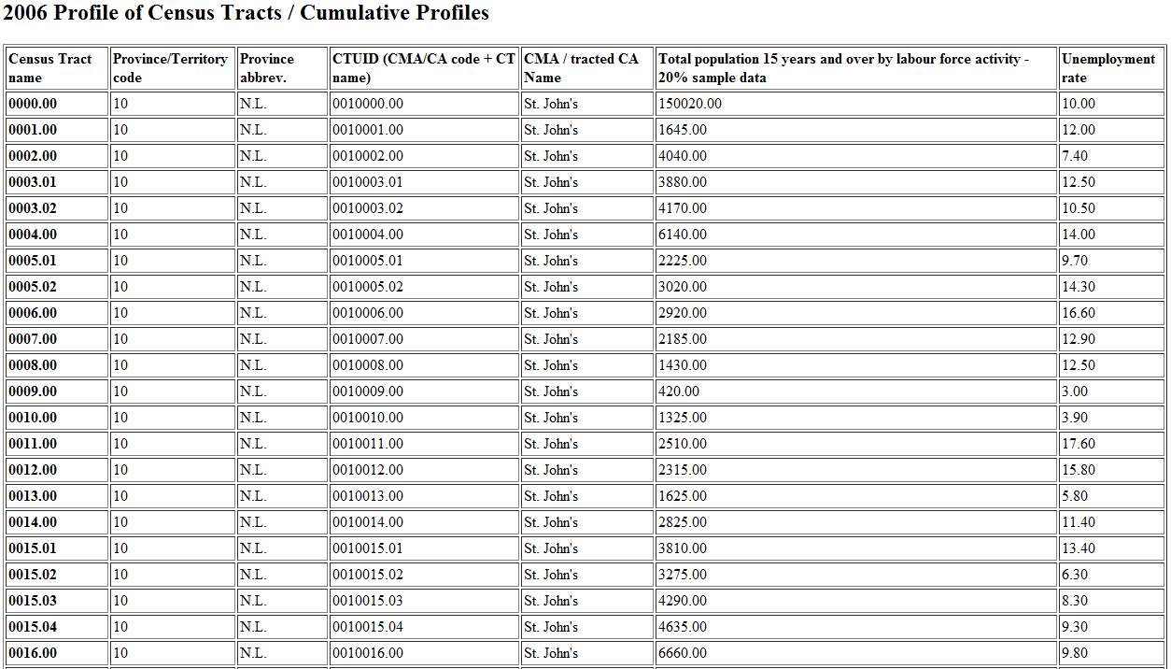
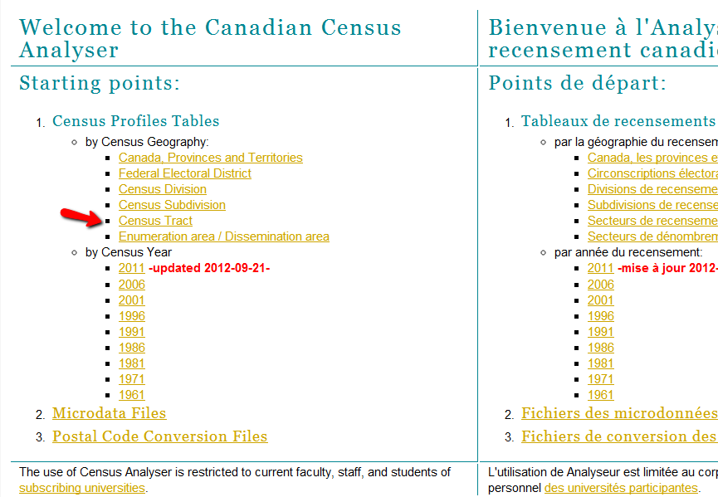
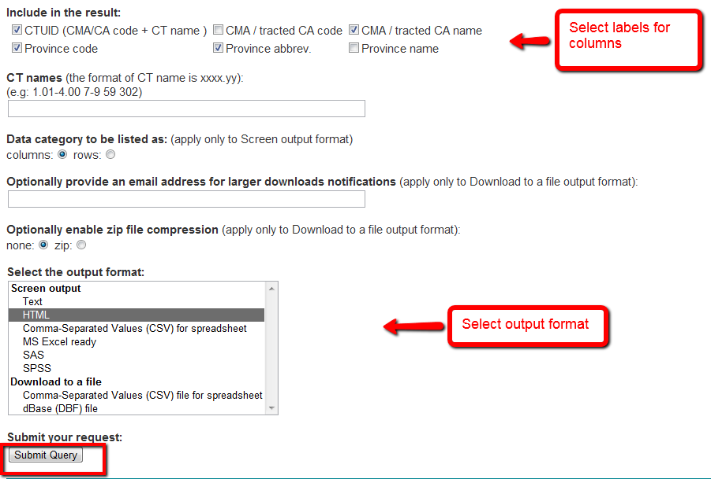
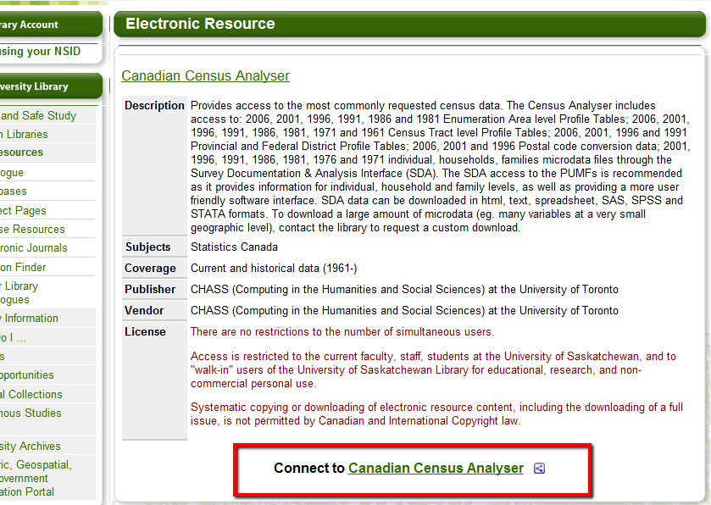
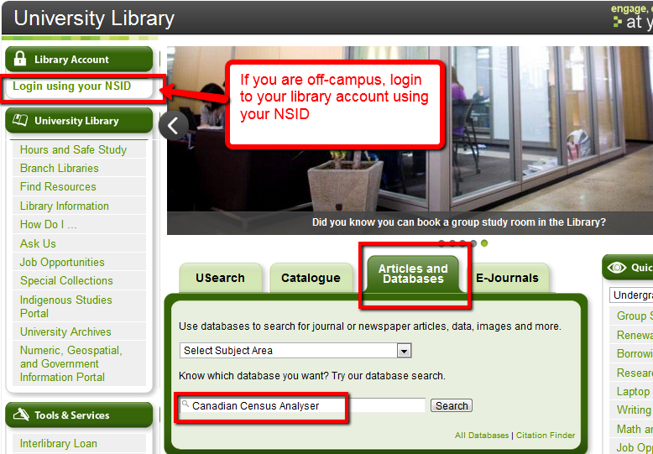
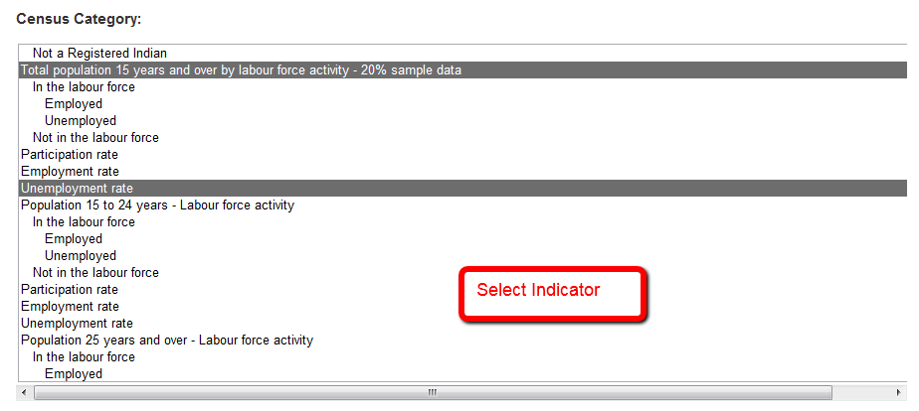
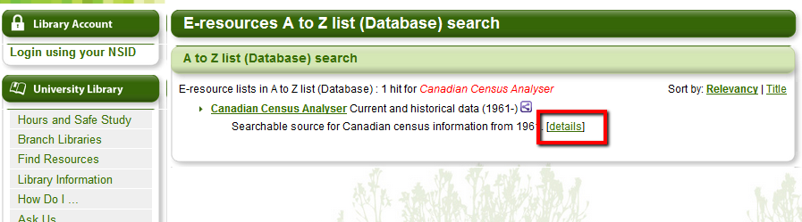
Census
Use Canadian Census Analyser
Data can be extracted at different levels of census geography (Provinces, Census Tracts, Federal Electoral Districts, etc.)
Data available for every census year (every five years)

Slide 7
Contact Us
Sunny Kaniyathu
306 966 8841; sunny.kaniyathu@usask.ca
Winnie Smit
306 966 7261; winnie.smit@usask.ca

