Slide 1

Tenure and Promotion Workshop
May 17, 2012

Slide 2
Agenda
Welcome and Introductions – Ken Reeder
Opening Remarks – David Farrar and Nancy Langton
Guide to Tenure & Promotion – Deena Rubuliak & Mark Trowell
Senior Appointments Committee – Susan Boyd
Key Insights – Fran Watters
Questions and Discussion

Slide 3
Our Objective
To provide faculty members with an understanding of the tenure and promotion processes.
To support the success of faculty members going forward for tenure and promotion.

Slide 4
Tenure & Promotion
Tenure Streams
Criteria
Tenure & Tenure Clocks
Promotion Reviews
Schedules
Procedures
For Assistance…

Slide 5
The Tenure Streams
The Professor Stream
Assistant Professor Associate Professor Professor
Instructor II
The Instructor Stream
Instructor I Senior Instructor Professor of Teaching

Slide 6
The Criteria
The Professor Stream
The Instructor Stream
Service
Service
Research
Teaching
Teaching

Slide 7
The Tenure Clock
The tenure clock begins on July 1 of the calendar year of hire
Extensions are granted for maternity & parental leaves (automatic) and sick leaves (on a case by case basis)
An individual may only be reviewed one time for tenure
All ranks, except Assistant Professor, may be reviewed early for tenure
A tenure track Assistant Professor may be reviewed early for promotion to Associate Professor and if granted, tenure will be automatic

Slide 8
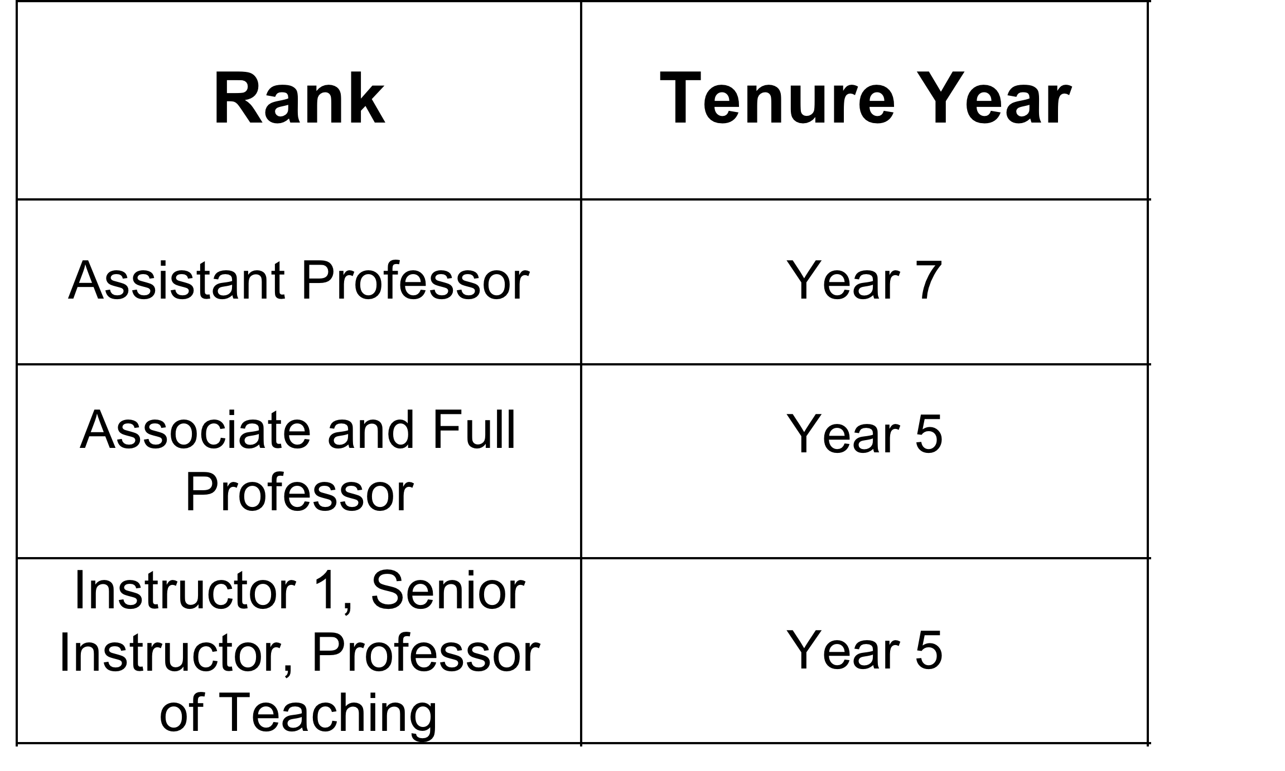
The Tenure Clock

Slide 9
The Procedures
The reappointment, tenure & promotion
procedures are set out in Articles 5 & 9 of
the Agreement on Conditions of
Appointment for Faculty, and are
supplemented by the Guide to Reappointment, Tenure and Promotion Procedures at UBC

Slide 10
Tenure and Promotion Clock

Slide 11
Head’s Meeting
By June 30, the Head must meet with all tenure track faculty annually.
For tenured faculty, we encourage annual meetings or, at minimum, at least in the 2 years prior to a promotion review.

Slide 12
Head’s Meeting
It’s an opportunity to clearly note the strengths, deficiencies and opportunities for improvement
It is also important to receive advice re the CV & other relevant material required for the next review.
The Head & candidate must agree in writing on matters discussed.

Slide 13
The Initial File
Unless otherwise agreed, the faculty member’s dossier and all relevant documentation necessary for review must be submitted by September 15.

Slide 14
Eligibility to be Consulted
The Head must consult with eligible members of the departmental standing committee on all reappointment, tenure and promotion cases.
Each Academic Unit is required to have documented procedures regarding consultation with the departmental standing committee for all reappointment, tenure and promotion cases.

Slide 15
Letters of Reference
All tenure and promotion cases require 4 letters of reference.
The candidate provides 4 names, of which 2 must be solicited.
The Head then consults with the departmental standing committee on choosing the final list of referees.

Slide 16
Letters of Reference: must be arm’s length
What does arm’s length mean?
Persons whose impartiality cannot be doubted. They are not normally expected to include such categories as relatives, close personal friends, clients, current or former colleagues, former thesis advisers, research supervisors, grant co-holders or co-authors.

Slide 17
What referees receive
The letter of request is only accompanied by the candidate’s CV and selected materials relevant for the assessment of scholarly achievements.
Teaching dossiers are usually only included for Senior Instructor cases.

Slide 18
Tenure & Promotion Reviews
Department Standing Committee meets after obtaining letters of reference
Department Standing Committee votes & recommends to Head
Serious concerns?
No
Yes
Invited to respond in writing to serious concerns

Slide 19
Tenure & Promotion Reviews
Head recommends to Dean
Head notifies candidate in writing of decision
Negative?
Yes
Invited to respond in writing to Dean

Slide 20
Tenure & Promotion Reviews
Dean seeks Faculty Committee vote
Dean recommends to President*
Dean notifies candidate of decision
Negative?
Yes
Invited to respond in writing to President

Slide 21
Supplementing the File
The University and the candidate have the right to supplement the file with new info up to the stage of the President’s decision

Slide 22
For Assistance…
The Collective Agreement, in particular Articles 2-5 & 9 of the Agreement on Conditions of Appointment for Faculty
Guide to Reappointment, Tenure and Promotion Procedures at UBC for 2011/12
Faculty Relations website: www.hr.ubc.ca/faculty_relations/tenure/
Faculty Association website:
www.facultyassociation.ubc.ca/promotiontenure.php
Call us!

Slide 23
Senior Appointments Committee
Professor Susan Boyd, SAC Chair

Slide 24
SAC Terms of Reference
Advise the President on the merits of individual cases with respect to promotion and tenure according to
Concepts of procedural fairness
The Collective Agreement, informed by UBC policy and SAC guidelines
Appropriate standards of excellence across and within faculties and disciplines
All relevant contextual matters
(Article 5.14 Agreement)

Slide 25
SAC: Committee Structure
Full SAC is a 20 person committee with representation from all Faculties
All are Professors
At least 2 members from UBCO
One member from the Faculty Association
See SAC Guide Article 10

Slide 26
SAC Subcommittees
Each candidate’s file reviewed in detail for merits & fairness by one of two SAC subcommittees
meetings twice a month
If satisfactory, case ranked “A” and forwarded to full SAC for approval (meets twice a month)
(Appendix 10 Guide)

Slide 27
SAC Subcommittee Review: Ranking
Ranking may be deferred pending
Receipt of additional information or clarification from Dean
Resolution of procedural concern by Faculty Relations

Slide 28
SAC Subcommittee Review
Cases ranked “B” are referred to full SAC for discussion with Dean
About 1/4 of all cases, including:
Cases with a negative recommendation from the Head or the Dean
Where SAC members feel case warrants a full discussion

Slide 29
SAC Process: Full Committee Review
“A” cases generally approved without discussion by full SAC
“B” case questions are sent to Dean
Dean joins full SAC for discussion of the case
Vote taken in Dean’s absence
Dean informed of result

Slide 30
SAC Process
Chair informs President of SAC recommendation and vote on each case
Chair also provides President notes on SAC discussion with the Dean regarding “B” cases

Slide 31
SAC Process
SAC recommendation and vote confidential
President reviews case and makes independent recommendation to Board
Note: this is a very paper-driven process!

Slide 32
Criteria: Senior Instructor A. 3.04
Old Agreement: “excellent teachers”
New Agreement:
excellence in teaching
demonstrated educational leadership
involvement in curriculum development and innovation
and other teaching and learning initiatives.

Slide 33
Professor of Teaching A. 3.05
outstanding achievement in teaching and educational leadership
distinction in the field of teaching and learning
sustained and innovative contributions to curriculum development, course design and other initiatives

Slide 34
Assistant Professor A. 3.06
evidence of ability in teaching and scholarly activity
involved in scholarly activity
is a successful teacher
is capable of providing instruction at the various levels

Slide 35
Associate Professor A. 3.07
evidence of successful teaching and scholarly activity beyond that expected of an Assistant Professor
Teaching effectiveness A. 4.02
sustained and productive scholarly activity
ability to direct graduate students
willingness to participate and participation in the affairs of the Department and the University

Slide 36
Tenure A. 4.01
granted to individuals who have maintained a high standard of performance and show promise of continuing to do so.
judged principally on performance in both teaching and in scholarly activity
Service is important, but cannot compensate for deficiencies in teaching and in scholarly activity
Competence is required both in teaching and in scholarly activity

Slide 37
Professor A. 3.08
reserved for those whose contributions are considered outstanding
met appropriate standards of excellence and have wide recognition in the field of their interest
high quality in teaching
sustained and productive scholarly activity
attained distinction in their discipline
participated significantly in academic and professional affairs

Slide 38
Frequent SAC Issues
Curricula vitae
External referee letters
Professional contributions
Scholarship of teaching
Teaching documentation

Slide 39
Curricula Vitae
Use UBC format; adapt as needed (see annotated version in Guide)
Avoid duplication
Explain contributions to collaborative grants & co-authored publications
Use narrative opportunities to provide context for teaching & scholarship
150 words max!
Updates: use clear, concise, dated supplements

Slide 40
External Referee Letters
Choose well-qualified, arm’s length referees, preferably from universities/programs with stature comparable to UBC
Provide information on referees to Head
Note: If Head is a co-author with candidate, someone else must write to referees

Slide 41
Scholarly Contributions
"Scholarly activity" means (A. 1.01):
research of quality and significance;
in appropriate fields, distinguished, creative or professional work of a scholarly nature;
and the dissemination of the results of that scholarly activity
(Article 4.03 Agreement)

Slide 42
“Traditional” Scholarship SAC Guide 3.1.5
Ensure that your Head understands publishing norms in your field and your contributions to your field
Refereed journals? Conference proceedings?
Quality of venues?
Quantity?
Impact
Are there accepted top tier venues?
Is a monograph required?
Is co-authorship expected; with grad students?
Are grants expected or needed to support your research?

Slide 43
Professional Contributions A. 4.03(b)
May constitute a portion or all of scholarly activity
“distinguished” architectural, artistic or engineering design/performance in arts or professional fields
Professional/clinical:
Significant applications of fundamental theory; or
Significant forms & applications of professional or clinical practice
Not routinely available from professionals in field

Slide 44
Professional Contributions Guide 3.1.12→
Explicitly recognize and consider from outset and at all levels of review
Must be capable of assessment by referees
Referee’s assessment of professional contributions and significance is critical
Leader or outstanding stature/rare expertise
Impact/reputation beyond UBC

Slide 45
Scholarship of Teaching A. 4.03(a)
evidenced by originality or innovation, demonstrable impact in a particular field or discipline, peer reviews, dissemination in the public domain, or substantial and sustained use by others;
Examples: textbooks/curriculum reform that change academic understanding or way a field is taught;
Not textbooks or curriculum revision of a routine nature

Slide 46
Scholarship of Teaching Guide 3.1(ii)
May constitute a portion or all of scholarly activity
Often disseminated in published form
Broad contributions to the improvement of teaching and learning
Beyond excellence in teaching
Original, innovative, impact and change field, substantial and sustained use by others

Slide 47
Scholarship of Teaching
Explicitly recognize and consider from outset and at all levels of review
Referee’s assessment of contributions, impact and stature is critical, especially if work is not refereed
Demonstrate leader or outstanding stature or expertise

Slide 48
Teaching A. 4.02
Effectiveness primary criterion, not popularity
Command over subject matter
Familiarity with recent developments
Preparedness & presentation
Accessibility to students
Influence on intellectual & scholarly development of students
Willingness to teach range of subject matter and levels

Slide 49
Teaching Documentation Guide A. 3.2.1→
Identify norms in unit
All substantial contributions must be documented and evaluated
Quantitative and qualitative summary and assessment of
All teaching responsibilities
Student and peer evaluations
Graduate student supervision
Other teaching contributions, accomplishments, awards, etc.

Slide 50
Key Insights
Importance of Teaching
Scholarly Activity
Fairness of Review Process

Slide 51
Closing Questions??
As always…..
Please check the Faculty Relations website, email, or call
Contact the Faculty Association for assistance
Thank you!!

