Slide 1
ECE 720T5 Fall 2012 Cyber-Physical Systems
Rodolfo Pellizzoni

Slide 2
Today’s Outline
Cyber-Physical Systems: different views
Intro to Real-Time Systems
Some knowledge of Real-Time is needed to read the papers.
Get people with no experience in Real-Time Systems up to speed!
One lecture only, so no time to go into details – please stop me if you don’t get it!

Slide 3
Administrative Matters
If you are taking the course for credit: by this Friday, please email me and let me know which track you wish to follow.
Applied track: schedule a meeting next week to get you started on the project (suggested: Thursday 27).
Research track: if you are looking for research ideas on the project, please contact me asap. Otherwise, we will schedule a meeting on the week of October 1 (proposal due Oct 8 early morning).

Slide 4
Cyber-Physical Systems: Different Views
Edward Lee. CPS: Design Challenges
Abstraction problem
Concurrent programming languages and timing models?
Redesign embedded architectures?

Slide 5
Intro to Real-Time Systems
Rodolfo Pellizzoni

Slide 6
Outline
Introduction and Task Model
Uniprocessor Real-Time Scheduling
Priority Inversion and Resource Sharing
Aperiodic Task Scheduling
Multiprocessor Scheduling
The End-to-End Delay Problem
Scheduling and Control Quality

Slide 7
Books
J. Liu: Real-Time Systems. Prentice Hall, 2000.
Best as an intro book, less good as a reference.
G.C. Buttazzo: Hard Real-Time Computing Systems: Predictable Scheduling Algorithms and applications. Springer, 2004.
Good reference on real-time scheduling.
No good book reference for multiprocessor systems.

Slide 8
Outline
Introduction and Task Model
Uniprocessor Real-Time Scheduling
Priority Inversion and Resource Sharing
Aperiodic Task Scheduling
Multiprocessor Scheduling
The End-to-End Delay Problem
Scheduling and Control Quality

Slide 9
Real-Time Systems
The correctness of the system depends not only on the logical result of the computation but also on the time at which the results are produced.
A correct value at the wrong time is a fault.
Processes attempt to control or react to events that take place in the outside world
These events occur in “real time” and tasks must be able to keep up with them
Processes are associated with timing constraints (deadlines)

Slide 10
Soft vs Hard Real-Time
Soft real-time: missing deadlines is undesirable, but will not lead to catastrophic consequences
Related to the concept of “Quality of Service”
Typically interested in average-case response time (turnaround time)
Ex: reservation systems, media players, phones, etc.
Hard real-time: missing deadlines is not an option
Interested in worst-case response time
Ex: airplanes, nuclear plants, military systems, etc.
However, more on control performance later…

Slide 11
Real-Time Spectrum
No RT
Soft RT
Hard RT
Computer simulation
User interface
Internet video, audio
Tele communication
Flight control

Slide 12
Task Model
Task: a real-time computation unit
Think of it as an execution thread with additional timing parameters (in particular: service time is known).
The job of the real-time scheduler is to schedule tasks.
Three main task models:
Aperiodic
Periodic
Sporadic

Slide 13
Aperiodic Tasks
Event-triggered computation.
Task is activated by an external event.
Task runs once to respond to the event.
Relative deadline D: available time to respond to the event.
Ex: event = loss of power. Task = drop control rods into nuclear reactor (this actually happened at Fukushima)

Slide 14
Periodic Task
Time-triggered computation
Task is activated periodically every T time units.
Each periodic instance of the task is called a job.
Each job has the same relative deadline (usually = to period).
Ex: most digital controllers.
Sporadic task: same as periodic task, but the task is activated at most every T time units (minimum interarrival time).
Ex: processing network packets.

Slide 15
Periodic Task – Main Concepts
Task τ_{i} (N tasks in the system, τ₁ to τ_{N})
Execution time C_{i} (sometimes e_{i})
Relative deadline D_{i}
Period T_{i} (sometimes p_{i})
Each job τ_{ij} of τ_{i} (first job: τ_{i0})
Activation time a_{ij} = a_{ij-1} + T_{i} (usually with a_{i0} = 0)
Sporadic: a_{ij} >= a_{ij-1} + T_{i}
Absolute deadline d_{ij} = a_{ij} + D_{i}

Slide 16
Periodic Task – Main Concepts
Task τ_{i} (N tasks in the system, τ₁ to τ_{N})
Execution time C_{i} (sometimes e_{i})
A good portion of the course: How do we compute this?

Slide 17
Periodic Task Model
a_{i0}=0
d_{i0}=8
a_{i1}=10
d_{i1}=18
a_{i2}=20
τ_{i0}
τ_{i1}
τ_{i}
0
10
20
t
C_{i}=3
response time for job#1: 6
D_{i}=8
T_{i}=10

Slide 18
Utilization & Schedulability Analysis
Task Utilization for a periodic/sporadic task: U_{i} = C_{i} / T_{i}.
Percentage of processor time required by the task.
System Utilization: U = U₁ + U₂ + … + U_{N}.
Percentage of processor time required by all tasks.
Base uniprocessor scheduling result: task set is clearly not schedulable if: U > 1.
For many scheduling algorithms, we can define a utilization bound U_{b} such that the task set if schedulable if: U <= U_{b}.

Slide 19
Other Details on the Analysis…
For a scheduling algorithm to be useful, it must be associated with a schedulability analysis.
Sufficient analysis: if analysis says YES, then task set is schedulable by the given algorithm. If the analysis says NO, we do not know.
Necessary analysis: if analysis says NO, then we know that there exists a valid scenario in which the task set misses a deadline.
Offline analysis: task set is decided before the system starts. Run schedulability analysis offline.
Admission control: new tasks can arrive at run-time. Run schedulability analysis on-line and admit new task only if all tasks can still meet deadlines

Slide 20
Other Details on the Task Set…
Jitter J_{i}: job τ_{ij} will be activated in the time window [a_{ij} , a_{ij} + J_{i}].
Can model unpredictability in the activation time or precedence constraints.
Synchronous task set: all jobs τ_{i0} are activated simultaneously at a_{i0} = 0.
In many cases this corresponds to the worst-case response time (critical instant).
a_{i0} is the offset of τ_{i0}.
Asynchronous task set: if a_{i0} != 0 for some task.
If we do not specify: Offset free - we do not know the a_{i0} (in which case, assume the worst case).

Slide 21
The Simplest Model
We first look at the simplest possible model, where:
All tasks are periodic
Single processor
Tasks do not share any resource
Not very realistic, but instructive (we have simple results)!
We will then (briefly) look at:
What happens when you start sharing resources
What happens if you schedule a mix of periodic/aperiodic tasks.
What happens if you use a multiprocessor
More complex task models

Slide 22
Outline
Introduction and Task Model
Uniprocessor Real-Time Scheduling
Priority Inversion and Resource Sharing
Aperiodic Task Scheduling
Multiprocessor Scheduling
The End-to-End Delay Problem
Scheduling and Control Quality

Slide 23
Uniprocessor Periodic Scheduling
Three main scheduling categories
Table-based scheduling
Build a table that dictates when each task executes
Problem: only works for periodic tasks
Problem: only works for off-line analysis
Sometimes the best choice for more complex task models
Fixed-priority scheduling
Each task is assigned a fixed priority
Dynamic-priority scheduling
Task priority varies at run-time (ex: each job of the task has a different priority)
Scheduler is typically preemptive – better system utilization

Slide 24
Rate-Monotonic Scheduling
Fixed-priority scheduling algorithm
Assumes periodic or sporadic tasks with D_{i} = T_{i} on a uniprocessor.
Assigns priorities to tasks on the basis of their periods: shorter period = higher priority.
Liu & Layland schedulability analysis: task set is schedulable if: U <= U_{b}(N) = N(2^{1/N} – 1)
Note that lim_{N->+inf} N(2^{1/N}-1) = log 2 ~= 0.693
What happens if U_{b}(N) < U <= 1?
Nothing can be said according to the analysis
Task set might or might not be schedulable

Slide 25
RM Example
Worst-case response time is produced when a_{i0} = 0.
Case#1:
τ₁ (C1 = 4, T1 = 8), high prio, τ₂ (C2 = 3, T1 = 12), low prio
Utilization: U = 4/8 + 3/12 = 0.75 < Ub(2) ~=0.828
Schedulability analysis: schedulable
τ₁
t
τ₂
0
10
20
t

Slide 26
RM Example
Case#2:
τ₁ (C1 = 4, T1 = 8), high prio, τ₂ (C2 = 4, T1 = 12), low prio
Utilization: U = 4/8 + 4/12 ~= 0.833 > Ub(2) ~=0.828
Schedulability analysis: we do not know
In reality: it is schedulable
τ₁
t
τ₂
0
10
20
t

Slide 27
RM Example
Case#3:
τ₁ (C1 = 4, T1 = 8), high prio, τ₂ (C2 = 6, T1 = 12), low prio
Utilization: U = 4/8 + 6/12 = 1 > Ub(2) ~=0.828
Schedulability analysis: we do not know
In reality: it is not schedulable
τ₁
t
τ₂
0
10
20
t
deadline miss

Slide 28
Earliest-Deadline First
Dynamic-Priority Scheduling Algorithm
Task priority is inversely proportional to its current absolute deadline
Earlier deadline = higher priority
Each job of a task has a different deadline, hence a different priority.
Assumes synchronous or offset-free periodic or sporadic tasks with D_{i} = T_{i} on a uniprocessor, then…
Schedulability analysis: the task set is schedulable if: U <= Ub = 1
Since task sets with U > 1 can not be scheduled by any algorithm, EDF is optimal

Slide 29
EDF Example
Case#3:
τ₁ (C1 = 4, T1 = 8), τ₂ (C2 = 6, T1 = 12)
Utilization: U = 4/8 + 6/12 = U_{b} = 1
Schedulability analysis: schedulable
τ₁
t
τ₂
0
10
20
t

Slide 30
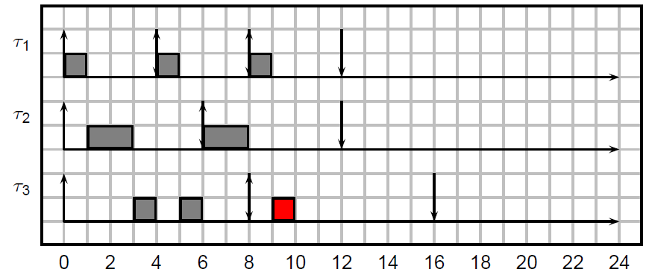
Another Example
τ₁ (C1 = 1, T1 = 4), τ₂ (C2 = 2, T1 = 6), τ₃ (C3 = 3, T3 = 8)
Utilization: U = 1/4 + 2/6 + 3/8 = 23/24
RM: don’t know (utilization bound), in reality: not schedulable

Slide 31
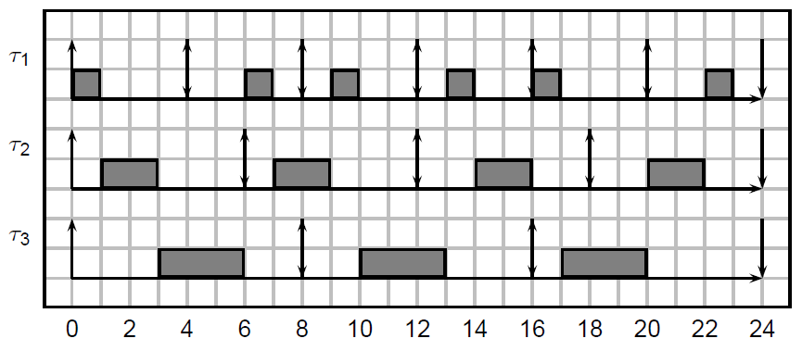
Another Example
τ₁ (C1 = 1, T1 = 4), τ₂ (C2 = 2, T1 = 6), τ₃ (C3 = 3, T3 = 8)
Utilization: U = 1/4 + 2/6 + 3/8 = 23/24
EDF: schedulable

Slide 32
EDF vs RM
In practice, industrial systems heavily favor RM over EDF. Why?
For most task sets, RM has better utilization bound than log 2.
There are more complex, necessary analysis.
If task periods are harmonic (every period is an integer divisor of any larger period), then U_{b} = 1. This happens often in practice.
RM is easier to implement in systems with limited number of priority levels.
RM is more transparent – easier to understand what is going on if something goes wrong (ex: overload).
I.e. if a task executes for longer than its prescribed worst-case time, higher priority tasks will be left untouched.

Slide 33
Different deadlines assignments
What happens if D_{i} != T_{i} ?
EDF still optimal.
Instead of RM, use DM – deadline monotonic (best among fixed priority algorithms).
If D_{i} < T_{i} , utilization bound still works by changing periods to deadlines in the formula – however this is pessimistic.
There exist exact schedulability analyses for both EDF and fixed priority that can be applied whatever the deadline – but they are pseudo-polynomial.
There are also analyses for asynchronous task sets – but exact analysis is exponential.

Slide 34
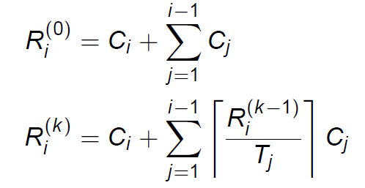
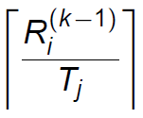
Fixed Priority – Exact Analysis
Iterative solution. Tasks ordered by decreasing priority.
R_{i}^{(k)} : worst-case response time for τ_{i} at step k.
If the iteration converges -> fixed point represents the worst-case response time for the task.
Key idea: is the max # of jobs of τ_{j} that interferes with τ_{i}

Slide 35
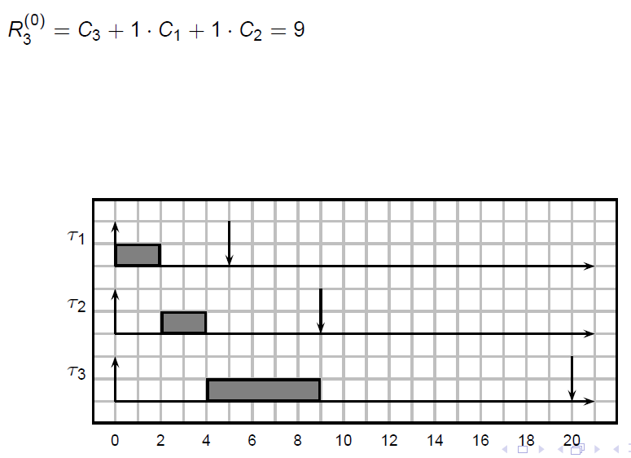
Fixed Priority – Exact Analysis
τ₁ (C1 = 2, T1 = 5), τ₂ (C2 = 2, T1 = 9), τ₃ (C2 = 5, T1 = 20); U = 0.872 > Ub(3) = 0.780

Slide 36
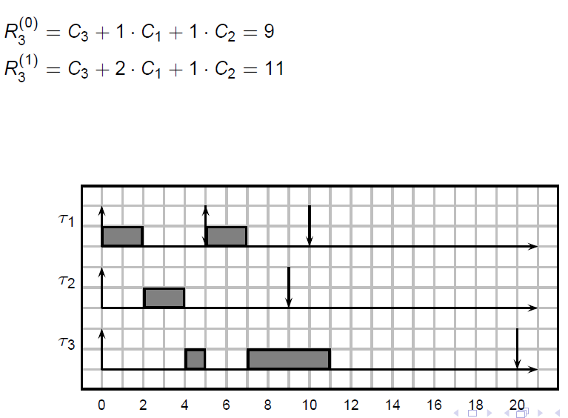
Fixed Priority – Exact Analysis
τ₁ (C1 = 2, T1 = 5), τ₂ (C2 = 2, T1 = 9), τ₃ (C2 = 5, T1 = 20); U = 0.872 > Ub(3) = 0.780

Slide 37
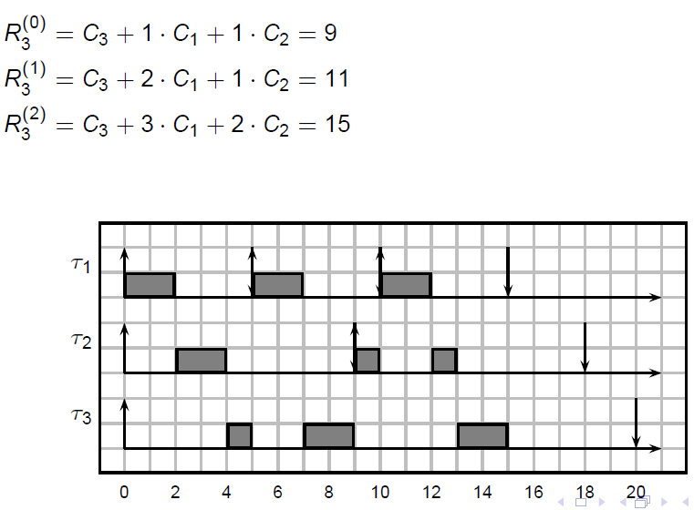
Fixed Priority – Exact Analysis
τ₁ (C1 = 2, T1 = 5), τ₂ (C2 = 2, T1 = 9), τ₃ (C2 = 5, T1 = 20); U = 0.872 > Ub(3) = 0.780

Slide 38
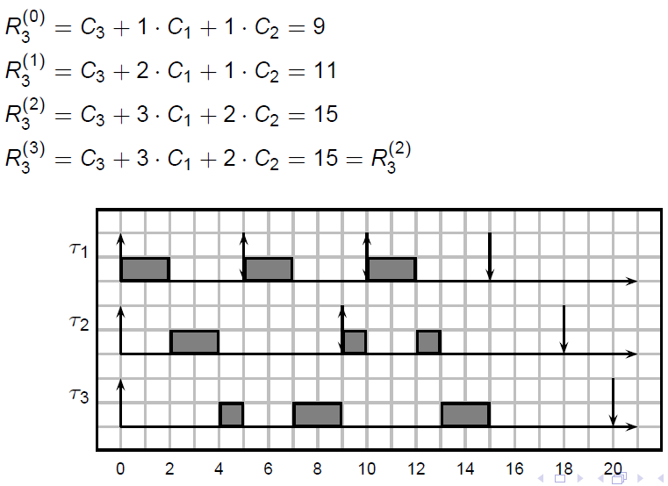
Fixed Priority – Exact Analysis
τ₁ (C1 = 2, T1 = 5), τ₂ (C2 = 2, T1 = 9), τ₃ (C2 = 5, T1 = 20); U = 0.872 > Ub(3) = 0.780

Slide 39
Outline
Introduction and Task Model
Uniprocessor Real-Time Scheduling
Priority Inversion and Resource Sharing
Aperiodic Task Scheduling
Multiprocessor Scheduling
The End-to-End Delay Problem
Scheduling and Control Quality

Slide 40
Mutual Exclusion and Priority Inversion
Real-time tasks often communicate through shared memory.
Each shared data structure is called a resource.
Mutual exclusion is enforced by semaphores protecting critical sections A, B, … (sometimes S₁, …, S_{K}).
Priority inversion: high prio task is blocked (waits for) low prio task.
Priority inversion is inevitable…
… but if we use normal semaphores, we get unbounded priority inversion.

Slide 41
Unbounded Priority Inversion
High prio task is delayed by execution of tasks outside critical sections.
w(A): lock semaphore (wait). s(A): unlock semaphore (signal).
: resource A
w(A)
s(A)
τ₁
t
τ₂ blocks τ₁!
τ₂
t
w(A)
s(A)
τ₃
0
10
20
t

Slide 42
Unbounded Priority Inversion
Is this a problem?
Yes! Mars Pathfinder crashed because of it.
Luckily, they “patched” the OS remotely.
: resource A
w(A)
s(A)
τ₁
t
τ₂ blocks τ₁!
τ₂
t
w(A)
s(A)
τ₃
0
10
20
t

Slide 43
Basic Priority Inheritance Protocol
Works for fixed-priority scheduling (ex: RM).
While τ_{i} blocks higher priority task τ_{j}, τ_{i} inherits the priority of τ_{j}.
Inheritance is transitive
If τ_{k} blocks τ_{i,} τ_{k} inherits the priority of τ_{j} through τ_{i.}
Avoids both unbounded priority inversion and deadlock (the latter only if there are no nested resources).

Slide 44
Example Priority Inheritance Protocol
: resource A
w(A)
s(A)
τ₁
t
τ₃ inherits
τ₁ priority
τ₂
t
w(A)
s(A)
τ₃
0
10
20
t

Slide 45
Example Priority Inheritance Protocol
τ₂ suffers indirect blocking here – blocked by τ₃ because of a resource shared with τ₁
: resource A
w(A)
s(A)
τ₁
t
τ₂
t
w(A)
s(A)
τ₃
0
10
20
t

Slide 46
Nested Resources
: resource A
w(B)
s(B)
: resource B
τ₁
τ₂
w(B)
w(A)
s(A)
s(B)
τ₃
t
t
w(A)
τ₁ prio
s(A)
τ₃ prio
τ₄
0
Note τ₄ gets
τ₁ priority through transitive inheritance!
20
t
τ₄ prio
τ₁ prio

Slide 47
Double Blocking
τ₁ blocked by τ₂
τ₁ blocked by τ₃
: resource A
: resource B
w(B)
s(B)
w(A)
s(A)
τ₁
w(B)
s(B)
τ₂
t
t
w(A)
s(A)
τ₃
0
20
t

Slide 48
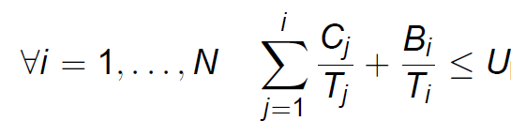
PIP - Analysis
A task can be blocked at most once on each resource
A task can be blocked for at most the duration of a single critical section by each lower priority task.
Iterative procedure can be used to compute the blocking time B_{i} for each task based on the rules…
For FP with D_{i} = T_{i} , sufficient schedulability analysis:

Slide 49
Improving PIP
Problem: under PIP a task can be blocked multiple times.
Solution: restrict the ability of a middle-priority task from entering critical section.
Ex: Stack Resource Policy (also known as Immediate Priority Ceiling Protocol)
Each resource is assigned a ceiling equal to the highest priority of any task using the resource
A task can preempt lower priority tasks only if its priority is higher than the ceiling of all locked resources.
Essential property: a task can be blocked by at most one critical section.
Also works for EDF (with ceiling = 1/D_{i})

Slide 50
Double Blocking
τ₂ blocked by τ₃
: resource A
: resource B
τ₁ blocked by τ₂
w(B)
w(A)
s(A)
s(B)
τ₁
w(B)
s(B)
τ₂
t
t
w(A)
s(A)
τ₃
0
20
t
Ceiling of both resource = priority of τ₁

Slide 51
Outline
Introduction and Task Model
Uniprocessor Real-Time Scheduling
Priority Inversion and Resource Sharing
Aperiodic Task Scheduling
Multiprocessor Scheduling
The End-to-End Delay Problem
Scheduling and Control Quality

Slide 52
Aperiodic Tasks
What happens if we mix aperiodic and periodic tasks?
Main idea: ensure that periodic tasks remain schedulable no matter what.
Aperiodic server
Insert aperiodic tasks into a queue (server)
Scheduler picks among periodic tasks or the aperiodic server
τ₁
…
τ_{i}
Schedulerr
Processor
…
τ_{N}
Aperiodics
Server

Slide 53
Aperiodic Servers
Server Goals:
Minimize response time of aperiodic tasks
Low overhead
Solution#1: background server
Execute aperiodics whenever the CPU is not running a periodic task (i.e., the server has lowest priority)
Problem: response time can be very high.

Slide 54
Aperiodic Servers
Solution#2: budget-based server
Server is assigned budget Q_{i} and period T_{i}.
The server behaves like a periodic task with C_{i} = Q_{i} and period T_{i}.
When the scheduler picks the server, if there is budget left, the server executes an aperiodic in the queue consuming its budget.
When budget = 0, server waits until the next period, then replenish the budget to Q_{i}.
Problem: what happens if the scheduler picks the server and there are no queued aperiodic tasks?
“Dumb” servers (polling server) lose budget.
“Smart” servers (ex: sporadic server) keep the budget but modify their activation (recharge) time.

Slide 55
Polling Server
τ₁
t
server
t
τ₃
t
T₂ = 8
drop all budget
immediately
budget
Q₂ = 2
1
0.5
t
2
wait replenishment
aperiodics
t
55

Slide 56
Sporadic Server
τ₁
t
server
t
τ₃
t
consume budget when
no higher priority task
is running
T₂ = 8
budget
Q₂ = 2
1
0.5
t
2
aperiodics
t
56
Notes:
There are additional rules not covered here…
You can think of the server as executing tau_3 in [9,9.5] – it’s essentially donating budget to a lower priority task

Slide 57
Outline
Introduction and Task Model
Uniprocessor Real-Time Scheduling
Priority Inversion and Resource Sharing
Aperiodic Task Scheduling
Multiprocessor Scheduling
The End-to-End Delay Problem
Scheduling and Control Quality

Slide 58
Scheduling on Multiprocessor
Two solutions for scheduling real-time tasks on multiprocessors.
Solution #1: partitioning
Statically assign tasks among M processors.
Ex: EDF. Each core is schedulable if sum of utilizations of tasks assigned to that core <= 1.
Problem can be rephrased as: given a set of objects with known sizes (task utilizations), place them into M equal-size containers.
Classic bin-packing problem – NP-hard.

Slide 59
Scheduling on Multiprocessor
Solution #2: global scheduling
Keep a global scheduling queue.
Whenever there is a free core, pick one task from the queue and schedule it on the core.
In practice, real-time adoption of multiprocessor is limited, especially for hard systems.
Partitioned scheduling preferred – three issues with global scheduling
Increases unpredictability – tasks can migrate among cores
Much more complex to implement
Does not necessarily perform better than partitioned

Slide 60
Global Scheduling
Problem: both fixed-priority and EDF scheduling perform poorly when there are long tasks.
: Processor A
We are wasting one processors here
: Processor B
τ₁
t
τ₂
t
τ₃ is barely schedulable (EDF)
τ₃
0
10
t

Slide 61
Global Scheduling
Optimal algorithm: p-fair.
Split the tasks into small chunks.
Allocate them on the cores in a “fair” way.
τ₁ (6,9)
t
: Processor A
τ₂ (6,9)
t
: Processor B
τ₃ (6,9)
0
9
t

Slide 62
Global Scheduling
Pros: task set schedulable on M cores iff U <= M ; the algorithm is optimal.
Cons: this does not take into account the cost of preemption and migration.
τ₁ (6,9)
t
: Processor A
τ₂ (6,9)
t
: Processor B
τ₃ (6,9)
0
10
t

Slide 63
Scheduling on Multiprocessor
Some other details…
There are several (only sufficient) schedulability analyses for EDF and FP – both based on utilization bounds and response time…
There are extensions for resource sharing protocols and aperiodic servers to multicores…
Very active research topic, but often ignores the main problem – how do we determine the worst-case computation time?

Slide 64
Outline
Introduction and Task Model
Uniprocessor Real-Time Scheduling
Priority Inversion and Resource Sharing
Aperiodic Task Scheduling
Multiprocessor Scheduling
The End-to-End Delay Problem
Scheduling and Control Quality

Slide 65
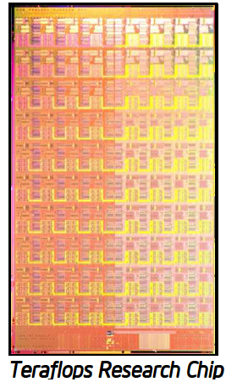
End-To-End Delay
So far we have considered periodically-activated tasks.
However, oftentimes tasks depend on communication messages.
…then send a message to a task on to this one…
τ₂
..and finally another message to this core.
Start on this cores…
τ₁
τ₃

Slide 66
End-To-End Delay
Key goal: compute End-To-End Delay.
Possible solution: use activation jitter.
Jitter J₂ of τ₂ : worst-case response time of τ₁
Jitter J₃ of τ₃ : worst-case response time of τ₂
τ₁
t
message
End-to-end deadline
J₂
τ₂
t
message
J₃
τ₃
0
10
20
t

Slide 67
End-To-End Delay
Can be solved with a brute-force iteration
Start from jitters = 0
Compute response times
Update jitters, repeat until convergence
τ₁
t
message
End-to-end deadline
J₂
τ₂
t
message
J₃
τ₃
0
10
20
t

Slide 68
End-To-End Delay
We will look at more intelligent methods when we talk about timing analysis…
τ₁
t
message
End-to-end deadline
J₂
τ₂
t
message
J₃
τ₃
0
10
20
t

Slide 69
Outline
Introduction and Task Model
Uniprocessor Real-Time Scheduling
Priority Inversion and Resource Sharing
Aperiodic Task Scheduling
Multiprocessor Scheduling
The End-to-End Delay Problem
Scheduling and Control Quality

Slide 70
Scheduling and Control Quality
We mentioned that typical periodic task = digital controller.
In practice, the quality of the control depends on:
Frequency of sensing/actuation (i.e. frequency of control)
Delay in actuation wrt sensing.
Scheduling decisions should take control quality into account…

