Slide 1
C&O 355 Lecture 24
N. Harvey
TexPoint fonts used in EMF.
Read the TexPoint manual before you delete this box.: AAAAAAAAAA

Slide 2
Topics
Semidefinite Programs (SDP)
Vector Programs (VP)
Quadratic Integer Programs (QIP)
QIP & SDP for Max Cut
Finding a cut from the SDP solution
Analyzing the cut

Slide 3
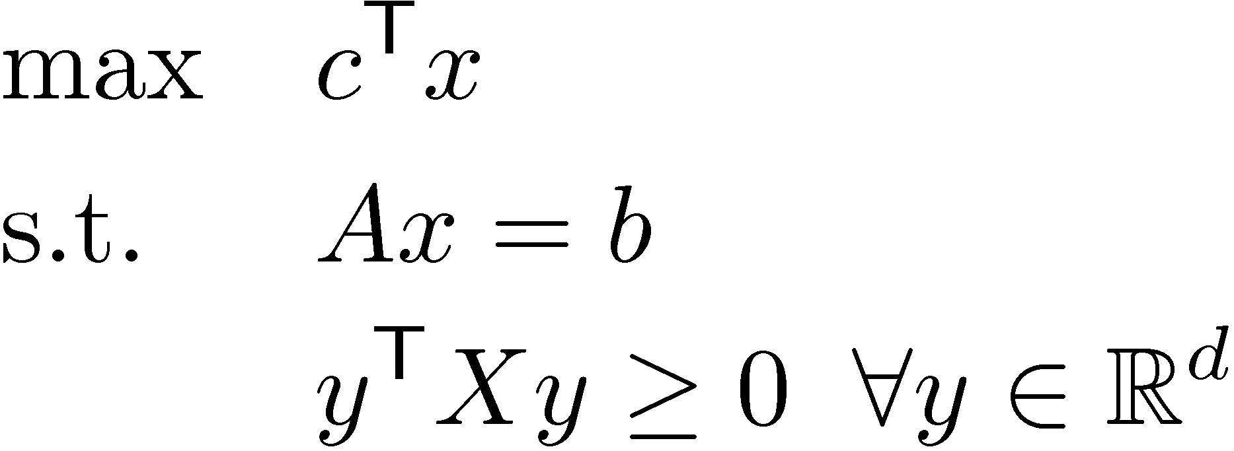
Semidefinite Programs
Where
x2R^{n} is a vector and n = d(d+1)/2
A is a mxn matrix, c2R^{n} and b2R^{m}
X is a dxd symmetric matrix, and x is the vector corresponding to X.
There are infinitely many constraints!

Slide 4
PSD matrices ´ Vectors in R^{d}
Key Observation: PSD matrices correspond directly to vectors and their dot-products.
→: Given vectors v₁,…,v_{d} in R^{d}, let V be the dxd matrix whose i^{th} column is v_{i}. Let X = V^{T}V. Then X is PSD and X_{i,j} = v_{i}^{T}v_{j} 8i,j.
←: Given a dxd PSD matrix X, find spectral decomposition X = U D U^{T}, and let V = D^{1/2} U. To get vectors in R^{d}, let v_{i} = i^{th} column of V. Then X = V^{T} V ) X_{i,j} = v_{i}^{T}v_{j} 8i,j.

Slide 5
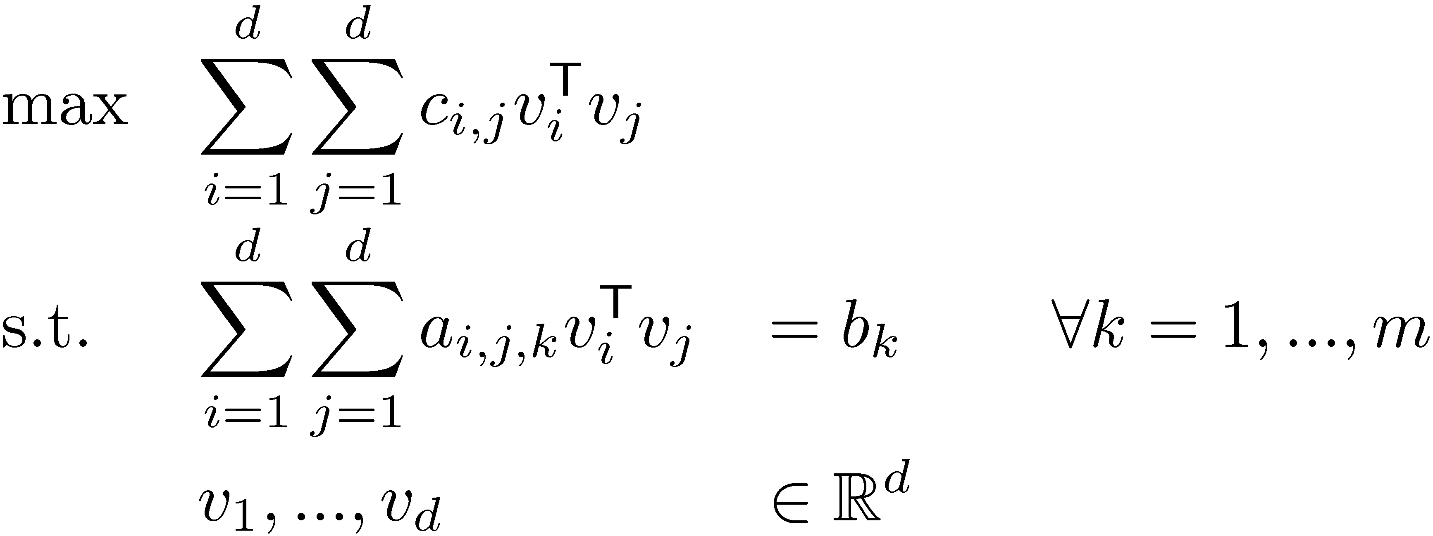
Vector Programs
A Semidefinite Program:
Equivalent definition as “vector program”

Slide 6
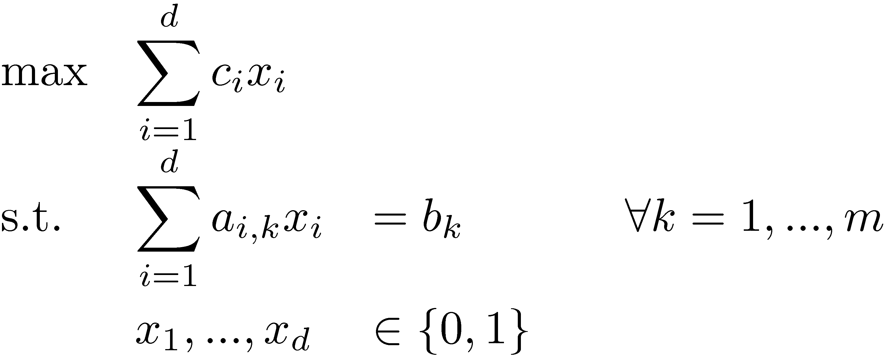
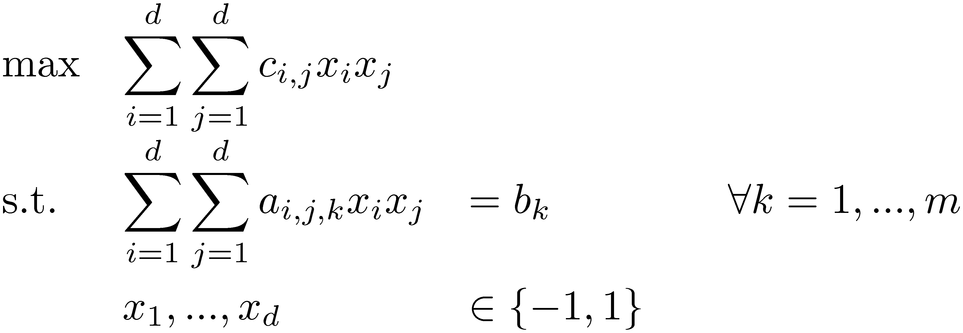
Integer Programs
Our usual Integer Program
Quadratic Integer Program
There are no efficient, general-purpose algorithms for solving IPs, assuming P≠NP.
Let’s make things even harder: Quadratic Objective Function & Quadratic Constraints!
Could also use {0,1} here.
{-1,1} is more convenient.

Slide 7
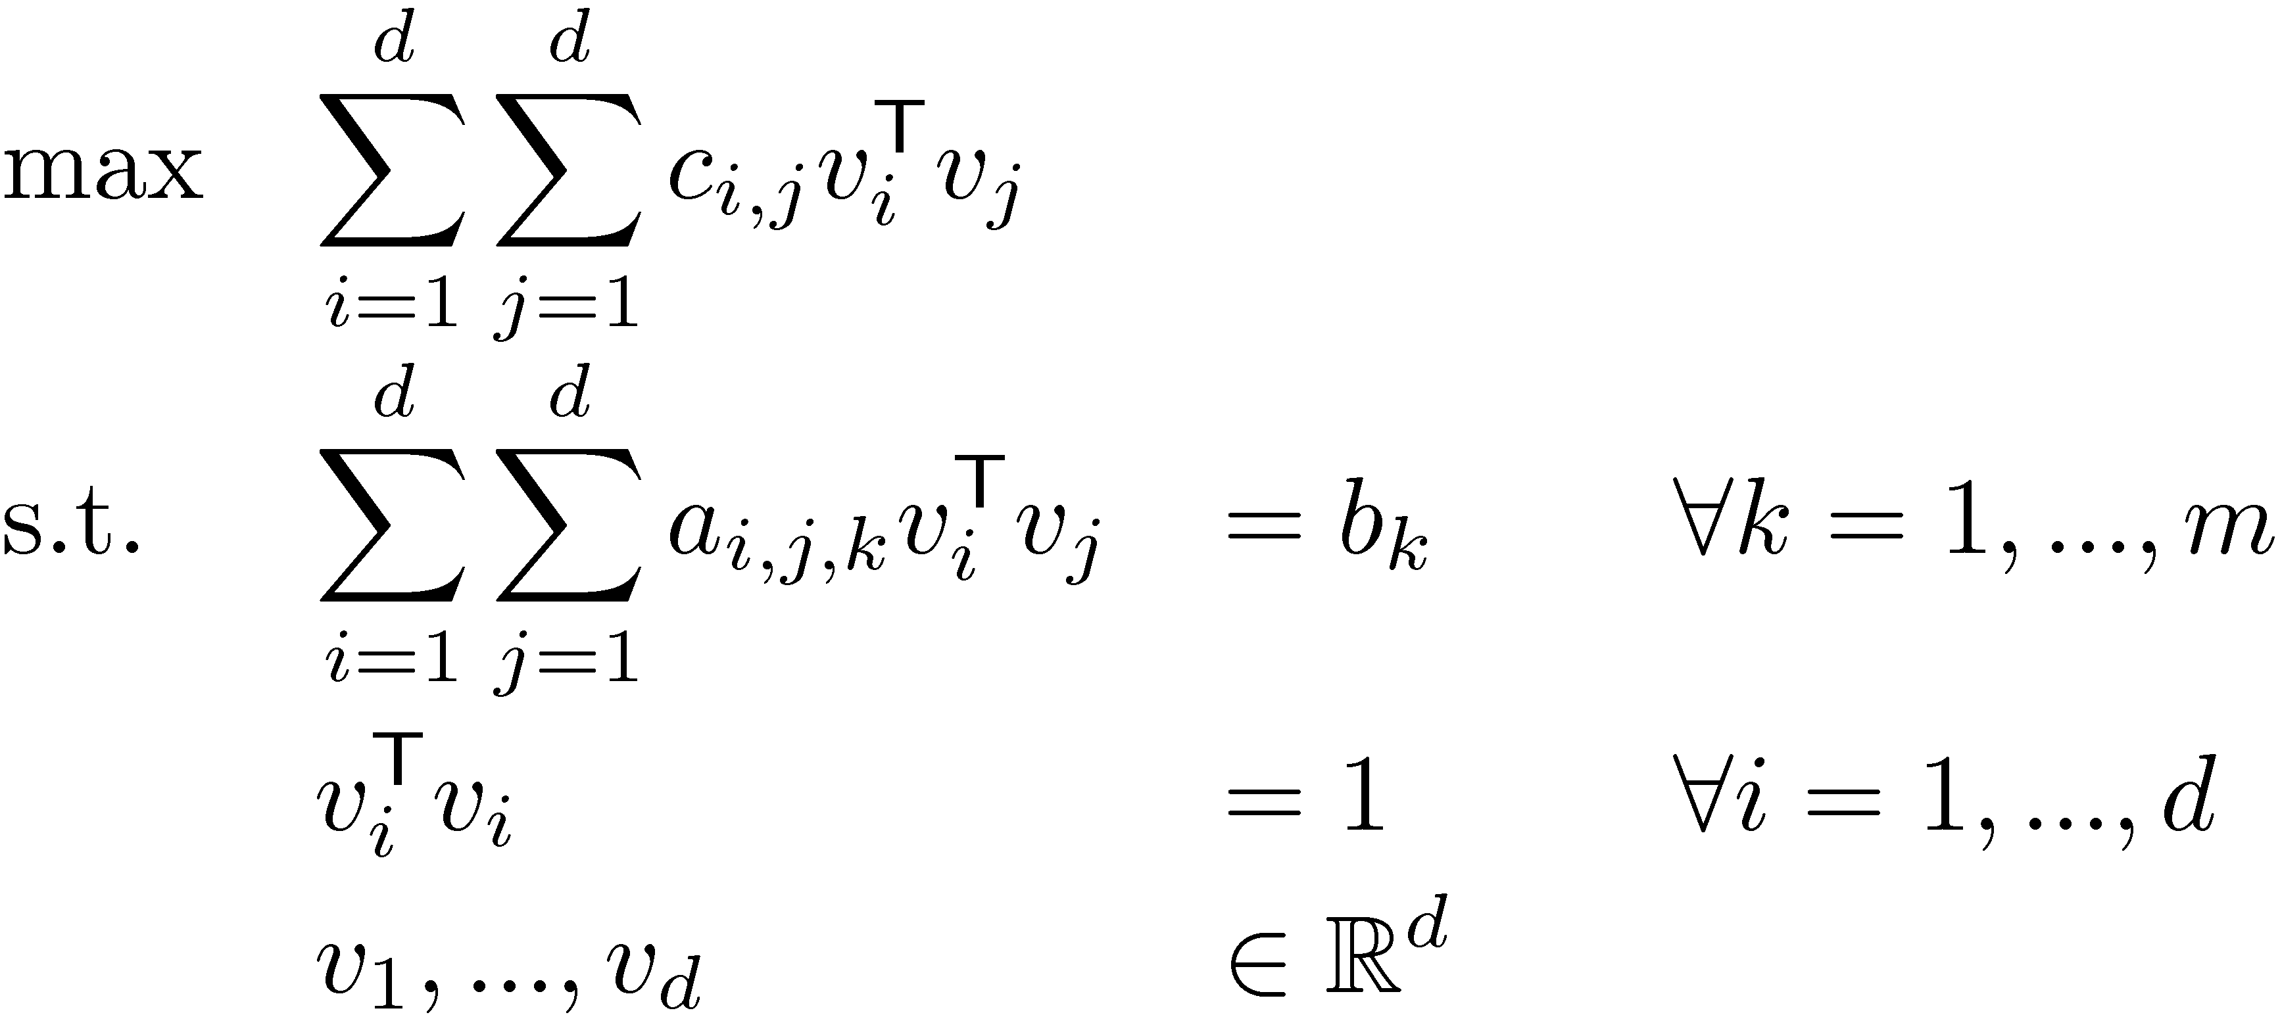
QIPs & Vector Programs
Quadratic Integer Program
Vector Programs give a natural relaxation:
Why is this a relaxation?
(QIP)
(VP)
If we added constraint v_{i} 2 { (-1,0,…,0), (1,0,…,0) } 8i, then VP is equivalent to QIP

Slide 8
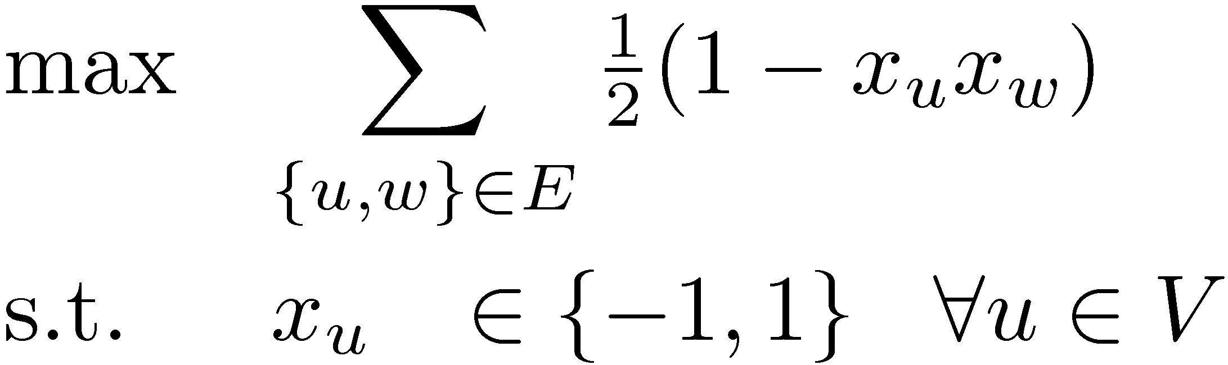
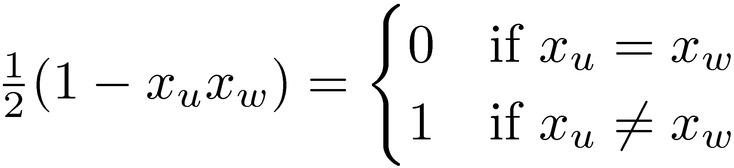
QIP for Max Cut
Let G=(V,E) be a graph with n vertices. For U µ V, let ±(U) = { {u,v} : u2U, v∉U } Find a set U µ V such that |±(U)| is maximized.
Make a variable x_{u} for each u 2 V
Claim: Given feasible solution x, let U = { u : x_{u} = -1 }. Then |±(U)| = objective value at x.
Proof: Note that
So objective value = |{ {u,w} : x_{u}≠x_{w} }| = |±(U)|. ¤
(QIP)

Slide 9
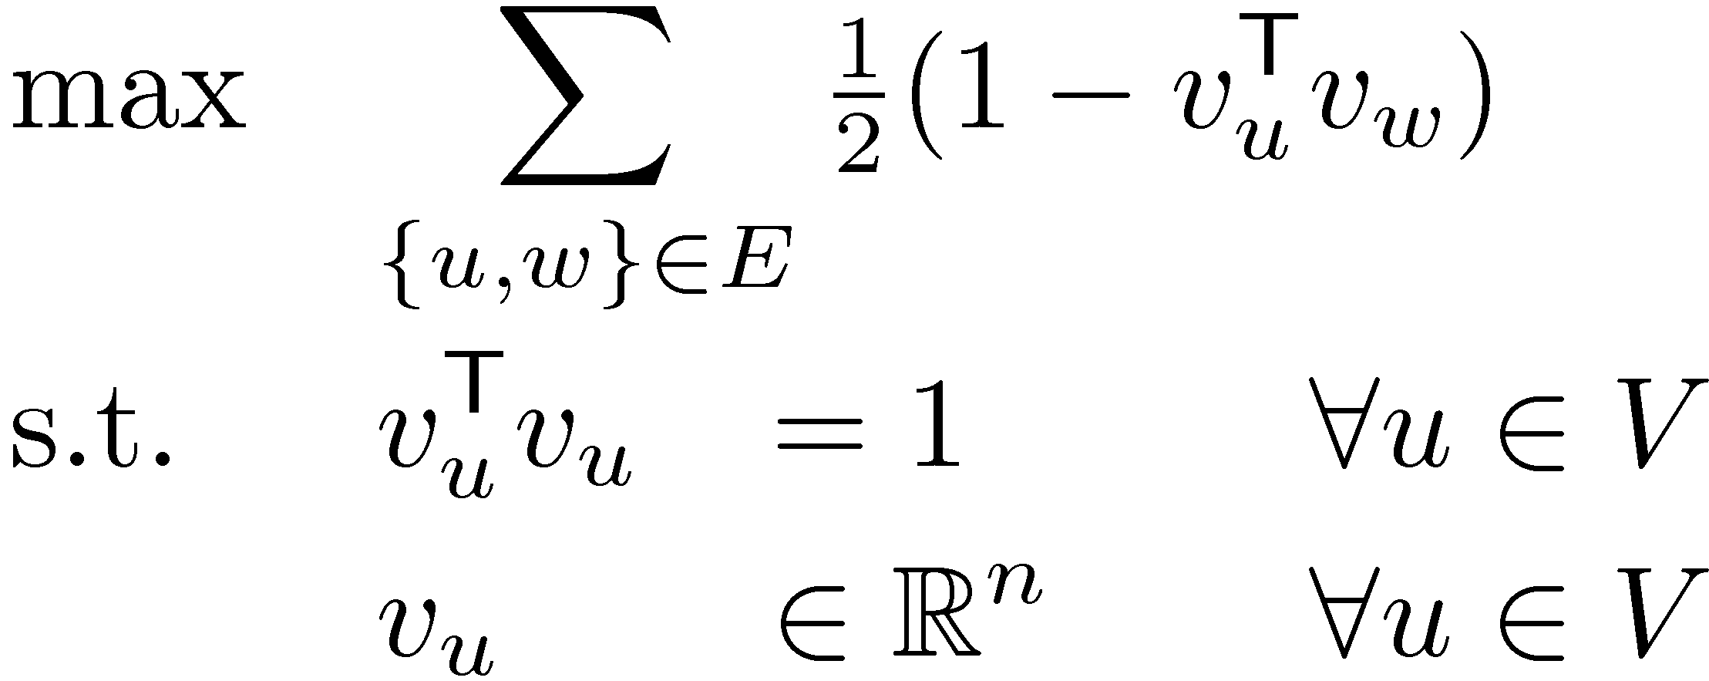
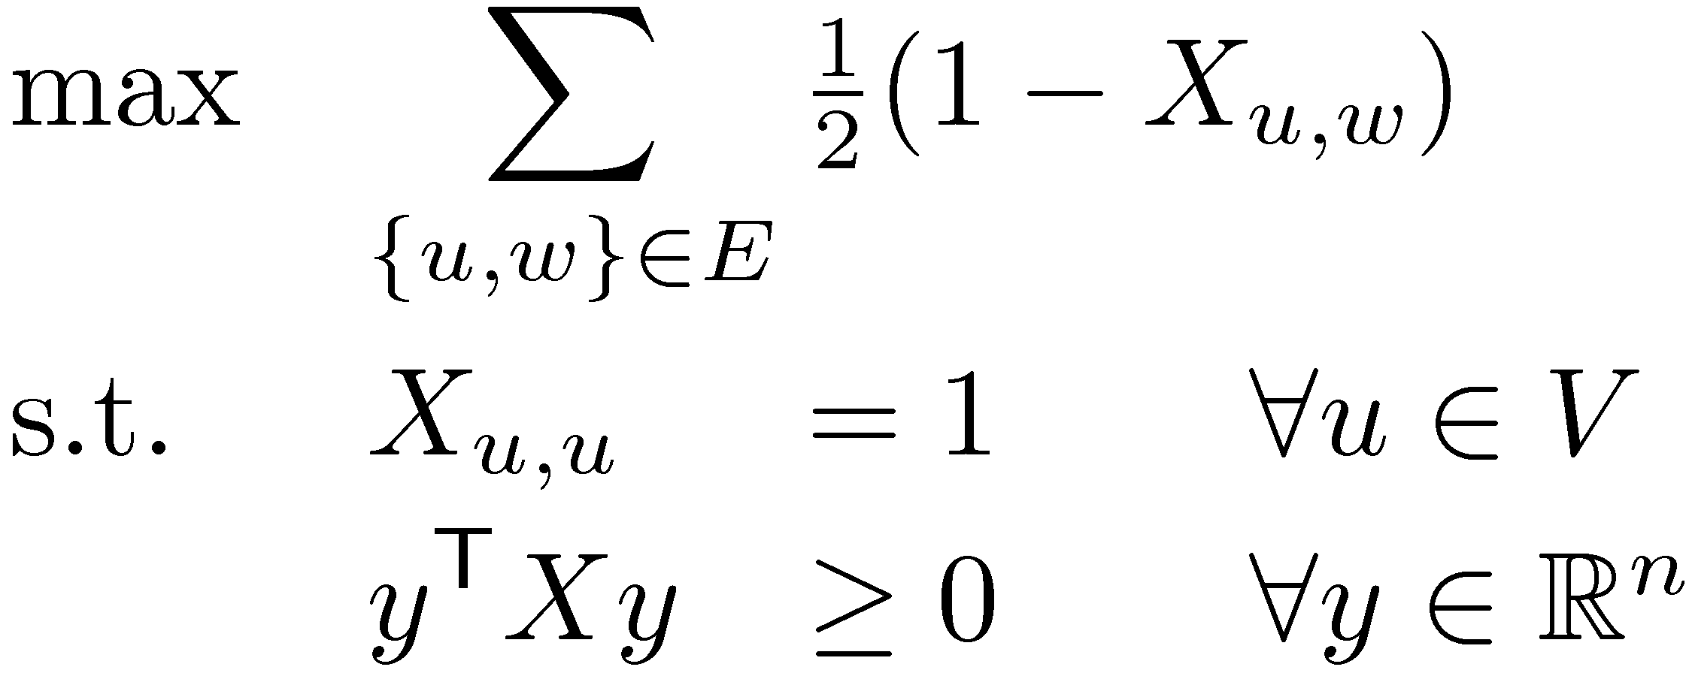
VP & SDP for Max Cut
Make a variable x_{u} for each u 2 V
Vector Program Relaxation
Corresponding Semidefinite Program
(QIP)
(VP)
This used to be d, but now it’s n, because n = |V|.
(SDP)

Slide 10
QIP vs SDP
(QIP)
(SDP)
Cannot be solved efficiently, unless P = NP
Can be solved by Ellipsoid Method
How does solving the SDP help us solve the QIP?
When we solved problems exactly (e.g. Matching, Min Cut), we showed IP and LP are equivalent.
This is no longer true: QIP & SDP are different.
Objective Value
0
Local Ratio Alg (Gets 50% of Max Cut)
QIP Optimum (The Max Cut)
SDP Optimum
How can the SDP Optimum be better than Max Cut?
The SDP optimum is not feasible for QIP – it’s not a cut!

Slide 11
Our Game Plan
Objective Value
0
Local Ratio Alg
Our Cut
QIP Optimum (The Max Cut)
SDP Optimum
Solve the SDP
Extract Our Cut from SDP optimum (This will be a genuine cut, feasible for QIP)
Prove that Our Cut is close to SDP Optimum, i.e. is as large as possible.
) Our Cut is close to QIP Optimum, i.e.,
So Our Cut is within a factor ® of the optimum
®
Value( Our Cut )
® =
Value( SDP Opt )
Value( Our Cut )
¸ ®
Value( QIP Opt )

Slide 12
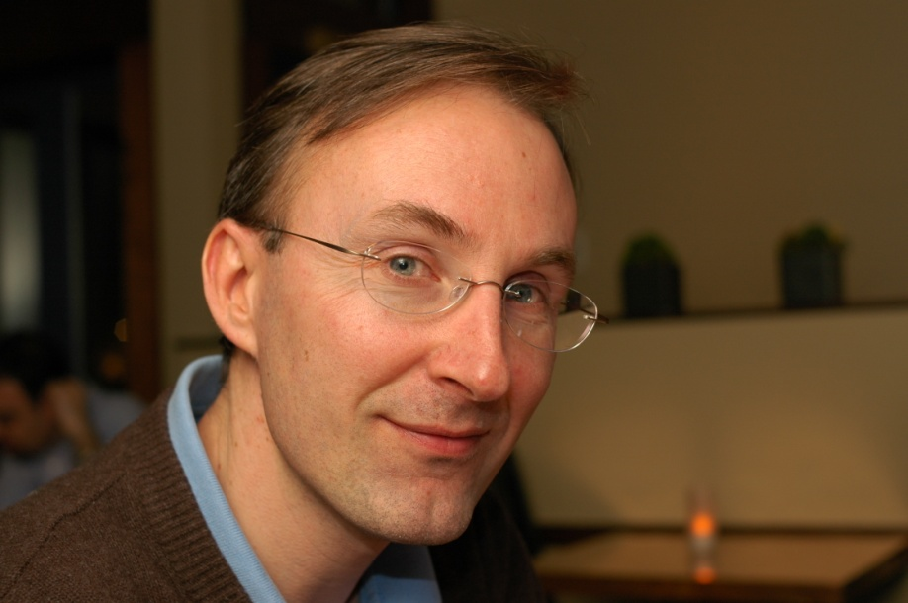

The Goemans-Williamson Algorithm
Theorem: [Goemans, Williamson 1994] There exists an algorithm to extract a cut from the SDP optimum such that
Value( Cut )
® =
¸ 0.878…
Value( SDP Opt )
Michel Goemans
David Williamson

Slide 13
The Goemans-Williamson Algorithm
Theorem: [Goemans, Williamson 1994] There exists an algorithm to extract a cut from the SDP optimum such that
Value( Cut )
® =
¸ 0.878…
Value( SDP Opt )
Astonishingly, this seems to be optimal:
Theorem: [Khot, Kindler, Mossel, O’Donnell 2005] No efficient algorithm can approximate Max Cut with factor better than 0.878…, assuming a certain conjecture in complexity theory. (Similar to P≠NP)

Slide 14
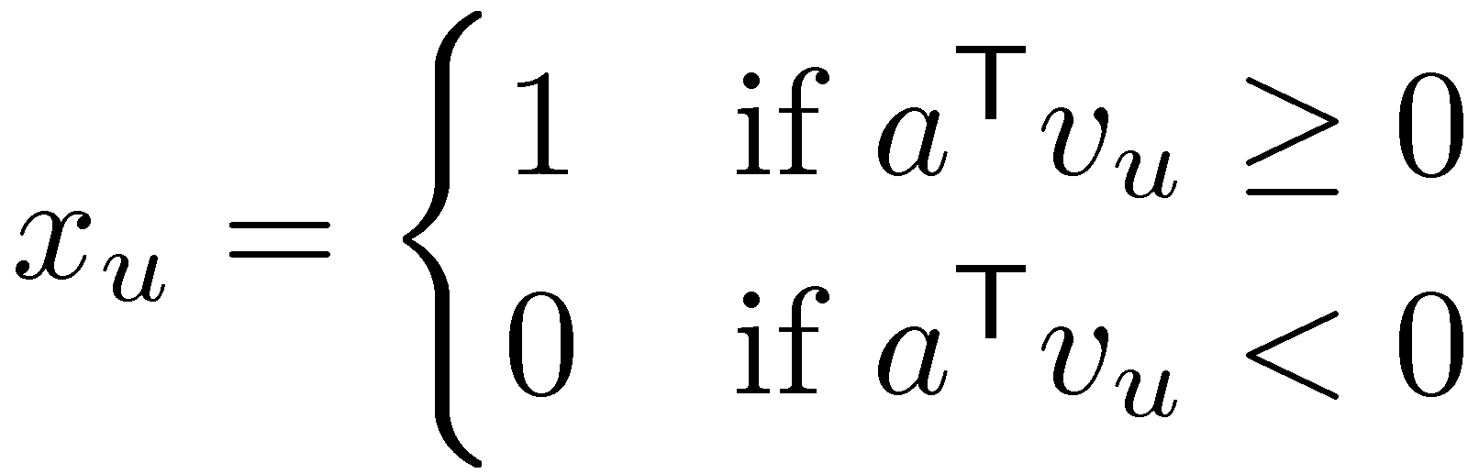
The Goemans-Williamson Algorithm
Solve the Max Cut Vector Program
Pick a random hyperplane through origin H = { x : a^{T}x = 0 } (i.e., a is a random vector)
Return U = { u : a^{T} v_{u} ¸ 0 }
(VP)
v_{w}
v_{x}
U = { u, w, x }
v_{u}
In other words,
origin
v_{y}
v_{t}
v_{z}

Slide 15
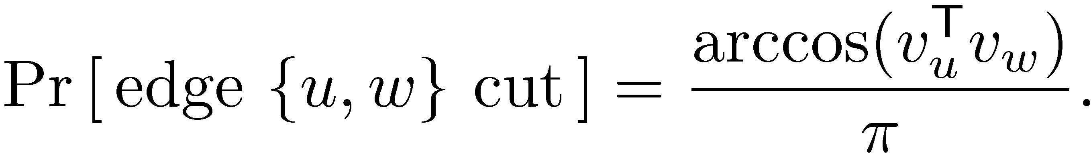
Analysis of Algorithm
Objective Value
0
Local Ratio Alg
Our Cut
QIP Optimum (The Max Cut)
SDP Optimum
®
Our Cut is U = { u : a^{T} v_{u} ¸ 0 }
Need to prove is large
But a is a random vector, so U is a random set ) Need to do a probabilistic analysis
Focus on a particular edge {u,w}: What is the probability it is cut by Our Cut?
Main Lemma:
Value( Our Cut )
® =
Value( SDP Opt )

Slide 16
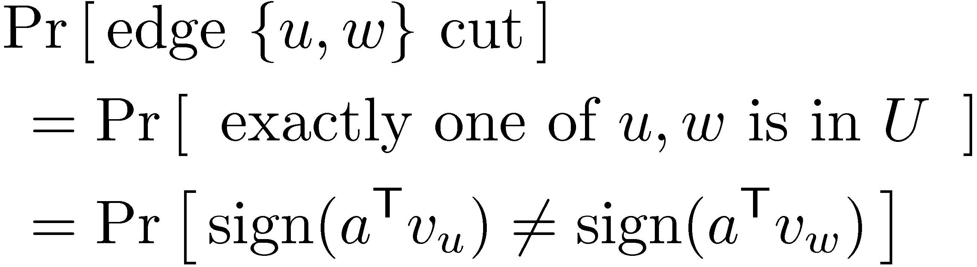
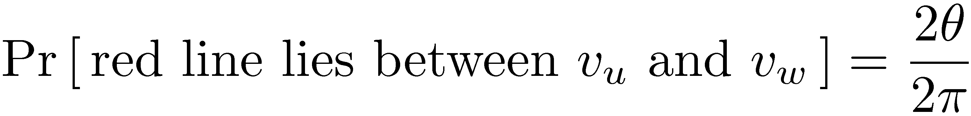
Main Lemma:
Proof:
Since direction of red line is uniformly distributed,
red line lies between v_{u} and v_{w}
v_{u}
a
µ
µ
v_{w}

Slide 17
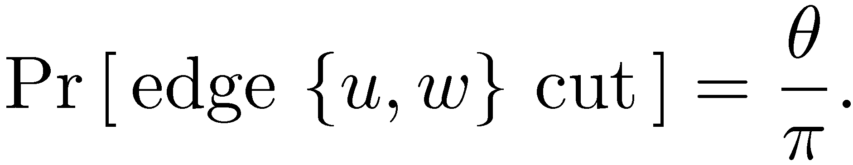
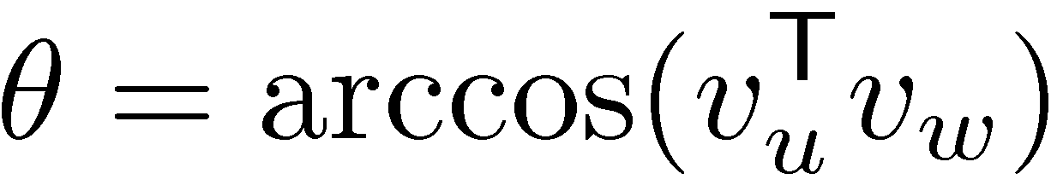
Main Lemma:
Proof:
Since direction of red line is uniformly distributed,
So
Recall: v_{u}^{T} v_{w} = kv_{u}k¢kv_{w}k ¢ cos(µ)
Since kv_{u}k=kv_{w}k=1, we have ¥
red line lies between v_{u} and v_{w}

Slide 18
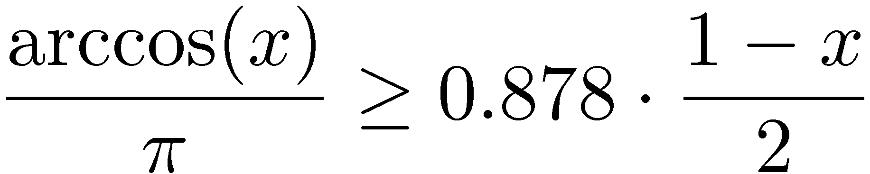
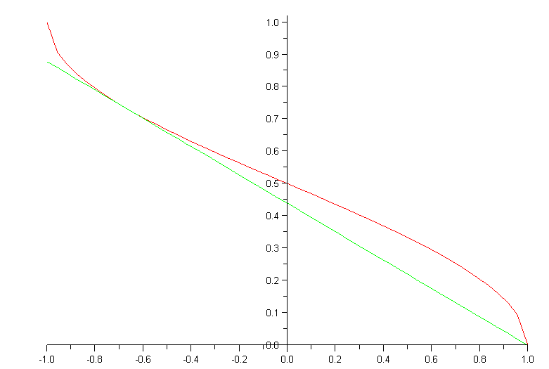
Main Lemma:
Claim: For all x2[-1,1],
Proof: By picture:
Can be formalized using calculus. ¥
arccos(x)
0.878 (1-x) /2

Slide 19
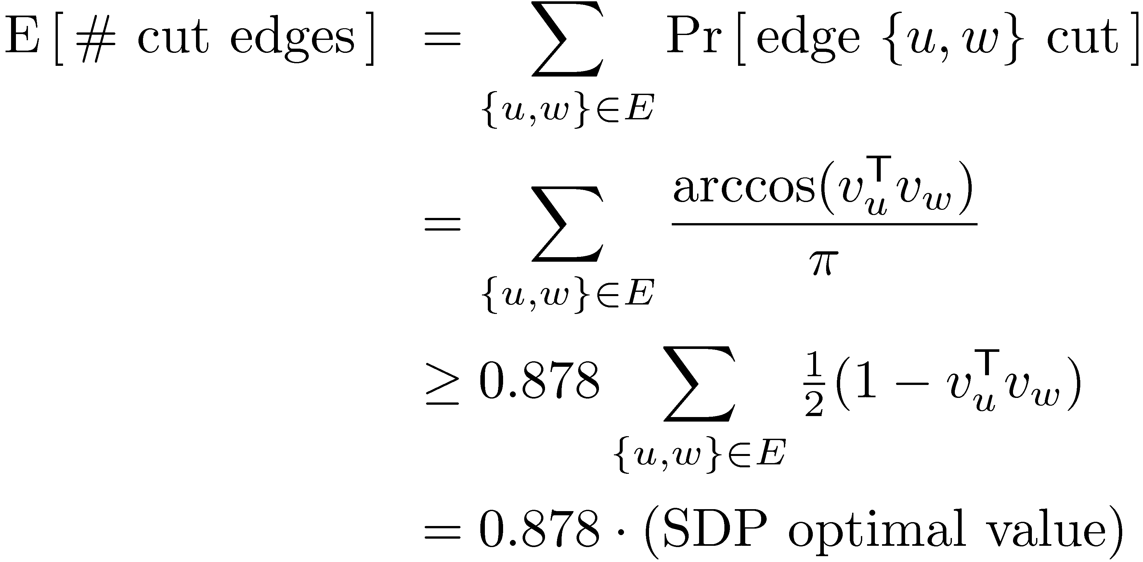
Main Lemma:
Claim: For all x2[-1,1],
So we can analyze # cut edges:
Recall: . So E[ ® ] ¸ 0.878.
Value( Our Cut )
® =
Value( SDP Opt )

Slide 20
Objective Value
So we can analyze # cut edges:
Recall: . So E[ ® ] ¸ 0.878.
0
Local Ratio Alg
Our Cut
QIP Optimum (The Max Cut)
SDP Optimum
® ¸ 0.878
Value( Our Cut )
® =
Value( SDP Opt )

Slide 21
Objective Value
So, in expectation, the algorithm gives a 0.878-approximation to the Max Cut. ¥
0
Local Ratio Alg
Our Cut
QIP Optimum (The Max Cut)
SDP Optimum
® ¸ 0.878

Slide 22
Matlab Example
U
Hyperplane H
Green edges are cut
38 of them
Blue edges are not cut
8 of them
SDP Opt. Value ¼ 39.56
) QIP Opt. Value · 39
® ¼ 38/39.56 = 0.9604
H cuts 38 edges
So Max Cut is either 38 or 39
Random graph: 20 vertices, 46 edges.
Embedded on unit-sphere in R²⁰, then projected onto 2 random directions.

Slide 23
Puzzle
My solution:
Install SDPT3 (Matlab software for solving SDPs) It has example code for solving Max Cut.
Run this code:
Output: cut=2880, sdpOpt=3206.5, ratio=0.8982
load 'Data.txt'; A = Data; % Load adjacency matrix from file
n = size(A,1); % n = number of vertices in the graph
m = sum(sum(A))/2; % m = number of edges of the graph
[blk,Avec,C,b,X0,y0,Z0,objval,R] = maxcut(A,1,1); % Run the SDP solver
X = R{1}; % X is the optimal solution to SDP
V = chol(X); % Columns of V are solution to Vector Program
a = randn(1,n); % The vector a defines a random hyperplane
x = sign( a * V )'; % x is our integral solution
cut = m/2 - x'*A*x/4 % This counts how many edges are cut by x
sdpOpt = -objval % This is the SDP optimal value
ratio = cut/sdpOpt % This compares cut to SDP optimum
Here we use the fact that product of Normal Distributions is spherically symmetric.

