Slide 1
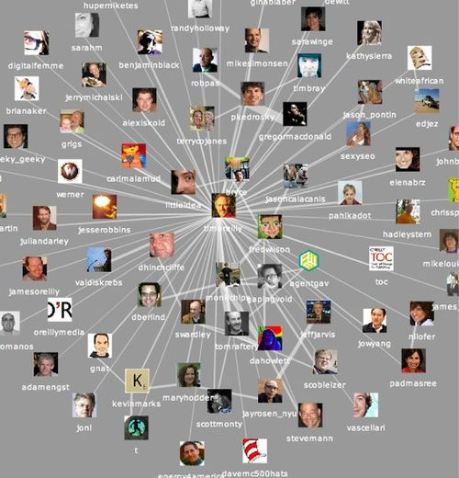
MITACS Workshop
On Social Networks
August 9, 2010
A short course
on complex networks
Anthony Bonato
Ryerson University

Slide 2










Friendship networks
network of friends (some real, some virtual) form a large web of interconnected links

Slide 3


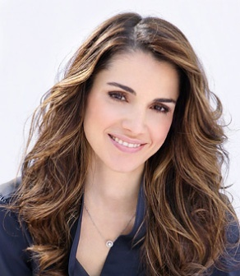
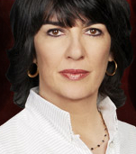
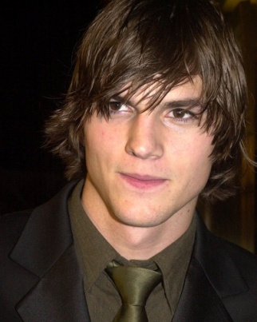
Ashton Kutcher is the centre of Twitterverse
Dalai Lama
Arnold
Schwarzenegger
Queen Rania
of Jordan
Christianne Amanpour
Ashton Kutcher

Slide 4
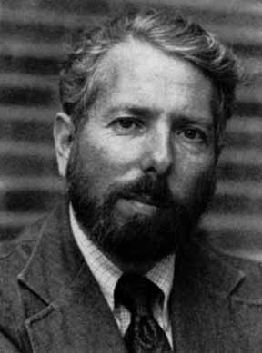
6 degrees of separation
Stanley Milgram: famous “chain letter” experiment in 1967

Slide 5
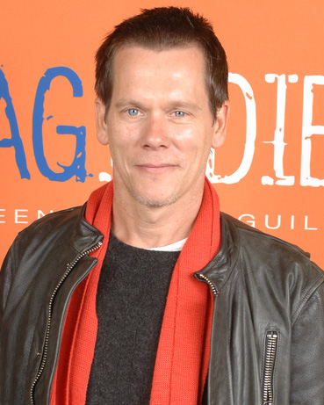
6 Degrees of Kevin Bacon

Slide 6

6 Degrees in Twitter
Java et al. (2009)
6 degrees of separation in Twitter
other researchers found similar results in Facebook, Myspace, …

Slide 7
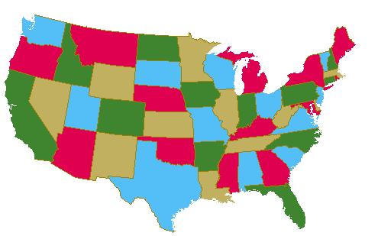
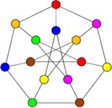
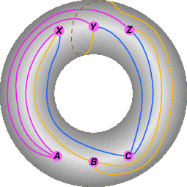
20th Century Graph Theory

Slide 8
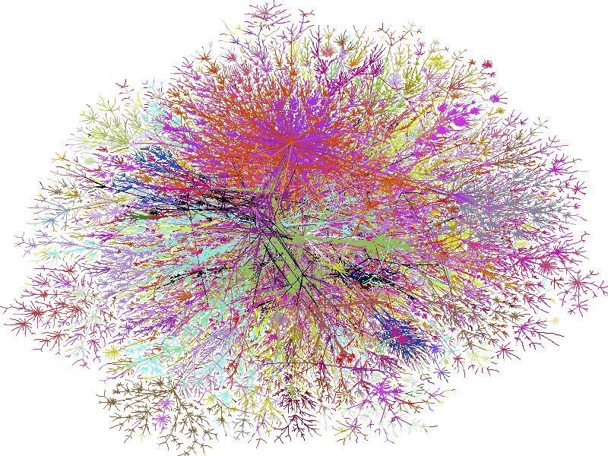
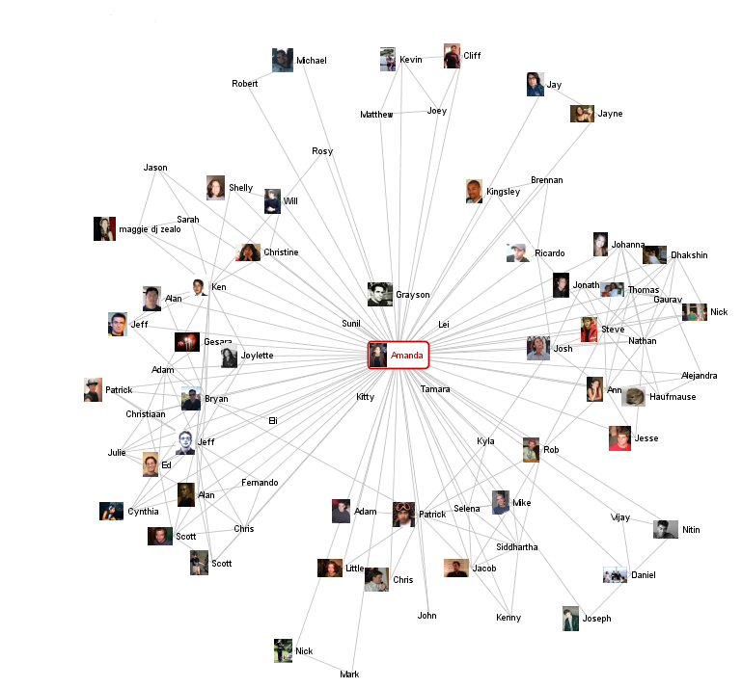
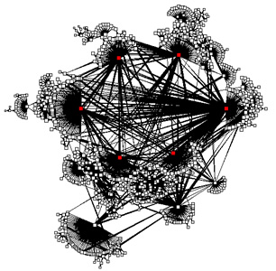
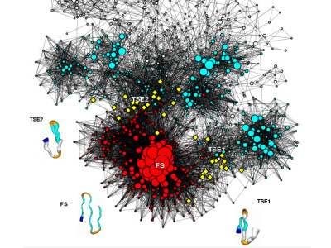
21st Century Graph Theory: Complex Networks
web graph, social networks, biological networks, internet networks, …

Slide 9
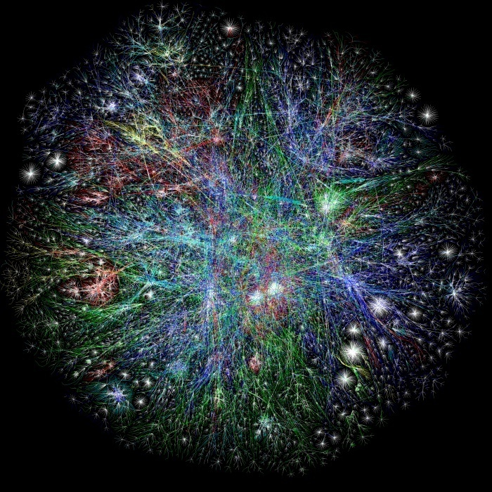
The web graph
nodes: web pages
edges: links
over 1 trillion nodes, with billions of nodes added each day

Slide 10
Nuit
Blanche
Ryerson
City of
Toronto
Four
Seasons
Hotel
Frommer’s
Greenland
Tourism

Slide 11
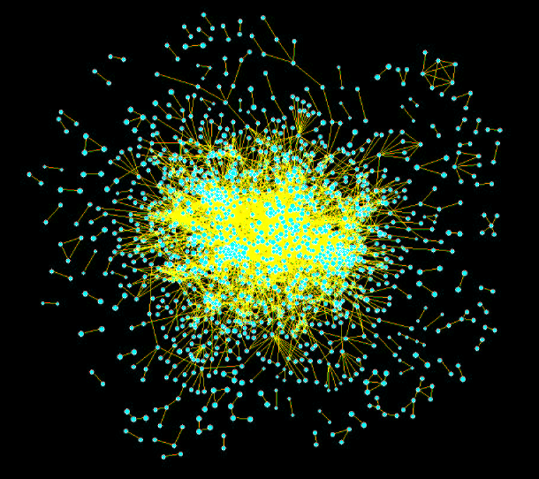
Biological networks: proteomics
nodes: proteins
edges:
biochemical interactions
Yeast:
2401 nodes
11000 edges

Slide 12
Social Networks
nodes: people
edges:
social interaction
(eg friendship)

Slide 13
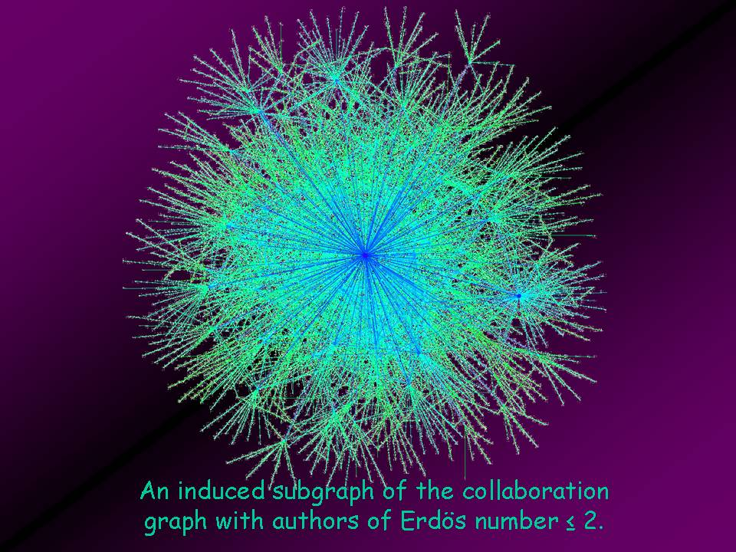

Slide 14
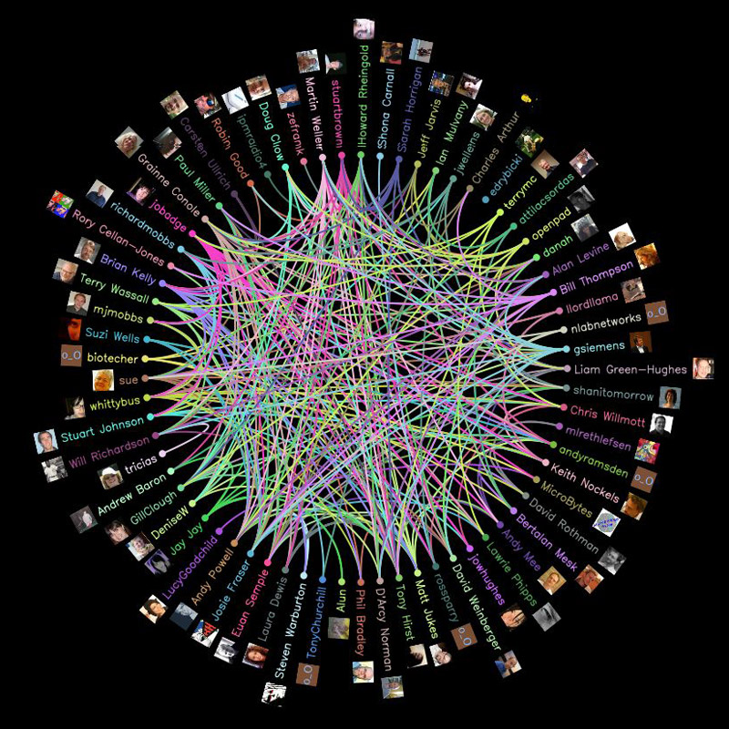
On-line Social Networks (OSNs) Facebook, Twitter, LinkedIn, MySpace…

Slide 15
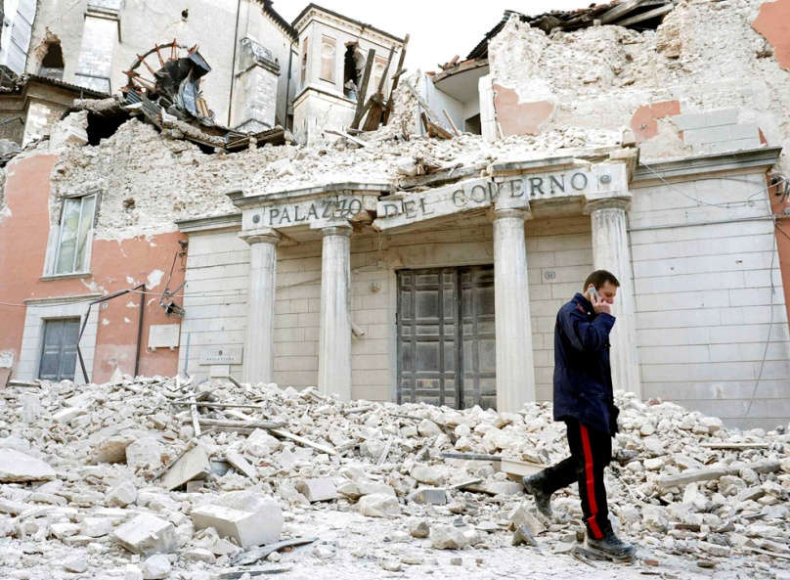

A new paradigm
half of all users of internet on some OSN
500 million users on Facebook, 100 million on Twitter
unprecedented, massive record of social interaction
unprecedented access to information/news/gossip

Slide 16
Notation
G = (V(G),E(G)): (un)directed graph
order |V(G)| (usually n or t)
deg_{G}(u) = degree of vertex u
d_{G} (u,v) = distance between u and v
diam(G) = maximum distance over all pairs u,v
N(x) = neighbour set of x

Slide 17
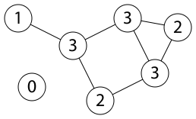
First Theorem of Graph Theory:

Slide 18
Other key parameters
degree distribution:
average distance:
clustering coefficient:
Wiener index, W(G)

Slide 19
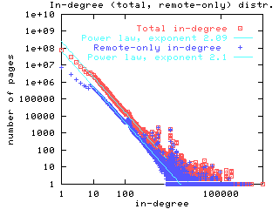
Properties of Complex Networks
power law degree distribution
(Broder et al, 01)

Slide 20
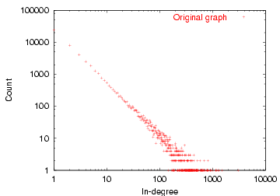
Interpreting a power law
Many low-degree nodes
Few high-degree nodes

Slide 21
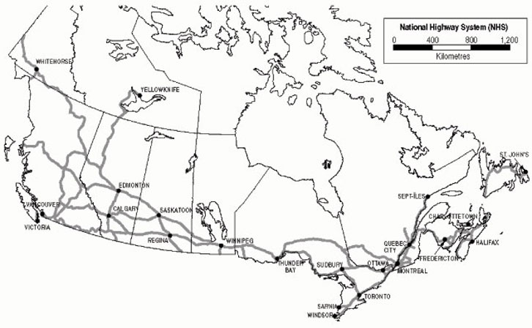
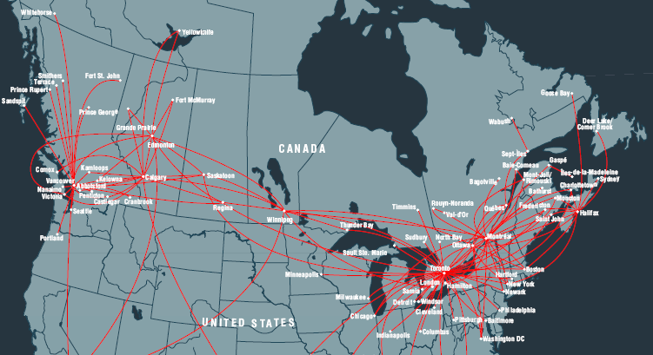
Binomial
Power law
Highway network
Air traffic network

Slide 22
Notes on power laws
b is the exponent of the power law
note that the law is
approximate: constants do not affect it
asymptotic: holds only for large n
may not hold for all degrees, but most degrees (for example, sufficiently large or sufficiently small degrees)

Slide 23
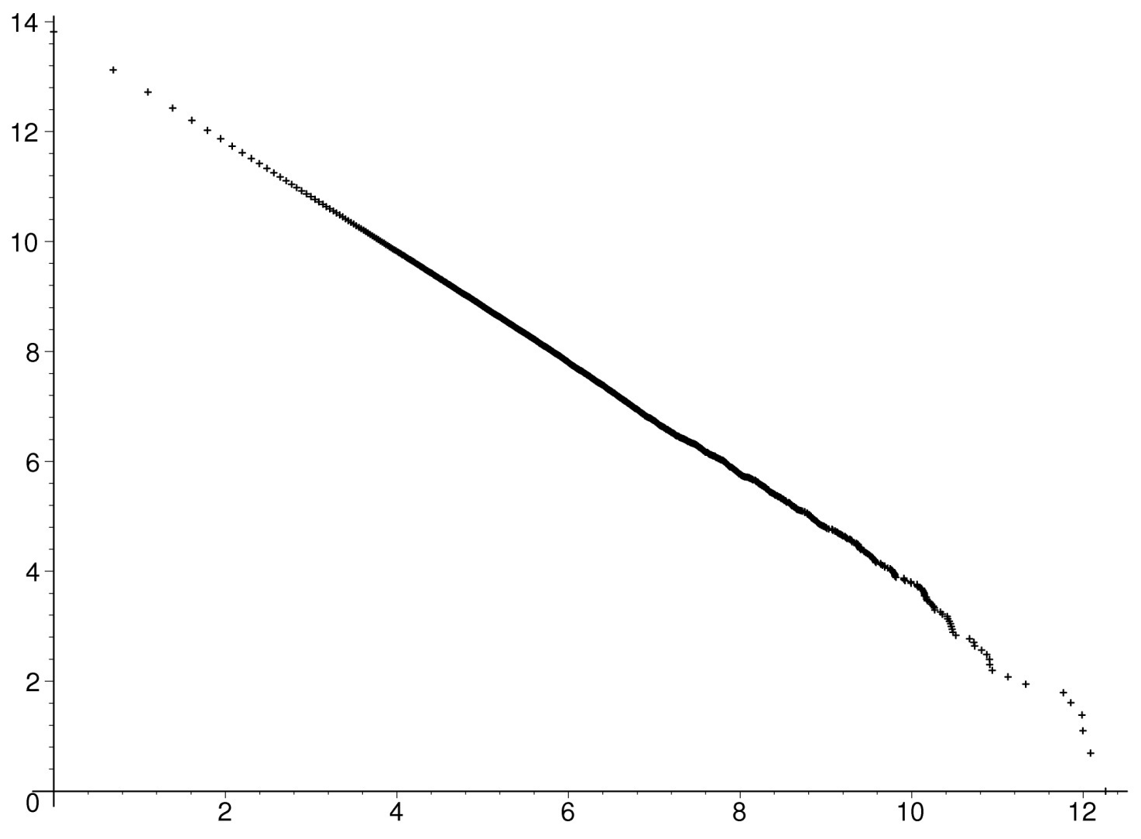
Degree distribution (log-log plot) of a power law graph

Slide 24
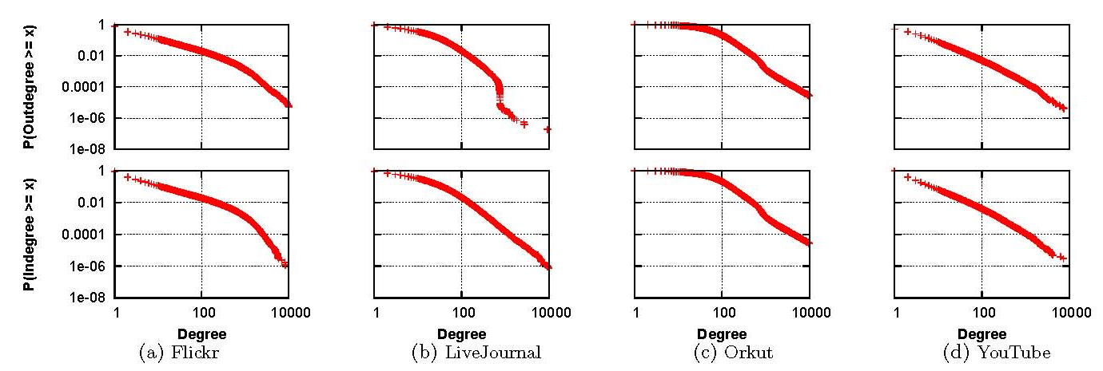
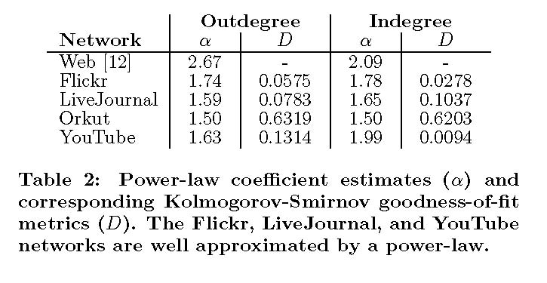
Power laws in OSNs

Slide 25
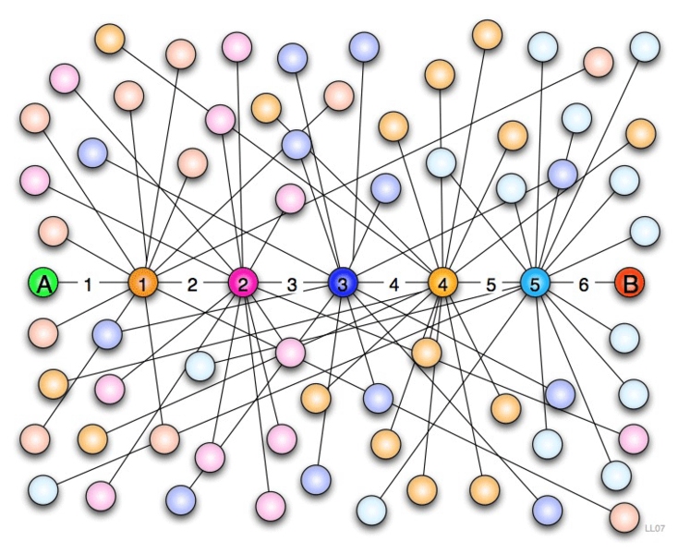
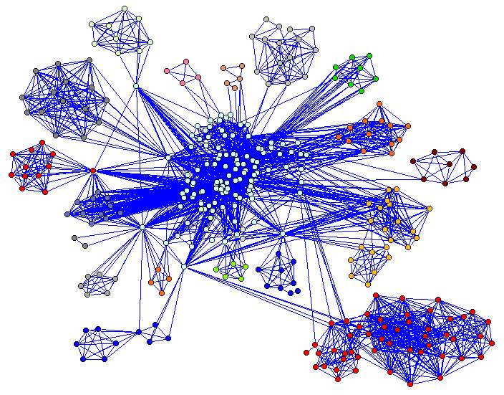
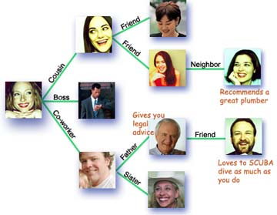
Small World Property
small world networks introduced by social scientists Watts & Strogatz in 1998
low distances
diam(G) = O(log n)
L(G) = O(loglog n)
higher clustering coefficient than random graph with same expected degree

Slide 26
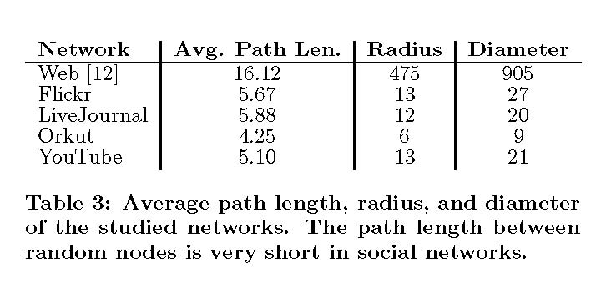
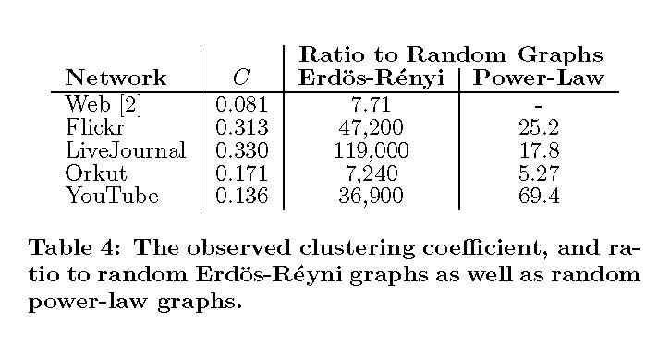
Sample data: Flickr, YouTube, LiveJournal, Orkut
(Mislove et al,07): short average distances and high clustering coefficients

Slide 27
Community structure
W. Zachary’s Ph.D. thesis (1972): observed social ties and rivalries in a university karate club (34 nodes,78 edges)
during his observation, conflicts intensified and group split

Slide 28
Why model complex networks?
uncover and explain the generative mechanisms underlying complex networks
predict the future
nice mathematical challenges
models can uncover the hidden reality of networks

Slide 29
“All models are wrong, but some are more useful.”
– G.P.E. Box

Slide 30
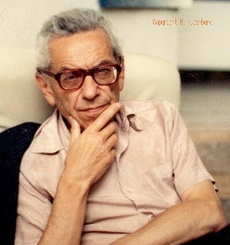
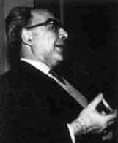
Classical random graphs
Paul Erdős
Alfred Rényi

Slide 31
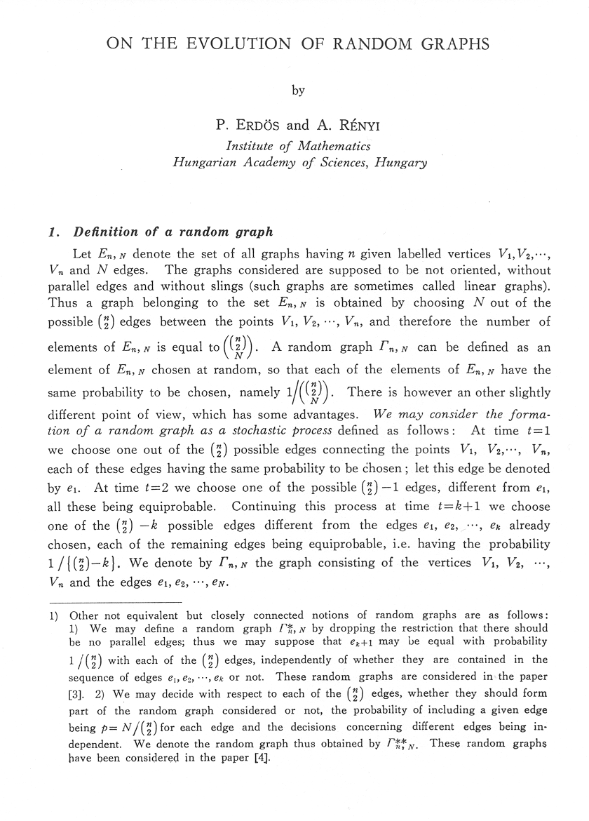

Slide 32
G(n,p) random graph model (Erdős, Rényi, 63)
p = p(n) a real number in (0,1), n a positive integer
G(n,p): probability space on graphs with nodes {1,…,n}, two nodes joined independently and with probability p
1
2
3
4
5

Slide 33
Degrees and diameter
an event A_{n} happens asymptotically almost surely (a.a.s.) in G(n,p) if it holds there with probability tending to 1 as n→∞
Theorem: A.a.s. the degree of each vertex of G in G(n,p) equals
concentration: binomial distribution
Theorem: If p is constant, then a.a.s diam(G(n,p)) = 2.

Slide 34
Aside: evolution of G(n,p)
think of G(n,p) as evolving from a co-clique to clique as p increases from 0 to 1
at p=1/n, Erdős and Rényi observed something interesting happens a.a.s.:
with p = c/n, with c < 1, the graph is disconnected with all components trees, the largest of order Θ(log(n))
as p = c/n, with c > 1, the graph becomes connected with a giant component of order Θ(n)
Erdős and Rényi called this the double jump
physicists call it the phase transition: it is similar to phenomena like freezing or boiling
see Joel Spencer’s recent article in Notices of the AMS

Slide 36
G(n,p) is not a model for complex networks
degree distribution is binomial
low diameter, rich but uniform substructures

Slide 37
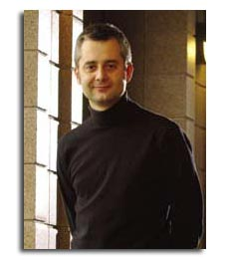

Preferential attachment model
Albert-László Barabási
Réka Albert

Slide 38
Preferential attachment
say there are n nodes x_{i} in G, and we add in a new node z
z is joined to the x_{i} by preferential attachment if the probability zx_{i} is an edge is proportional to degrees:
the larger deg(x_{i}), the higher the probability that z is joined to x_{i}

Slide 39
Preferential attachment (PA) model (Barabási, Albert, 99), (Bollobás,Riordan,Spencer,Tusnady,01)
parameter: m a positive integer
at time 0, add a single edge
at time t+1, add m edges from a new node v_{t+1} to existing nodes
the edge v_{t+1} v_{s} is added with probability

Slide 40
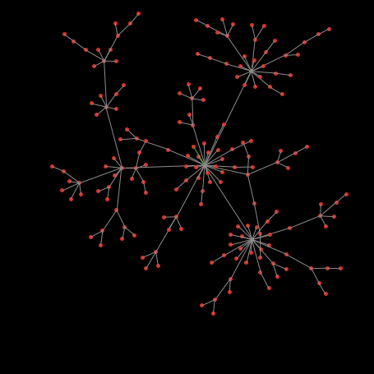
Preferential Attachment Model (Barabási, Albert, 99), (Bollobás,Riordan,Spencer,Tusnady,01)
Wilensky, U. (2005). NetLogo Preferential Attachment model.
http://ccl.northwestern.edu/netlogo/models/PreferentialAttachment.

Slide 41
Properties of the PA model
(BRST,01) A.a.s. for all k satisfying 0 ≤ k ≤ t^{1/15}
(Bollobás, Riordan, 04) A.a.s. the diameter of the graph at time t is

Slide 42
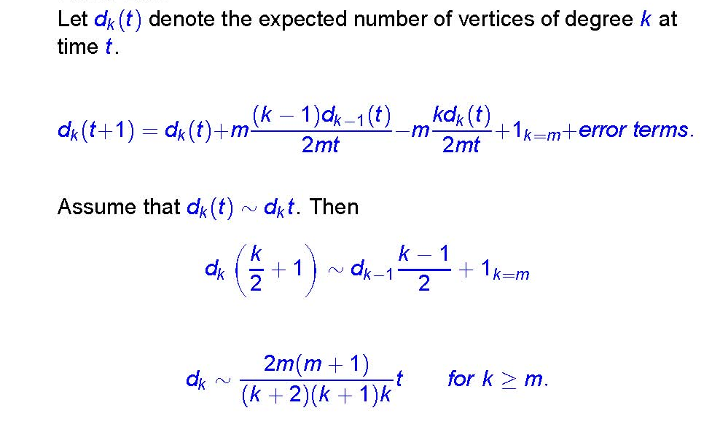
Sketch of proof of power law

Slide 43
Copying models
new nodes copy some of the link structure of an existing node
Motivation:
web page generation (Kumar et al, 00)
mutation in biology (Chung et al, 03)

Slide 44
N(v)
v
N(u)
u
y
x

Slide 45
Properties of the copying model
power laws:
Kumar et al: exponent in interval (2,∞)
Chung, Lu: (1,2)
bipartite subgraphs:
Kumar et al: larger expected number of bicliques than in PA models
simplified model of community structure

Slide 46


Off-line web graph model
Fan Chung Graham
Lincoln Lu

Slide 47
Random graphs with given expected degree sequence (Chung, Lu, 2003)
let w=(w₁, …, w_{n}) be a sequence
G(w): probability space of graphs on [n], where i and j are joined independently with probability
G(w) is the space of random graphs with given expected degree sequence w
if w=(pn,…pn), then G(w) is just G(n,p)
if w follows a power law, we obtain random power law graphs

Slide 48
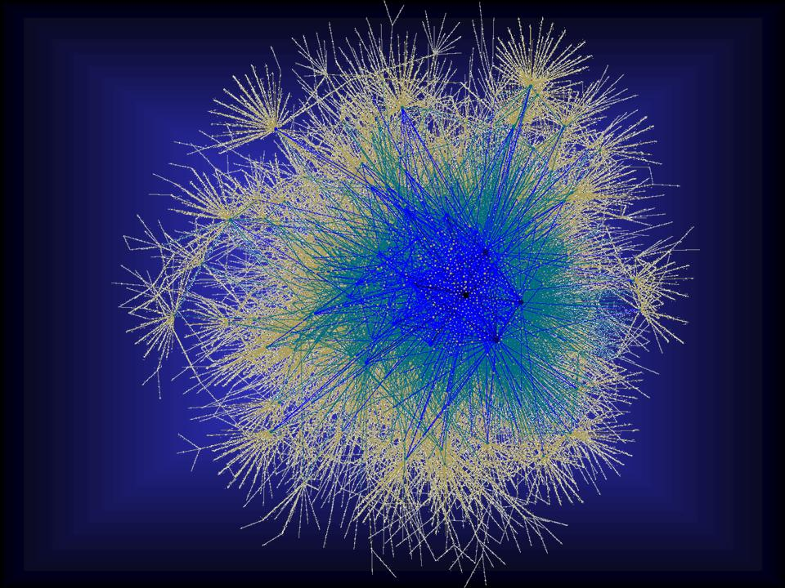
Random power law graphs
(Chung, Lu, 03-07) a.a.s. following properties hold:
degree distribution follows a power law
diameter log(n)
average distance
loglog(n)
eigenvalues follows power law

Slide 49
Protean graphs (Fortunato, Flammini, Menczer,06), (Łuczak, Prałat,06), (Janssen, Prałat,09)
parameter: α in (0,1)
each node is ranked 1,2, …, n by some function r
1 is best, n is worst
at each time-step, one new node is born, one randomly node chosen dies (and ranking is updated)
link probability r^{-α}
many ranking schemes a.a.s. lead to power law graphs: random initial ranking, degree, age, etc.

Slide 50
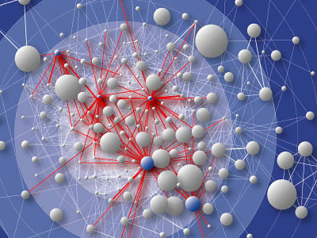
Geometry of the web?
idea: web pages exist in a topic-space
a page is more likely to link to pages close to it in topic-space

Slide 51
Random geometric graphs
nodes are randomly placed in some compact subset of m-dimensional space
nodes are joined if their distance is less than a threshold value
(Penrose, 03)

Slide 52
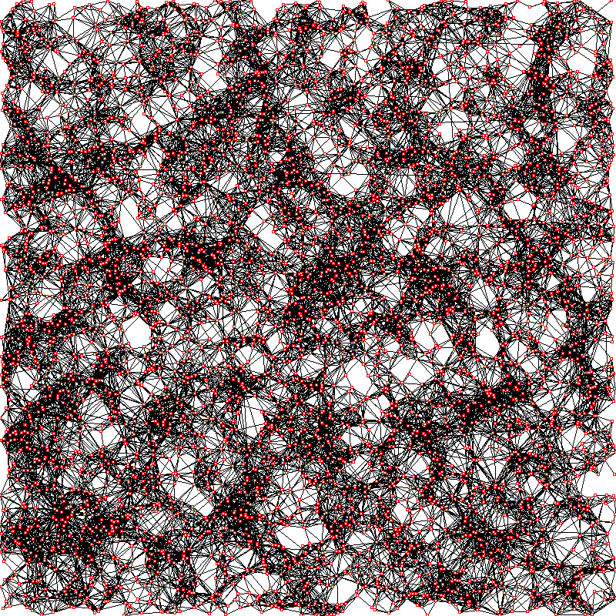
Simulation with 5000 nodes

Slide 53
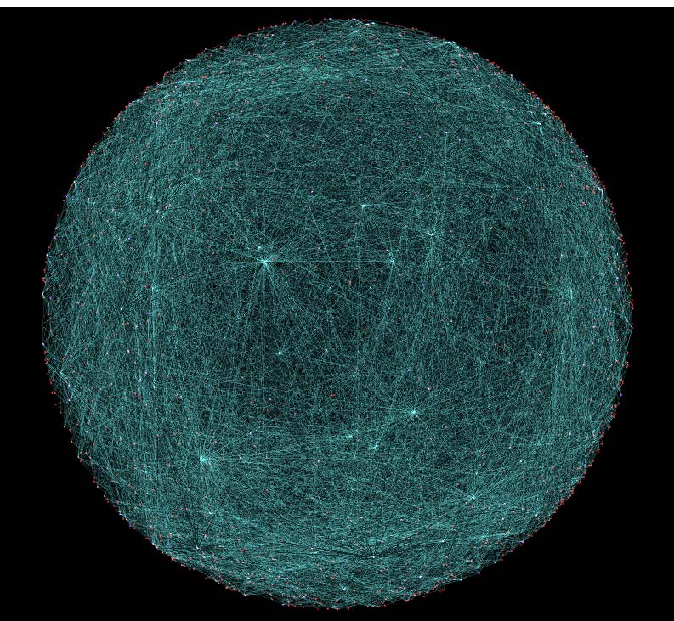
Geometric Preferential Attachment (GPA) model (Flaxman, Frieze, Vera, 04/07)
nodes chosen on-line u.a.r. from sphere with surface area 1
each node has a region of influence with constant radius
new nodes have m neighbours, chosen
by preferential attachment; and
only in the region of influence
a.a.s. model generates power law,
low diameter graphs with small
separators/sparse cuts

Slide 54
Spatially Preferred Attachment (SPA) model (Aiello,Bonato,Cooper,Janssen,Prałat, 08)
parameter: p a real number in (0,1]
nodes on a sphere with surface area 1
at time 0, add a single node chosen u.a.r.
at time t, each node v has a region of influence B_{v} with radius
at time t+1, node z is chosen u.a.r. on sphere
if z is in B_{v}, then add vz independently with probability p

Slide 55
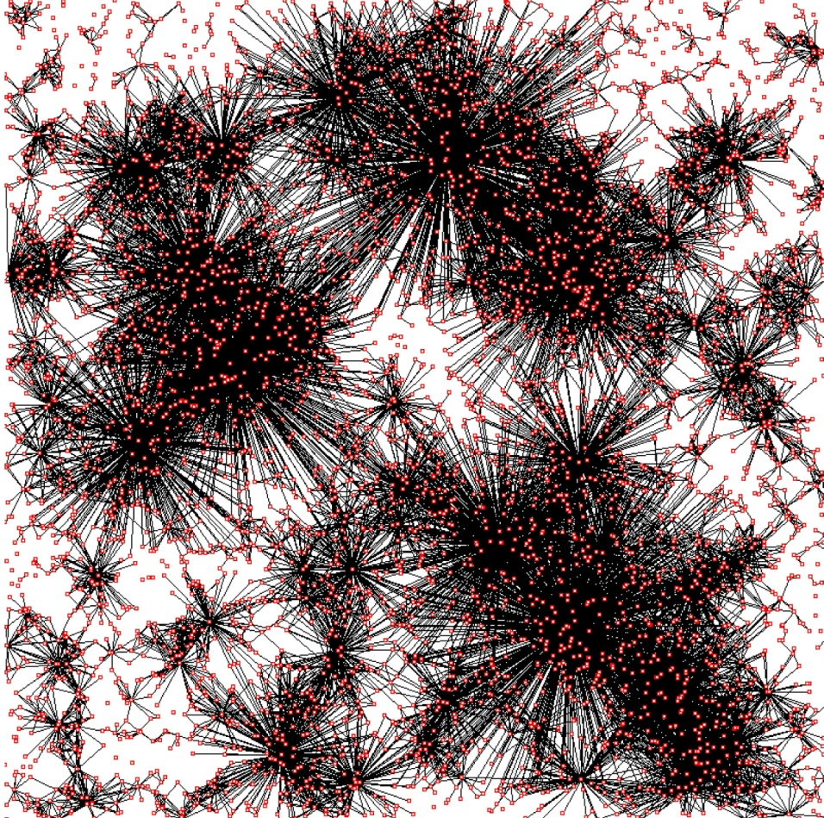
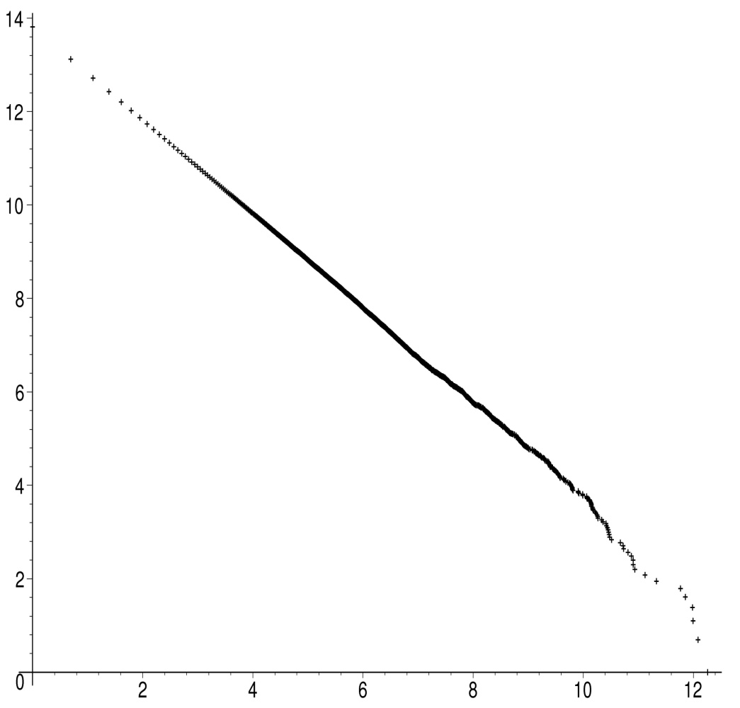
Simulation: p=1, t=5,000

Slide 56
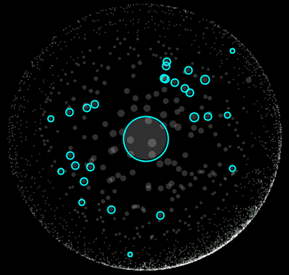
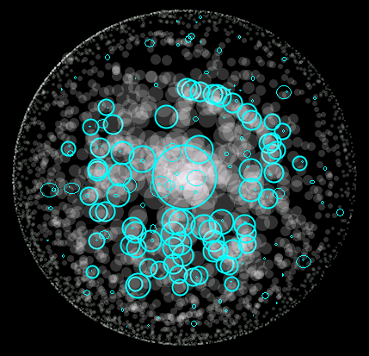
as nodes are born,
they are more
likely to enter some
B_{v} with larger
radius (degree)
over time, a
power law
degree
distribution
results

Slide 57
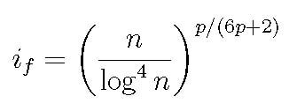
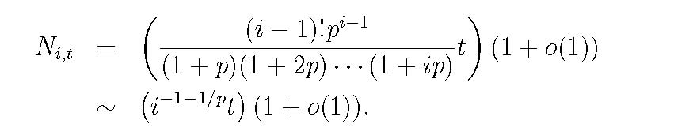
Theorem (ACBJP, 08)
Define
Then a.a.s. for t ≤ n and i ≤ i_{f},
power law exponent 1+1/p

Slide 58
Sketch of proof
derive an asymptotic expression for E(N_{i,t})

Slide 59
solve the recurrence asymptotically:

Slide 60
prove that N_{i,t} is concentrated on E(N_{i,t}) via martingales
standard approach is to use c-Lipshitz condition: change in N_{i,t} is bounded above by constant c
c-Lipschitz property may fail: new nodes may appear in an unbounded number of overlapping regions of influence
prove this happens with exponentially small probabilities using the differential equaton method

Slide 61
Directions and challenges
on-line models where nodes and edges are added and deleted over time
easy to pose, hard to analyze
develop a calculus of complex networks models
mild conditions on model ensure power laws (with concentration), small world, etc.
general to specific:
rigorous models tailored internet graphs, PPI, OSNs, …

Slide 62


Slide 64
Social network analysis
On-line
Milgram (67): average distance between Americans is 6
Watts and Strogatz (98): introduced small world property
Adamic et al. (03): OSN at Stanford
Liben-Nowell et al. (05): LiveJournal
Kumar et al. (06): Flickr, Yahoo!360
Golder et al. (06): Facebook
Ahn et al. (07): Cyworld (South Korea), MySpace and Orkut
Mislove et al. (07): Flickr, YouTube, LiveJournal, Orkut
Java et al. (07): Twitter

Slide 65
(Leskovec, Kleinberg, Faloutsos,05):
many complex networks (including on-line social networks) obey two additional laws:
Densification Power Law
networks are becoming more dense over time; i.e. average degree is increasing
|(E(G_{t})| ≈ |V(G_{t})|ª
where 1 < a ≤ 2: densification exponent

Slide 66
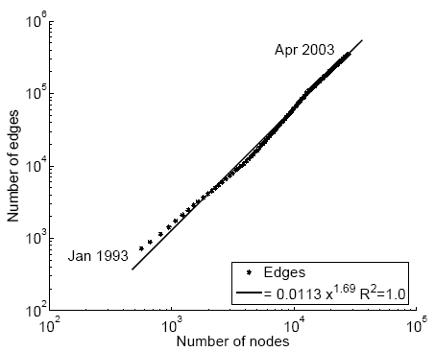
Densification – Physics Citations
1.69

Slide 67
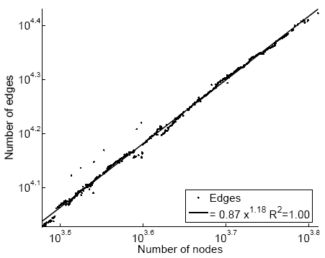
Densification – Autonomous Systems
1.18

Slide 68
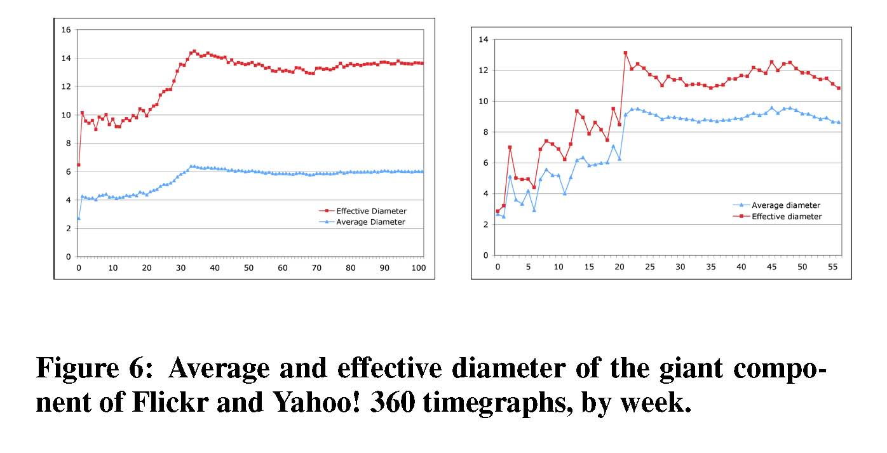
Decreasing distances
distances (diameter and/or average distances) decrease with time
(Kumar et al,06):
Notes:
Diameter first, DPL second
Check diameter formulas
As the network grows the distances between nodes slowly grow

Slide 69

Diameter – ArXiv citation graph
diameter
time [years]

Slide 70

Models for the laws
Leskovec, Kleinberg, Faloutsos (05, 07):
Forest Fire model
stochastic
densification power law, decreasing diameter, power law degree distribution
Leskovec, Chakrabarti, Kleinberg,Faloutsos (05, 07):
Kronecker Multiplication
deterministic
densification power law, decreasing diameter, power law degree distribution

Slide 71

Many different models

Slide 72
Models of OSNs
few models for on-line social networks
goal: find a model which simulates many of the observed properties of OSNs,
densification and shrinking distance
must evolve in a natural way…

Slide 73

Transitivity

Slide 74
Iterated Local Transitivity (ILT) model (Bonato, Hadi, Horn, Prałat, Wang, 08)
key paradigm is transitivity: friends of friends are more likely friends
nodes often only have local influence
evolves over time, but retains memory of initial graph

Slide 75
ILT model
start with a graph of order n
to form the graph G_{t+1} for each node x from time t, add a node x’, the clone of x, so that xx’ is an edge, and x’ is joined to each node joined to x
order of G_{t} is n2^{t}

Slide 76





G₀ = C₄

Slide 77
Properties of ILT model
average degree increasing to with time
average distance bounded by constant and converging, and in many cases decreasing with time; diameter does not change
clustering higher than in a random generated graph with same average degree
bad expansion: small gaps between 1st and 2nd eigenvalues in adjacency and normalized Laplacian matrices of G_{t}

Slide 78
Densification
n_{t} = order of G_{t}, e_{t} = size of G_{t}
Lemma: For t > 0,
n_{t} = 2^{t}n₀, e_{t} = 3^{t}(e₀+n₀) - n_{t}.
→ densification power law:
e_{t} ≈ n_{t}ª, where a = log(3)/log(2).

Slide 79
Proof of Lemma
(1): deg_{t+1}(x) = 2deg_{t}(x)+1, deg_{t+1}(x’) = deg_{t}(x)+1
define:
By (1),
By induction, we derive that
and so

Slide 80

Average distance
Theorem 2: If t > 0, then
average distance bounded by a constant, and converges; for many initial graphs (large cycles) it decreases
diameter does not change from time 0

Slide 81
Clustering Coefficient
Theorem 3: If t > 0, then
c(G_{t}) = n_{t}^{log(7/8)+o(1)}.
higher clustering than in a random graph G(n_{t},p) with same order and average degree as G_{t}, which satisfies
c(G(n_{t},p)) = n_{t}^{log(3/4)+o(1)}

Slide 82
Sketch of proof of lower bound
each node x at time t has a binary sequence corresponding to descendants from time 0, with a clone indicated by 1
let e(x,t) be the number of edges in N(x) at time t
we may show that
e(x,t+1) = 3e(x,t) + 2deg_{t}(x)
e(x’,t+1) = e(x,t) + deg_{t}(x)
if there are k many 0’s in the binary sequence of x, then
e(x,t) ≥ 3^{k-2}e(x,2) = Ω(3^{k})

Slide 83
Sketch of proof, continued
there are many nodes with k many
0’s in their binary sequence
hence,

Slide 84


Adjacency matrix, A

Slide 85
Spectral results
the spectral gap λ of G is defined by
max{|λ₁-1|, |λ_{n-1}-1|}
where 0 = λ₀ ≤ λ₁ ≤ … ≤ λ_{n-1} ≤ 2 are the eigenvalues of the normalized Laplacian of G: I-D^{-1/2}AD^{1/2} (Chung, 97)
for random graphs, λ = o(1)
in the ILT model, λ > ½
bad spectral expansion found in the ILT model characteristic of social networks but not the web graph (Estrada, 06)
in social networks, there are a higher number of intra- rather than inter-community links

Slide 86

…Degree distribution
generate power law graphs from ILT?
ILT model gives a binomial-type distribution

Slide 87

Geometry of OSNs?
OSNs live in social space: proximity of nodes depends on common attributes (such as geography, gender, age, etc.)
IDEA: embed OSN in 2-, 3-
or higher dimensional space

Slide 88
Dimension of an OSN
dimension of OSN: minimum number of attributes needed to classify nodes
like game of “20 Questions”: each question narrows range of possibilities
what is a credible mathematical formula for the dimension of an OSN?

Slide 89

Geometric model for OSNs
we consider a geometric model of OSNs, where
nodes are in m-dimensional Euclidean space
threshold value variable: a function of ranking of nodes

Slide 90
Geometric Protean (GEO-P) Model (Bonato, Janssen, Prałat, 10)
parameters: α, β in (0,1), α+β < 1; positive integer m
nodes live in m-dimensional hypercube
each node is ranked 1,2, …, n by some function r
1 is best, n is worst
we use random initial ranking
at each time-step, one new node v is born, one randomly node chosen dies (and ranking is updated)
each existing node u has a region of influence with volume
add edge uv if v is in the region of influence of u

Slide 91
Notes on GEO-P model
models uses both geometry and ranking
number of nodes is static: fixed at n
order of OSNs at most number of people (roughly…)
top ranked nodes have larger regions of influence

Slide 92

Simulation with 5000 nodes

Slide 93
Simulation with 5000 nodes
random geometric
GEO-P

Slide 94
Properties of the GEO-P model (Bonato, Janssen, Prałat, 2010)
asymptotically almost surely (a.a.s.) the GEO-P model generates graphs with the following properties:
power law degree distribution with exponent
b = 1+1/α
average degree d = (1+o(1))n^{(1-α-β)}/2^{1-α}
densification
diameter D = O(n^{β/(1-α)m} log^{2α/(1-α)m} n)
small world: constant order if m = Clog n

Slide 95
Degree Distribution
for m < k < M, a.a.s. the number of nodes of degree at least k equals
m = n^{1 - α - β} log^{1/2} n
m should be much larger than the minimum degree
M = n^{1 – α/2 - β} log^{-2 α-1} n
for k > M, the expected number of nodes of degree k is too small to guarantee concentration

Slide 96
Density
average number of edges added at each time-step
parameter β controls density
if β < 1 – α, then density grows with n (as in real OSNs)

Slide 97

Diameter
eminent node:
old: at least n/2 nodes are younger
highly ranked: initial ranking greater than some fixed R
partition hypercube into small hypercubes
choose size of hypercubes and R so that
each hypercube contains at least log²n eminent nodes
sphere of influence of each eminent node covers each hypercube and all neighbouring hypercubes
choose eminent node in each hypercube: backbone
show all nodes in hypercube distance at most 2 from backbone

Slide 98
Spectral properties
the spectral gap λ of G is defined by the difference between the two largest eigenvalues of the adjacency matrix of G
for G(n,p) random graphs, λ is large
in the GEO-P model, λ is much smaller
A.Tian (2010): witness bad spectral expansion in real OSN data

Slide 99
Dimension of OSNs
given the order of the network n, power law exponent b, average degree d, and diameter D, we can calculate m
gives formula for dimension of OSN:

Slide 100


Uncovering the hidden reality
reverse engineering approach
given network data (n, b, d, D), dimension of an OSN gives smallest number of attributes needed to identify users
that is, given the graph structure, we can (theoretically) recover the social space

Slide 101
6 Dimensions of Separation
OSN | Dimension
YouTube | 6
Twitter | 4
Flickr | 4
Cyworld | 7

Slide 102

Future directions
what precisely is a community in an OSN?
could help us with applications such as targeted advertising and counterterrorism

Slide 103

Fitting the GEO-P model
simulate GEO-P model
fit model to data
is theoretical estimate of the dimension of an OSN accurate?

Slide 104

Who is popular?
how to find popular users?
not just degree
If you have popular friends, then you should be more popular
dominating sets; Cops and Robbers
“SocialRank” ?
OSN version of Google’s PageRank algorithm

Slide 105



preprints, reprints, contact:
Google: “Anthony Bonato”

Slide 106

journal relaunch
new editors
accepting theoretical and empirical papers on complex networks, OSNs, biological networks

