Slide 1
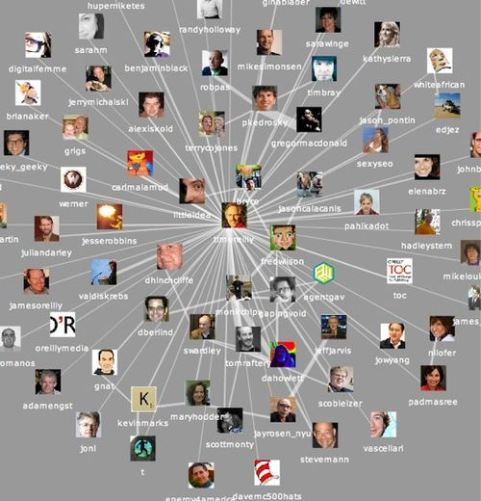
WOSN’10
June 22, 2010
A geometric model for
on-line social networks
Anthony Bonato
Ryerson University

Slide 2
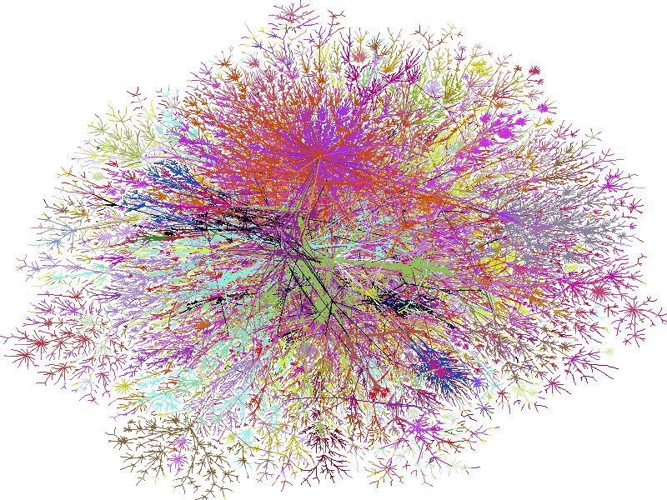
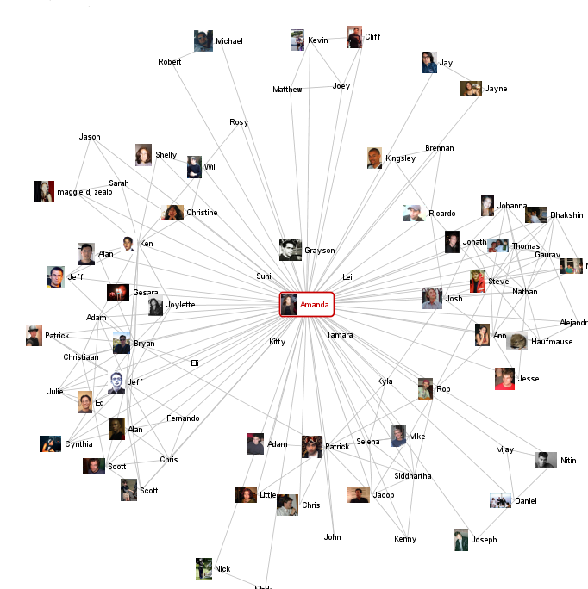
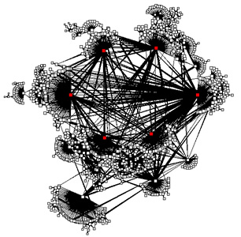
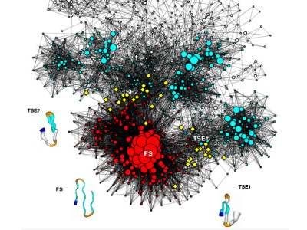
Complex Networks
web graph, social networks, biological networks, internet networks, …

Slide 3
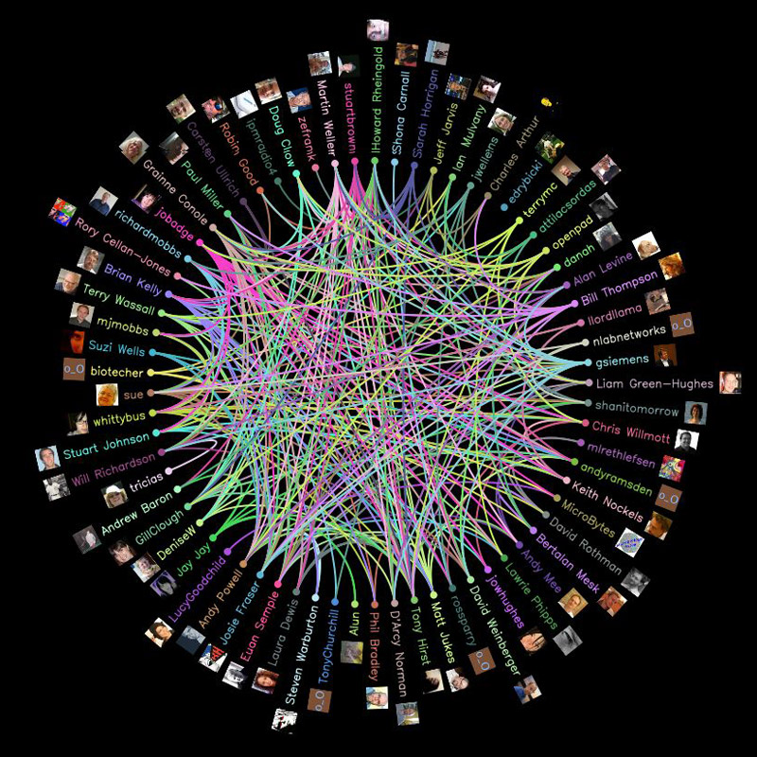
On-line Social Networks (OSNs) Facebook, Twitter, LinkedIn, MySpace…

Slide 4
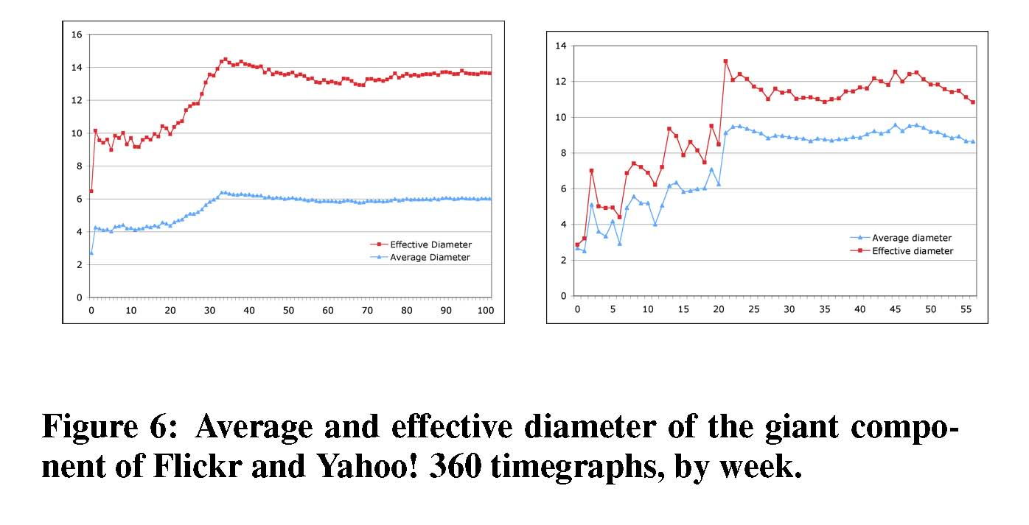
Properties of OSNs
observed properties:
power law degree distribution, small world
community structure
densification power law and shrinking distances
(Kumar et al,06):

Slide 5
Why model complex networks?
uncover and explain the generative mechanisms underlying complex networks
predict the future
nice mathematical challenges
models can uncover the hidden reality of networks

Slide 6
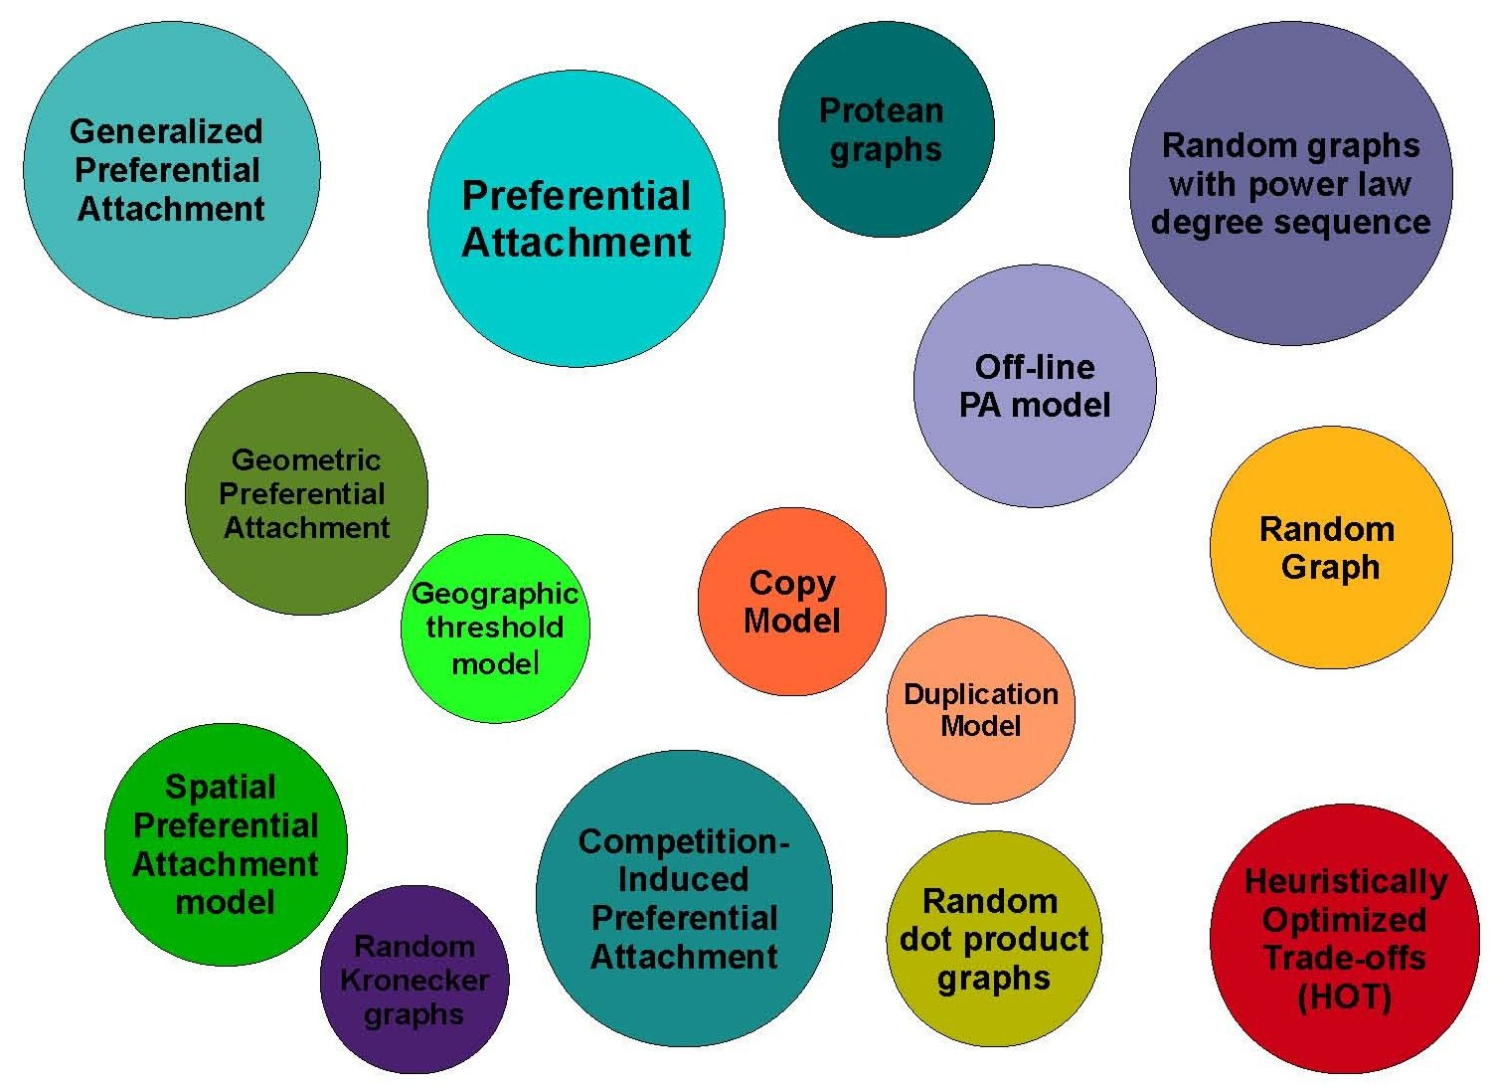
Many different models

Slide 7
Models of OSNs
relatively few models for on-line social networks
goal: find a model which simulates many of the observed properties of OSNs
must evolve in a natural way…

Slide 8
“All models are wrong, but some are more useful.”
– G.P.E. Box

Slide 9
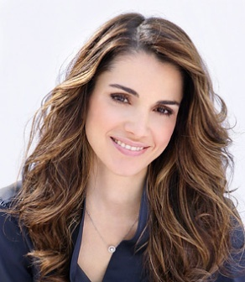

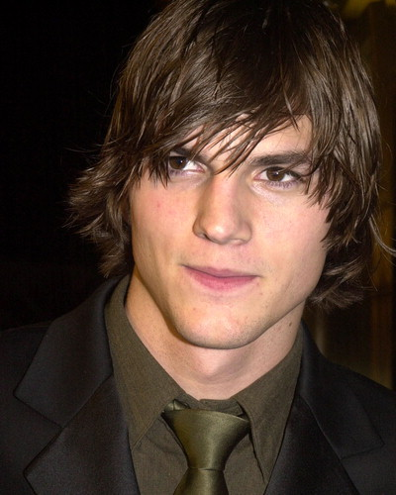
Transitivity

Slide 10
Iterated Local Transitivity (ILT) model (Bonato, Hadi, Horn, Prałat, Wang, 08)
key paradigm is transitivity: friends of friends are more likely friends
nodes often only have local influence
evolves over time, but retains memory of initial graph

Slide 11
ILT model
start with a graph of order n
to form the graph G_{t+1} for each node x from time t, add a node x’, the clone of x, so that xx’ is an edge, and x’ is joined to each node joined to x
order of G_{t} is n2^{t}

Slide 12
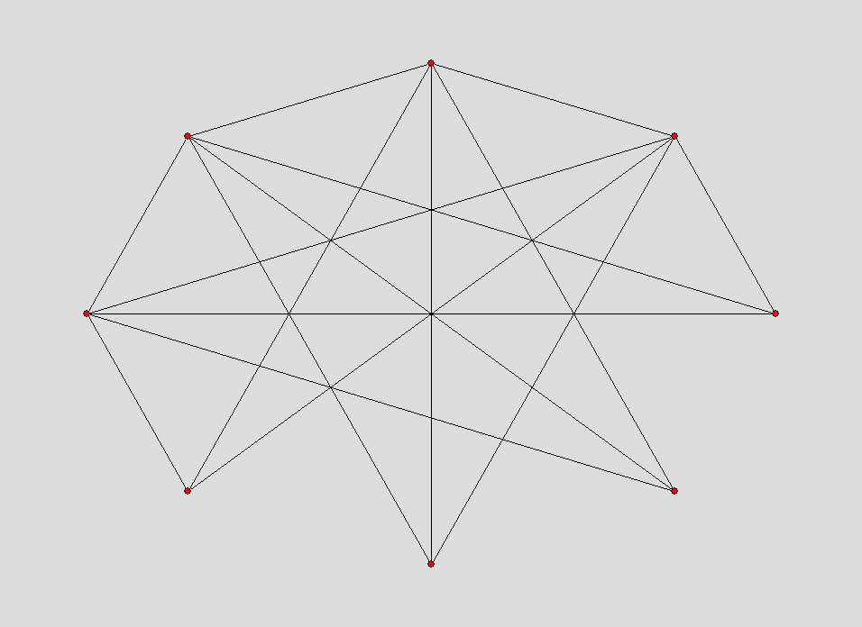
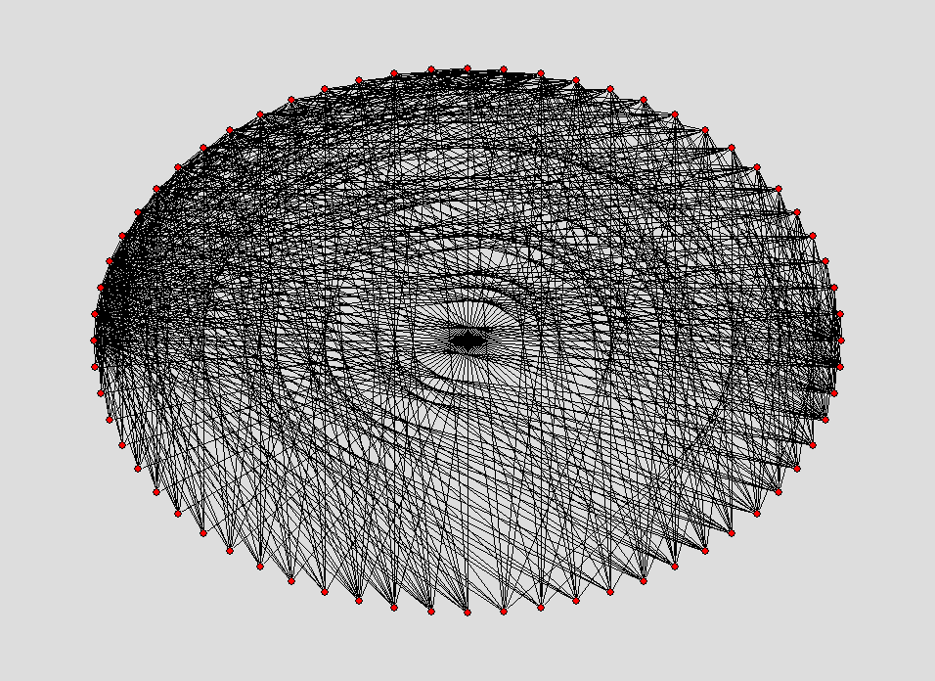
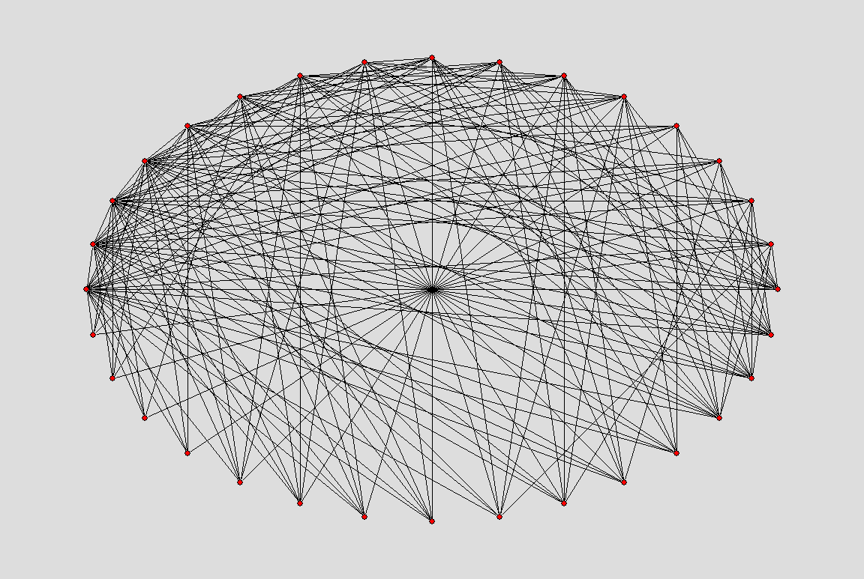
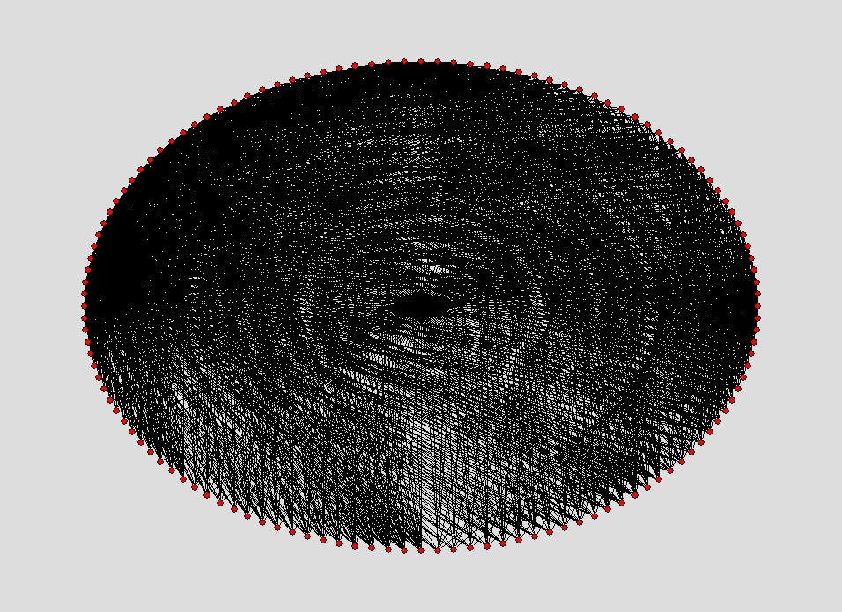
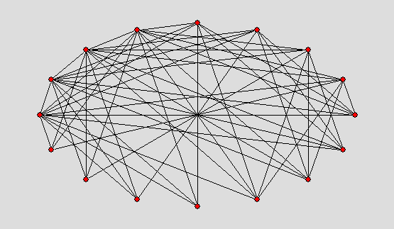
G₀ = C₄

Slide 13
Properties of ILT model
densification power law
distances decrease over time
community structure: bad spectral expansion (Estrada, 06)

Slide 14
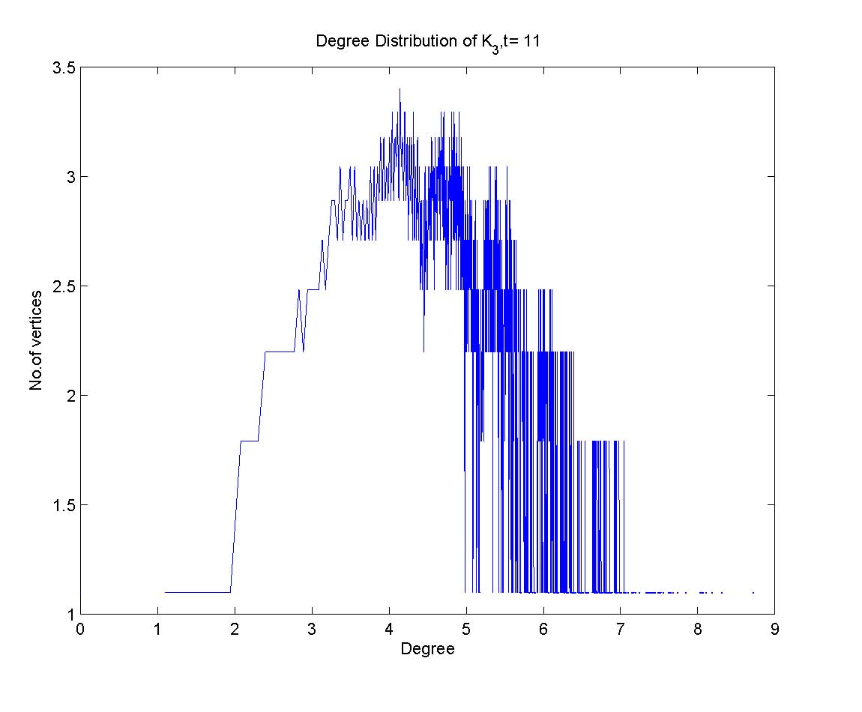
…Degree distribution

Slide 15
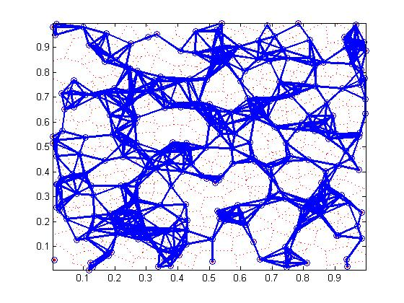
Geometry of OSNs?
OSNs live in social space: proximity of nodes depends on common attributes (such as geography, gender, age, etc.)
IDEA: embed OSN in 2-, 3-
or higher dimensional space

Slide 16
Dimension of an OSN
dimension of OSN: minimum number of attributes needed to classify or group users
like game of “20 Questions”: each question narrows range of possibilities
what is a credible mathematical formula for the dimension of an OSN?

Slide 17
Random geometric graphs
nodes are randomly placed in space
each node has a constant sphere of influence
nodes are joined if their sphere of influence overlap

Slide 18
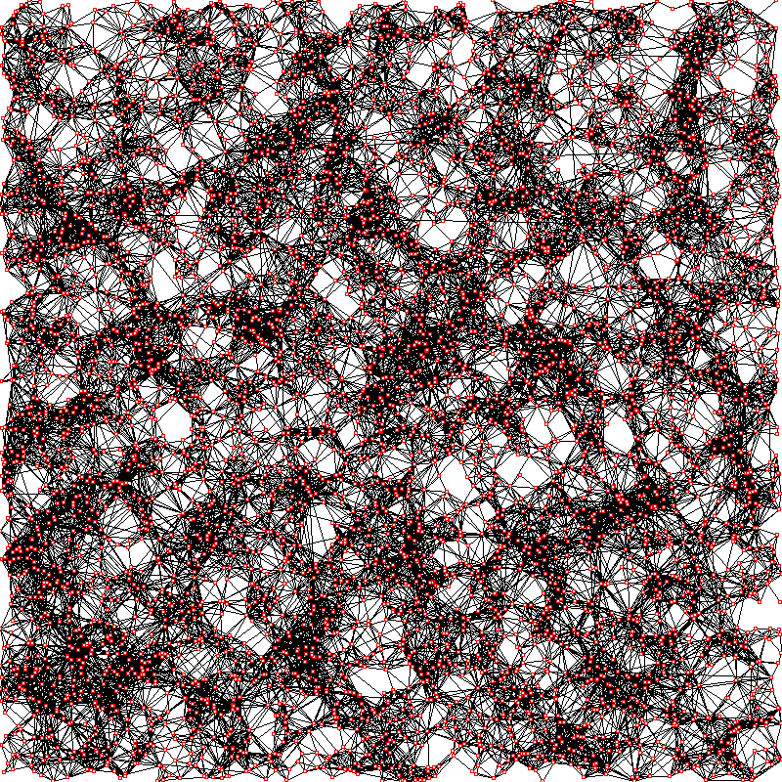
Simulation with 5000 nodes

Slide 19
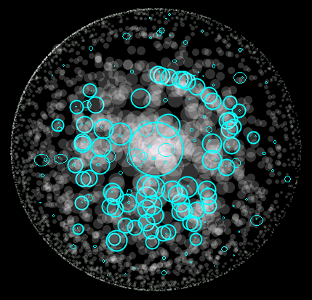
SPA model (Aiello, Bonato, Cooper, Janssen, Prałat, 08)
volume of sphere of influence proportional to in-degree
nodes are added and spheres of influence shrink over time

Slide 20
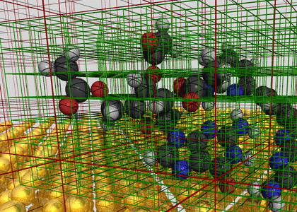
Geometric model for OSNs
we consider a geometric model of OSNs, where
nodes are in m-dimensional hypercube in Euclidean space
volume of sphere of influence variable: a function of ranking of nodes

Slide 21
Geometric Protean (GEO-P) Model (Bonato, Janssen, Prałat, 10)
parameters: α, β in (0,1), α+β < 1; positive integer m
nodes live in m-dimensional space
each node is ranked 1,2, …, n by some function r
1 is best, n is worst
we use random initial ranking
at each time-step, one new node v is born, one randomly node chosen dies (and ranking is updated)
each existing node u has a sphere of influence with volume
add edge uv if v is in the region of influence of u

Slide 22
Notes on GEO-P model
models uses both geometry and ranking
number of nodes is static: fixed at n
order of OSNs at most number of people (roughly…)
top ranked nodes have larger regions of influence

Slide 23
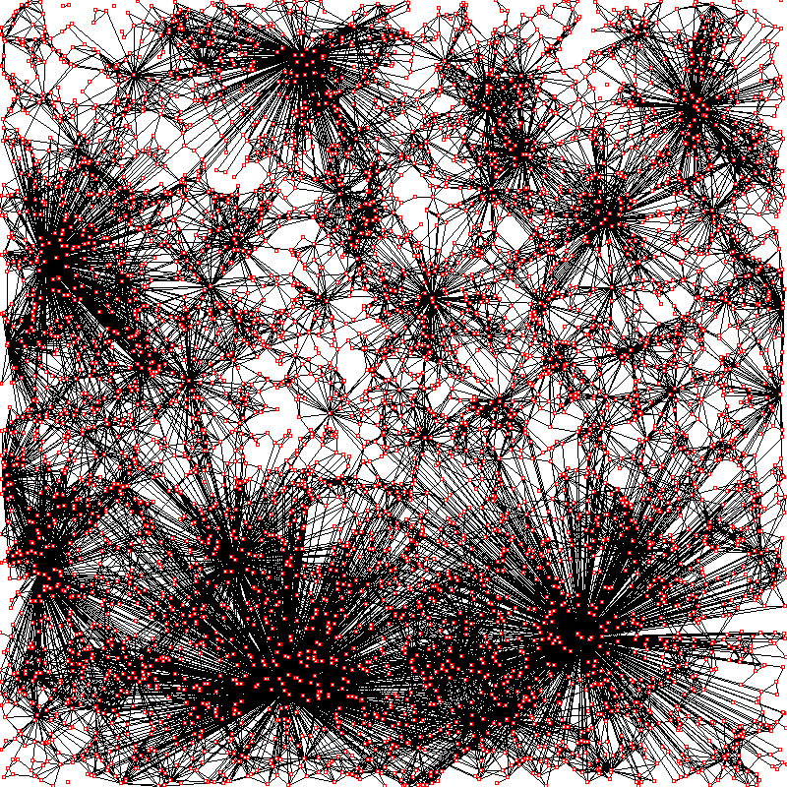
Simulation with 5000 nodes

Slide 24
Simulation with 5000 nodes
random geometric
GEO-P

Slide 25
Properties of the GEO-P model (Bonato, Janssen, Prałat, 2010)
asymptotically almost surely (a.a.s.) the GEO-P model generates graphs with the following properties:
power law degree distribution with exponent
b = 1+1/α
average degree d = (1+o(1))n^{(1-α-β)}/2^{1-α}
densification
diameter D = O(n^{β/(1-α)m} log^{2α/(1-α)m} n)
small world: constant order if m = Clog n

Slide 26
Degree Distribution
for m < k < M, a.a.s. the number of nodes of degree at least k equals
m = n^{1 - α - β} log^{1/2} n
m should be much larger than the minimum degree
M = n^{1 – α/2 - β} log^{-2 α-1} n
for k > M, the expected number of nodes of degree k is too small to guarantee concentration

Slide 27
Density
average number of edges added at each time-step
parameter β controls density
if β < 1 – α, then density grows with n (as in real OSNs)

Slide 28
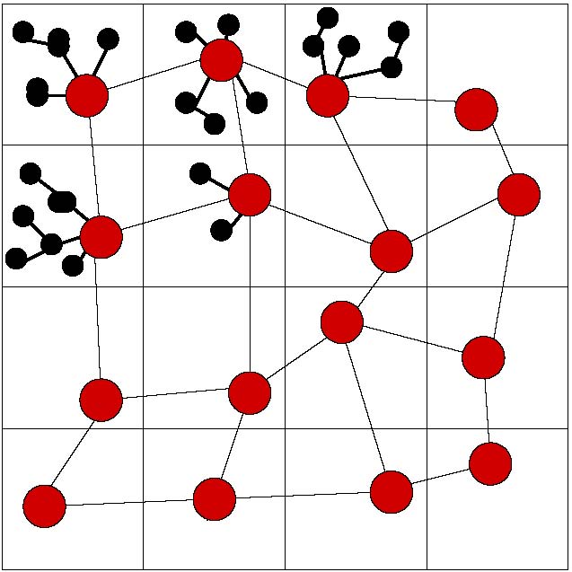
Diameter
eminent node:
old: at least n/2 nodes are younger
highly ranked: initial ranking greater than some fixed R
partition hypercube into small hypercubes
choose size of hypercubes and R so that
each hypercube contains at least log²n eminent nodes
sphere of influence of each eminent node covers each hypercube and all neighbouring hypercubes
choose eminent node in each hypercube: backbone
show all nodes in hypercube distance at most 2 from backbone

Slide 29
Spectral properties
the spectral gap λ of G is defined by the difference between the two largest eigenvalues”of the adjacency matrix of G
for G(n,p) random graphs, λ tends to 0 as order grows
in the GEO-P model, λ is close to 1
bad expansion/big spectral gaps in the GEO-P model found in social networks but not in the web graph (Estrada, 06)
in social networks, there are a higher number of intra- rather than inter-community links

Slide 30
Dimension of OSNs
given the order of the network n, power law exponent b, average degree d, and diameter D, we can calculate m
gives formula for dimension of OSN:

Slide 31
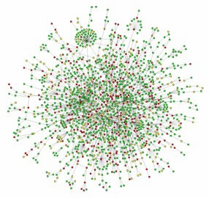
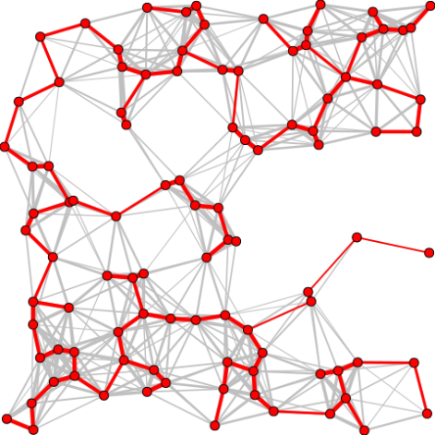
Uncovering the hidden reality
reverse engineering approach
given network data (n, b, d, D), dimension of an OSN gives smallest number of attributes needed to identify users
that is, given the graph structure, we can (theoretically) recover the social space

Slide 32
6 Dimensions of Separation
OSN | Dimension
YouTube | 6
Twitter | 4
Flickr | 4
Cyworld | 7

Slide 33
Research directions
fitting GEO-P model to data
is theoretical estimate of dimension of log n accurate?
find similarity measures (as with PPI)
community detection
first map network in social space
spread of influence
SIS, SIR models
firefighting, Cops and Robbers

Slide 34





preprints, reprints, contact:
Google: “Anthony Bonato”

Slide 35

journal relaunch
new editors
accepting theoretical and empirical papers on complex networks, OSNs, biological networks

