Slide 1


VARiD: A Variation Detection Framework for Color- and Letter-Space platforms
Adrian Dalca^{1,2}, Steven Rumble³, Sam Levy⁴, Michael Brudno^{2,5}
Massachusetts Institute of Technology
University of Toronto
Stanford University
The Scripps Research Institute
Donnelly Centre and the Banting and Best Department of Medical Research

Slide 2
Variation detection from NGS reads
Determine differences (variation) between reference and donor using NGS reads of the donor
Reference: TCAGCATCGGCATCGACTGCACAGGACCAGTCGATCGAC
Donor: ???????????????????????????????????????
GCATCGACTGCA
CGGGATCGACTG
Aligned reads: ATCCATTGCA
GATCCACTGCAC
motivation | methods | results | summary

Slide 3
Motivation
Color-space and Letter-space platforms
bring them together
Methods
Results
Summary

Slide 4
Sequencing Platforms
> NC_005109.2 | BRCA1 SX3
TCAGCATCGGCATCGACTGCACAGG
letter-space
Sanger, 454, Illumina, etc
color-space
AB SOLiD
less software tools available
> NC_005109.2 | BRCA1 AF3
T212313230313232121311120
many differences -> useful to combine this information
sequencing biases
inherent errors
advantages
motivation | methods | results | summary
Notes:
Mention that we use numbers for colors
- Don’t List Differences

Slide 5
Color Space
Translation Matrix
Translation Automata
> T212313230313232121311120
motivation | methods | results | summary

Slide 6
Color Space
Translating
> T212313230313232121311120
> T
C
A
G
C
A
T
C
G
G
C
A
T
C
G
A
C
T
G
C
A
C
A
G
G
A
G
Sequencing Error vs SNP
Sequencing Error
> T212313230313232121311120
> T212313230310232121311120
> TCAGCATCGGCAAGCTGACGTGTCC
SNP
> TCAGCATCGGCATCGACTGCACAGG > TCAGCATCGGCAGCGACTGCACAGG
> T212313230312332121311120
C
T
motivation | methods | results | summary
Notes:
Known first letter –part of the linker, not of the read

Slide 7

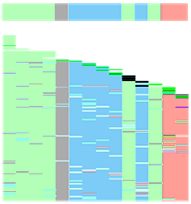
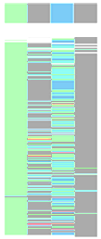
Color Space
clear distinction between a sequencing error and a SNP
can this help us in SNP detection? sounds like it!
single color change → error,
2 colors changed → (likely) SNP.
Easy snp call
Well covered bases
Difficult Case
reference in
color-space
reads
position
motivation | methods | results | summary

Slide 8
Motivation
Motivation
variation caller to handle both letter-space & color-space reads
Detection
Heterozygous SNPs
Homozygous SNPs
Tri-allelic SNPs
small indels
account for various errors, quality values & misalignments
VARiD
system to make inferences on the donor bases
variation detection
motivation | methods | results | summary

Slide 9
Motivation
Methods
Simple HMM Model
states, emissions, transitions, FB
Extended HMM Model
gaps, diploids, exceptions
Results
Summary

Slide 10
Hidden Markov Model (HMM)
Statistical model for a system - states
Assume that system is a Markov process with state unobserved.
Markov Process: next state depends only on current state
We can observe the state’s emission (output)
each state has a probability distribution over outputs
S₁
S₂
S₃
e₁
e₁
e₁
e₂
e₂
e₂
motivation | methods | results | summary

Slide 11
Hidden Markov Model (HMM)
Apply HMM to variation detection:
we don’t know the state (donor), but
we can observe some output determined by the state (aligned reads)
motivation | methods | results | summary

Slide 12
Hidden Markov Model (HMM)
unknown donor
. . . . . B₆ B₇ B₈ B₉ . . . . .
B₆ B₇
B₇ B₈
B₈ B₉
AA
AA
AA
AC
AC
AC
color 0
color 0
color 0
color 1
color 1
color 1
motivation | methods | results | summary
Notes:
- Will go to states, emissions and transitions

Slide 13
States
B₆ B₇
The donor could be:
letters: AA color 0
letters: AC color 1
:
letters: TT color 0
16 combinations
Why pairs of letters? Handle colors.
AA and TT gives the same colors. Can’t just model colors
motivation | methods | results | summary
Notes:
REDUNDANT?

Slide 14
Transitions
. . . B₆ B₇ B₈ . . .
States
16 possible states
only look at second letter
B₆ B₇
B₇ B₈
AA
AA
:
.
.
.
.
.
.
.
.
.
AT
CA
Transitions
only certain transitions allowed
when allowed, p(X_{t}|X_{t-1}) = freq(X_{t})
each state depends only on the previous states (Markov Process)
Possible States
:
CT
GA
:
:
TT
TT
motivation | methods | results | summary
Notes:
- Will go to states, emissions and transitions

Slide 15
Emissions
Unknown
genome
..... B₆B₇B₈B₉ .....
B₇ B₈
Color
reads
T01020100311223
T1030101311223
T20100311223
color 0
color 1
color 0
Letter
reads
ATTGCGCAATGCG
TTGGGCAATGCGA
GCGCACTGCGAC
AA
AA
AC
motivation | methods | results | summary

Slide 16
Emission Probabilities
AA
probability
p(em|AA)
emission
color 0
1 – 3ε
TT
color 1
ε
Same color emission
distribution
color 2
ε
color 3
ε
letters A
1- 3ξ
letters C
ξ
TT
letters G
ξ
Different letter emission
distribution
letters T
ξ
motivation | methods | results | summary

Slide 17
Emission Probabilities
..... B₆B₇B₈B₉ .....
Combining emission probabilities
probability that this state emitted these reads.
T01020100311223
T1030101311223
T20100311223
E.g. For state CC:
ATTGCGCAATGCG
TTGGGCAATGCGA
GCGCACTGCGAC
motivation | methods | results | summary

Slide 18
Simple HMM
Summary
unknown state
donor pair at location
transitions
transition probabilities
emissions
reads at location
emission probabilities
B₆ B₇
AA
AC
color 0
color 1
motivation | methods | results | summary

Slide 19
Forward-Backward Algorithm
Have set-up a form of an HMM
run Forward-Backward algorithm
get probability distribution over states at each position
AA
:
AT
likely state
CA
:
CT
Variation Detection:
compare most likely state with reference:
ref: GCTATCCA
don: ...AT...
GA
:
:
TT
probability
motivation | methods | results | summary
Notes:
- FB intuition !!!

Slide 20
Motivation
Methods
Simple HMM Model
states, emissions, transitions, FB
Extended HMM Model
gaps, diploids, exceptions
Results
Summary

Slide 21
Extended HMM
Simple HMM
only detects homozygous SNPs
Extended HMM:
short indels
heterozygous SNPs
complex error profiles & quality values
motivation | methods | results | summary

Slide 22
Expansion: Gaps and heterozygous SNPs
Expand states
Have states that include gaps
emit: gap or color
A-
--
-G
AG TG
Have larger states, for diploids
T- T-
Transitions built in similar fashion as before
Same algorithm, but in all we have 1600 states with very sparse transitions
motivation | methods | results | summary

Slide 23
Expansion
Emission probabilities
Support quality values
Use variable error rates for emissions
Translate through the first color
first color is incorrect
letter-space signal
Donor: ACAGCATCGGCATCGACTGC 1123132303123321213 read: >T2123132303123321213 > C123132303123321213
Post-process putative SNPs
correlated adjacent errors may support het SNPs
check putative SNPs
motivation | methods | results | summary
Notes:
know the error rate (= error rate at first color) note: not ok to translate the whole read due to effects of color-space error, but one letter is safe. handle like a normal letter-space emission

Slide 24
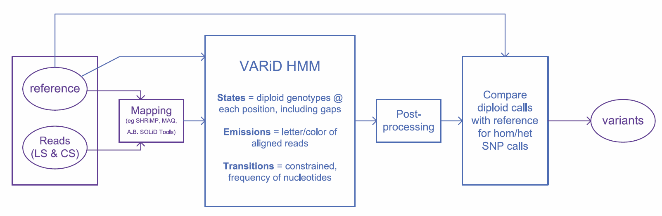
Summary
blue: varid steps
motivation | methods | results | summary

Slide 25
Motivation
Methods
Results
Summary

Slide 26
Results
Human dataset from Harismendy et al, 2009. (NA17156,17275,17460,17773)
454, SOLiD, Sanger
Color-space dataset:
Compare random subsets:
Corona (with AB mapper)
VARiD (with SHRiMP)
VARiD (with AB mapper)
Conclusions:
the three pipelines perform
very similarly.
High-coverage results is as good as can be achieved
F-measure
motivation | methods | results | summary
Notes:
SAY: Although VARiD should be used to combine datasets, for now we only tested it on purely color-space data
SAY: (most FN?) Low coverage for the 2nd allele- add a column for indels?

Slide 27
Results
F-measure
Letter-space dataset:
Compare random subsets :
GigaBayes (with Mosaik)
VARiD (with SHRiMP)
VARiD (with Mosaik)
Conclusion:
the three pipelines perform
very similarly.
High-coverage results is as good as can be achieved
motivation | methods | results | summary
Notes:
SAY: Although VARiD should be used to combine datasets, for now we only tested it on purely color-space data
SAY: (most FN?) Low coverage for the 2nd allele- add a column for indels?

Slide 28
Results
VARiD Motivation:
Combining Letter-space and Color-space data to achieve increased accuracy in at-cost comparison
Assuming a same-cost
comparison of:
VARiD
 |  |  | letter-space
 | F-meas. | 0x | 1x | 2.5x | 5x | 10x
Color-space | 0x | 0.0 | 19.4 | 43.5 | 59.1 | 71.7
 | 10x | 47.8 | 51.8 | 59.4 | 69.5 | 76.5
 | 20x | 60.6 | 58.9 | 65.3 | 73.4 | 80.3
 | 50x | 73.1 | 69.8 | 73.6 | 80.0 | 83.5
 | 100x | 75.6 | 75.2 | 77.9 | 82.7 | 86.0
10x letter-space (LS)
100x color-space (CS)
5x LS and 50x CS
motivation | methods | results | summary
Notes:
SAY: Although VARiD should be used to combine datasets, for now we only tested it on purely color-space data
SAY: (most FN?) Low coverage for the 2nd allele- add a column for indels?

Slide 29
Motivation
Methods
Results
Summary

Slide 30
Summary
Summary of VARiD
HMM modeling underlying donor
Treats color-space and letter-space together in the same framework
no translation – take advantage of each technology’s properties
accurately calls SNPs, short indels in both color- and letter-space
improved results with hybrid data.
Website: http://compbio.cs.utoronto.ca/varid (VARiD freely available)
Contact: varid@cs.utoronto.ca
motivation | methods | results | summary
Notes:
For ADJ SNP: would need an extra run
Stress: Fully Probabilistic
TOOK OUT ADJACENT SNPs example

Slide 31






Acknowledgements
Acknowledgements
Steven Rumble, Sam Levy, Michael Brudno
Misko Dzamba
Funding
Partial Participant Support Award :
ISCB, Department of Energy, and National Science Foundation
Website: http://compbio.cs.utoronto.ca/varid (VARiD freely available)
Contact: varid@cs.utoronto.ca
motivation | methods | results | summary
Notes:
For ADJ SNP: would need an extra run
Stress: Fully Probabilistic
TOOK OUT ADJACENT SNPs example

