Slide 1
Radon Diffusion In Polyethylene
Motivation
PE used as shielding in DM experiments
Rn daughter ²¹⁰Po may produce neutrons (α,n)
Determine allowed exposure of PE to air
Experimental Setup – Diffusion Model
Measurement – Efficiency Simulation
Data Analysis
Motivation
Experimental Setup – Diffusion Model
Measurement – Efficiency Simulation
Data Analysis
Wolfgang Rau
Queen’s University Kingston

Slide 2
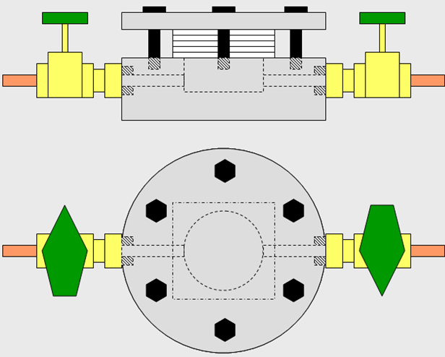
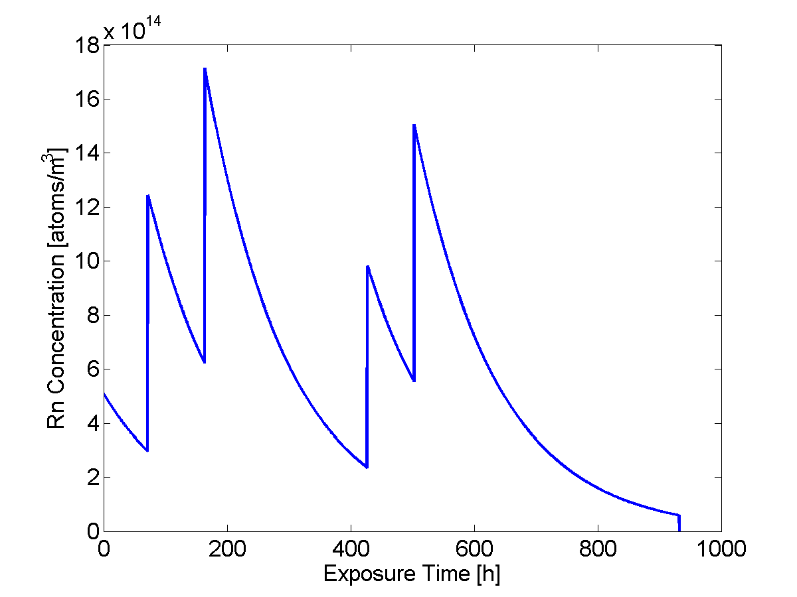
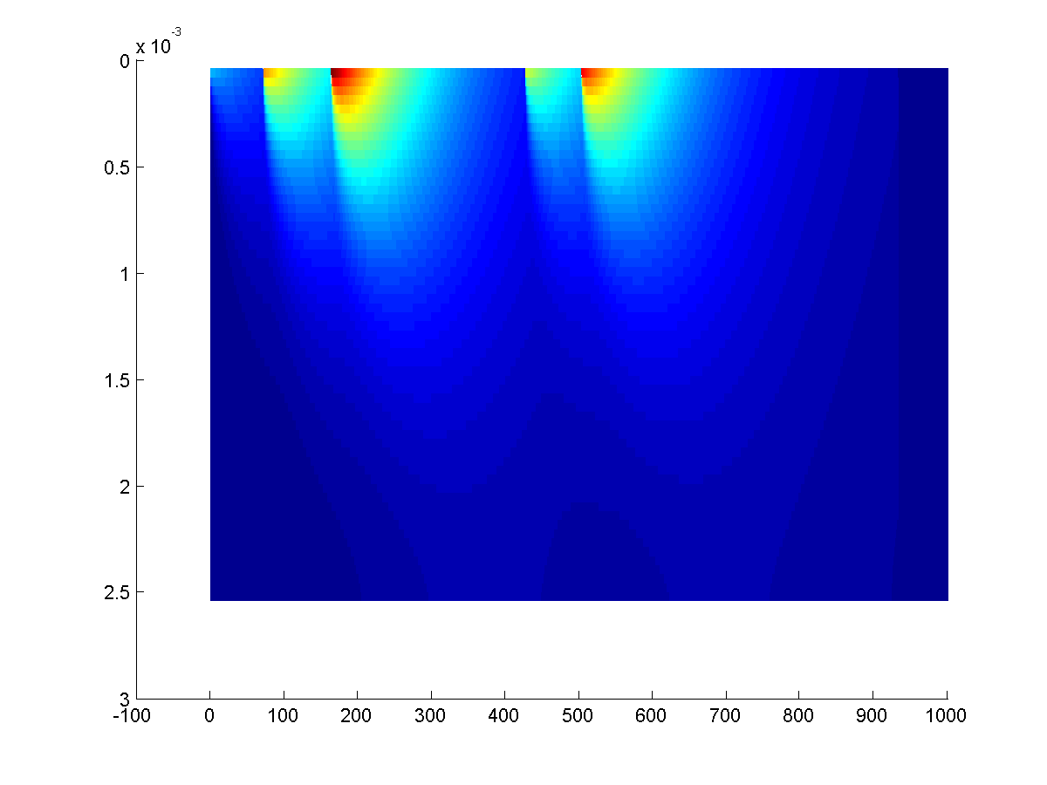
1 Exposure - Diffusion
Constant Rn concentration
infinite exposure time → exponential profile
Actual Rn concentration C(t) (example):
→ need a diffusion and decay model
Radon Chamber
PE sample
(stack of
sheets)
t
x
Fill radon into chamber repeatedly
Let it diffuse and decay
t
x

Slide 3
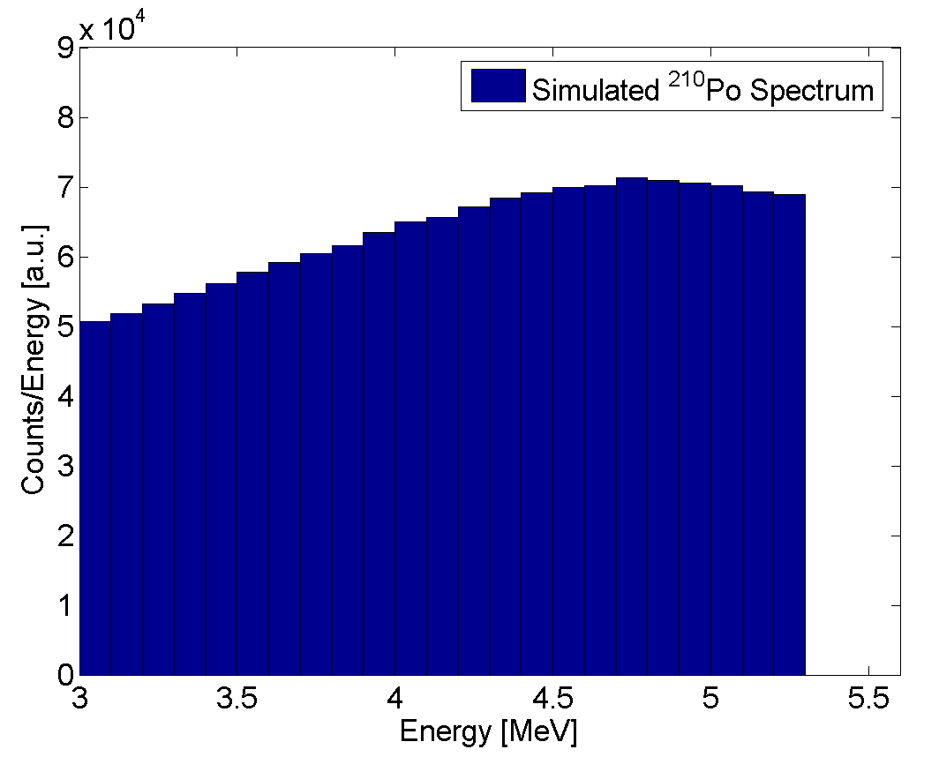
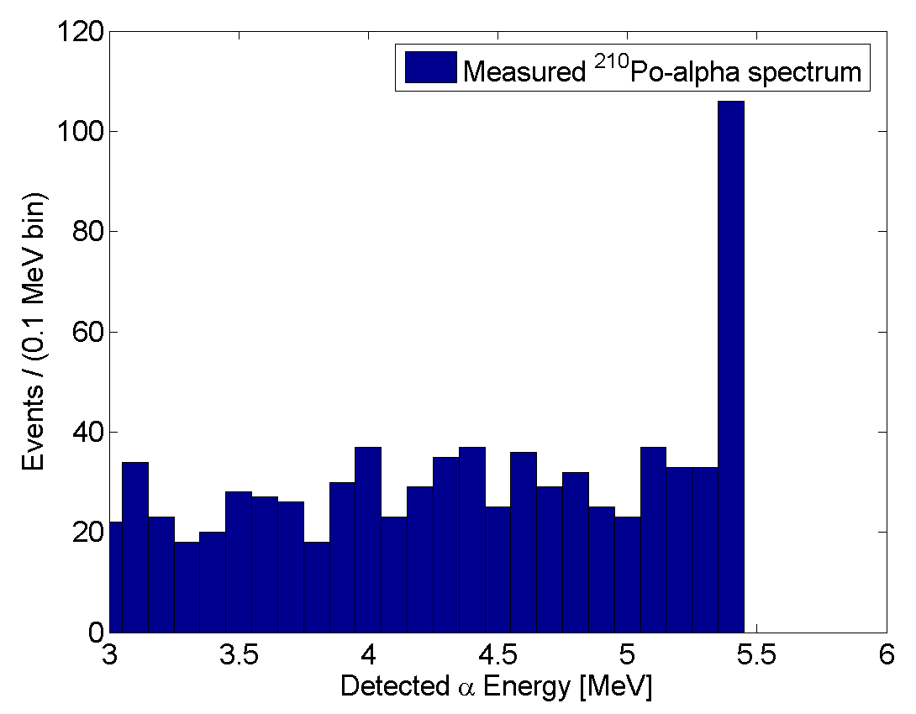
2 Detection
α Detector
Monte Carlo for α emission (geometry)
Determine α energy loss in PE (SRIM) → detection efficiency and E spectrum
Rn decay in air pockets → surface Po
→ ignore high energy events
PE
α detector: Ortec, NIM module with two detector chambers MCA, Maestro

Slide 4
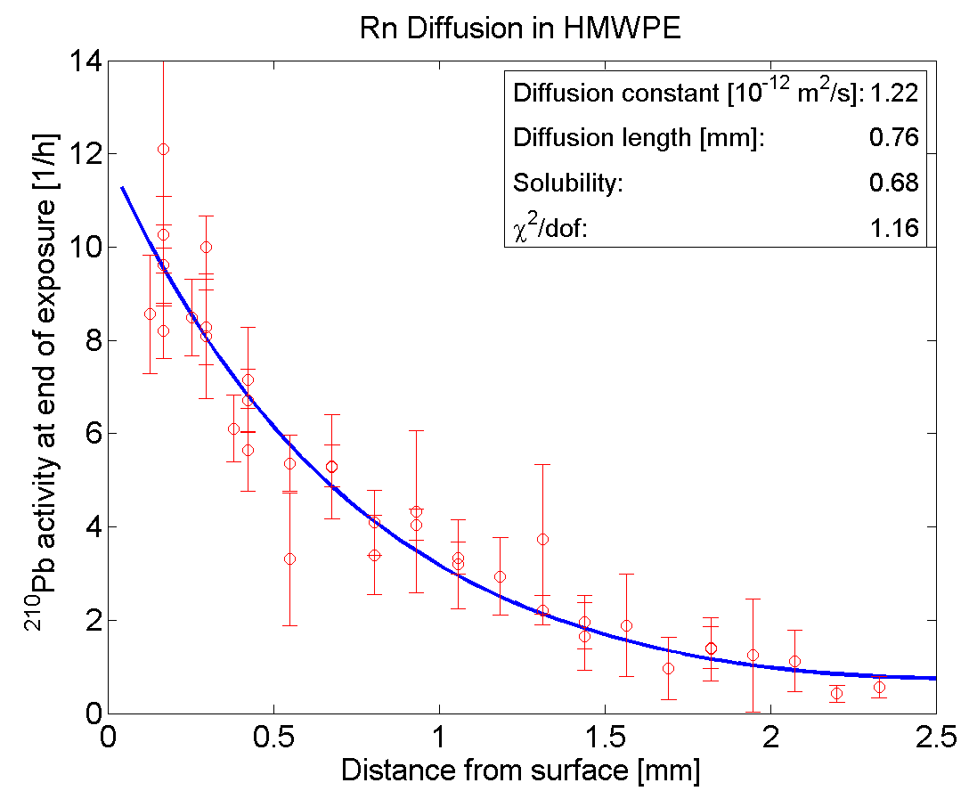
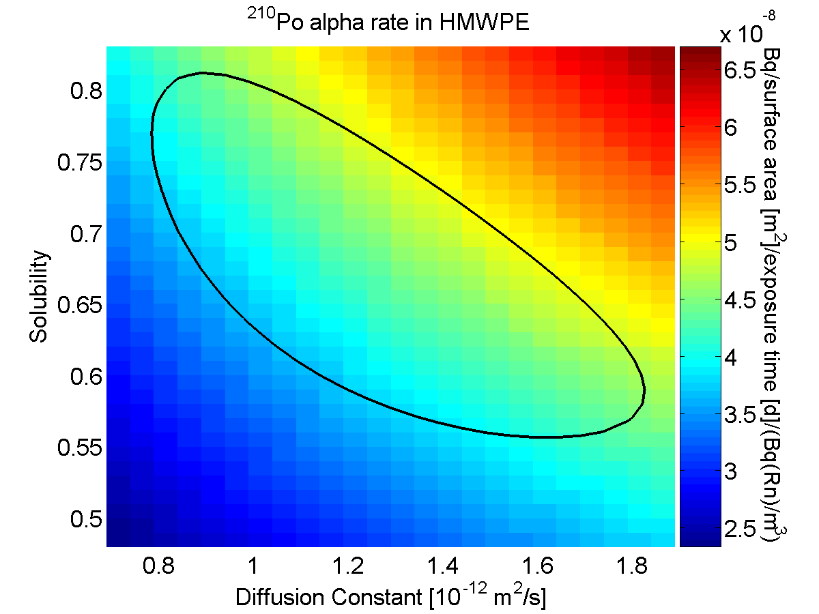
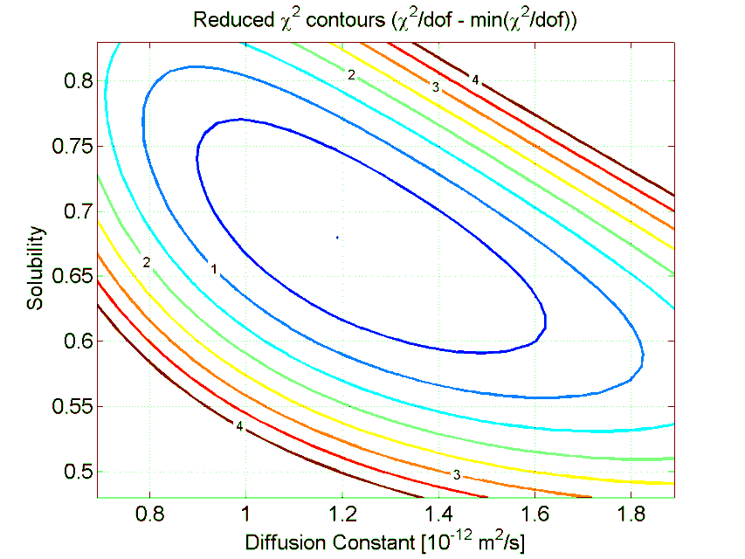
3 Analysis
NOTE: ²¹⁰Po continues to build up long after exposure (part of diff & decay model)
Fit model with 2 free parameters (diffusion constant and solubility) to data
For visualization: extrapolate and convert measured Po rate to ²¹⁰Pb rate at end of exposure based on best fit model parameters
Calculated χ² contours to determine uncertainties → two parameters correlated
Calculate ²¹⁰Po activity → uncertainty surprisingly small

Slide 5
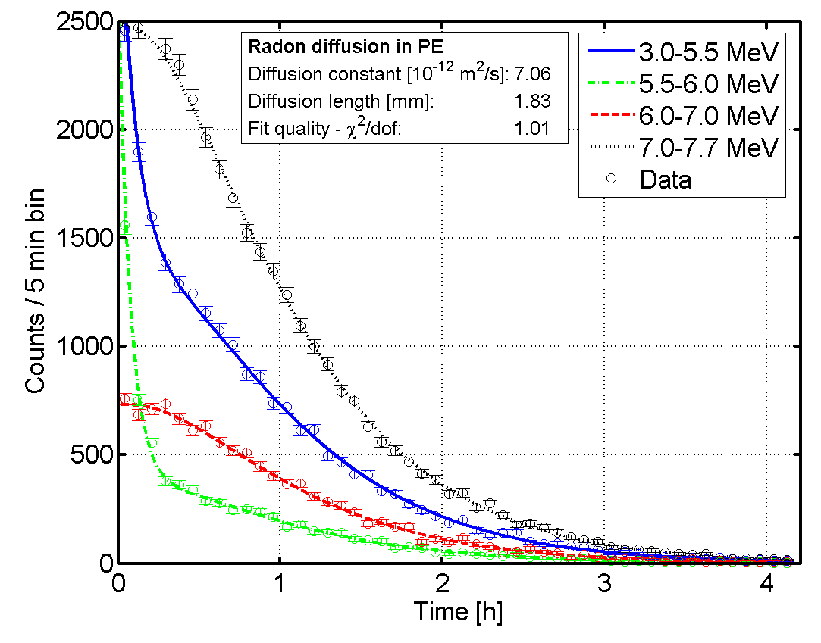
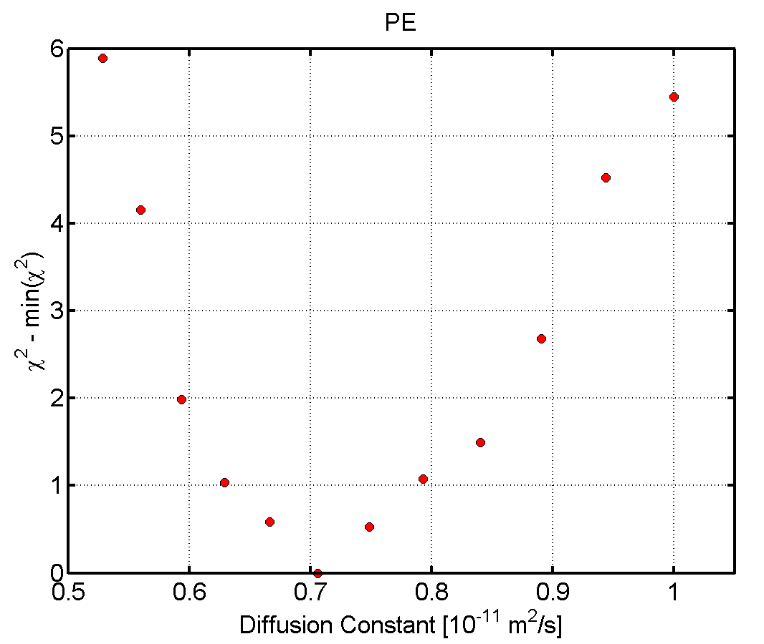
4 Short-lived Daughters
Expose single sheet
Measure immediately after end of exposure
Modeled αs from ²²²Rn, ²¹⁸Po and ²¹⁴Po
3 parameters: diff. constant, surface activity, Δt (end of exposure – start of measurement)
NO solubility
Evaluate in 4 energy bins
Good agreement between model and data
Diffusion constant significantly larger

Slide 6
5 Results
 | ²¹⁰Po |  |  | Short-lived
 | Solubility | Diff const [e12 m²/s] | Diff length [mm] | Diff const [e12 m²/s] | Diff length [mm]
UHMWPE | 0.68 ± 0.10 | 1.2 ± 0.2 | 0.76 ± 0.06 | 6.0 ± 0.8 | 1.7 ± 0.1
PE | 0.45 ± 0.07 | 3.7 +1.4-1.0 | 1.3 ± 0.20 | 7.1 ± 0.8 | 1.8 ± 0.1
Additional systematics
Actual Rn activity
Air pockets likely small
Lateral diffusion (< 10 %)
Vacuum?
Humidity?
6 Conclusion
7 Thanks
Method works reasonably well
Potential to reduce systematics
n production in PE not yet determined
To my (summer) students:
Brian Drover,
Mina Rohanizadegan,
Graham Edge, Hai Jun Cho

