Slide 1


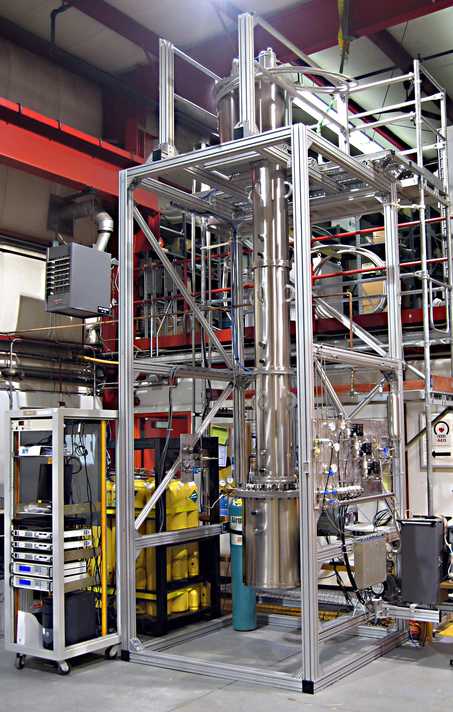
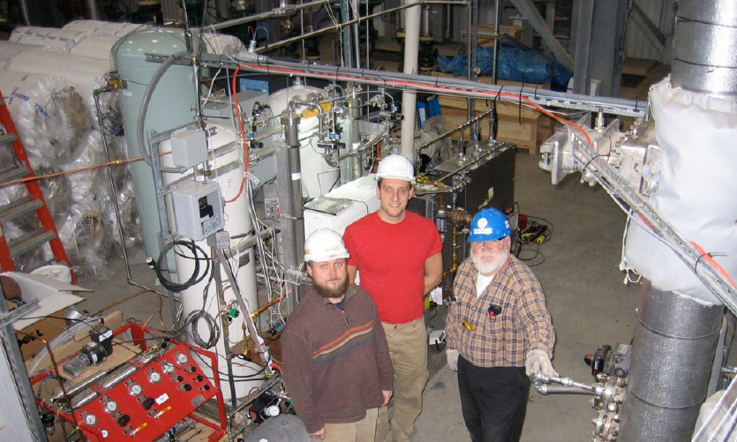
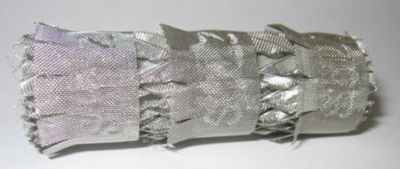
Depleted Argon From Underground Sources
A. Alton¹, H. O. Back², C. Galbiati², A. Goretti², C. Kendziora³, B. Loer², D. Montanari², P. Mosteiro², S. Pordes³
Augustana College
Princeton University
Fermi National Accelerator Laboratory
As a strong scintillator argon is an ideal medium for Dark Matter detection. However, a limiting contamination in atmospheric argon is the beta emitter ³⁹Ar (³⁹Ar → ³⁹K + e⁻ +‾ν_{e} (Q = 535 keV)). It is possible to reject beta events through pulse shape analysis, but ³⁹Ar limits the size of a detector due to event pile-up. ³⁹Ar is produced in the upper atmosphere in ⁴⁰Ar(n,2n) reactions, and is found in the atmosphere at a level of 8.1×10⁻¹⁶ ³⁹Ar/⁴⁰Ar; corresponding to more than 1 Bq/kg of atmospheric argon. A place to search for argon gas deplete in ³⁹Ar is deep underground where the cosmic ray flux is highly suppressed and therefore ³⁹Ar production rate is significantly reduced. We have identified a CO₂ well in southwestern Colorado that contains argon. The ³⁹Ar concentration in this argon has been measured to be reduced by more than a factor of 25. However, the argon must be extracted from the CO₂ and further purified in order to be used in a detector.
Chromatographic Gas Separation
Getting the argon
Continuous Distillation Gas Separation
Purifying the argon
He, Ar, N₂ mixture
It is possible to trap gases on an absorptive media, while allowing other gases to pass. The absorptive media will eventually become saturated with the trapped gases, but the absorption efficiency is proportional to the pressure. We therefore absorb gases under pressure, and force the release of the gases by pumping a vacuum on the media. The media is then regenerated for further absorption.
Gas flows through one column under pressure. CO₂, O₂, H₂O and CH₄ are absorbed on zeolite
Simultaneously the other column is pumped on to remove the trapped gases
The difference in boiling points of a multi component liquid allows us to perform separation through distillation.
Distillation can be done continuously in a column packed with a high surface area material, and a temperature gradient. The liquid will boil and the gas recondenses continuously on the packing material. Gases rise and recondense, while liquids sink and reboil. The component with the lower boiling point rises preferentially and the component with the higher boiling point drops down to the lower volume. By maintaining a constant temperature gradient and a constant flow of liquid into the column, an equilibrium is set up, and very pure material can be extracted from the column.
Waste gas (He and N₂)
Zeolite column
Zeolite column
Lower boiling point gas preferentially moves up column
Gas from well
Absorbed gas returned to company
Outside of Cortez Colorado we have built such a vacuum-pressure swing absorption unit to extract the depleted argon from a CO₂ well. Our unit consist of 2 stages, of 2 columns each. The first stage traps CO₂, O_{2,} and other unwanted gases on zeolite under pressure. Still under pressure the second stage continues to remove these gases as well as some of the nitrogen.
When a column is nearly saturated, the gas is allowed to flow through another column and a vacuum is pumped on the first column to regenerate the media. The CO₂ and other gases are then returned to the company.
Inject liquefied Ar/N₂into column
Packed column
Temperature gradient
Higher boiling point liquid preferentially moves down column
Product gas (pure Argon)
Vacuum-Pressure Swing Absorption (VPSA) unit in Colorado
At Fermilab a cryogenic distillation column is being constructed. This column is 320 cm tall and 2 cm in diameter. The custom packing material make this column equivalent to 40 theoretical stages.
Gas composition from the CO₂ well:
96% - CO₂
2.4% - N₂
5,700 ppm - CH₄
4,300 ppm - He
2,100 ppm - Other hydrocarbons
1,000 ppm - H₂O
600 ppm - Ar
Below sensitivity - O₂
5.5 cm
Collected output gas:
N₂ – 70%
He – 27.5%
Ar –2.5%
Cryogenic distillation column located at Fermilab
Column packing material
Expected Performance:
Purity – 99.9999% pure argon
Production rate – 5kg/day
26kg of depleted argon collected to date

