Slide 1
Using Information Fragments to Answer the Questions Developers Ask
Thomas Fritz and Gail C. Murphy
University of British Columbia

Slide 2
What is the evolution of the code?
Which features and functions have been changing?
Who owns this piece of code?
What [have] people done lately?
What classes has my team been working on?
How is the team organized?
Who is working on what?
What classes have been changed?
What caused this build to break?
Who has made changes to my classes?
Who is working on the same classes as I am and for which work item?
Which API has changed?
Who owns a test case?
Has progress been made on blockers (blocking work items) in your milestone?

Slide 3
Test
What is the evolution of the code?
Which features and functions have been changing?
Who
Who owns this piece of code?
people
What [have] people done lately?
team
What classes has my team been working on?
team
How is the team organized?
Who
Who is working on what?
Team
What classes have been changed?
What caused this build to break?
Who
Who has made changes to my classes?
Who
Who is working on the same classes as I am and for which work item?
Which API has changed?
Who
Who owns a test case?
Has progress been made on blockers (blocking work items) in your milestone?

Slide 4

Test
What is the evolution of the code?
features
Which features and functions have been changing?
Who owns this piece of code?
What
What [have] people done lately?
What classes has my team been working on?
How is the team organized?
Who is working on what?
what
Team
What classes have been changed?
What caused this build to break?
What
Who has made changes to my classes?
Who is working on the same classes as I am and for which work item?
work item
Which API has changed?
Who owns a test case?
Has progress been made on blockers (blocking work items) in your milestone?
blockers
Work Items

Slide 5

Test
evolution
What is the evolution of the code?
Which features and functions have been changing?
Who owns this piece of code?
changing
What [have] people done lately?
What classes has my team been working on?
How is the team organized?
Who is working on what?
Team
changed
Changes
What classes have been changed?
What caused this build to break?
changes
Who has made changes to my classes?
Who is working on the same classes as I am and for which work item?
Which API has changed?
changed
Who owns a test case?
progress
Has progress been made on blockers (blocking work items) in your milestone?
Work Items

Slide 6

Test
code
What is the evolution of the code?
Which features and functions have been changing?
Who owns this piece of code?
Code
code
What [have] people done lately?
classes
What classes has my team been working on?
How is the team organized?
Who is working on what?
Team
classes
Changes
What classes have been changed?
What caused this build to break?
Who has made changes to my classes?
classes
Who is working on the same classes as I am and for which work item?
classes
API
Which API has changed?
Who owns a test case?
Has progress been made on blockers (blocking work items) in your milestone?
Work Items

Slide 7
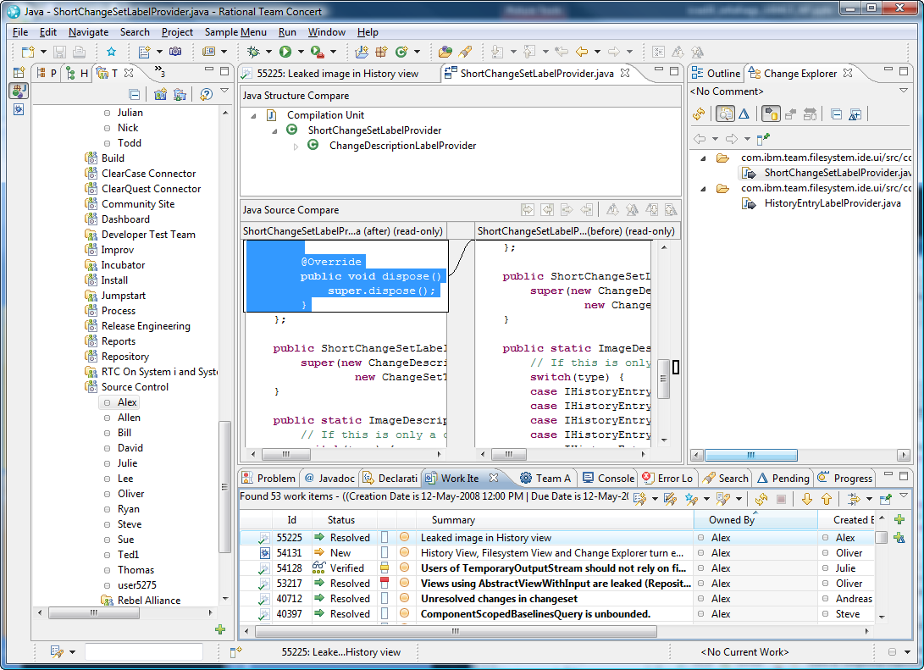

Code
Code
Team
Team
Changes
Changes
Work Items
Work Items

Slide 8
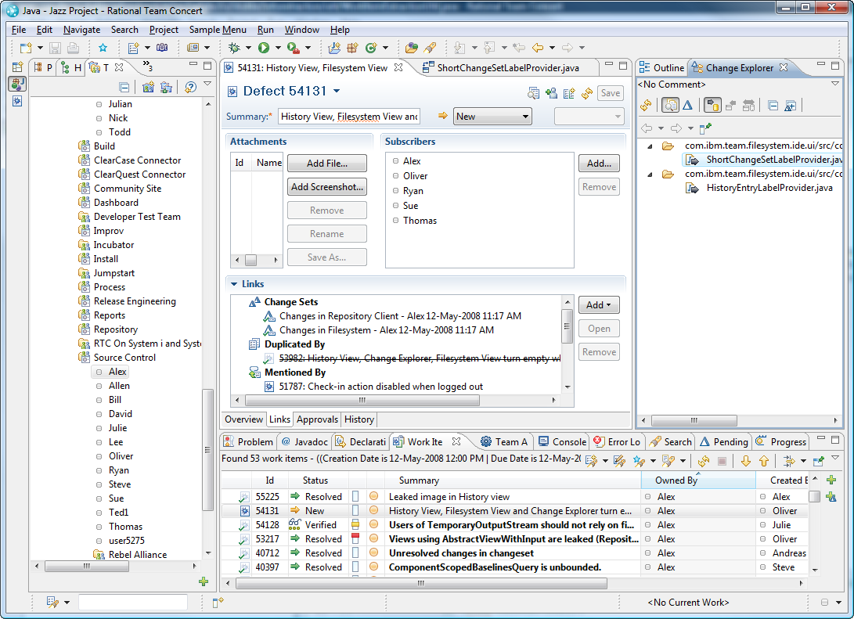
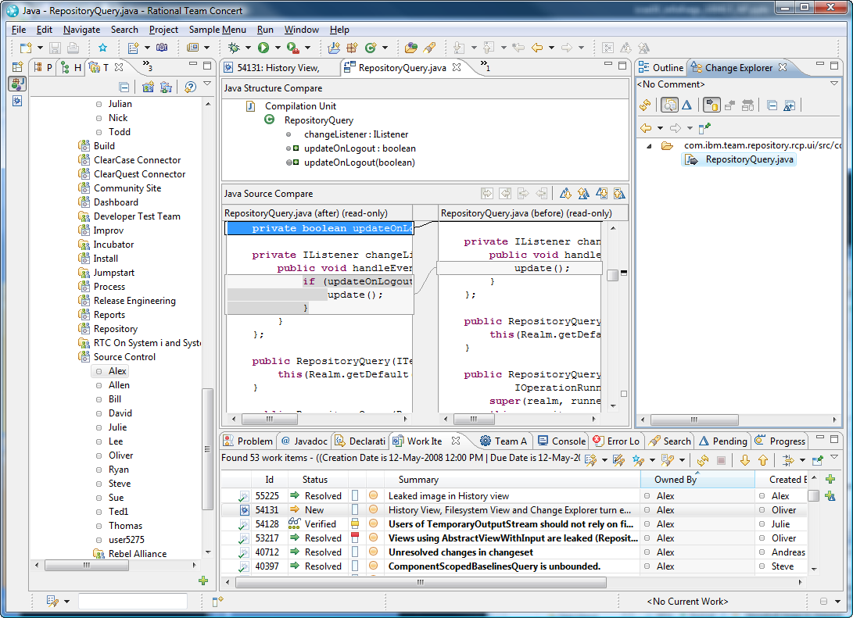
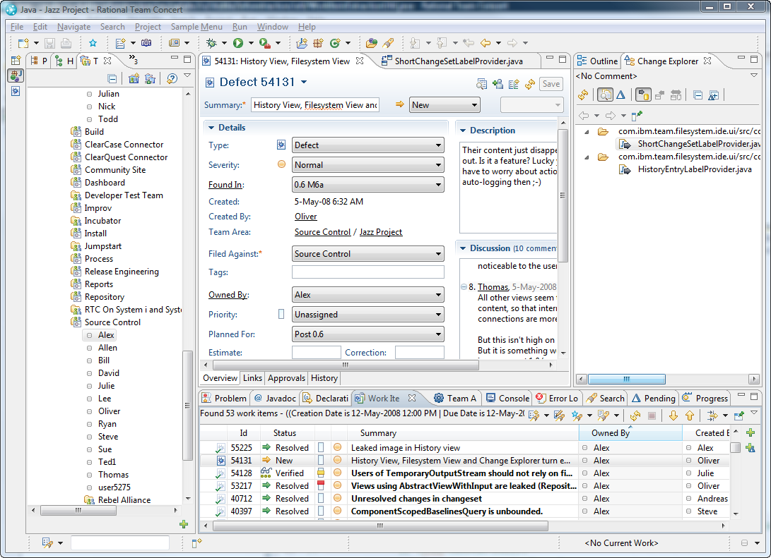
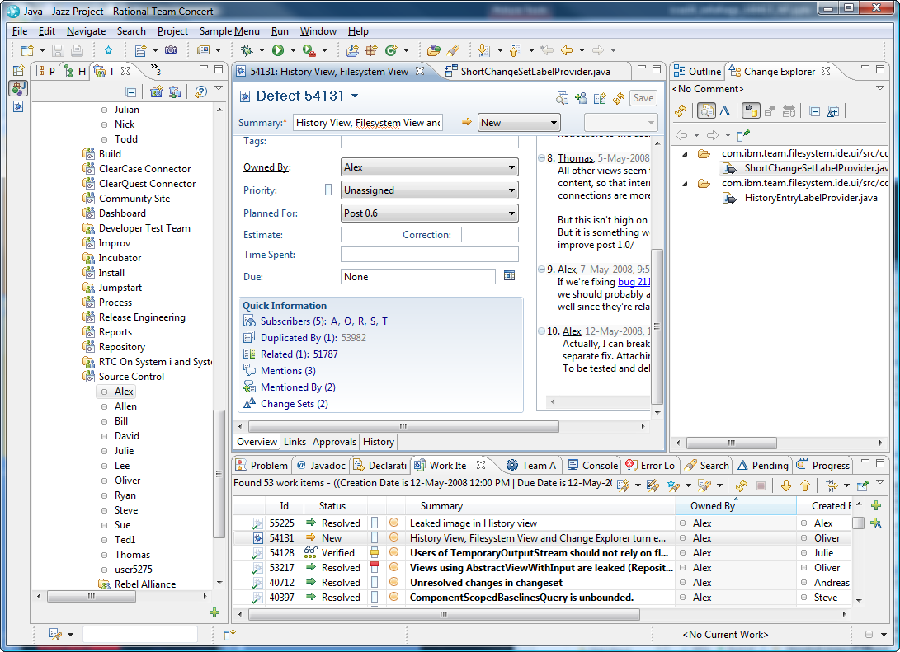
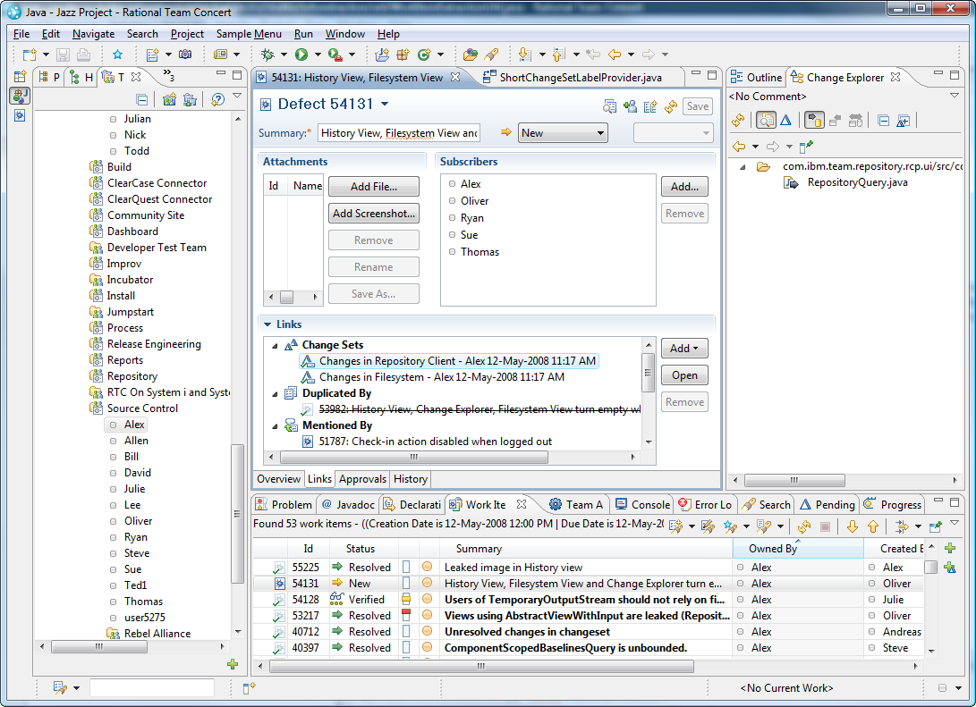
Code
Team
Changes
Work Items

Slide 9
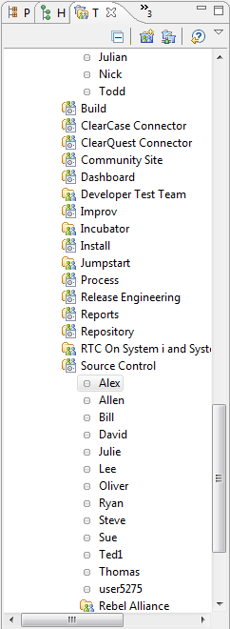
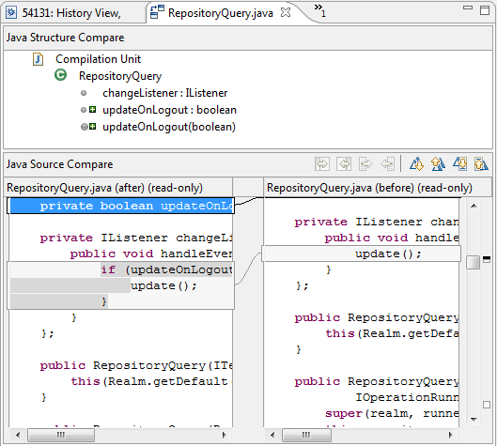
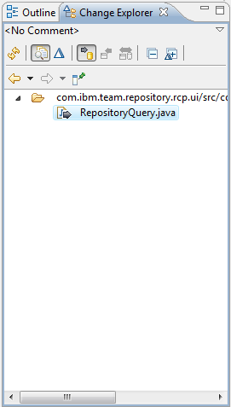
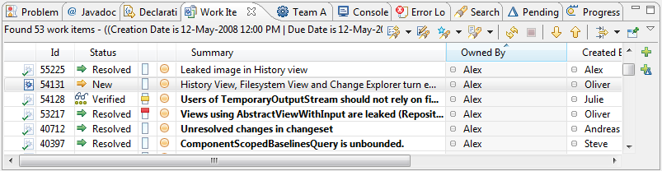
Code
Team
Changes
Can we automate the integration of information from multiple domains?
Work Items

Slide 11
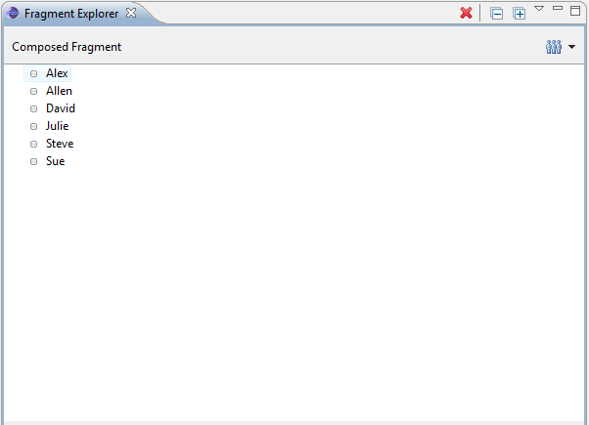
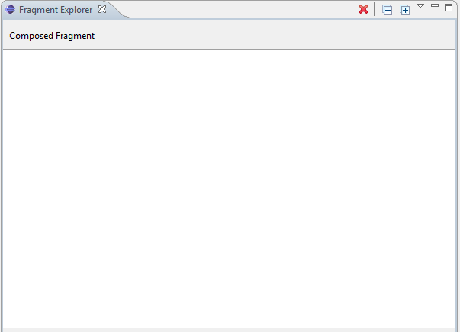
“What has my team been working on?”
Team Fragment

Slide 12
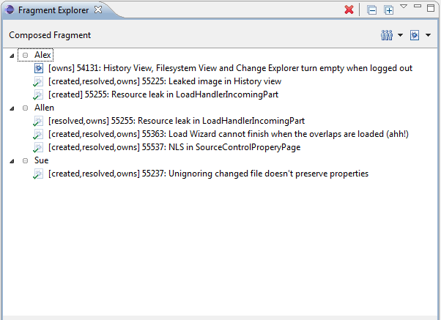
“What has my team been working on?”
Work Item Fragment

Slide 13
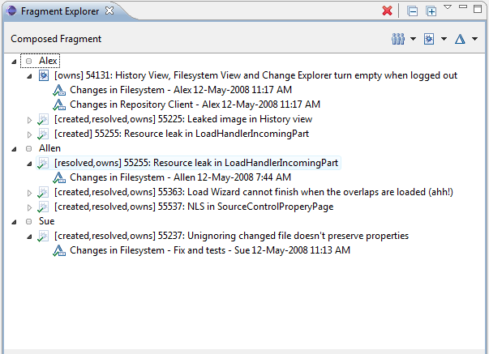
“What has my team been working on?”
Change Set Fragment

Slide 14
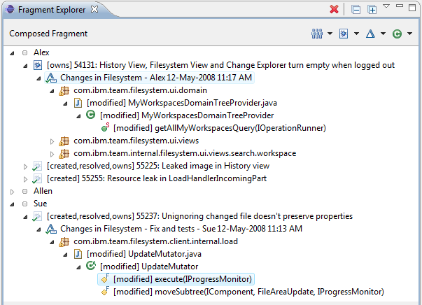
“What has my team been working on?”
Source Code Fragment

Slide 15

“What has my team been working on?”

Slide 16
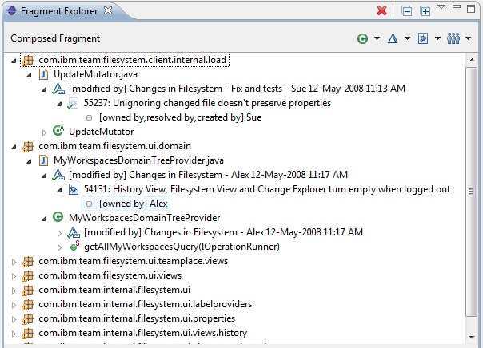
“What has my team been working on?”

Slide 17
“What has my team been working on?”
Team Fragment
Work Item Fragment
Change Set Fragment
Source Code Fragment

Slide 18
Information Fragment Model
David
Allen
Φ
Julie
(○,◻)
Team Fragment
Presentation 1
id
Composition
WI 315
Φ
(◻,○)
Defect 303
Work Item Fragment
Presentation 2

Slide 19
Information Fragments
Subset of information
F =(V, E, l_{F} )
V: uniquely identifiable items with domain, type and properties
E: relationships between nodes
WI 315: Can’t ...
id: 315
owner: David
l _{F} : mapping V → {Fragments}
duplicate of
D303: Popup can ...
id: 303
owner: Julie

Slide 20

Composition
F' : union of input fragments (nodes/edges)
+ newly created edges based on properties
David
owner
WI 315: Can’t ...
id: 315
owner: David
id: David
Julie
duplicate of
id: Julie
owner
Allen
D303: Popup can ...
id: Allen
id: 303
owner: Julie
F_{T}
F' =
F_{WI}
id

Slide 21
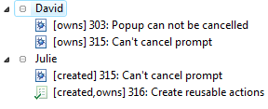
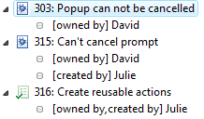
Presentation
Φ
(t, wi)
owner
D 303
David
owner
WI 315
creator
Julie
creator, owner
WI 316
Allen
Φ
(wi, t)

Slide 23
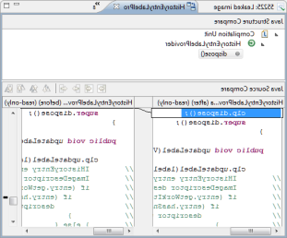
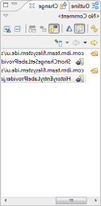
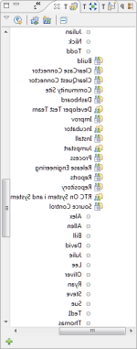
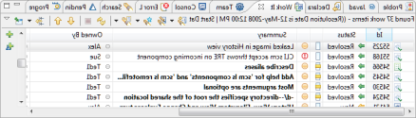
What is the evolution of the code?
Which features and functions have been changing?
Who owns this piece of code?
What [have] people done lately?
What classes has my team been working on?
How is the team organized?
Who is working on what?
Information Fragment Model
What classes have been changed?
What caused this build to break?
Who has made changes to my classes?
Who is working on the same classes as I am and for which work item?
Which API has changed?
Who owns a test case?
Has progress been made on blockers (blocking work items) in your milestone?

Slide 24
Evaluating our Model
Can developers use the model to answer the questions?
A
Can developers use the model effectively without detailed understanding of the model ?
Multiple Cases Study with 18 professional developers

Slide 25
Evaluation – Method
 |  | Source Code | Change Sets | Teams | Work Items
(1) | What classes have been changed? | X | X
(2) | Who has made changes to my classes? | X | X | X
(3) | What has changed between two builds and who has changed it? | X | X | X
(4) | What have people been working on? |  |  | X | X
(5) | What classes has my team been working on? | X | X | X | X
(6) | What’s the most popular class? (changed most) | X | X
(7) | Who owns this piece of code? (modified most) | X | X | X
(8) | How do recently delivered changes affect changes that I am working on? | X | X
8 questions from original 78 to cover domains of interest

Slide 26
Evaluation – Method
8 questions from original 78 to cover domains of interest
Questions made more specific to reduce interpretations and match available data
10-15 minute tutorial
Yesterday, on which classes (of the SCM code) have Alex and Allen on the SCM team been working on and why? For each developer name one class and the reason for the change.
“What classes has my team been working on?”
18 developers from 4 different teams

Slide 27
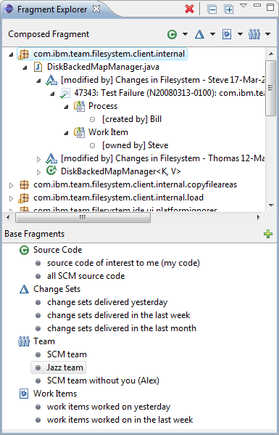
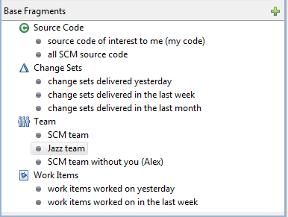
Evaluation – Prototype

Slide 28
Evaluation – Results (Success)
Failure
Hint Given
Success
94%
success

Slide 29
Evaluation – Results (Time)
mean time
2.3 mins

Slide 30
Evaluation – Results
p
Can developers use the model to answer the questions?
Can developers use the model effectively without detailed understanding of the model?
p
94 % success rate
2.3 mins mean time
10 – 15 mins training
hint given in only 9 cases (6%)

Slide 31
Evaluation – User Comments
Easy to use
“I throw everything in and reorder it [...] and see if it seems reasonable.”
Answers multi-domain questions
“for this type of thing I never really thought of trying to solve these problems [...], I try and find some obscure way [instead]?”
“it is answering questions that I don’t think we can answer right now”

Slide 32
Evaluation – User Comments
Understanding links takes time
“lot of trial and error”, but
“made sense in the end”
Participants liked the tool
“pretty nifty”
“cool”
“neat tool”
“well done”
“definitely useful”
“pretty cool”
“really really cool”

Slide 33
Evaluation – Threats
Predefined information fragments
8 questions may not be representative
Unfamiliar data

Slide 34
Discussion
How to best select information fragments?
actual selection
predefined
Is it possible to automatically choose composition?

Slide 35
Related Work
Following information links
Feldspar [Chau et al. 2008], JQuery [Janzen et al. 2003]
Querying for information
Relational views [Linton 1984], CodeQuest [Hajiyev et al. 2006]
Automatically linking information
Hipikat [Cubranic et al. 2005], Deep Intellisense [Holmes et al. 2008]
Composing different information
Ferret [de Alwis et al. 2008]

Slide 36
What is the evolution of the code?
Which features and functions have been changing?
Who owns this piece of code?
What [have] people done lately?
What classes has my team been working on?
How is the team organized?
Who is working on what?
Information Fragment Model
What classes have been changed?
What caused this build to break?
Who has made changes to my classes?
Who is working on the same classes as I am and for which work item?
Which API has changed?
Who owns a test case?
Has progress been made on blockers (blocking work items) in your milestone?

