Slide 1


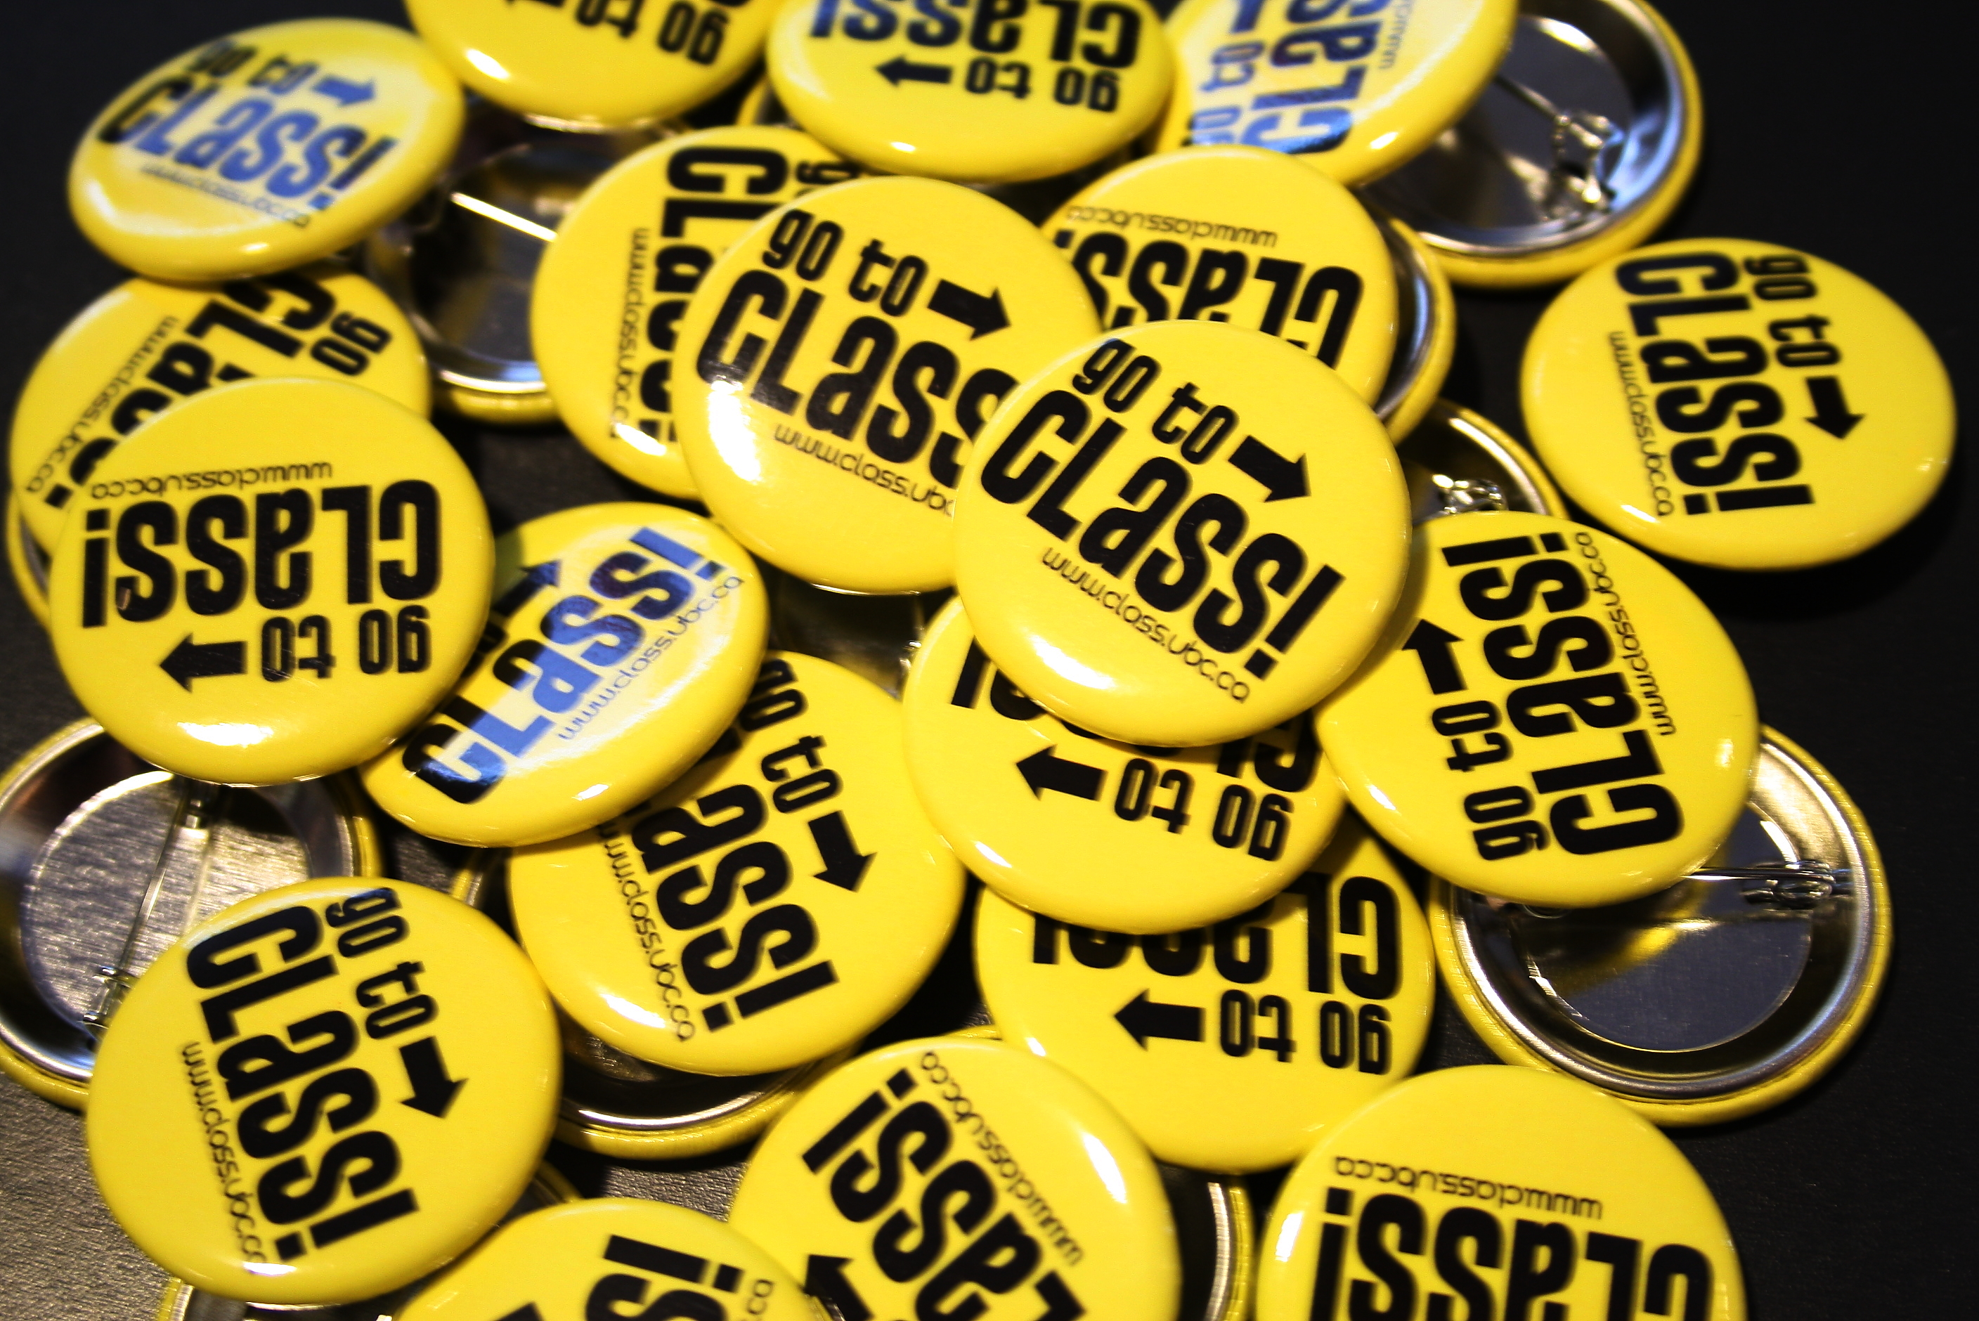
The Keys to First-Year Success at UBC: Conference for Learning and Academic Student Success (CLASS)
Updated by: Joseph Young
Project Manager, CLASS 2011 Conference
Acknowledgements: Jay Chan, Student Development Office, and the Teaching and Learning Enhancement Fund
Introduction
Rationale – Why?
Attendance Analysis
In addition to the points listed previously relating to the decision to make CLASS a week-long event this year, the rationale for CLASS has its basis in several points.
As far as scheduling is concerned, late October was chosen (and has been chosen before) for two key reasons: firstly, it is shortly after a large number of first-year midterms. This means that students who are struggling will have a better idea of their situation and may be more inclined to attend than they would have been previously. Secondly, it achieves this goal without being so late in the semester that first-year students do not have the time to make significant changes to their level of success before the end of the academic year. This balance has been shown effective in previous years, and, as mentioned above, has been adopted again.
The rationale for the event itself is a dense and multi-faceted one, but it largely based on the idea that students want to be successful and want to be a part of a community, but may not, at such an early stage in their university lives, have the tools to go out and discover how these goals can be met. By helping students to meet them as early as possible, they are gifted not only with that success, but with the confidence to continue succeeding and to help others succeed after them.
There are many barriers to success encountered by first-year students attempting to transition into a university environment. These include an increased workload and academic demands, stronger impetus on the student to manage their time effectively and independently, and a large, unfamiliar community that it can, at first, feel difficult to become a part of.
Each of these, on their own or taken together, can quickly and severely have an adverse effect on student performance.
The Conference for Learning and Academic Student Success (CLASS) addresses these issues through the provision of numerous and varied opportunities to gain study and time management skills, network with peers and mentors, and become aware of and engaged in on-campus involvement opportunities. This is done through subject-specific study skills seminars, (presented by practicing professors) a resource fair showcasing involvement and assistance opportunities from across campus, four separate faculty-specific mentorship lunches where first-year students re-connect with their MUG leaders and meet other senior students interested in providing help, support and mentorship, and many “concurrent workshops,” held on numerous days throughout the week – these are workshops created and facilitated by students, for students. These, when taken in tandem with everything else being offered at CLASS, offer a well-rounded opportunity for first-year students to maximize their chances for success at UBC.
CLASS 2011 Attendance by Faculty
CLASS 2011 had over 350 different first-year students (a great turnout!) attend various events between October 24 and 28, 2011. As has been the case in previous years, the majority of CLASS attendees came from the faculty of Science, but all faculties were reasonably well represented. The predominance of Science students is not surprising, as many planning committee members have strong ties to the faculty of Science and, as such, have significant contacts and support already in place within it. With this in mind, collaboration between CLASS and other faculties at UBC has been very successful this year, with the conference’s visibility and cross-faculty appeal being very strong.
Another interesting statistic to consider from this year’s event is the large percentage of international students in attendance, making up nearly 20% of conference attendees. This is a great success for CLASS as increased inclusion of international students was a goal this year.
History
Marketing
The concept for CLASS originated with the “Get Learn’d Conference,” held in 2008. A pilot conference was held in January of that year for 75 Science students, providing them with skills deemed necessary for academic success in their specific areas of study. Following this success, a TLEF grant provided the means to put on the first annual fully-fledged “Get Learn’d Conference,” on October 4th of 2008, which provided support to 250 first and second year students in the Faculties of Arts, Science and Engineering.
Since that time, CLASS (renamed as of the 2009 conference) has provided support to hundreds of students each year, over the course of one day in October, through the presentation of workshops, subject-specific seminars, and peer coaching opportunities facilitated through connections with Peer Programs, Wellness Educators and various student Undergraduate Societies, among others.
The most significant change to the format of the conference for 2011 has been to provide a week-long event, with different experiences being offered every day. The rationale for this change is to simply make it easier for students to attend at least some aspects of the conference over the course of the week, rather than having to make an all-or-nothing commitment to one day. Also, providing a number of opportunities increases the chances that students will not choose to miss a seminar based on inconvenience, as they are likely to be able to find several things that fit their schedule over the course of the week.
A large number of promotional strategies were used to raise awareness of CLASS. The most significant of these is the CLASS website (www.class.ubc.ca), containing all pertinent info about the conference and its offerings, as well as registration forms and links to partner pages and sponsor information. The website also featured several student-created videos – one promoting CLASS and its benefits, and two featuring interviews pertinent to the conference (one with Dr. Catherine Rawn, the event’s opening keynote speaker, and one with Claire Heymans, a current UBC student and CLASS Planning Committee member, discussing her experiences as a conference delegate and planner).
Beyond this, CLASS employed cross-promotional marketing with the Inter University Conference on Education, and was featured on the Chapman Learning Commons website. Also, a promotional Facebook page and Twitter account were created.
In terms of promotions beyond the online world, CLASS distributed buttons and yellow sunglasses to first years to help increase visibility and ran promotional booths in key buildings throughout campus during the lead-up to the event. Lastly, in the week preceding the conference, committee members and volunteers made announcements in a variety of first-year classes – these were particularly successful, with our registration numbers increasing dramatically after their implementation.
Also, during the conference week, students were given “report cards” that they could get stamped at each event they attended to be eligible for prize draws. The hope behind this was to encourage attendance at multiple events.
Campus Partners
CLASS partnered with the following groups: Chapman Learning Commons, The Interuniversity Conference on Education, UBC Thrive and the Arts Undergraduate Society.
Sponsors
CLASS 2011 sponsors included: Wescadia Catering, Prep 101,The Princeton Review, Travel Cuts, Happy Planet, Gold’s Gym, The Bird Coop Fitness Centre, UBC Bookstore, Staples and Blenz Coffee.

