Slide 1
Cross-Layer Optimization for Video Streaming in Single-Hop Wireless Networks
Cheng-Hsin Hsu
Joint Work with Mohamed Hefeeda
Simon Fraser University, Canada
MMCN ‘09
January 19, 2009

Slide 2
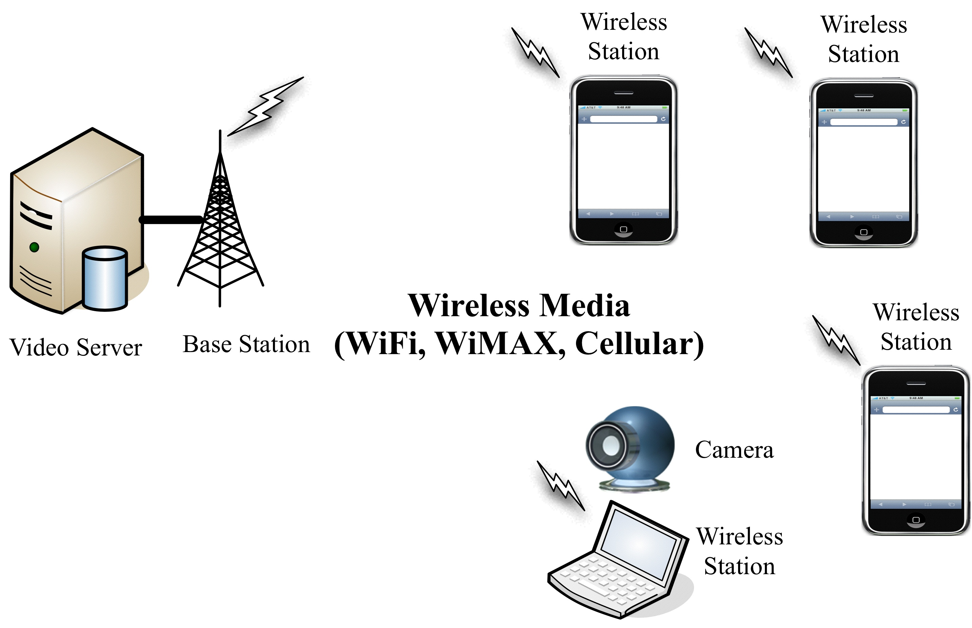
Video Optimization in Wireless Networks
Resource Allocation Problem
-- shared air medium
Notes:
Video optimization in wireless networks
1. We consider a resource allocation problem (wireless medium) in a single wireless cell/sub-network
2. Multiple stations share wireless medium
3. Wireless stations send and/or receive video streams to/from the video server
4. Video server is connected to the base station with a high speed link

Slide 3
Video Optimization Problem
Goal: maximize video quality for stations by properly allocating shared resources
Challenge: stations have diverse constraints
channel conditions
processing powers
energy levels
video characteristics
Approach:
propose a cross-layer optimization framework
then, instantiate the framework for 802.11e WLANs

Slide 4
Video Optimization Framework
P-R-D Characteristics
The
Optimization
Algorithm
Complexity
Scalable
Video Coder
APP
Opt. Coding Rate
MAC Parameters
QoS-Enabled
Controller
Opt. Bandwidth
LINK
Share Allocation
Channel Rate
Radio
Module
PHY
Notes:
In this framework, we consider three layers. From application to link to physical.
The algorithm allocate resource budget to wireless stations.
This decision is made by jointly taking parameters from multiple layers. Then produce and enforce the best allocation on each wireless station.
We study the interaction among layers.
5. Next, we present the general application model, which is followed by the Link and Physical models.

Slide 5
Complexity Scalable Video Coders
P-R-D models relate distortion as a func D(.) of r_{s} (coding rate), p_{s} (coding power),
and V (video characteristics)
Distortion
Coding Power
Complexity
Scalable
Coder
P-R-D
Characteristics
The
Optimization
Algorithm
Opt.
Coding Rate
Complexity
Scalable
Coder
Notes:
Higher rate->better quality at the same power consumption. Similar to conventional R-D models
However, because wireless stations are mostly battery-powered, we had to consider the energy consumption of video decoders. Higher power->better quality at the same rate. Because higher power enables us to employ more elaborate optimization, thus lead to better quality.
Complexity scalable coders require extension from R-D to P-R-D models. P-R-D models are also known as C-R-D model, where C stands for complexity.

Slide 6
QoS Enabled Controller
Link Layer
achieves/enforces QoS differentiation
allocates bandwidth (b_{s}) to station s, s.t. , where B(.) is the link capacity
Physical layer
diverse channel rate (y_{s})
QoS-Enabled
Controller
MAC Parameters
Channel Rate
The
Optimization
Algorithm
Opt. Share of
Bandwidth
QoS-Enabled
Controller
Notes:
what is qos enabled link layer? First, like traditional link layer protocol, it coordinates access to the air medium. The difference is it can achieve QoS differentiation among wireless stations. Using this, we can allocate bandwidth among wireless stations.

Slide 7
General Formulation
r_{s} : coding rate
b_{s} : b/w share
Find Opt. policy
such that
s.t.
Capacity B(.) is a function of
# of stations, link protocols, channel rates
Distortion D(.) is a function of
coding rate, coding power, video characteristics

Slide 8
General Formulation (cont.)
Formulation PG is general
any D(.) and B(.) can be adopted
can be numerically or analytically solved
Different objective functions
MMSE: minimizing average mean-square error
MMAX: minimizing maximum distortion

Slide 9
Instantiate PG for 802.11e WLAN
802.11e is a supplement for supporting QoS
Why 802.11e?
widely deployed, QoS differentiation, more challenging than TDMA networks
802.11e supports two modes
EDCA: distributed contention-based
HCCA: polling-based contention-free
Why EDCA?
simple, commonly implemented, higher b/w utilization
Notes:
Legacy 802.11 standard were defined in late 90’, and 802.11e is finalized in around 2005.
1. More flexibility: no centralized admission and scheduling algorithms
2. Better bandwidth utilization: resource reservations are typically made for worse case scenarios
3. Easier deployment: less and simpler configurations make EDCA likely to be the dominating mode in the market

Slide 10
EDCA Overview
QoS differentiation: several Access Categories (ACs)
Each AC is assigned different back-off parameters
AC | Voice | Video | Best-Effort | Background
AIFS | 2 | 2 | 5 | 7
CWmin | 3 | 7 | 15 | 15
CWmax | 7 | 15 | 1023 | 1023
TXOP | 4096 | 2048 | 1024 | 1024

Slide 11
EDCA Overview (cont.)
AIFS: Arbitration Inter Frame Space
CW: Contention Window
TXOP: Transmission Opportunity
AIFS
TXOP
Medium
is Busy
Back-off
Time
Trans-mission
Medium
is idle
Random Back-off
Time from CW
Start
Transmission
Notes:
Random back-off time is chosen from [1, CW+1]

Slide 12
Per-Station QoS Differentiation
Assign different EDCA parameters to stations
CW, AIFS , then frequency and bandwidth
TXOP , then transmission time and bandwidth
But, how we choose the EDCA parameters to achieve a given bandwidth share?
More importantly, how can we estimate overhead & collisions
Notes:
How to enforce airtime allocation in EDCA?
There are two ways to enforce this differentiation: frequency and duration. Frequency: grab, duration: keep.
3. We chose TXOP also because it is as effective as frequency based approach.
4. It is also much less complicated than frequency based method.
5. In frequency based method, EA is often molded using a complicated Markovian Chain, therefore, estimating EA is computational intensive.
6. .Consequently, varying TXOP limit allows us to derive closed-form EA formula

Slide 13
Airtime and Efficient Airtime
Bandwidth allocation == airtime allocation
Airtime: let be the fraction of time allocated to station s
r_{s}: application (streaming) rate
y_{s}: channel rate
Effective Airtime: the fraction of time when the shared medium transmits real data
overhead and collisions are deducted
Notes:
Why need airtime?
In 802.11e, only one station can transmit at any moment.
Bandwidth allocation enforcement can be seen as airtime allocation enforcement.
\phi_s shows how much resource is assigned to station s. E.g., : r_s = 1 Mbps, y_s = 10 Mbps, it requires 10% airtime.
We need to consider overheads and collisions, therefore, the aggregate \phi would be less than 1.

Slide 14
Our Effective Airtime Model
p-persistent EDCA Analysis [Ge et. Al 07]
wireless station draws the back-off time from a geometric distribution with parameter p
stateless, so more tractable
analysis can be mapped to EDCA using
We develop a closed-form EA model
EDCA
Parameters
EA Model
Effective
Airtime
Notes:
The main difference is, Ge assume fixed and short TXOP. We consider varying TXOP. In addition, we incorporate several simplification for a closed form formula.
Now we show our EA model….
p_persistent EDCA is a stateless variation of standard EDCA. Therefore, p-persistent EDCA is more tractable (easier to analyze)
It is proved in the literature that p-persistent EDCA can be transformed to standard EDCA.
We consider longer and heterogeneous TXOP limits

Slide 15
Effective Airtime Model (cont.)
relatively
small
>= 1
where is a function of several 802.11
parameters, such as AIFS.

Slide 16
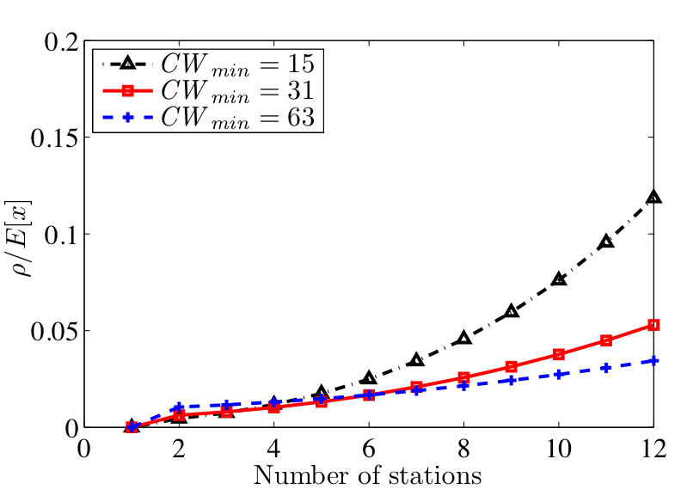
Effective Airtime Model (cont.)
It is indeed small and can be dropped
Notes:
Rho / E[X] is really small, as show in the figure.
And we will empirically validate this in simulations.

Slide 17
802.11e Formulation
s.t.
where
But, what is D(.)?
Notes:
1. We rewrite our optimization problem for 802.11
Basically, bandwidth enforcement is converted to airtime enforcement.
But how we estimate the video distortion at each wireless station?

Slide 18
MPEG-4 P-R-D Model [He et al. 05’]
Distortion
: video sequence variance
: coder efficiency
: power consumption
For convenience, we let
Notes:
We use an MPEG-4 P-R-D model in the literature. This model has been shown to be fairly accurate through extensive experiments.
We would get into the details. At high level, we define two model parameters \alpha and \beta, where
\alpha represents video sequence variance. \beta represent coder efficient and physical layer rate.
We want to emphasize that our problem can also adopt other models

Slide 19
Optimal Solution
Solve it using Lagrangian method for closed-form solutions
at base station
at wireless station
Notes:
Convex -> Therefore, local optimum is the global optimum
We write airtime \phi in this closed-form formula.
We also write lagragian parameter \lambda in a closed-form formula, which is not shown here for time limitation.
Once we have \phi_s, we compute the required TXOP limit. Again, equation is not given here for time limitation.
Next, we evaluate our solution using simulations and experiments.

Slide 20
Optimal Allocation Algorithm
Base
Station
Compute and
adjust TXOP
Wireless
Station 1
Wireless
Station 3
Compute and
adjust TXOP
Wireless
Station 2
Compute and
adjust TXOP
Notes:
Here, the computation is carried out at access point, but because the algorithm is very efficient, they can be carried out at each wireless station!
Overhead in both computational and communication are small

Slide 21
OPNET Simulations
Implement log-normal path loss model
more realistic simulations
OPNET uses free space model by default
Implement resource allocation algorithms on two new wireless nodes
base station, wireless station
Implement two algorithms
EDCA (current algorithm), and OPT (our algorithm)
Notes:
We chose OPNET, because it is a very detailed network simulator.
We implement log-normal path loss model for more realistic simulations
We implement two new network nodes in OPNET

Slide 22
Simulation Setup
deploy 6~8 of wireless stations
wireless stations stream videos to base station
each wireless station periodically (every 5 secs) reports its status to base station
base station computes the allocation
each wireless station configures its TXOP limit
base station collects stats, such as receiving rate and video quality

Slide 23
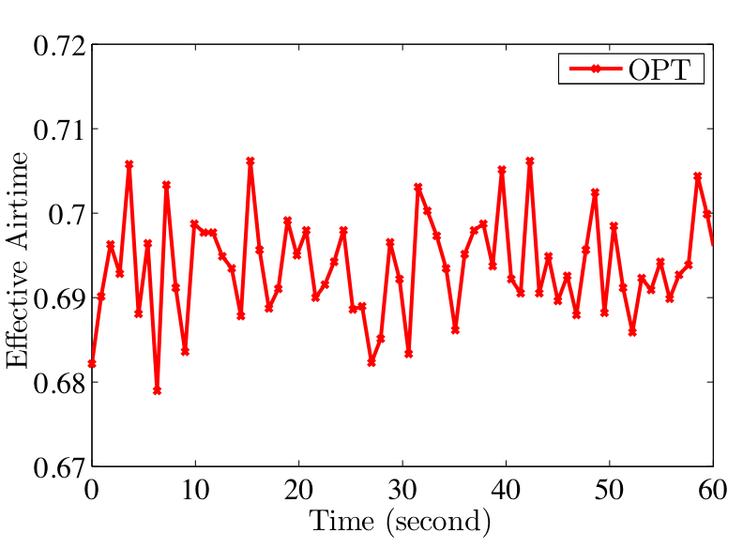
Validation of our EA Model
The empirical Effective Airtime
follows our estimation (69%)

Slide 24
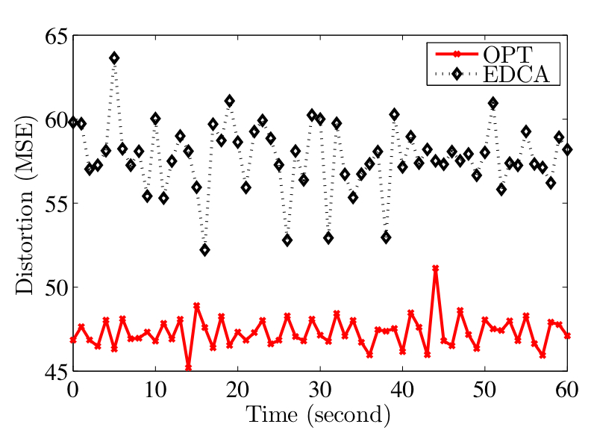
Potential Quality Improvement
About 28% Distortion Reduction

Slide 25
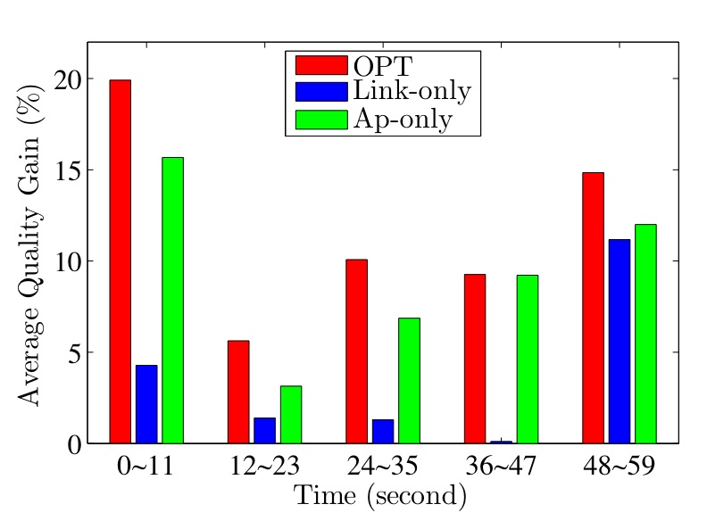
Dynamic Channel Conditions
OPT works in dynamic environments
OPT outperforms opt. algms in ind. layers.
Notes:
We move the Wses around, Wses closer to the base station will get better reception and higher bitrate.

Slide 26
Real 802.11e Testbed
Use Atheoros AR5005G 802.11e chip
Implement OPT and EDCA algorithms in its Linux driver
Configure a base station and two wireless stations
Wireless stations report status every 10 sec

Slide 27
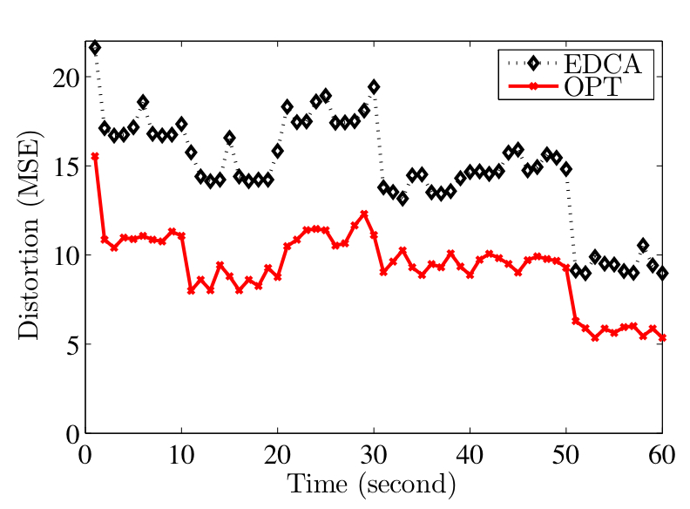
Sample Result from the Testbed
Quality improvement:
up to 100% in MSE, or 3 dB in PSNR

Slide 28
Conclusions
Proposed a general video optimization framework
Instantiated the problem for 802.11e networks
Presented models for 802.11e and developed an effective airtime model
Analytically solved the optimization problem
Evaluated the solution using OPNET simulator and real implementation. Both show promising quality improvements.

