Slide 1
Staying Aware of Relevant Feeds in Context
Thomas Fritz
University of British Columbia

Slide 2
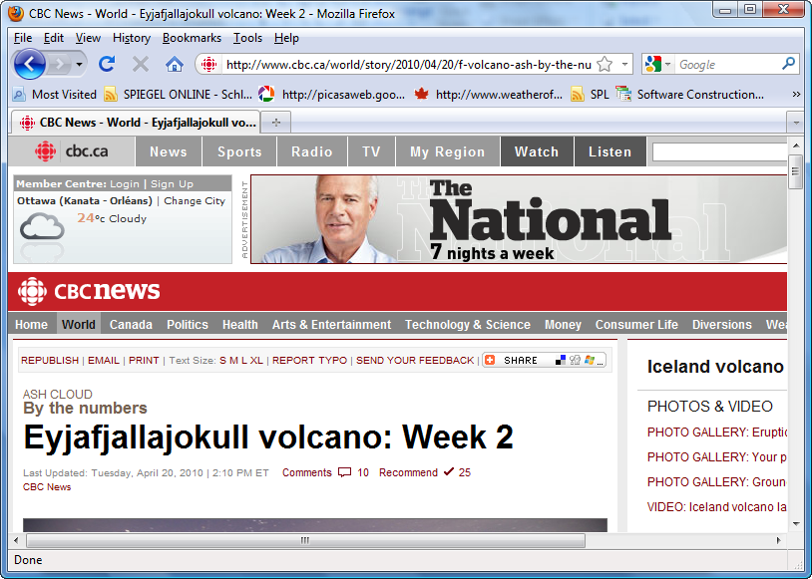

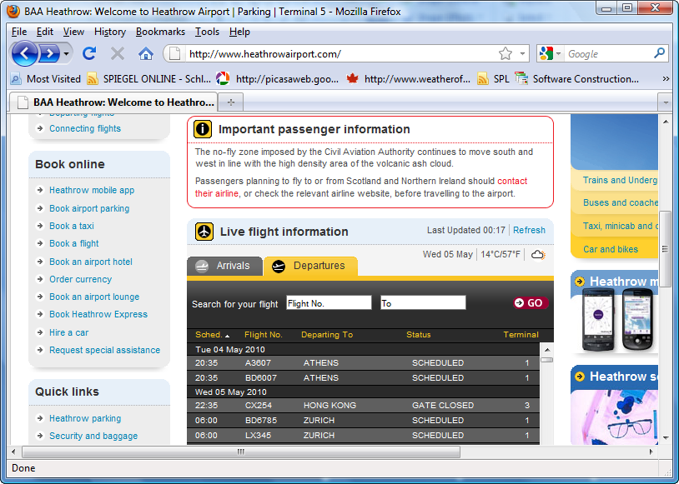
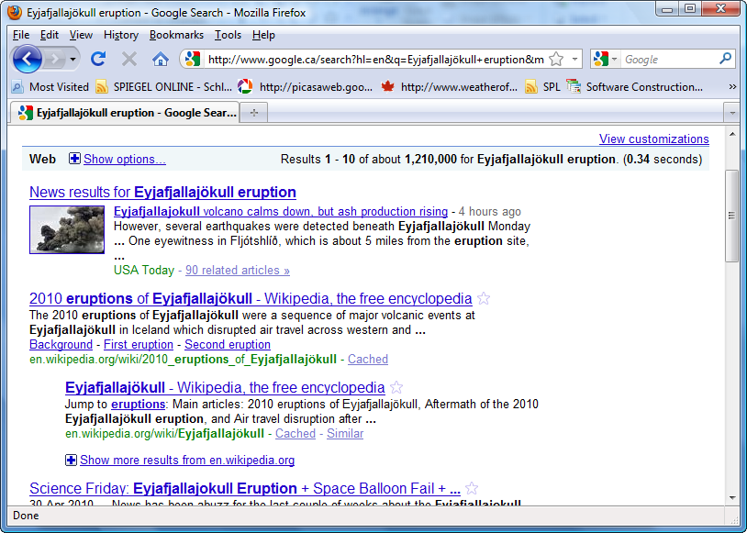
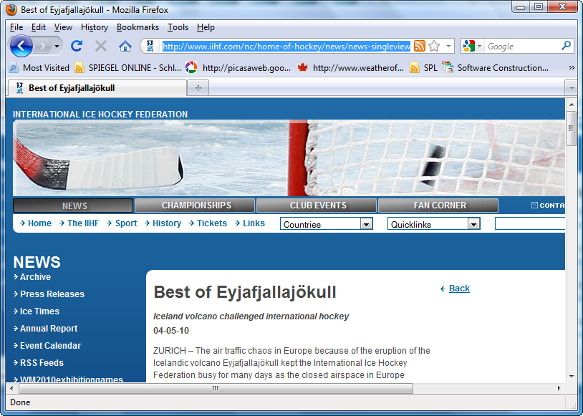
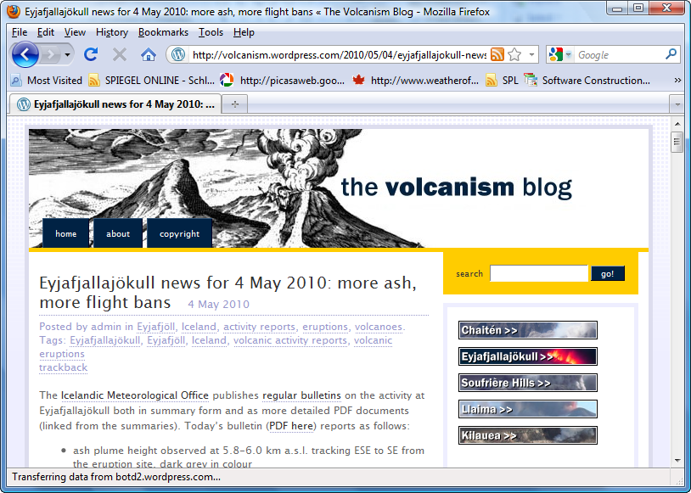
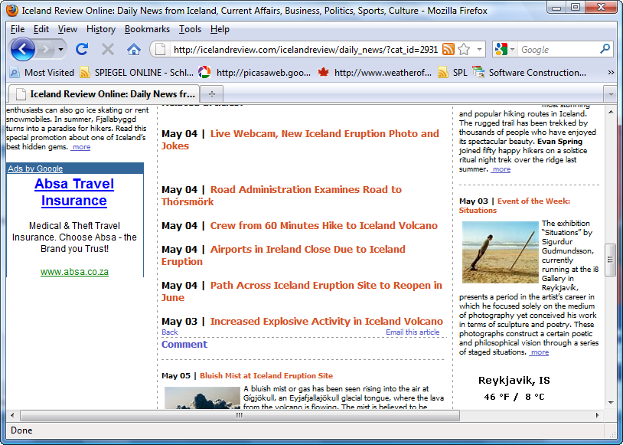

Slide 3







Tuesday
5:32 am 7836 system_server consumes excessive CPU processing...
7:25 am 7037 Different virtual keyboards for landscape and portrait...
7:26 am androidosblog Mozilla unveils Firefox for Android pre-a ht..
7:51 am Do not play alarms if alarm stream volume is 0.
8:06 am 7589 Android dev team ignores its own bugtracker
8:07 am Use onStartCommand since onStart is deprecated.
8:11 am Fix issue 2192673: Music Pausing Even when notifications...
8:12 am Just pushed out #Android NDK r3 with OpenGL ES 2.0 su...
8:14 am peterkumagai#catbaron2 Android携帯電話向けの音楽プ...
8:14 am MotoDroid@mikeod35 Well everything I could find about i...
8:17 am 7186 MediaPlayer not calling onPrepared() for certain MP...
8:20 am Service API changes starting with Android 2.0
8:21 am mariov51 RT @Techmem: It's Official: Adobe Flash support..
8:27 am [android-developers] ListView with multiple layouts formats..
8:29 am Kill the alarm when a call comes in.
8:45 am 6 months agoFix issue #2154688: when alarm rings ,devic...
8:48 am 7909 Camera preview does not work on HTC Desire
8:49 am [android-developers] problem to install .apk on phone
8:58 am Your feedback on Samples/Tutorials/Articles
...
Overlooking relevant information results in productivity loss [Damian et al. 2007]

Slide 4


Awareness View
com.android.alarm
Alarm
Kill the alarm when a call comes in. 8:29 am
Changes to Google Calendar API 2:09 pm
com.android.alarm.clock
AlarmAlert
1942 Alarms don’t work if phone is off 10:06 am
Wake screen before launching AlarmAlert 2:26 pm
AlarmClock
3116 [TimePicker] Alarm clock GUI problem 11:28 am

Slide 5
Information Fragment Model
Alert
Clock
Φ
Alarm
(○,◻)
Code Fragment
Presentation 1
id
Composition
Bug1942
Φ
(◻,○)
Bug 3116
Bug Fragment
Presentation 2

Slide 6
Information Fragments
Subset of information
F =(V, E, l_{F} )
V: uniquely identifiable items with domain, type and properties
E: relationships between nodes
Bug 1942
id: 1942
changes: Alert,.
l _{F} : mapping V → {Fragments}
duplicate of
Bug 3116
id: 3116
changes: Clock

Slide 7

Composition
F' : union of input fragments (nodes/edges)
+ newly created edges based on properties
Alert
changes
Bug 1942
id: 1942
changes: Alert
id: Alert
Clock
duplicate of
id: Clock
changes
Alarm
Bug 3116
id: Alarm
id: 3116
changes: Clock
F_{C}
F_{B}
id

Slide 8
Presentation
Φ
(c, b)
Alert
Kill the alarm when a call ... 8:29
changes
Bug 1942
Clock
Alert
3116 [TimePicker] Clock GUI ... 11:28 am
changes
Bug 3116
Clock
Alarm
Φ
Kill the alarm when a call ... 8:29
(b, c)
Alert
3116 [TimePicker] Clock GUI ... 11:28 am
Clock

Slide 9
Uniqueness about Dynamics
Continuous Evaluation
Lifetime Aspect

Slide 10
Evaluation
Case Study with professsional developers (jEdit)
H1: Relevant items can be retrieved with high precision and recall.
H2: “Awareness View” supports developer in finding relevant items.
H3: Composition provides context to support interpretation of information.

Slide 11
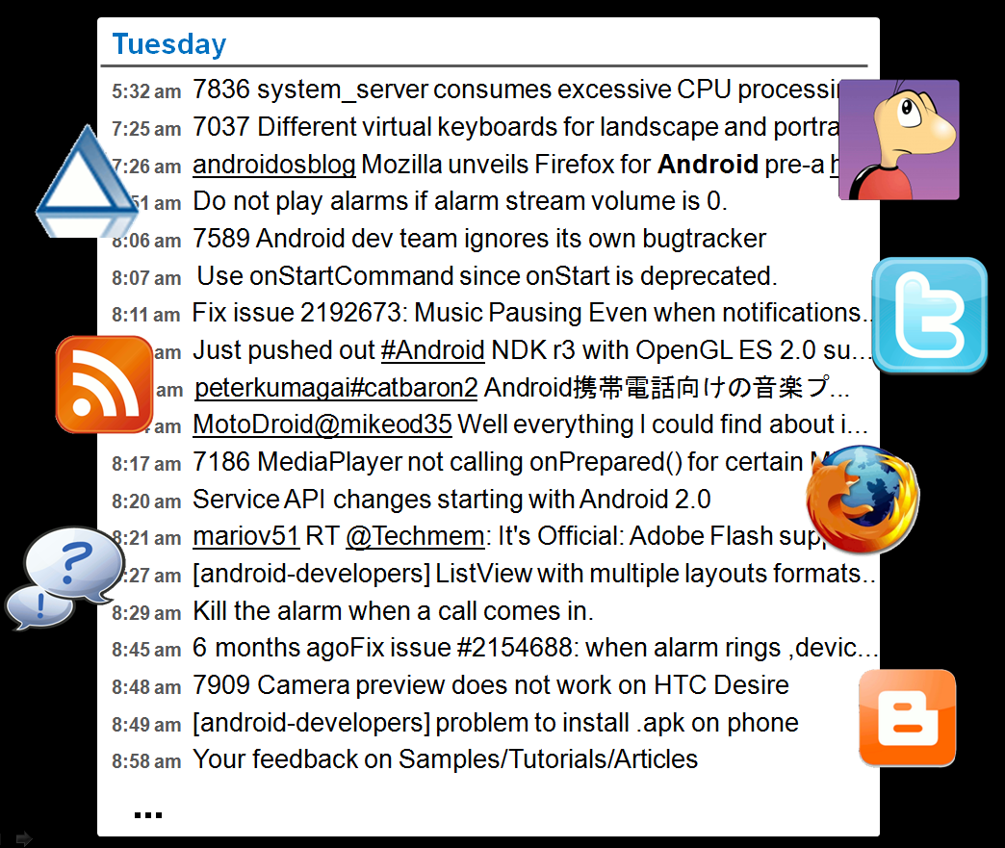
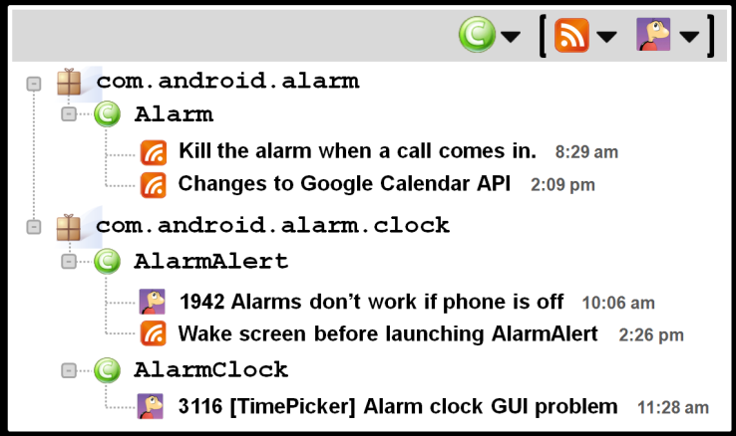
Dynamic + Static Information Fragment Model
Stay Aware of Relevant Information in Developer’s Work Context

