Slide 1

The Postdoctoral Appointment Process at Western
London, January 31st, 2012
Notes:
Main Page

Slide 2
The Postdoctoral Appointment Process
Background
Results of Review
Current Process
Q & A

Slide 3
Background
July 1, 2008 – SGPS formed
January 2011 – Central funds provided to hire Postdoctoral Services Coordinator
March 2011 – Postdoctoral Task Force
Mandate: improve the experience of postdoctoral scholars at Western
Postdoctoral Appointment Process

Slide 4
Results of Review
Awareness about rights and responsibilities
Communication issues
Postdoctoral scholars
Research and funding agencies
Eligibility standards for scholars
Postdoctoral Appointment Process

Slide 5
Goals
Connect Western with incoming postdoctoral scholars
Inform postdoctoral scholars of their rights and responsibilities
Ensure eligibility standards
Automate processes where possible while ensuring transparency
Postdoctoral Appointment Process

Slide 6
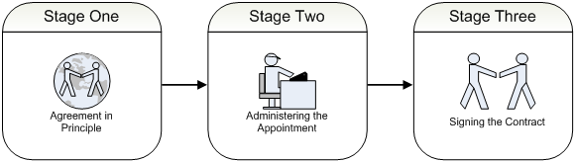
Current Process - Overview
AGREEMENT
Prospective scholar and supervisor establish contact
Discussion leads to preliminary negotiation
Initiation of process
AUTOMATE PROCESS
1. Appointment form
1.1 e-mail to supervisor
1.2 e-mail to administrator
2. Department recommendation form
2.1 Digital letter of offer
2.2 e-mail to Dean’s Office
3. Dean’s Office confirmation
IN PERSON
1. Scholar arrives on campus
2. Scholar & supervisor sign agreement / letter of appointment
3. Scholar brings documents to SGPS

Slide 7
Current Process
Stage One – Agreement in Principle
Prospective postdoctoral scholar and supervisor establish contact
Discussion leads to some form of preliminary negotiation concerning his/her appointment as a postdoctoral scholar
Indication that postdoctoral scholar can initiate appointment form

Slide 8
Current Process
Stage Two – Administering the Appointment
1. Prospective scholar directed to complete the online appointment form including:
Personal details
Citizenship
Academic credentials
Supervisor

Slide 9
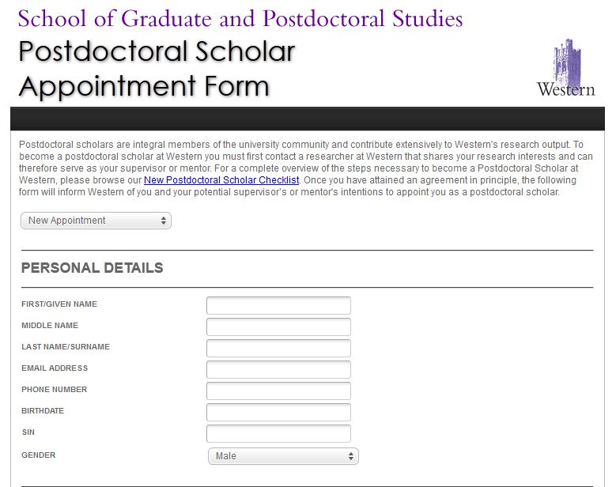

Slide 10
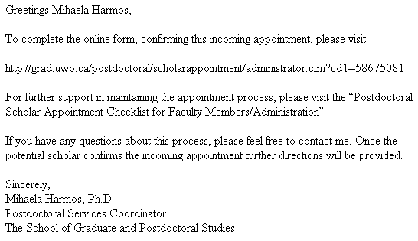
Current Process
Stage Two – Administering the Appointment
1.1 e-mail sent to identified supervisor
e-mail serves to inform
supervisor about the
next stage of the
appointment process

Slide 11
Current Process
Stage Two – Administering the Appointment
2. Supervisor completes appointment information through department recommendation form including:
Duration
Salary
Funding source

Slide 12
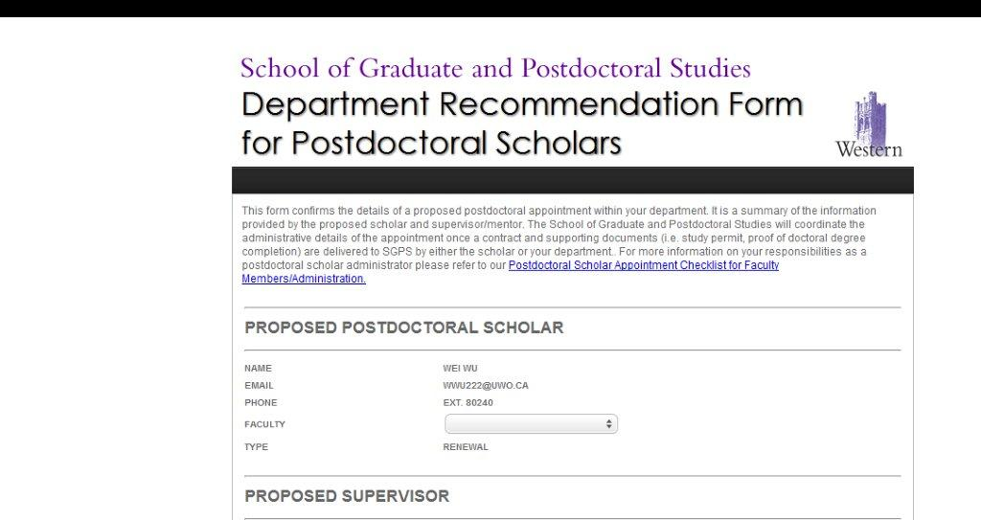

Slide 13
Current Process
Stage Two – Administering the Appointment
1.2 e-mail sent to identified administrator
e-mail connects administrator
with next stage of the
appointment process

Slide 14
Current Process
Stage Two – Administering the Appointment
2. Administrator confirms and completes appointment information through department recommendation form including:
Account number
Speed code

Slide 16
Current Process
Stage Two – Administering the Appointment
2.1 Prospective scholar informed of confirmation via digital letter of offer
If international, scholar uses letter to begin work permit process

Slide 17
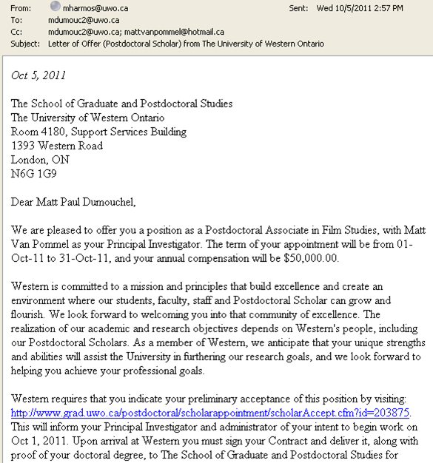

Slide 18
Current Process
Stage Two – Administering the Appointment
2.2 e-mail sent to Dean’s Office to confirm the appointment

Slide 19
Current Process
Stage Two – Administering the Appointment
3. Dean’s Office confirms the appointment in GradNet

Slide 20
Current Process
Stage Three – Signing the Contract
1. Scholar arrives on campus
2. Signs postdoctoral fellow agreement/letter of appointment with supervisor/department
3. Brings to SGPS (Mihaela Harmos):
Proof of degree
Agreement/letter of appointment
If international, work permit

Slide 21
Current Process - Summary
AGREEMENT
Prospective scholar and supervisor establish contact
Discussion leads to preliminary negotiation
Initiation of process
AUTOMATE PROCESS
1. Appointment form
1.1 e-mail to supervisor
1.2 e-mail to administrator
2. Faculty recommendation form
2.1 Digital letter of offer
2.2 Email to Dean’s Office
3. Dean’s Office confirmation
IN PERSON
1. Scholar arrives on campus
2. Scholar & supervisor sign agreement / letter of appointment
3. Scholar brings documents to SGPS

Slide 22
Goals
Connect Western with incoming postdoctoral scholars
Inform postdoctoral scholars of their rights and responsibilities
Ensure eligibility standards
Automate processes where possible while ensuring transparency
Postdoctoral Appointment Process

