Slide 1
Outline
Introduction
Background
Distributed Database Design
Database Integration
Semantic Data Control
Distributed Query Processing
Multimedia Query Processing
Distributed Transaction Management
Data Replication
Parallel Database Systems
Distributed Object DBMS
Peer-to-Peer Data Management
Web Data Management
Web Models
Web Search and Querying
Distributed XML Processing
Current Issues

Slide 2
Web Overview
Publicly indexable web:
More than 25 billion static HTML pages.
Over 53 billion pages in dynamic web
Deep web (hidden web)
Over 500 billion documents
Most Internet users gain access to the web using search engines.
Very dynamic
23% of web pages change daily.
40% of commercial pages change daily.
Static versus dynamic web pages
Publicly indexable web (PIW) versus hidden web (or deep web)

Slide 3
Properties of Web Data
Lack of a schema
Data is at best “semi-structured”
Missing data, additional attributes, “similar” data but not identical
Volatility
Changes frequently
May conform to one schema now, but not later
Scale
Does it make sense to talk about a schema for Web?
How do you capture “everything”?
Querying difficulty
What is the user language?
What are the primitives?
Aren’t search engines or metasearch engines sufficient?

Slide 4
Web Graph
Nodes: pages; edges: hyperlinks
Properties
Volatile
Sparse
Self-organizing
Small-world network
Power law network

Slide 5
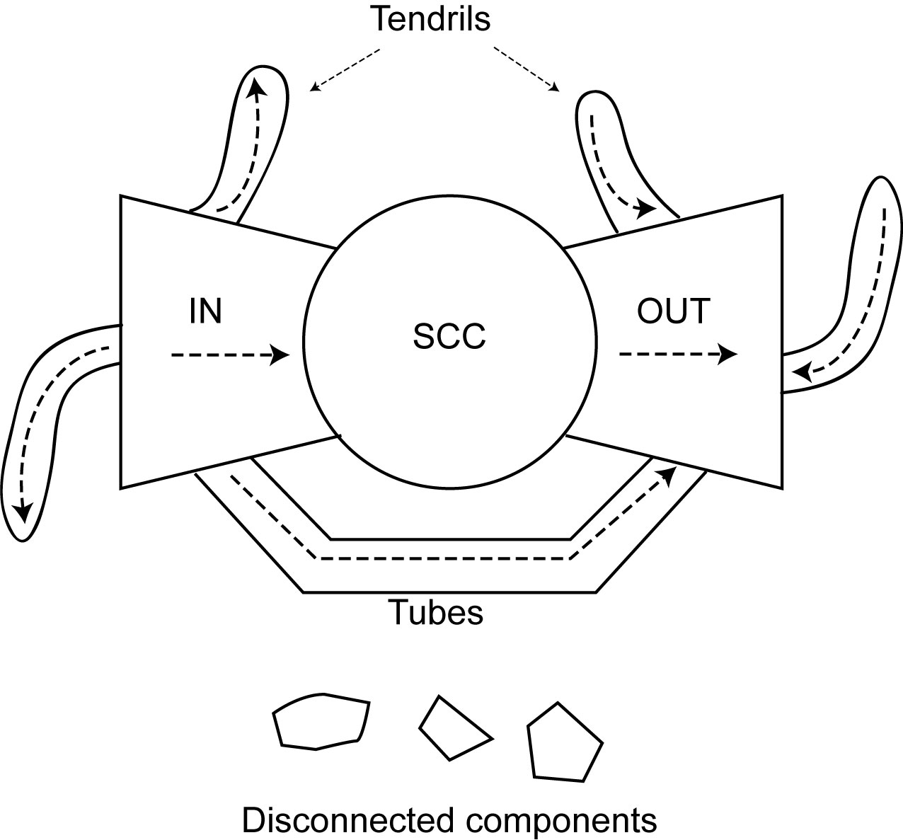
Structure of the Web

Slide 6
Web Data Modeling
Can’t depend on a strict schema to structure the data
Data are self-descriptive
{name: {first:“Tamer”, last: “Ozsu”}, institution: “University of Waterloo”, salary: 300000}
Usually represented as an edge-labeled graph
XML can also be modeled this way
name
salary
institution
“UW”
300000
first
last
“Tamer”
“Ozsu”

Slide 7
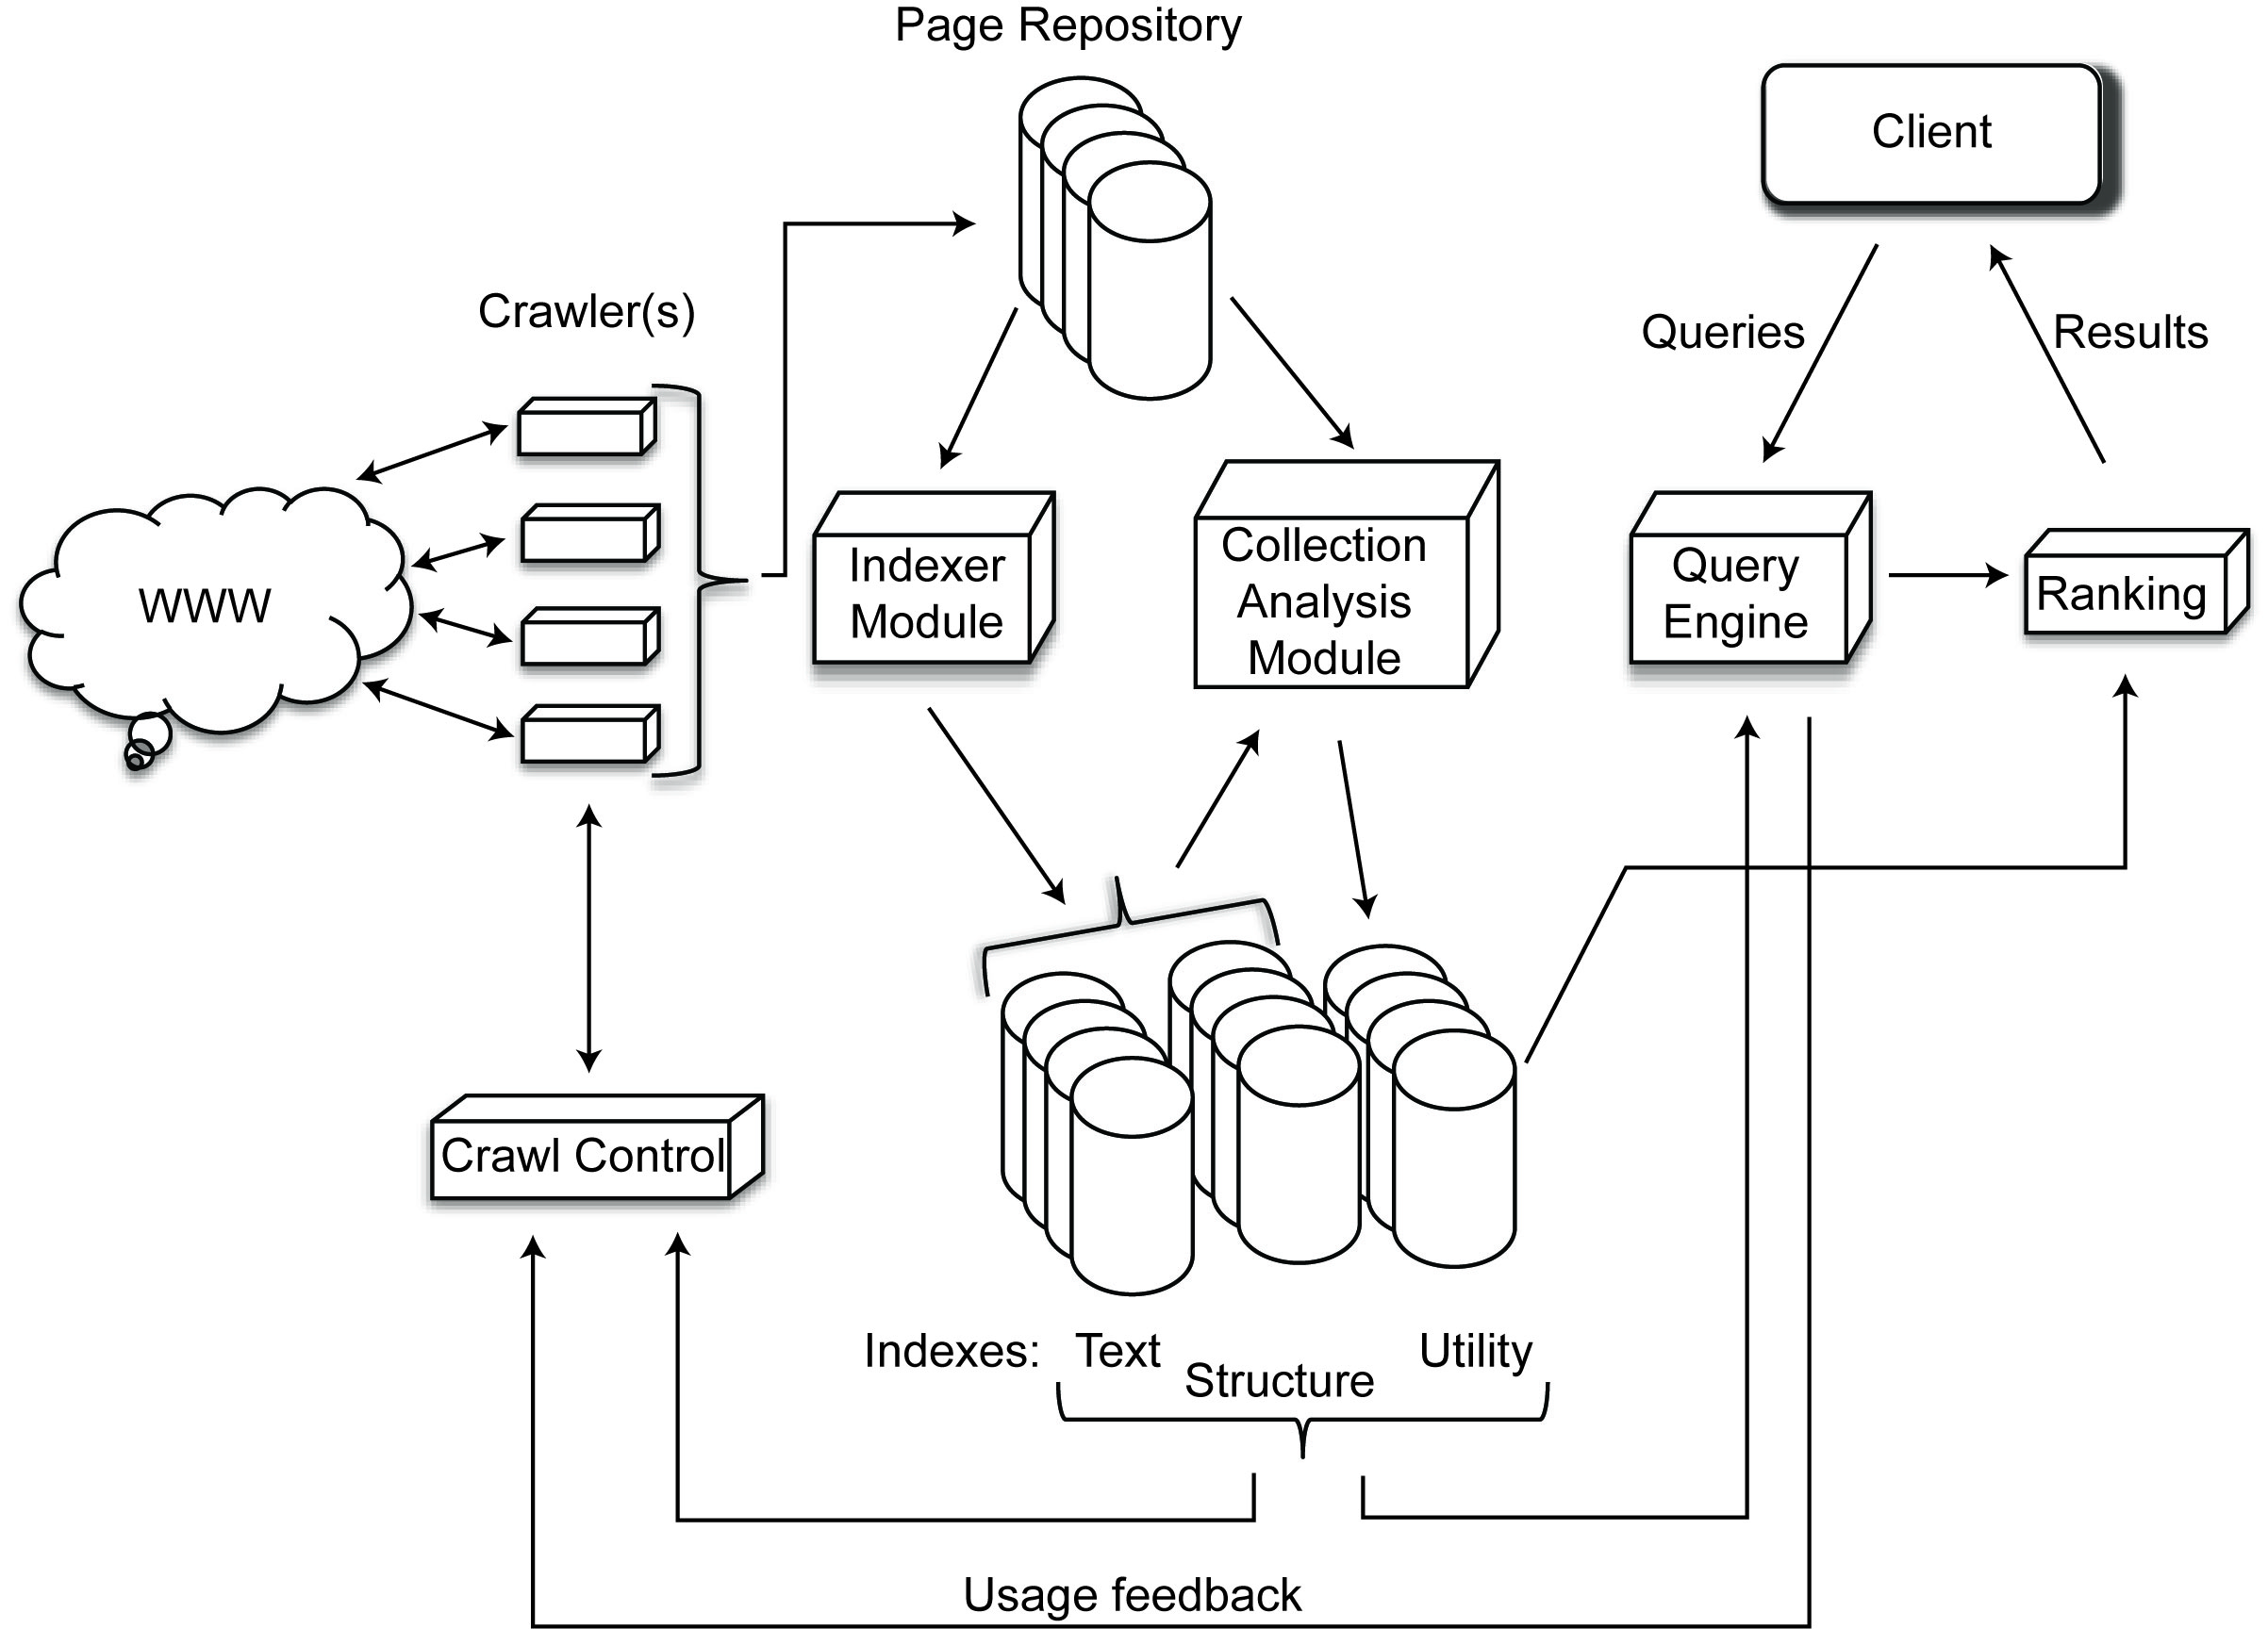
Search Engine Architecture

Slide 8
Web Crawling
What is a crawler?
Crawlers cannot crawl the whole Web. It should try to visit the “most important” pages first.
Importance metrics:
Measure the importance of a Web page
Ranking
Static
Dynamic
Ordering metric
How to choose the next page to crawl

Slide 9

Static Ranking - PageRank
Quality of a page determined by the number of incoming links and the importance of the pages of those links
PageRank of page p_{i}:
B_{pi}: backlink pages of p_{i} (i.e., pages that point to p_{i})

Slide 10
Ordering Metrics
Breadth-first search
Visit URLs in the order they were discovered
Random
Randomly choose one of the unvisited pages in the queue
Incorporate importance metric
Model a random surfer: when on page P, choose one of the URLs on that page with equal probability d or jump to a random page with probability (1-d)

Slide 11
Web Crawler Types
Many Web pages change frequently, so the crawler has to revisit already crawled pages → incremental crawlers
Some search engines specialize in searching pages belonging to a particular topic → focused crawlers
Search engines use multiple crawlers sitting on different machines and running in parallel. It is important to coordinate these parallel crawlers to prevent overlapping → parallel crawlers

Slide 12
Indexing
Structure index
Link structure
Text index
Indexing the content
Suffix arrays, inverted index, signature files
Inverted index most common
Difficulties of inverted index
The huge size of the Web
The rapid change makes it hard to maintain
Storage vs. performance efficiency

Slide 13
Web Querying
Why Web Querying?
It is not always easy to express information requests using keywords.
Search engines do not make use of Web topology and document structure in queries.
Early Web Query Approaches
Structured (Similar to DBMSs): Data model + Query Language
Semi-structured: e.g. Object Exchange Model (OEM)

Slide 14
Web Querying
Question Answering (QA) Systems
Finding answers to natural language questions, e.g. What is Computer?
Analyze the question and try to guess what type of information that is required.
Not only locate relevant documents but also extract answers from them.

Slide 15
Approaches to Web Querying
Search engines and metasearchers
Keyword-based
Category-based
Semistructured data querying
Special Web query languages
Question-Answering

Slide 16
Semistructured Data Querying
Basic principle: Consider Web as a collection of semistructured data and use those techniques
Uses an edge-labeled graph model of data
Example systems & languages:
Lore/Lorel
UnQL
StruQL

Slide 17
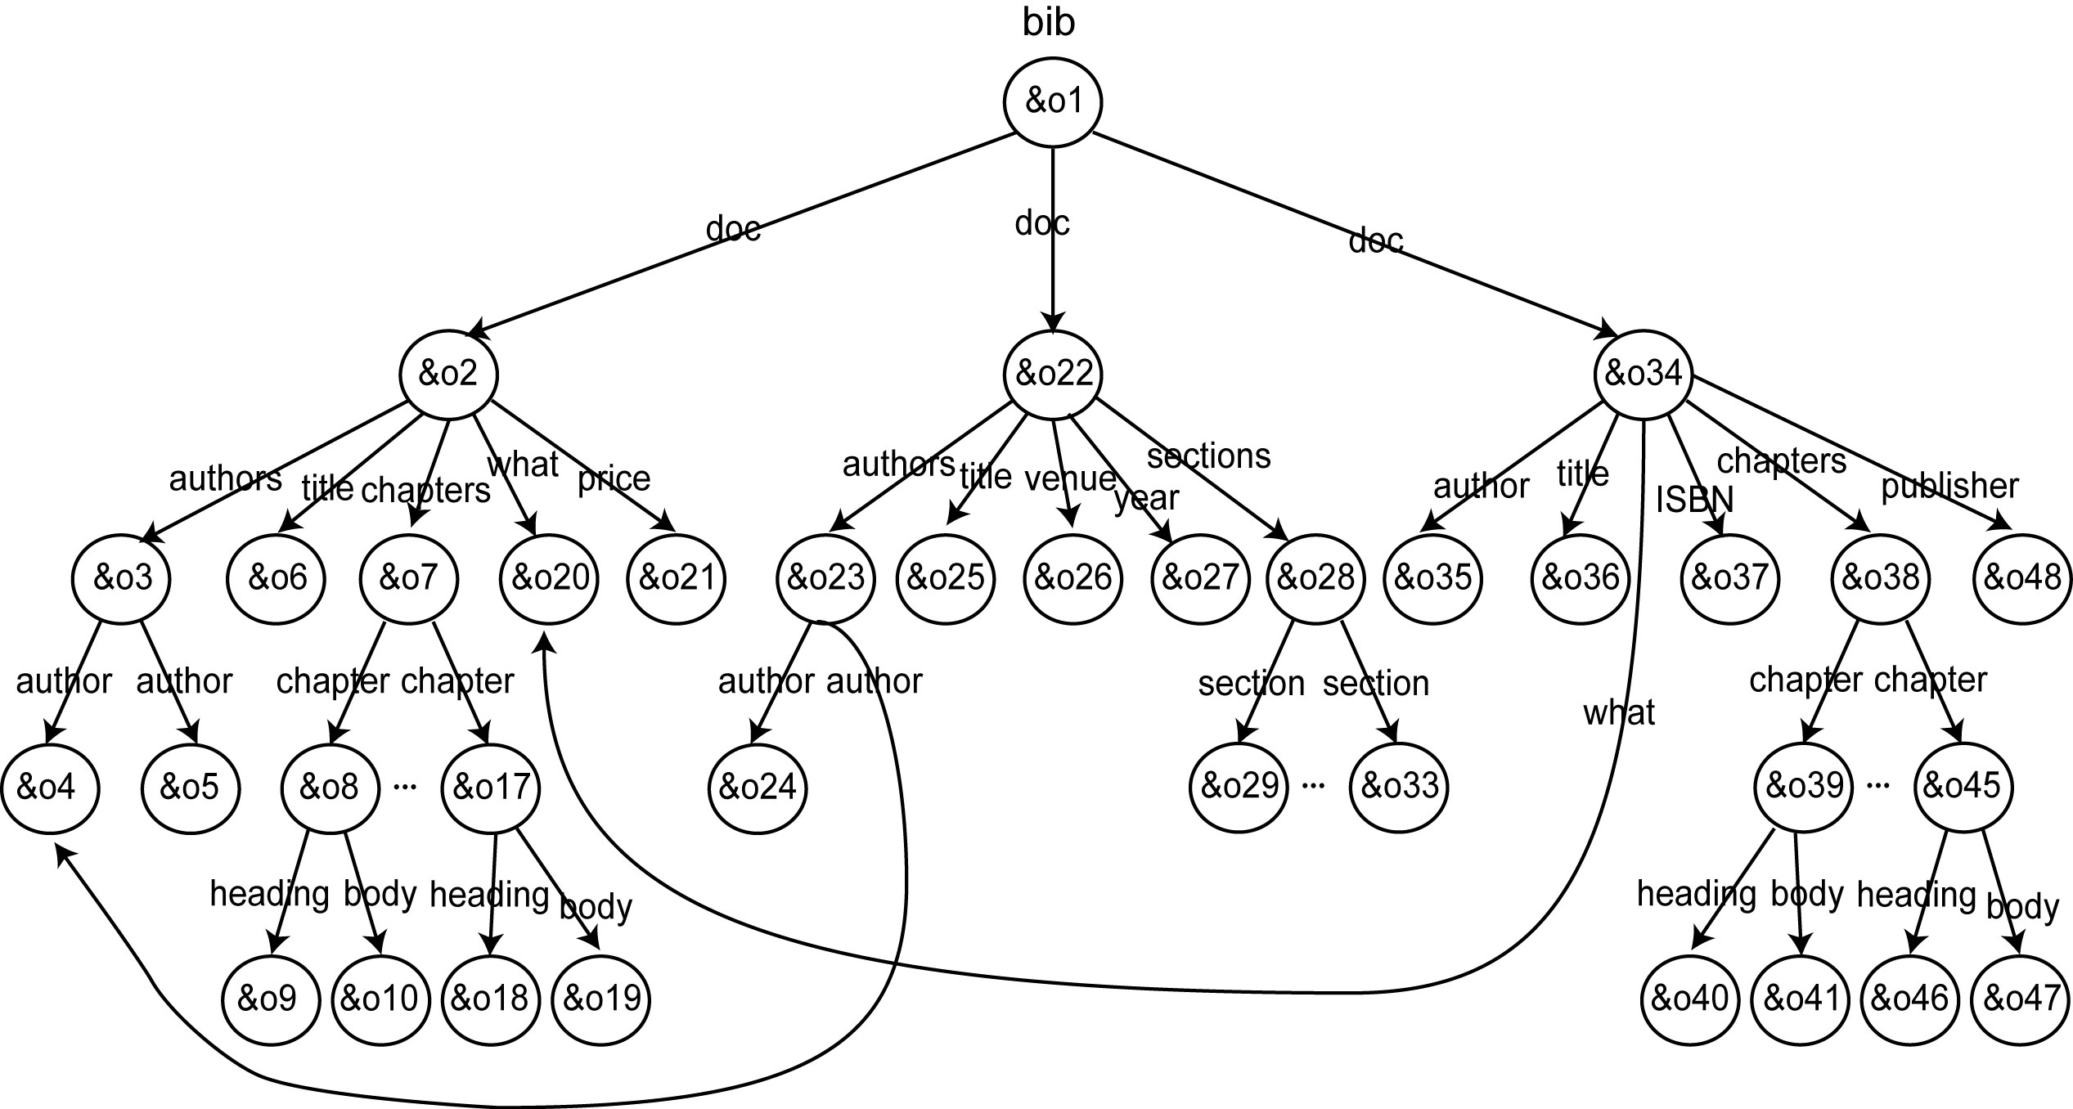
OEM Model

Slide 18
Lorel Example
Find the titles of documents written by Patrick Valduriez
SELECT D.title
FROM bib.doc D
WHERE bib.doc(.authors)?.author = “Patrick Valduriez”
Find the authors of all books whose price is under $100
SELECT D(.authors)?.author
FROM bib.doc D
WHERE D.what = “Books” AND D.price < 100
Notes:
Note: slide is animated

Slide 19
Evaluation
Advantages
Simple and flexible
Fits the natural link structure of Web pages
Disadvantages
Data model too simple (no record construct or ordered lists)
Graph can become very complicated
Aggregation and typing combined
DataGuides
No differentiation between connection between documents and subpart relationships

Slide 20
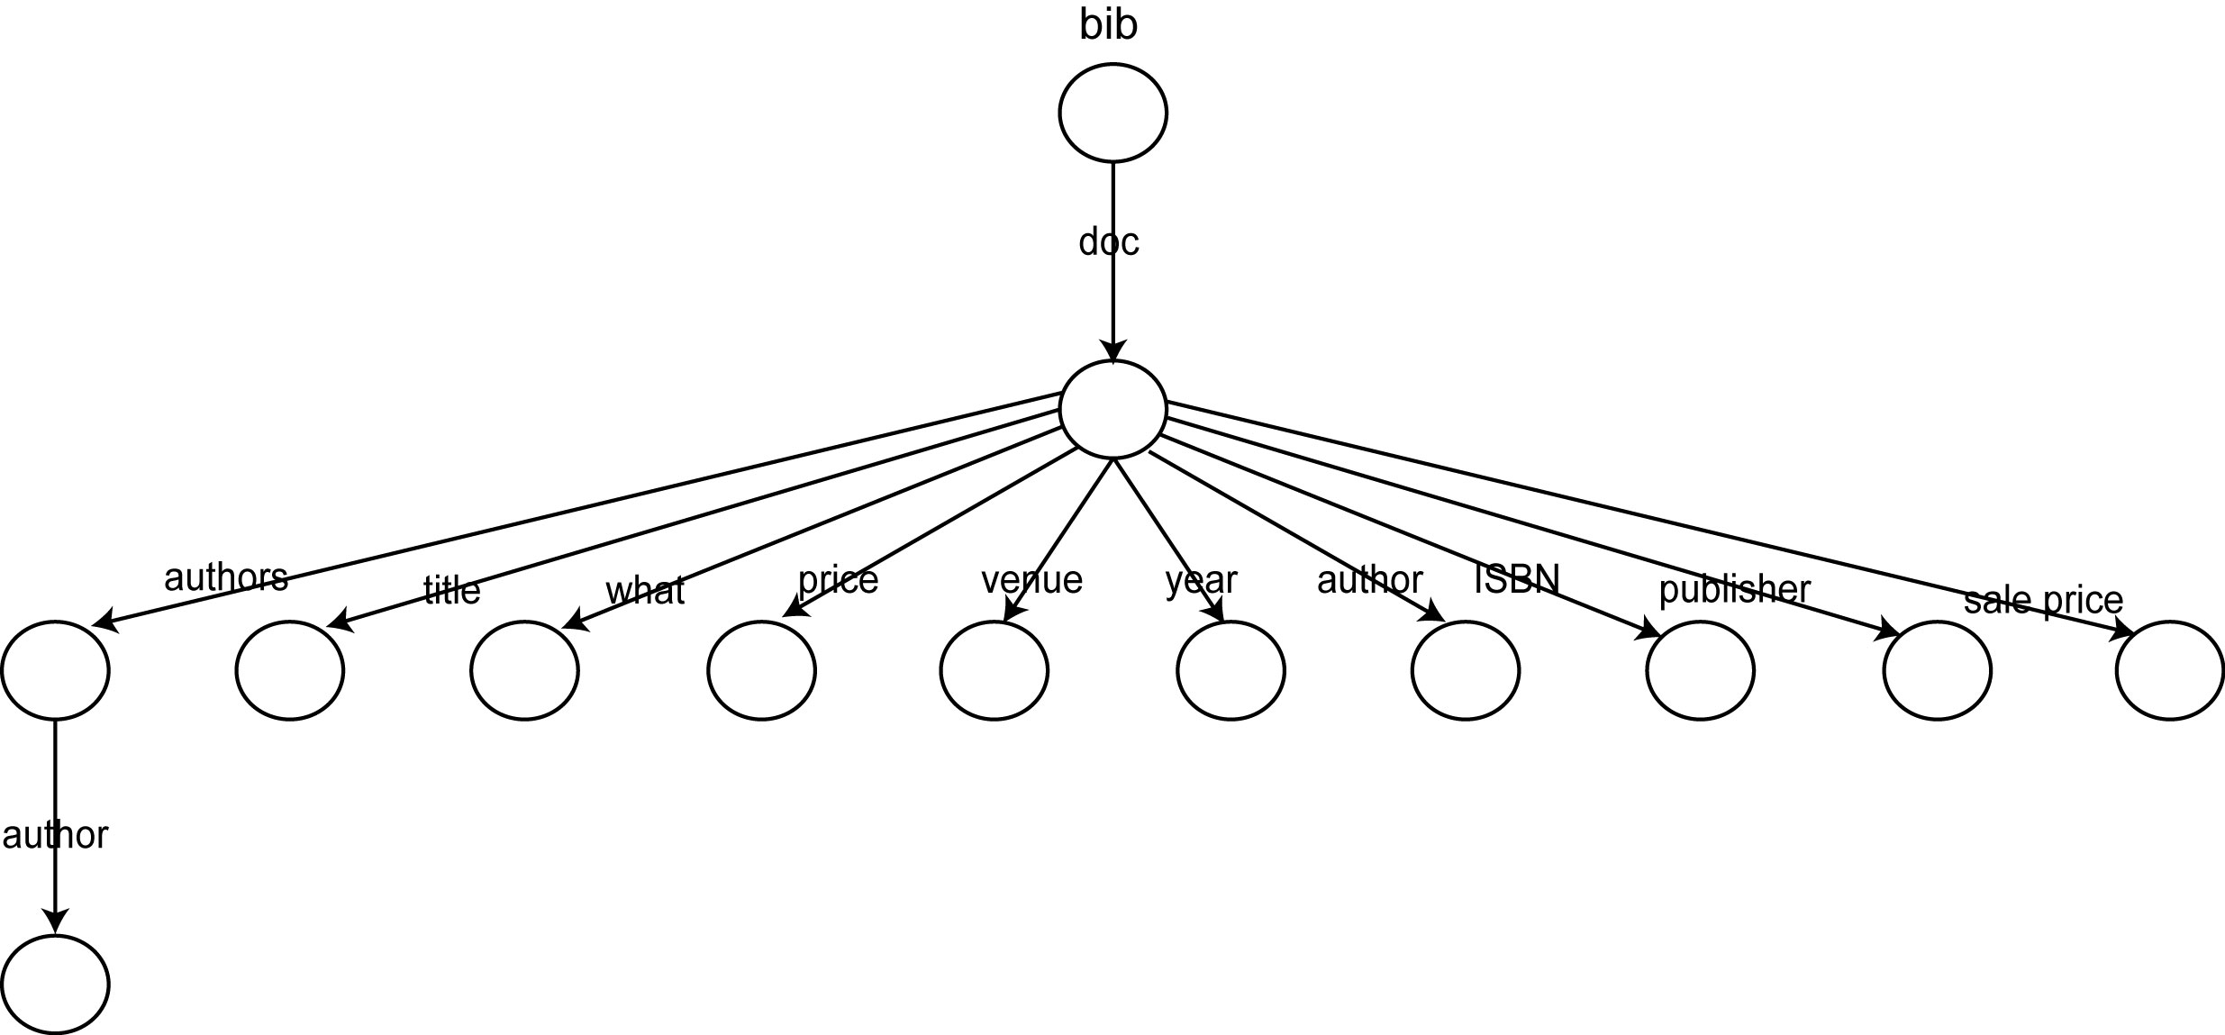
DataGuide

Slide 21
Web Query Languages
Basic principle: Take into account the documents’ content and internal structure as well as external links
The graph structures are more complex
First generation
Model the web as interconnected collection of atomic objects
WebSQL
W3QS
WebLog
Second generation
Model the web as a linked collection of structured objects
WebOQL
StruQL

Slide 22
WebSQL Examples
Simple search for all documents about “hypertext”
SELECT D.URL, D.TITLE
FROM DOCUMENT D
SUCH THAT D MENTIONS “hypertext”
WHERE D.TYPE = “text/html”
Find all links to applets from documents about “Java”
SELECT A.LABEL, A.HREF
FROM DOCUMENT D
SUCH THAT D MENTIONS “Java”
ANCHOR A
SUCH THAT BASE = X
WHERE A.LABEL = “applet”
Demonstrates two scoping methods and a search for links.

Slide 23
WebSQL Examples (cont’d)
Find documents that have string “database” in their title that are reachable from the ACM Digital Library home page through paths of length ≤ 2 containing only local links.
SELECT D.URL, D.TITLE
FROM DOCUMENT D
SUCH THAT ”http://www.acm.org/dl”=|->|->-> D
WHERE D.TITLE CONTAINS “database”
Demonstrates the use of different link types.
Find documents mentioning “Computer Science” and all documents that are linked to them through paths of length ≤ 2 containing only local links
SELECT D1.URL, D1.TITLE, D2.URL, D2.TITLE
FROM DOCUMENT D1
SUCH THAT D1 MENTIONS “Computer Science”
DOCUMENT D2
SUCH THAT D1=|->|->-> D2
Demonstrates combination of content and structure specification in a query.

Slide 24
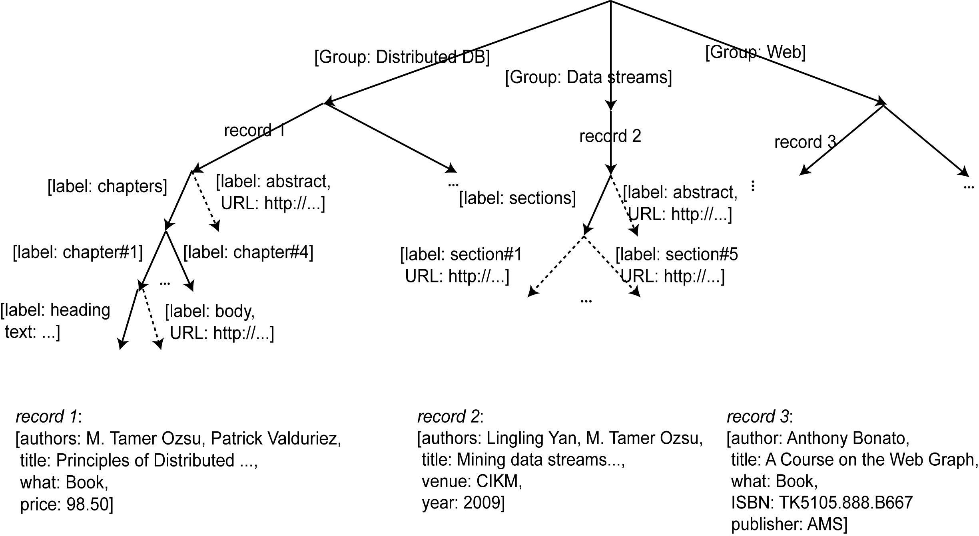
WebOQL
Prime
Peek
Hang
Concatenate
Head
Tail
String pattern match (~)

Slide 25
WebOQL Examples
Find the titles and abstracts of all documents authored by “Ozsu”
SELECT [y.title, y’.URL]
FROM x IN dbDocuments, y in x’
WHERE y.authors ~ “Ozsu”

Slide 26
Evaluation
Advantages
More powerful data model - Hypertree
Ordered edge-labeled tree
Internal and external arcs
Language can exploit different arc types (structure of the Web pages can be accessed)
Languages can construct new complex structures.
Disadvantages
You still need to know the graph structure
Complexity issue

Slide 27
Question-Answer Approach
Basic principle: Web pages that could contain the answer to the user query are retrieved and the answer extracted from them.
NLP and information extraction techniques
Used within IR in a closed corpus; extensions to Web
Examples
QASM
Ask Jeeves
Mulder
WebQA

Slide 28
QA Systems
Analyze and classify the question, depending on the expected answer type.
Using IR techniques, retrieve documents which are expected to contain the answer to the question.
Analyze the retrieved documents and decide on the answer.

Slide 29
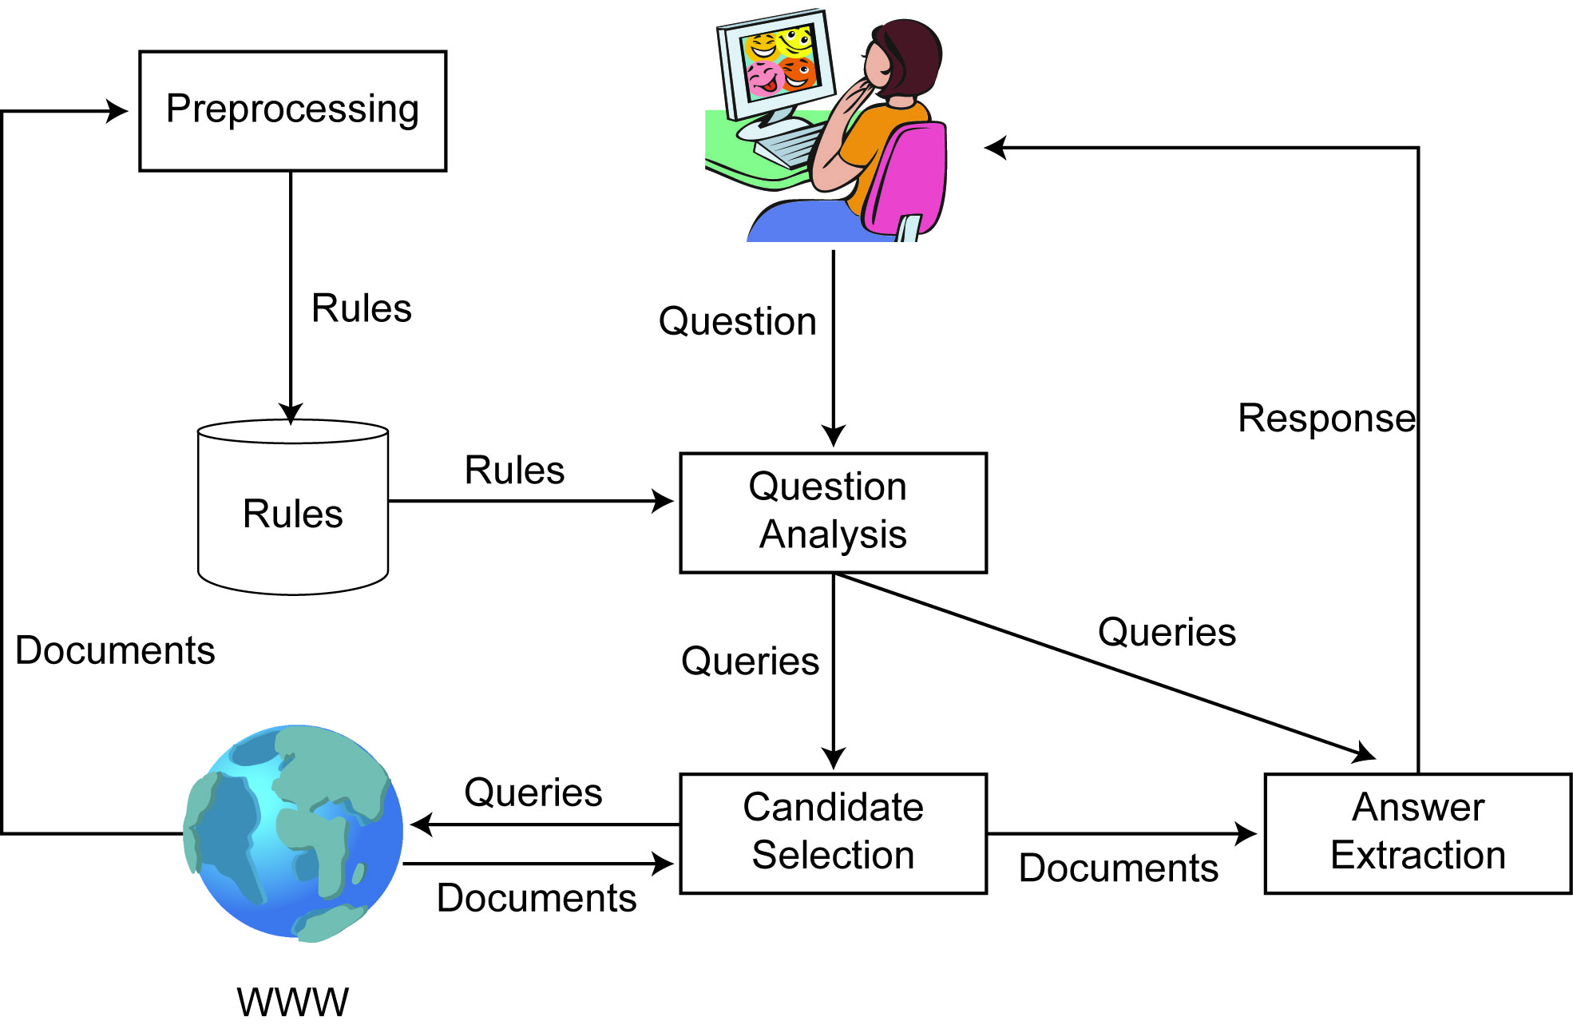
Question-Answer System

Slide 30
Searching The Hidden Web
Publicly indexable web (PIW) vs. hidden web
Why is Hidden Web important?
Size: huge amount of data
Data quality
Challenges:
Ordinary crawlers cannot be used.
The data in hidden databases can only be accessed through a search interface.
Usually, the underlying structure of the database is unknown.

Slide 31
Searching The Hidden Web
Crawling the Hidden Web
Submit queries to the search interface of the database
By analyzing the search interface, trying to fill in the fields for all possible values from a repository
By using agents that find search forms, learn to fill them, and retrieve the result pages
Analyze the returned result pages
Determine whether they contain results or not
Use templates to extract information

Slide 32
Searching The Hidden Web
Metasearching
Database selection – Query Translation – Result Merging
Database selection is based on Content Summaries.
Content Summary Extraction:
RS-Ord and RS-Lrd
Focused Probing with Database Categorization

Slide 33
Searching The Hidden Web
Metasearching
Database Selection:
Find the best databases to evaluate a given query.
bGlOSS
Selection from categorized databases

Slide 34
Distributed XML
XML increasingly used for encoding web data → data representation language
Web 2.0
Data exchange language
Web services
Used to encode or annotate non-web semistructured or unstructured data
Data repository sizes growing → use distribution

Slide 35
XML Overview
Similarities to semistructured models discussed earlier
Data is divided into pieces called elements
Elements can be nested, but not overlapped
Nesting represents hierarchical relationships between the elements
Elements have attributes
Elements can also have relationships to other elements (ID-IDREF)
Can be represented as a graph, but usually simplified as a tree
Root element
Zero or more child elements representing nested subelements
Document order over elements
Attributes are also shown as nodes

Slide 36
XML Schema
Can be represented by a Document Type Definition (DTD) or XMLSchema
Simpler definition using a schema graph: 5-tuple ⟨∑, Ψ, s, m, ρ⟩
∑ is an alphabet of XML document node types
Ψ ⊆ ∑ × ∑ is a set of edges between node types
e=(σ₁, σ₂) ∈ Ψ denotes item of type σ₁ may contain an item of type σ₂
s: Ψ → {ONCE, OPT, MULT}
ONCE: item of type σ₁ must contain exactly one item of type σ₂
OPT: item of type σ₁ may or may not contain an item of type σ₂
MULT: item of type σ₁ may contain multiple items of type σ₂
m: ∑ → {string}
m(σ) denotes the domain of text content of an item of type σ
ρ is the root node type

Slide 37
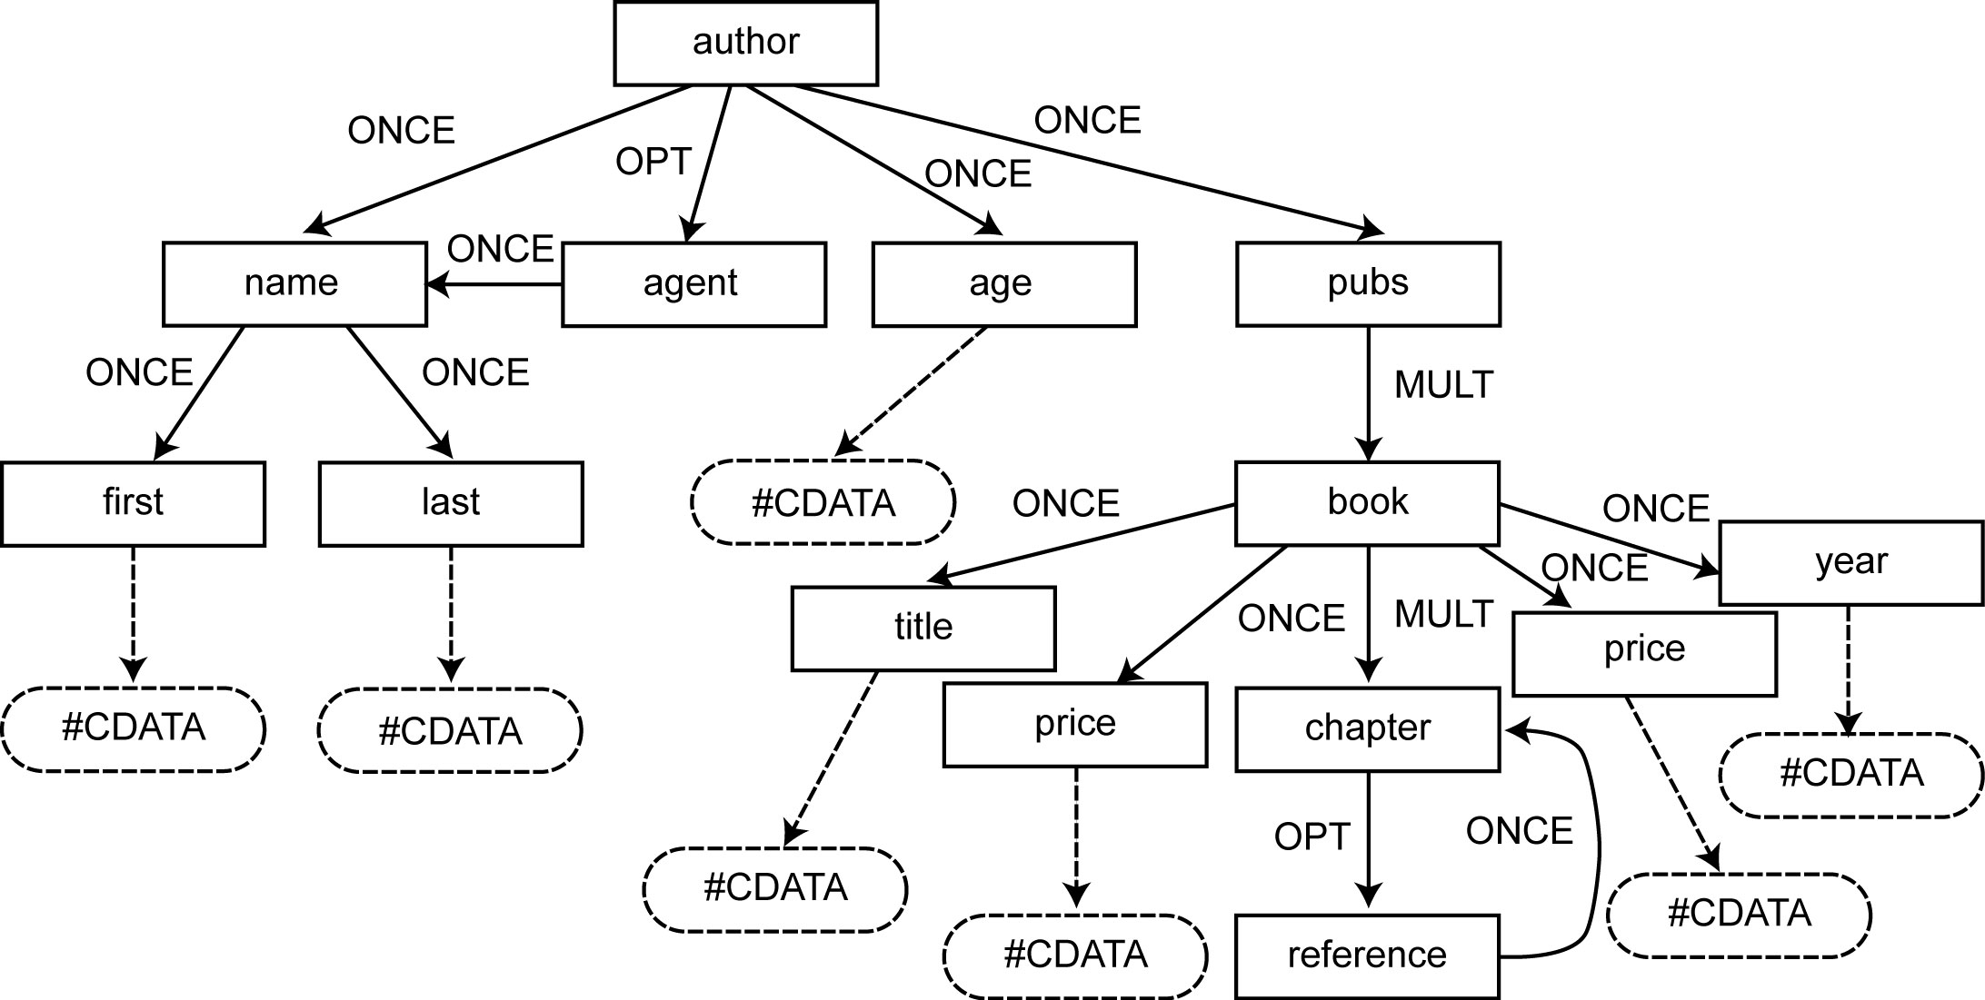
Example

Slide 38
Path Expressions
A list of steps
Each step consists of
An axis (13 of them)
A name test
Zero or more qualifiers
Last step is called a return step
Syntax
Path::= Step(“/”Step)*
Step::= axis”::”NameTest(Qualifier)*
NameTest::= ElementName|AttributeName|”*”
Qualifier::=“[”Expre”]”
Expr::=Path(Comp Atomic)?
Comp:==“=”|“>”|“<”|“>=”|“<=”|“!=”
Atomic::==“`”String”’”
child (/)
descendent
descendent-or-self (//)
parent
attribute (/@)
self (.)
ancestor
ancestor-or-self
following-sibling
following
preceding-sibling
preceding
namespace

Slide 39
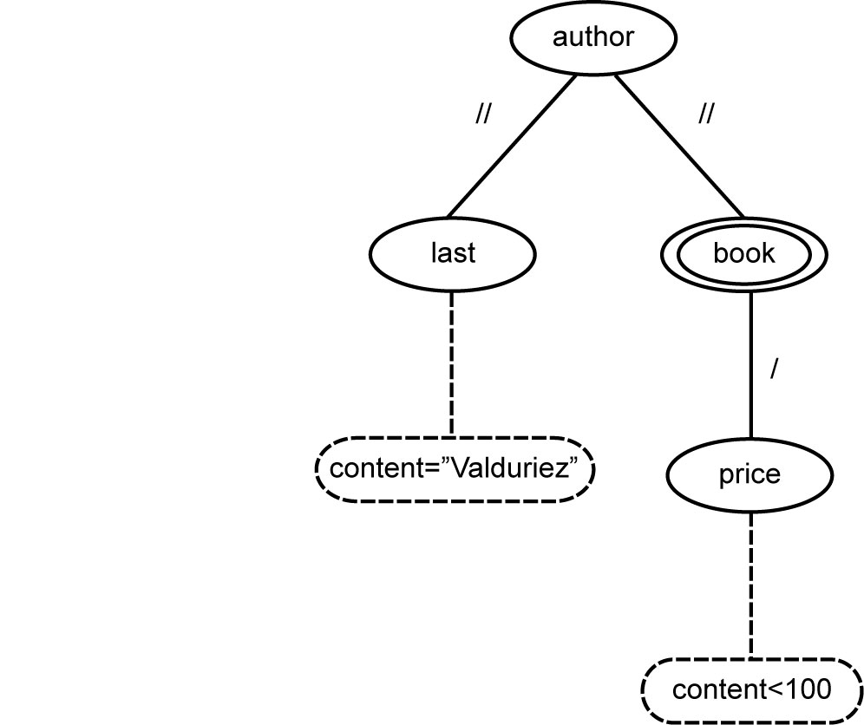
Path Expression Example
/author[.//last = “Valduriez”]//book[price < 100]
Name constraints
Correspond to name tests
Structural constraints
Correspond to axes
Value constraints
Correspond to value comparisons
Query pattern tree (QTP)

Slide 40
XQuery
FLWOR expression
“for”, “let”, “where”, “order by”, “return” clauses
Each clause can reference path expressions or other FLWOR expressions
Similar to SQL select-from-where-aggregate but operating on a list of XML document tree nodes
Example: Return a list of books with their title and price ordered by their attribute names
let $col := collection(“bib”)
for $author in $col/author
order by $author.name
for $b in $author/pubs/book
let $title := $b/title
let $price := $b/price
return $title, $price

Slide 41
XML Query Processing Techniques
Large object (LOB) approach
Store original XML documents as-is in a LOB column
Similar to storing documents in a file system
Simple to implement and provides byte-level fidelity
Slow in processing queries due to XML parsing at query execution time
Extended relational approach
Shred XML documents into object-relational tables and columns and stored in relational or object-relational systems
If properly designed, can perform very well (uses well established relational technology)
Insertion, fragment extraction, structural update, and document reconstruction require considerable effort
Native approach
Use a tree-structured data model and introduce operators that are optimized for tree navigation, insertion, deletion, and update
Usually well balanced tradeoff among criteria
Requires specialized processing and optimization techniques

Slide 42
Path Expression Evaluation
Navigational approach
Built on top of native XML storage systems
Match the QTP by traversing the XML document tree
Query-driven: each location step is translated into an algebraic operator which performs the navigation
Data-driven: builds an automaton for a path expression and executes the automaton by navigating the XML document tree
Join-based approach
Usually based on extended relational storage systems
Each location step is associated with an input list of elements whose names match with the name test of the step
Two lists of adjacent location steps are joined based on their structural relationship (structural join operation)
Evaluation
Join-based efficient in evaluating dependent axes, but not as efficient as navigational in queries that have only child axes

Slide 43
Fragmenting XML Data
Ad hoc fragmentation
No explicit, schema-based fragmentation specification
Arbitrarily cut edges in XML document graphs
Example: Active XML
Static part of document: XML data
Dynamic part of document: function call to web services
Original document
<author>
<name>J. Doe</name>
…
<call fun=“getPub(‘J. Doe’)” />
</author>
After service call
<author>
<name>J. Doe</name>
…
<pubs>
<book> … </book>
…
</pubs>
</author>

Slide 44
Fragmenting XML Data (cont’d)
Structure-based fragmentation
Fragmentation is based on characteristics of schema or data
Similar to relational fragmentation
Horizontal fragmentation
Based on selection
Specified by set of predicates on data
Vertical fragmentation
Based on projection
Specified by fragmenting the set of node types in the schema
Hybrid fragmentation

Slide 45
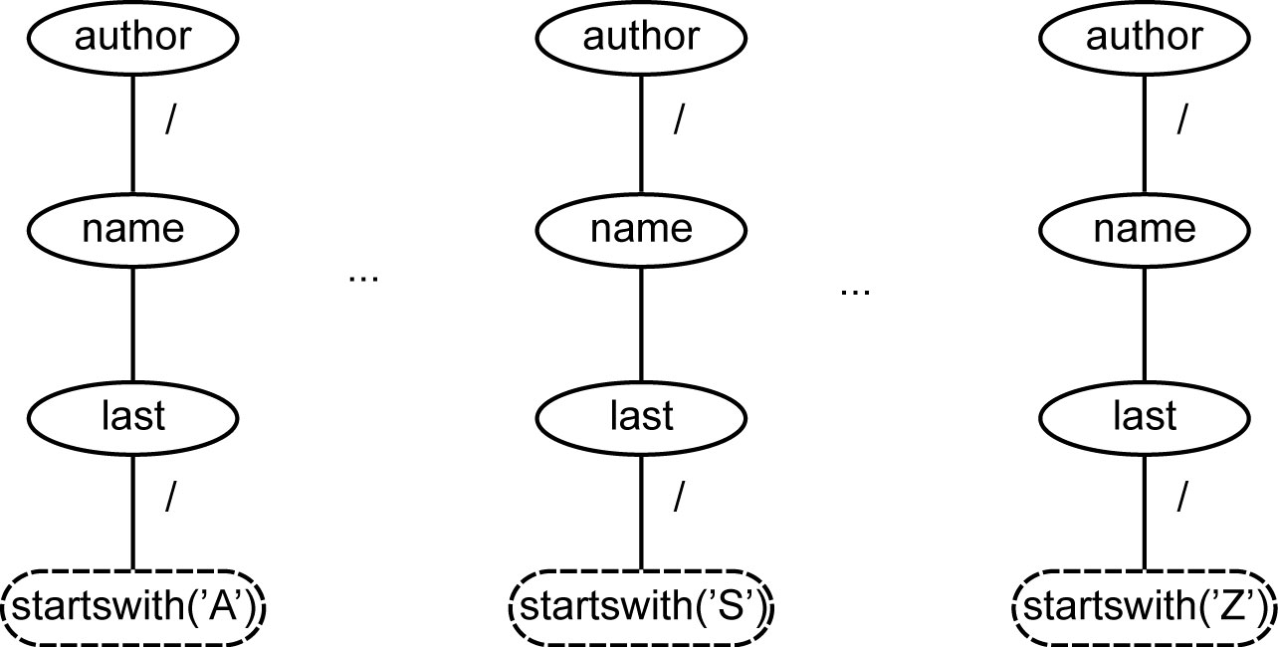
Horizontal Fragmentation
Let D = {d₁, d₂, … , d_{n}} be a collection of document trees such that each d_{i} ∈ D follows the same schema. Define a set of predicates P = {p₀, p₁, …, p_{l−1}} such that ∀d ∈ D: ∃ unique p_{i} ∈ P where p_{i}(d). Then F = {{d ∈ D| p_{i}(d)} | p_{i} ∈ P} is a horizontal fragmentation of D.
Fragmentation tree patterns (FTP)

Slide 46
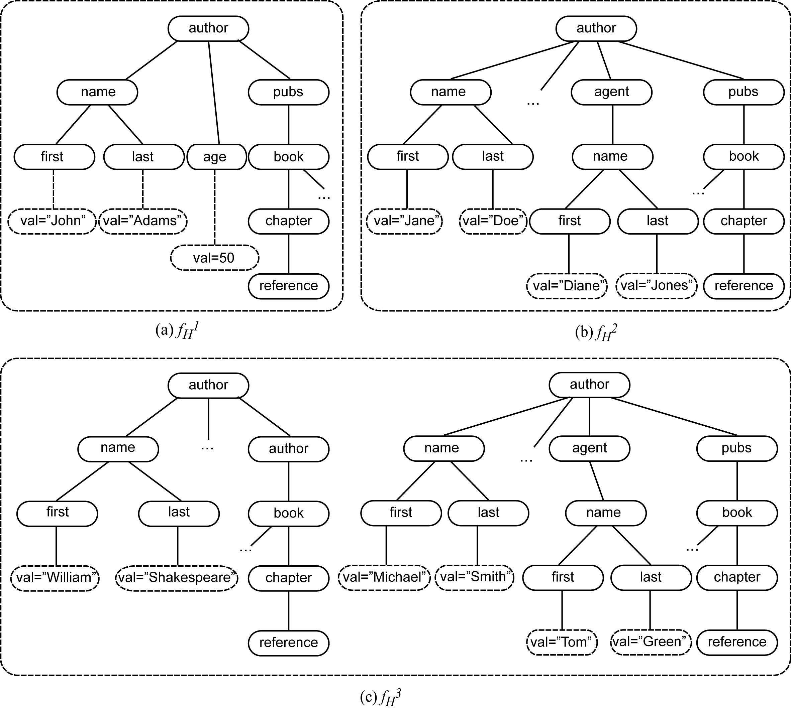
Horizontal Fragmentation Example – Instance

Slide 47
Vertical Fragmentation
Let 〈∑, Ψ, s, m, ρ〉 be a schema graph. Then we can define a vertical fragmentation function ϕ : ∑ → F∑ where F∑ is a partitioning of ∑.
Fragment that has the root element is called the root fragment
Child fragment and parent fragment are defined

Slide 48
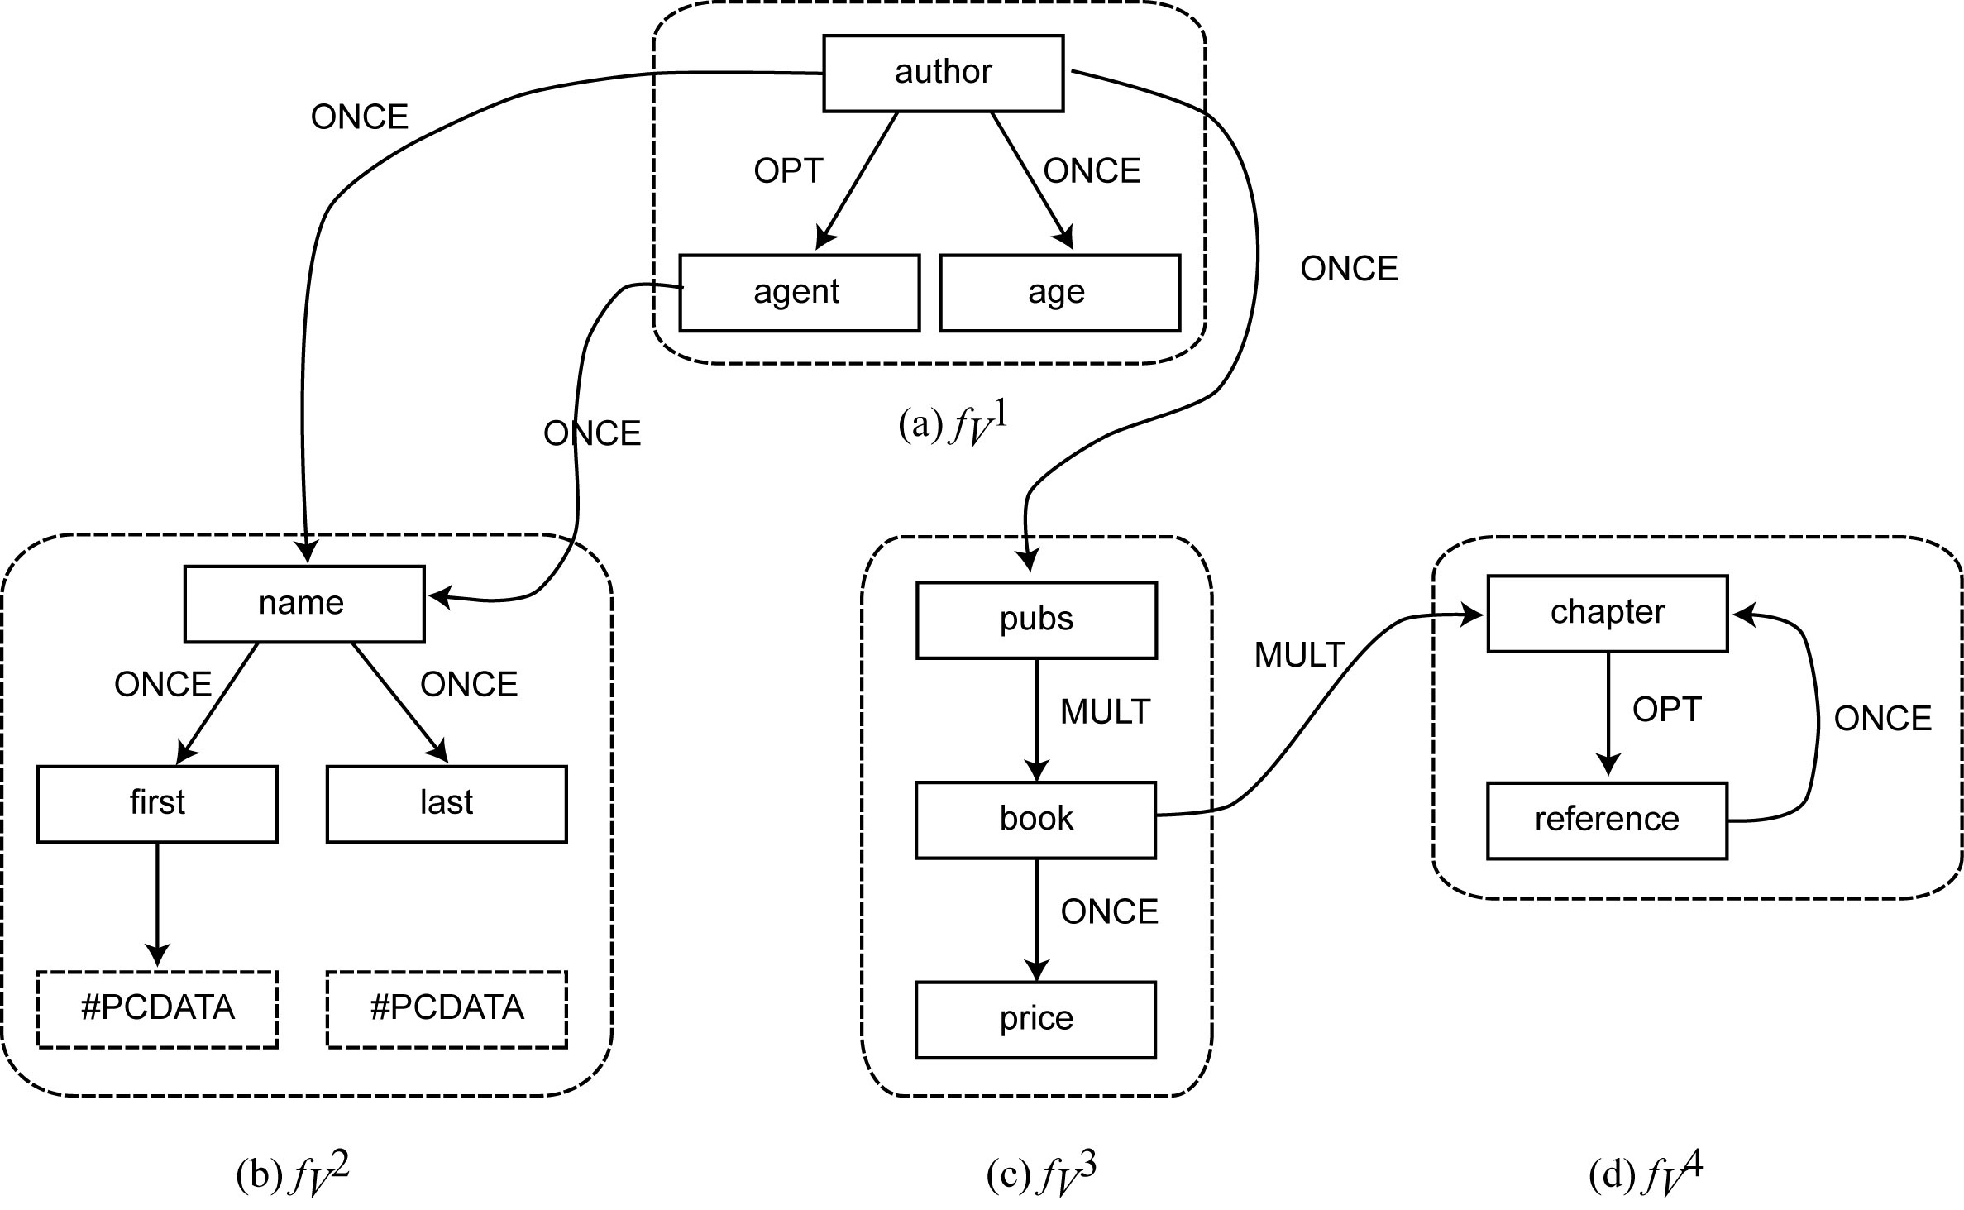
Vertical Fragmentation Example – Schema

Slide 49
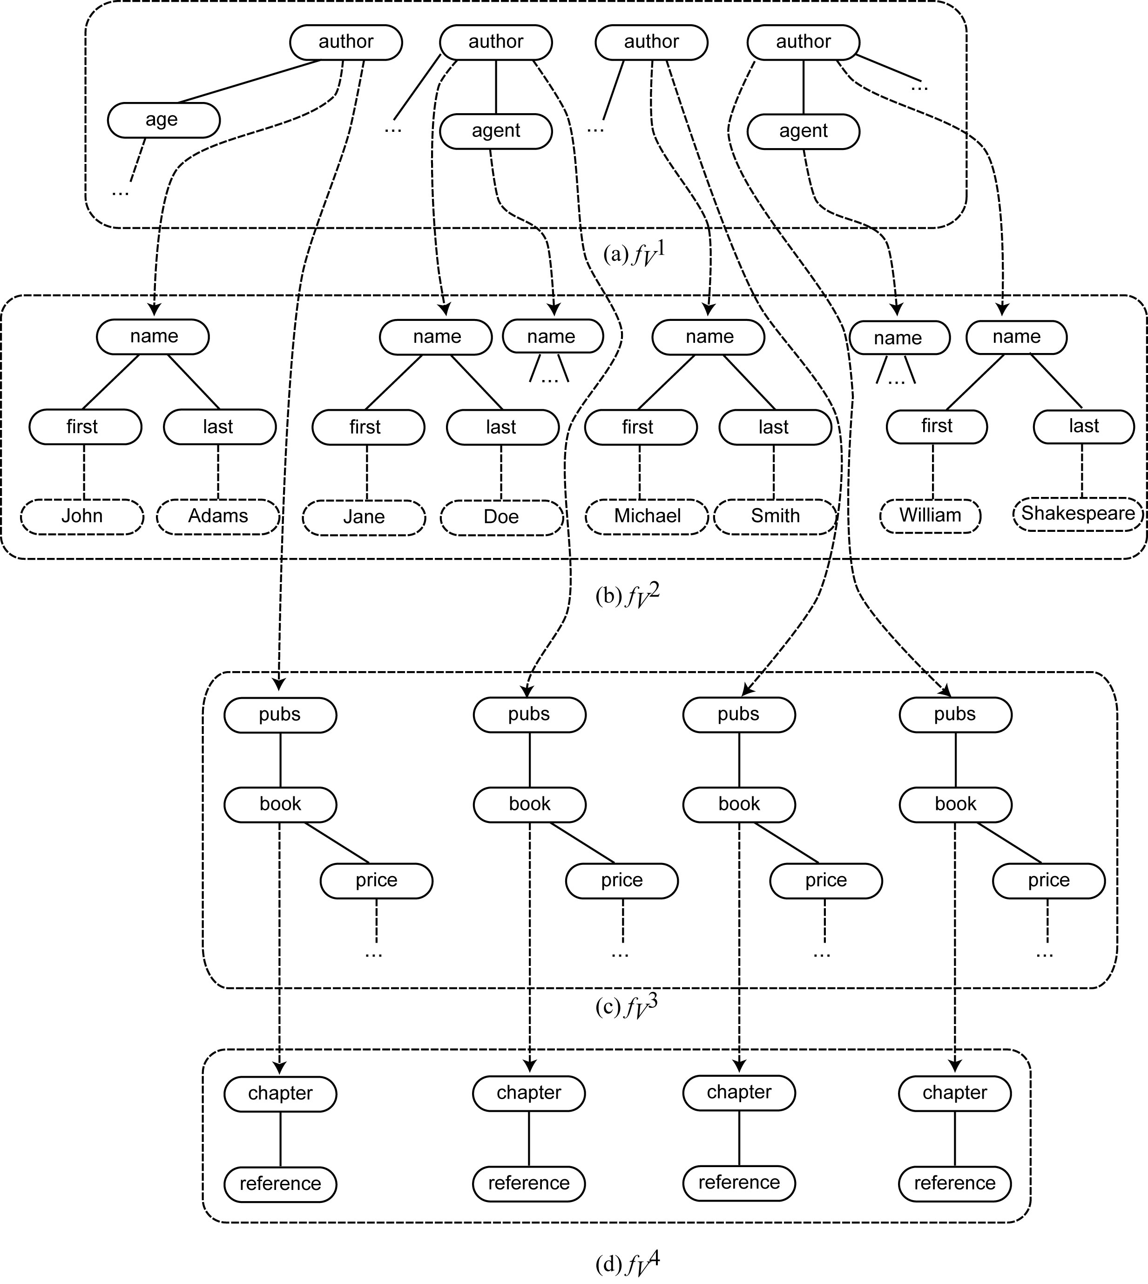
Vertical Fragmentation Example – Instance

Slide 50
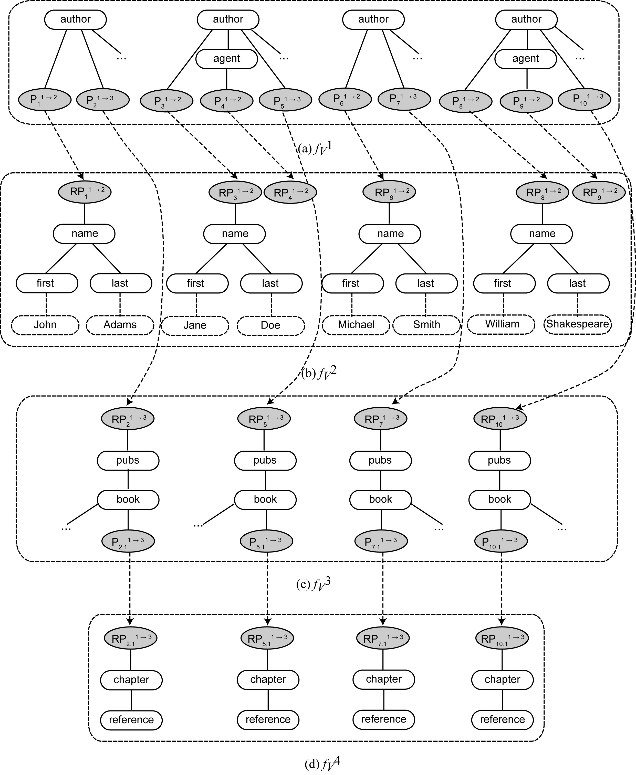
Proxy Nodes

Slide 51
Optimizing Distributed XML
Data shipping versus query shipping
Data shipping moves data from where it is to where the query is posed and processes it there
XQuery built-in functionality: fn:doc(URI)
Simple to implement
Provides only inter-query parallelism (no intra-query parallelism)
Requires sufficient storage space at each site to hold data
Large data moving overhead
Query shipping (or function shipping) decomposes the query such that each subquery is evaluated at a site where the data reside
Better parallelization
Difficult in the context of XML – both the function and its parameters need to be shipped
Packaging required to implement call-by-value semantics
Serialization of the subtree rooted at the parameter node is packaged and shipped

Slide 52
Data Shipping in XML
Difficulties with packaging:
There may be some axes (e.g., parent, preceding-sibling) that are now “downward” from the parameter node requiring access to data that may not be available in the subtree of the parameter node.
Node identity problems: Two identical nodes passed as parameters and returned as results are represented by call-by-value semantics as two different nodes.
Document order of nodes – serialization may not obey these
Interaction between different subqueries that access the same document on a given peer

Slide 53
Query Shipping Approach
Partial function evaluation
Given f(x,y), partial evaluation would compute f on one of the inputs and generate a partial answer, which would be another function f’ that is only dependent on the second input.
Query is considered a function and data fragments its inputs.
Processing outline:
Phase 1:
Coordinating site assigns the query to those sites that hold a relevant fragment.
Each site evaluates the query (in parallel) on its local data.
For some data nodes, the value of each query qualifier is known; for others, the value of some qualifiers is a Boolean formula whose value is not yet fully determined
Phase 2: The selection part of the query is (partially) evaluated → for each node of each fragment, either it is part of the query’s answer, or it is not even a candidate to be part of the answer
Phase 3: Check candidate nodes again to determine which ones are indeed in the result and send them to the coordinator

Slide 54
Query Shipping Approach (cont’d)
XRPC
Introduce a remote procedure call functionality through
execute at {Expr}{FunApp(ParamList)}
where Expr is the explicit or computed URI of the peer where FunApp() is to be applied.
Call-by-projection
A runtime projection technique to minimize message sizes.
Preserves node identities and structural properties of XML node parameters as well.
A node parameter is analyzed to see how it is used by a remote function.
Only those descendants of the node parameter that are actually used by the remote function are serialized into the request message.
Nodes outside the subtree of nth node parameter are added to the request message if they are needed by the remote function.

Slide 55
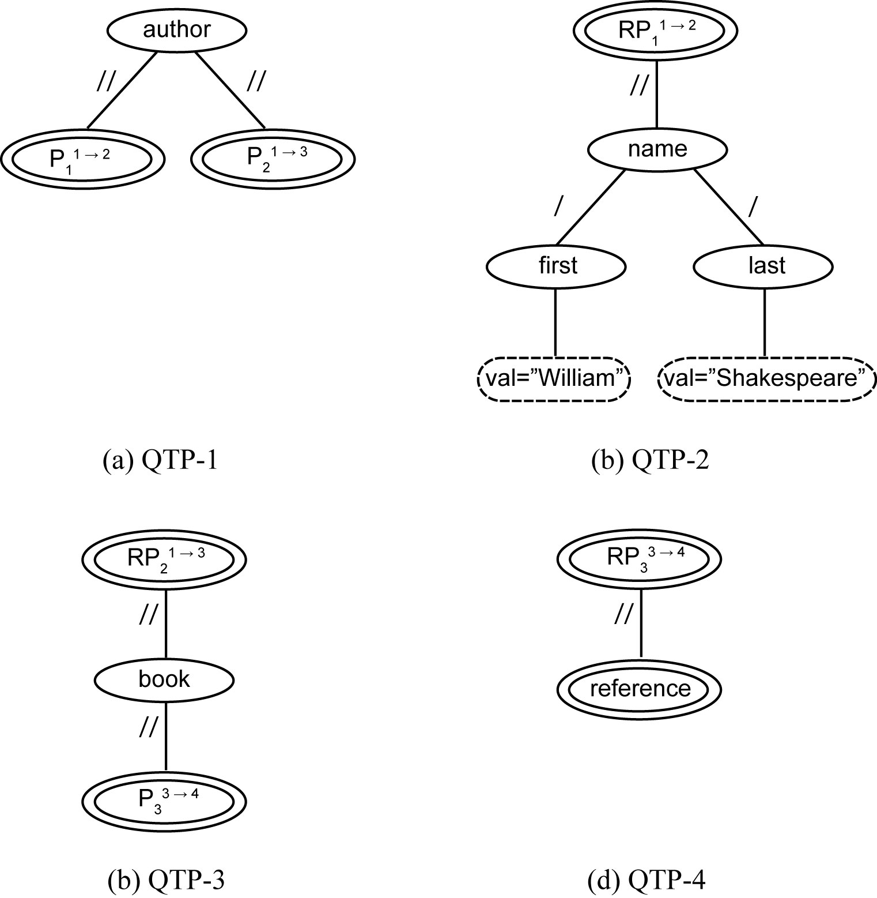
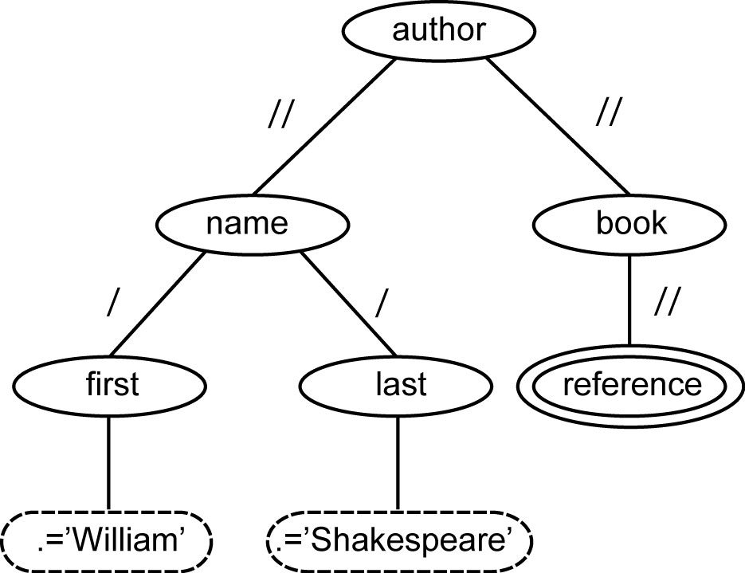
Query Shipping Approach (cont’d)
Use the fragmentation specification and the query specification
The following considers vertical fragmentation
GQTP
Subqueries

