Slide 1
Scholarly Communications Landscape : UCB and SFU
Charles Eckman, Dean of Library Services & University Librarian, SFU
SLAIS LIBR 995L
Vancouver, June 2, 2011

Slide 2
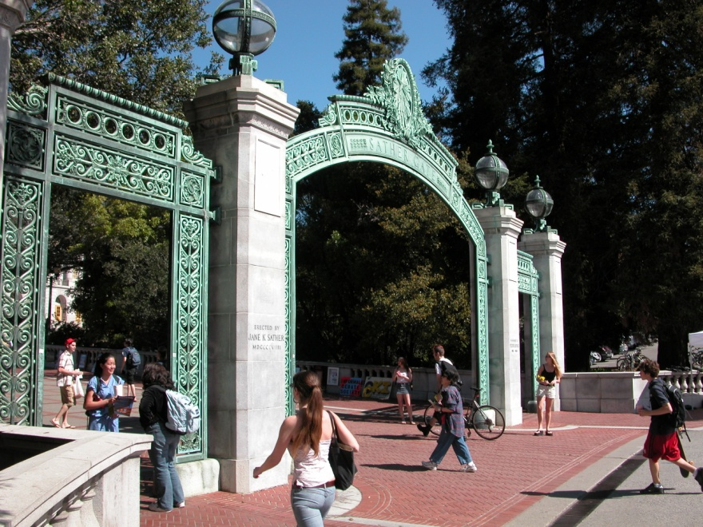
University of California, Berkeley
1868
students
25,540 undergraduate
10,298 graduate
1582 faculty
130 academic departments
Over 80 research centers
Highest number of PhD granted annually in the U.S.
largest number of highly ranked graduate programs in US per latest NRC study

Slide 3
UCB faculty leaders
bePress founded 1999 by Robert Cooter (law) and Aaron S. Edlin (economics/law) – sustainable publishing
PLoS co-founded 2000 by Mike Eisen (cell biology)
Randy Shekman (microbiology, HHI)— editor Annual Review of Cell and Developmental Biology.
Judson King (chemical engineering). Center for Studies in Higher Education (CSHE) Diane Harley.
Project Bamboo, Tony Cascardi (comparative literature, Townsend Center for the Humanities)
Notes:
Patric Brown (Stanford) and Harold Varmus (present director of NCI, former Memorial Sloan Kettering Cancer Center Pres.

Slide 4
2005 UCB faculty conference on SC
“If Berkeley faculty are to change their behavior, the campus must be willing to provide individuals with start up funds. Faculty interested in establishing new, open-access journals could use campus seed money to offset editorial and technical costs. Similarly, the campus could provide funding support for scholars who wish to publish in open-access publications that charge author fees.”
-Executive Summary of the Faculty Conference on Scholarly Publishing, March 2005

Slide 5
2007 UC faculty survey
93% say impact factor is important in choosing a publication venue
75% are aware of journal pricing crisis
73% indicate change in scholarly communication system is needed (26% say "substantial" change is needed in their discipline)
70% say journal affordability is not a factor in choosing a publication venue

Slide 6
2007 UC faculty survey
63% agree that the existing peer review process discourages new forms of high-quality peer-reviewed publishing
54% say high price of journals mitigates the impact of their research
23% say their OA publishing will increase in the next twelve months
22% say they have published in an open access venue

Slide 7
draft UC OA policy (2007)
[seeks to achieve] a balance between the publisher’s goals and the author’s goals of sharing the material to further scholarship [and] asserts and confirms the UC faculty author as the copyright holder [and] supports authors’ retention of rights in order to use and develop their works without restrictions...
[F]aculty shall routinely grant to The Regents of the University of California a license to place in a non-commercial open-access online repository the faculty member’s scholarly work published in a scholarly journal or conference proceedings.
Faculty may opt out of this policy for any specific work...

Slide 8
sense of reviews
strong support for intent and goals, but consistent concerns about implementation, concentrating on:
Burden of opting out (default requirement to retain rights in a work and to deposit it for open access perceived as a threat to academic freedom; a workload burden; a threat to publishers);
Proposed link to academic reviews (recording the access characteristics of publications in review files perceived as inappropriate, burdensome, unnecessary);
Unknown but imagined large support structures and costs (to create “open access agents;” to support negotiations with publishers; to track compliance; to maintain a repository; etc.)

Slide 9
UCB OA Fund
desire for hybrid support
society editors (promote experimentation and transition to OA for these cost-effective jrnls)
senate committee (useful to junior faculty who need support and exposure)
compromise @ US $1500 cap (half of the OA journal article cap) to exert cost control
fund goes live January 2008

Slide 10
fund status
68 articles funded
OA article average US $1500
hybrid articles; average US $1280
value of hybrid component
conversation w/ faculty (why not full reimbursement)
conversation w/ CDL and some publishers re expenditures
only 25% UCB OA publishing requires use of the fund
budget US $50k per annum
well under 1% of budget

Slide 11
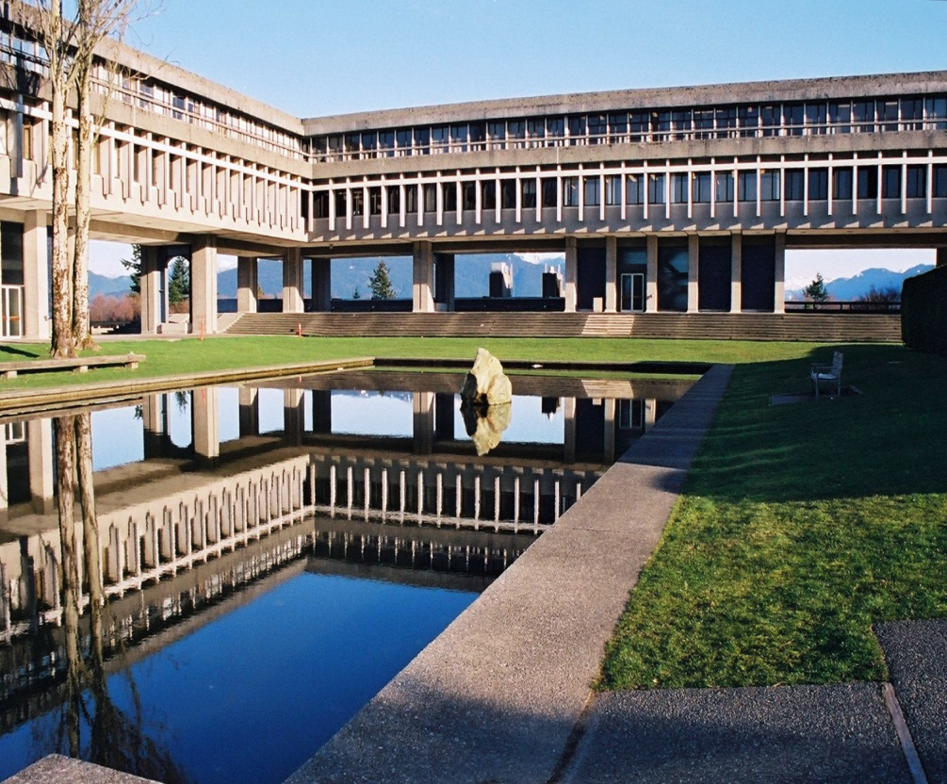
Simon Fraser University
1965
students:
29697 undergraduate
5507 graduate
942 faculty
30 academic departments
133 doctorates awarded in 2009
ranks third among Canadian universities in publication impact index (Research Infosource)

Slide 12
PKP software
Existing
Open Journal Systems (OJS)
Open Conference Systems (OCS)
Open Harvester Systems (OHS)
Development
Web Application Library (WAL)
Open Monograph Press (OMP)
Notes:
John Willinsky, Stanford and UBC is Founder and Director
SFU Lead software developer since 2007 – Brian Owen AUL for systems and processing is the Managing Director
5.5 Staff
Sustainability strategy

Slide 13
SC Services (library-based)
public programming (OA Week, PKP workshops, etc.)
SUMMIT IR
OA Fund (non-hybrid, 28 articles, grant work)
scholarly Digitization Fund (8 projects)
free journal hosting (PKP-based)

Slide 14
SC Services (planned)
data management
SFU open monograph press
research productivity
facilitate OA mandate

