Slide 1
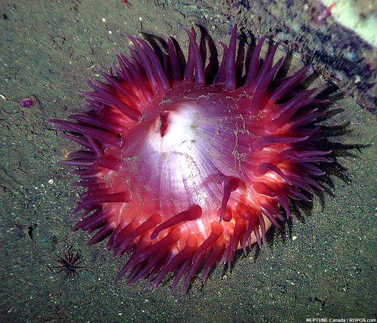
LIBR 559L – Emerging trends, June 9, 2011
Anemone – Neptune Canada
http://www.flickr.com/photos/neptunecanada/3717943155/sizes/o/in/set-72157619793977229/
CC-BY-NC-SA
Heather Morrison
http://pages.cmns.sfu.ca/heather-morrison/
This work is licensed under a Creative Commons Attribution-NonCommercial-ShareAlike 3.0 Unported License.

Slide 2
Scholarly monographs
News: National Academies Press makes PDF of all their monographs (4,000 titles) freely available to download:
http://www8.nationalacademies.org/onpinews/newsitem.aspx?RecordID=06022011

Slide 3
On copyediting
Study Finds Open Access Manuscripts ‘Good Enough’ Without Copyediting
http://news-libraries.mit.edu/blog/access-manuscripts/5538/ - Ellen Duranceau, comment on “Copyediting’s Role in an Open Access World,” Against the Grain, vol. 23, no.2, April 2011, pp. 30-34.
“Thatcher expected to find the open access manuscripts deficient in comparison with the final copyedited and published articles, but found instead that “By and large, the copyediting did not result in any major improvements of the manuscripts” and that “the vast majority of the changes made were for the sake of enforcing a house formatting style and cleaning up a variety of inconsistencies and infelicities, none of which reached into the substance of the writing or affected the meaning other than by adding a bit more clarity here and there.”
Stuart Shieber, the Benefits of Copyediting. June 2011. The Occasional Pamphlet. http://blogs.law.harvard.edu/pamphlet/2011/06/04/the-benefits-of-copyediting/

Slide 4
Economics – journals and price increases in dollars and %: compounding
Title | Publisher | Actual cost in USD | 5% increase (year 1) | Year 1 price | 5% increase (year 2)
Canadian Historical Review | U. of Toronto Press | $ 140 | $7 | $147 | $7
Historical Research | Wiley-Blackwell | $ 459 | $23 | $482 | $24
Journal of Contemporary History | Sage Publications | $ 863 | $43 | $906 | $45
Journal of Neurogenetics | Informa Healthcare (Taylor & Francis) | $ 1515 | $76 | $1,591 | 80
Data from Ulrich’s. All journals are quarterly. Actual cost for 2011. 5% increases for years 1 and 2 are hypothetical, designed to illustrate the difference in dollar amount with the same % increase for journals with widely varying pricing. Note that not only is the price for the costliest journal presented more than 10 times higher than the price for the least costly journal – a 5% increase is also more than 10 times higher as well. Note also the increase in dollar amount increases in the second year, which become higher as the price becomes higher. This is a simply illustration of the effects of compounding. Note also that two years of price increases for the costliest journal exceeds the actual full cost of the least costly journal, both before and after the price increases.
Notes:
Data from Ulrich’s. All journals are quarterly. Actual cost for 2011. 5% increases for years 1 and 2 are hypothetical, designed to illustrate the difference in dollar amount with the same % increase for journals with widely varying pricing. Note that not only is the price for the costliest journal presented more than 10 times higher than the price for the least costly journal – a 5% increase is also more than 10 times higher as well. Note also the increase in dollar amount increases in the second year, which become higher as the price becomes higher. This is a simply illustration of the effects of compounding. Note also that two years of price increases for the costliest journal exceeds the actual full cost of the least costly journal, both before and after the price increases.

Slide 5
Research: what’s the question?

Slide 6
Emerging trends…
…collaboration
…interdisciplinarity
…open
…standards
…data
…data visualization
…knowledge translation / community interaction

Slide 7
Marcin Jakubowski: Open-sourced blueprints for civilization
http://www.ted.com/talks/marcin_jakubowski.html

Slide 8
Collaboration & interdisciplinarity
International conferences on Webometrics, Informetrics and Scientometrics (WIS) / some in E-LIS
The biologist & the computer department
Project SMART http://www.smartneuralprostheses.com/
Neptune Canada on YouTube http://www.neptunecanada.ca/news/multimedia-gallery/
Electronic Textual Cultures Lab (U Vic) http://etcl.uvic.ca/
Notes:
Neptune – note Neptune Sciences is a group on Mendeley
Education & Outreach

Slide 9
Open data / open government
Datalibre.ca http://datalibre.ca/
How’d they vote? http://howdtheyvote.ca/
Visualizing.org http://www.visualizing.org/
Notes:
Visualizing.org – Visualizing Human Development, Visualizing Economy 2.0

Slide 10
Open research
Open Access Directory – Research Questions
http://oad.simmons.edu/oadwiki/Research_questions

Slide 11
Connecting with society
SSHRC / Connecting with society / community engagement
Willinsky / PKP = Public Knowledge Project

Slide 12
CIHR Strategic Directions 2010 – 2013 http://www.cihr-irsc.gc.ca/e/42152.html
1. invest in world-class research
2. address health and health system research priorities
3. accelerate the capture of health and economic benefits of health research (knowledge transfer & partnerships)
4. achieve organizational excellence, foster ethics and demonstrate impact

Slide 13
NSERC http://www.nserc-crsng.gc.ca/
Two minutes with Victoria M. Kaspi http://www.nserc-crsng.gc.ca/Media-Media/2minutes-2minutes/Kaspi-Kaspi_eng.asp
Impact Stories http://www.nserc-crsng.gc.ca/Media-Media/ImpactStories-ArticlesPercutants_eng.asp
Notes:
Partnerships – public / private / research collaborations – across funding agencies
Note communication aspects of scholar’s biographies

Slide 14
OJS possibilities
Enhancement suggestions: for PKP forums, hackfest suggestions (PKP conference, Access conference), crowdfunding
Hackfest – call for proposals http://pkp.sfu.ca/ocs/pkp/index.php/pkp2011/index/pages/view/hackfest
Access 2011 conference – Hackfest http://access2011.library.ubc.ca/hackfest/
Navigation bar – illustration
Policies – making visible
Reading tools
Sponsorships (Journal Management / Details)
Announcements

Slide 15
OJS: adding items to Navigation bar and adding an informational document
Journal Management / Setup / the Look / 5.5 Navigation Bar
Add title & URL – go to bottom, click Save and Continue
To add an informational file, create the file (in html to make it viewable over the web), under Journal Management in Files Browser, create a directory and upload the file. Click on the file name to get the URL, copy and paste into the Navigation bar.

