Slide 1

Discovery of Conservation Laws via Matrix Search
Oliver Schulte and Mark S. Drew
School of Computing Science
Simon Fraser University
Vancouver, Canada
oschulte@cs.sfu.ca
Notes:
20 min total

Slide 2
Outline
Problem Definition: Scientific Model Discovery as Matrix Search.
Algorithm for discovering maximally simple maximally strict conservation laws.
Comparison with:
Particle physics Standard Model (quark model).
Molecular structure model.
Notes:
“Maximally simple maximally” strict is a new concept.
The Standard quark model is the main model of matter and its interactions in physics. (It’s a big deal.)

Slide 3
The Matrix Search Model
Scientific principle: possible changes in the world are those that conserve relevant quantities. (e.g. conserve energy, electric charge).
(Valdes, Zytkow, Simon AAAI 1993) Modelling reactions in chemistry, physics, engineering.
n entities participating in m reactions.
Input: Reaction integer matrix R_{mxn}.
Output: Integer matrix Q_{nxq} s.t. RQ = 0.
Q represents hidden features or conserved quantities. These classify reactions as “possible” or “impossible”.
Notes:
This is the abstract set up. Examples follow right away.

Slide 4
Example: Particle Physics
Reactions and Quantities represented as Vectors (Aris 69; Valdés-Pérez 94, 96)
i = 1,…n entities
r(i) = # of entity i among reagents - # of entity i among products.
A quantity is conserved in a reaction if and only if the corresponding vectors are orthogonal.
A reaction is “possible” iff it conserves all quantities.
Notes:
Arrow notation: particles on left interact to produce partices on right. Main point: both reactions and quantities/features can be represented as vectors.
Examples: using Baryon Number and electric charge, first reaction is classified as possible, second reaction is not, because it fails to conserve Baryon number.

Slide 5
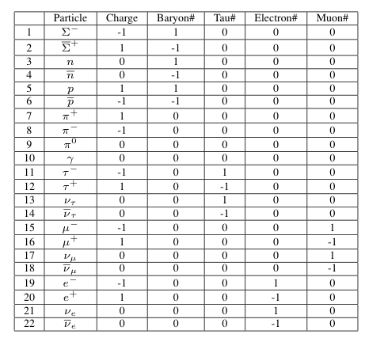
Conserved Quantities in the Standard Model
Standard Model based on Gell-Mann’s quark model (1964).
Full set of particles: n = 193.
Quantity Particle Family (Cluster).
Notes:
The table lists some key quantities assigned to some particles by the Standard Model. It’s from a physics textbook.
For 4 of the quantities, the particles that are assigned nonzero form a family. E.g., the first 6 particles form the Baryon family.
Cluster is used in the sense of partition element (not in terms of a similarity metric).
Main point: the quantities can be used to classify reaction and to cluster/group particles.

Slide 6
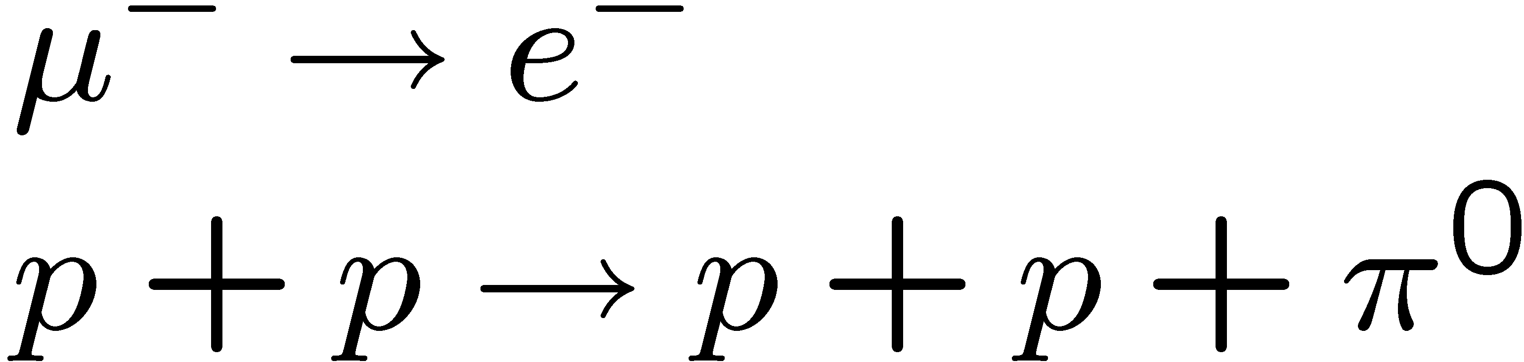
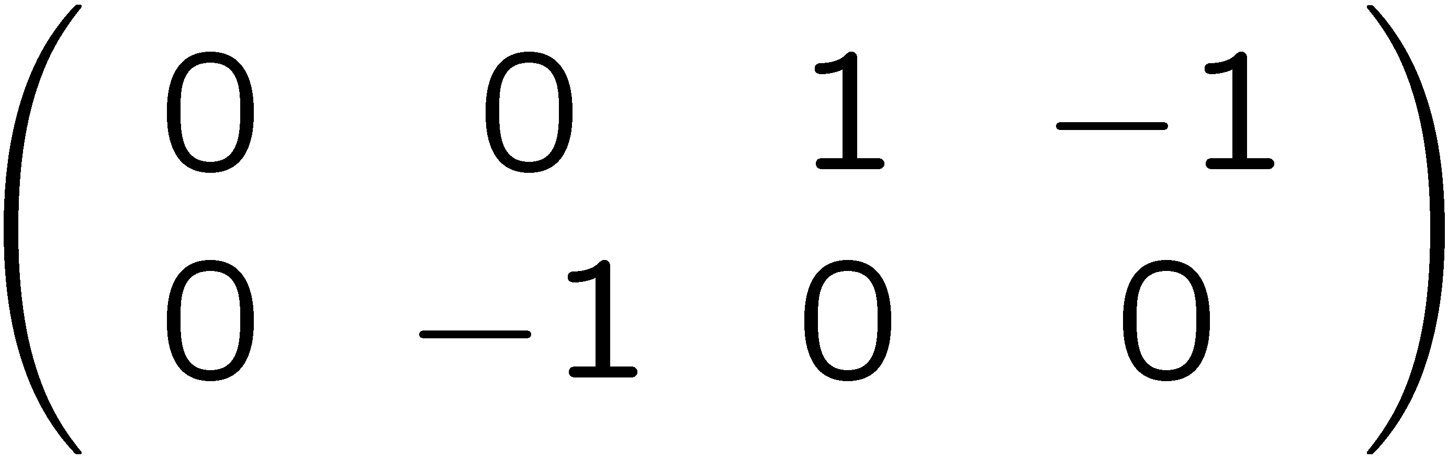
The Learning Task (Toy Example)
Given:
fixed list of known detectable particles.
Input reactions
Not Given:
# of quantities
Interpretation of quantities.
Reactions
Output
Reaction Matrix R
Quantity Matrix Q
Learning
Cols in Q are conserved, so RQ = 0.

Slide 7
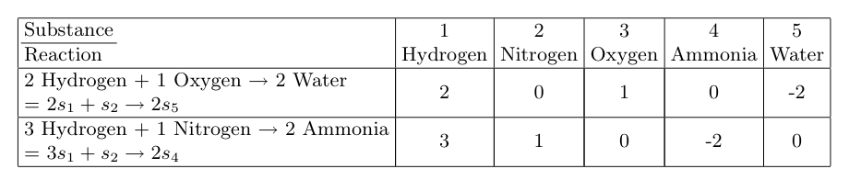
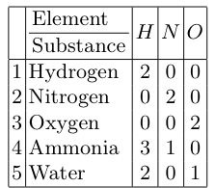
Chemistry Example
Langley et al. 1987.
Reactions among Chemical Substances
Interpretation: #element atoms in each substance molecule.
#element atoms conserved in each reaction!
Notes:
The problem finds conserved quantities. The physical interpretation is neither given to nor provided by the program.
The reference is Langley, P., Simon, H., Bradshaw, G., Zytkow, J.: Scientific Discovery: Computational Explorations of the Creative Processes. MIT Press, Cambridge (1987).

Slide 8
The Totalitarian Principle
There are many matrices Q satisfying RQ = 0---how to select?
Apply classic “maximally specific criterion” from version spaces (Mitchell 1990).
Same general intuition used by physicists:
“everything that can happen without violating a conservation law does happen.” Ford 1963.
“anything which is not prohibited is compulsory”. Gell-Mann 1960s.
Learning-theoretically optimal (Schulte and Luo COLT 2005)
Notes:
Learning theory reference can be skipped, may be interesting for the ALT audience.

Slide 9
Maximal Strictness (Schulte IJCAI 09)
Definition. Q is maximally strict for R if Q allows a minimal superset of R. Proposition. Q is maximally strict for R iff the columns of Q are a basis for the nullspace of R. nullspace of R = null(R) = {v: Rv = 0}
the smallest generalization of observed reactions R = linear span of R
larger generalization of observed reactions R
Unobserved allowed reactions
R
Notes:
Informally, the nullspace of R is the set of vectors that are orthogonal to all (reaction) vectors in R. I.e., it’s the space of quantities that are conserved in all observed reactions.
The main point: using linear algebra, it’s easy to characterize and compute maximally strict sets of conserved quantities.

Slide 10
Maximally Simple Maximally Strict Matrices (MSMS)
L1-norm |M| of matrix M = sum of absolute values of entries.
Definition. Conservation matrix Q is an MSMS matrix for reaction matrix R iff Q minimizes |Q| among maximally strict matrices.

Slide 11
Minimization Algorithm
Problem. Minimize L1-norm |Q|, subject to nonlinear constraint: Q columns are basis for nullspace of R.
Key Ideas.
Preprocess to find a basis V of null(R). Search space = {X s.t. Q = VX}. X is small continuous change-of-basis matrix.
Discretize after convergence.
Set small values to 0.
Multiply by lcd to obtain integers.
Notes:
Even though we ultimately want integer matrices, we learn with continuous values.
Details are described in the paper and in the code, which is on-line.

Slide 12
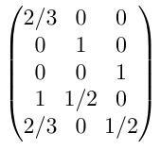
Example: Chemistry
Input Data
Minimization Program
multiply by lcd
MSMS Matrix
Notes:
First illustration of the program.
On the input data from Langley, et al. it finds exactly the right matrix.
The program does not add labels like “HNO”, nor the concept of “element” vs. “molecule”. It does find the right hidden quantities, which can then be interpreted in these terms.

Slide 13
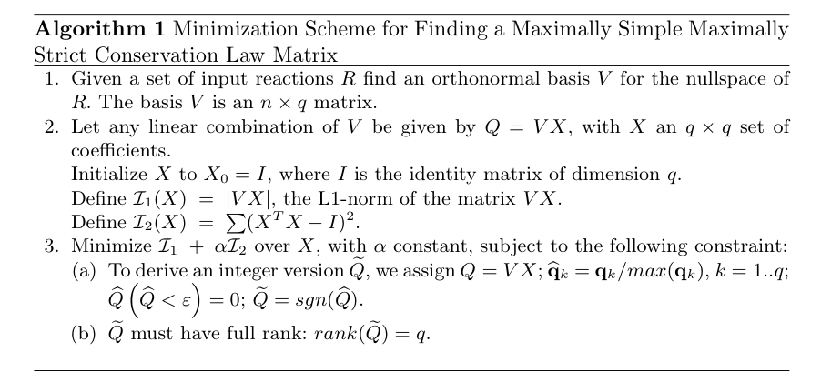
Pseudo Code
Notes:
Line 3: Use 2nd quadratic objective function to encourage matrices with full rank (i.e., maximal numbers of independent quantities).
With just the L1-norm, the search is pulled too much towards the all 0 matrix – empirical evidence follows.
Other details can be skipped.

Slide 14
Comparison with Standard Model
Implementation in Matlab, use built-in null function. Code available on-line.
Dataset
complete set of 193 particles (antiparticles listed separately).
included most probable decay for each unstable particle ⇒ 182 reactions.
Some others from textbooks for total of 205 reactions.
Notes:
Standard important reactions taken from the Annual Review of Particle Physics.

Slide 15
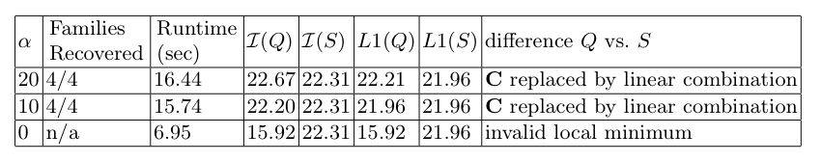
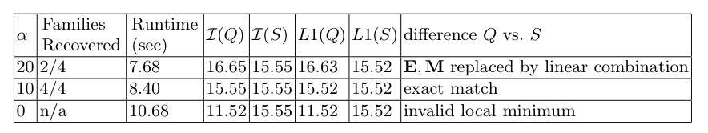
Results
S = Standard Model Laws.
Q = output of minimization.
Ex2: charge given as input.
Notes:
Ex1: Alpha = 0 means pure L1 minimization without the second component.
With alpha = 0, minimizing the L1 norm by itself does not give a maximally strict theory.
With greater alpha, we get back all four particle families.
The Standard Model quantities are maximally strict and minimize the L1-norm (21.96 before discretization).
The system finds an alternative model that is also maximally strict and minimizes the L1-norm. (Different linear combination of the Standard Model Quantities.)
Ex 2: Motivation: Charge is measurable in electromagnetic fields, so is actually given in the data.
For alpha = 0, system fails again.
For alpha = 10, recovers exactly the Standard Model. Which is the unique L1-minimum.
For alpha = 20, system finds a maximally strict model, but not the L1-minimum.
Lesson: in practice, try different values of alpha to find best L1-minimum.
Theorem: We can prove that disjoint families (clusters) will be recovered in general, not just on this dataset. Reference Slide 18.

Slide 16
Conclusion
Conservation Matrix Search problem: for input reactions R, solve RQ=0.
New model selection criterion: choose maximally simple maximally strict Q.
Efficient local search optimization.
Comparison with Standard quark Model
Predictively equivalent.
(Re)discovers particle families-predicted by theorem.
Cogsci perspective: MSMS criterion formalizes scientists’ objective.
Notes:
Cogsci perspective: The MSMS criterion appears to formalize what scientists want in conservation laws. Our minimization routine does not, however, model how scientists go about finding conservation laws.

Slide 17

Thank You
Any questions? Oliver at oschulte@cs.sfu.ca

Slide 18
Simplicity and Particle Families
Theorem (Schulte and Drew 2006). Let R be a reaction data matrix. If there is a maximally strict conservation matrix Q with disjoint entity clusters, then
The clusters (families) are uniquely determined.
There is a unique MSMS matrix Q*.
Baryon#
Electron#
Muon#
Tau#
p
n
e⁻
μ⁻
τ⁻
Σ⁰
Σ⁻
ν_{e}
ν _{μ}
ν _{τ}
Quantity#1
Quantity#2
Quantity#3
Quantity#4
Any alternative set of 4 Q#s with disjoint carriers
Notes:
Backup slide to explain the performance guarantee theorem. Holds for any dataset.
Informal summary: if the data can be explained with conservation laws based on clusters of entities, these clusters are unique, and minimizing the L1 norm will find them.
An example is the setting of Experiment 2 with charge given as part of the input.

